Slide 1
TRANSFERS R US
GROUP NO: 2
MENTOR: Shelan Jeawak
GROUP MEMBERS:
Sude Fidan 21068639 (20%)
Fiorella Scarpino 21010043 (20%)
William Barnes 21031340 (20%)
Jack Douet 21025153 (20%)
Troy Akbulut 21015976 (20%)

Slide 2
Introduction
We are creating a web-based dashboard for updating the market value of football players. System will read data from games influences the players’ value and prediction of how they will perform in future games. Our efficient web-based system will also predict the potential transfer value of players.

Slide 3
Overview
Smart Objectives - Jack Douet
Gantt Chart - Sude Fidan
Raci Matrix - Sude Fidan
Risk Register - Fiorella Scarpino
Methodology - Fiorella Scarpino
Diagrams - Troy Akbulut
Requirements - William Barnes
Literature Review - Jack Douet
Test Cases - Troy Akbulut

Slide 4
SMART OBJECTIVES
Specific, Measurable, Attainable, Realistic, and Time bound
1 | 2 | 3 | 4
User-friendly interface | Accurate calculations | Accurate adjustments | Efficiency and readability

Slide 5
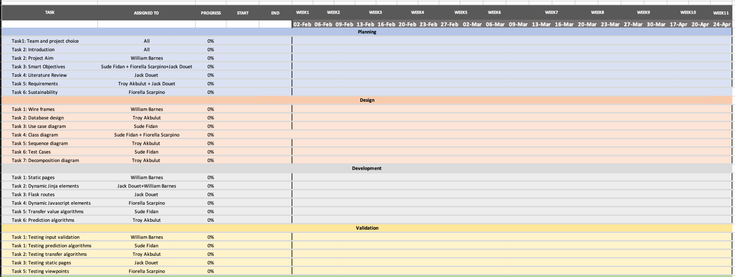
GANTT CHART – FIRST VERSION

Slide 6
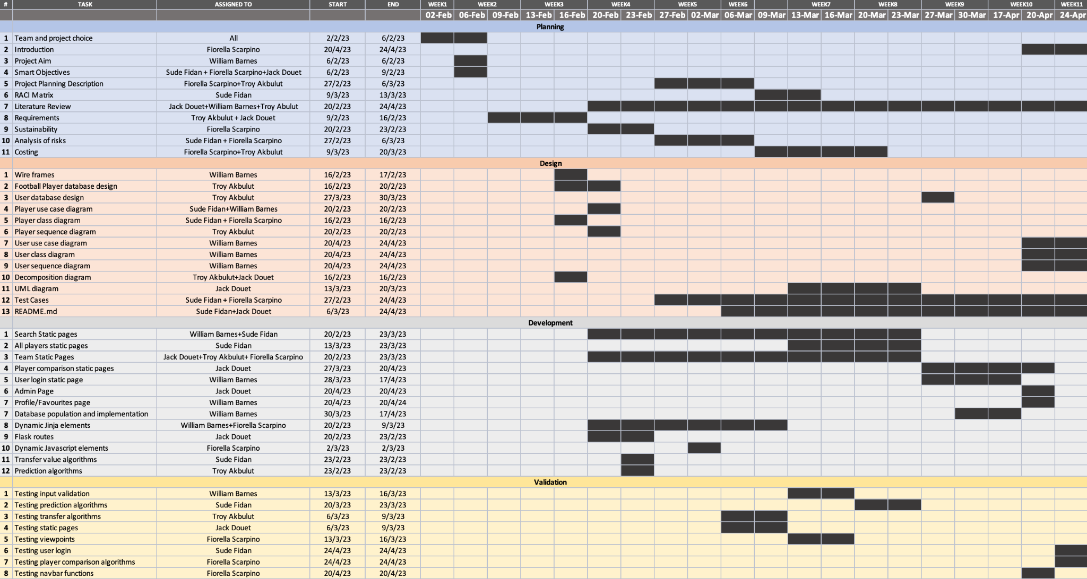
GANTT CHART – FINAL VERSION

Slide 7
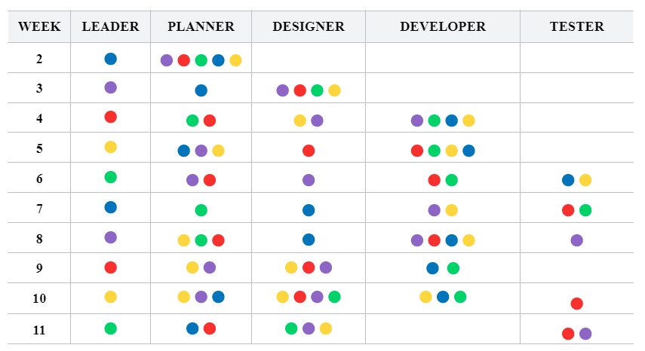
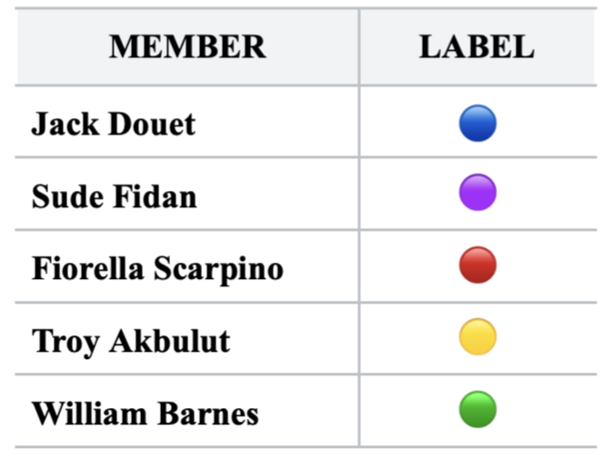
RACI MATRIX

Slide 8
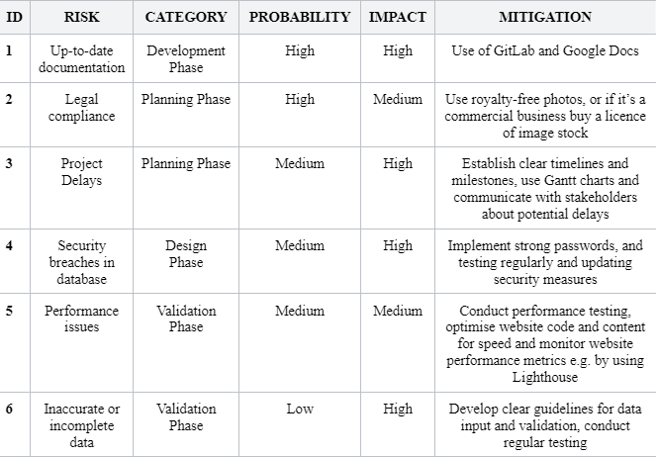
RISK REGISTER

Slide 9
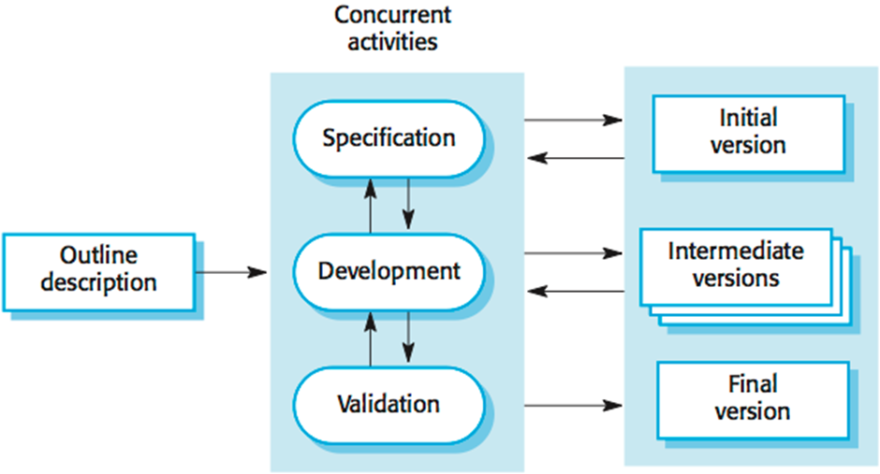
METHODOLOGY
The methodology we are using is the incremental development framework. We are using it because it allows for flexibility, and is dynamic.

Slide 10
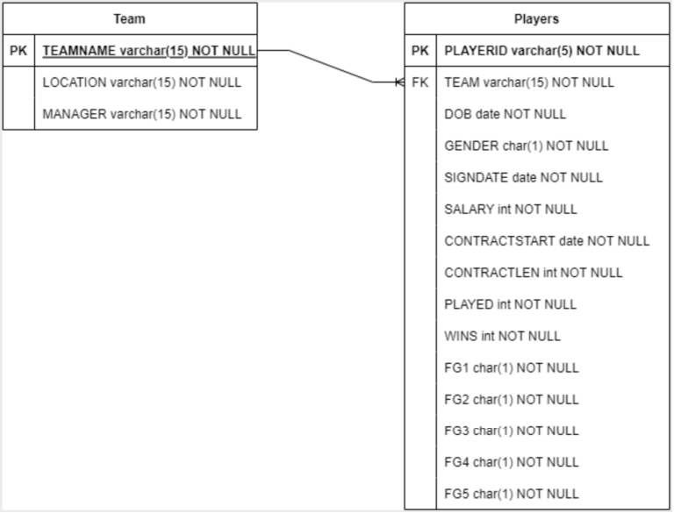
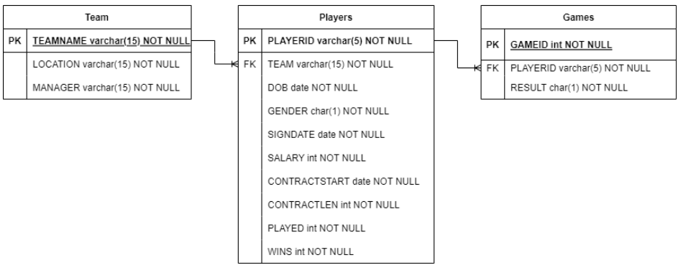
INITIAL DATABASE DESIGN

Slide 11
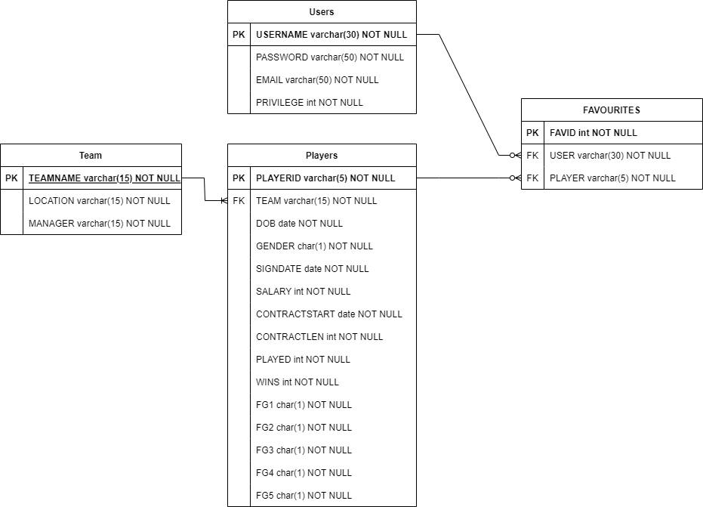
FINAL DATABASE DESIGN

Slide 12
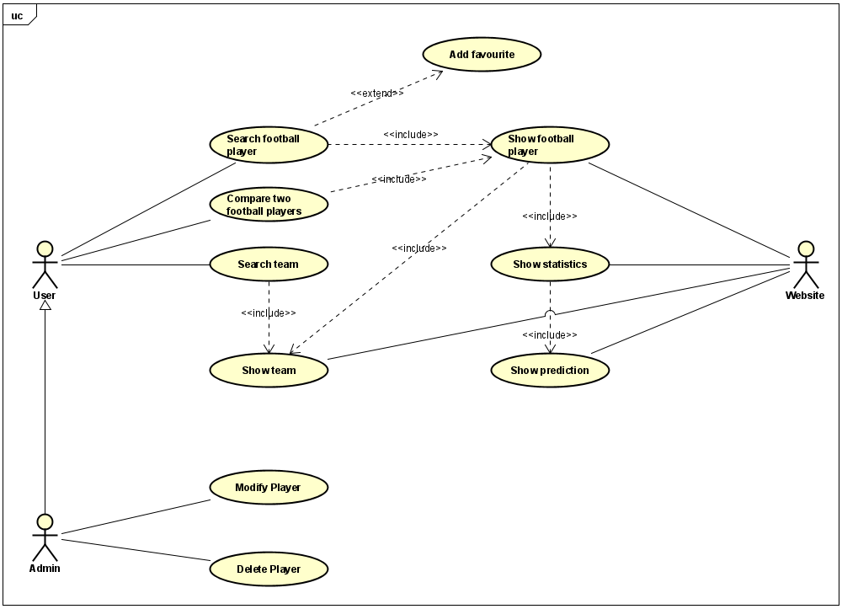
USE CASE DIAGRAM

Slide 13
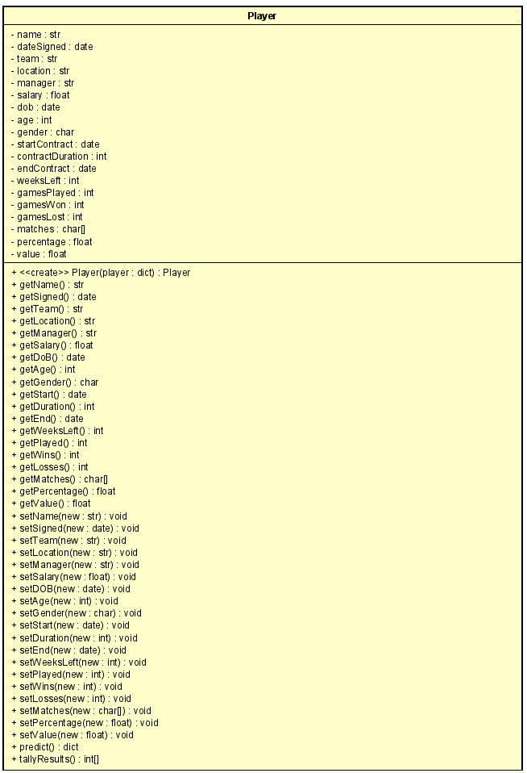
PLAYER CLASS DIAGRAM

Slide 14
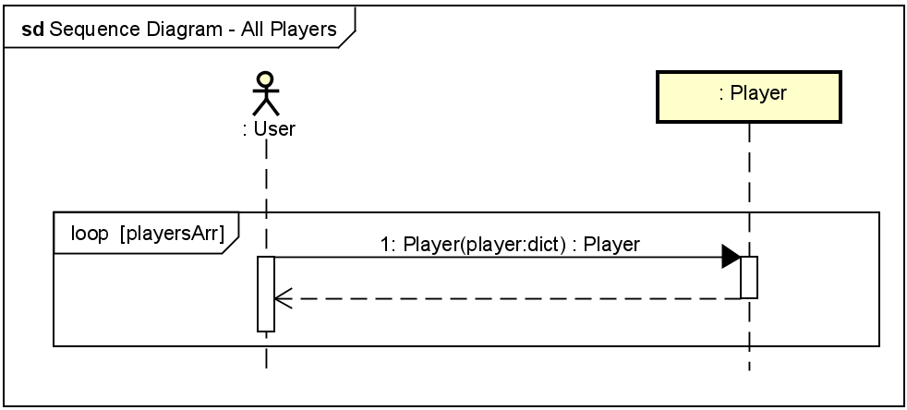
SEQUENCE DIAGRAM – ALL PLAYERS

Slide 15
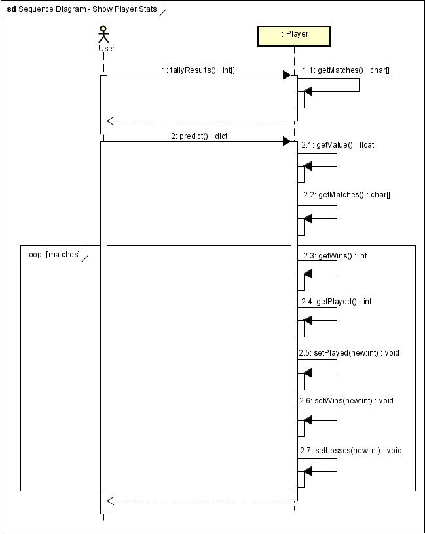
SEQUENCE DIAGRAM – SHOW PLAYER STATS

Slide 16
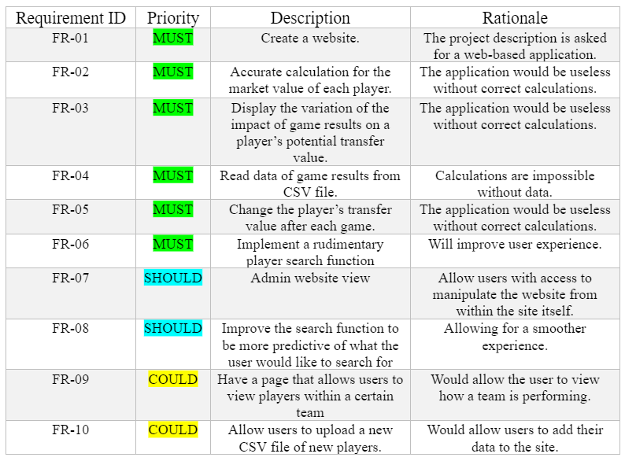

FUNCTIONAL REQUIREMENTS

Slide 17
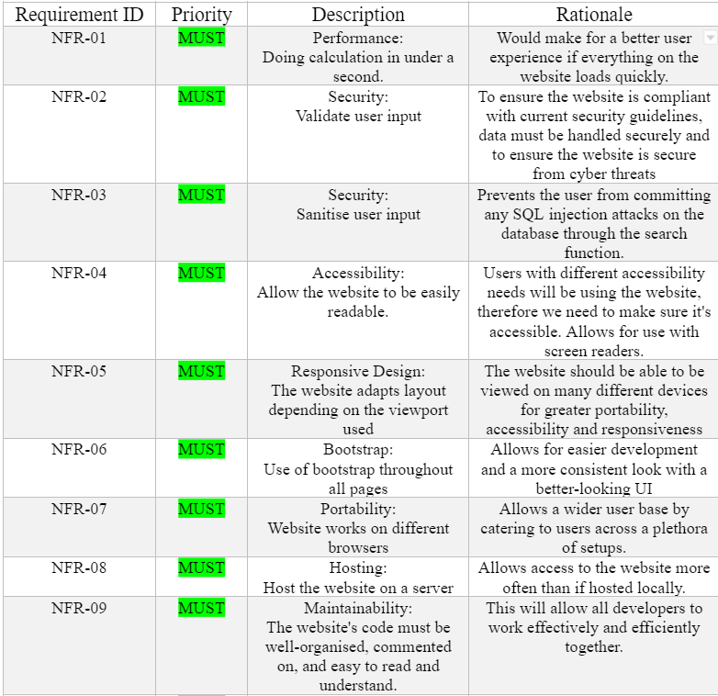
NONFUNCTIONAL REQUIREMENTS

Slide 18
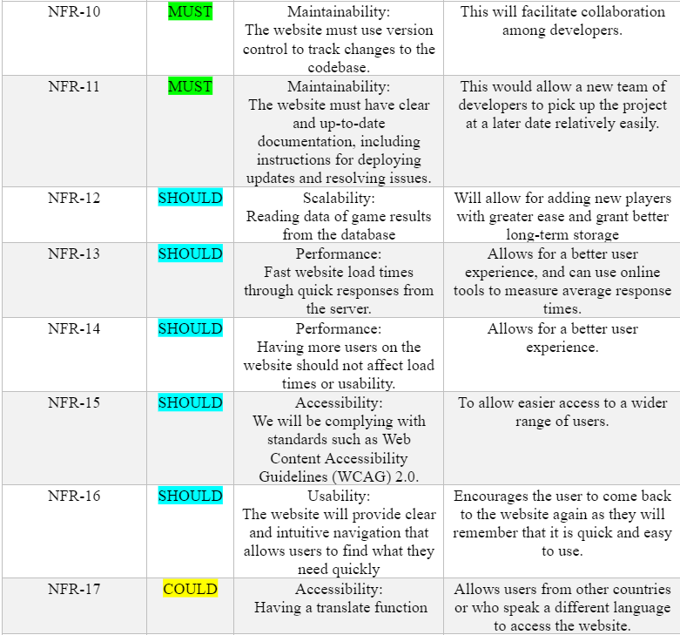
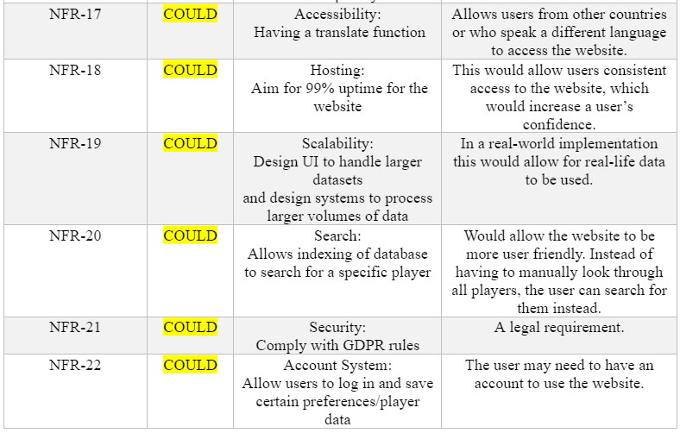
NONFUNCTIONAL REQUIREMENTS – CONT.

Slide 19
LITERATURE REVIEW
PROBLEM TOPIC
DEVELOPMENT TOOLS
APPLICATION AREA

Slide 20
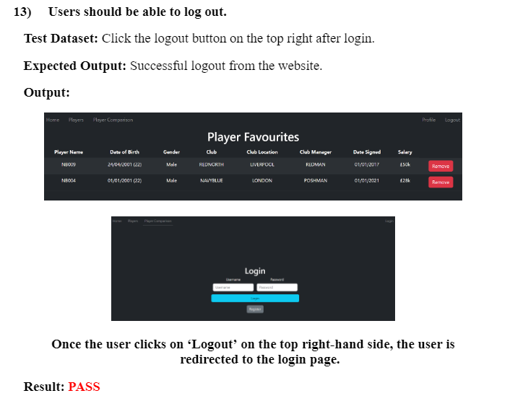
TEST CASES
We have total number of 21 test cases.
E.g.,

Slide 21
Any Questions?
THANK YOU FOR LISTENING TO US

