Slide 1
Programming and Alexa

Slide 2
About me
Fiona Knight
f.l.knight@staffs.ac.uk
@Fiona_knight on twitter
Lecturer in Computer Science, web and programming

Slide 3

Computer Science…
…Needs some form of computer programming

Slide 4
Its all about inputs and outputs
How can a computer and human communicate?
Code can be written so it can doesn’t mind where the input is from just that’s it’s the correct input
It can then output so the interface can use it
Then people who design and code the front end interface to humans can then care about them getting a great user experience
Screen
Voice
We can take the same code and change the inputs and outputs

Slide 5
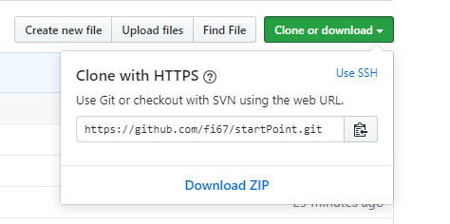
We have about an hour
Lets write some code …
https://github.com/fi67/startPoint
Download zip

Slide 6
What we will build
Rock Paper Scissors Cat
On the web
In Alexa

Slide 7
Visual Studio Code
Lets look at the files
Web page with images on it
Style sheet to style it
Link to JavaScript file
On the following slides we will add the JS file.
The code for each bit is in the notes at the bottom of the slides

Slide 8
First – Initialise Variables
Initialise variables
These are ones used all over the application
Seen as GLOBAL
Runs function to setup input
Notes:
//intialise variables
let userChoice;
let computerChoice;
let gameAnswer;
let catState = 2;
setupWebInput();

Slide 9
Next – Set Up The Inputs
Set Up Input function
This is specific to the device – in this case web
Click events for images and header
Notes:
function setupWebInput() {
let choices = document.getElementsByClassName("choice");
let cat = document.getElementById("cat");
let elephant = document.getElementById("elephant");
cat.addEventListener("click", userPick);
elephant.addEventListener("click", userPick);
for (let i = 0; i < choices.length; i++) {
choices[i].addEventListener("click", userPick);
}
}

Slide 10
Next – Get the user choice
Get user choice
Uses the id for the item the user clicks on to set up the user choice
Logs it to the console so you can see it during development
Notes:
function userPick(evt) {
userChoice = this.id;
console.log(userChoice);
playGame();
}

Slide 11
Next – Game Logic
Function for the game logic
This also calls display output
Notes:
function playGame() {
let answers = ["rock", "paper", "scissors", "cat"];
computerChoice = answers[Math.floor(Math.random() * 4)];
console.log(computerChoice);
catState = 2;
let result = "";
if (userChoice === computerChoice) {
result = "it's a draw!"
} else if ((userChoice === "cat") || (computerChoice === "cat")) {
catState = Math.floor(Math.random() * 2);
console.log(catState);
if (userChoice === "cat") {
if (catState === 0) {
result = "The user picked angry cat! The computer wins!";
} else {
result = "The user picked happy cat! The user wins!";
}
} else {
if (catState === 0) {
result = "The computer picked angry cat! The user wins!";
} else {
result = "The computer picked happy cat! The computer wins!";
}
}
} else if (userChoice === "rock") {
if (computerChoice === "scissors") {
result = "you win, as rock blunts scissors!";
} else {
result = "the computer wins, as paper wraps rock!";
}
} else if (userChoice === "paper") {
if (computerChoice === "rock") {
result = "you win, as paper wraps rock!!";
} else {
result = "the computer wins, as scissors cuts paper!";
}
} else if (userChoice === "scissors") {
if (computerChoice === "paper") {
result = "you win, as scissors cuts paper!!";
} else {
result = "the computer wins, as rock blunts scissors!!";
}
}
if (result === "") {
gameAnswer = `User picked ${userChoice}, this is not a valid choice, please try again`;
} else {
gameAnswer = `User picked ${userChoice} , computer picked ${computerChoice} - ${result}`;
}
userOutput()
}

Slide 12
Next – Display the outputs
Display Output function
Outputs the result to the web page
Selects the cat audio if the user inputs the cat
Notes:
function userOutput() {
if ((userChoice === "cat") || (computerChoice ==="cat")) {
let myAudio = document.getElementById("myAudio");
let myCatAudio = "";
if (catState === 1) {
myCatAudio = "Catmeow1.mp3";
} else if (catState === 0) {
myCatAudio = "AngryCat.mp3";
}
myAudio.src = myCatAudio;
myAudio.addEventListener("canplaythrough", function(){myAudio.play()});
}
let winner = document.getElementById("winner");
winner.innerHTML = gameAnswer;
}

Slide 13
Testing the page
Make sure your speakers are on
Open the page in chrome
Right click index.html – open with chrome
Press F12 to see the console
Click a choice (rock, paper, scissors)
Click the cat image
Click the main header

Slide 14
Now lets take it to Alexa

Slide 15
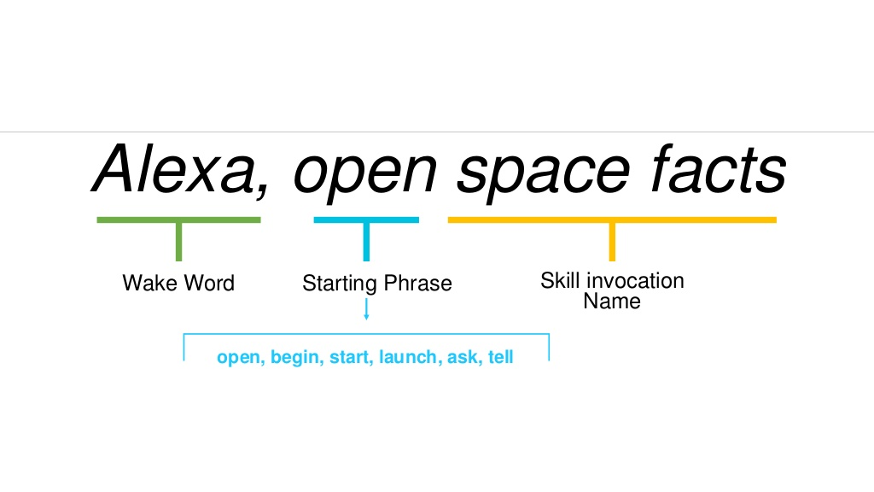
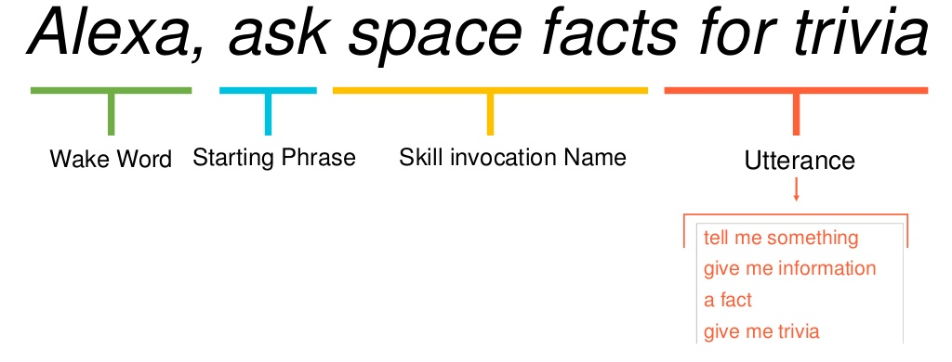
NOTE: Skills Order of items to say

Slide 16
Log in to Alexa Developer
https://developer.amazon.com/alexa/console/ask
Sign in to your Amazon account

Slide 17
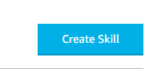
Next
If you have created skills before you should see your list of skills.
Otherwise you will have an information screen
On either screen you will have a button ‘Create Skill’
Click this button and you will be taken to the next screen

Slide 18
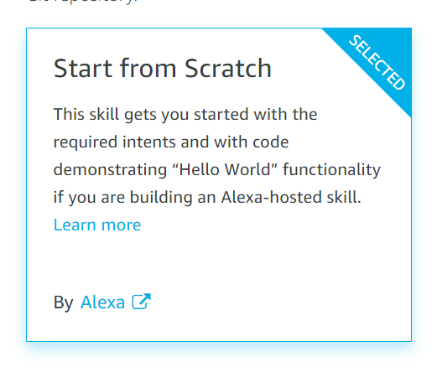
Next
Give it a name
Select English(UK) as the default language
Pick Ireland in the top right hand corner
Create a skill and choose start from scratch

Slide 19
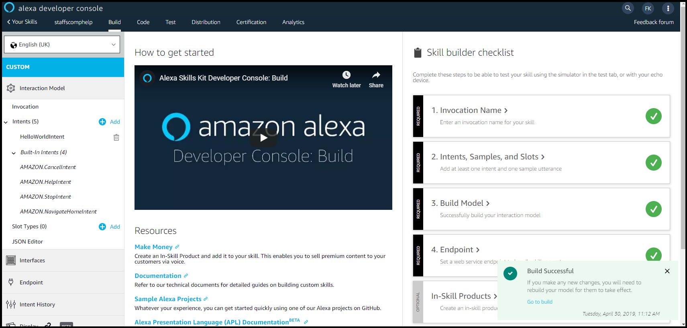
Next
Click the ’Create Skill’ button at the top of the screen and you should get the skill screen

Slide 20
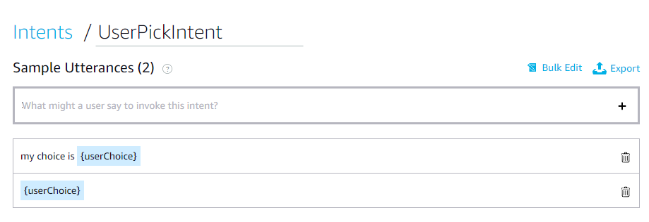
Lets look at
Invocations
Slot types > New Slot – rock, paper, scissors, cat
Interaction Model > Intents > New Intent UserPickIntent
Test

Slide 21
Code
We will use the bits in alexa.js

Slide 22

Questions

