Slide 1
Welcome to the School of Computing & Digital Technologies

Slide 2
Computing
Our awards
Computer Science
Computer Science (Cloud Technologies)
Computer Science (Internet and Web Management)
Computer Science (Network Computing)
Computer Science (Software Development)
Computer Science (Cyber Security)
AI and Robotics

Slide 3
Computer Science
Needs some form of computer programming
Programming done in a language

Slide 4

Lets have a look at one language JavaScript
Jeff Atwood, co-founder of Stack Overflow, stated ‘I'll call Atwood's Law: any application that can be written in JavaScript, will eventually be written in JavaScript.’ (Atwood, 2007).

Slide 5
Languages based on JavaScript
EcmaScript
TypeScript
Dart
Elm
CoffeeScript
Reason
Etc…

Slide 6
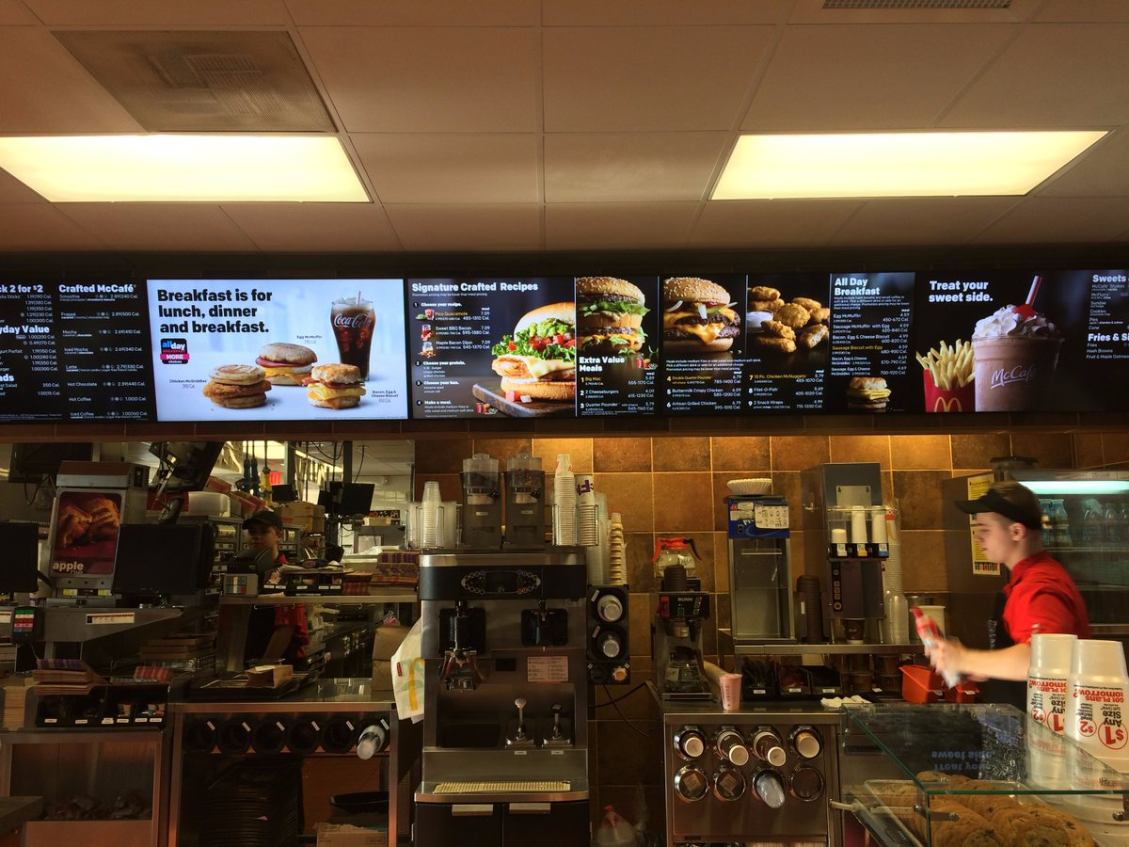
JS - You can create more than web sites!
https://twitter.com/AJStacy06/status/857628546507968512
25,000 menu configurations

Slide 7
Current Uses Of JS
Websites
Desktop Applications (e.g. visual studio code)
Mobile Applications (e.g React Native)
Backend Coding (NodeJS) / Package Handlers (NPM)
‘Node is designed to build scalable network applications’…with npm – ‘the largest ecosystem of open source libraries in the world’ – https://nodejs.org/en/
Games (WebGL / Unity / GamePad API / AirConsole)
Video and Camera Chats (WebRTC)

Slide 8
Current Uses Of JS (Cont)
Programming home devices (Alexa / Google Home)
Via Amazon AWS lambda - Build for voice - https://developer.amazon.com/alexa-skills-kit
Via Google functions - Actions SDK - https://developers.google.com/actions/sdk/
Smart Watch Apps (Fitbit / pebble.js)
Internet Of Things (Arduino / Raspberry Pi / Smart lights / Heating)

Slide 9
Current Uses Of JS (Cont)
AI – using clever APIs – Google Vision, Watson
Virtual and Augmented Reality (React 360 / WebXR)
Google state that ‘The immersive web is a spectrum from complete reality to completely immersive, with various levels in between.’ (Google, 2018)
ETC…

Slide 10
JS and Media
http://madebyevan.com/webgl-water/
https://demo.marpi.pl/spider/
https://musiclab.chromeexperiments.com/Song-Maker/
https://surebak.github.io/

Slide 11
Its all about inputs and outputs
How can a computer and human communicate?
We can take the same code and just change the input and output….

Slide 12
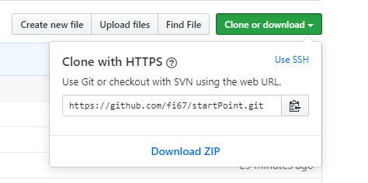
We have a couple of hours
Lets write some code …
https://github.com/fi67/startPoint
Download zip

Slide 13
What we will build
Rock Paper Scissors Cat
On the web
In Alexa

Slide 14
Visual Studio Code
Lets look at the files
Web page with images on it
Style sheet to style it
Link to JavaScript file
On the following slides we will add the JS file.
The code for each bit is in the notes at the bottom of the slides

Slide 15
Inputs
HTML page, which the user will be able to click on
Code in JS which runs the setup function
Click events for images and header
Notes:
setupInput();
function setupInput() {
//For web site
let choices = document.getElementsByClassName("choice");
let cat = document.getElementById("cat");
let elephant = document.getElementById("elephant");
cat.addEventListener("click", userPick);
elephant.addEventListener("click", userPick);
for (let i = 0; i < choices.length; i++) {
choices[i].addEventListener("click", userPick);
}
}

Slide 16
Next – Get the user choice
Get user choice
Uses the id for the item the user clicks on to set up the user choice
Logs it to the console so you can see it during development
Notes:
function userPick(evt) {
//For web site
let userChoice = this.id;
console.log(userChoice);
playGame(userChoice);
}

Slide 17
Next – Game Logic
Function for the game logic
Notes:
function playGame(userChoice) {
let answers = ["rock", "paper", "scissors", "cat"];
let gameAnswer;
let result="";
let catState = -1; // Indicates not cat selected
if (! answers.includes(userChoice)) {
gameAnswer = `You picked ${userChoice}, this is not a valid choice, please try again`;
} else {
let computerChoice = answers[Math.floor(Math.random() * 4)];
console.log(computerChoice);
if (userChoice === computerChoice) {
result = "it's a draw!"
} else if ((userChoice === "cat") || (computerChoice ==="cat")) {
catState = Math.floor(Math.random() * 2);
console.log(catState);
if (userChoice === "cat") {
if (catState === 0) {
result = "The cat is angry! The computer wins!";
} else {
result = "The cat is happy! You win!";
}
} else {
if (catState === 0) {
result = "The cat is angry! You win!";
} else {
result = "The cat is happy! The computer wins!";
}
}
} else if (userChoice === "rock") {
if (computerChoice === "scissors") {
result ="You win, as rock blunts scissors!";
} else {
result = "The computer wins, as paper wraps rock!";
}
} else if (userChoice === "paper") {
if (computerChoice === "rock") {
result = "You win, as paper wraps rock!!";
} else {
result = "The computer wins, as scissors cuts paper!";
}
} else if (userChoice === "scissors") {
if (computerChoice === "paper") {
result = "You win, as scissors cuts paper!!";
} else {
result = "The computer wins, as rock blunts scissors!!";
}
}
gameAnswer = `You picked ${userChoice} , computer picked ${computerChoice}. ${result}`;
}
return displayOutput(gameAnswer,catState);
}

Slide 18
Next – Display the outputs
Display Output function
Outputs the result to the web page
Sets up the sounds for the angry and happy cat
Notes:
function displayOutput(gameAnswer,catState)
{
let catSound;
if (catState !== -1) {
if (catState === 0) {
catSound = "AngryCat.mp3"; //for web
} else {
catSound = "Catmeow1.mp3"; // for web
}
// for web
let myAudio = document.getElementById("myAudio");
myAudio.addEventListener("canplaythrough", function(){myAudio.play()});
myAudio.src = catSound;
}
document.getElementById("winner").innerHTML = gameAnswer;
return true;
// end for web
}

Slide 19
Testing the page
Make sure your speakers are on
Open the page in chrome
Right click index.html – open with chrome
Press F12 to see the console
Click a choice (rock, paper, scissors)
Click the cat image
Click the main header

Slide 20
Now lets take it to Alexa

Slide 21
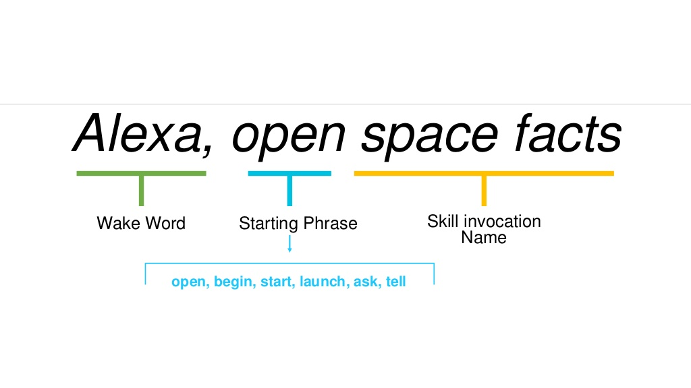
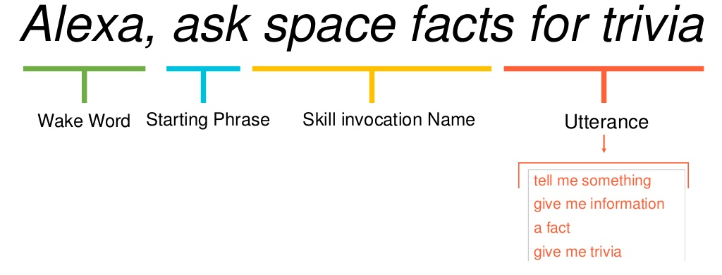
NOTE: Skills Order of items to say

Slide 22
Log in to Alexa Developer
https://developer.amazon.com/alexa/
Choose ‘Create Alexa Skills’
Choose ‘Start A skill’

Slide 23
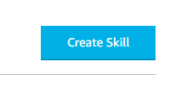
Next
If you have created skills before you should see your list of skills.
Otherwise you will have an information screen
On either screen you will have a button ‘Create Skill’
Click this button and you will be taken to the next screen

Slide 24
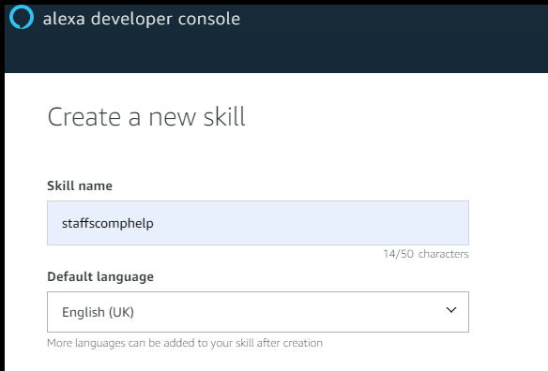
Next
Give it a name and language
I’m calling it fee rock me
Select English as the default language

Slide 25
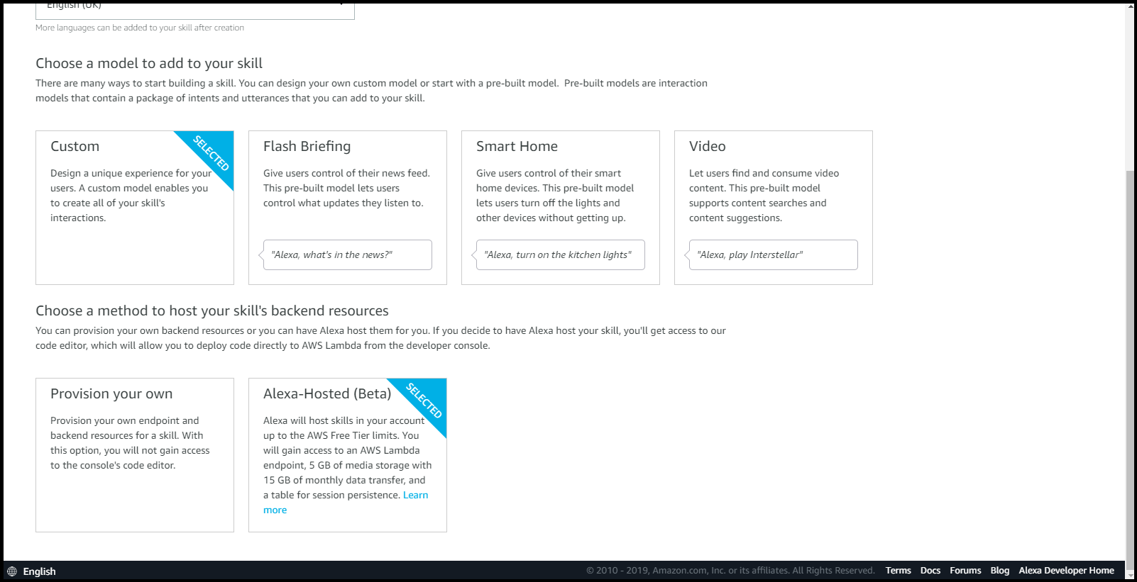
Next
We are going to use the new beta service to code our skill (so we don’t have to use our AWS account)
Choose ‘Custom’ and ‘Alexa Hosted’

Slide 26
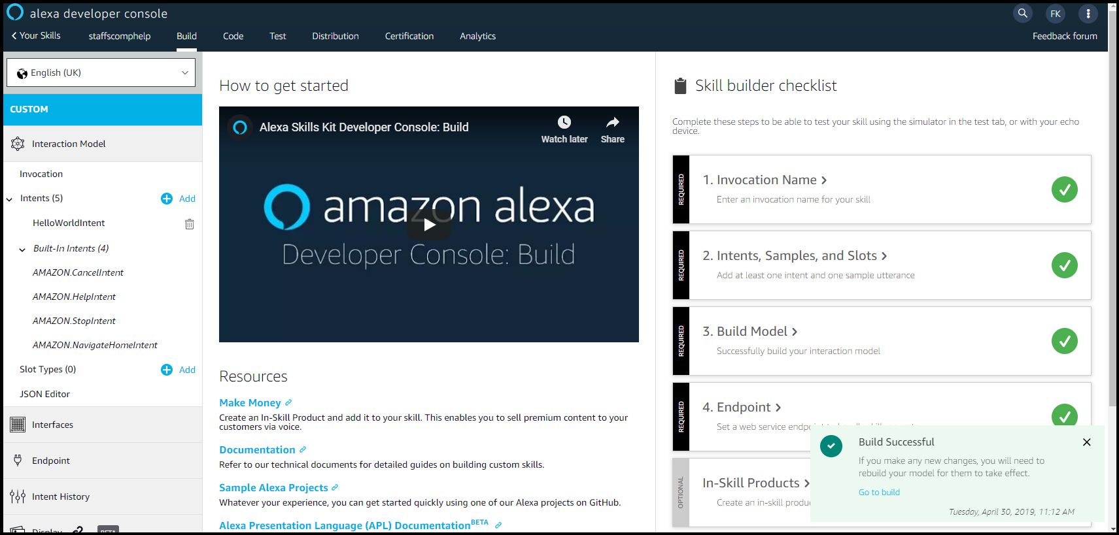
Next
Click the ’Create Skill’ button at the top of the screen and you should get the skill screen

Slide 27
Hello World Skill
This has set up a hello world skill with all the stages completed.
Lets look at this

Slide 28
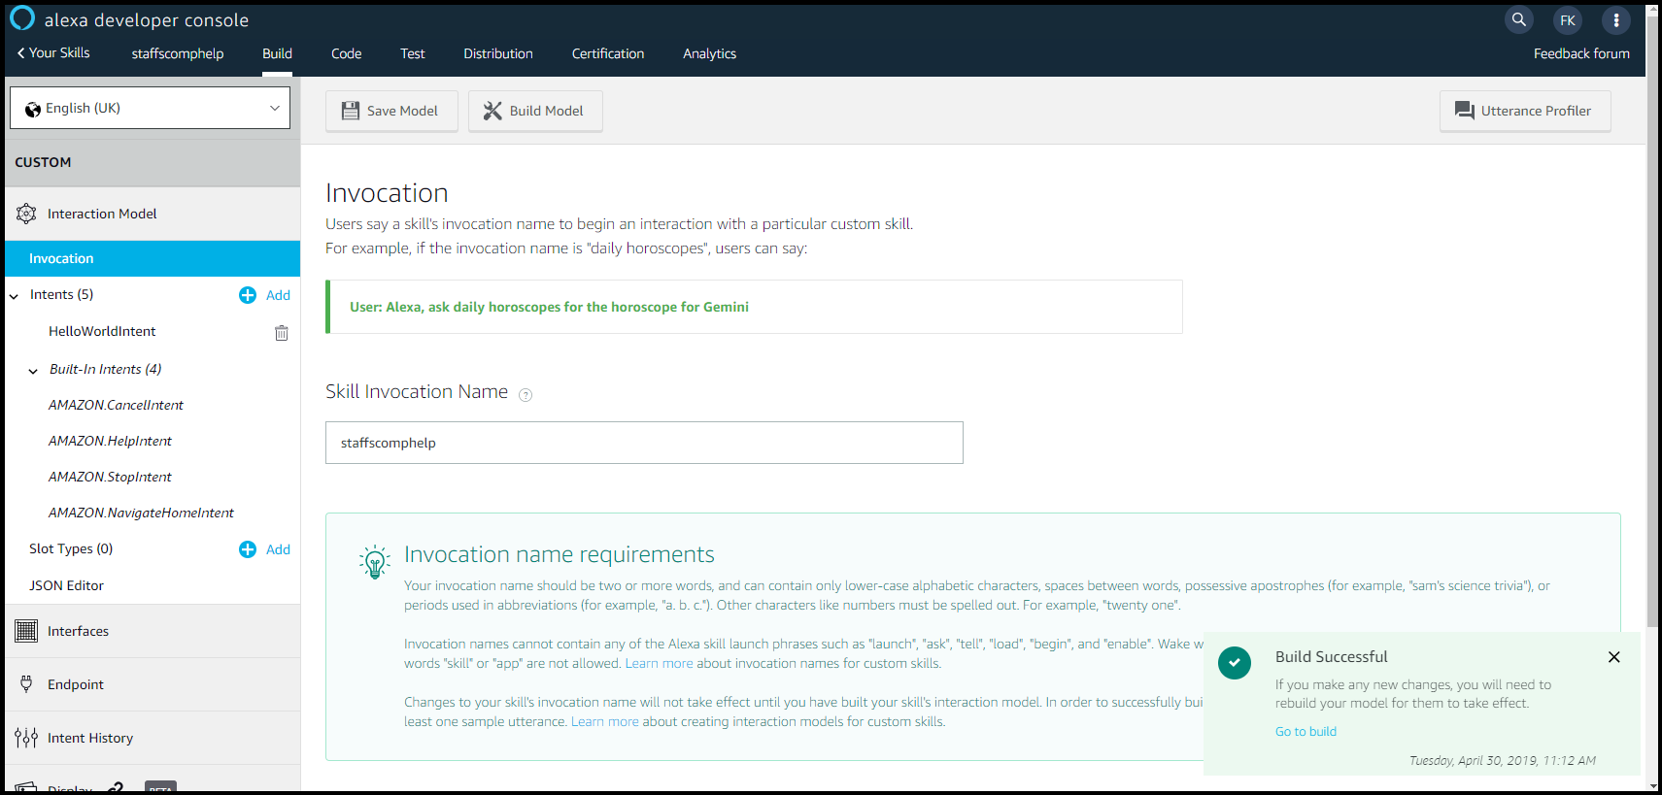
Click on Invocation

Slide 29
More about Invocation name
This should be something memorable and something the user is likely to say
Your invocation name should be two or more words, and can contain only lower-case alphabetic characters, spaces between words, possessive apostrophes (for example, "sam's science trivia"), or periods used in abbreviations (for example, "a. b. c.").
Other characters like numbers must be spelled out. For example, "twenty one". Invocation names cannot contain any of the Alexa skill launch phrases such as "launch", "ask", "tell", "load", "begin", and "enable".
Wake words including "Alexa", "Amazon", "Echo", "Computer", or the words "skill" or "app" are not allowed.
You can change this until the skill is published

Slide 30
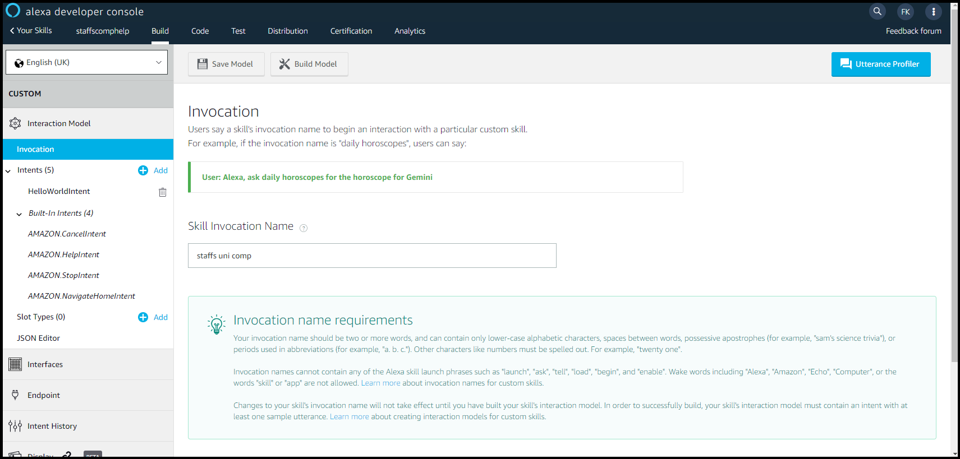
Choose your invocation
I’m leaving it as is
If you change it - Save the model

Slide 31
Intents
What the user wants to do is an intention – its what you ask to do
Users can have lots of different intentions when using your skill
What sort of things could you ask when you first wake up in the morning?

Slide 32
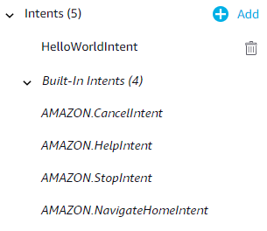
Intents
You will notice you have been set up with 4 built in intents – cancel, help, stop and navigate home
You have also been set up with a HelloWorldIntent

Slide 33
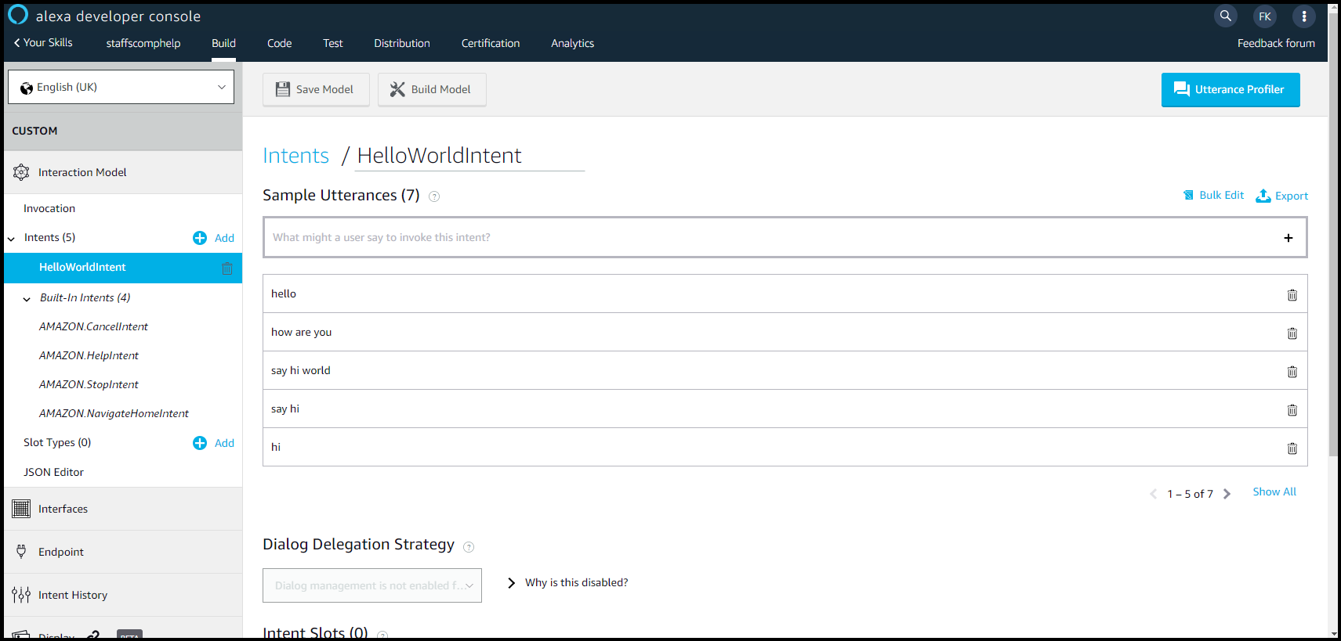
Click on HelloWorldIntent

Slide 34
Utterances
What the user will say – ways to express intents
Best sourced from real people
Usually add at least 7 – ideally around 30 per intent
You have
Hello
How are you
Say hi world
Say hi
hi

Slide 35
Utterances
With your wake up in the morning skill what would you utter?

Slide 36
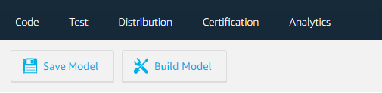
Saving and Building
Add another utterance to Hello World
Whenever you make a change it is best to save and build the model
Press ‘Save Model’ and you will be notified it has saved successfully (the button will also grey out)
Press ‘Build Model’ and the model will build (this may take some time)

Slide 37
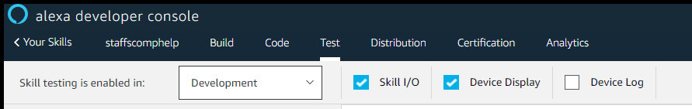
Testing the skill
First we will test the skill on line in the tester in the kit
Click on test at the top of the screen and change the skill testing to ‘development’

Slide 38
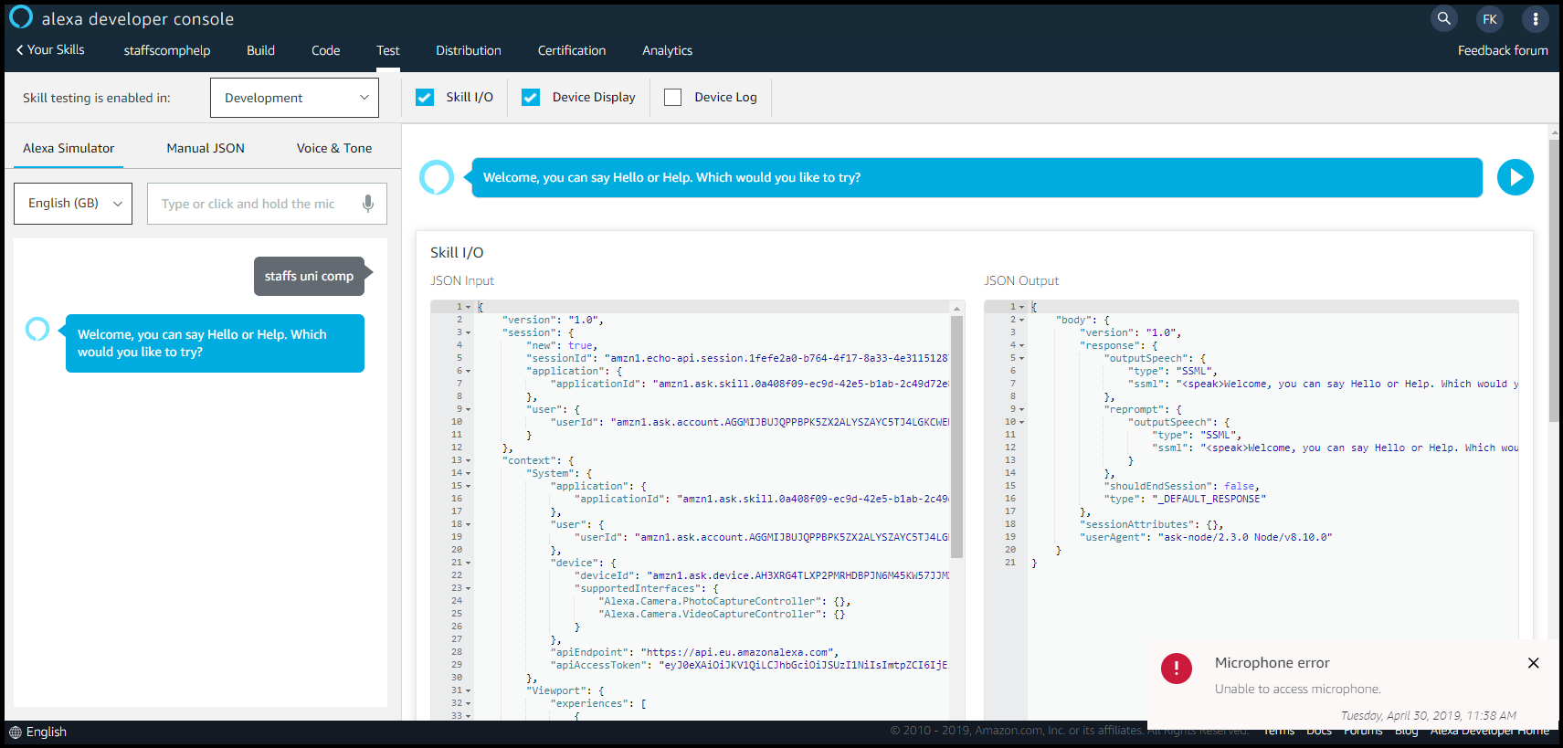
Next
Type in your invocation and press enter (or you can use the microphone if its set up)
You should get a reply and a screen like the one below

Slide 39
Lets look at the inputs and outputs

Slide 40
Creating our rock paper scissors cat skill

Slide 41
Adding Inputs
Back to the Build window

Slide 42
Slots
Slots are things that hold values you can use
Lets say we had a slot called ‘drink’ – what sort of values could it hold?
Lets add a slot for our user choice in rock paper scissors cat
Click on slot types
Add a new slot (details on next slide)

Slide 43
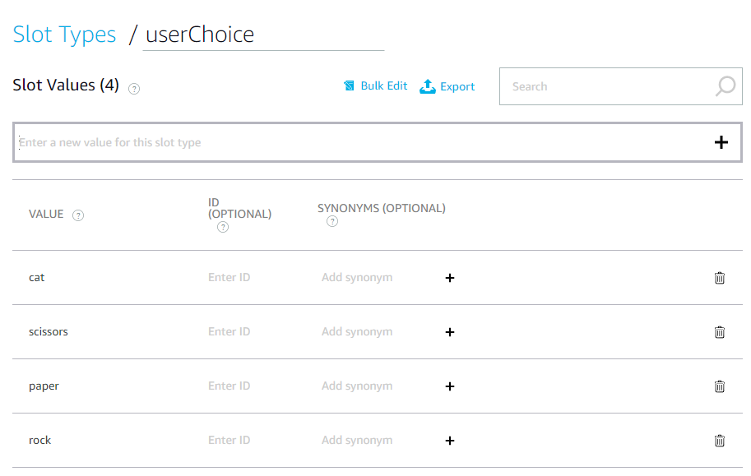

Slide 44
Next – Adding our utterances
Click on intents
Add a new intent (next slide)

Slide 45
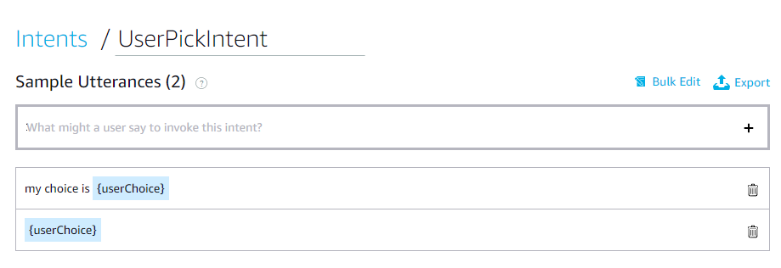
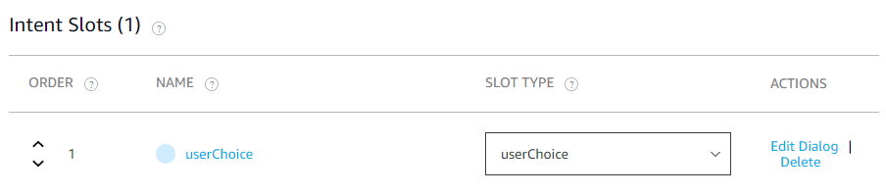

Slide 46
Next
Save and Build the model

Slide 47
Now…
We need to add some code in the background (on the server)
We have a ‘magic’ link to the server

Slide 48
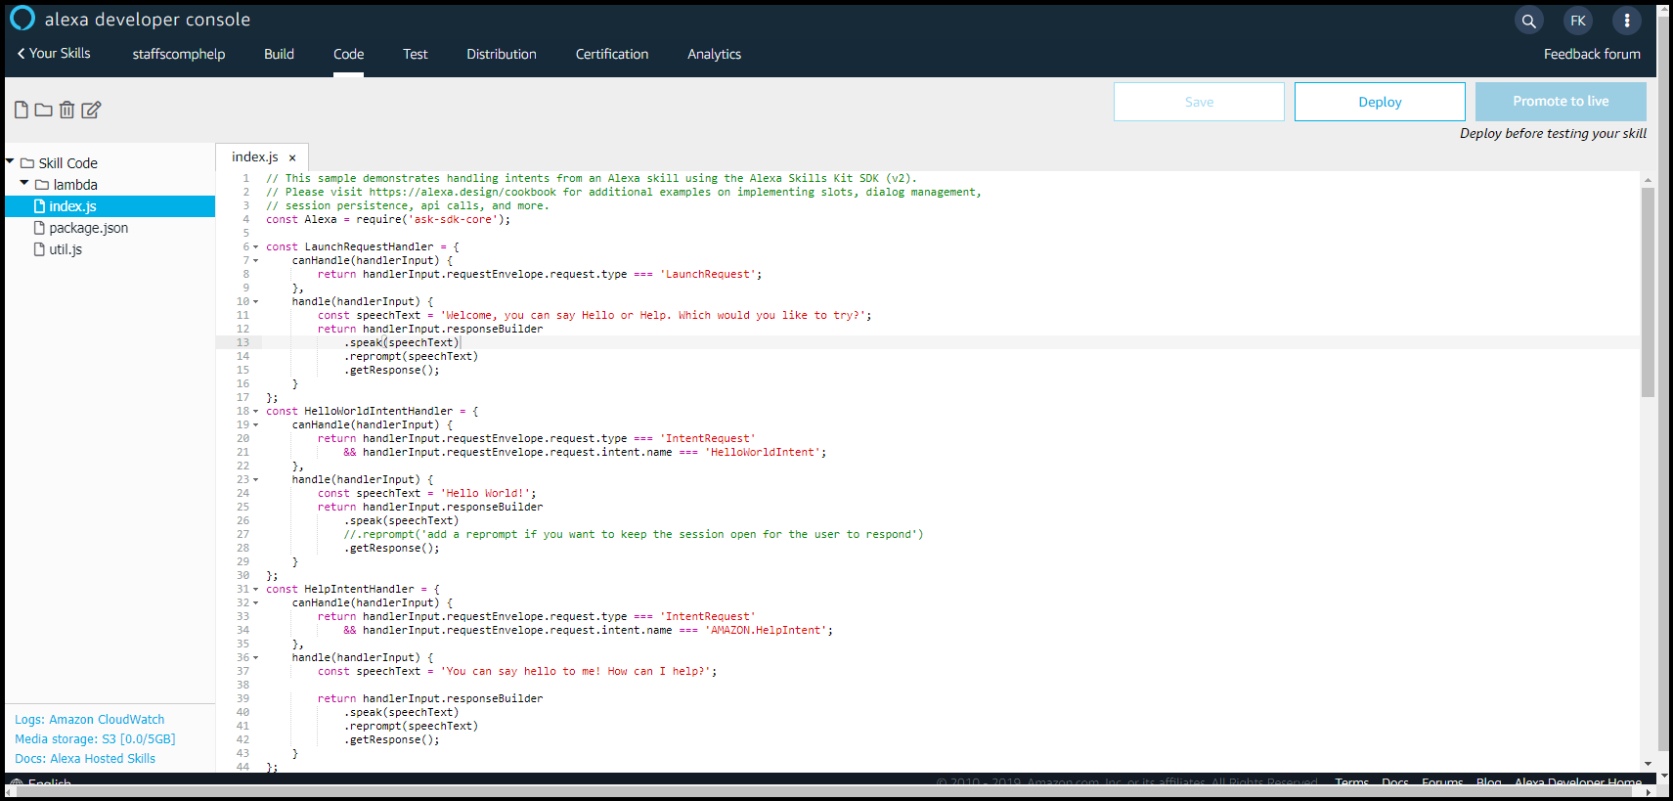
The code
Click on the code tab at the top and you will see a page similar to the one below

Slide 49
Code
const Alexa = require('ask-sdk-core’);
This skill is using the new ask-sdk-core code to get most of the alexa functionality
Details of this kit are shown at https://ask-sdk-for-nodejs.readthedocs.io/en/latest/index.html

Slide 50
Handlers
These handle any intents the skill has
For every intent we have there should be a handler
LaunchRequestHandler – launches the intent we want to start with – when the user says
Help, cancel, stop are built in
Each intent has a separate handler and code block

Slide 51
Change the launch
Change the prompts in the Launch Handler
const speechText = "Welcome to my rock paper scissors cat game, please make your choice";
.reprompt('Try rock, paper, scissors or cat')

Slide 52
Linking our new intent
Delete the hello world intent
Add in the new handler in its place
Also change the exports.handler to have this new intent (towards the bottom of the code
You will get some crosses – we will sort those in a bit
Notes:
const UserPickIntentHandler = {
canHandle(handlerInput) {
return handlerInput.requestEnvelope.request.type === 'IntentRequest'
&& handlerInput.requestEnvelope.request.intent.name === 'UserPickIntent';
},
handle(handlerInput) {
let userChoice = handlerInput.requestEnvelope.request.intent.slots.userChoice.value;
const speechText = playGame(userChoice);
return handlerInput.responseBuilder
.speak(speechText)
.reprompt('Try rock, paper, scissors or cat')
.getResponse();
}
};

Slide 53
Game Logic

Slide 54
We can use the one we created!!!
Copy the playGame function from the web site to just before the lines
// This handler acts as the entry point for your skill, routing all request and response
// payloads to the handlers above. Make sure any new handlers or interceptors you’ve
// defined are included below. The order matters - they're processed top to bottom.
exports.handler = Alexa.SkillBuilders.custom()

Slide 55
Outputs

Slide 56
Outputs
Copy in the displayOutput function below your playgame function
We need to make some changes

Slide 57
Sound Changes
Using SSML - https://developer.amazon.com/docs/custom-skills/speech-synthesis-markup-language-ssml-reference.html
Can test it in the test window
We are using Sounds – using the inbuilt Alexa Sounds library
https://developer.amazon.com/docs/custom-skills/ask-soundlibrary.html

Slide 58
Sounds
Angry cat sound
catSound = "<audio src='soundbank://soundlibrary/animals/amzn_sfx_cat_angry_meow_1x_01'/>";
Happy cat sound
catSound = "<audio src='soundbank://soundlibrary/animals/amzn_sfx_cat_meow_1x_01'/><audio src='soundbank://soundlibrary/animals/amzn_sfx_cat_meow_1x_02'/>";

Slide 59
Other changes
Get rid of the web only bits
Can comment them out with //
Add in the return for alexa
return "<speak>" + catSound + gameAnswer + "</speak>";

Slide 60
Save and test it

Slide 61
Taking it further
Could make it play best of 5
Could save the state of who plays and how many they won last time
Could go further by adding AI – making Alexa ‘smart’
If you have time – try the first of these

Slide 62

Questions

Slide 63
Follow Us On:
@StaffsWebGroup
@StaffsComputing

