Slide 1

Welcome to the School of Computing & Digital Technologies
Internet and Web

Slide 2
Web
Our award - Computer Science (Internet and Web Management)
What can I do on the Web???

Slide 3
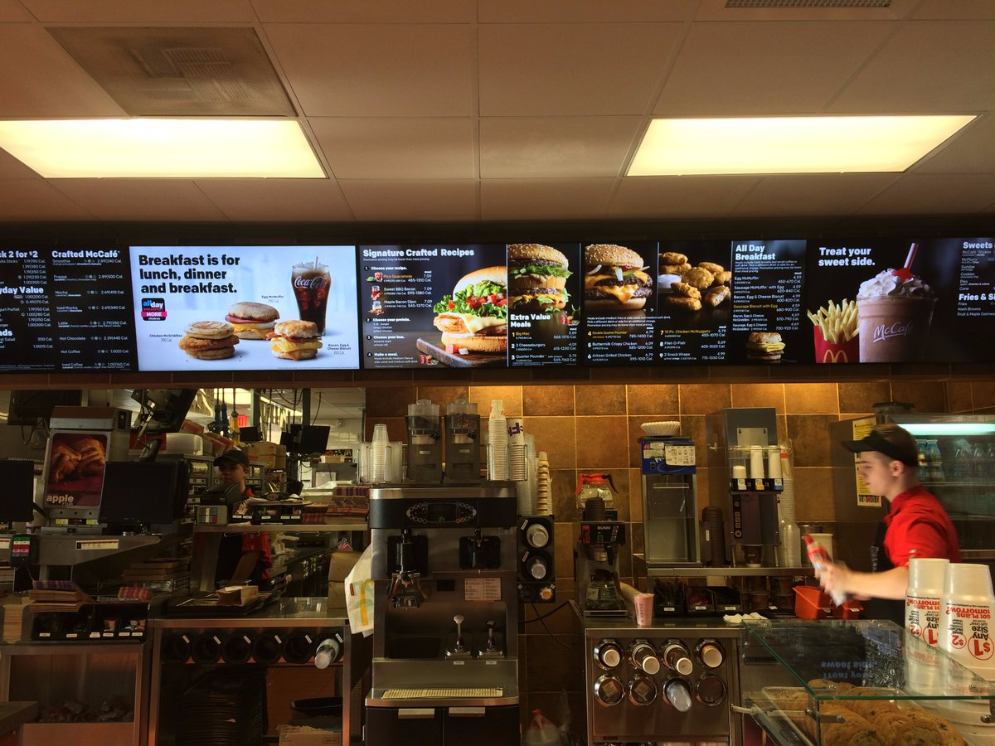
You can create more than web sites!
https://twitter.com/AJStacy06/status/857628546507968512
25,000 menu configurations

Slide 4
Welcome to the Web
http://madebyevan.com/webgl-water/
https://demo.marpi.pl/spider/

Slide 5

What’s this have in common
JavaScript
Jeff Atwood, co-founder of Stack Overflow, stated ‘I'll call Atwood's Law: any application that can be written in JavaScript, will eventually be written in JavaScript.’ (Atwood, 2007).

Slide 6
Languages based on JavaScript
EcmaScript
TypeScript
Dart
Elm
CoffeeScript
Reason
Etc…

Slide 7
Current Uses Of JS (Cont.)
Websites
Desktop Applications (e.g. visual studio code)
Mobile Applications (e.g React Native)
Backend Coding (NodeJS) / Package Handlers (NPM)
‘Node is designed to build scalable network applications’…with npm – ‘the largest ecosystem of open source libraries in the world’ – https://nodejs.org/en/

Slide 8
Current Uses Of JS (Cont.)
Games (WebGL / Unity / GamePad API / AirConsole)
Video and Camera Chats (WebRTC)

Slide 9
Current Uses Of JS (Cont)
Programming home devices (Alexa / Google Home)
Via Amazon AWS lambda - Build for voice - https://developer.amazon.com/alexa-skills-kit
Via Google functions - Actions SDK - https://developers.google.com/actions/sdk/
Smart Watch Apps (Fitbit / pebble.js)
Internet Of Things (Arduino / Raspberry Pi / Smart lights / Heating)

Slide 10
Current Uses Of JS (Cont)
AI – using clever APIs – Google Vision, Watson
Virtual and Augmented Reality (React 360 / WebXR)
Google state that ‘The immersive web is a spectrum from complete reality to completely immersive, with various levels in between.’ (Google, 2018)
ETC…

Slide 11
Its all about inputs and outputs
How can a computer and human communicate?
We can take the same code and just change the input and output….

Slide 12
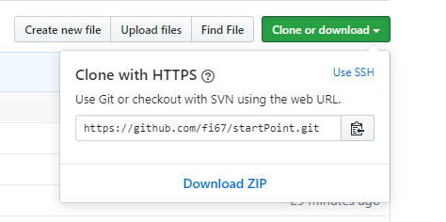
We have about an hour
Lets write some code …
https://github.com/fi67/startPoint
Download zip

Slide 13
What we will build
Rock Paper Scissors Cat
On the web
In Alexa

Slide 14
Visual Studio Code
Lets look at the files
Web page with images on it
Style sheet to style it
Link to JavaScript file
On the following slides we will add the JS file.
The code for each bit is in the notes at the bottom of the slides

Slide 15
First – Initialise Variables
Initialise variables
These are ones used all over the application
Seen as GLOBAL
Runs function to setup input
Notes:
//intialise variables
let userChoice;
let computerChoice = "";
let answers = ["rock", "paper", "scissors", "cat"];
let myAudio;
let gameAnswer;
setupInput();

Slide 16
Next – Set Up The Inputs
Set Up Input function
This is specific to the device – in this case web
Click events for images and header
Audio details
Notes:
function setupInput() {
let choices = document.getElementsByClassName("choice");
let cat = document.getElementById("cat");
let elephant = document.getElementById("elephant");
elephant.addEventListener("click", userPick);
myAudio = document.getElementById("myAudio");
myAudio.addEventListener("canplaythrough", function(){myAudio.play()});
cat.addEventListener("click", userPick);
for (let i = 0; i < choices.length; i++) {
choices[i].addEventListener("click", userPick);
}
}

Slide 17
Next – Display the outputs
Display Output function
Outputs the result to the web page
Selects the cat audio if the user inputs the cat
Notes:
function displayOutput()
{
let winner = document.getElementById("winner");
if (userChoice ==="cat") {
myAudio.src = "Catmeow1.mp3";
}
winner.innerHTML = gameAnswer;
}

Slide 18
Next – Get the user choice
Get user choice
Uses the id for the item the user clicks on to set up the user choice
Logs it to the console so you can see it during development
Notes:
function userPick(evt) {
userChoice = this.id;
console.log(userChoice);
playGame();
}

Slide 19
Next – Game Logic
Function for the game logic
This also calls display output
Notes:
function playGame() {
computerChoice = answers[Math.floor(Math.random() * 3)];
console.log(computerChoice);
let result = "";
if (userChoice === "cat") {
result = "meow meow meow MEOW"
}
if (userChoice === computerChoice) {
result = "it's a draw!"
} else if (userChoice ==="rock") {
if (computerChoice ==="scissors") {
result ="you win, as rock blunts scissors!"
} else {
result = "the computer wins, as paper wraps rock!"
}
} else if (userChoice ==="paper") {
if (computerChoice ==="rock") {
result = "you win, as paper wraps rock!!"
} else {
result = "the computer wins, as scissors cuts paper!"
}
} else if (userChoice ==="scissors") {
if (computerChoice ==="paper") {
result = "you win, as scissors cuts paper!!"
} else {
result = "the computer wins, as rock blunts scissors!!"
}
}
if (result === "") {
gameAnswer = `User picked ${userChoice}, this is not a valid choice, please try again`;
} else {
gameAnswer = `User picked ${userChoice} , computer picked ${computerChoice} - ${result}`;
}
displayOutput();
}

Slide 20
Testing the page
Make sure your speakers are on
Open the page in chrome
Right click index.html – open with chrome
Press F12 to see the console
Click a choice (rock, paper, scissors)
Click the cat image
Click the main header

Slide 21
Now lets take it to Alexa

Slide 22
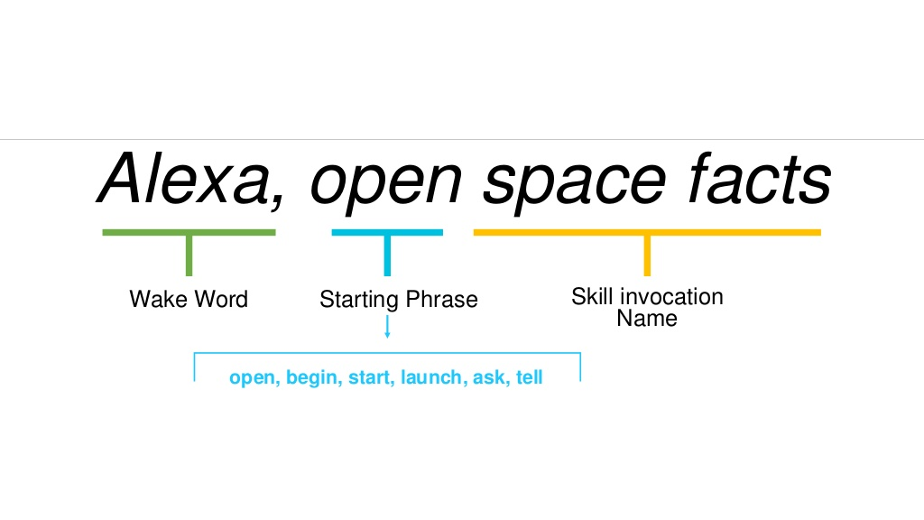
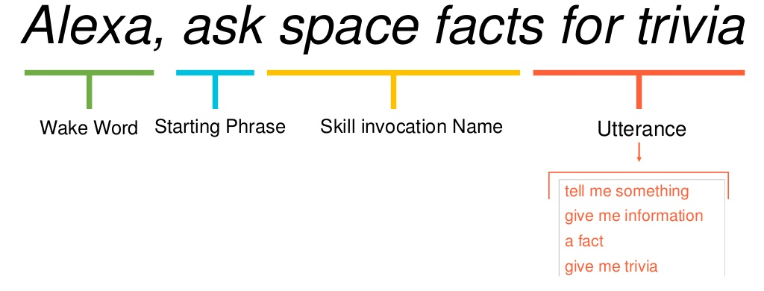
NOTE: Skills Order of items to say

Slide 23
Log in to Alexa Developer
https://developer.amazon.com/alexa/
Username – fi.knight.67@gmail.com
Choose Alexa
Choose Alexa Skills Kit

Slide 24
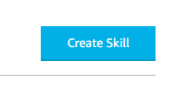
Next
If you have created skills before you should see your list of skills.
Otherwise you will have an information screen
On either screen you will have a button ‘Create Skill’
Click this button and you will be taken to the next screen

Slide 25
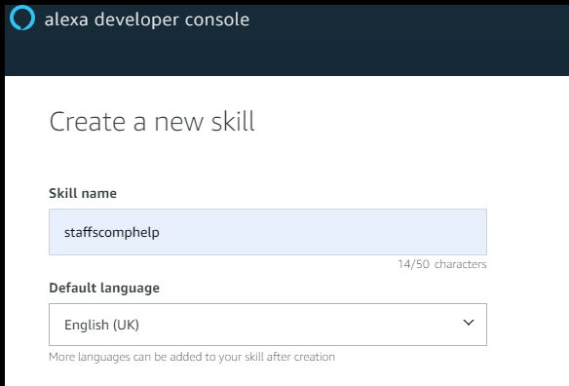
Next
Give it a name and language
I’m calling it Fiona rock paper
Select English as the default language

Slide 26
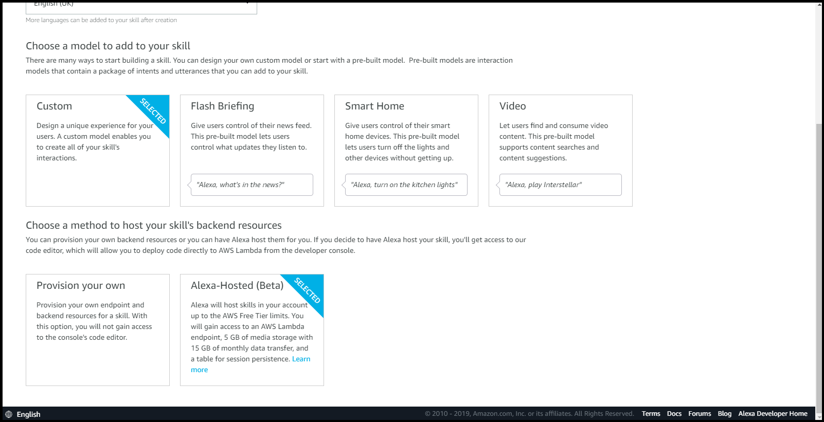
Next
We are going to use the new beta service to code our skill (so we don’t have to use our AWS account)
Choose ‘Custom’ and ‘Alexa Hosted’

Slide 27
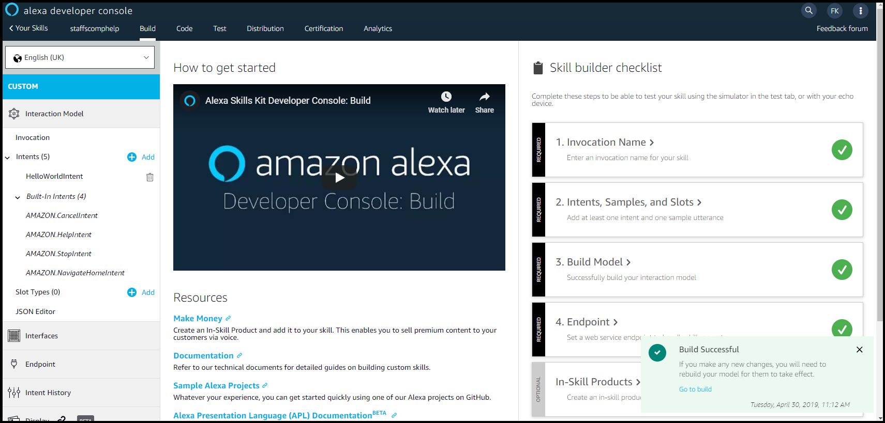
Next
Click the ’Create Skill’ button at the top of the screen and you should get the skill screen

Slide 28
Hello World Skill
This has set up a hello world skill with all the stages completed.
Lets look at each part

Slide 29
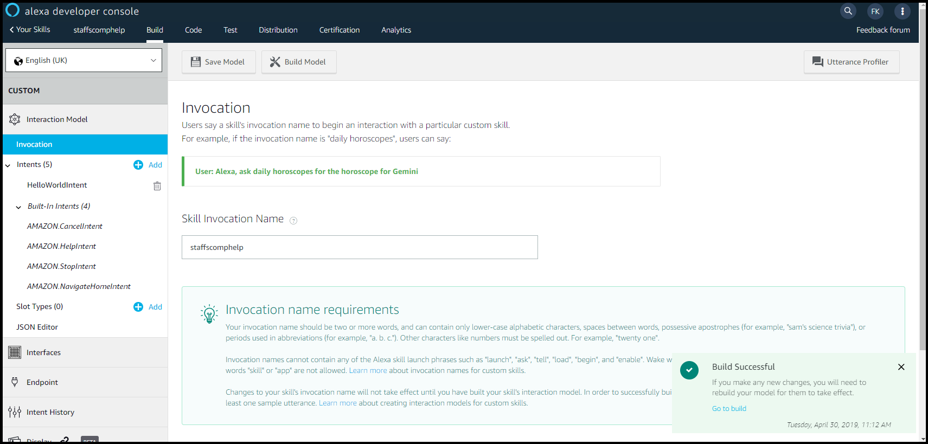
Click on Invocation

Slide 30
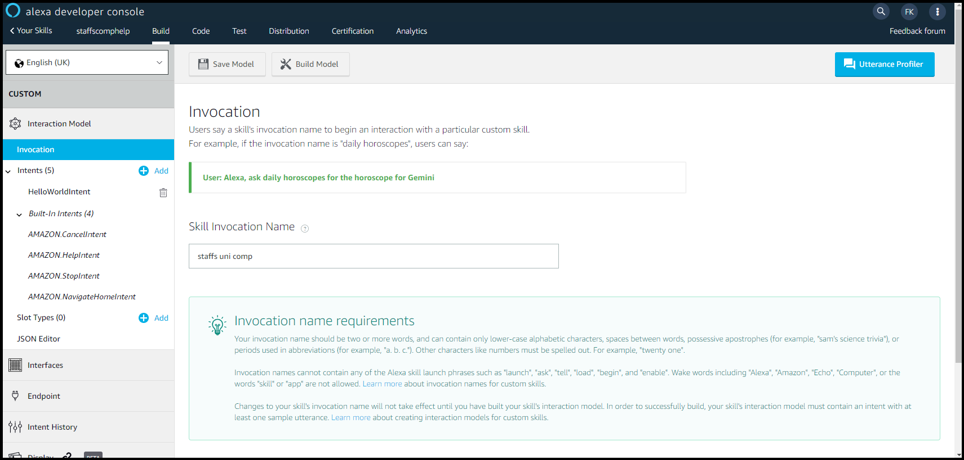
Choose your invocation
I’m saving it as ‘Fiona rock paper’
Save the model

Slide 31
More about Invocation name
This should be something memorable and something the user is likely to say
Your invocation name should be two or more words, and can contain only lower-case alphabetic characters, spaces between words, possessive apostrophes (for example, "sam's science trivia"), or periods used in abbreviations (for example, "a. b. c.").
Other characters like numbers must be spelled out. For example, "twenty one". Invocation names cannot contain any of the Alexa skill launch phrases such as "launch", "ask", "tell", "load", "begin", and "enable".
Wake words including "Alexa", "Amazon", "Echo", "Computer", or the words "skill" or "app" are not allowed.
You can change this until the skill is published

Slide 32
Intents
What the user wants to do is an intention – when the user speaks to the skill
The user can say this in lots of different ways

Slide 33
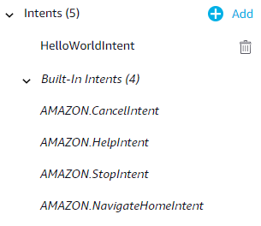
Intents
You will notice you have been set up with 4 built in intents – cancel, help, stop and navigate home
You have also been set up with a HelloWorldIntent

Slide 34
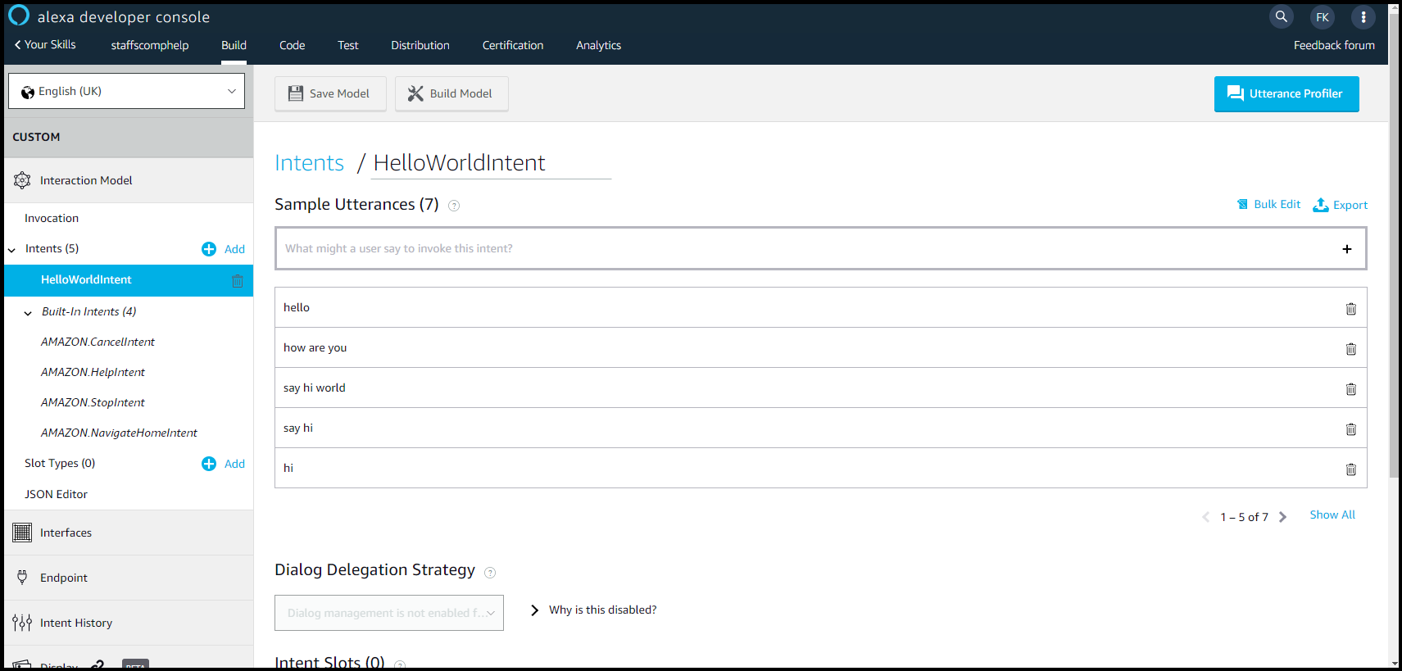
Click on HelloWorldIntent

Slide 35
utterences
What the user will say – ways to express intents
Best sourced from real people
Usually add at least 7 – ideally around 30 per intent
You have
Hello
How are you
Say hi world
Say hi
hi

Slide 36
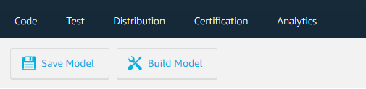
Saving and Building
Whenever you make a change it is best to save and build the model
Press ‘Save Model’ and you will be notified it has saved successfully (the button will also grey out)
Press ‘Build Model’ and the model will build (this may take some time)

Slide 37
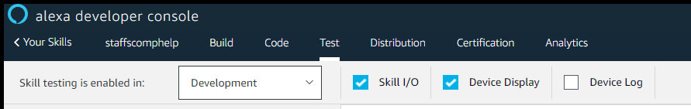
Testing the skill
First we will test the skill on line in the tester in the kit
Click on test at the top of the screen and change the skill testing to ‘development’

Slide 38
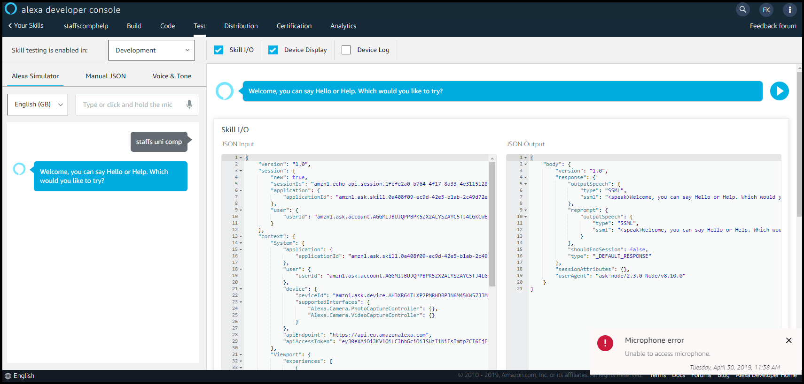
Next
Type in Fiona rock paper (or whatever your invocation is) and press enter (or you can use the microphone if its set up)
You should get a reply and a screen like the one below

Slide 39
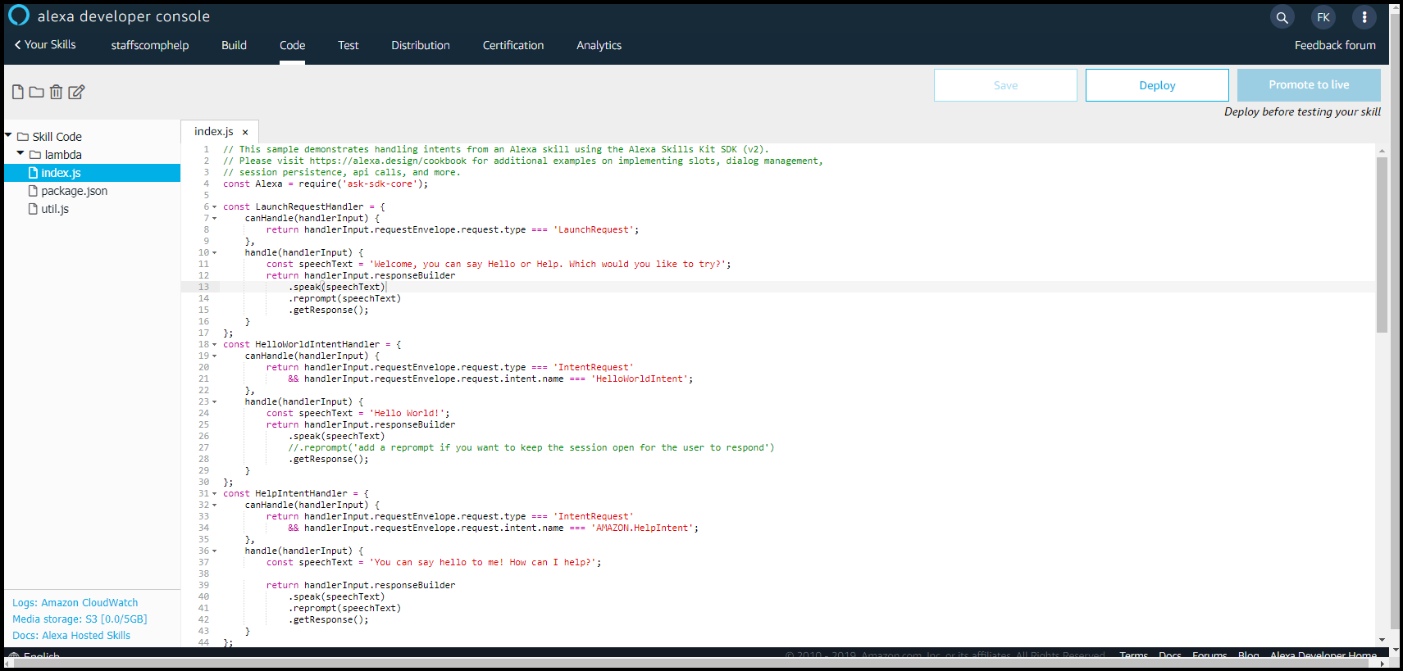
The code
Click on the code tab at the top and you will see a page similar to the one below

Slide 40
Code
const Alexa = require('ask-sdk-core’);
This skill is using the new ask-sdk-core code to get most of the alexa functionality
Details of this kit are shown at https://ask-sdk-for-nodejs.readthedocs.io/en/latest/index.html

Slide 41
Handlers
These handle any intents the skill has
For every intent we have there should be a handler
LaunchRequestHandler – launches the intent we want to start with – when the user says
Help, cancel, stop are built in
Each intent has a separate handler and code block

Slide 42
Changing Hello World to Rock Paper scissors
Click on Build in the menu at the top
Click on slot types
Add a new slot (next page)

Slide 43
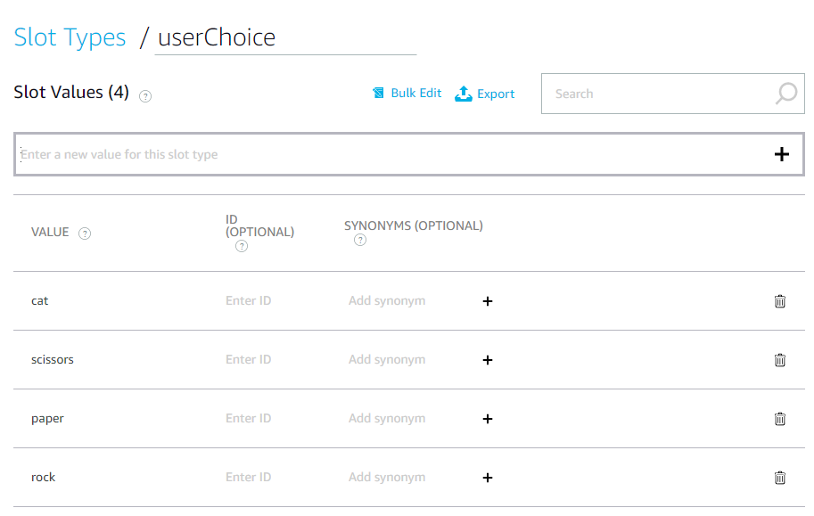

Slide 44
Next
Click on intents
Change the hello world intent (next slide)

Slide 45
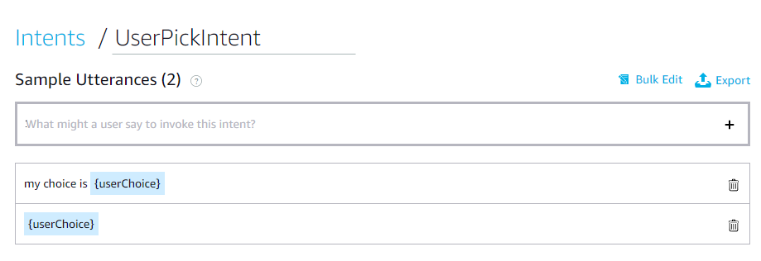
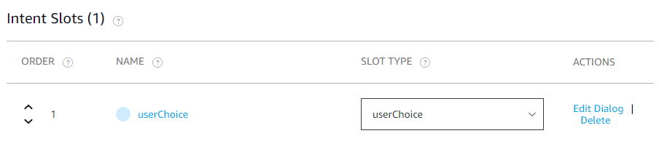

Slide 46
Click on code
Variables at top
Notes:
//intialise variables
let userChoice;
let computerChoice = "";
let answers = ["rock", "paper", "scissors", "cat"];
let myAudio;
let gameAnswer;
setupInput();

Slide 47
Change the launch
Launch Handler
Notes:
const LaunchRequestHandler = {
canHandle(handlerInput) {
return handlerInput.requestEnvelope.request.type === 'LaunchRequest';
},
handle(handlerInput) {
const speechText = "Welcome to Fiona's rock paper scissors cat game, please make your choice";
return handlerInput.responseBuilder
.speak(speechText)
.reprompt('Try rock, paper, scissors or cat')
.getResponse();
}
};

Slide 48
Change the hello world intent
Also change the exports handler
Notes:
const UserPickIntentHandler = {
canHandle(handlerInput) {
return handlerInput.requestEnvelope.request.type === 'IntentRequest'
&& handlerInput.requestEnvelope.request.intent.name === 'UserPickIntent';
},
handle(handlerInput) {
userChoice = handlerInput.requestEnvelope.request.intent.slots.userChoice.value;
playGame();
const speechText = gameAnswer;
gameAnswer = "";
return handlerInput.responseBuilder
.speak(speechText)
.reprompt('Try rock, paper, scissors or cat')
.getResponse();
}
};

Slide 49
Add in our functions
Game
Setup
Comment out the code
Output
Change to code below
Notes:
function displayOutput()
{
/* let winner = document.getElementById("winner");
if (userChoice ==="cat") {
myAudio.src = "Catmeow1.mp3";
}
winner.innerHTML = gameAnswer;*/
if (userChoice ==="cat") {
gameAnswer = "<speak>" + gameAnswer + "<audio src='soundbank://soundlibrary/animals/amzn_sfx_cat_meow_1x_01'/><audio src='soundbank://soundlibrary/animals/amzn_sfx_cat_meow_1x_02'/></speak>"
}
}

Slide 50
Save and test
Could go further by adding AI – again in JS

Slide 51

Questions

Slide 52
Follow Us On:
@StaffsWebGroup

