Slide 1

Welcome to Software Development

Slide 2
About me
Fiona Knight - f.l.knight@staffs.ac.uk
Course Leader - Undergraduate Software Development
Lecturer on
Software and web modules
Interaction Design and UX

Slide 3
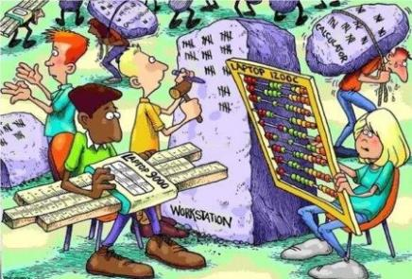
Where would we be..
..Without computers?
Computers need software

Slide 4
What is software development?
Programming with several languages
Programming for multiple devices
Programming concepts for the future
Specify, design, write, test software
Agile approach

Slide 5

Computer Science….
…Needs some form of computer programming

Slide 6
Programming
Part of a ‘computer science’ degree
Specialist degree is Software development / software engineering
Many different languages
Java, C#, C, JavaScript, Dart, Go, Rust, Kotlin, PHP, Ruby etc. etc.

Slide 7
Its all about inputs and outputs
How can a computer and human communicate?
Code can be written
so it can doesn’t mind where the input is from
just that’s it’s the correct format for the input
It can then output on whatever interface it needs to
People who design and code the front-end can then care about them getting a great user experience
Screen
Voice
Use the same code and change the inputs and outputs

Slide 8

Let’s take one language
JavaScript
Jeff Atwood, co-founder of Stack Overflow, stated ‘I'll call Atwood's Law: any application that can be written in JavaScript, will eventually be written in JavaScript.’ (Atwood, 2007).

Slide 9
Languages based on JavaScript
TypeScript
ECMAScript
Dart
Elm
CoffeeScript
Reason
Etc…

Slide 10
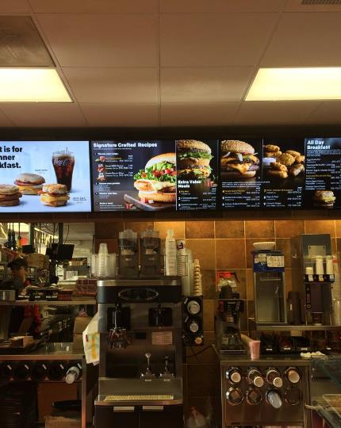
JS - you can create more than web sites!
https://twitter.com/AJStacy06/status/857628546507968512
25,000 menu configurations

Slide 11
Current uses of JS
Websites
Desktop Applications (e.g. visual studio code)
Mobile Applications (e.g. React Native)
Backend Coding (NodeJS) / Package Handlers (NPM) - ‘Node is designed to build scalable network applications’…with npm – ‘the largest ecosystem of open-source libraries in the world’ – https://nodejs.org/en/
Games (WebGL / Unity / GamePad API / AirConsole)
Video and Camera Chats (WebRTC)

Slide 12
Current uses of JS (cont.)
Programming home devices (Alexa / Google Home)
Via Amazon AWS lambda - Build for voice - https://developer.amazon.com/alexa-skills-kit
Via Google functions - Actions SDK - https://developers.google.com/actions/sdk/
Smart Watch Apps (Fitbit)
Internet Of Things (Arduino / Raspberry Pi / Smart lights / Heating)
AI – using clever APIs – Google Vision, Watson
Virtual and Augmented Reality (React 360 / WebXR)
ETC…

Slide 13
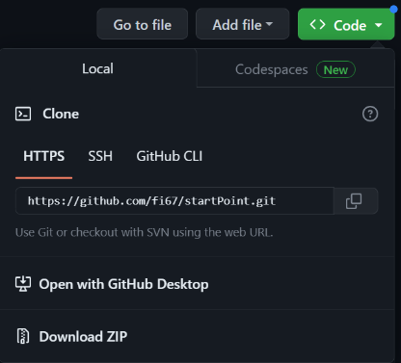


Let’s get to the code…
The starter files - https://github.com/fi67/startPoint
Download zip
Rock Paper Scissors Cat
Build on the web
Demo of it on Alexa

Slide 14
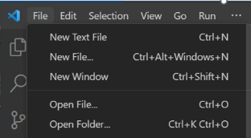
Visual Studio Code
We will use visual studio code (other editors are available!)
If you want it – its free - https://code.visualstudio.com/
We will open the folder with all the files in it
Let’s look at the files
Web page with images on it
Style sheet to style it
Link to JavaScript file
On the following slides we will add the JS file.- the code for each bit is in the snippets.txt file

Slide 15
Initialise
Initialise variables
These are ones used all over the application
Seen as GLOBAL
Runs function to setup input

Slide 16
Set Up The Inputs
Set Up Input function
This is specific to the device – in this case web
Click events for images and header

Slide 17
Get the user choice
Uses the id for the item the user clicks on to set up the user choice
Logs it to the console so you can see it during development

Slide 18
Game Logic
Function for the game logic
This also calls display output

Slide 19
Display the outputs
Outputs the result to the web page
Selects the cat audio if the user inputs the cat

Slide 20
Testing the application
Make sure your speakers are on
Open the page in chrome
Simple way, but not the best - right click index.html – open with chrome
Press F12 to see the console
Click a choice (rock, paper, scissors)
Click the cat image
Click the main header

Slide 21
Now let’s take it to Alexa!

Slide 22
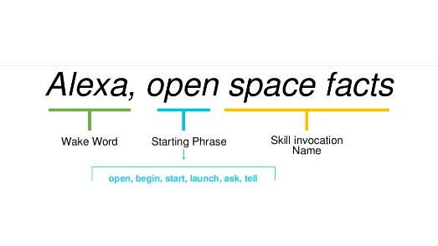
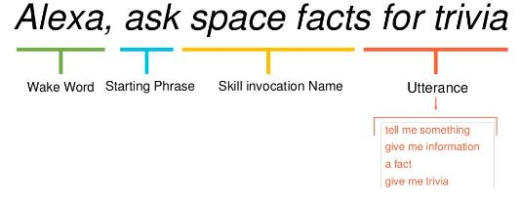
Alexa has Skills!

Slide 23

Alexa Developer Console
https://developer.amazon.com/alexa/console/ask
Sign in to your Amazon account
If you have created skills before you should see your list of skills.
Otherwise you will have an information screen
On either screen you will have a button ‘Create Skill’
Click this button and you will be taken to the next screen

Slide 24
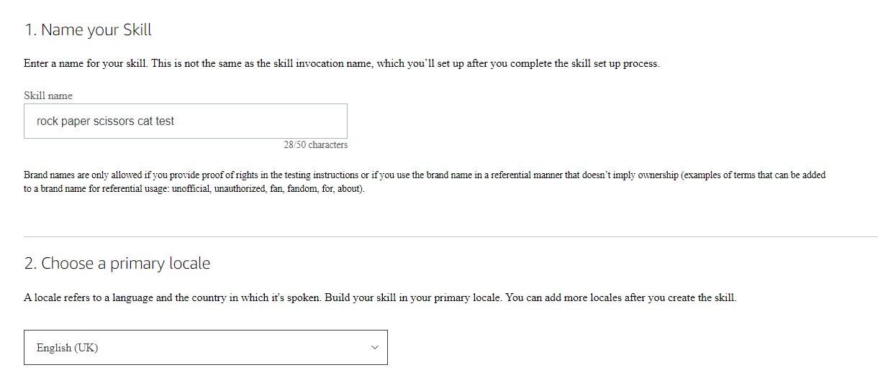
Give it a name
Choose English(UK)
Click Next

Slide 25
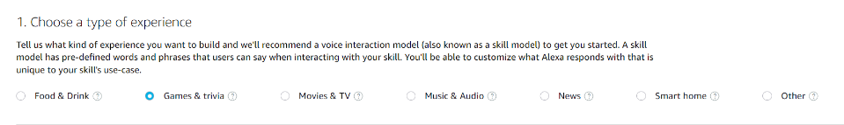
Choose type of experience – in this case games and trivia

Slide 26
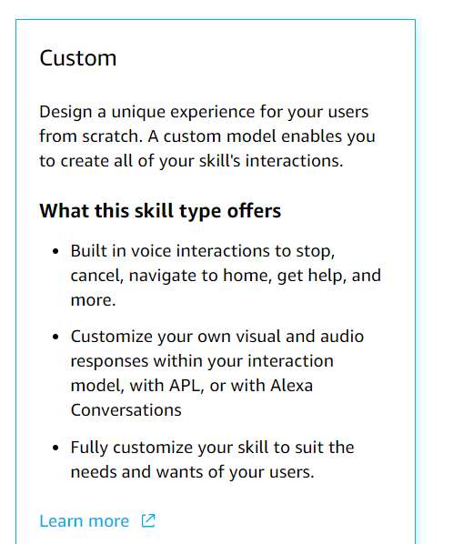
Choose a model - custom

Slide 27
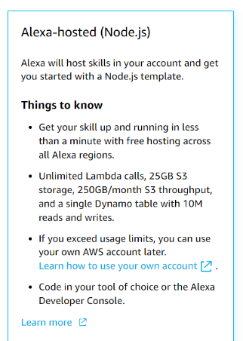
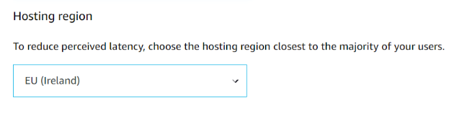
Choose hosting services – Alexa hosted (node.js)
Choose a hosting region – EU Ireland
Click Next

Slide 28
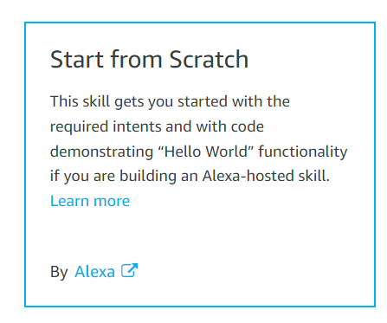

Choose a template – start from scratch
Click Next
Review your choices and click Create skill
It will take about a minute

Slide 29
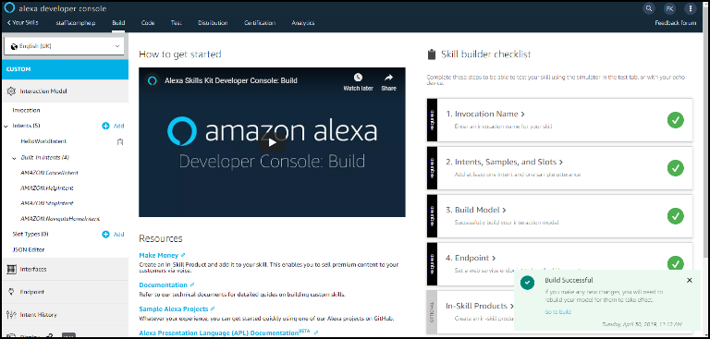
The skill screen

Slide 30
At every stage
Whenever you make a change, it is best to save and build the skill
Press ‘Save’ and you will be notified it has saved successfully (the button will also grey out)
Press ‘Build skill’ and the skill will build (this may take some time)

Slide 31
Variables – called Slots
These are like variables with values
In our case what the user chooses and what the computer can choose between

Slide 32
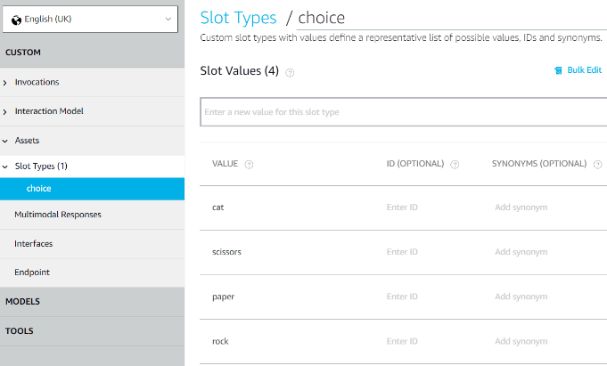
Add a slot type
Slot types > Add slot type called choice
values rock, paper, scissors, cat (save it)

Slide 33
Intents
What the user wants to do is an intention – its what you ask to do
Users can have lots of different intentions when using your skill
They will give you an utterance which you need to react to with the skill
What sort of things could you ask when you first wake up in the morning?

Slide 34
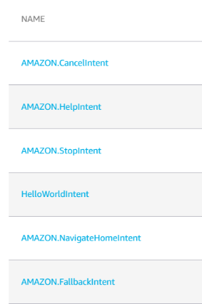
Built-in Intents
Click on ‘Interaction Model’
Click on ‘intents’
You will notice you also have been set up with 5 built in intents – cancel, help, stop and navigate home, fallback
And a hello world intent

Slide 35
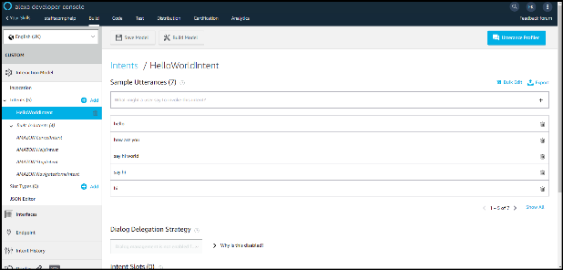
Utterances
What the user will say – ways to express intents
Best sourced from real people
Usually add at least 7 – ideally around 30 per intent
Look at hello world
Hello
How are you
Say hi world
Say hi
hi

Slide 36
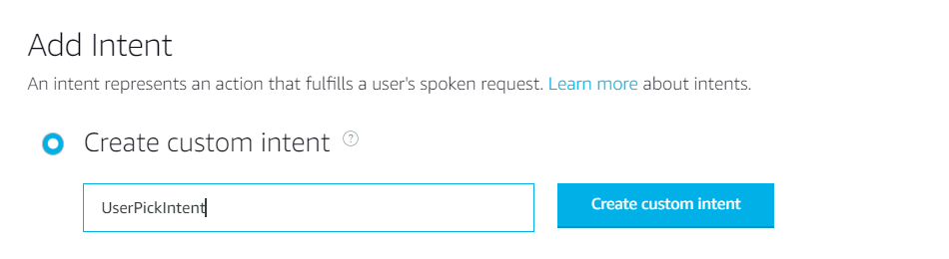
Intents
Invocations
Interaction Model > Intents > Add Intent
UserPickIntent
Create custom intent

Slide 37
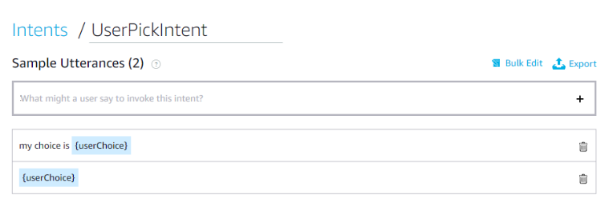
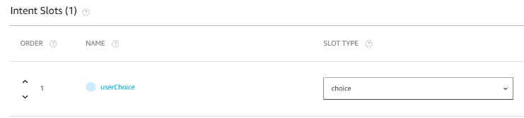
Intents
Add this and then save

Slide 38
Invocation name
This should be something memorable and something the user is likely to say
Your invocation name should be two or more words, and can contain only lower-case alphabetic characters, spaces between words, possessive apostrophes (for example, "sam's science trivia"), or periods used in abbreviations (for example, "a. b. c.").
Other characters like numbers must be spelled out. For example, "twenty one".
Invocation names cannot contain any of the Alexa skill launch phrases such as "launch", "ask", "tell", "load", "begin", and "enable".
Wake words including "Alexa", "Amazon", "Echo", "Computer", or the words "skill" or "app" are not allowed.
You can change this until the skill is published

Slide 39
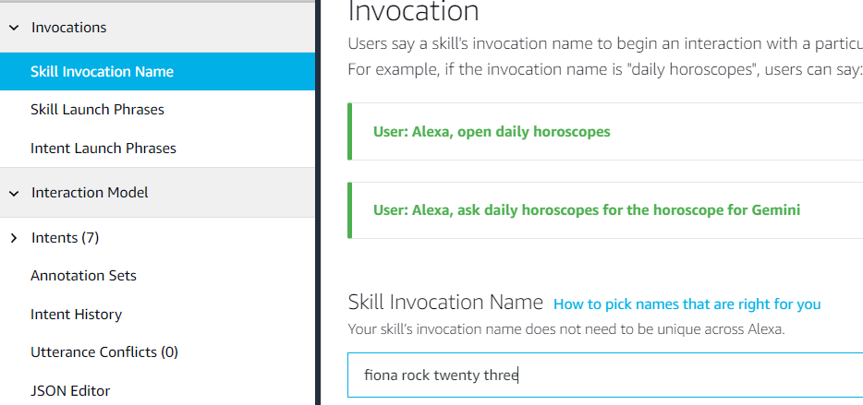
invocation > skill invocation name

Slide 40
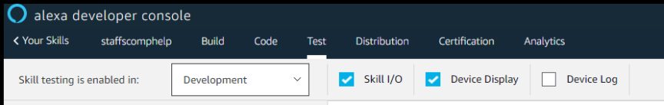
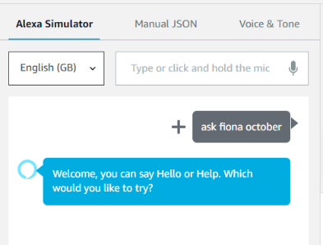
Testing the skill
Click on test at the top of the screen and change the skill testing to ‘development’
Type in your invocation and press enter
You should get a reply

Slide 41
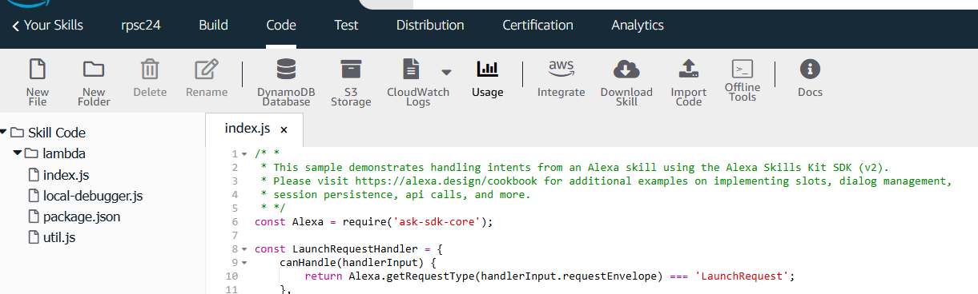
Front-end done!
Now to code it
We have a ‘magic’ link to the server
It uses Lambda – serverless computing on the AWS cloud
You have lots of ‘runs’ for free with the developer kit

Slide 42
We will use the bits in alexa.js that I provided you
Let us add each bit at a time
At the top there is a link to the library
const Alexa = require('ask-sdk-core’);
We will add our 4 variables underneath this

Slide 43
Handlers
These handle any intents the skill has
For every intent we have there should be a handler
LaunchRequestHandler – launches the intent we want to start with – when the user says
Help, cancel, stop are built in
Each intent has a separate handler and code block

Slide 44
Changing the handlers
Let us look at launch – this is what is said when we ‘invoke’ our ‘skill’
Add the change in to make it more relevant than hello world
Under the helloworld handler block we can add our userpick handler block – this handles the game
This also takes the ‘input’ from the user

Slide 45
At the end of the code
There is a block of exports
Change this to add our new handler
At the very bottom add the functions – playGame (same as we had in the web version) and userOutput (now using voice to output the response)

Slide 46
save, deploy and test
Save and deploy in the code window
Go to the test window
Invoke the skill using the invocation phrase
Test the game ☺

Slide 47
How could you take this further?
Best of 5 (live version Kitty RPC on Alexa)
Adding AI (interacting with chat GTP? Or other AI engines to ‘learn’ how to play)
Version for the TV, mobile, watch
All this can still be in JS

Slide 48
One last thing… JS and Media
http://madebyevan.com/webgl-water/
https://demo.marpi.pl/spider/
https://musiclab.chromeexperiments.com/Song-Maker/
https://students.washington.edu/aodhan/webgl_globe.html
https://www.autodraw.com/

Slide 49

Thank You ☺
Any questions?
F.L.Knight@staffs.ac.uk

