Slide 1

Welcome to the Department of Computing

Slide 2
About me
Fiona Knight
f.l.knight@staffs.ac.uk
Lecturer in Computer Science, web and programming

Slide 3

Computer Science…
…Needs some form of computer programming

Slide 4
Programming
Part of a ‘computer science’ degree
Specialist area is Software development / software engineering
Many different languages
Java, C#, C, JavaScript, Dart, Go, Rust, Kotlin, PHP, Ruby etc. etc.

Slide 5
Its all about inputs and outputs
How can a computer and human communicate?
Code can be written so it can doesn’t mind where the input is from just that’s it’s the correct input
It can then output so the interface can use it
Then people who design and code the front end interface to humans can then care about them getting a great user experience
Screen
Voice
We can take the same code and change the inputs and outputs

Slide 6

Lets have a look at one language
JavaScript
Jeff Atwood, co-founder of Stack Overflow, stated ‘I'll call Atwood's Law: any application that can be written in JavaScript, will eventually be written in JavaScript.’ (Atwood, 2007).

Slide 7
Languages based on JavaScript
EcmaScript
TypeScript
Dart
Elm
CoffeeScript
Reason
Etc…

Slide 8
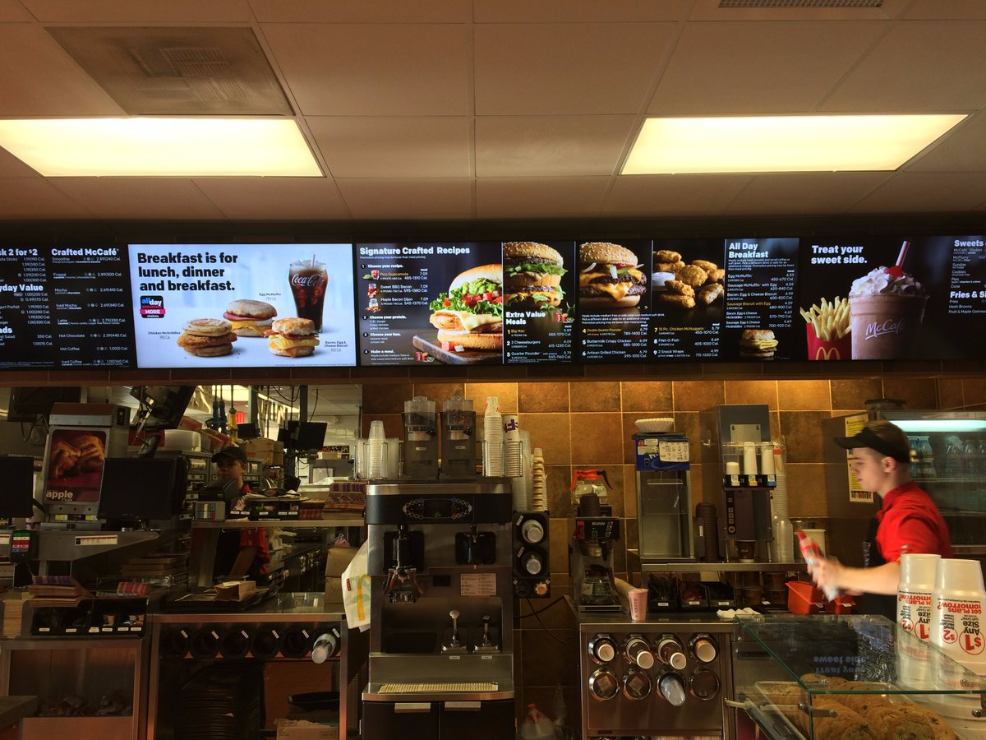
JS - You can create more than web sites!
https://twitter.com/AJStacy06/status/857628546507968512
25,000 menu configurations

Slide 9
Current Uses Of JS
Websites
Desktop Applications (e.g. visual studio code)
Mobile Applications (e.g React Native)
Backend Coding (NodeJS) / Package Handlers (NPM)
‘Node is designed to build scalable network applications’…with npm – ‘the largest ecosystem of open source libraries in the world’ – https://nodejs.org/en/
Games (WebGL / Unity / GamePad API / AirConsole)
Video and Camera Chats (WebRTC)

Slide 10
Current Uses Of JS (Cont)
Programming home devices (Alexa / Google Home)
Via Amazon AWS lambda - Build for voice - https://developer.amazon.com/alexa-skills-kit
Via Google functions - Actions SDK - https://developers.google.com/actions/sdk/
Smart Watch Apps (Fitbit)
Internet Of Things (Arduino / Raspberry Pi / Smart lights / Heating)

Slide 11
Current Uses Of JS (Cont)
AI – using clever APIs – Google Vision, Watson
Virtual and Augmented Reality (React 360 / WebXR)
Google state that ‘The immersive web is a spectrum from complete reality to completely immersive, with various levels in between.’ (Google, 2018)
ETC…

Slide 12
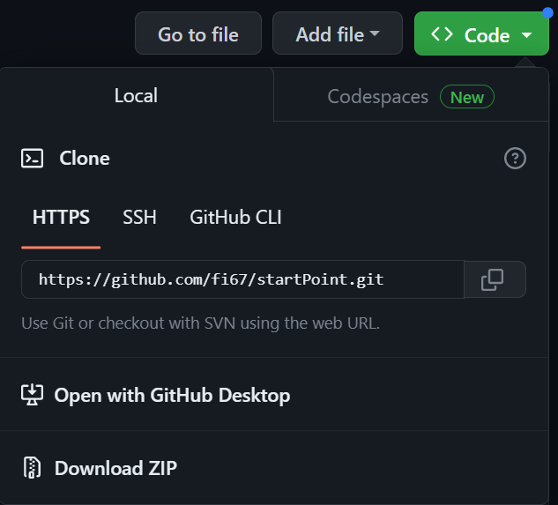


Lets write some code …
The starter files
Download zip at home if you want to try it
https://github.com/fi67/startPoint

Slide 13
What we will do
Rock Paper Scissors Cat
Build on the web
Build it on Alexa

Slide 14
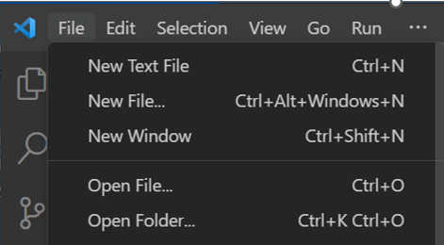
Visual Studio Code
We will use visual studio code (other editors are available!)
If you want it – its free - https://code.visualstudio.com/
We will open the folder with all the files in it
Lets look at the files
Web page with images on it
Style sheet to style it
Link to JavaScript file
On the following slides we will add the JS file.- the code for each bit is in the snippets.txt file

Slide 15
First – Initialise
Initialise variables
These are ones used all over the application
Seen as GLOBAL
Runs function to setup input
Notes:
//intialise variables
let userChoice;
let computerChoice;
let gameAnswer;
let catState;
// run the setup function setupWebInput();

Slide 16
Next – Set Up The Inputs
Set Up Input function
This is specific to the device – in this case web
Click events for images and header
Notes:
function setupWebInput() {
let choices = document.getElementsByClassName("choice");
let cat = document.getElementById("cat");
let elephant = document.getElementById("elephant");
cat.addEventListener("click", userPick);
elephant.addEventListener("click", userPick);
for (let i = 0; i < choices.length; i++) {
choices[i].addEventListener("click", userPick);
}
}

Slide 17
Next – Get the user choice
Get user choice
Uses the id for the item the user clicks on to set up the user choice
Logs it to the console so you can see it during development
Notes:
function userPick(evt) {
userChoice = this.id;
console.log(userChoice);
playGame();
}

Slide 18
Next – Game Logic
Function for the game logic
This also calls display output
Notes:
function playGame() {
let answers = ["rock", "paper", "scissors", "cat"];
computerChoice = answers[Math.floor(Math.random() * 4)];
console.log(computerChoice);
catState = 2;
let result = "";
if (userChoice === computerChoice) {
result = "it's a draw!"
} else if ((userChoice === "cat") || (computerChoice === "cat")) {
catState = Math.floor(Math.random() * 2);
console.log(catState);
if (userChoice === "cat") {
if (catState === 0) {
result = "The user picked angry cat! The computer wins!";
} else {
result = "The user picked happy cat! The user wins!";
}
} else {
if (catState === 0) {
result = "The computer picked angry cat! The user wins!";
} else {
result = "The computer picked happy cat! The computer wins!";
}
}
} else if (userChoice === "rock") {
if (computerChoice === "scissors") {
result = "you win, as rock blunts scissors!";
} else {
result = "the computer wins, as paper wraps rock!";
}
} else if (userChoice === "paper") {
if (computerChoice === "rock") {
result = "you win, as paper wraps rock!!";
} else {
result = "the computer wins, as scissors cuts paper!";
}
} else if (userChoice === "scissors") {
if (computerChoice === "paper") {
result = "you win, as scissors cuts paper!!";
} else {
result = "the computer wins, as rock blunts scissors!!";
}
}
if (result === "") {
gameAnswer = `User picked ${userChoice}, this is not a valid choice, please try again`;
} else {
gameAnswer = `User picked ${userChoice} , computer picked ${computerChoice} - ${result}`;
}
userOutput()
}

Slide 19
Next – Display the outputs
Display Output function
Outputs the result to the web page
Selects the cat audio if the user inputs the cat
Notes:
function userOutput() {
if ((userChoice === "cat") || (computerChoice ==="cat")) {
let myAudio = document.getElementById("myAudio");
let myCatAudio = "";
if (catState === 1) {
myCatAudio = "Catmeow1.mp3";
} else if (catState === 0) {
myCatAudio = "AngryCat.mp3";
}
myAudio.src = myCatAudio;
myAudio.addEventListener("canplaythrough", function(){myAudio.play()});
}
let winner = document.getElementById("winner");
winner.innerHTML = gameAnswer;
}

Slide 20
Testing the page
Make sure your speakers are on
Open the page in chrome
Simple way, but not the best - right click index.html – open with chrome
Press F12 to see the console
Click a choice (rock, paper, scissors)
Click the cat image
Click the main header

Slide 21
Now lets take it to Alexa

Slide 22
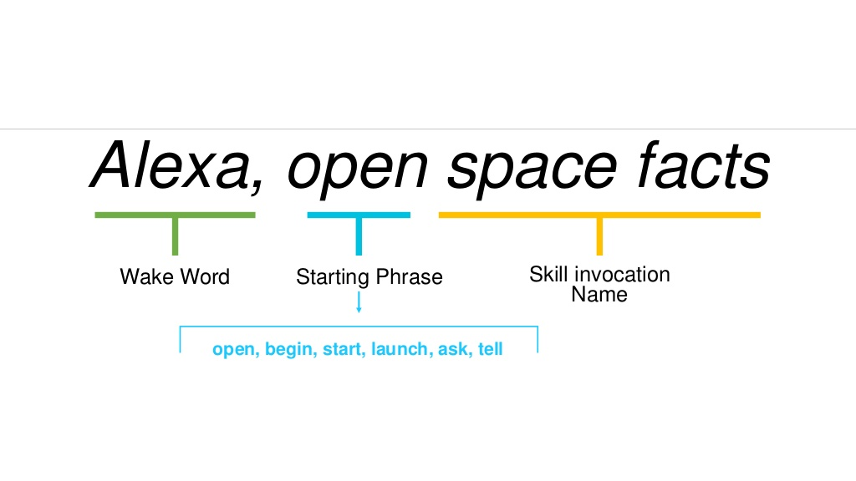
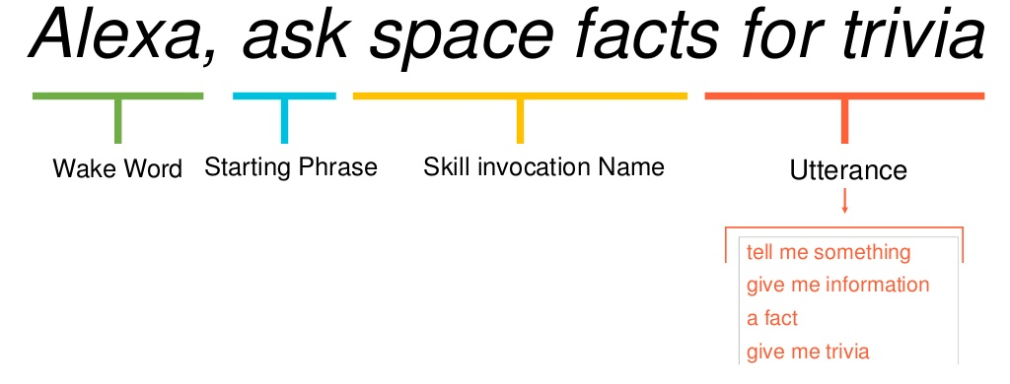
NOTE: Skills Order of items to say

Slide 23
Due to the creation of accounts taking time..
I will show you what to do so you can try this at home.

Slide 24
Log in to Alexa Developer
https://developer.amazon.com/alexa/console/ask
Sign in to your Amazon account

Slide 25
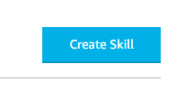
Next
If you have created skills before you should see your list of skills.
Otherwise you will have an information screen
On either screen you will have a button ‘Create Skill’
Click this button and you will be taken to the next screen

Slide 26
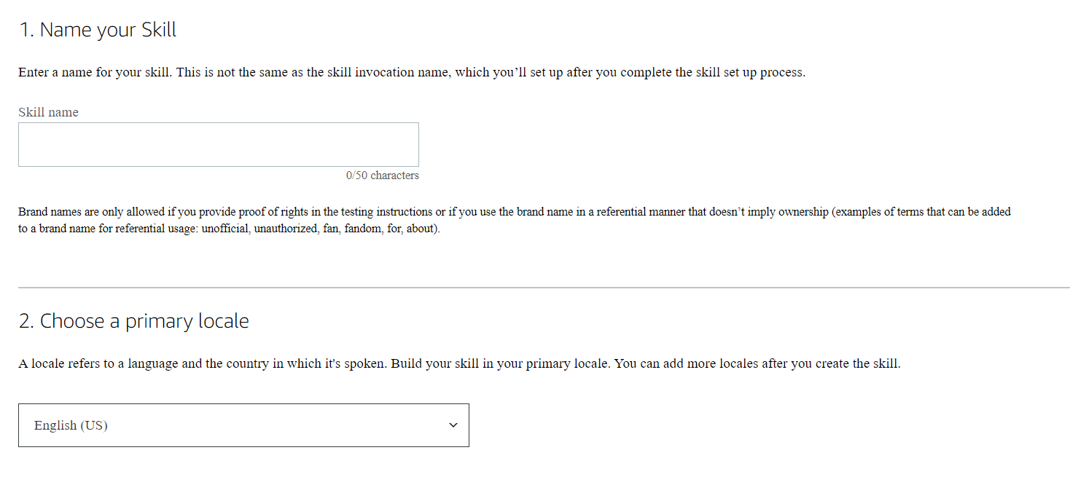
Step 1
Give it a name
Choose English(UK)
Click Next

Slide 27
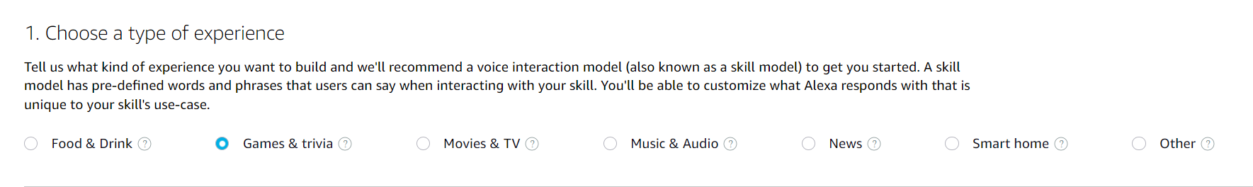
Step 2 (1)
Choose type of experience – in this case games and trivia

Slide 28
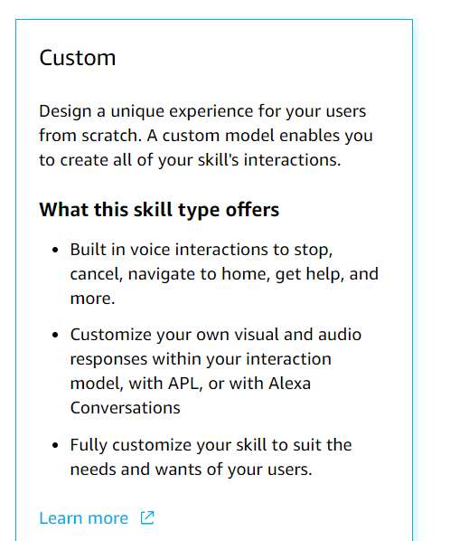
Step 2 (2)
Choose a model - custom

Slide 29
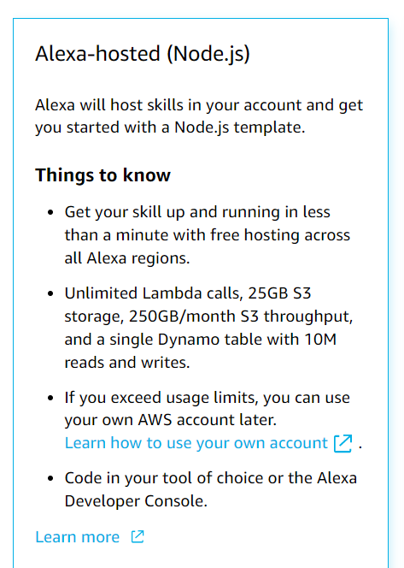
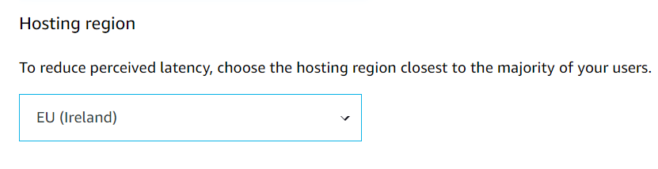
Step 2 (3)
Choose hosting services – Alexa hosted (node.js)
Choose a hosting region – EU Ireland
Click Next

Slide 30
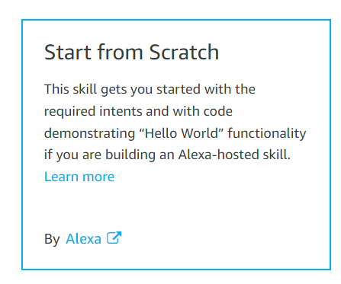
Step 3
Choose a template – start from scratch
Click Next

Slide 31

Step 4
Review your choices and click Create skill
It will take about a minute

Slide 32
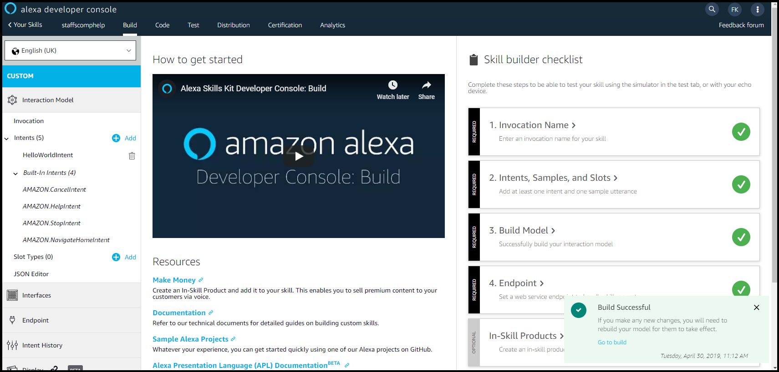
The skill screen
You should get the skill screen

Slide 33
At every stage
Whenever you make a change it is best to save and build the model
Press ‘Save Model’ and you will be notified it has saved successfully (the button will also grey out)
Press ‘Build Model’ and the model will build (this may take some time)

Slide 34
Slots
These are like variables with values
In our case what the user chooses and what the computer can choose between

Slide 35
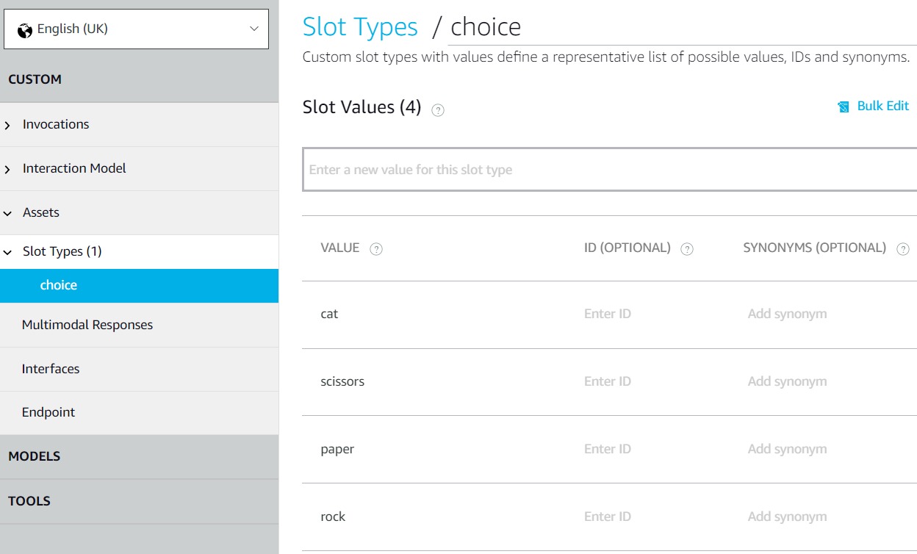
Add a slot type
Slot types > Add slot type called choice
values rock, paper, scissors, cat

Slide 36
Intents
What the user wants to do is an intention – its what you ask to do
Users can have lots of different intentions when using your skill
They will give you an utterance which you need to react to with the skill
What sort of things could you ask when you first wake up in the morning?

Slide 37
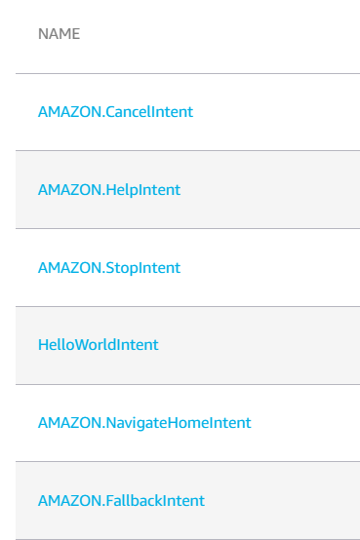
Created intents
You will notice you also have been set up with 5 built in intents – cancel, help, stop and navigate home, fallback
And a hello world intent

Slide 38
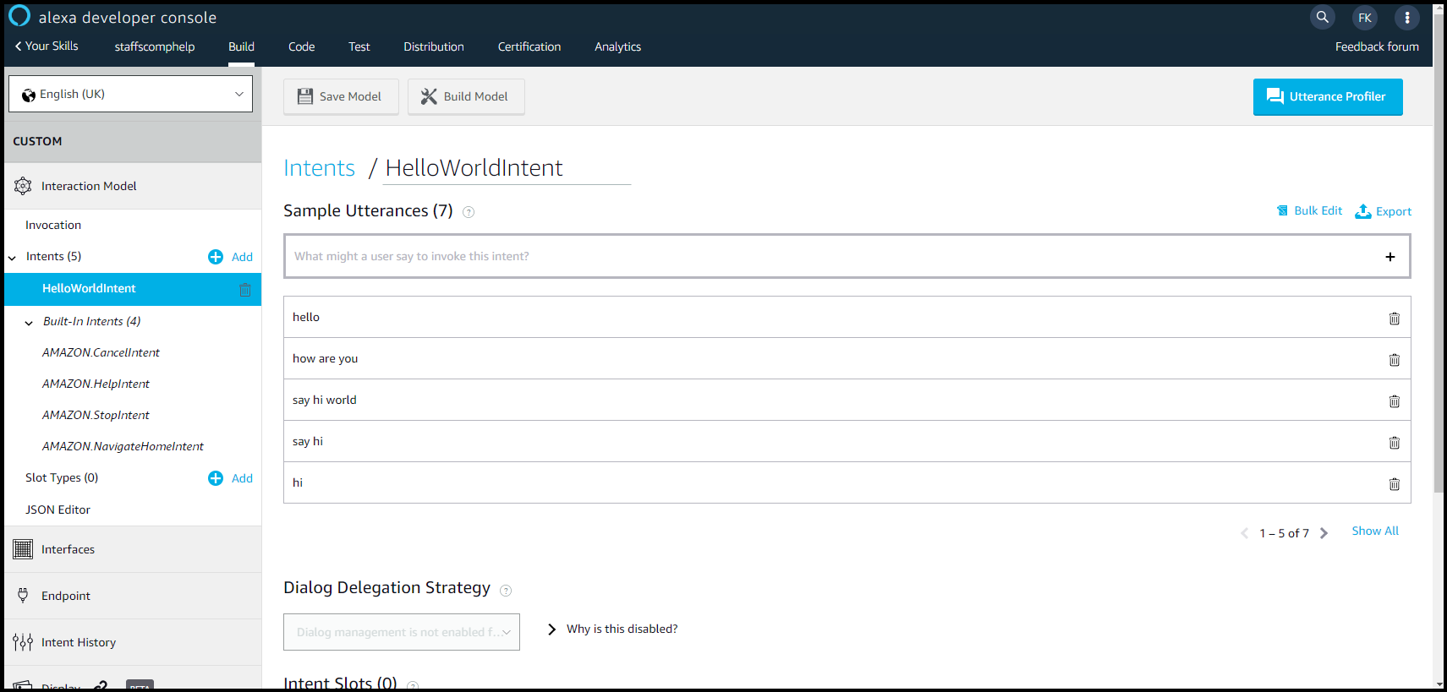
Utterances
What the user will say – ways to express intents
Best sourced from real people
Usually add at least 7 – ideally around 30 per intent
Look at hello world
Hello
How are you
Say hi world
Say hi
hi

Slide 39
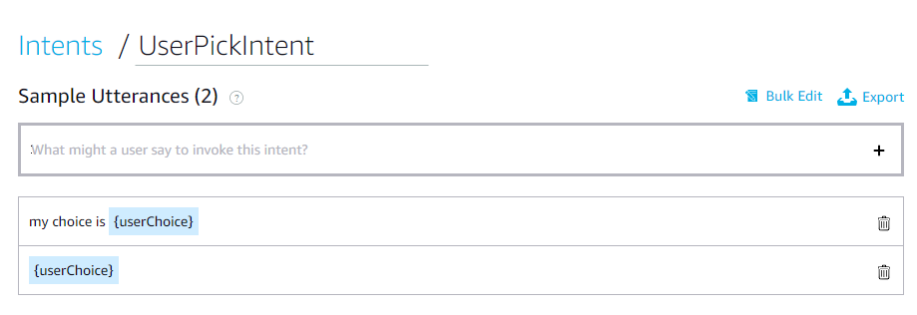
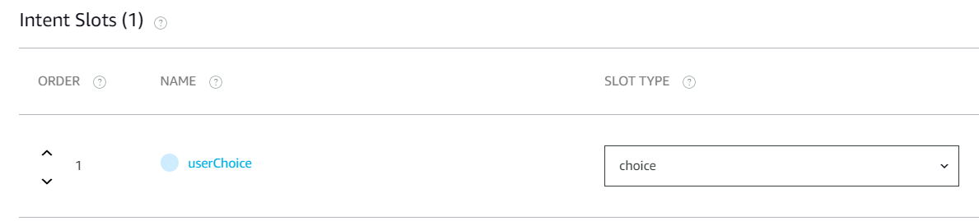
Intents
Invocations
Interaction Model > Intents > Add Intent
UserPickIntent

Slide 40
Invocation name
This should be something memorable and something the user is likely to say
Your invocation name should be two or more words, and can contain only lower-case alphabetic characters, spaces between words, possessive apostrophes (for example, "sam's science trivia"), or periods used in abbreviations (for example, "a. b. c.").
Other characters like numbers must be spelled out. For example, "twenty one".
Invocation names cannot contain any of the Alexa skill launch phrases such as "launch", "ask", "tell", "load", "begin", and "enable".
Wake words including "Alexa", "Amazon", "Echo", "Computer", or the words "skill" or "app" are not allowed.
You can change this until the skill is published

Slide 41
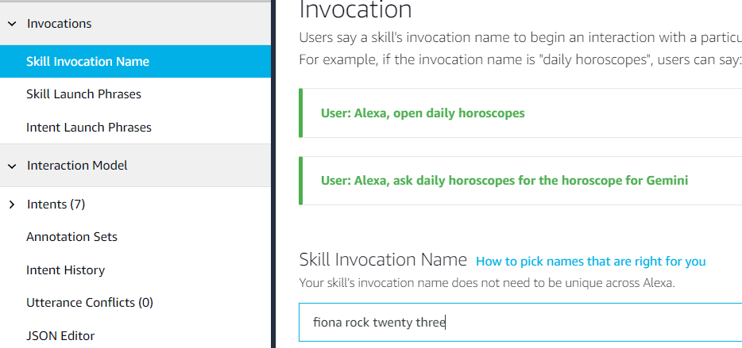
Invocation
Invocation > skill invocation name

Slide 42
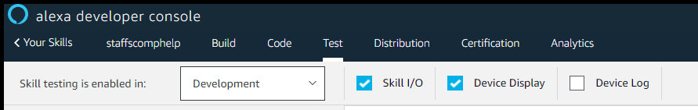
Testing the skill
First we will test the skill on line in the tester in the kit
Click on test at the top of the screen and change the skill testing to ‘development’

Slide 43
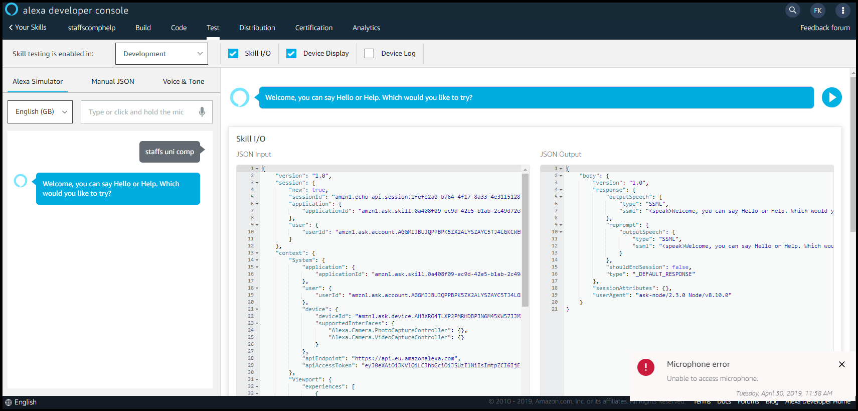
Next
Type in your invocation and press enter
You should get a reply and a screen like the one below

Slide 44
At the moment…
It doesn’t work correctly
We need to add some code in the background (on the server)
We have a ‘magic’ link to the server
It uses Lambda – serverless computing on the AWS cloud
You have lots of ‘runs’ for free with the developer kit

Slide 45
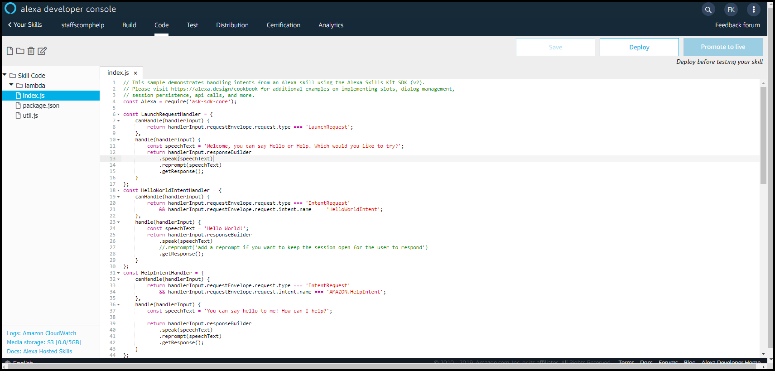
The code
Click on the code tab at the top and you will see a page similar to the one below

Slide 46
Code
We will use the bits in alexa.js that I provided you
Let us add each bit at a time

Slide 47
At the top
There is a link to the library
const Alexa = require('ask-sdk-core’);
We will add our 4 variables underneath this

Slide 48
Handlers
These handle any intents the skill has
For every intent we have there should be a handler
LaunchRequestHandler – launches the intent we want to start with – when the user says
Help, cancel, stop are built in
Each intent has a separate handler and code block

Slide 49
Launch Handler
Let us look at launch – this is what is said when we ‘invoke’ our ‘skill’
Add the change in to make it more relevant than hello world

Slide 50
Our handler
Under the helloworld handler block we can add our userpick handler block – this handles the game
This also takes the ‘input’ from the user

Slide 51
At the end
There is a block of exports
Change this to add our handler in
At the very bottom add the functions – playGame (same as we had in the web version) and userOutput (now using voice to output the response)

Slide 52
Save and deploy
This makes it available to our account
Test it first in the test window (remember to invoke first)
See if it works on Alexa (I will use my phone)

Slide 53
How could you take this further?
Best of 5
Adding AI (interacting with chat GTP? Or other AI engines to ‘learn’ how to play)
All this can still be in JS

Slide 54
One last thing… JS and Media
http://madebyevan.com/webgl-water/
https://demo.marpi.pl/spider/
https://musiclab.chromeexperiments.com/Song-Maker/
https://www.newnaw.com/pub/js/webglglobe/worldelevation/

Slide 55

Questions

Slide 56


