Slide 1
VULKAN
STE SMV
AUTHOR: MATIJA HRASTNIK R-4.a
MENTOR: Bostjan Resinovic
Klavdija Spur Jereb
11.28.2025

Slide 2

AGENDA
1
WHAT IS VULKAN
HOW TO USE VULKAN
VULKAN STRUCTURE
COMPARISON
PRACTICAL PART
2
3
4
5

Slide 3
GLOSSARY
1. Engraving
2. Nozzle
3. Designer Software
4. Laser Cutting Machine
5. Wooden Products

Slide 4

WHAT IS vulkan
Graphics/GPU API
Khronos Group
2016, replaced OpenGL
Low Level Control

Slide 5
Why vulkan?
Performance -> very explicit, good control of the GPU
Cross platform: Linux, Windows, macOS (MoltenVK)
Validation Layers

Slide 6
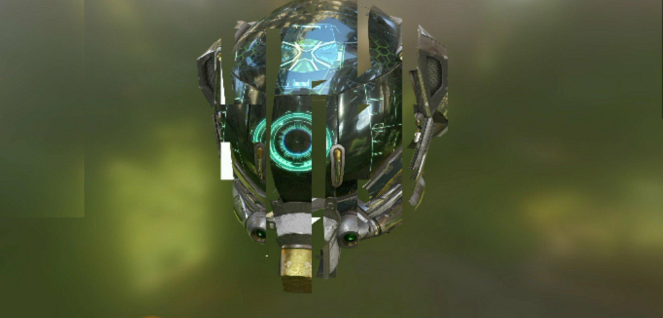
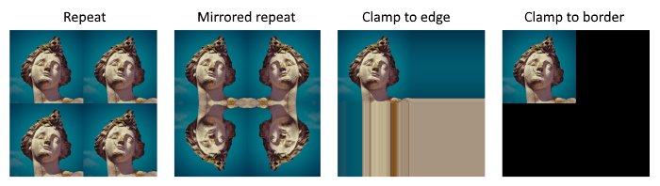
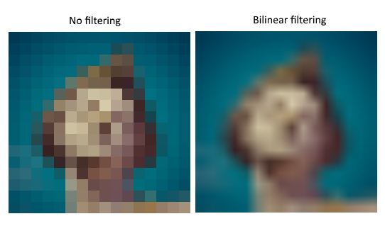
What can it do
Use the GPU explicitly
Compute operations
Image Adressing
Sample Shading
Anti Aliasing
github.com/SaschaWillems/
Vulkan Hardware RT from Sascha Willems

Slide 7
Core concepts
Devices & Queues
Pipelines: Fixed and Programmable stages
Command Buffers: Recorded GPU commands (reusable)
Synchronization: Explicit fences, semaphores

Slide 8

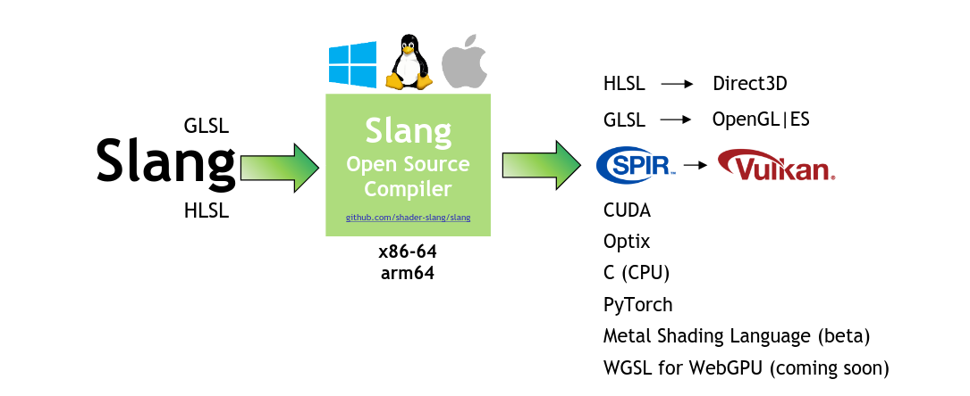
Development enviorment
LunarG SDK
Windowing Enviorment
Linear Algebra library
SPIR compiler
GLM, GLFW, Slang

Slide 9
The Structure and it’s advancements
Manual memory management (< version 1.3)
Functions: vk_…
Structs: Vk_…
Enumerations:VK_...
RAII
New vk:: namespace

Slide 10
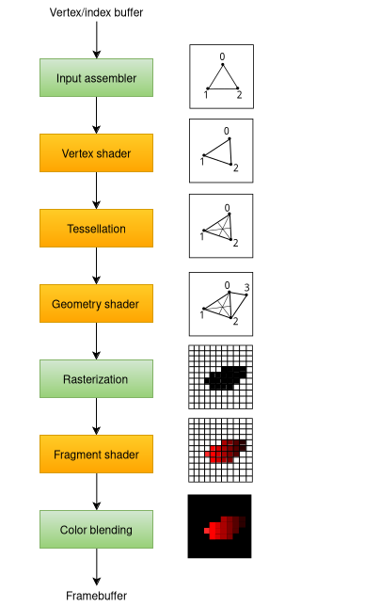
PROGRAM
Setup: Instance, setup device
Swapchain
Render Pass: Define attachments
Pipeline: Shaders, settings
Draw: Record commands

Slide 11


COMPARISON
Current state of graphics development
Vulkan’s initial shortsighted design
Extremely low level and explicit
Breadth of support
  D3D does not support Linux

Slide 12
CONCLUSION
Explored core Vulkan concepts
Gained knowledge of the universal graphics pipeline
Created a funcitoning application during learning

Slide 13
SOURCES
All images CC0 licensed
https://docs.vulkan.org/guide/latest/index.html

