Slide 1
Agile Methodologies and Jira for Software Requirements Management
Illustrating Jira for Requirements Management, Traceability,
Change Management & Evaluation
M.Sami Ullah
Fiaz Ahmad
Umar
FA24-BSE-080
FA24-BSE-127
FA24-BSE-110
Software Requirements Engineering

Slide 2
Learning Objectives
Learning Objectives
✓ Understand how Agile methodologies define software requirements
✓ Learn Jira as a requirements management tool
✓ Explore requirement traceability using Jira
✓ Understand change management in Agile with Jira
✓ Evaluate requirements using Jira dashboards & reports
Agile Methodology
Jira Tool
Requirements Engineering
Agile Methodologies & Jira for Requirements Management
2026

Slide 3
Agile Methodologies: Requirements in Agile
Key Agile Principles for Requirements
▸ User Stories: Requirements expressed as 'As a [role], I want [feature] so that [benefit]'
▸ Product Backlog: Prioritized list of all requirements
▸ Sprints: Time-boxed iterations (1-4 weeks) to deliver working software
▸ Iterative Refinement: Requirements evolve through feedback
▸ Acceptance Criteria: Define when a requirement is 'done'
▸ Continuous Collaboration: PO, Dev Team & Stakeholders work together
Agile Manifesto Values
Individuals & Interactions > Processes & Tools
Working Software > Comprehensive Documentation
Customer Collaboration > Contract Negotiation
Responding to Change > Following a Plan
Scrum Framework Components
• Product Owner → Manages Product Backlog
• Scrum Master → Facilitates Agile Process
• Development Team → Delivers Increment
• Sprint Planning / Daily Standup / Review / Retrospective
CLO4: Agile Methodologies & Jira for Requirements Management
2026

Slide 4
Introduction to Jira
What is Jira?
Jira is a project management and issue tracking tool developed by Atlassian.
Originally designed for bug tracking, now widely used for Agile software development.
Supports Scrum, Kanban, and hybrid Agile methodologies.
Highly customizable workflows, fields, and reporting.
Key Features for Requirements
✓ Issue Tracking: Create, assign, and track requirements as issues
✓ Customizable Workflows: Define requirement lifecycle states
✓ Agile Boards: Visualize work with Scrum/Kanban boards
✓ Dashboards & Reports: Monitor progress and quality
✓ Integration: Connect with Confluence, Bitbucket, Test Management tools
JIRA
by Atlassian
Issue & Project Tracking
Jira Products for Requirements
• Jira Software → Agile project management (Scrum/Kanban)
• Jira Service Management → Change & IT service management
• Jira Work Management → Business team project tracking
• Jira Align → Enterprise Agile planning & portfolio management
CLO4: Agile Methodologies & Jira for Requirements Management
2026

Slide 5
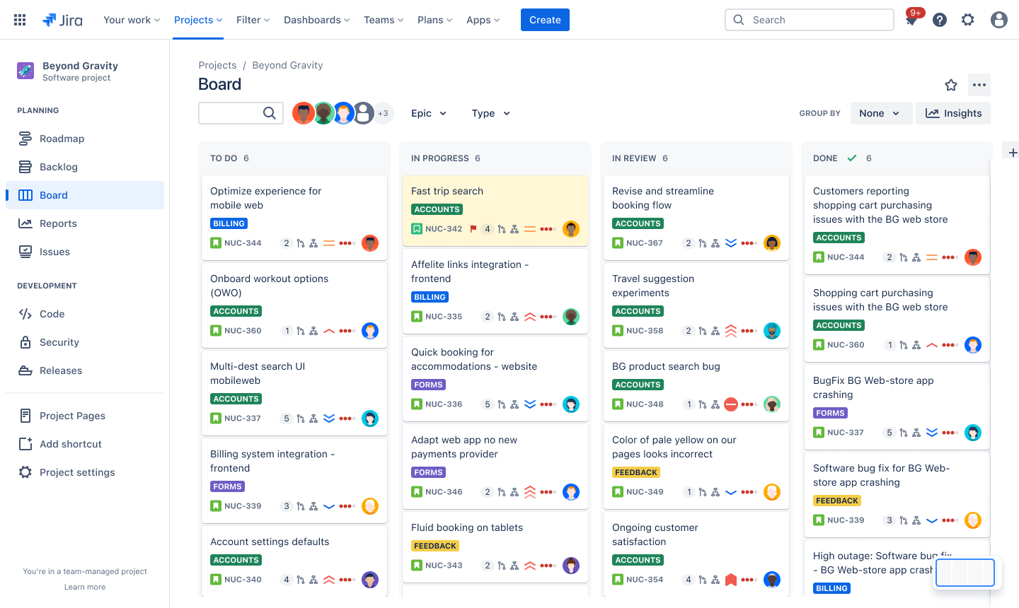
Requirements Management in Jira
Jira manages requirements through Issues, Epics, and User Stories organized in Agile Boards. The screenshot below shows a Kanban board with requirements flowing through workflow states.
Epics: Group related user stories
Workflow: To Do → In Progress → Done
Labels & Priorities: Categorize requirements
CLO4: Agile Methodologies & Jira for Requirements Management
2026

Slide 6
Requirements Management: Key Concepts
Creating Requirements in Jira
• Issue Types: Epic, Story, Task, Bug, Sub-task
• User Story Format: 'As a [user], I want [feature] so that [benefit]'
• Acceptance Criteria: Defined in issue description or custom fields
• Story Points: Effort estimation using Fibonacci scale (1,2,3,5,8,13)
• Priority Levels: Highest, High, Medium, Low, Lowest
• Components: Group requirements by system module
• Labels: Free-form tags for categorization
Backlog & Sprint Management
• Product Backlog: Single source of truth for all requirements
• Sprint Backlog: Subset selected for current iteration
• Sprint Planning: Team commits to deliver selected stories
• Definition of Ready: Clear, estimated, and testable before sprint
• Definition of Done: All acceptance criteria met, tested, reviewed
• Burndown Chart: Track remaining work during sprint
• Velocity Chart: Measure team capacity over sprints
Agile Methodologies & Jira for Requirements Management
2026

Slide 7
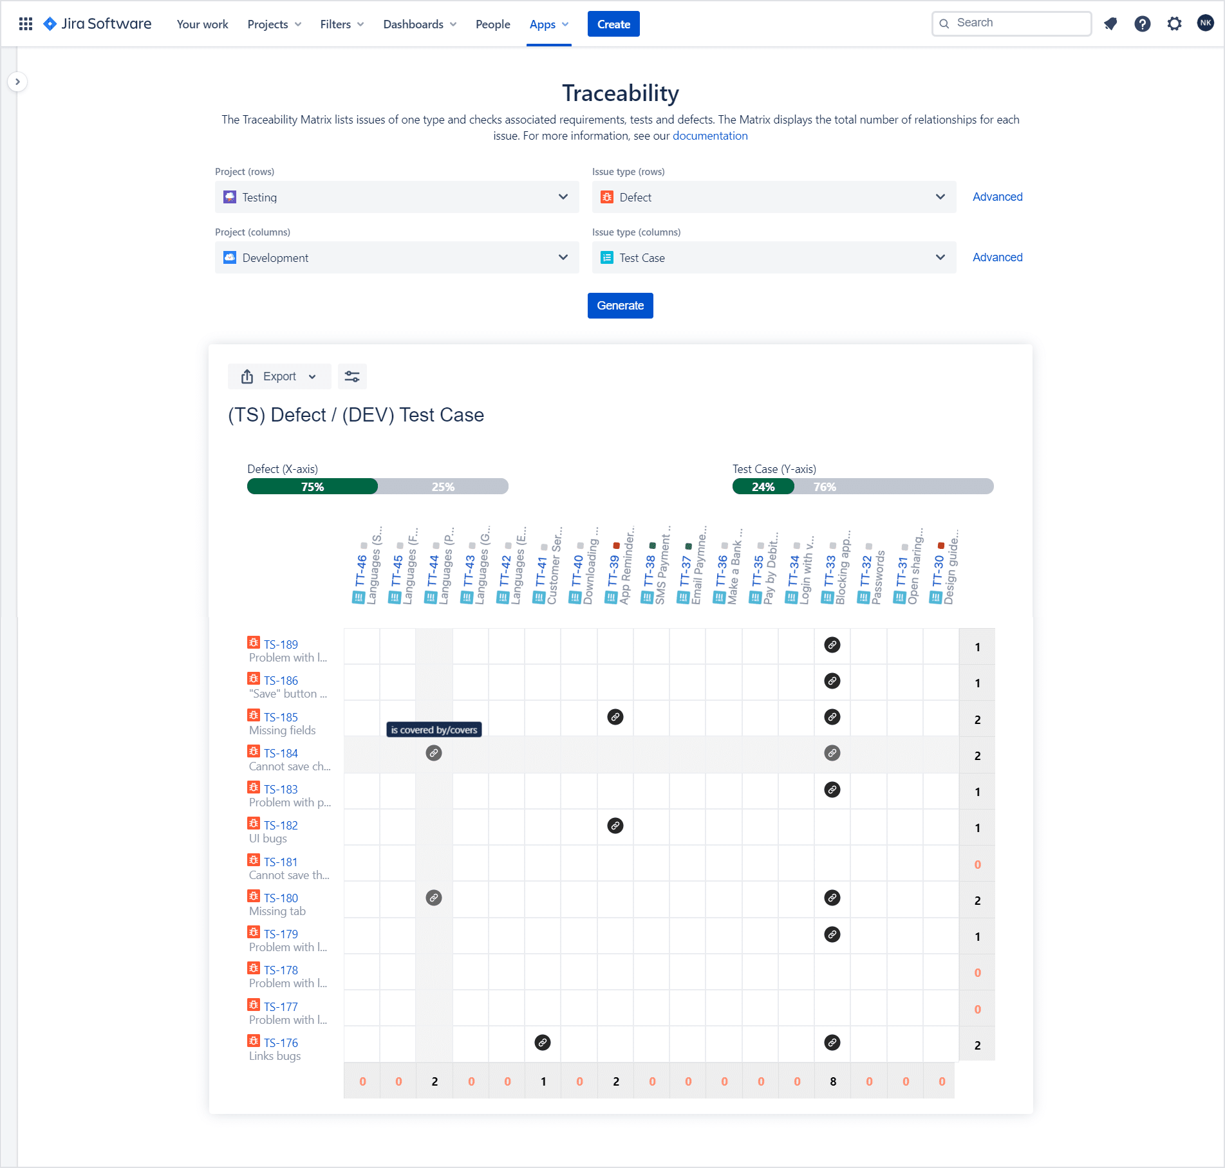
Requirement Traceability in Jira
Traceability ensures every requirement can be tracked forward to design, code, tests, and defects — and backward to its origin. Jira provides built-in linking and RTM (Requirements & Test Management) apps.
Types of Traceability
▸ Forward Traceability: Req → Design → Code → Test Case → Result
▸ Backward Traceability: Test Case → Code → Design → Requirement
▸ Bi-directional: Both directions for full coverage
▸ Cross-project: Link requirements across multiple Jira projects
Jira Link Types
• Relates to / Blocks / Is blocked by
• Tests / Is tested by
• Covers / Is covered by
• Clones / Is cloned by
• Duplicates / Is duplicated by
Fig: Jira Traceability Matrix showing requirement-to-test-case links
Agile Methodologies & Jira for Requirements Management
2026

Slide 8
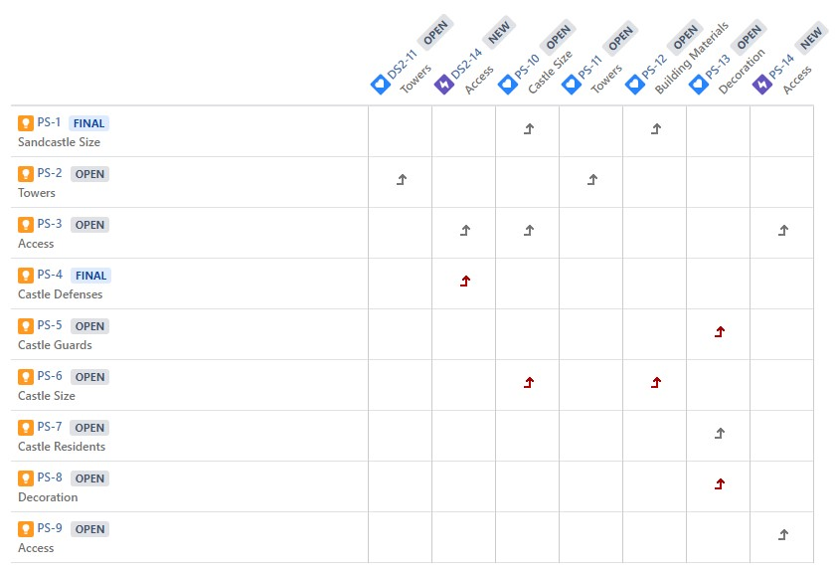
Traceability Matrix (RTM) in Jira
The Requirements Traceability Matrix (RTM) maps each requirement to its associated test cases, defects, and implementation status.
Requirements (Rows) vs Test Cases (Cols)
Status Indicators: OPEN, FINAL, NEW
Coverage Gaps highlighted automatically
Agile Methodologies & Jira for Requirements Management
2026

Slide 9
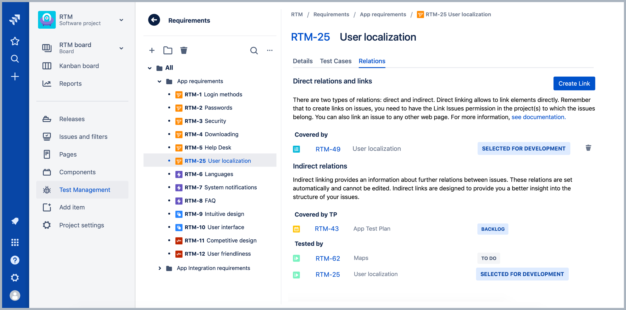
Requirement Relations & Issue Linking
Jira allows creating direct and indirect relations between requirements, test cases, and other artifacts. This enables full lifecycle traceability.
Direct Links: Manually created between issues
Indirect Relations: Auto-generated via structure
Coverage: Tested by, Covered by, Verified
Agile Methodologies & Jira for Requirements Management
2026

Slide 10
Requirement Change Management in Jira
Why Change Management Matters
• Agile welcomes change — but it must be controlled
• Unmanaged changes lead to scope creep and missed deadlines
• Every requirement change needs impact analysis
• Stakeholders must be informed of change consequences
• Audit trail ensures compliance and accountability
• Jira workflows enforce approval gates for changes
Change Management Process in Jira
1. Change Request: New issue or modify existing requirement
2. Impact Analysis: Check linked items (tests, code, docs)
3. Approval Workflow: Review → Planning → CAB Review
4. Implementation: Update requirement and linked artifacts
5. Verification: Re-run tests to ensure no regression
6. Closure: Post-implementation review and documentation
Agile Methodologies & Jira for Requirements Management
2026

Slide 11
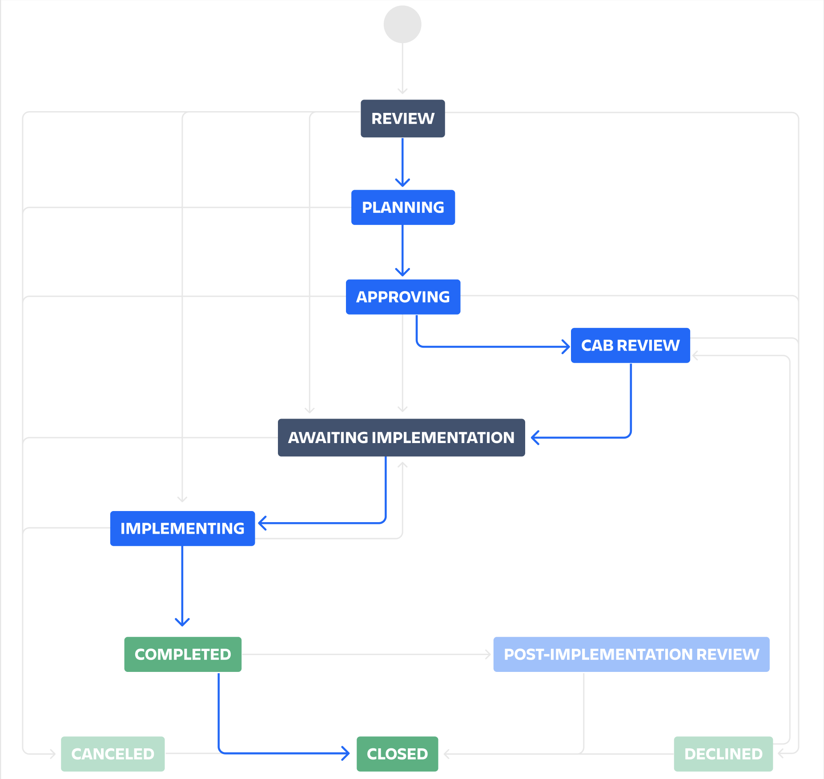
Jira Change Management Workflow
Jira Service Management provides pre-built change management workflows with approval stages, ensuring controlled and auditable requirement changes.
Review → Planning → Approving
CAB Review → Implementation → Post-Review
Completed / Closed / Declined / Canceled
Agile Methodologies & Jira for Requirements Management
2026

Slide 12
Requirements Evaluation in Jira
What is Requirements Evaluation?
• Verifying requirements are complete, correct, and feasible
• Checking test coverage for each requirement
• Measuring requirement quality and stability
• Tracking sprint velocity and team capacity
• Identifying risks and blockers early
• Ensuring 'Definition of Done' is met
Evaluation Metrics in Jira
▸ Test Coverage: % of requirements with test cases
▸ Test Execution: Pass/Fail/Blocked/Not Run rates
▸ Defect Density: Bugs per requirement
▸ Sprint Velocity: Story points completed per sprint
▸ Burndown Rate: Work remaining vs time
▸ Requirement Stability: Change frequency over time
Agile Methodologies & Jira for Requirements Management
2026

Slide 13
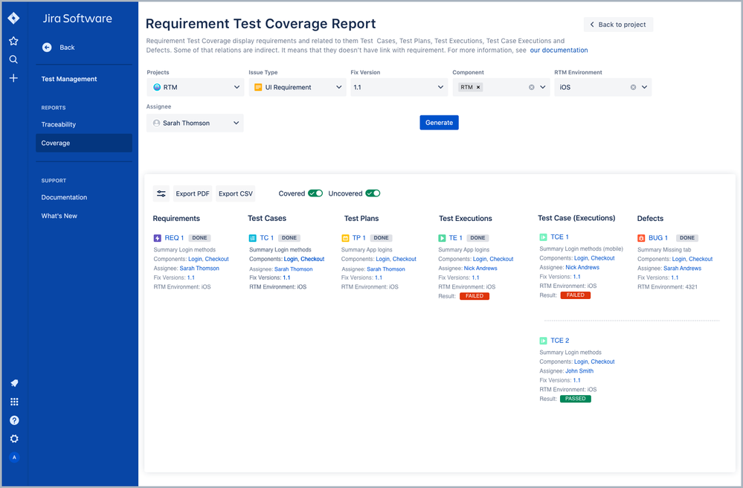
Requirement Test Coverage Report
Jira's Requirements & Test Management (RTM) app generates coverage reports showing which requirements have test cases, test plans, and defects linked.
Requirements → Test Cases → Test Plans
Test Executions & Defects linked
Coverage: Covered vs Uncovered status
Agile Methodologies & Jira for Requirements Management
2026

Slide 14
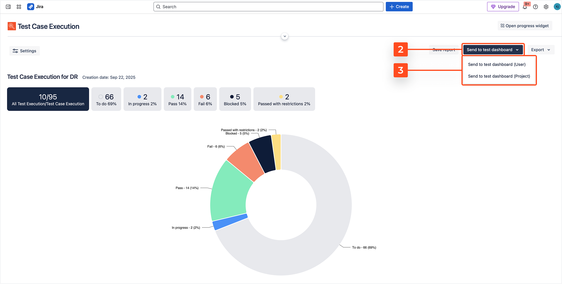
Test Execution Dashboard
Jira dashboards visualize test execution status with charts showing passed, failed, blocked, and in-progress test cases for requirements validation.
Total Test Cases: 10,095 executed
Status Breakdown: Pass / Fail / Blocked
Pie Chart: Visual execution summary
Agile Methodologies & Jira for Requirements Management
2026

Slide 15
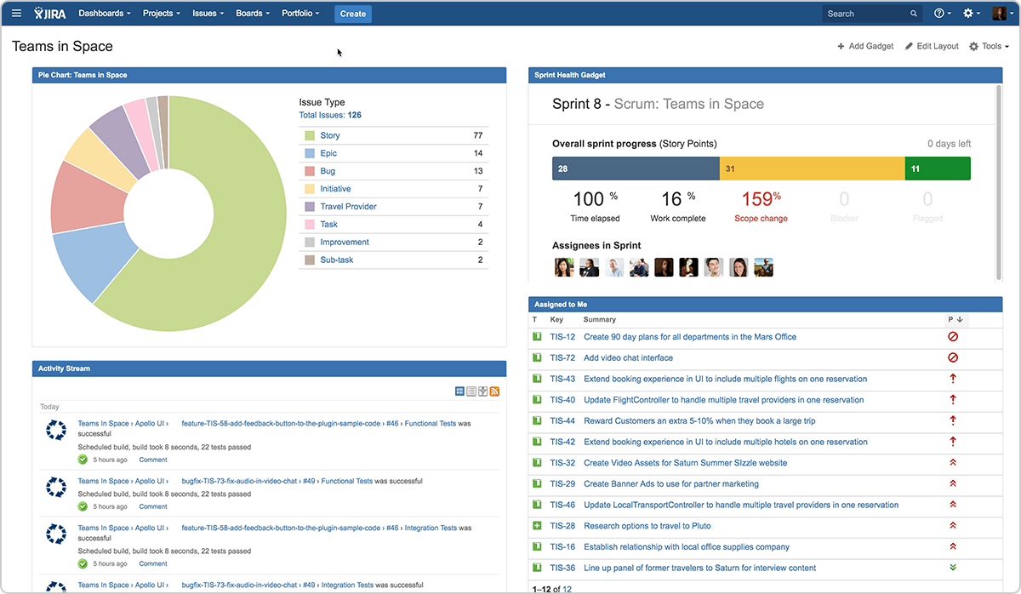
Jira Dashboards for Requirements Evaluation
Jira dashboards combine multiple gadgets to provide real-time visibility into project health, sprint progress, and requirement quality metrics.
Sprint Health & Progress Gadgets
Issue Type Distribution Charts
Activity Stream & Assigned Issues
CLO4: Agile Methodologies & Jira for Requirements Management
2026

Slide 16
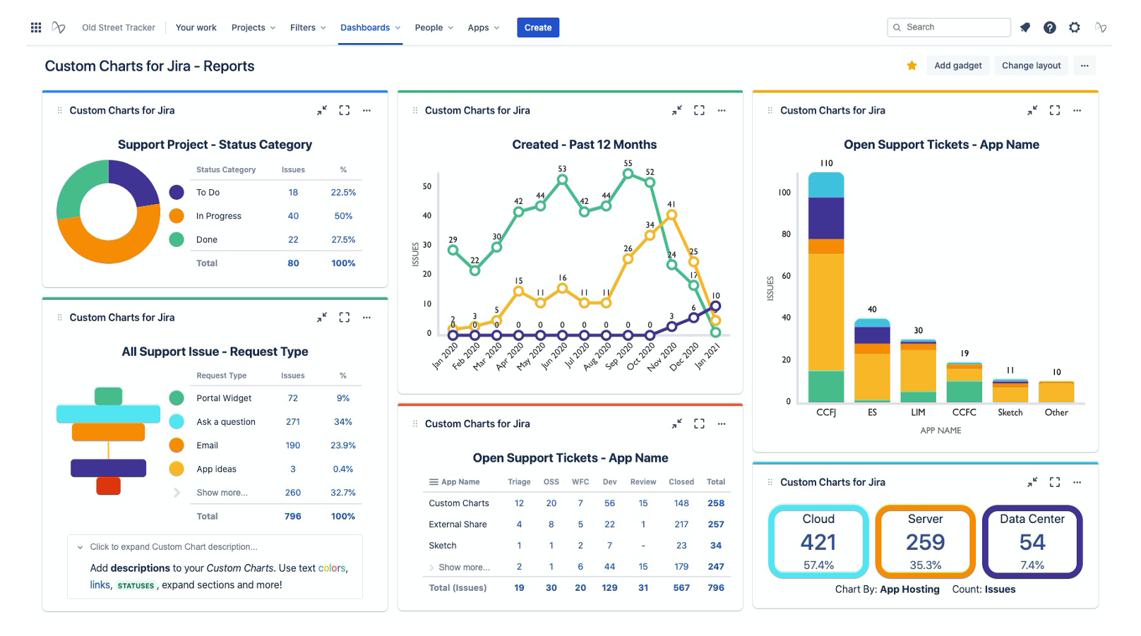
Custom Reports & Charts for Evaluation
Advanced reporting apps in Jira generate custom charts for status categories, ticket trends, support metrics, and app-specific analysis.
Status Category Pie Charts
Trend Analysis: Created tickets over 12 months
Stacked Bar Charts by App/Component
Agile Methodologies & Jira for Requirements Management
2026

Slide 17
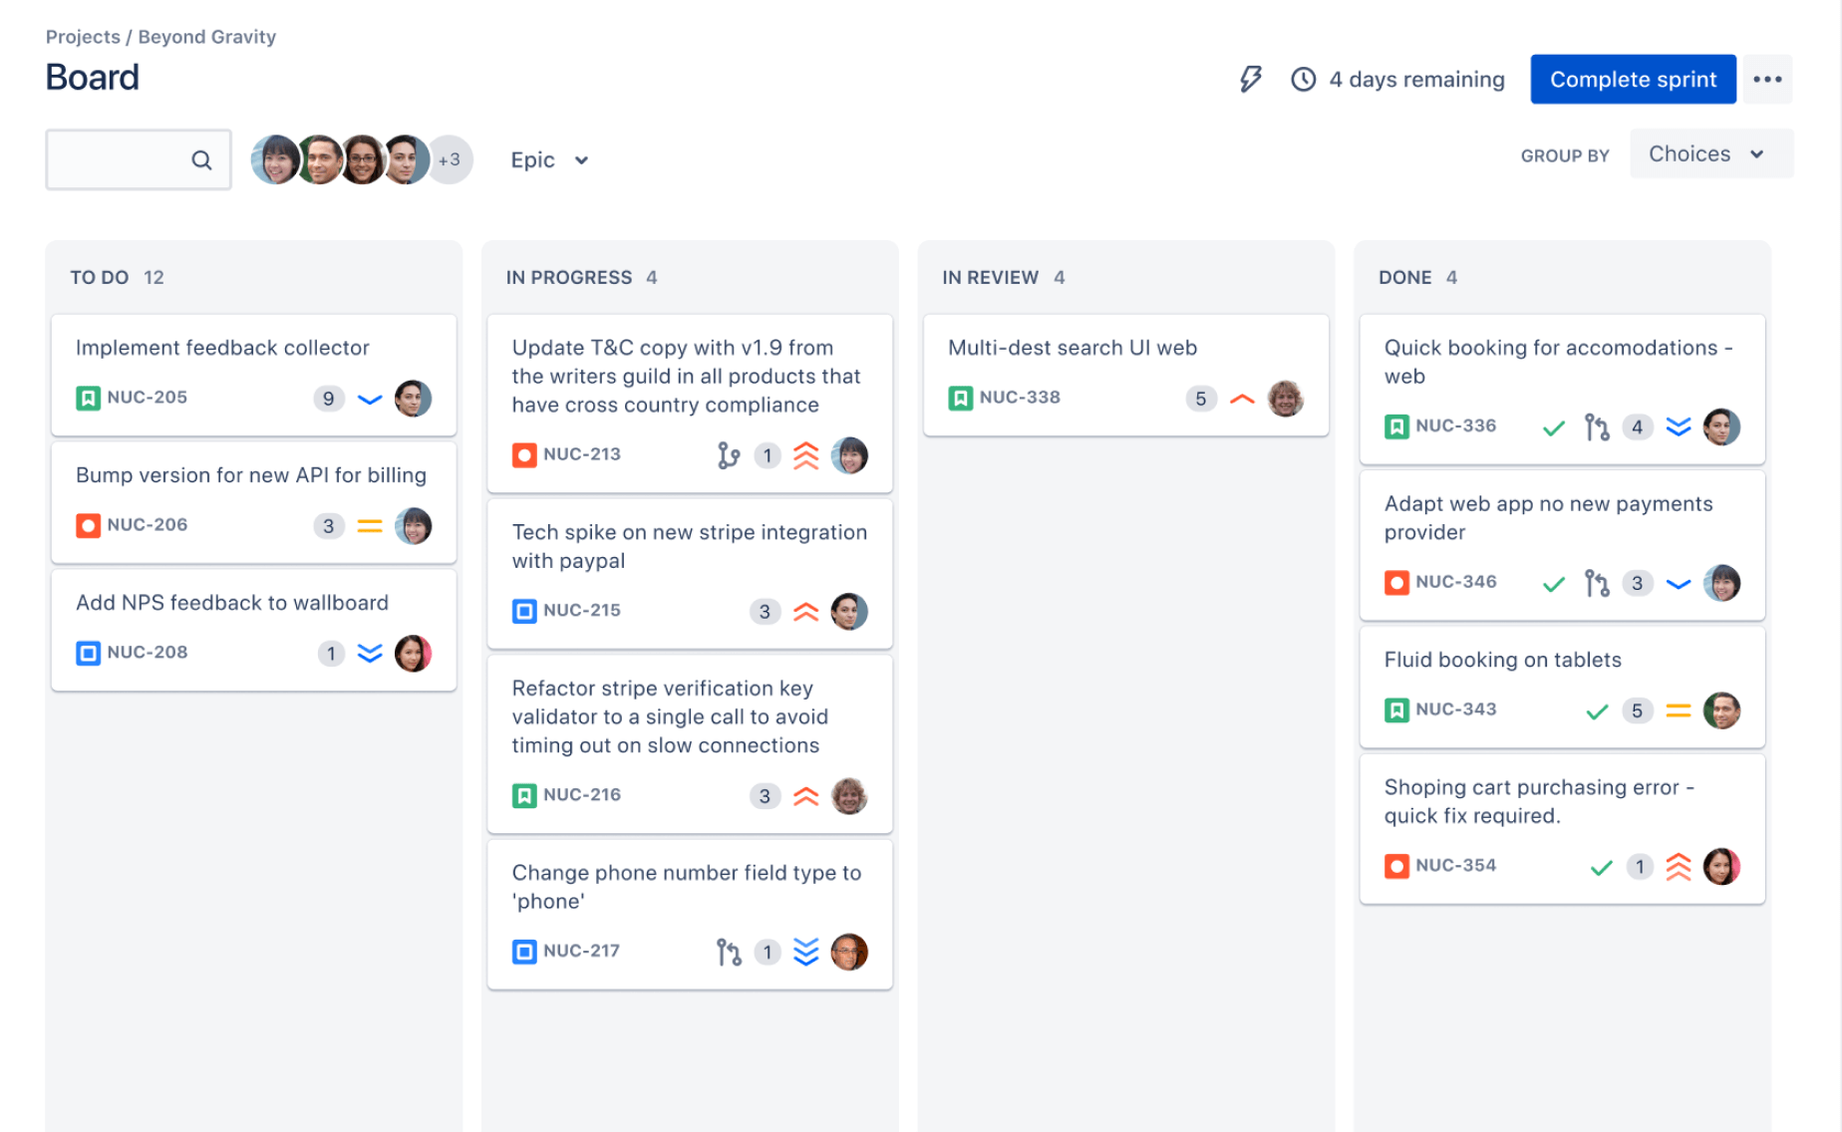
Sprint Board: Agile Requirements in Action
The Sprint Board visualizes requirements moving through Agile workflow states during a sprint, enabling real-time progress tracking.
To Do → In Progress → In Review → Done
Story Points & Assignee visible per card
Sprint progress: 4 days remaining
Agile Methodologies & Jira for Requirements Management
2026

Slide 18
Summary: Jira for Agile Requirements Engineering
Activity | Jira Feature | Agile Benefit
Requirements Management | Issues, Epics, Backlog, Sprints | User stories as living documents; iterative refinement
Requirement Traceability | Issue Links, RTM Matrix, Coverage Reports | End-to-end visibility; impact analysis
Change Management | Workflows, History, Versioning, Approvals | Controlled flexibility; audit trail
Requirements Evaluation | Dashboards, Reports, Velocity Charts | Data-driven decisions; continuous improvement
CLO4: Agile Methodologies & Jira for Requirements Management
2026

Slide 19
Practical Agile Workflow in Jira
1. Create Epics & Stories
2. Sprint Planning & Backlog
3. Daily Standups & Board
4. Link Tests & Trace
5. Manage Changes & Approvals
6. Evaluate & Report
Detailed Workflow Steps:
→ Product Owner creates Epics and User Stories in the Product Backlog
→ During Sprint Planning, the team selects stories and commits to the Sprint Backlog
→ Daily Standups use the Board to track progress and remove blockers
→ QA links Test Cases to Requirements ensuring full traceability coverage
→ Any requirement changes go through the Approval Workflow with impact analysis
→ Sprint Review uses Dashboard Reports to evaluate completion and quality
Agile Methodologies & Jira for Requirements Management
2026

Slide 20
Challenges & Best Practices
Common Challenges
⚠ Over-complex workflows slowing down the team
⚠ Poor issue descriptions leading to ambiguity
⚠ Inconsistent use of labels and custom fields
⚠ Too many notifications causing alert fatigue
⚠ Lack of training on Jira best practices
⚠ Integration gaps between Jira and other tools
⚠ Scope creep due to uncontrolled backlog growth
Best Practices
✓ Keep workflows simple — max 5-7 statuses
✓ Use clear, actionable user story formats
✓ Standardize fields and labels across projects
✓ Configure notification schemes wisely
✓ Provide regular Jira training for all users
✓ Automate repetitive tasks with Jira Automation
✓ Regular backlog grooming sessions
✓ Use dashboards for data-driven retrospectives
Agile Methodologies & Jira for Requirements Management
2026

Slide 21
Jira vs Other Requirements Management Tools
Feature | Jira | Azure DevOps | Rally (CA Agile)
Agile Board | ⭐⭐⭐ Excellent | ⭐⭐⭐ Excellent | ⭐⭐⭐ Excellent
Traceability | ⭐⭐⭐ With RTM app | ⭐⭐⭐ Built-in | ⭐⭐⭐ Built-in
Change Mgmt | ⭐⭐⭐ JSM workflows | ⭐⭐ Good | ⭐⭐ Good
Reporting | ⭐⭐⭐ Highly customizable | ⭐⭐⭐ Good | ⭐⭐ Basic
CLO4: Agile Methodologies & Jira for Requirements Management
2026

Slide 22
Conclusion
Key Takeaways
1. Jira is a comprehensive tool for managing Agile software requirements throughout their lifecycle
2. Requirements Management: Epics, Stories, Backlogs, and Sprints provide structure to Agile planning
3. Traceability: Issue linking and RTM matrices ensure full visibility from requirement to test to deployment
4. Change Management: Configurable workflows with approval gates control scope while embracing Agile flexibility
5. Evaluation: Dashboards, reports, and metrics enable data-driven assessment of requirement quality and completeness
"Agile does not mean no documentation — it means just enough documentation, at the right time, in the right place. Jira provides that place."
— Modern Software Requirements Engineering
Thank You!
Questions & Discussion
CLO4: Agile Methodologies & Jira for Requirements Management
2026

