Slide 1
NIF

Slide 2
Overview
A NIF (Native Implemented Function) is a function that is implemented in C instead of Erlang

Slide 3
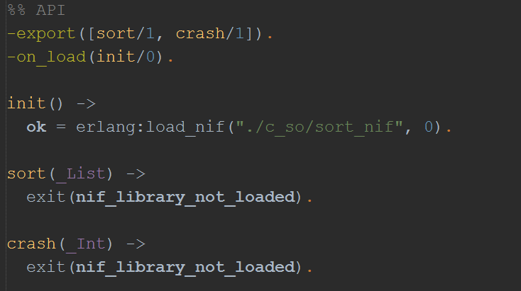
Erlang part

Slide 4
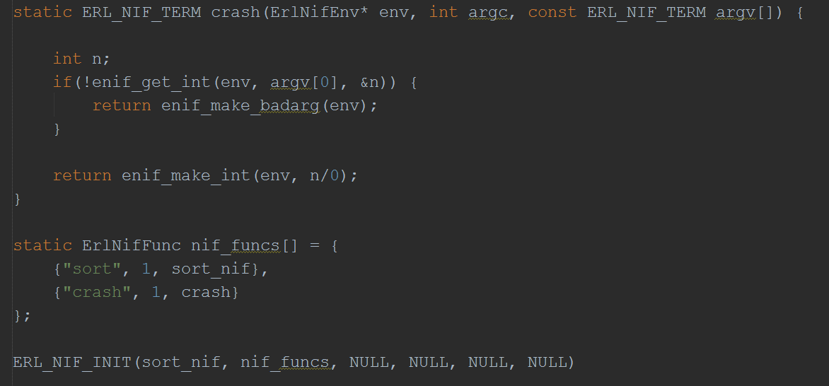
C part
Notes:
<number>

Slide 5
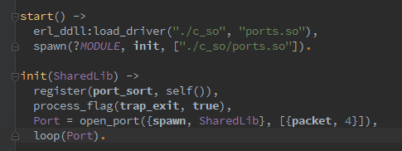
For more comparison: ports

Slide 6
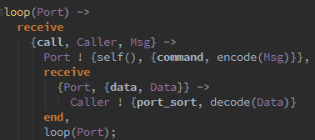
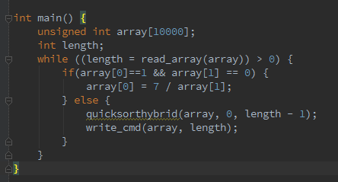

Slide 7
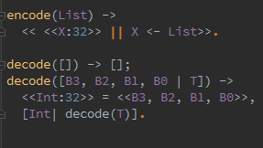

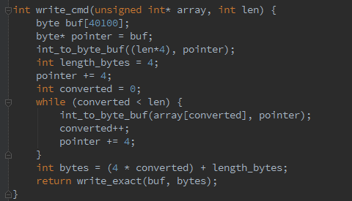

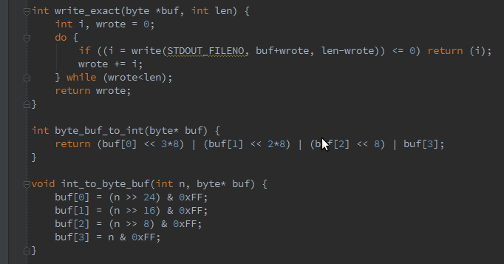

VS

Slide 8
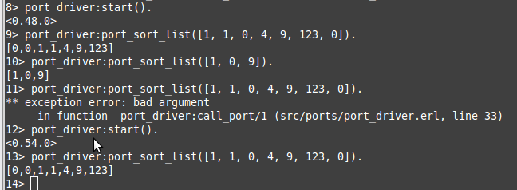

Slide 9
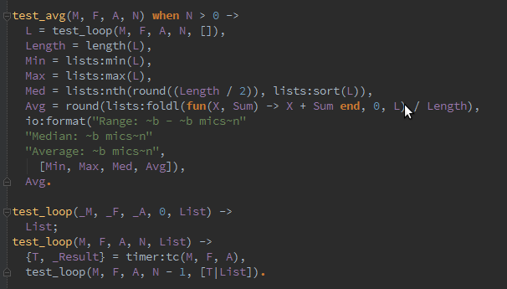
Time for some testing

Slide 10
 | NIF | PORTS
SPEED | Very fast, in specific situations could be faster than bif | Much slower bacause of byte communication
CRASH | Brings the virtual machine down | Behaves almost like a process – makes managing crash easy.
CODE | Erlang code very simple, focus on code in C, conversion between C types and Erlang terms | Much more work to manage communication between Erlang and C parts

Slide 11
Pros
NIFs let you achieve the highest speed
Minimises amount of Erlang code to manage C
Library providing Erlang ↔ C communication and types convertion.
Notes:
<number>

Slide 12
Cons
If crash when running NIF whole virtual machine is down
Long-running NIFs will take over a scheduler and prevent Erlang from efficiently handling many processes
Problems with scaling

Slide 13
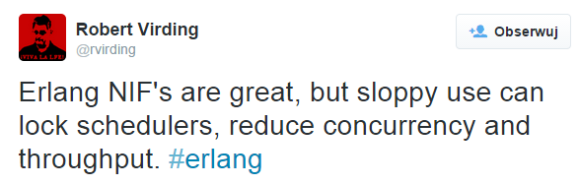
Summary

Slide 14
References
All code and this presentation is available on:
https://github.com/fib1123/nif_erlangproject
For more information check:
http://www.erlang.org/doc/tutorial/nif.html
http://www.erlang.org/doc/man/erl_nif.html

