Slide 1
NIF

Slide 2
Overview
A NIF (Native Implemented Function) is a function that is implemented in C instead of Erlang

Slide 3
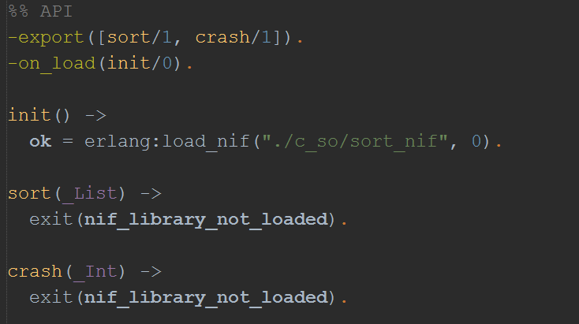
Erlang part

Slide 4
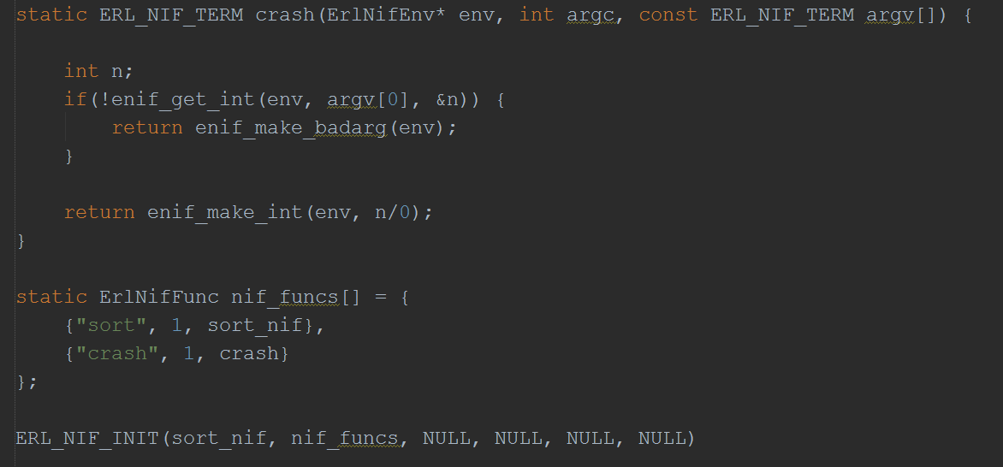
C part

Slide 5
Pros
NIFs let you achieve the highest speed

Slide 6
Cons
If crash when running NIF all virtual machine is down
Long-running NIFs will take over a scheduler and prevent Erlang from efficiently handling many processes
Problems with scaling

Slide 7
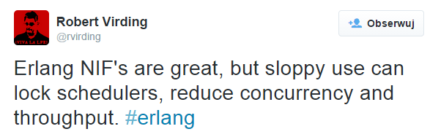
Summary

Slide 8
References
All code and this presentation is available on:
https://github.com/fib1123/nif_erlangproject
For more information check:
http://www.erlang.org/doc/tutorial/nif.html
http://www.erlang.org/doc/man/erl_nif.html

