Slide 1
Air Quality and Pollution Assessment
Environmental Metrics and Demographic Insights for
Predicting Air quality.
Presented by FIBA.KK

Slide 2
TABLE OF CONTENTS
INTRODUCTION
DATA OVERVIEW
DATA PREPROCESSING
EDA
MODEL BULIDING AND VALIDATION
MODEL EVALUATION

Slide 3
INTRODUCTION
This dataset focuses on air quality assessment across various regions. The dataset contains 5000 samples and captures critical environmental and demographic factors that influence pollution levels. Air quality has become a pressing global concern due to its direct and significant impact on human health, ecosystems, and climate. This project aims to utilize machine learning techniques to predict air quality by integrating environmental and demographic data. This study will provide actionable insights that can drive better urban planning, public health interventions, and environmental policies.

Slide 4
DATA OVERVIEW
CHOOSING A DATA: The datasets is a csv file selected from Kaggle.
BREIF DISCRIPTION :The dataset includes different quality of air, including values for temperature, humidity ,PM2,PM10,NO2,SO2,CO ,proximity of industrial area, population density .The data helps in analyzing and predicting air quality based on the given features.

Slide 5
COLUMNS
key Features:
Temperature : Average temperature of the region.
Humidity: Relative humidity recorded in the region.
PM2.5 Concentration : Fine particulate matter levels.
PM10 Concentration : Coarse particulate matter levels.
NO2 Concentration : Nitrogen dioxide levels.
SO2 Concentration : Sulfur dioxide levels.
CO Concentration : Carbon monoxide levels.
Proximity to Industrial Areas : Distance to the nearest industrial zone.
Population Density : Number of people per square kilometer in the region

Slide 6
Target variable: (Air Quality Levels)
Good: Clean air with low pollution levels.
Moderate: Acceptable air quality but with some pollutants present.
Poor: Noticeable pollution that may cause health issues for sensitive groups.
Hazardous: Highly polluted air posing serious health risks to the population.

Slide 7
DATA PREPOROCESSING
Handling missing data: No null values were found on the dataset.
Encoding: Label Encoder
Label Encoding is a technique used in data preprocessing to convert categorical variables into numerical values. This transformation is essential for machine learning models that require numerical input to perform calculations.
Outlier treatment:
Feature Engineering :

Slide 8
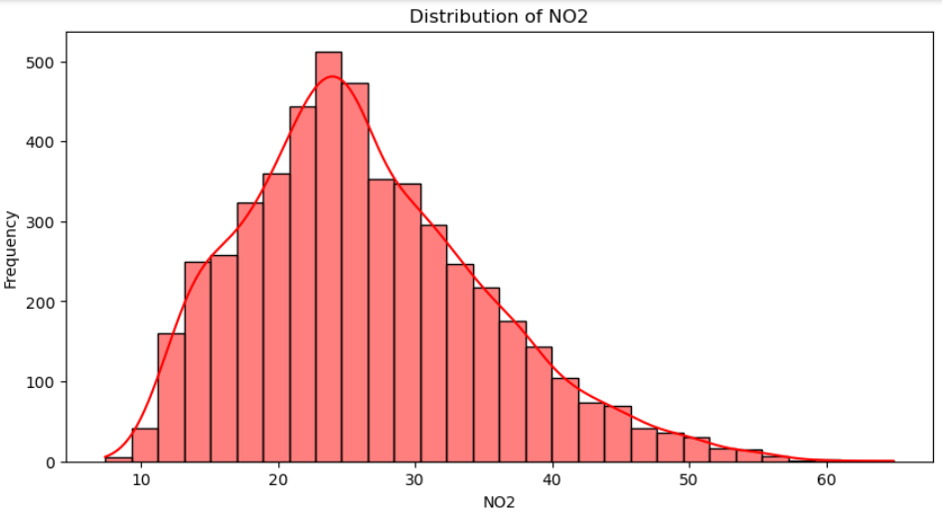
EXPLORATORY DATA ANALYSIS
Findings : This HISTOGRAM shows the frequency distribution of ‘NO2' values. The KDE line provides a smoothed estimate of the distribution, making it easier to see the underlying pattern. The NO2 levels follow a right-skewed distribution, The majority of NO2 values lie between 10 and 40 micrograms/m³.Very high levels (>50) are uncommon, indicating pollution spikes.

Slide 9
MODEL BUILDING
Best model : Random Forest Classifier
A Random Forest Classifier is a powerful ensemble learning algorithm used for classification tasks. It operates by constructing multiple decision trees during training and outputs the mode (majority vote) of their predictions for classification tasks.
In Air quality prediction the model achieved an impressive accuracy score of 0.944.

Slide 10
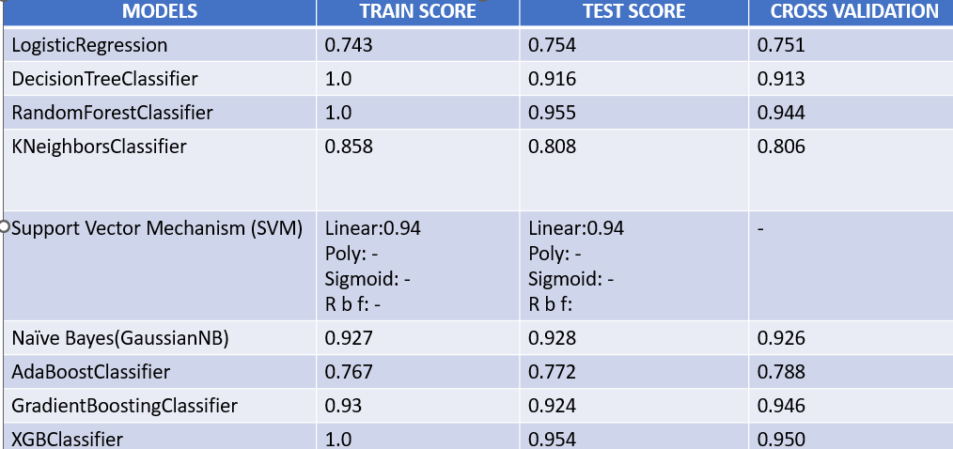
MODEL VALIDATION
Summary: Best performing model: random forest classifier with an average test score of 0.955

Slide 11
FUTURE WORK
Real-Time Air Quality Prediction : Deploy the model as a web app or API for real-time air quality monitoring.
Policy and Public Health Applications : Collaborating with government agencies to use the model for air pollution control strategies.
Climate & Health Impact Assessment : Study long-term air quality trends concerning climate change factors.
Explainability & Interpretability : Use explainable AI methods to understand feature importance and model decisions , Investigate causal relationships between pollutants and external factors (e.g., traffic, industry emissions).

Slide 12
MODEL EVALUATION
Random Forest Classifier
Random forest best parameter: ‘n_estimators’: 2, ‘ max_depth ’ : 2
Random forest Cross-Validated Best Score: 0.945
Random Forest test accuracy : 0.9483

Slide 13
CONCLUTION
developed a predictive model to assess air quality with a high accuracy of 0.94%. The visualization techniques helped to understand seasonal and geographical variations in air pollution. For modeling, experimented with multiple machine learning algorithms, ultimately selecting the best-performing model based on validation metrics. Our final model, achieving 0.94% accuracy. Overall, this project provides valuable insights into air pollution trends and presents a robust predictive model that can assist in environmental decision-making and public health awareness.

