Slide 1
#
Notes:
Since it was founded in 2006, Twitter has rapidly scaled to become one of the most powerful online platforms for connecting people, and ideas. Twitter now has an estimated more than 700 million users worldwide. And, hashtags play a crucial role in jumping in on topic based conversations.

Slide 2
#
Notes:
However, as we all know, there are some problems with hashtags.

Slide 3
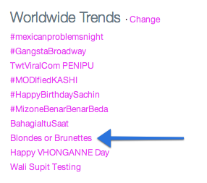
Notes:
Take for example the worldwide trends of this morning. You’ll see

Slide 4
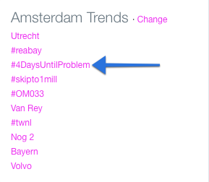
Notes:
Take for example the worldwide trends of this morning. You’ll see

Slide 5


Slide 6

#LetUsIn

Slide 7
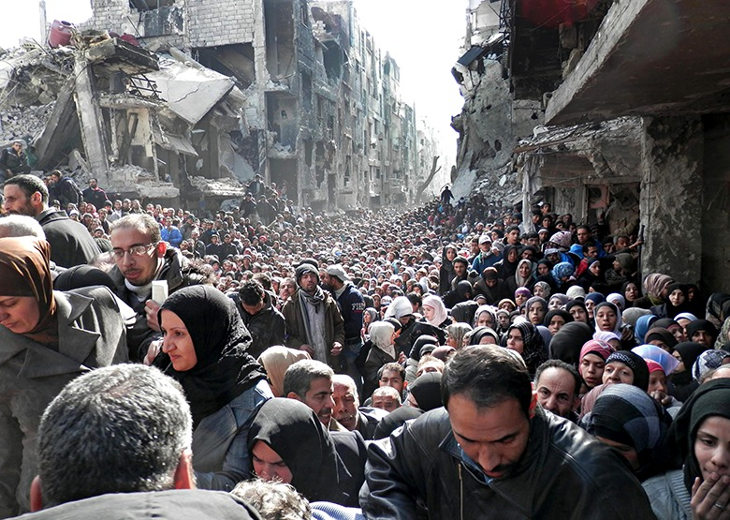

Slide 8
#NoToquenElYasuni

Slide 9


Slide 10
#WhereAreOur85Daughters

Slide 11


Slide 12
#CancelColbert

Slide 13


Slide 14

#

Slide 15
#
Hashtag
Activism
Platform

Slide 16

High Barrier to Entry
Low Barrier
to Entry
Notes:
Since it was founded in 2006, Twitter has rapidly scaled to become one of the most powerful online platforms for connecting people, and ideas. Twitter now has an estimated more than 700 million users worldwide.

Slide 17

Campaign Leaders
Submit hashtag
Get exposure
Track campaign
success

Slide 18
Users
Subscribe to topics
Get alerts on new
campaigns
Tweet with pre-filled
tweets
Notes:
Since it was founded in 2006, Twitter has rapidly scaled to become one of the most powerful online platforms for connecting people, and ideas. Twitter now has an estimated more than 700 million users worldwide.

Slide 20
Launch Strategy

Slide 21
End Result

Slide 22
#
www.hashtagivist.com

