Slide 1
Tutorial on OpenFlow Fed4FIRE – Open Tutorial Day
Carlos Bermudo (carlos.bermudo@i2cat.net)
Berlin, December 10th 2014

Slide 2
Introduction
Refreshing OF slicing
OpenFlow testbeds in Fed4FIRE
Running an OF experiment
Create an OF topology including i2CAT and VWall VMs and run an OF controller (emulating L2 learning switch) that controls the switch in the topology.
POX tricks & tips

Slide 3
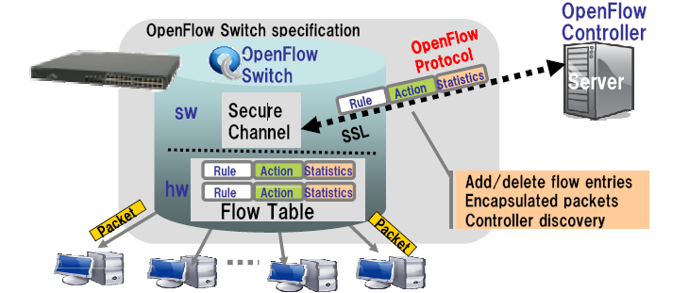
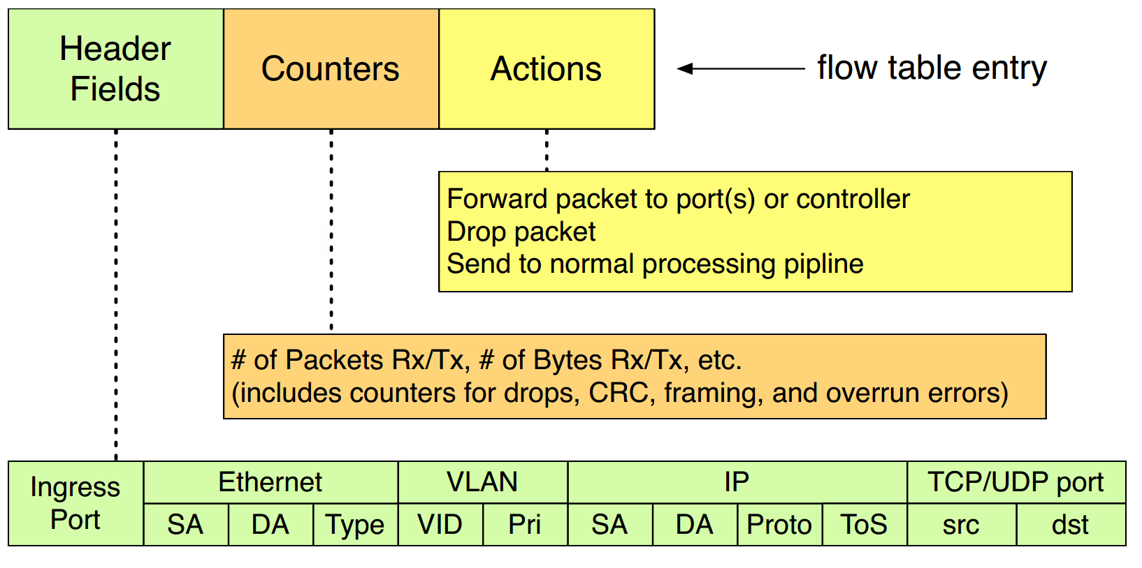
Definition: OpenFlow
Characteristics:
Software controller
Secure channel with devices
Matching on OF packet headers

Slide 4



Software: OpenFlow controllers’ overview
Platform / Framework that allow experimenters to develop components / applications to control the behavior of their data flows
NOX, POX
NOX: 1st OpenFlow controller
POX: high-level SDN API
Supported protocol(s): OpenFlow 1.0
Supported language(s): C++ (NOX), Python (POX)
https://github.com/noxrepo/nox-classic/wiki/Developing-in-NOX
https://openflow.stanford.edu/display/ONL/POX+Wiki
Ryu
Open-sourced Network Operating System (NOS)
Supported protocol(s): OpenFlow 1.0, 1.3, 1.4
Supported language(s): Python
http://ryu.readthedocs.org/en/latest/writing_ryu_app.html
http://yuba.stanford.edu/~casado/of-sw.html

Slide 5
Software: Flow slicing
The problem
Each experiment generates a set of data flows
Multiple experiments running at the same time
Different data flows (experiments) must be isolated
FlowVisor
Special purpose OpenFlow controller that acts as a transparent proxy between OpenFlow switches and multiple OpenFlow (user) controllers.

Slide 6
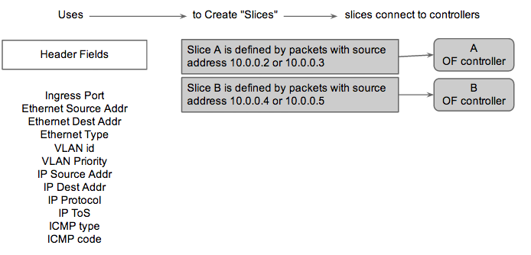
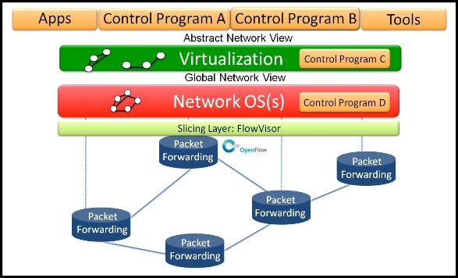
Software: Flow slicing
FlowVisor

Slide 7
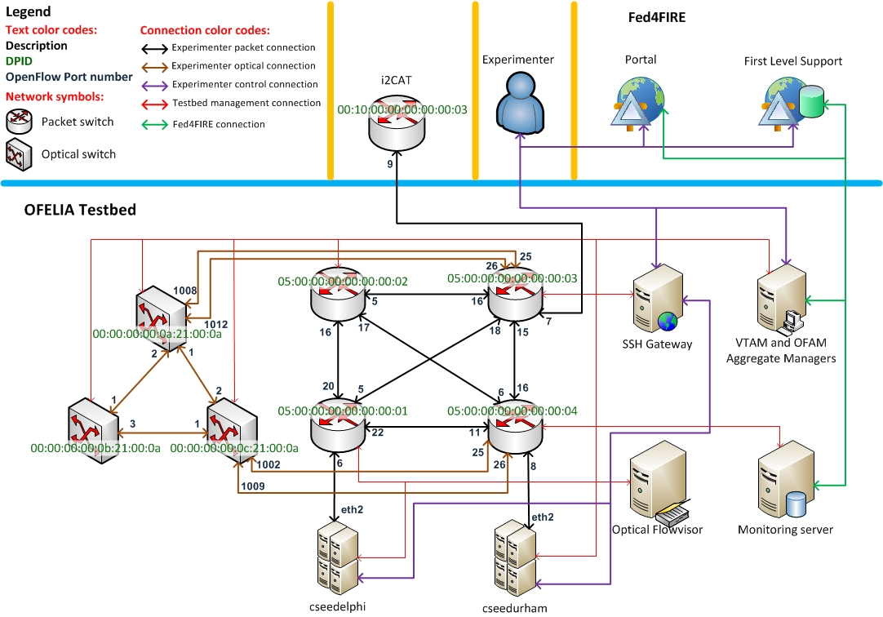
OpenFlow testbeds: UNIVBRIS
4 x Packet Switches (NEC IP8800)
2 x dedicated virtualization servers
3 x fixed WDM optical switches (ADVA FSP3000)

Slide 8
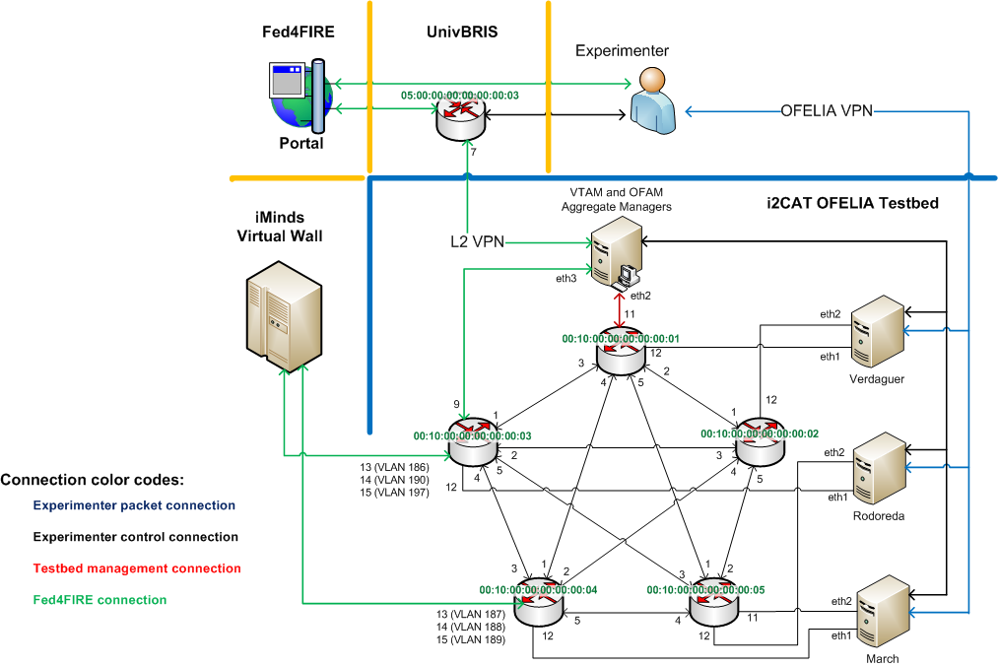
OpenFlow testbeds: i2CAT
5 x NEC IP8800/S3640-24T2XW, 24 ports (1/10GE)
3 x dedicated physical servers

Slide 9
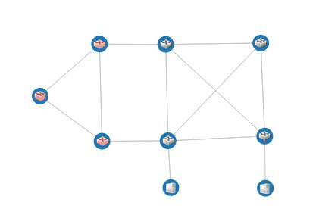
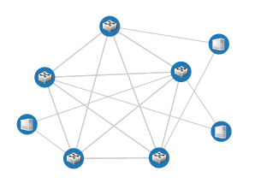
OF testbeds in federation environments
Connectivity in Fed4FIRE
Public Internet
VirtualWall
UNIVBRIS
i2CAT
L2 VPN

Slide 10




Running an experiment
Creating the slivers
create vm
SFA
VT AM
create vm
CLI/UI
jFed
SFI
OMNI
createSliver
create vm
createSliver
createSliver
SFA
OF AM
define links
FV

Slide 11
Running an experiment
Creating the slivers
Setting the controller
SFA
VT AM
CLI/UI
jFed
SFI
OMNI
SFA
OF AM
set controller
FV

Slide 12
Running an experiment
Creating the slivers
Setting the controller
Sending data within the slice
transmitter
receiver
SFA
VT AM
CLI/UI
jFed
SFI
OMNI
SFA
OF AM
FV

Slide 13
Let’s Create a Slice
Create the VWall Node using jFed
Create the i2CAT VMs
Reserve FS at i2CAT

Slide 14
Supporting files
Download and unzip the file from:
https://github.com/fp7-ofelia/ocf/wiki/GENI-usage
vtam_request_i2cat
ofam_request_i2cat
jFedi2CAT
Let’s take a look at the topology
Verdaguer
TutorialVM1
TutorialCtrl
Rodoreda
TutorialVM2
00:10:00:00:00:00:00:01
00:10:00:00:00:00:00:03
eth1
3
1
12
eth1
12
13 (vlan 186)
14 (vlan 190)
15 (vlan 197)
eth1
VirtualWall
node

Slide 15
VT AM Request
<?xml version="1.0"?>
<RSpec type="SFA" expires="2015-02-18T11:21:29Z" generated="2013-02-18T10:21:29Z">
<network name="vt_ocf" slice="">
<node component_manager_id="urn:publicid:IDN+i2cat:vtam+cm" component_id="urn:publicid:IDN+i2cat:vtam+node+Verdaguer" exclusive="false" component_name="urn:publicid:IDN+i2cat:vtam+node+Verdaguer">
<sliver>
<name>tutorialVM1</name>
<uuid>myuuid</uuid>
<project-id>project4</project-id>
<slice-id>slice2</slice-id>
<slice-name>slice2</slice-name>
<operating-system-type>GNU/Linux</operating-system-type>
<operating-system-version>5.0</operating-system-version>
<operating-system-distribution>Debian</operating-system-distribution>
<server-id>serverid</server-id>
<hd-setup-type>file-image</hd-setup-type>
<hd-origin-path>default/test/lenny</hd-origin-path>
<virtualization-setup-type>paravirtualization</virtualization-setup-type>
<memory-mb>128</memory-mb>
</sliver>
</node>
<node component_manager_id="urn:publicid:IDN+i2cat:vtam+cm" component_id="urn:publicid:IDN+i2cat:vtam+node+Verdaguer" exclusive="false" component_name="urn:publicid:IDN+i2cat:vtam+node+Verdaguer">
<name>tutorialVMCtrl</name> …
</node>
<node component_manager_id="urn:publicid:IDN+i2cat:vtam+cm" component_id="urn:publicid:IDN+i2cat:vtam+node+Rodoreda" exclusive="false" component_name="urn:publicid:IDN+i2cat:vtam+node+Rodoreda">
<name>tutorialVM2</name> ….
</node>
</network>
</RSpec>

Slide 16
OF AM Request
<rspec xmlns="https://github.com/fp7-ofelia/ocf/blob/ocf.rspecs/openflow/schemas/request.xsd" […] type="request">
<openflow:sliver email="a@b.com" description="OF request example">
<openflow:controller url="tcp:10.216.12.57:6633" type="primary"/>
<openflow:group name="fs1">
<openflow:datapath component_id="urn:publicid:IDN+openflow:optin:i2cat.of_ocf+datapath:00:10:00:00:00:00:00:01"
component_manager_id="urn:publicid:IDN+openflow:optin:i2cat.of_optin+authority+am"
dpid="00:10:00:00:00:00:00:01">
<openflow:port name="GBE0/4" num="3"/>
<openflow:port name="GBE0/12" num="12"/>
</openflow:datapath>
<openflow:datapath component_id="urn:publicid:IDN+openflow:optin:i2cat.of_ocf+datapath:00:10:00:00:00:00:00:03"
component_manager_id="urn:publicid:IDN+openflow:optin:i2cat.of_optin+authority+am"
dpid="00:10:00:00:00:00:00:03">
<openflow:port name="GBE0/3" num="1"/>
<openflow:port name="GBE0/3" num="12"/>
<openflow:port name="GBE0/13" num="13"/>
</openflow:datapath>
</openflow:group>
<openflow:match>
<openflow:use-group name="fs1" />
<openflow:packet>
<openflow:dl_vlan value=“186" />
</openflow:packet>
</openflow:match>
</openflow:sliver>
</rspec>

Slide 17
Creating a Node on vwall2 using jFed
http://jfed.iminds.be
Quick Start
Login
Open
jFedi2CAT.rspec
Run

Slide 18
Creating VM at i2CAT
Edit file i2catVM.rspec
<name>tutorialVM</name> ← alphanumeric name for the virtual machine
Execute
omni createslice <SLICENAME>
omni -a https://137.222.204.27:5001/xmlrpc/sfa/ createsliver <SLICENAME> vtam_request_i2cat.rspec
Save the returned IP address, it will be the controller

Slide 19
Reserving the FS at i2CAT
Edit i2catOF.rspec
<openflow:controller url="tcp:10.216.12.XX:6633" type="primary"/> ← replace controller IP by the previous one returned by i2CAT manifest RSpec
<openflow:dl_vlan value=“YYY" /> ← vlan number depends on port selected to link with VWall
Execute
omni -a https://137.222.204.27:5005/xmlrpc/sfa/ createsliver <SLICENAME> ofam_request_i2cat.rspec
Switch 3 |  | Switch 4
Port | Vlan | Port | Vlan
13 | 186 | 13 | 187
14 | 190 | 14 | 188
15 | 197 | 15 | 189

Slide 20
Access & Configure the OFELIA VMs
Open console in vwall node
ssh the VMs using root@vm_ip
apt-get install vlan
ifconfig <iface> up
for this tutorial: eth1, depending on IFs between servers and switchs
vconfig add <iface> <vlan>
VLANs shared with VWall 186-190 and 197
ifconfig <iface>.<vlan> 192.168.12.X/24 up

Slide 21
Access & Configure the OFELIA VMs
Open console in vwall node
sudo vconfig add vlan1001 <vlan>
Vlan1001 is the IF linked to i2CAT
Command will create IF vlanX
VLANs shared with i2CAT 186-190 and 197
ifconfig <iface> 192.168.12.X/24 up

Slide 22
Access and configure the Controller
access to the vwall node
ssh to the controller (root:openflow)
apt-get update
apt-get install git
git clone https://github.com/noxrepo/pox.git
cd pox/
git checkout dart ← Otherwise won’t work
./pox.py log.level --CRITICAL forwarding.l2_learning

Slide 23
Try ping between nodes
Ping, ping, ping
from i2CAT VM to i2CAT VM
from Virtual Wall to i2CAT VM and viceversa
POX overview
To run an app:
./pox.py <python path to app name>
port
verbose
loglevel

Slide 24
POX overview
To run an app:
./pox.py <python path to app name>
--port
--verbose
--loglevel

Slide 25
Useful links
POX Tutorial
http://sdnhub.org/tutorials/pox/
POX Wiki
https://openflow.stanford.edu/display/ONL/POX+Wiki#POXWiki-FAQs
OpenFlow Tutorial with POX
http://blog.pythonicneteng.com/2013/02/openflow-tutorial-with-pox.html
UnivBris user manual
http://univbrisofeliaf4f.blogs.ilrt.org/

Slide 26

Questions?
CONTROLLER
OpenFlow SWITCH
carlos.bermudo@i2cat.net

Slide 27
Acknowledgement
This work was carried out with the support of the Fed4FIRE-project (“Federation for FIRE"), an Integrated project receiving funding from the European Union’s Seventh Framework Programme for research, technological development and demonstration under grant agreement no 318389
It does not necessarily reflect the views of the European Commission. The European Commission is not liable for any use that may be made of the information contained herein.
Notes:
THIS SLIDE SHOULD ALWAYS BE THE LAST SLIDE OF YOUR PRESENTATION!!!!

Slide 28
Backup slides

Slide 29
My first App
In /pox directory, create a *.py file
Import (at least) nox core and OF lib and some utils
from pox.core import core
import pox.openflow.libopenflow_01 as of
from pox.lib.util import dpid_to_str
Set up the launch() method
Develop your app
def launch (**kwargs):
core.registerNew(<MyApp>,kwargs)

Slide 30
POX tricks – Listen events
Register callback functions for specific events thrown by either the OpenFlow handler module or specific modules like Topology Discovery
From the launch or from the init of a class, perform core.openflow.addListenerByName(“EVENTNAME”, CALLBACK_FUNC, PRIORITY)
Register object with the OpenFlow handler module or specific modules like Topology Discovery
From typically the init of a class, perform addListeners(self). Once this is added, the controller will look for a function with the name _handle_EVENTNAME(self, event). This method is automatically registered as an event handler.
[1]
[1]

Slide 31
POX tricks – Parse packets
From a handled event (i. e. packet-in) POX provides ways to parse the packet and identify the headers.
packet = event.parsed
mac = packet.src
packet.type [ipv4, icpm, tcp, etc.]

Slide 32
POX tricks – Send messages
msg = of.ofp_packet_out()
message msg.buffer_id = event.ofp.buffer_id msg.in_port = packet_in.in_port
msg.match = of.ofp_match.from_packet(packet)
action = of.ofp_action_output(port = of.OFPP_FLOOD)
msg.actions.append(action)
self.connection.send(msg) [1]

Slide 33

Advices
Read ALL samples
Catch ALL exceptions
Log ALL with info
Use existing apps
Remember that POX can load several apps at the same time
If possible, apply TDD. Ensure that the code of your app is almost bullet-proof
Slide powered by master Yoda

Slide 34
UnivBris OF AM Request
<?xml version="1.0" encoding="UTF-8"?>
<rspec xmlns="http://www.geni.net/resources/rspec/3"
xmlns:xs="http://www.w3.org/2001/XMLSchema-instance"
xmlns:openflow="/opt/ofelia/ofam/local/schemas"
xs:schemaLocation="http://www.geni.net/resources/rspec/3
http://www.geni.net/resources/rspec/3/request.xsd
http://www.geni.net/resources/rspec/ext/openflow/3
http://www.geni.net/resources/rspec/ext/openflow/3/of-resv.xsd"
type="request">
<openflow:sliver email="carlos.bermudo@i2cat.net" description="From UOB delphi to i2cat VPN">
<openflow:controller url="tcp:10.216.12.29:6633" type="primary"/>
<openflow:group name="fs1">
<openflow:datapath component_manager_id="urn:publicid:IDN+openflow:ofam:univbris+authority+cm"
component_id="urn:publicid:IDN+openflow:ofam:univbris+datapath+05:00:00:00:00:00:00:01"
dpid="05:00:00:00:00:00:00:01">
<openflow:port name="GBE0/6" num="6"/>
<openflow:port name="GBE0/5" num="5"/>
</openflow:datapath>
<openflow:datapath component_id="urn:publicid:IDN+openflow:ofam:univbris+datapath+05:00:00:00:00:00:00:03"
component_manager_id="urn:publicid:IDN+openflow:ofam:univbris+authority+cm"
dpid="05:00:00:00:00:00:00:03">
<openflow:port name="GBE0/19" num="18"/>
<openflow:port name="GBE0/7" num="7"/>
</openflow:datapath>
</openflow:group>
<openflow:match>
<openflow:use-group name="fs1" />
<openflow:packet>
<openflow:dl_vlan value= "778"/>
</openflow:packet>
</openflow:match>
</openflow:sliver>
</rspec>

Slide 35
UnivBris VT AM Request
<RSpec type="SFA" expires="2014-06-13T11:21:29Z" generated="2014-06-13T10:21:29Z">
<network name="vt_ocf" slice="">
<node component_id="urn:publicid:IDN+univbris:vtam+node+cseedelphi" component_manager_id="urn:publicid:IDN+univbris:vtam+cm" component_name="urn:publicid:IDN+univbris:vtam+node+cseedelphi" exclusive="false">
<sliver>
<name>tutorialVM</name>
<uuid>myuuid</uuid>
<project-id>project1</project-id>
<slice-id>test8</slice-id>
<slice-name>test9</slice-name>
<operating-system-type>GNU/Linux</operating-system-type>
<operating-system-version>7.0</operating-system-version>
<operating-system-distribution>Debian</operating-system-distribution>
<server-id>serverid</server-id>
<hd-setup-type>full-file-image</hd-setup-type>
<hd-origin-path>debian7uob/debian7uob.img</hd-origin-path>
<virtualization-setup-type>hvm</virtualization-setup-type>
<memory-mb>1024</memory-mb>
<interfaces>
<interface ismgmt="true">
<name>eth0</name>
<mac>00:16:3E:2D:AE:27</mac>
<ip>10.216.22.60</ip>
<mask>255.255.255.0</mask>
<gw>10.216.20.1</gw>
<dns1>8.8.8.8</dns1>
<dns2>4.2.2.1</dns2>
</interface>
</interfaces>
</sliver>
</node>
</network>
</RSpec>

Slide 36
Request Resources from VTAM (GeniV3)
Allocate it First!
omni -a https://137.222.204.27:5001/xmlrpc/geni/3/ -V3 allocate <SLICENAME> vtam_geni3_request_i2cat.rspec
Provision it!
omni -a https://137.222.204.27:5001/xmlrpc/geni/3/ -V3 provision <SLICENAME>
RSpec:
<?xml version="1.0" encoding="UTF-8" standalone="yes"?>
<rspec generated="2014-03-22T01:53:21.460+01:00" type="request“ xsi:schemaLocation="http://www.geni.net/resources/rspec/3 http://www.geni.net/resources/rspec/3/request.xsd" xmlns="http://www.geni.net/resources/rspec/3" " " xmlns:xsi="http://www.w3.org/2001/XMLSchema-instance">
<node client_id="Verdaguer" component_id="urn:publicid:IDN+ocf:i2cat:vtam+node+Verdaguer" component_manager_id="urn:publicid:IDN+ocf:i2cat:vtam+authority+cm" exclusive="true">
</node>
</rspec>

Slide 37
Requesting OFAM Resources (GeniV3)
Allocate it First!
omni -a https://137.222.204.27:5005/xmlrpc/geni/3/ -V3 allocate <SLICENAME> ofam_request_i2cat.rspec
Provision it!
omni -a https://137.222.204.27:5005/xmlrpc/geni/3/ -V3 provision <SLICENAME>
Then wait for approval ☺

