Slide 1
Web development and privacy
GDPR and the e-privacy directive
2020-09-14

Slide 2

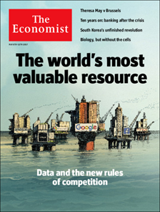
Part 1 – Introduction to GDPR
The General Data Protection Regulation exists to protect individuals' fundamental rights and freedoms, in particular their right to protection of their personal data.

Slide 3
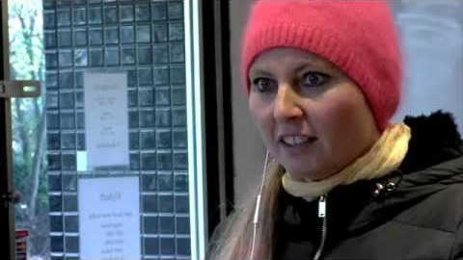
Introduction - Films

Slide 4
What Is GDPR?
New EU legislation - General Data Protection Regulation
GDPR is a legal framework for the collection and processing of personal information from individuals who live in the European Union (EU).
The Regulation applies regardless of where websites are based, it must be heeded by all sites that attract European visitors, even if they don't specifically market goods or services to EU residents.
The Regulation also applies to all processing of personal data by an organization within the EU.

Slide 5
GDPR is intended to
Enforce the EU Convention on Human Rights
Make citizens masters of their own personal data
Strengthen and unify data protection for individuals within the European Union
Unify and simplify the regulatory environment for international businesses

Slide 6
GDPR is intended to
The General Data Protection Regulation (GDPR) applies throughout the European Union and its purpose is to create a uniform and harmonised level for the protection of personal data so that the free movement of personal data within Europe is not hindered.

Slide 7
Gdpr - fines and penalties
https://www.enforcementtracker.com/

Slide 8

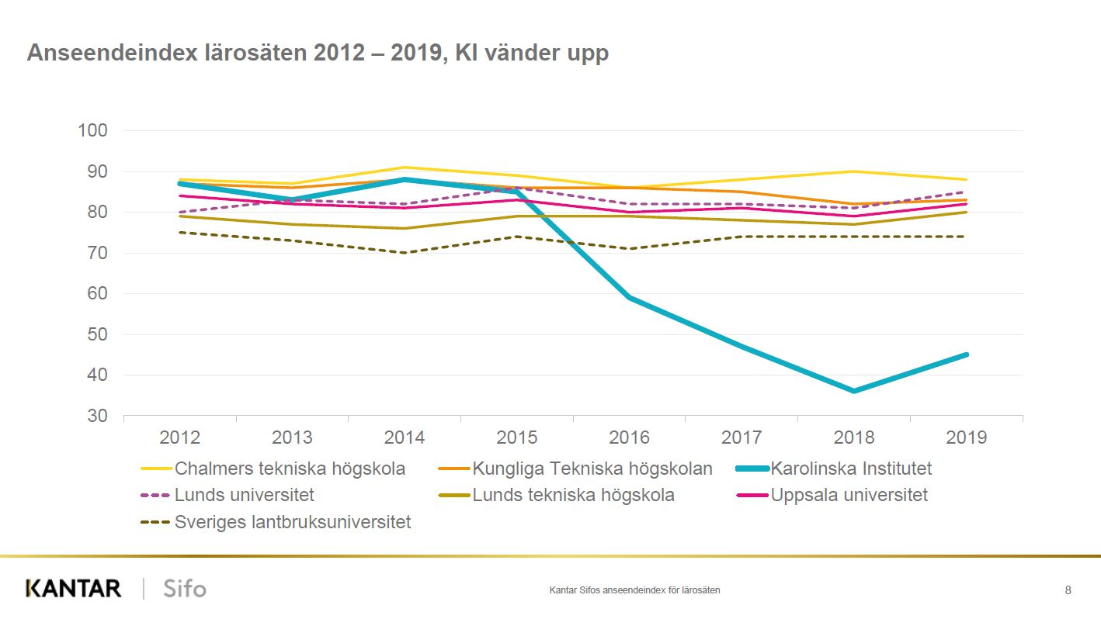
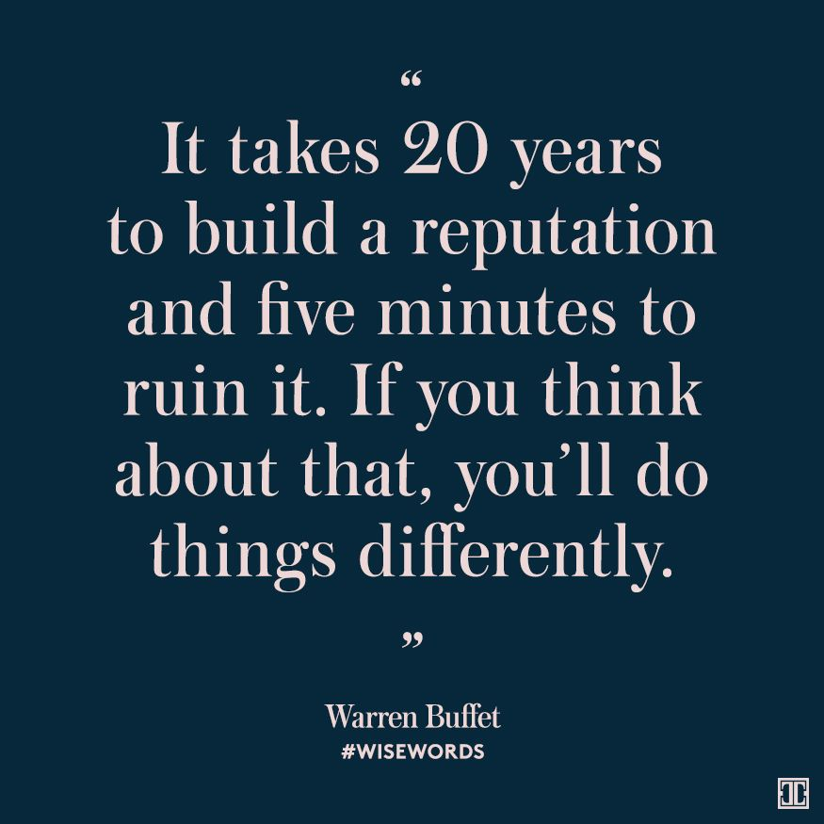

Slide 9
What is personal data?
Any information that directly or indirectly can be attributed to a living person.
Direct
Indirect
Objective
Subjective
Encrypted
SENSITIVE PERSONAL DATA:
- race or ethnic origin
- political opinions
- religious or philosophical beliefs
- trade-union membership
- health or sex life and sexual orientation
- genetic or biometric data
Personal data
Name, adress, postal code, social security number, car registration number, pictures, voice recordings, videos etc.

Slide 10
PROCESSING PERSONAL DATA
Changing
Transfering
Reusing
Collecting
Compiling
Retaining
Registering
Structuring
Anonymizing
Expediting
Distributing
Organizing
Sharing
Correcting
Arranging
Interlinking
Extraditing
Deleting
Destroying
Analyzing

Slide 11
Definitions of key roles
DATA SUBJECT
An identified or identifiable natural person.
CONTROLLER
A natural or legal person, public authority, agency or other body that determines the purposes and means of the processing of personal data.
PROCESSOR
A natural or legal person, public authority, agency or other body which processes personal data on behalf of the controller.

Slide 12
DATA PROCESSING - PRINCIPLES
Purpose limitation - Determined, specific, explicit and limited
Lawfulness - Lawful basis
Minimization - In context of relevance and purpose
Accuracy - Data is correct and up to date
Information - Duty to inform data subjects
Protection - Reduce risks based on risk assessment
Retention - Accomplish purpose, then delete personal data

Slide 13
Lawful basis for processing
Legal obligation
Necessary to exercise public authority
Contractual necessity
Protection of vital interests
Public interest
Legitimate interest
or
Consent

Slide 14
considerations
Factors to consider when processing personal data:
Purpose: Why is personal data processing needed?
Legality: Is the purpose lawful? What is the lawful basis?
Minimize: What data is needed for my purpose and for how long?
Security: How do I reduce or eliminate risks?

Slide 15
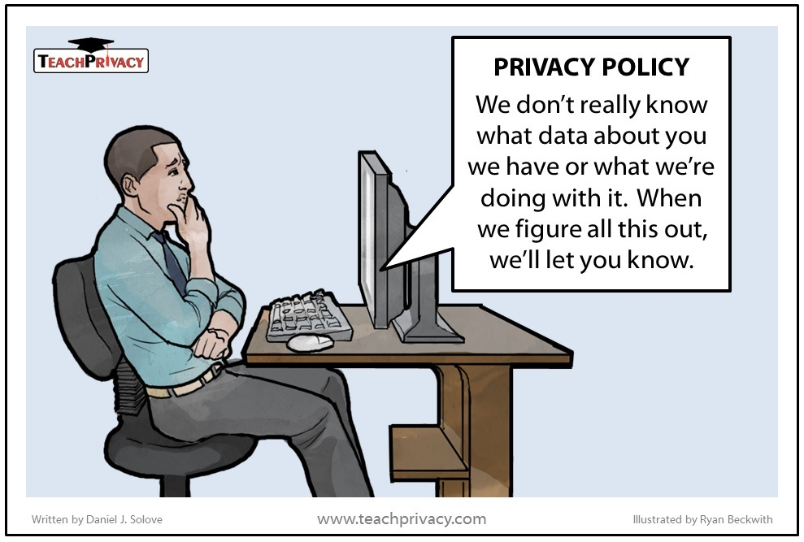
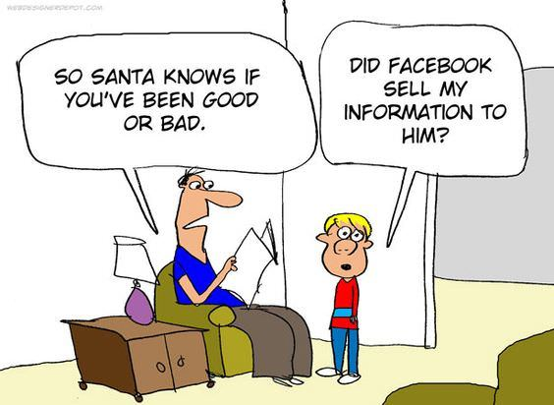
PART 2 - E-Privacy directive

Slide 16

Introduction - Films

Slide 17
The e-privacy directive (EPD)
A specialized EU-regulation focused on protecting privacy and security of personal data in electronic communications
ePD is focused on communications
ePD covers more than personal data, specifically web cookies and traffic data
A new e-Privacy Directive is in the works.

Slide 18
The E-privacy direktive and cookies
In Sweden: the Electronic Communications Act - Lag (2003:389) om elektronisk kommunikation
”6 kap 18 § Data may be stored in or retrieved from a subscriber's or user's terminal equipment only if the subscriber or user has access to information about the purpose of the processing and consents to it. This does not prevent such storage or access as is necessary for the transmission of an electronic message via an electronic communications network or which is necessary to provide a service expressly requested by the user or subscriber.”

Slide 19
precedent – eu Court
The European Court of Justice states that the use of cookies requires the active consent of website visitors (ruling in case C-673/17, 1-10-2019).
A box checked in advance is not enough.
The ruling means that most websites must review how they obtain website visitors' consent for cookies used for analytics tools, marketing, advertising networks and other purposes.

Slide 20
Consent in gdpr
The legal basis of consent means that the data subject has agreed to the processing of personal data
Consent must be voluntary and equal
Voluntary means that data subjects have a genuinely free choice and control over their personal data
The data subject must not suffer negative consequences if he does not give his consent, e.g. denied access to or access to content on a web page

Slide 21
Checklist - web development
Is personal data processing necessary?
Define a specific and defined purpose
Decide appropriate security measures (Storage, encryption, etc.)
Set data retention period
Register data processing in a GDPR-register
Manage lawful basis and information to data subjects
Collect and process data (Cookies, customer data etc.)
Delete data according to set data retention period

Slide 22
Start
Can you provide the service (to some extent) without collecting the data?
Yes
Make the data collection optional, explain to the user the benefits with providing the data
No
Is the data you are collecting about the user necessary for the user to use your service?
No worries, collect the data
Yes
No
Make an agreement with the user to collect the data, collect the data if/after the user has agreed on the agreement

Slide 23
Cookies – the good, the bad and the ugly
Examples of personal data processing - Web
The good: https://www.datainspektionen.se/
The bad and ugly: https://www.mirror.co.uk/
Factors:
Purpose
Information to data subjects
Legal basis
Minimization

Slide 24
Resources
www.datainspektionen.se
Data Protection Agency (DPA) for Sweden - Issues directives and codes of statutes. The DPA also handles complaints and carries out inspections.
https://dataskydd.net/
Dataskydd.net is a private non-profit organization working on making data protection easier.
https://webbkoll.dataskydd.net/sv/
A web-based test tool that finds out how good the data protection is on a website, and gives tips on how to fix the problems that the test tool finds

Slide 26
Qa om cookies
- Måste en användare godkänna användandet av alla olika sorters kakor (temporära/sessionsknutna, långlivade, etc.)? - Får man använda kakor innan användaren har godkänt/nekat användande av kakor? - Vad behövs för att få en användares godkännande att använda kakor? - Hur styrker man att en användare har givit sitt godkännande? - Vad för risker finns det med att använda kakor utan att användaren godkänner det? - Är det OK att vägra användaren åtkomst till sidan om denne inte accepterar kakor? - Vad behöver man tänka på om användare kan skapa konton och logga in på ens hemsida (då personuppgifter sparas)? - Om användare kan skicka in något anonymt (t.ex. gästboksinlägg), påverkas det av GDPR på något vis? Även om det inte kan knytas till en specifik individ?

