Slide 1
Rostrella
NHS and private-hospital staff rostering software · £9.0m Series B
Final IC
22 October 2024
Marcus Ellery-Hunt (Partner, lead)
Priya Venkataraman (Principal)
Joel Aldous (Associate)

Slide 2
We recommend investing £7.0m in Rostrella’s £9.0m Series B for 13% of the company
We recommend that the Committee approves a £7.0m investment in Rostrella’s £9.0m Series B at a £44.0m pre-money valuation, giving Merrow Vale 13% fully diluted and a base-case return of 2.2x MOIC and 21.6% IRR, above our 20% hurdle.
£7.0m
  Of the £9.0m round; Merrow Vale leads
13%
  Fully diluted, post-money (£53.0m)
Approve the investment, subject to written confirmation of the framework extension and the outstanding IP assignment. Do not complete without the extension letter.

Slide 3
The round is £9.0m of Series B Preferred Shares at £44.0m pre-money, with standard investor protections
Term | Proposed
Instrument | Series B Preferred Shares in Rostrella Health Ltd
Round size and participants | £9.0m: Merrow Vale £7.0m (lead); Calder Health Ventures £2.0m (existing Series A investor)
Valuation | £44.0m pre-money (3.7x Sep-24 ARR); £53.0m post-money
Ownership | Merrow Vale 13% fully diluted post-money
Liquidation preference | 1.0x non-participating, pari passu with Series A, senior to ordinary shares
Anti-dilution | Broad-based weighted average
Governance | Board of five: CEO, CTO, one Series A, one Merrow Vale, one independent chair with NHS experience. Investor consent for budget, new share issues, changes to clinical-safety or data-protection governance, and disposals
ESOP | Pool topped up by 2% of the pre-money fully diluted capital; 11% of post-money
Use of proceeds | Bank and analytics product £3.5m; commercial team £3.0m; implementation capacity £1.5m; working capital £1.0m
Information rights | Monthly management accounts within 20 days; annual budget; quarterly board pack including the ARR bridge
Closing conditions | Written confirmation of the framework extension; IP assignment from one former contractor; expected completion 12 November 2024
Source: Draft Series B term sheet v4 (16 October 2024); Brightwater Legal LLP summary

Slide 4
Rostrella is the default rostering platform for NHS trusts and is moving into private hospitals and agency spend
The default rostering platform for NHS trusts, now entering private hospitals
The bank and agency marketplace turns a workflow tool into a cost-saving platform
Contracted, defensive revenue with clear operating leverage
87 customer organisations: 63 NHS trusts and boards (26% of the c.240 in the UK) and 24 private hospital groups and sites
142,000 clinical and support staff rostered; 4% annual logo churn
Sep-24 ARR of £11.8m, up 37% in twelve months
Bank module live at 29 customers; they cut agency spend by 11% on average
Accounts with the bank module show 119% net revenue retention against 106% for rostering-only accounts
Roadmap adds shift-swap and cross-trust collaborative banks, funded by this round
Average contract term of 3.4 years; 71% of ARR has more than two years remaining
EBITDA margin improves from -57% (FY22A) to -16% (FY24A); the plan reaches EBITDA breakeven in FY26F
Gross margin rises from 74% to 77% by FY27F as implementation becomes standardised
Source: Rostrella management accounts and contract register, Sep-24; Merrow Vale analysis; 11 customer calls

Slide 5
Rostrella has £11.8m of ARR across 87 organisations, growing 37% with 112% net revenue retention
£11.8m
87
112%
Annual recurring revenue
  Sep-24, up 37% year on year
Customer organisations
  63 NHS trusts and boards; 24 private groups
Net revenue retention
  Trailing twelve months to Sep-24
74%
142,000
-16%
Gross margin
  FY24A, up from 73% in FY23A
Staff rostered
  Clinical and support staff on the platform
EBITDA margin
  FY24A, EBITDA of -£1.5m
Source: Rostrella management accounts FY24A (audited); Rostrella contract register and billing extract, Sep-24

Slide 6
The UK market for NHS and private-hospital workforce software is £210m today and grows 9% a year to £296m
Serviceable UK market of £210m in 2024, rising to £296m by 2028 (9% a year); Rostrella’s £11.8m ARR is a 6% share
The bank and agency platform segment is the largest and fastest growing (£92m to £140m) as trusts consolidate bank staffing and cap agency use
Demand drivers: the national agency-spend cap, safe-staffing rules and integrated care systems building collaborative staff banks
Two incumbents (Shiftwell, Rotamed) hold c.70% of trust rostering licences on legacy architectures; neither offers a native bank marketplace
Serviceable UK market by segment, £m
Source: NHS workforce spend data and private-hospital operator surveys, 2024; Ashgrove Strategy commercial diligence, Sep-24

Slide 7
Revenue is planned to reach £22.1m by FY27F, with EBITDA breakeven in FY26F and a 77% gross margin
£m | FY22A | FY23A | FY24A | FY25F | FY26F | FY27F
Revenue | 4.9 | 7.0 | 9.6 | 12.8 | 16.9 | 22.1
Growth | 40% | 43% | 37% | 33% | 32% | 31%
Gross margin | 71% | 73% | 74% | 75% | 76% | 77%
EBITDA | -2.8 | -2.2 | -1.5 | -0.7 | 0.9 | 3.3
EBITDA margin | -57% | -31% | -16% | -5% | 5% | 15%
Closing ARRª | 5.3 | 7.9 | 10.6 | 13.6 | 17.9 | 23.2
Revenue, £m (actual in plum, management plan in lilac)
FY24A revenue of £9.6m, up 37%; Sep-24 ARR of £11.8m is up 37% year on year
FY25F growth of 33% is supported by £1.1m of contracted ARR not yet live at Sep-24
The £9.0m round funds the plan to breakeven with a minimum cash balance of £6.8m
a. Financial year ends 31 March (FY24A is the year to March 2024). ARR is contracted annualised recurring revenue at the period end; Sep-24 ARR was £11.8m.
Source: Rostrella audited accounts FY22A to FY24A; FY25F to FY27F management plan reviewed by Merrow Vale

Slide 8
CAC payback has fallen from 29 to 21 months while logo churn stays at 4% a year
21 months
3.6x
112%
4%
CAC payback
  FY24A; 25 months in FY23A
LTV:CAC
  Five-year view, including expansion
Net revenue retention
  Trailing twelve months to Sep-24
Annual logo churn
  FY24A; average ACV £136k
CAC payback, months
Payback improved as trust implementations moved from bespoke projects to a standard 12-week onboarding
Average contract term is 3.4 years; 71% of ARR has more than two years remaining
Accounts using the bank module show 119% net revenue retention against 106% for rostering-only accounts
Source: Rostrella billing and CRM data, Sep-24; Merrow Vale analysis

Slide 9
The principal risks are NHS procurement timing and incumbent bundling; contract length and the bank module mitigate both
Risk | Mitigant | Residual
NHS procurement is slow or paused, delaying new trust wins and go-lives, and pushing revenue recognition into later financial years | Framework listing runs to 2027 with an extension option to 2029 (written confirmation of the extension process is a closing condition); £1.1m of ARR is contracted but not yet live; 71% of ARR has more than two years remaining, so the installed base does not depend on new procurement | Medium
NHS budget pressure forces price reductions at renewal, or trusts bring rostering back into a wider workforce suite | Customers report 11% average agency-spend savings with the bank module, which more than funds the licence; renewal pricing has been flat to +3% for three years; no trust has reduced scope at renewal since FY22 | Medium
Incumbents (Shiftwell, Rotamed) bundle rostering into electronic patient record contracts at a discount | Both incumbents run legacy architectures and neither has a native bank marketplace; Rostrella integrates with the three main EPR vendors; no customer was lost to bundling in FY24 and two incumbent customers moved to Rostrella in H1 FY25 | Medium
A cyber or data-protection incident affecting patient-adjacent staff and shift data | ISO 27001 certified; DSPT standards met; independent penetration test with no critical findings; cyber insurance of £5m; clinical safety officer in post and DCB0129 safety case current; incident response rehearsed with two trust customers | Low
Bank marketplace fails to reach liquidity, or breaches agency-worker or rate-cap rules | Bank is live at 29 customers with 11% average agency savings; rate-cap compliance is built into shift pricing and reviewed by counsel; no breach reported; roadmap adds collaborative banks across trusts to deepen liquidity | Medium
Dependence on the CEO and CTO and on a small commercial team (nine quota-carrying staff) | New chief revenue officer starts in November 2024; 2% ESOP top-up reserved for senior hires; key-person cover in place; two of the three board seats outside management are experienced NHS or health-technology operators | Medium
Customer concentration: the top five customers are 21% of ARR | All five are on contracts with more than three years remaining; the largest single customer is 6% of ARR and uses four modules; none has a break clause before 2026 | Low
Implementation capacity limits go-lives and delays ARR conversion | Standard 12-week onboarding replaced bespoke projects in FY24; £1.5m of the round funds implementation hires; partner network for peak demand; go-live backlog of £1.1m ARR is covered by planned hires | Low
Source: Merrow Vale analysis; Ashgrove Strategy commercial and Calloway Finch LLP financial diligence reports

Slide 10
The base case returns 2.2x and 21.6% IRR, above our hurdle, and the bear case returns our capital
 | Bear | Base | Bull
Exit year | 2029 | 2028 | 2027
Holding period (years) | 5.0 | 4.0 | 3.0
LTM revenue at exit (£m) | 24.0 | 31.2 | 27.5
Exit multiple (EV / LTM revenue) | 2.5x | 4.0x | 5.0x
Exit enterprise value (£m)ª | 60.0 | 124.8 | 137.5
Dilution to exit^{b} | 12% | 7% | 5%
Merrow Vale proceeds (£m)^{c} | 7.0 | 15.3 | 17.3
MOIC | 1.0x | 2.2x | 2.5x
IRR | 0.0% | 21.6% | 35.1%
Pre-money £44.0m is 3.7x Sep-24 ARR of £11.8m
Post-money £53.0m is 4.1x FY25F revenue of £12.8m
Merrow Vale pays £7.0m for 13% fully diluted
Revenue compounds at 31% to 33% a year to FY27F (£22.1m), then fades to 22% by FY29
Exit at 4.0x LTM revenue, close to the 3.7x entry ARR multiple: no multiple expansion
Bank module reaches 60 customers by FY27F, from 29 today
a. Exit EV = LTM revenue at exit multiplied by the exit multiple; net debt assumed nil. b. Dilution from the ESOP refresh and one further funding round. c. Bear-case proceeds reflect the 1.0x non-participating liquidation preference. Revenue beyond FY27F extrapolated at 27% (FY28) and 22% (FY29); LTM revenue at an October exit blends two financial years.
Source: Merrow Vale returns model v5, 18 October 2024

Slide 11
Diligence is substantially complete: six workstreams are green and two amber items are conditions to completion
Workstream | Adviser | Status | Headline finding or open point
Commercial | Ashgrove Strategy | G | 11 customer calls with trust CIOs and chief nurses: 10 would recommend Rostrella; bank module value validated
Financial, tax and quality of earnings | Calloway Finch LLP | G | FY24A revenue reconciled to within 0.4%; ARR bridge verified to billing (appendix A1); no material tax exposure
Legal | Brightwater Legal LLP | A | IP assignment outstanding from one former contractor; closing condition
Clinical safety | Medisafe Assurance | G | DCB0129 safety case and hazard log current; clinical safety officer in post
Information governance and cyber | Cipher Row Consulting | G | DSPT standards met; ISO 27001 certified; penetration test with no critical findings
Framework and procurement | Brightwater Legal LLP | A | Listing runs to 2027 with an extension option to 2029; written confirmation of the extension process awaited
Management references | Merrow Vale | G | Five references on the CEO and CTO; all positive
Responsible investment | Merrow Vale | G | Exclusion screen passed; data-protection and clinical-safety actions in the 100-day plan
Source: Adviser reports received 30 September to 17 October 2024; Merrow Vale deal team status at 18 October 2024

Slide 12
Appendix
A1 ARR bridge by quarter (model extract)
A2 Contract profile

Slide 13
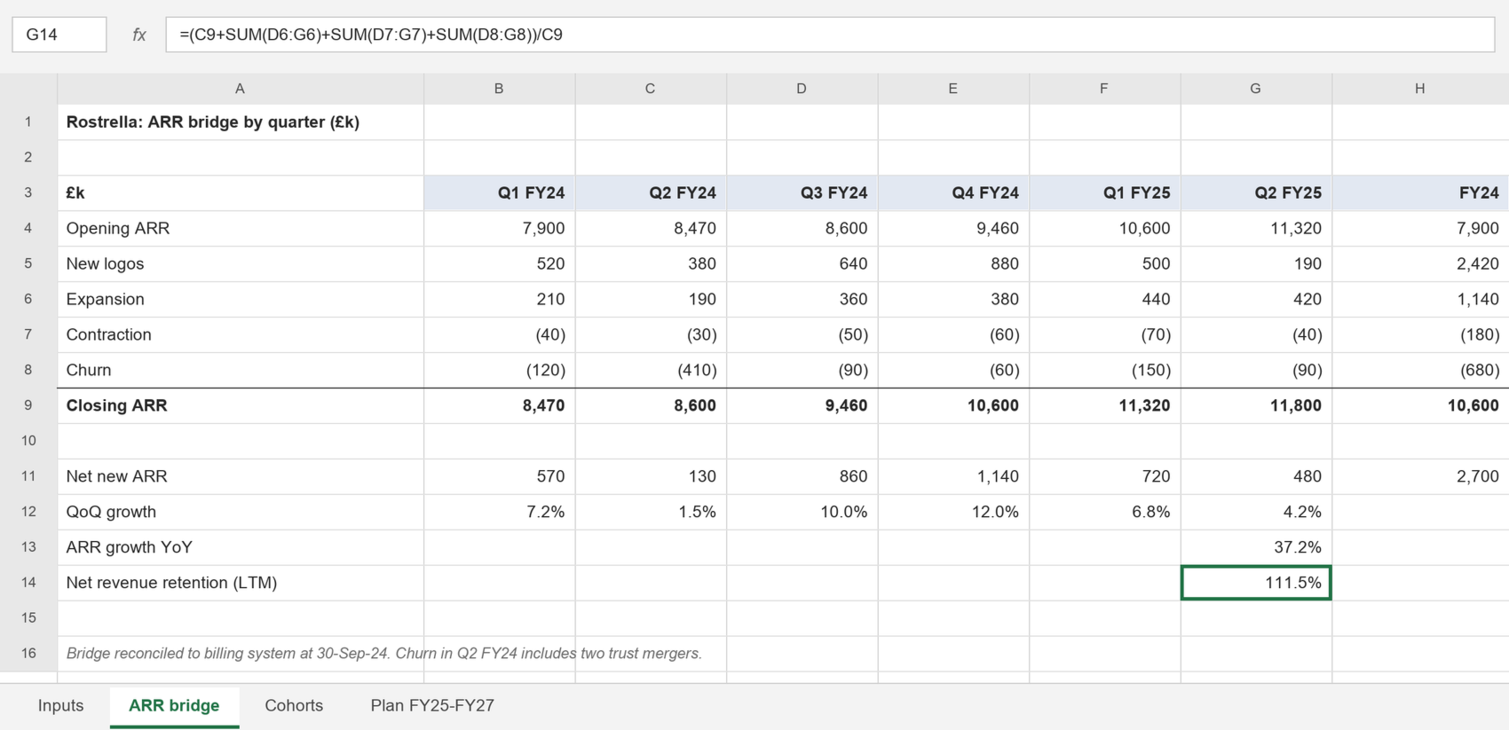
ARR bridge by quarter: closing ARR of £10.6m at March 2024 and £11.8m at September 2024 (model extract)
Source: Rostrella finance model v14, ARR bridge tab (screenshot, 18 October 2024)

Slide 14
Contract profile: 71% of ARR has more than two years remaining
Remaining term | ARR (£m) | % of ARR | Customers
More than three years | 4.5 | 38% | 24
Two to three years | 3.9 | 33% | 28
One to two years | 2.2 | 19% | 22
Under one year | 1.2 | 10% | 13
Total | 11.8 | 100% | 87
Source: Rostrella contract register, 30 September 2024. Whole percentages; rounded figures sum to 100%.

