Slide 1
Netflix Predictions
Mike Fiddler
8/1/22

Slide 2
What should we produce to maximize profit?
We are looking at a data set from Netflix comprised of thousands of movies and shows to see if we can figure out what types of film we should be making for todays audiences.
We are basing our predictions off of IMDB score. (A simple rating of 1-10, 10 being best and 1 being lowest score.)
Our features include type (show or movie), genre, TMDB score and runtime.

Slide 3
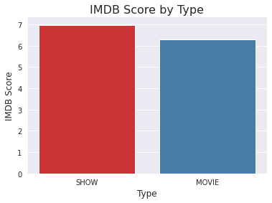
Is there a easy answer? No!
Here we see it’s not as easy as focusing on just one type of entertainment. While shows do get the edge in IMDB score we can see that people still love movies as well.

Slide 4
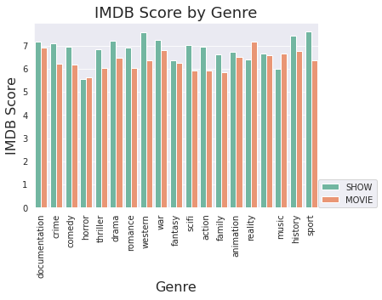
What to avoid!
Horror genre over both types is the lowest.
Scifi, action, western and family movies are also low scoring.

Slide 5
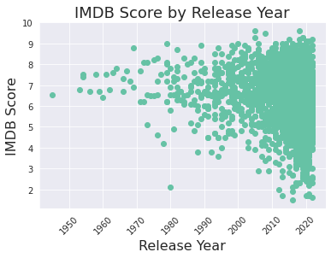
Relevance
While our data goes back to 1940s most of our ratings and therefore predictions are of films over the past 20 years.

Slide 6
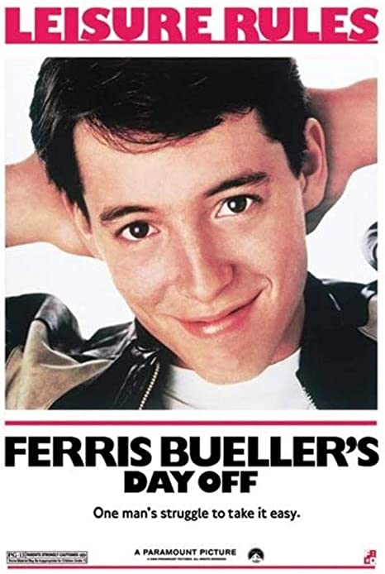
Limitations
Films that become cult classics or are highly touted by critics does not translate into high IMDB scores. (Only IMDB uses can case a vote on IMDB. This could include critics but their vote is not lent extra weight just because it’s their job.)
Source: Amazon.com: Ferris Buellers Day Off Leisure Rules One Mans Struggle to Take It Easy Comedy Movie Cool Wall Decor Art Print Poster Vintage Metal Tin Sign 12 x 8 Inch: Posters & Prints

Slide 7
Why am I confidant?
.81!
What does this mean?
It means my models predictions are only off (on average) by .81 points.
If I predict a films IMDB score to be 7 the actual prediction would be within less then 1 point of its actual score.

Slide 8
4 models down to 1
After pouring over all the metrics and ways I have to evaluate my models I recommend using the bagging model. While all my models have are somewhat overfit (they perform better on the training data vs the test data) I my best results with the bagging model.

