Slide 1
Problem Definition (FICTION)
Taxicom is a New York based taxi company with the ambition to become more digital and data driven. Their main ambition is to develop strong data & analytics capabilities in the organization. Senior management has acknowledged the importance of data and reached out to Accenture for help.
Key challenges:
There is currently no clear insights in how data is flowing through their systems.
Customer feedback is difficult to action as currently there is no platform to easily access the data.
ETL pipelines are built ad-hoc negatively impacting overall data quality.
New York traffic impacts fare rates due to longer duration impacting competitive pricing.
Core questions:
How can fare data be used and organized to increase price competiveness?
What capabilities are required from a people perspective?
What can AI and ML do to better understand and optimize routes for drivers?
Can Accenture present a representative ETL pipeline?
How can AI support in understanding customer feedback?

Slide 2


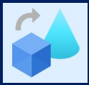





Solution Architecture
Azure
Databricks
Data Flow
Azure AD
Ingest
Transform
NYC Taxi Data
& Weather Data
Azure Data Lake Storage
(Raw Data)
Azure Data Lake Storage (Processed Data)
Azure SQL Database
Azure Data Factory
Azure Data Factory

Slide 3


Solution Architecture
Data Transformation
Data Reporting
Data Extraction
Data Warehousing
ADF
Azure
DB
Data Flow
ADF
SQL DB
Data Lake Storage
E T L Process

Slide 4
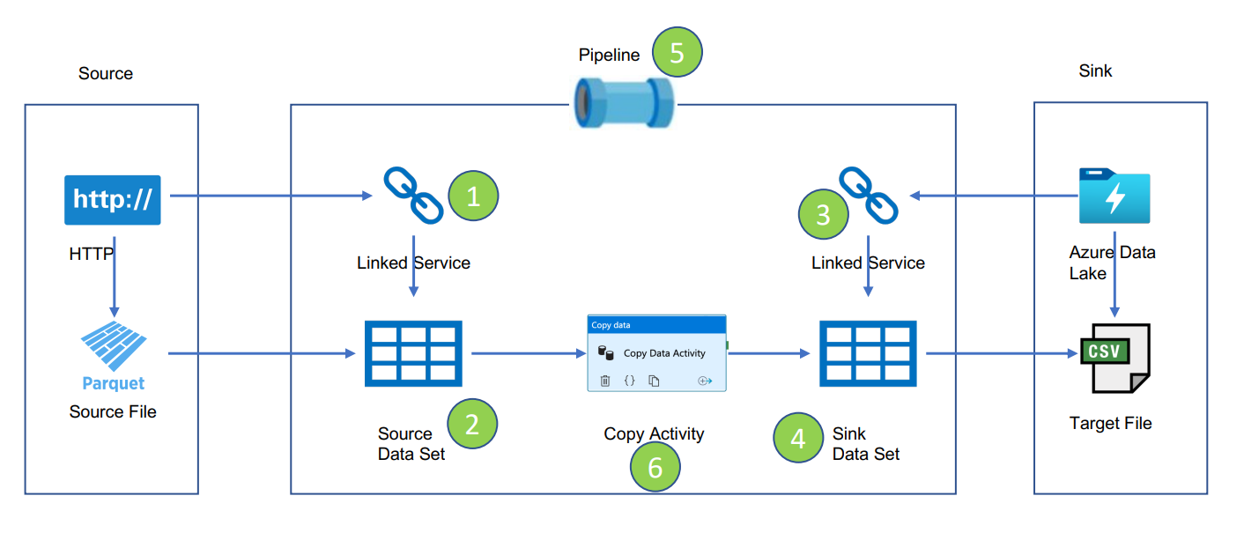
Data Extraction Workflow
1 | ls_http_nyc_gov ls_http_ncei_gov
2 | ds_nyc_taxi_binary_http ds_taxi_zone_lookup_csv_http ds_weather_csv_http
3 | ls_adls_uberreportingdl
4 | ds_nyc_taxi_binary_dl ds_taxi_zone_lookup_csv_dl ds_weather_csv_dl
5 | pl_ingest_data
6 | Lookup+ForEach+Copy Activities

Slide 5
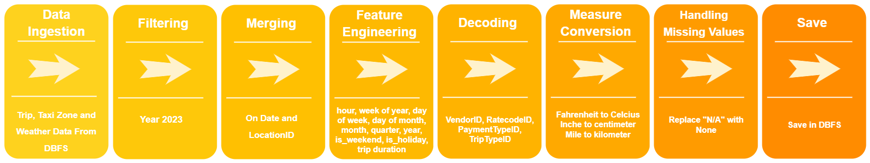
Data Transformation Workflow in Databricks
Notes
Since there was no permission to access Azure Data Lake Storage from Databricks yet, the raw datasets were manually uploaded into DBFS and processed by Databricks.
When the relevant access permission is obtained, the raw datasets will be ingested from the Data Lake “Raw” Container and the transformed dataset will be loaded to “Processed” Container.

Slide 6
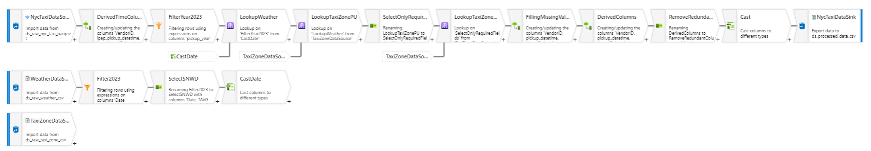
Data Transformation Pipeline in ADF DataFlow
Notes
Only NYC Taxi Trip Data of January 2023 was processed in the ADF Transformation Pipeline.
NYC Taxi Trip Parquet Data for months other than January 2023 could not be directly processed by ADF due to structural problems. For this reason, Data Transformation operations were conducted seamlessly with Databricks.
In this pipeline, data transformation was performed by the same actions used in Databricks, but in different orders.

