Slide 1
ET AI HACKATHON 2026
AI-Driven Cyber Resilience
for Critical National Infrastructure
Behavioral Anomaly Detection + MITRE ATT&CK Attribution Agent
Problem Statement #7 • Solo build
Fida M S

Slide 2
THE PROBLEM
Detection is too slow — and everyone knows it
APTs deliberately operate low-and-slow to stay under signature thresholds. By the time a signature exists, the attack has already succeeded somewhere else.
1.59M+
70%
Weeks to
Months
cybersecurity incidents handled
by CERT-In in 2023 alone
of government entities run on
end-of-life IT infrastructure
typical gap between initial
compromise and detection
The pattern that keeps repeating
AIIMS Delhi (2022): ransomware, 2+ weeks offline. CBSE (2024 & early 2026): exam records breached, emergency shutdowns across states. In every case: the data existed. The intelligence layer to act on it before damage — didn't.
02

Slide 3
OUR APPROACH
Two sub-agents, built and proven — not five, half-built
The problem statement suggests five sub-agents. We scoped to two, deliberately: a smaller thing that's actually true beats a bigger thing that's vaporware.
BUILT & VALIDATED
DELIBERATE ROADMAP, NOT BUILT
Behavioral Anomaly Detection Engine — per-entity baseline + Isolation Forest + peer-novelty signal
Autonomous Incident Response Orchestrator (SOAR) — needs live security tooling to integrate against
APT Campaign Attribution Agent — retrieves matching MITRE ATT&CK techniques, generates analyst narrative
Government Infrastructure Vulnerability Prioritisation — needs a real CVE/asset feed
Benchmarked on synthetic data (7,200 windows) AND real UNSW-NB15 traffic (6,257 windows, 2.5M raw connections)
Cyber Resilience Digital Twin — needs a real org's security architecture to model
Tactic-level attribution accuracy actually measured: 97.4%
Cut because a solo hackathon build can't credibly fake live integrations — not because they don't matter.
03

Slide 4
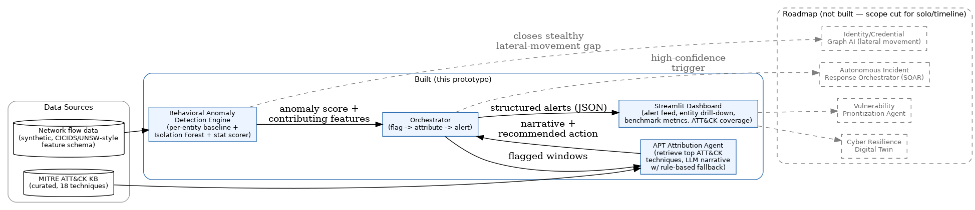
SYSTEM ARCHITECTURE
From raw network signal to an actioned alert
Solid = built and working in this prototype. Dashed = roadmap, deliberately out of scope (see previous slide).
04

Slide 5
COMPONENT 1
Behavioral Anomaly Detection Engine
Learns what's normal for THIS host, flags deviation from ITS OWN baseline — not a signature match.
01
Per-entity baseline
Mean/std of every feature, computed per host, unsupervised — no labels needed in production.
02
Isolation Forest
Catches multi-feature COMBINATIONS that are jointly unusual, even if no single feature looks extreme alone.
03
Statistical max-deviation scorer
Fast-path catch for “loud” single-feature spikes — 100% recall on obvious attacks.
04
Peer-novelty signal (added this build)
Tracks whether a host reaches destinations it's NEVER contacted before — catches stealthy lateral movement volume alone misses.
05

Slide 6
COMPONENT 2
APT Campaign Attribution Agent
Retrieve-then-generate: turns a raw anomaly score into an analyst-readable explanation with a recommended action.
1
2
3
4
Anomaly flagged
Retrieve
Generate
Structured alert
Entity + score + top contributing features from the detection engine
→
Matches contributing features against 18 curated MITRE ATT&CK techniques, weighted by deviation rank
→
Claude synthesizes a narrative + recommended action from top candidates (auto rule-based fallback if no API key)
→
JSON: entity, techniques, confidence, action, full audit trail
06

Slide 7
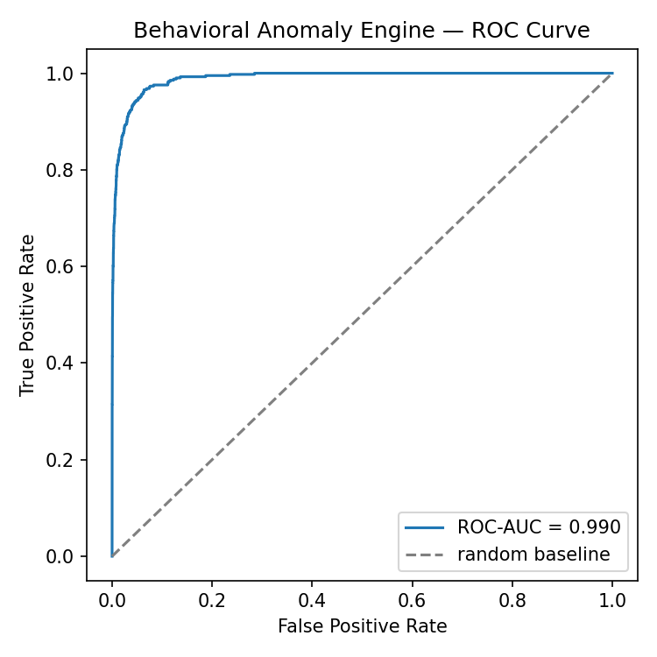
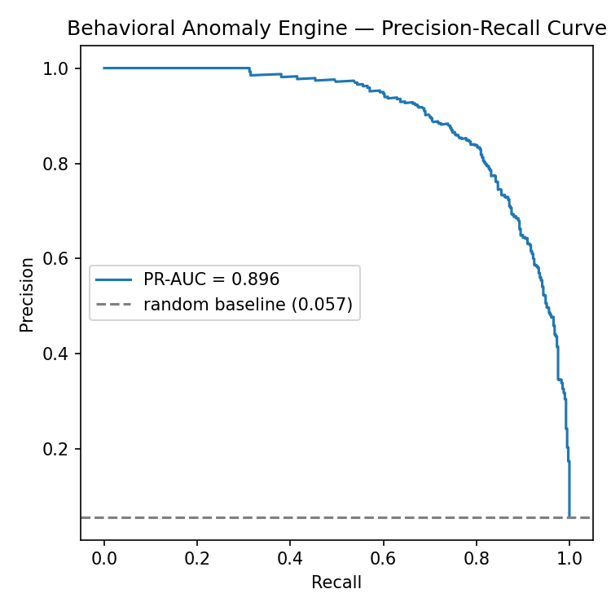
RESULTS — SYNTHETIC BENCHMARK
7,200 windows, 5 attack families, honest metrics
0.990
82.9%
78.7%
1.35%
ROC-AUC
Recall @ operating point
Precision @ operating point
False positive rate
What “operating point” means
ROC-AUC/PR-AUC are threshold-independent. The precision/recall/FPR numbers are read at ONE chosen alert-volume threshold — tightening or loosening it trades these against each other. Full curves shown so nothing is cherry-picked to one convenient point.
07

Slide 8
THE NUMBER THAT ACTUALLY MATTERS
Loud attacks: caught every time. Stealthy: the honest picture
A trade-off we didn't hide
Adding the peer-novelty feature raised stealthy lateral movement recall from 5.9% → 31% and stealthy port-scan to 97.6%.
But stealthy brute-force recall FELL (67.6% → 37.8%): this engine flags a fixed alert budget per run, so improving one attack type's ranking can push another below the cutoff.
Documented, not smoothed over. Fix: per-attack-type thresholds (roadmap).
08

Slide 9
INDEPENDENT VALIDATION
Validated against real UNSW-NB15 traffic — not just our own synthetic data
2.54M real network connections, aggregated into 6,257 real behavioral windows, 43 real hosts. Same engine, unchanged.
Why the gap — and why that's the point
Real UNSW-NB15's dominant attacks are Exploits and Fuzzers — single malicious packets/payloads, not sustained volume shifts.
This engine is behavioral: it's built to catch sustained pattern change (scans, floods, brute force). A one-packet exploit doesn't necessarily move the aggregate stats.
Still clearly above random (0.81 ROC-AUC) — but this is a real method limitation, stated directly, not smoothed into a friendlier number.
09

Slide 10
EVALUATION FOCUS: ATTRIBUTION ACCURACY
96.2% technique-level attribution accuracy — the exact ATT&CK ID, not just the tactic
What this metric IS and ISN'T
96.2%
Third-party data (real UNSW-NB15) genuinely has no ATT&CK technique-ID ground truth — that needs a red team tagging every packet, which doesn't exist here or anywhere for this dataset.
But for the SYNTHETIC data, that excuse doesn't apply: we wrote the attack simulators ourselves to model specific named techniques (port scan→T1595, brute force→T1110, DoS→T1498, exfiltration→T1041, lateral movement→T1021). That design intent is legitimate ground truth for data we generated — so exact technique-ID accuracy is measured directly, not proxied.
A secondary, looser check — top candidate's TACTIC matches expectation (e.g. Reconnaissance for a port scan) — still holds too: 97.4% top-1 / 99.4% top-3.
Both measured only on synthetic data: real UNSW-NB15's categories (Exploits, Fuzzers, Generic…) aren't ATT&CK labels and don't map onto our KB cleanly enough to be meaningful there.
Top-1 technique accuracy
98.8% top-3 • n = 340 true-positive alerts
By attack type — technique top-1
Port scan
100%
DoS
97.3%
Brute force
96.4%
Lateral movement
94.9%
Exfiltration
91.4%
10

Slide 11
ROADMAP
What closes the gaps we found — in priority order
1
Identity/credential-graph signals
Closes the rest of the stealthy lateral-movement gap. Peer-novelty closed part of it using traffic alone; the honest ceiling for flow-only data is well below what real auth/identity data would achieve.
2
Per-attack-type adaptive thresholds
Removes the brute-force-vs-lateral-movement trade-off from Slide 8 — one global alert budget is the root cause.
3
Payload/signature-assisted layer
Closes the real-data gap from Slide 9. Exploits/fuzzing attacks need packet-content inspection alongside behavioral baselining.
4
Next-stage move prediction
Attribution agent currently explains what already happened; ranking likely NEXT ATT&CK techniques was in-scope for this sub-agent originally.
5
Autonomous Incident Response (SOAR)
Pre-approved containment playbooks, gated by confidence threshold, human escalation above a blast-radius limit.
11

Slide 12
The takeaway
Every number in this deck is one we can defend.
Synthetic benchmark AND real-world validation. A feature that measurably improved detection AND the trade-off it caused. An attribution accuracy number that didn't exist until we built the eval for it. That's the standard the rest of this build was held to.
Working prototype • Architecture diagram • Real + synthetic benchmarks • Full source on GitHub
Thank you.
12

