Slide 1
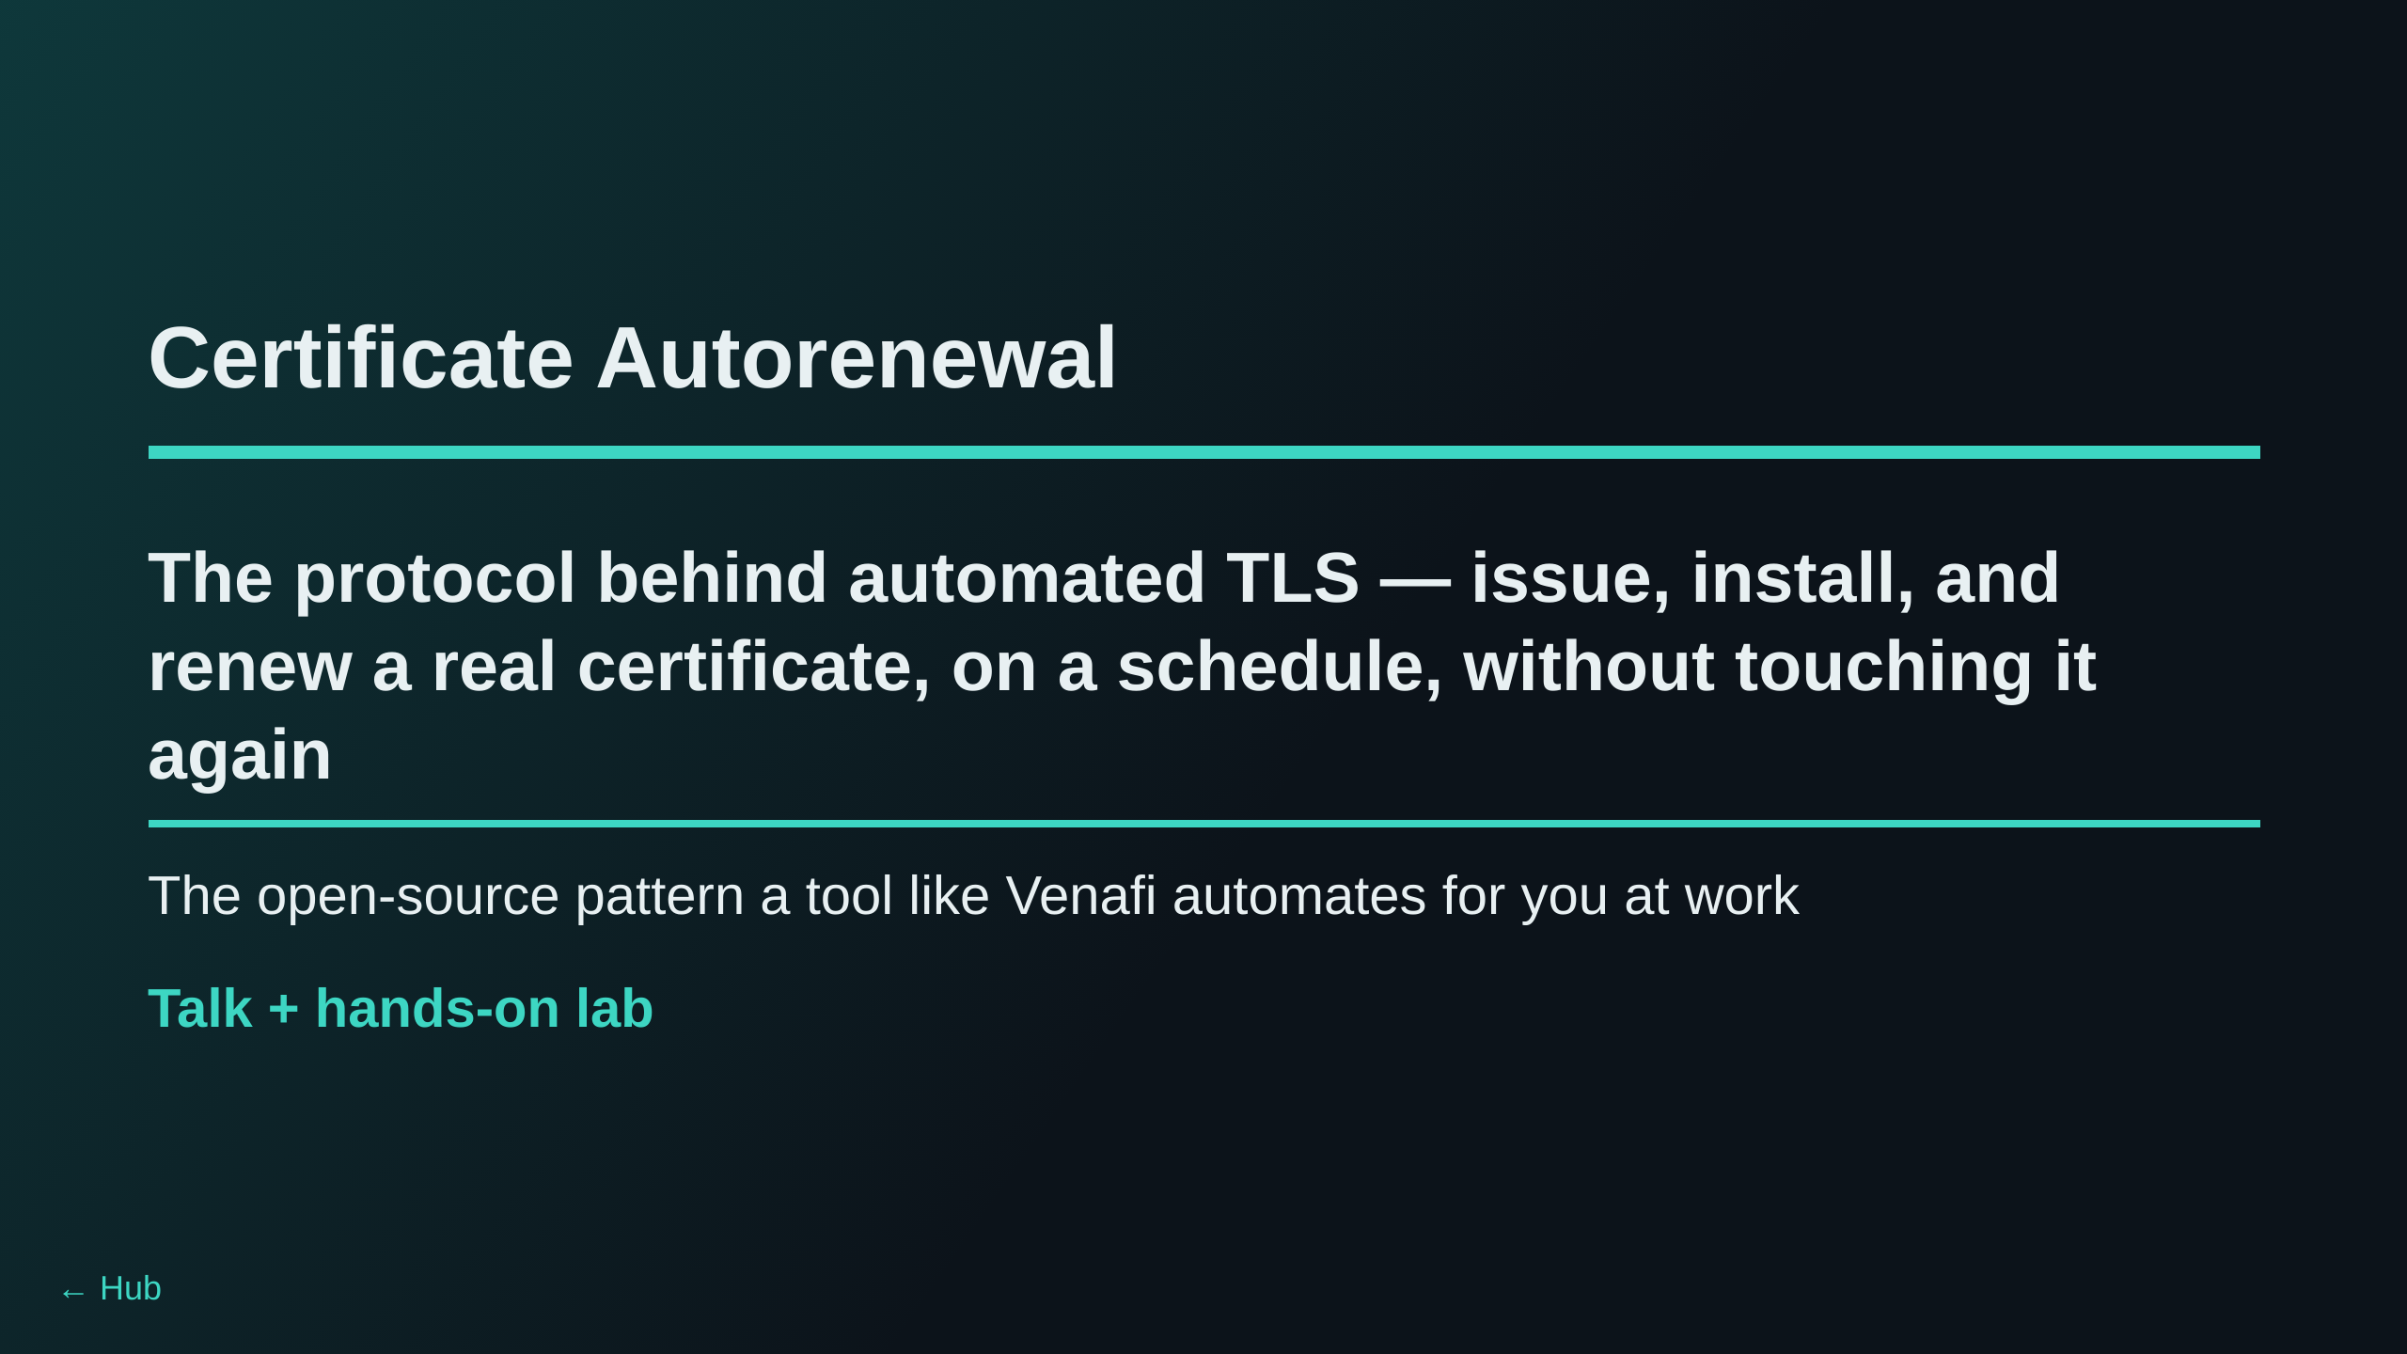
Notes:
No ties to any corporate CA service in this lab — step-ca, certbot, and
acme.sh are all open-source, self-hosted, and run entirely inside this
workshop's own containers. The point isn't "here's Venafi" — it's "here's
what issuance/renewal automation actually does under the hood," so the
Venafi case at work reads as an instance of a pattern, not a black box.

Slide 2
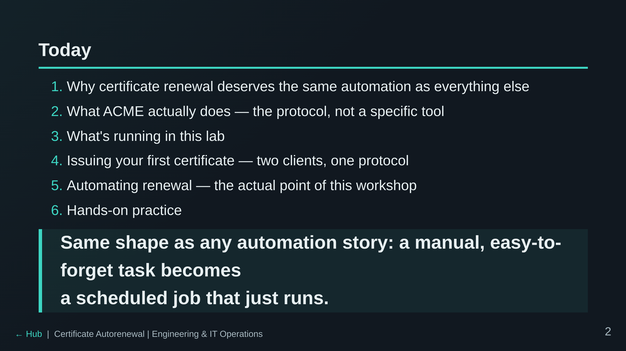

Slide 3
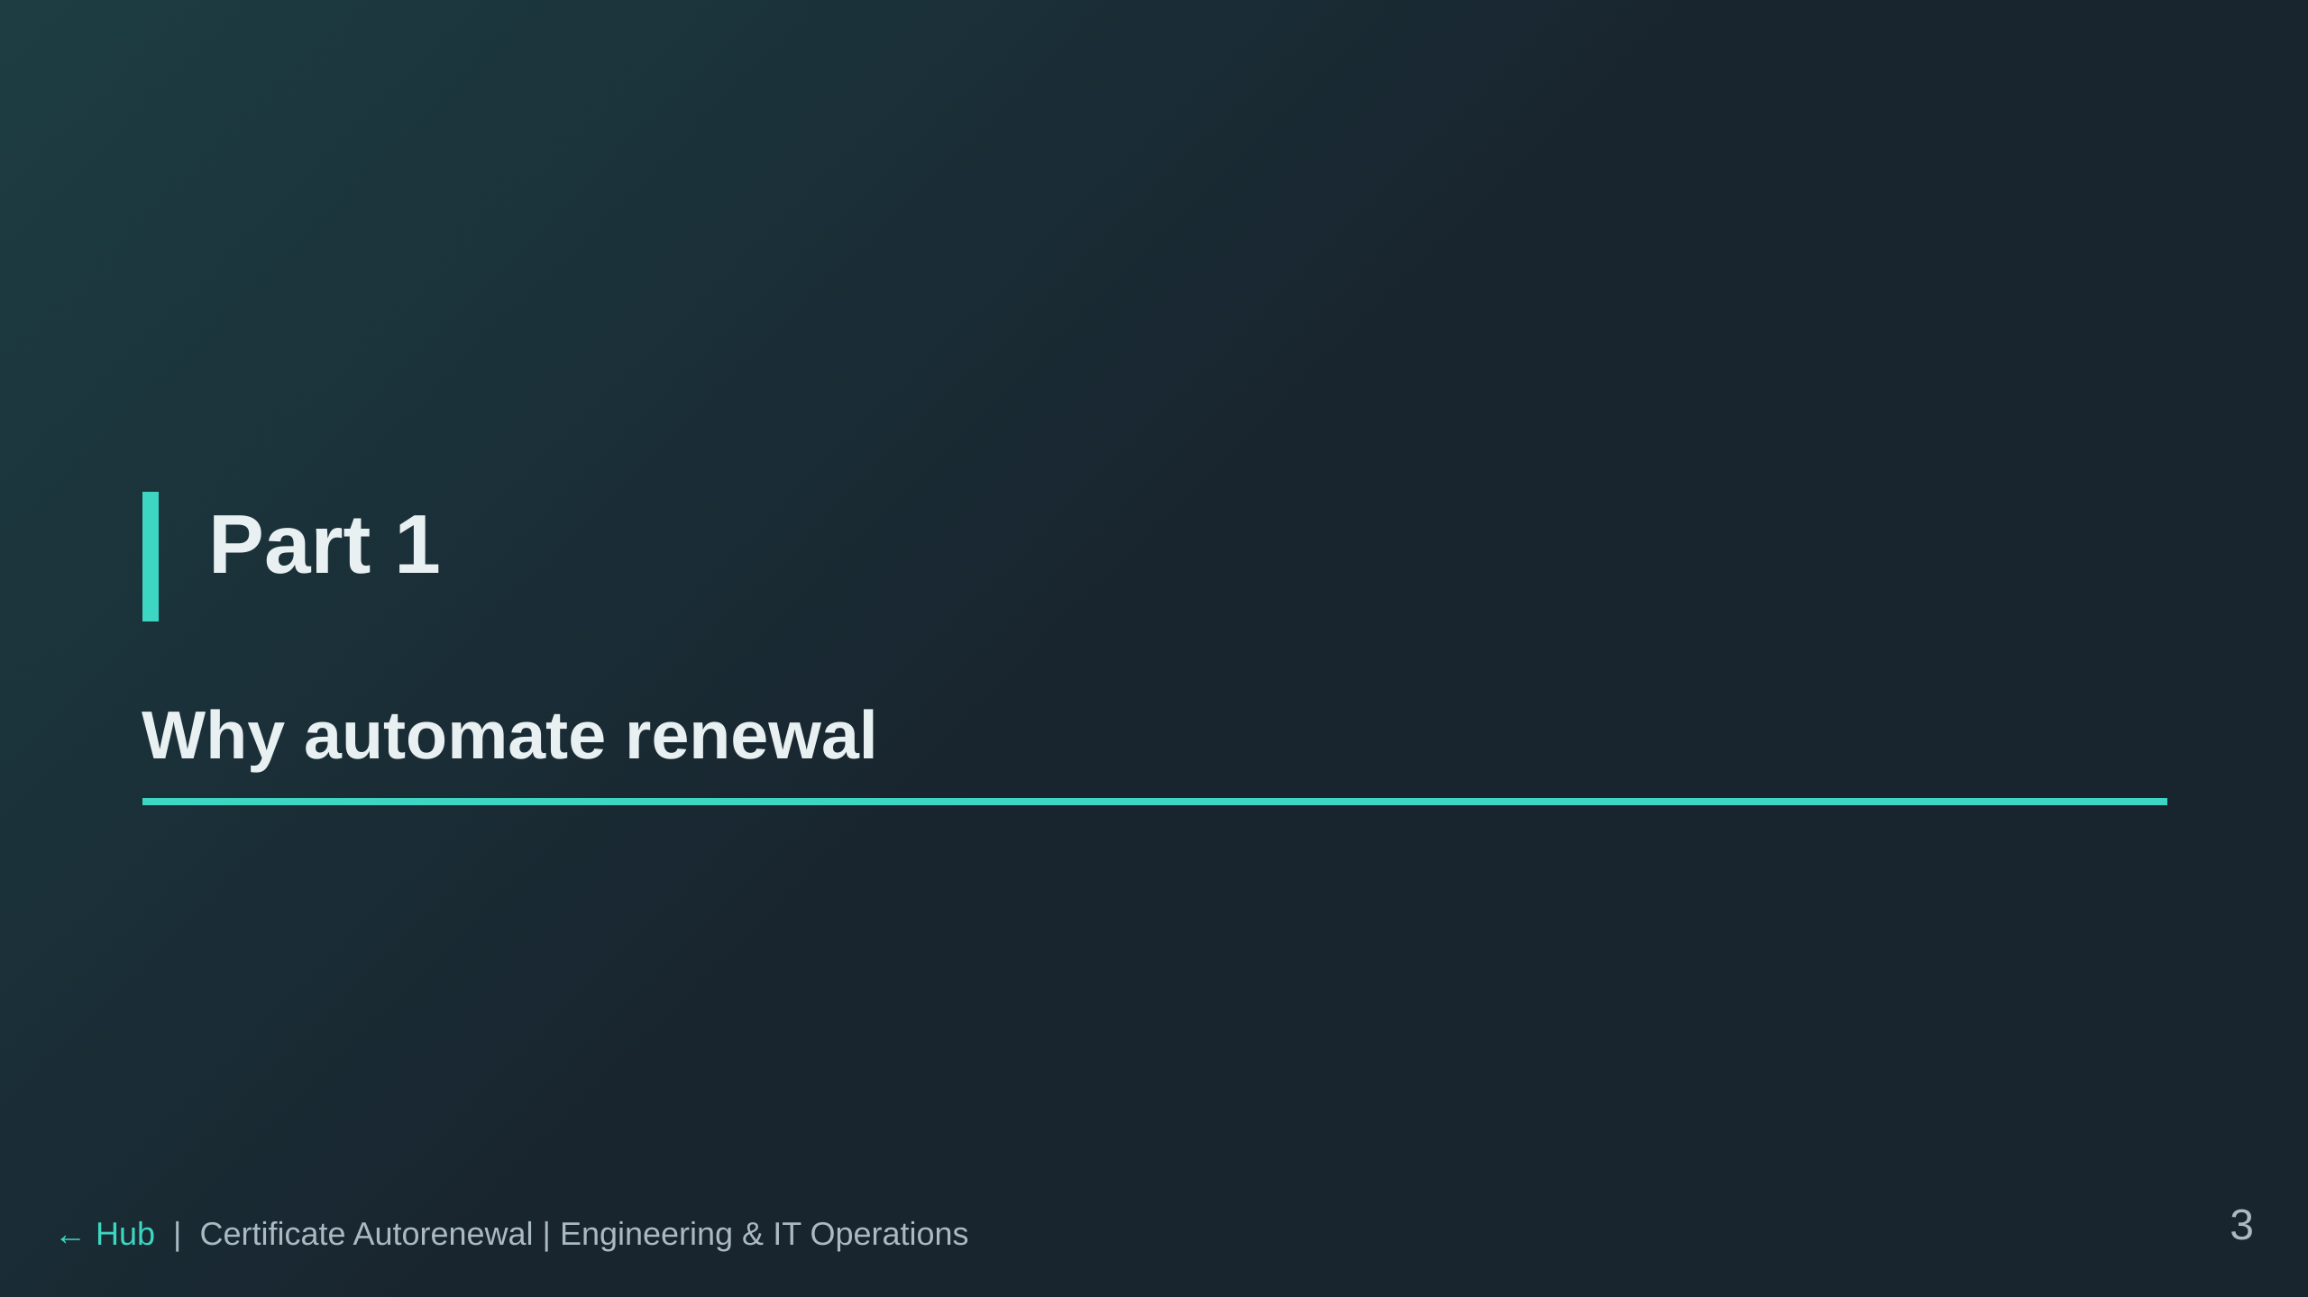

Slide 4
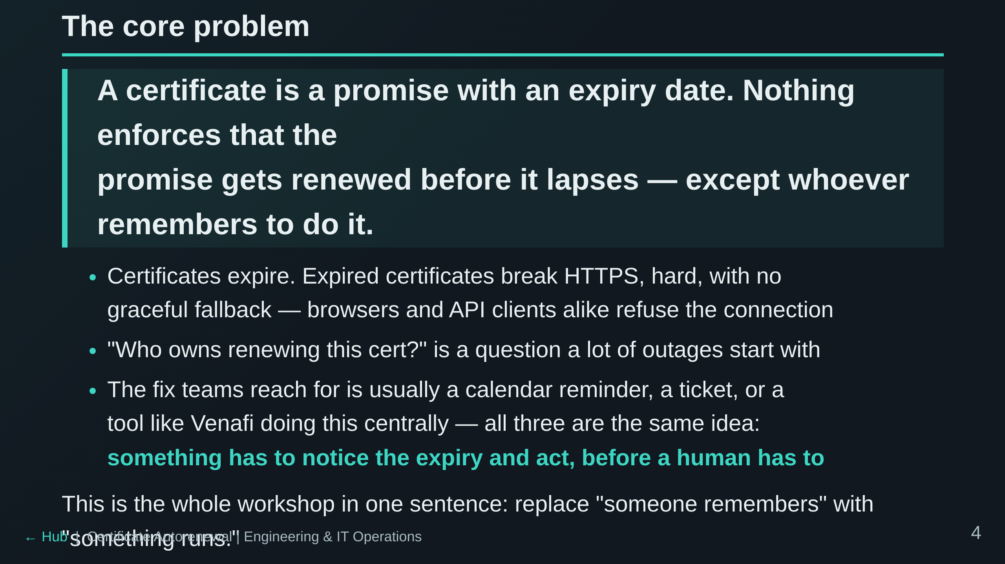
Notes:
Worth pausing here — this is the motivating problem everything else in the
deck answers. Everyone in the room has probably seen an expired-cert outage
at some point; let that land before moving to the mechanism.

Slide 5
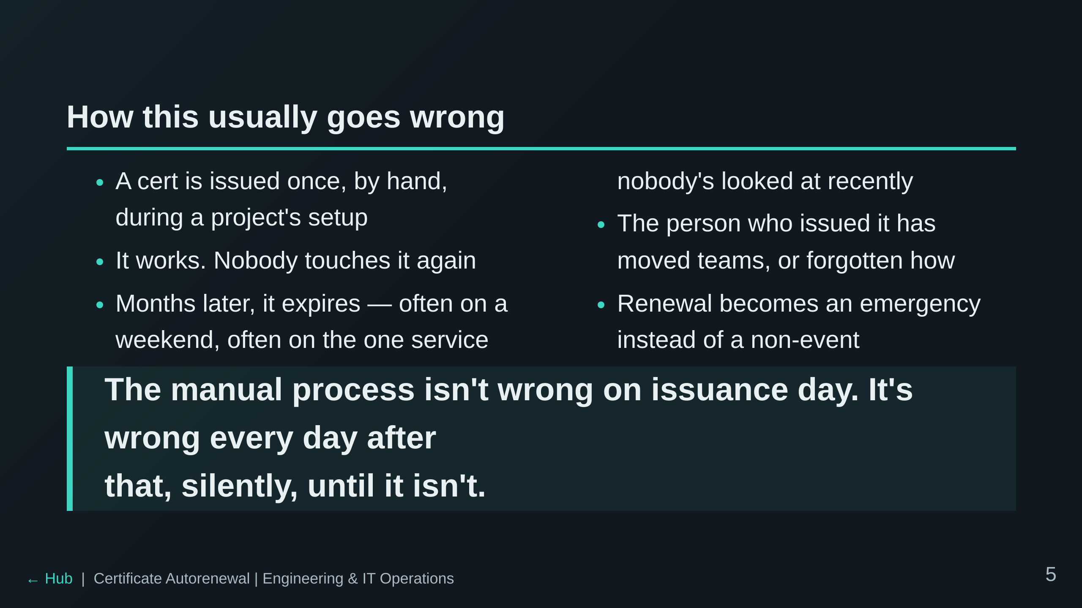

Slide 6
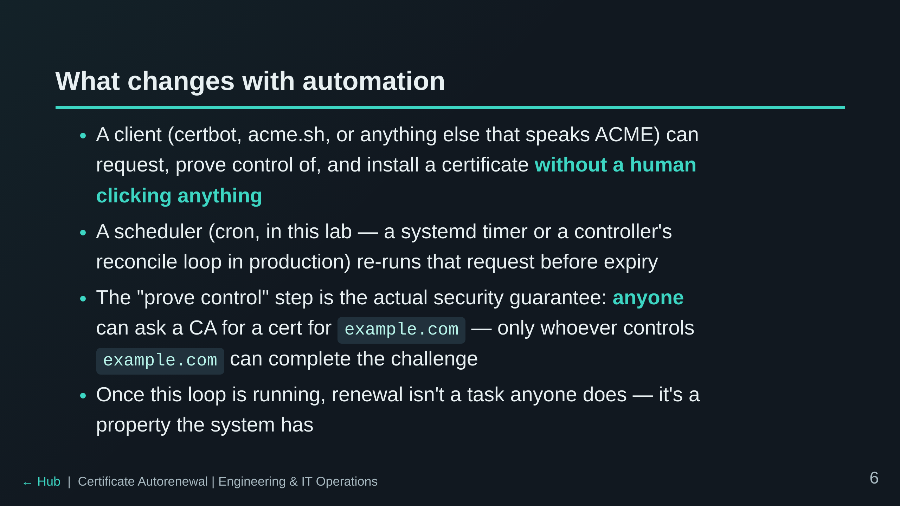
Notes:
This is the pivot into Part 2: the "prove control" step above is exactly
what ACME's challenge/response exchange formalizes. Everything in Part 2
is mechanism for the claim just made here.

Slide 7
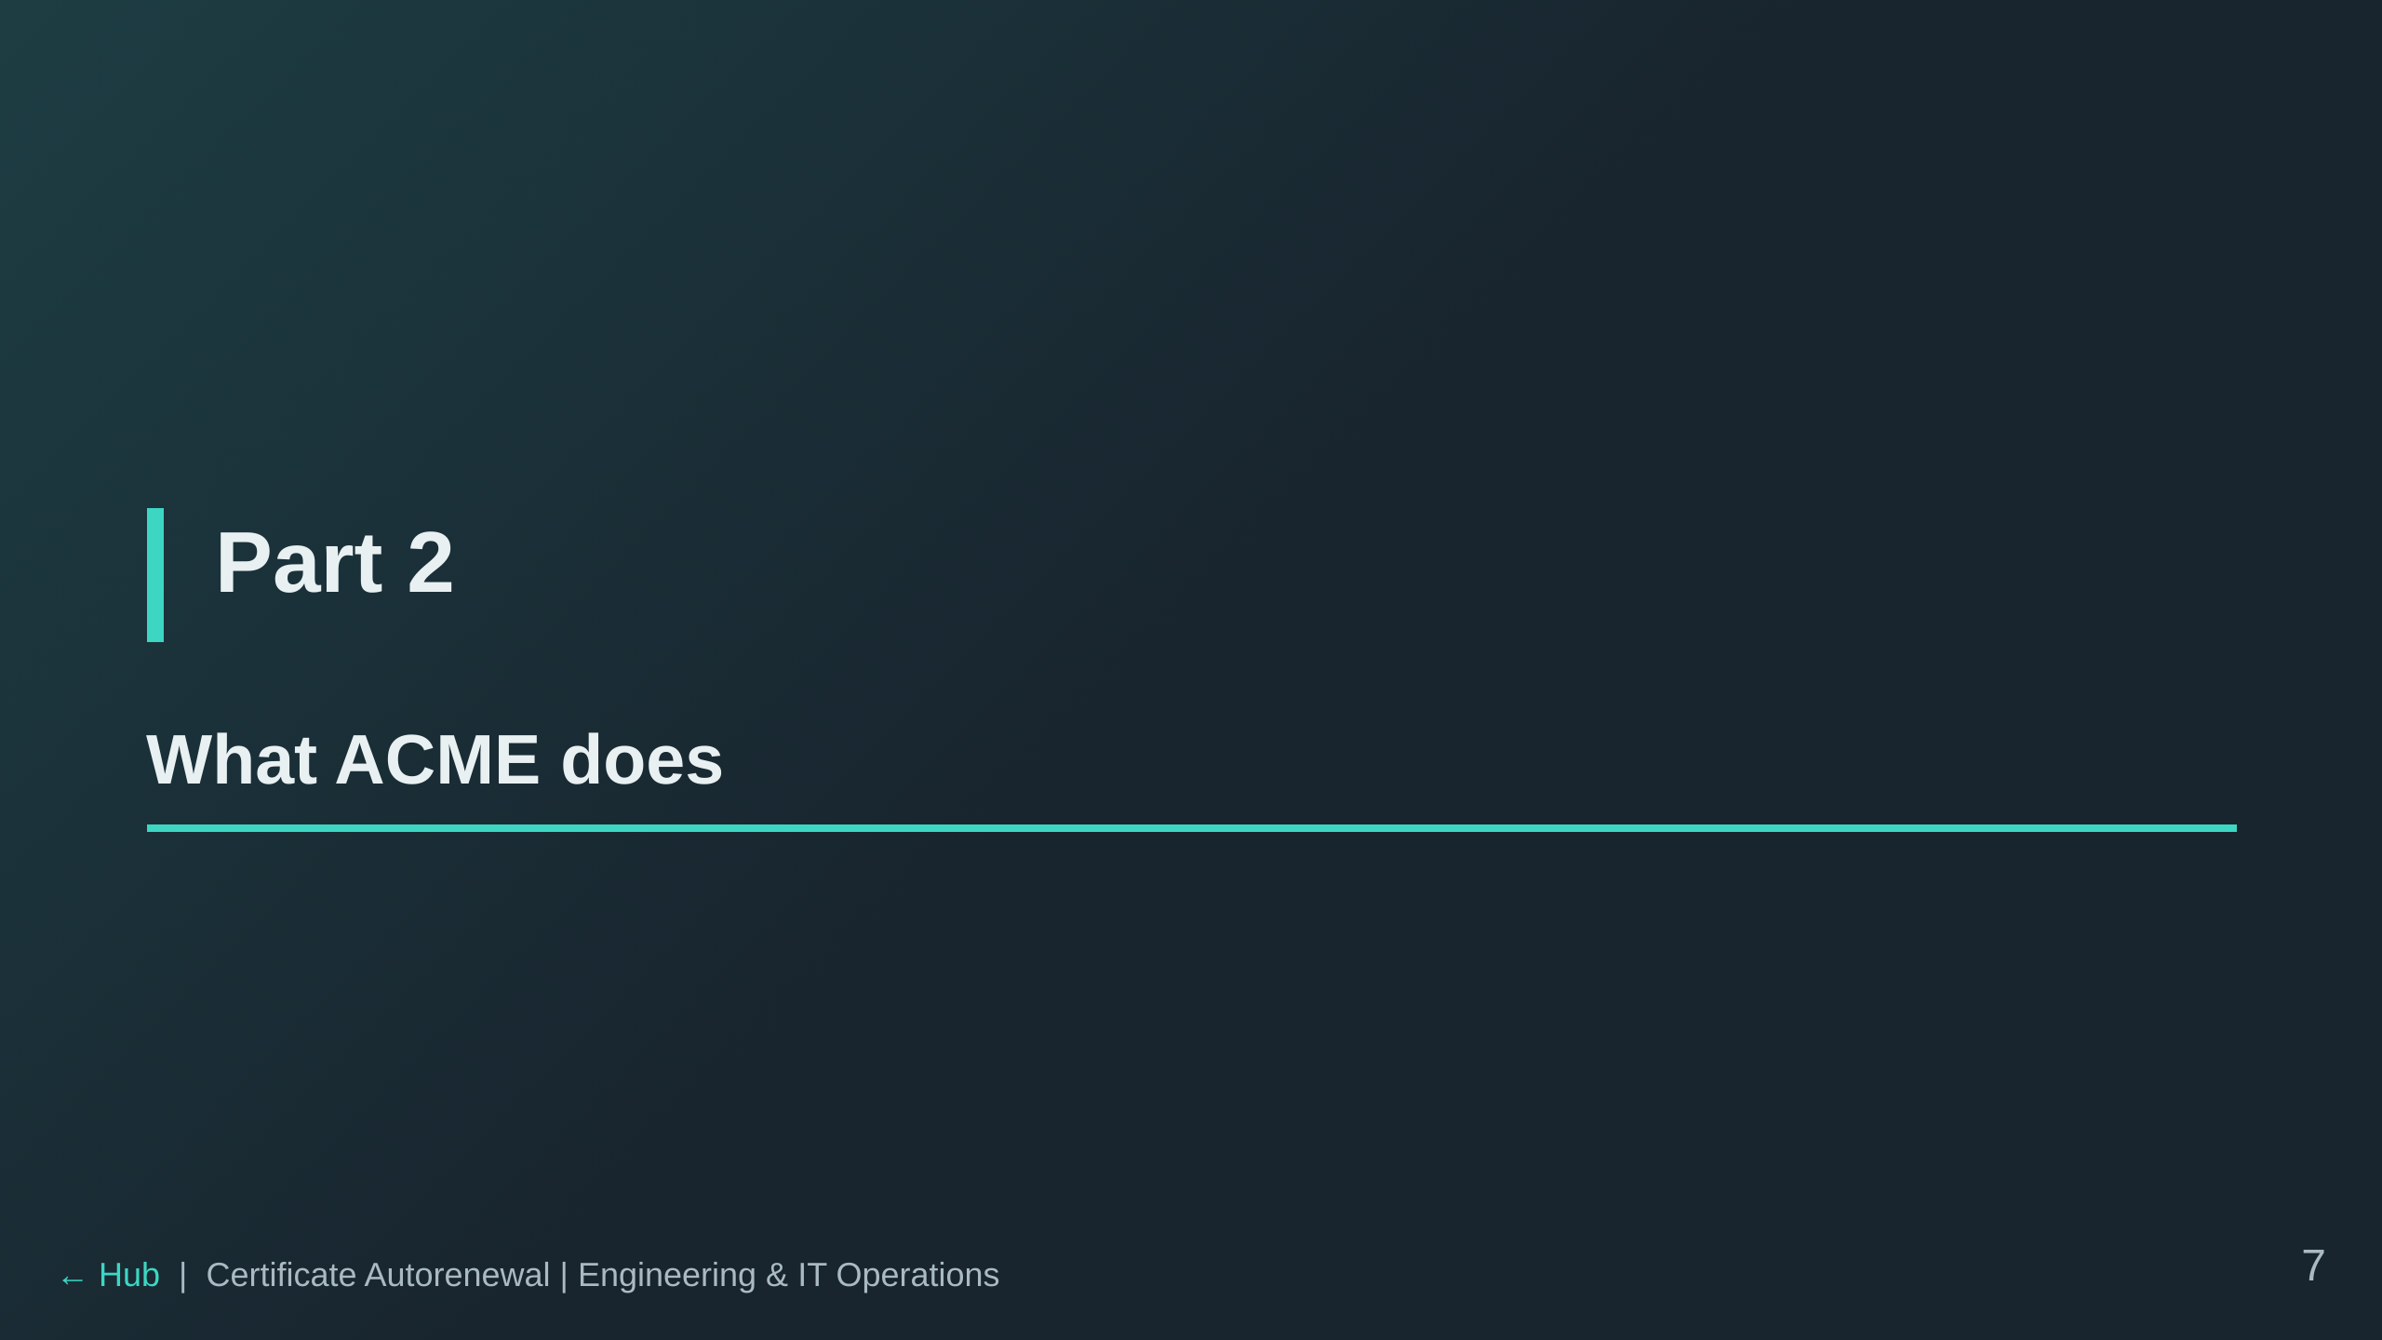

Slide 8
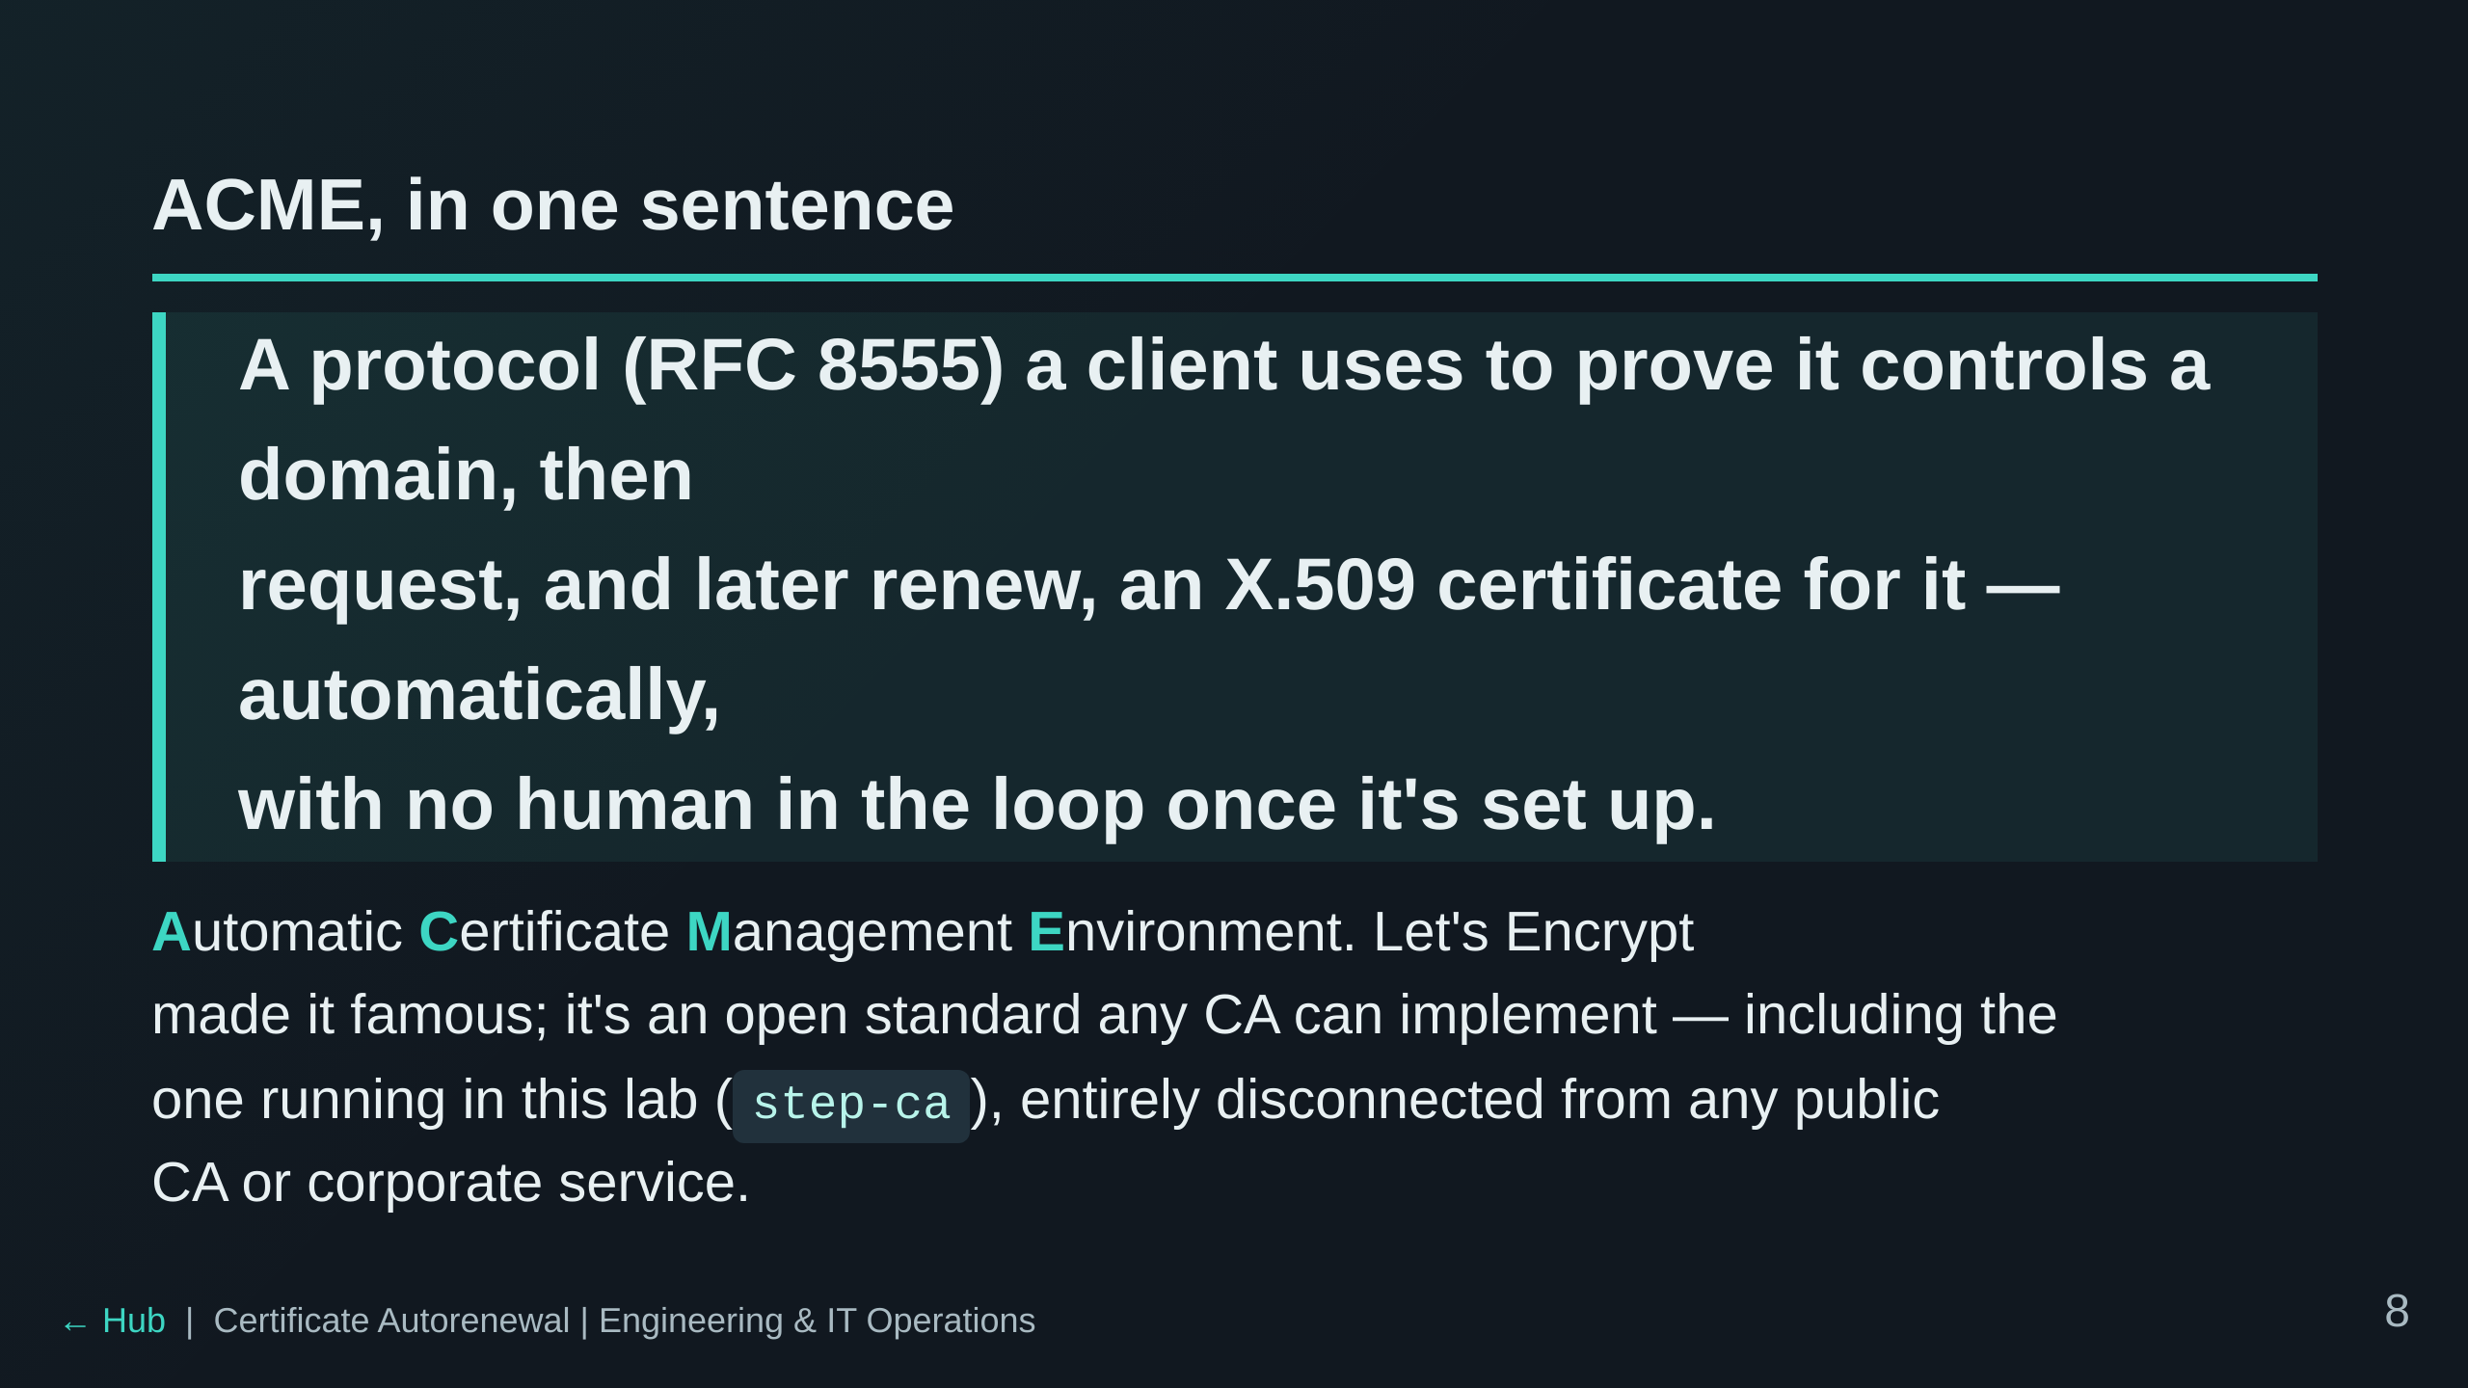

Slide 9
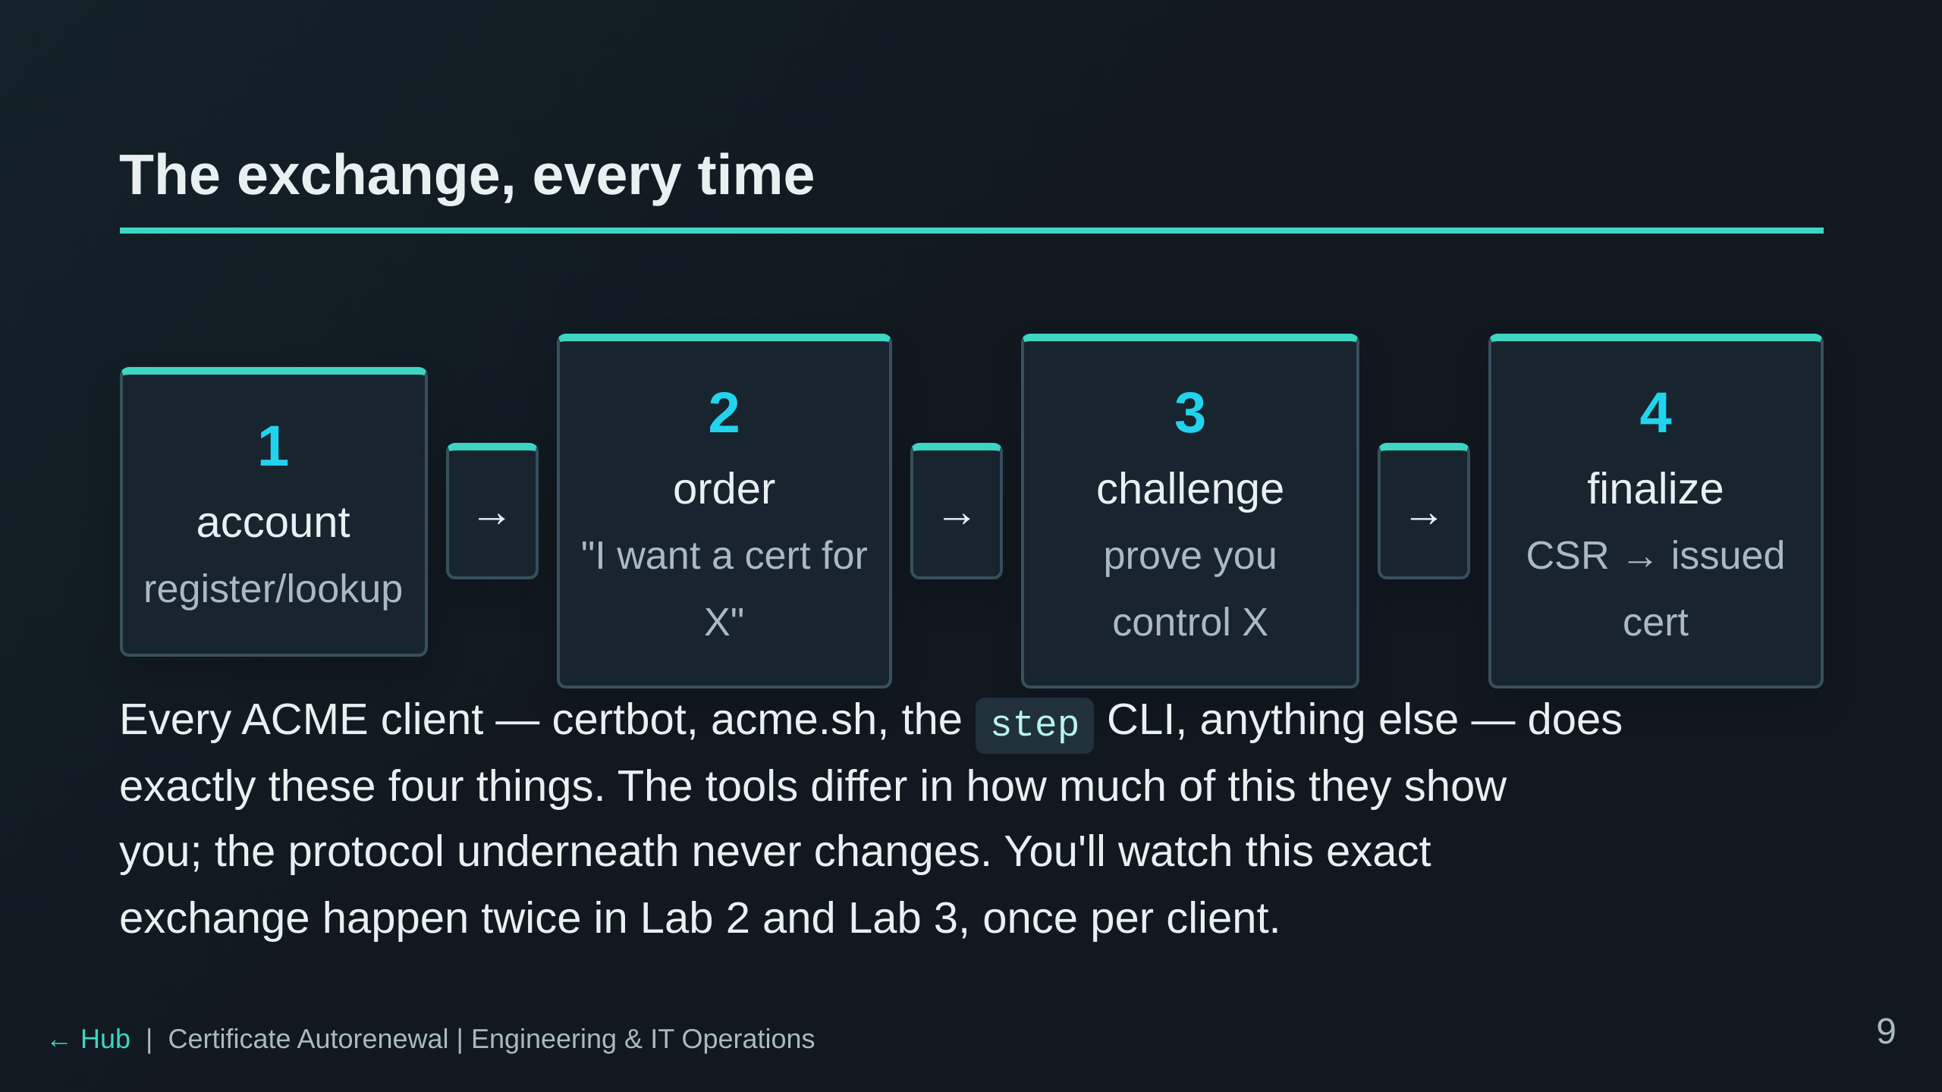

Slide 10
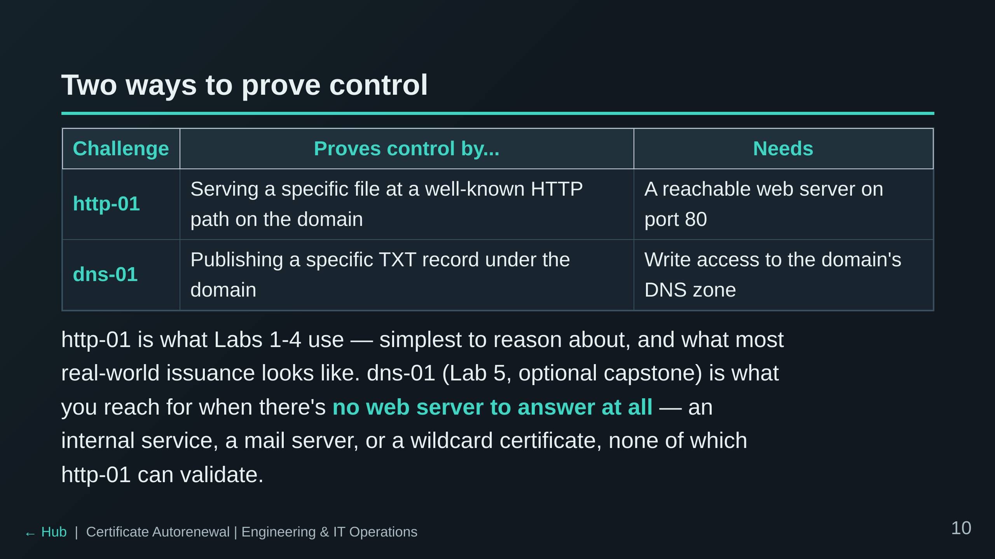

Slide 11
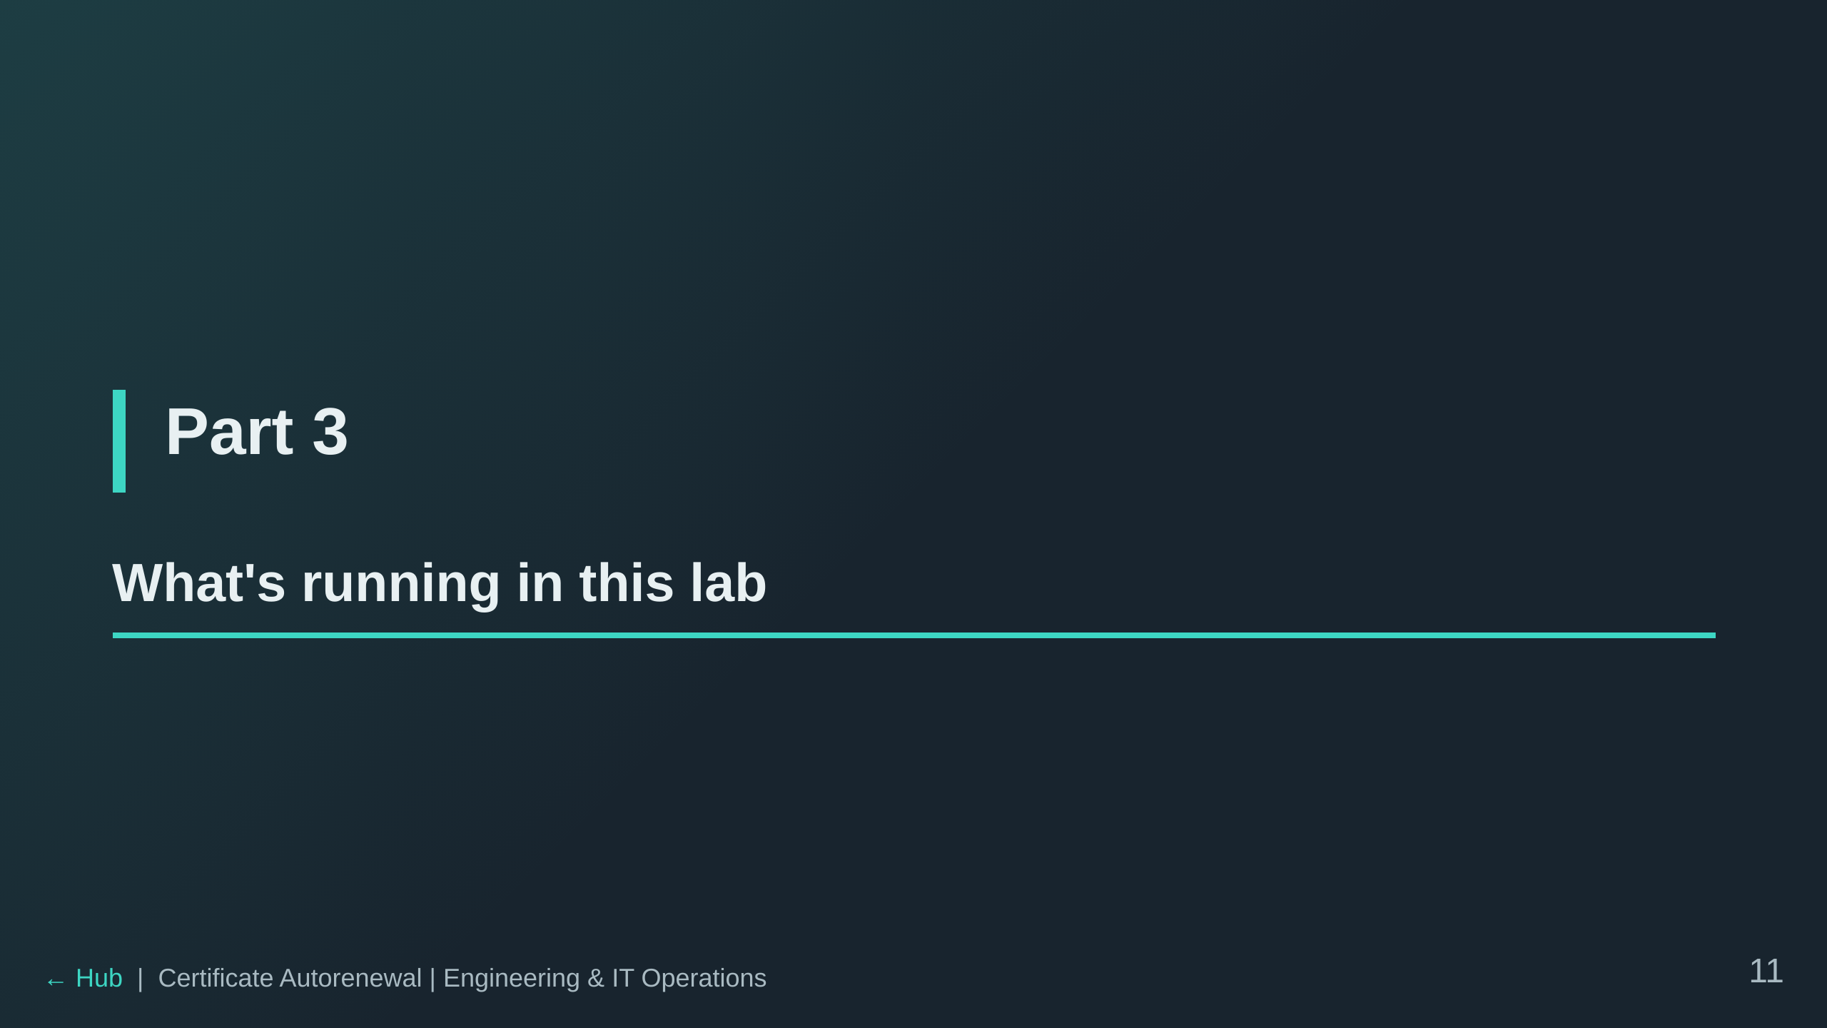

Slide 12
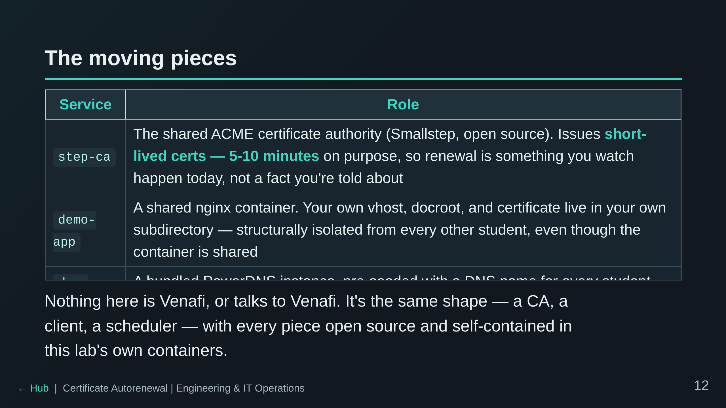

Slide 13
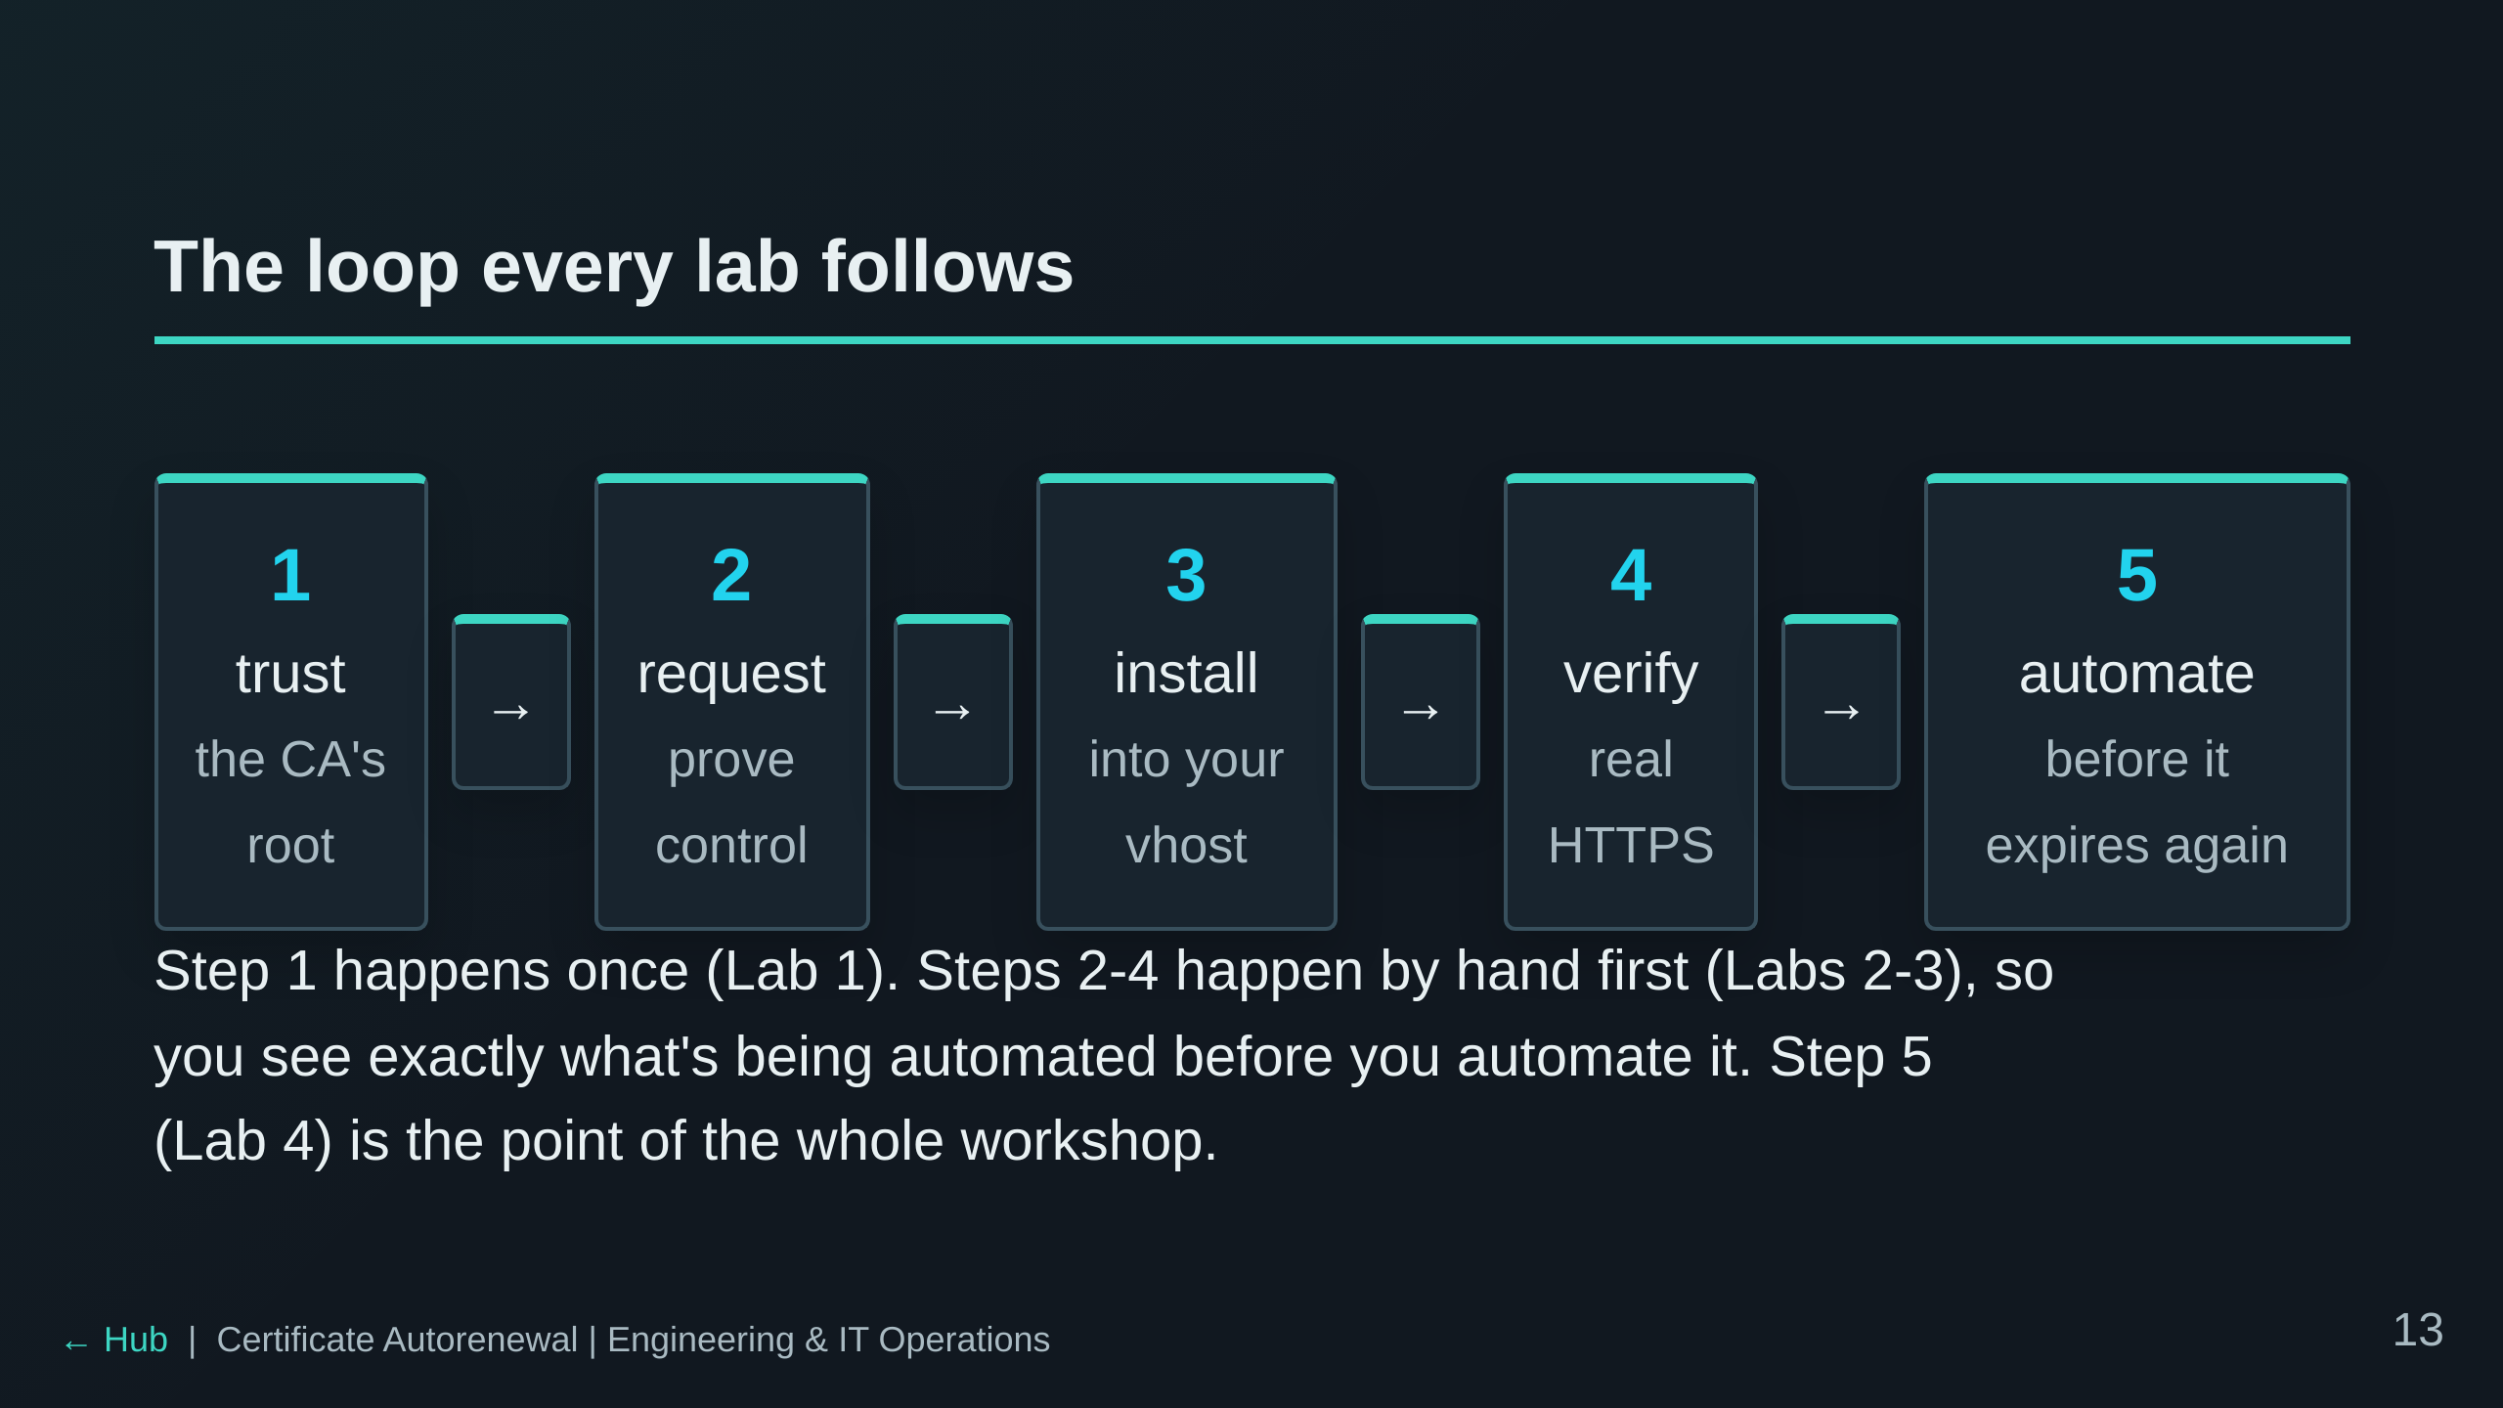

Slide 14
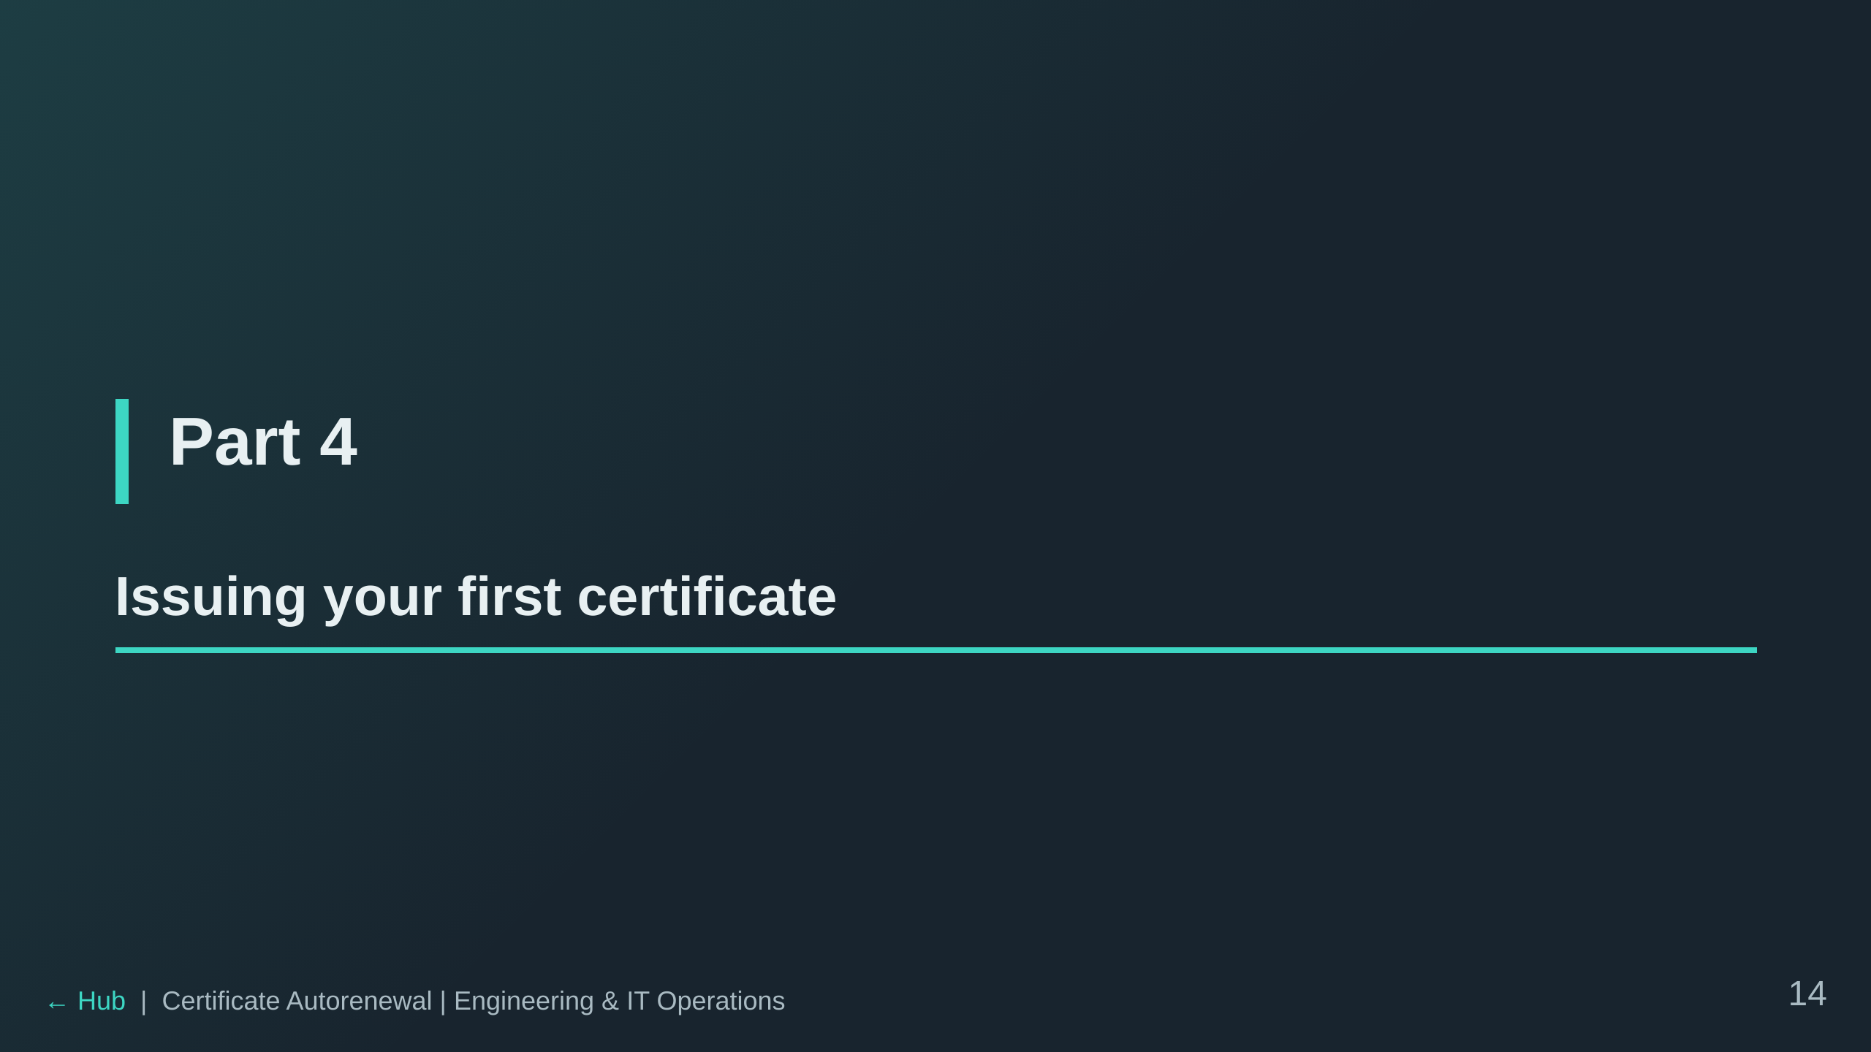

Slide 15
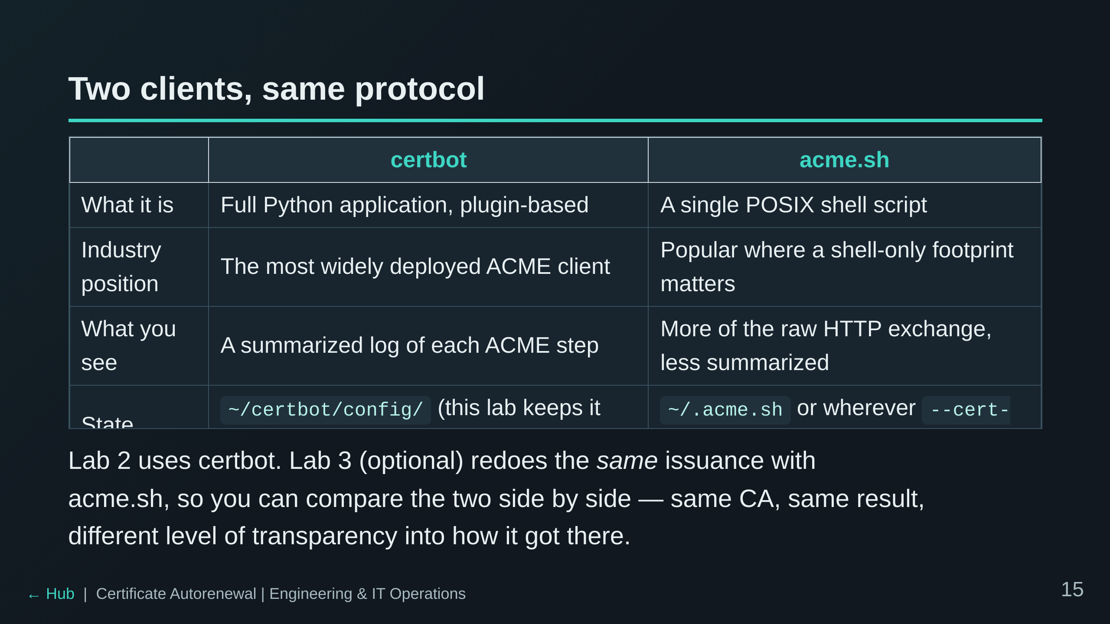

Slide 16
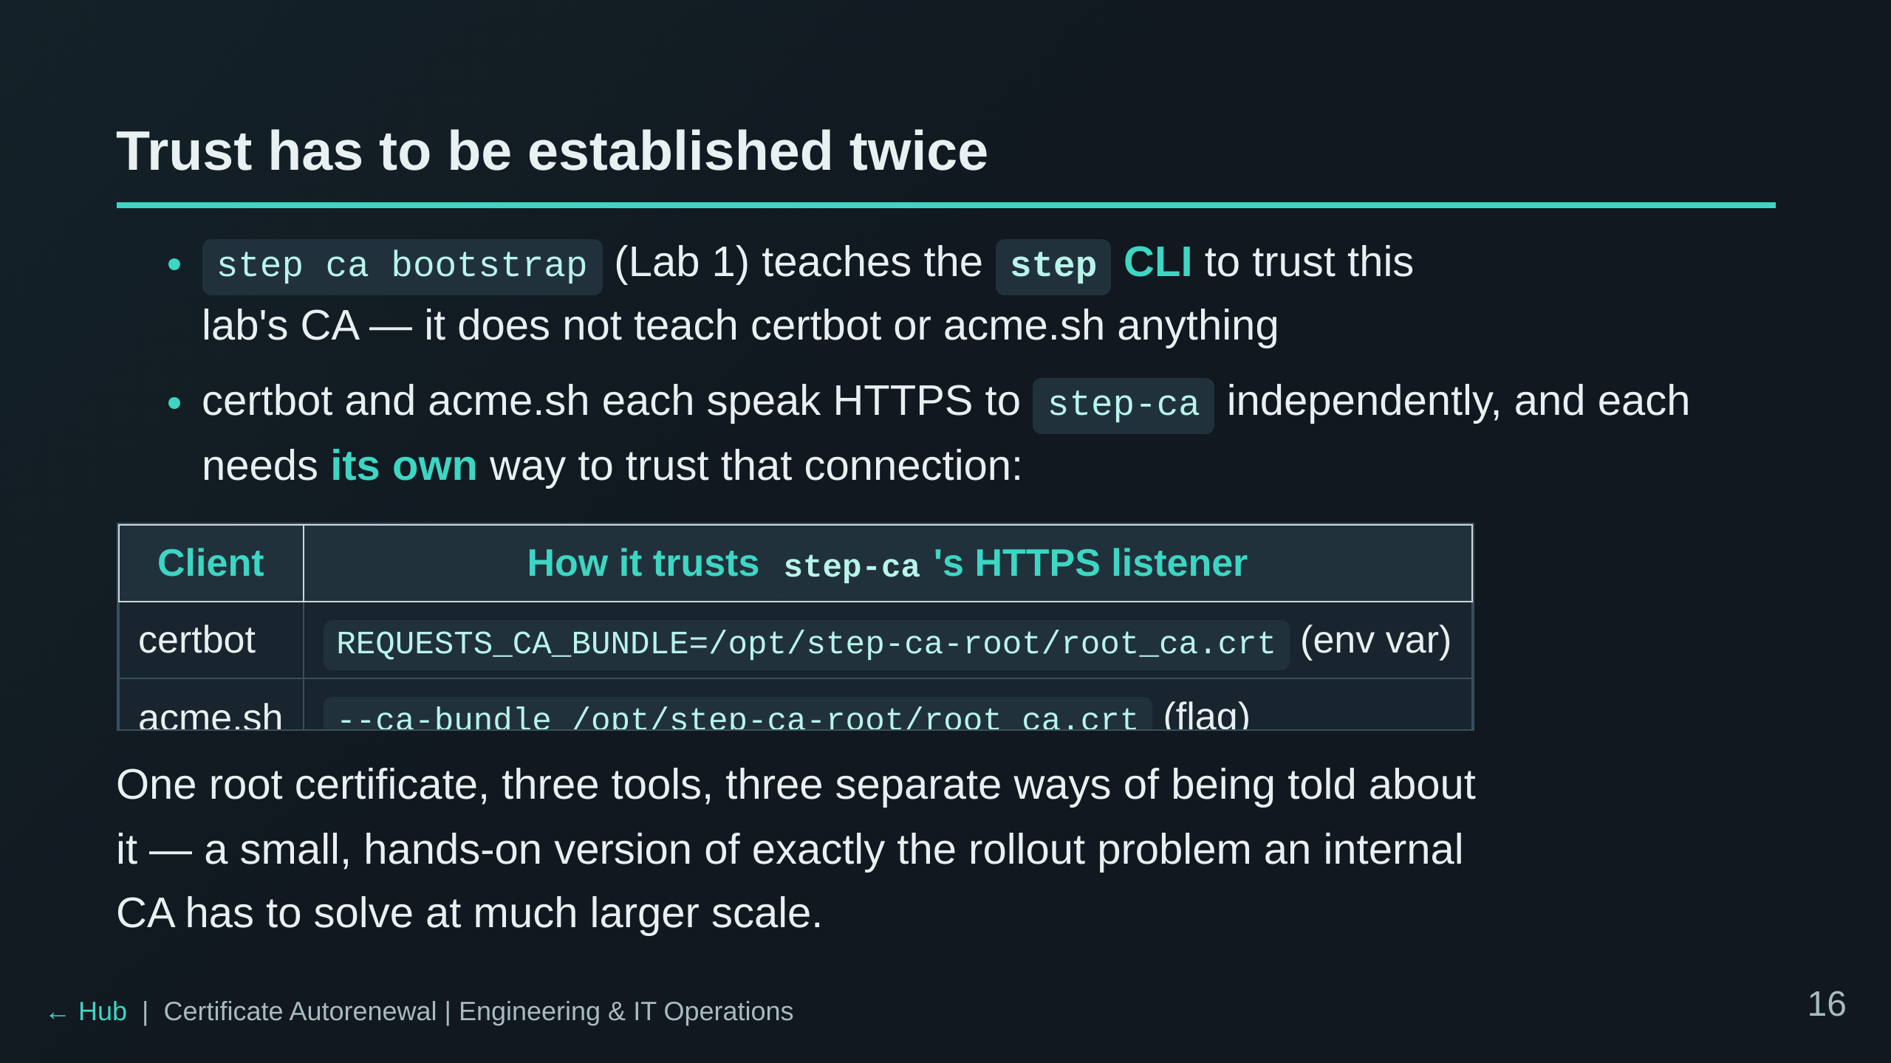

Slide 17
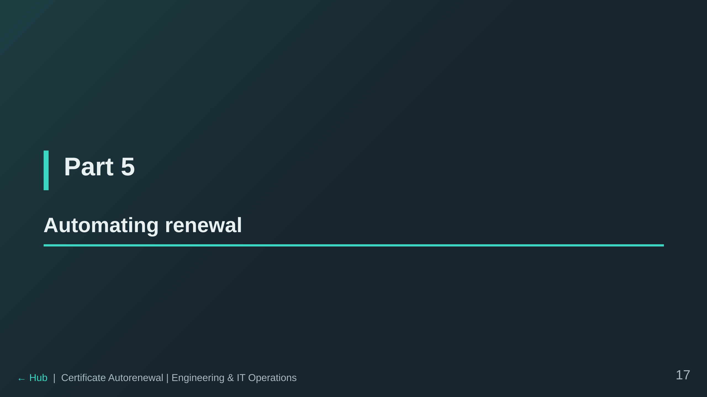

Slide 18
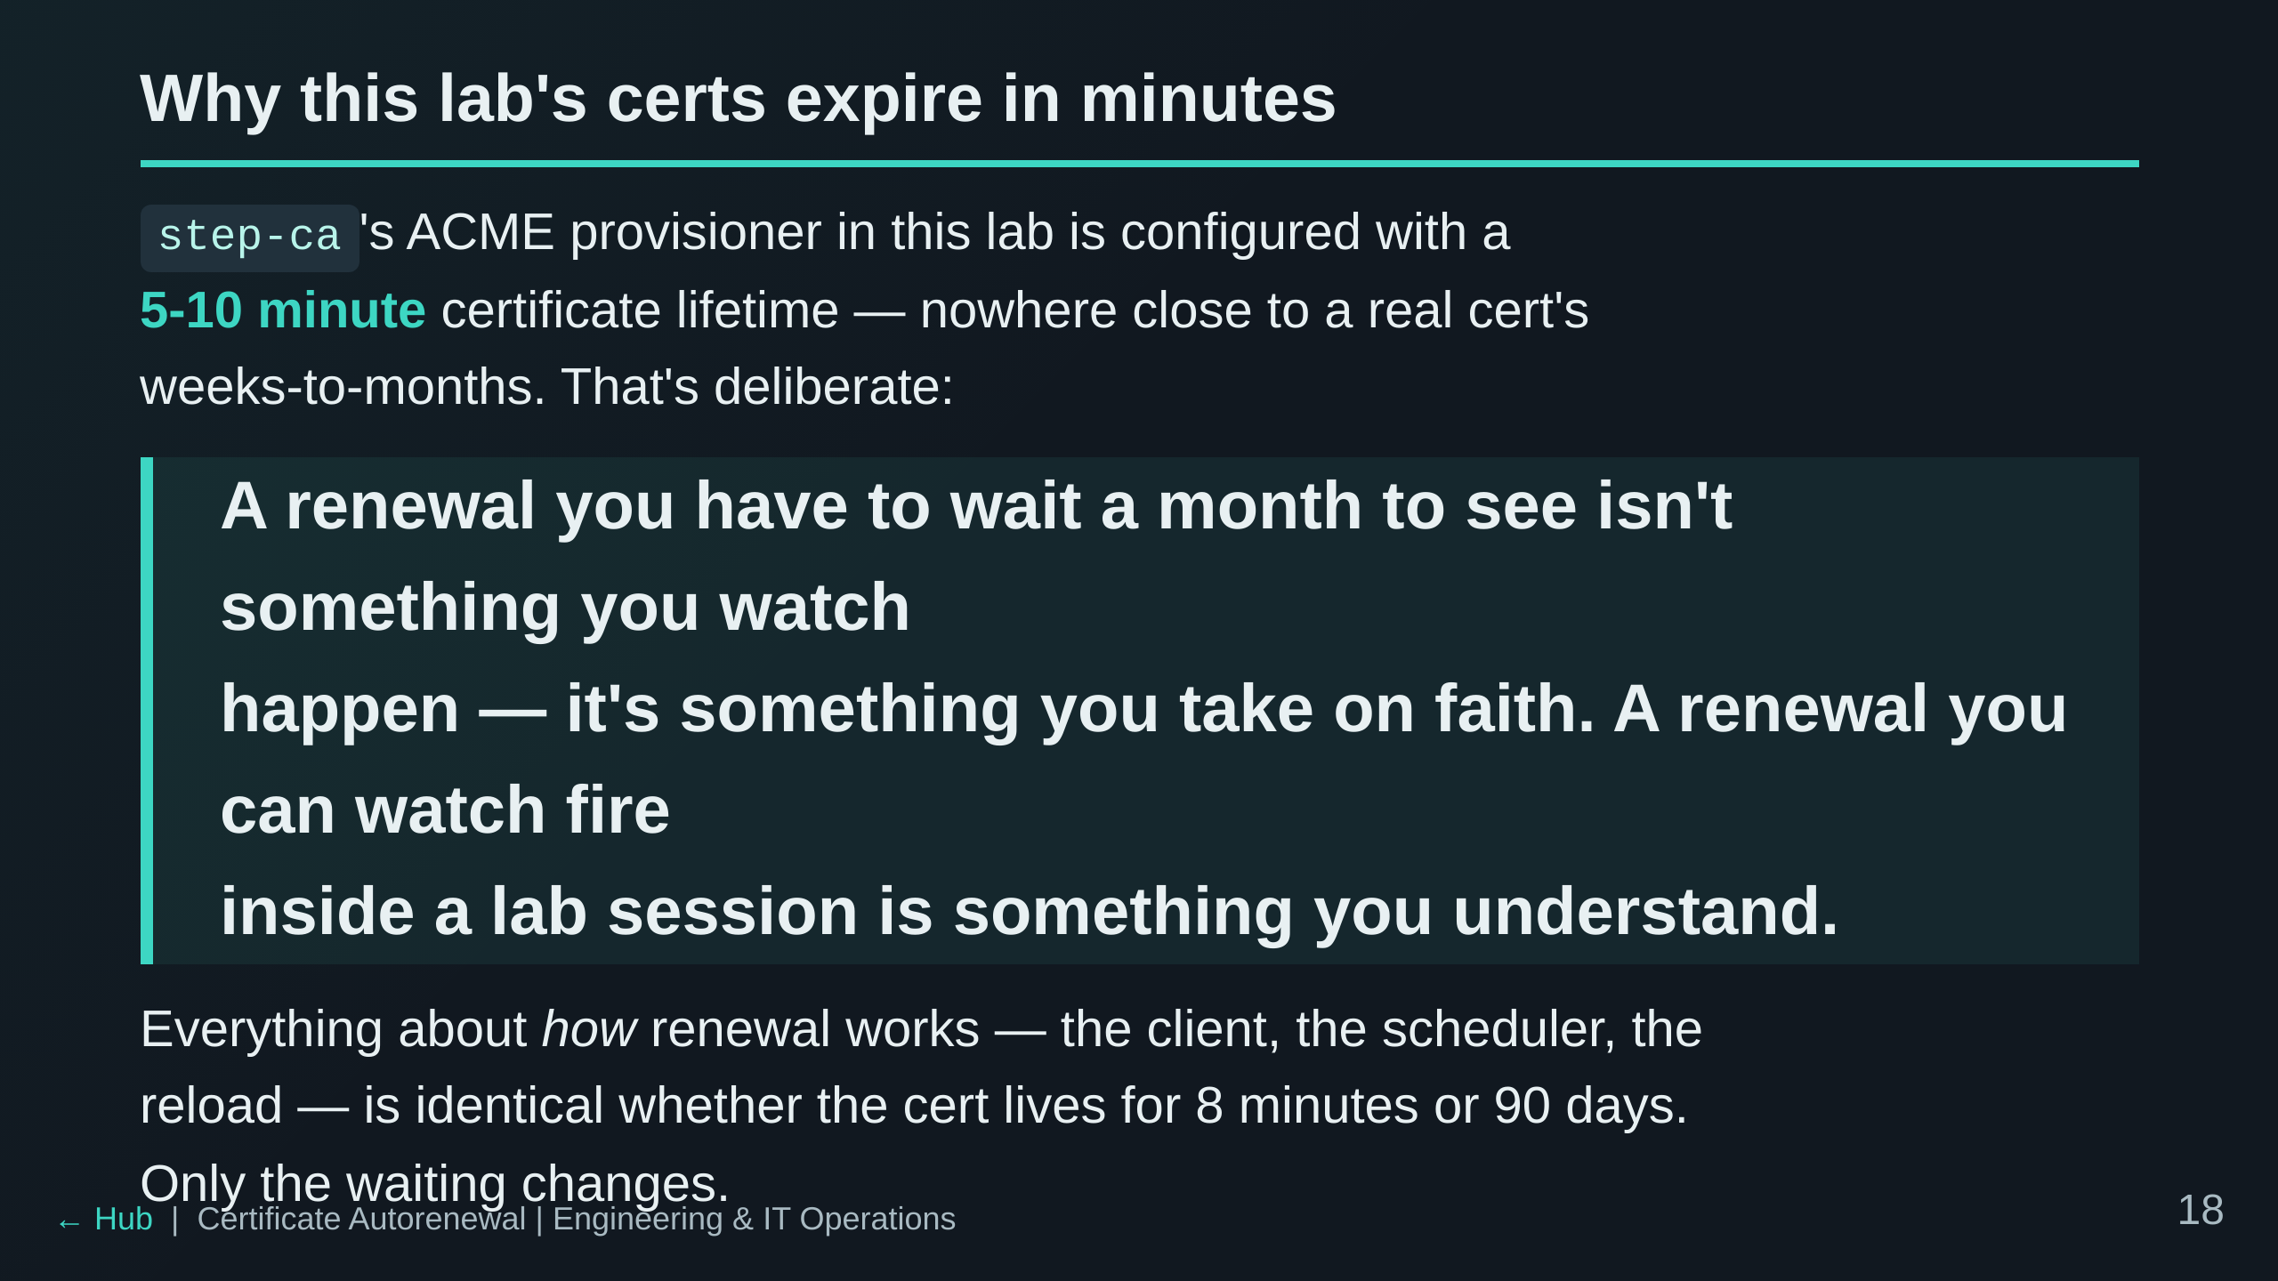

Slide 19
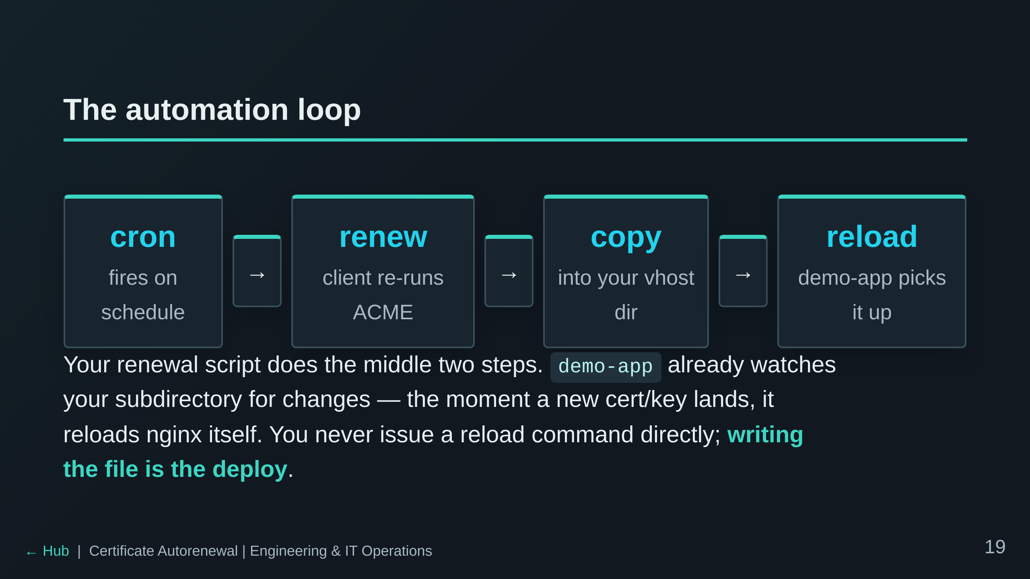

Slide 20
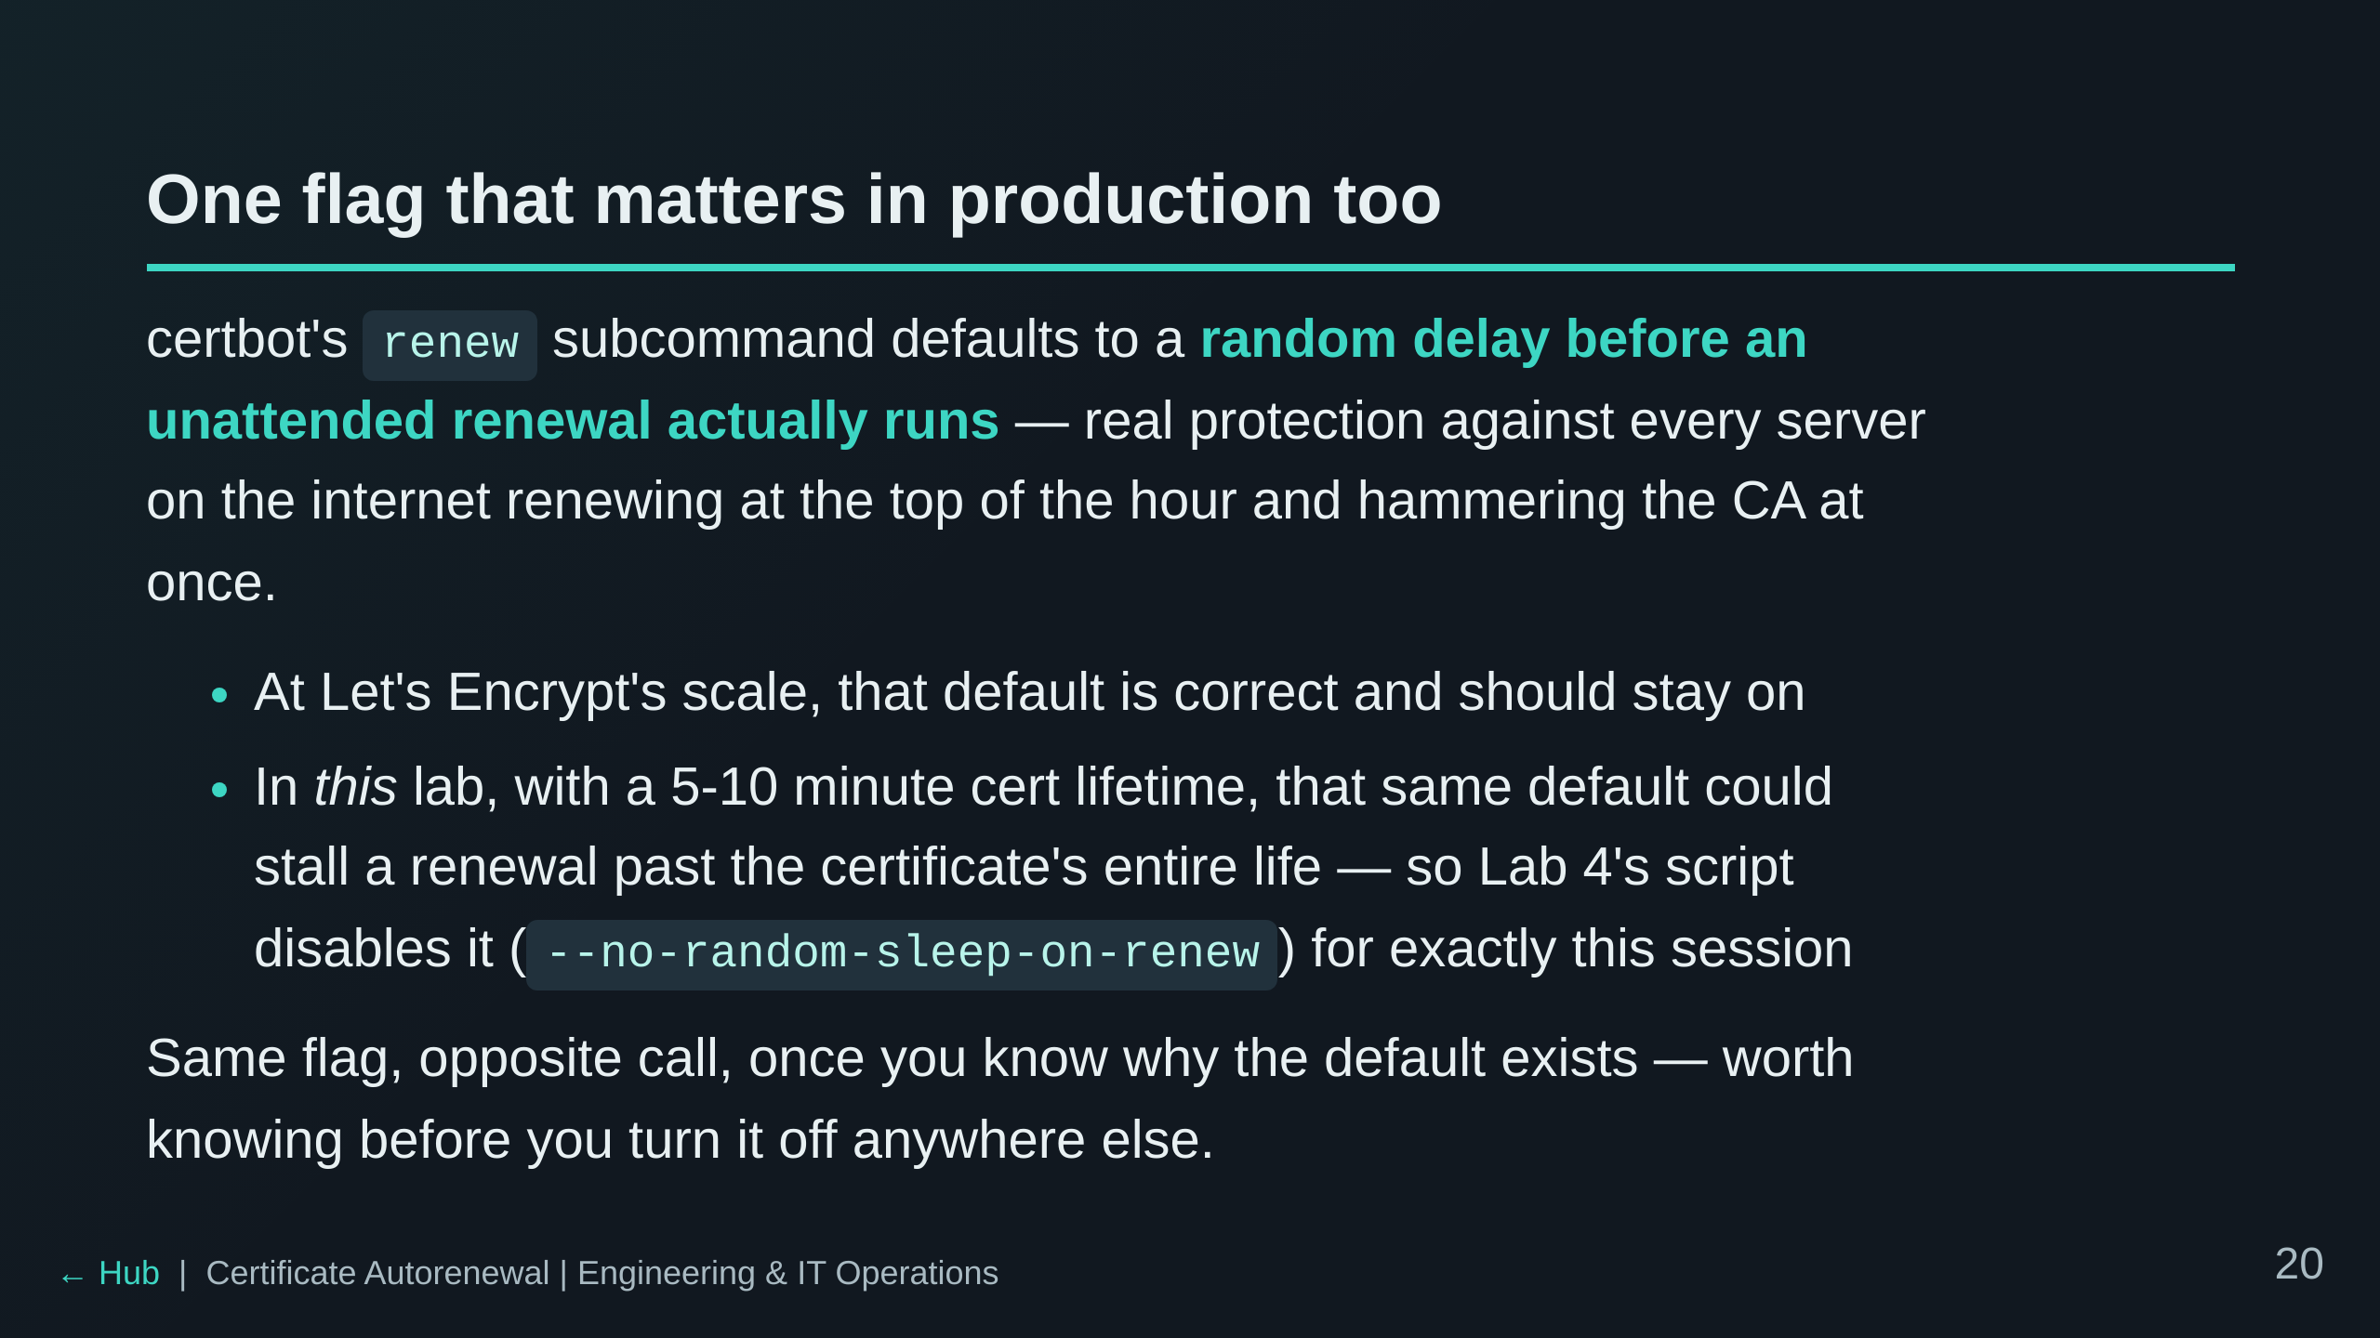

Slide 21
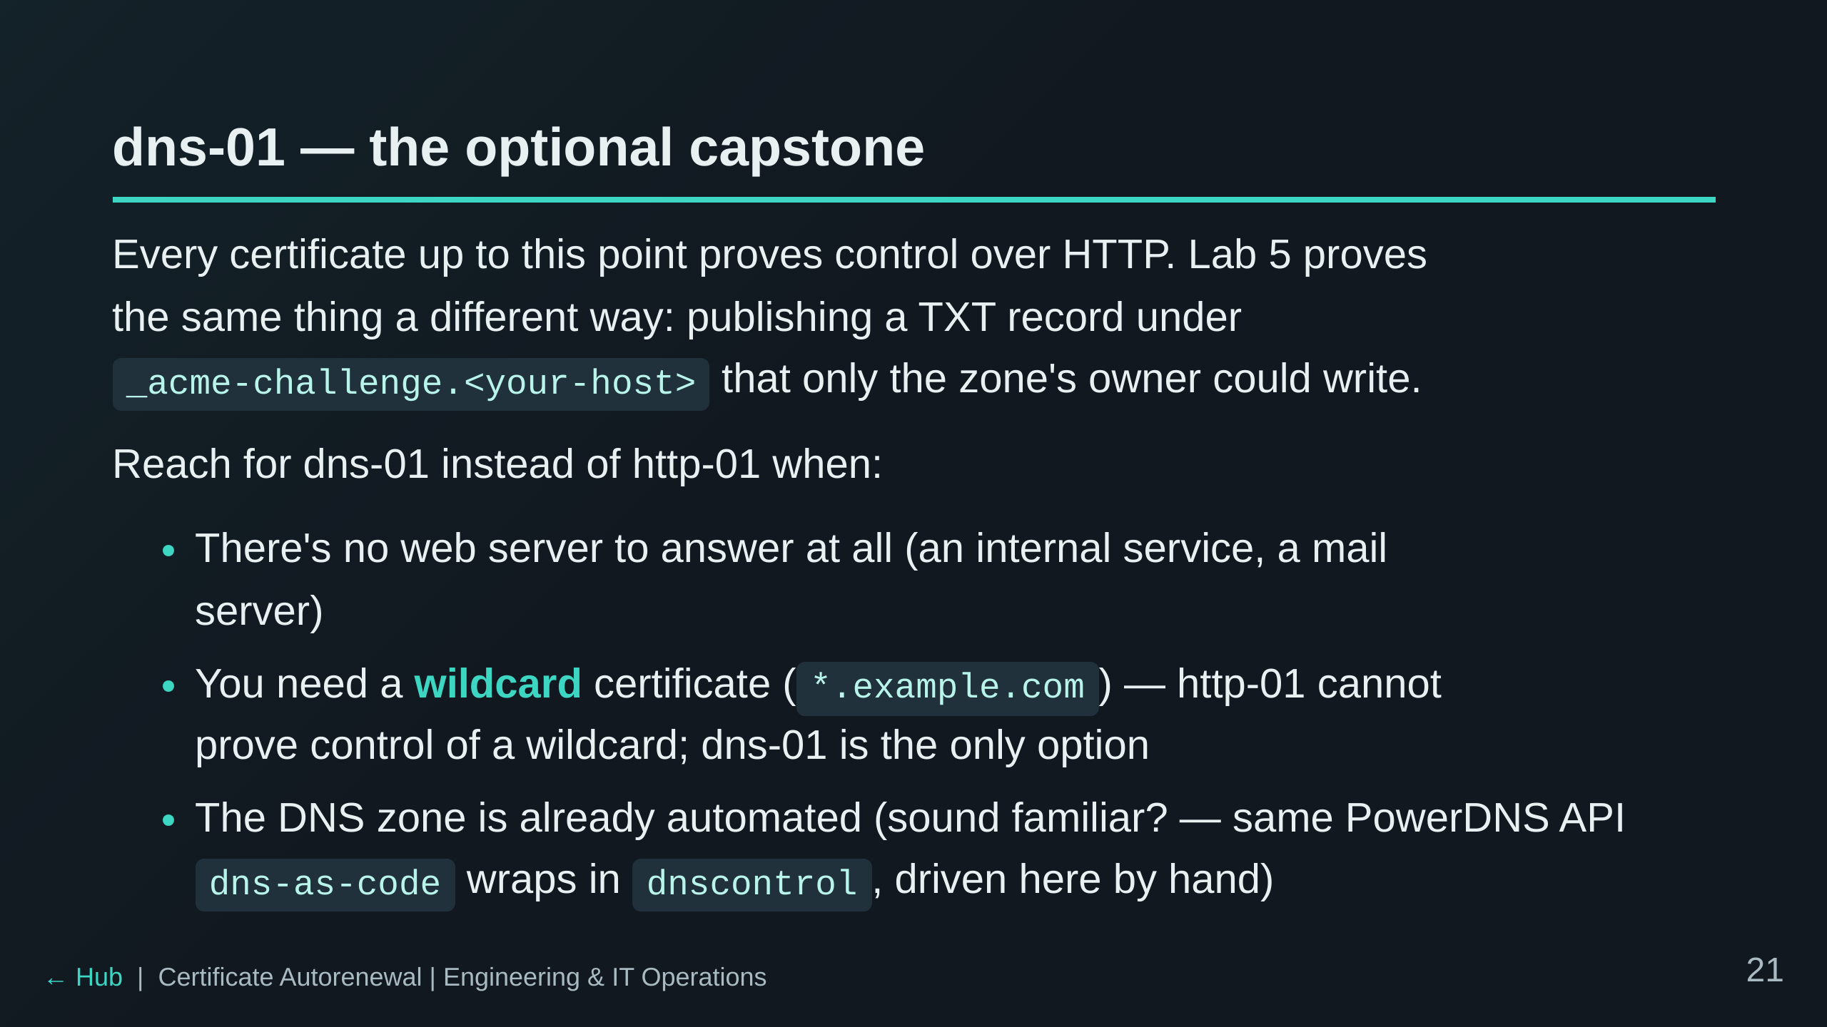

Slide 22
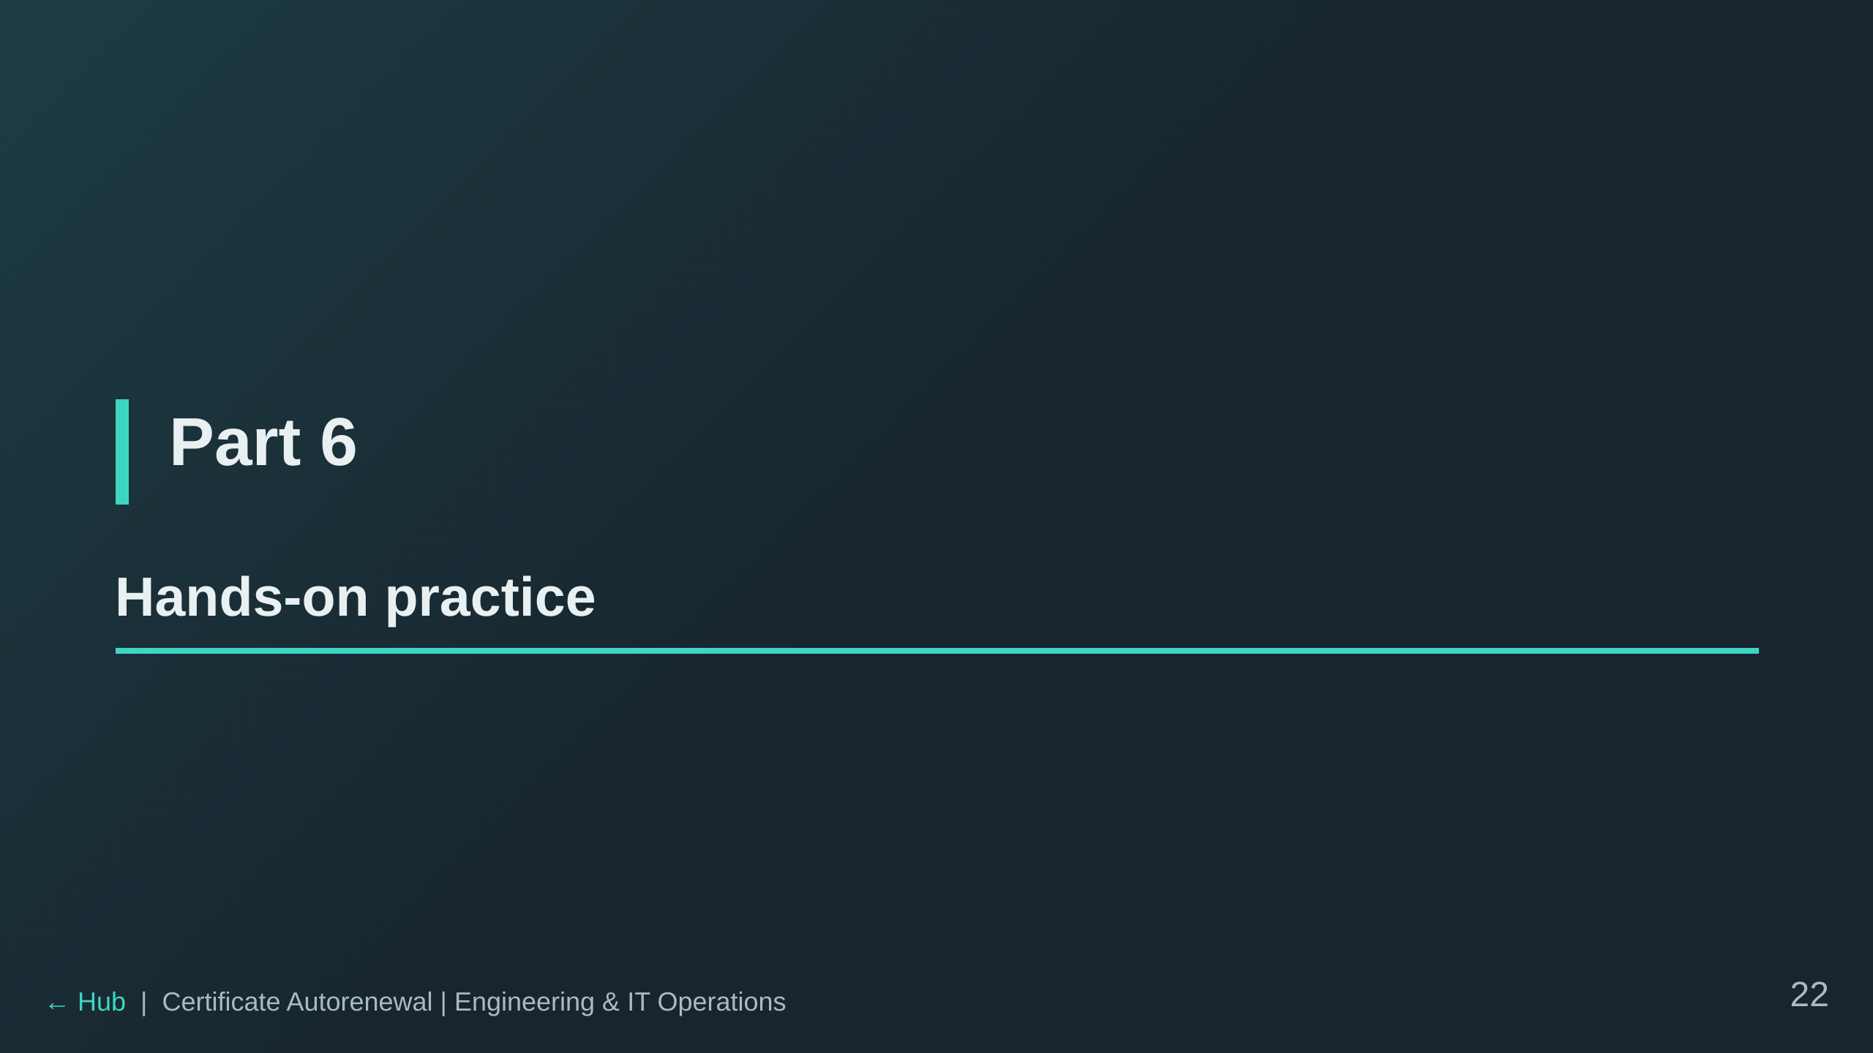

Slide 23
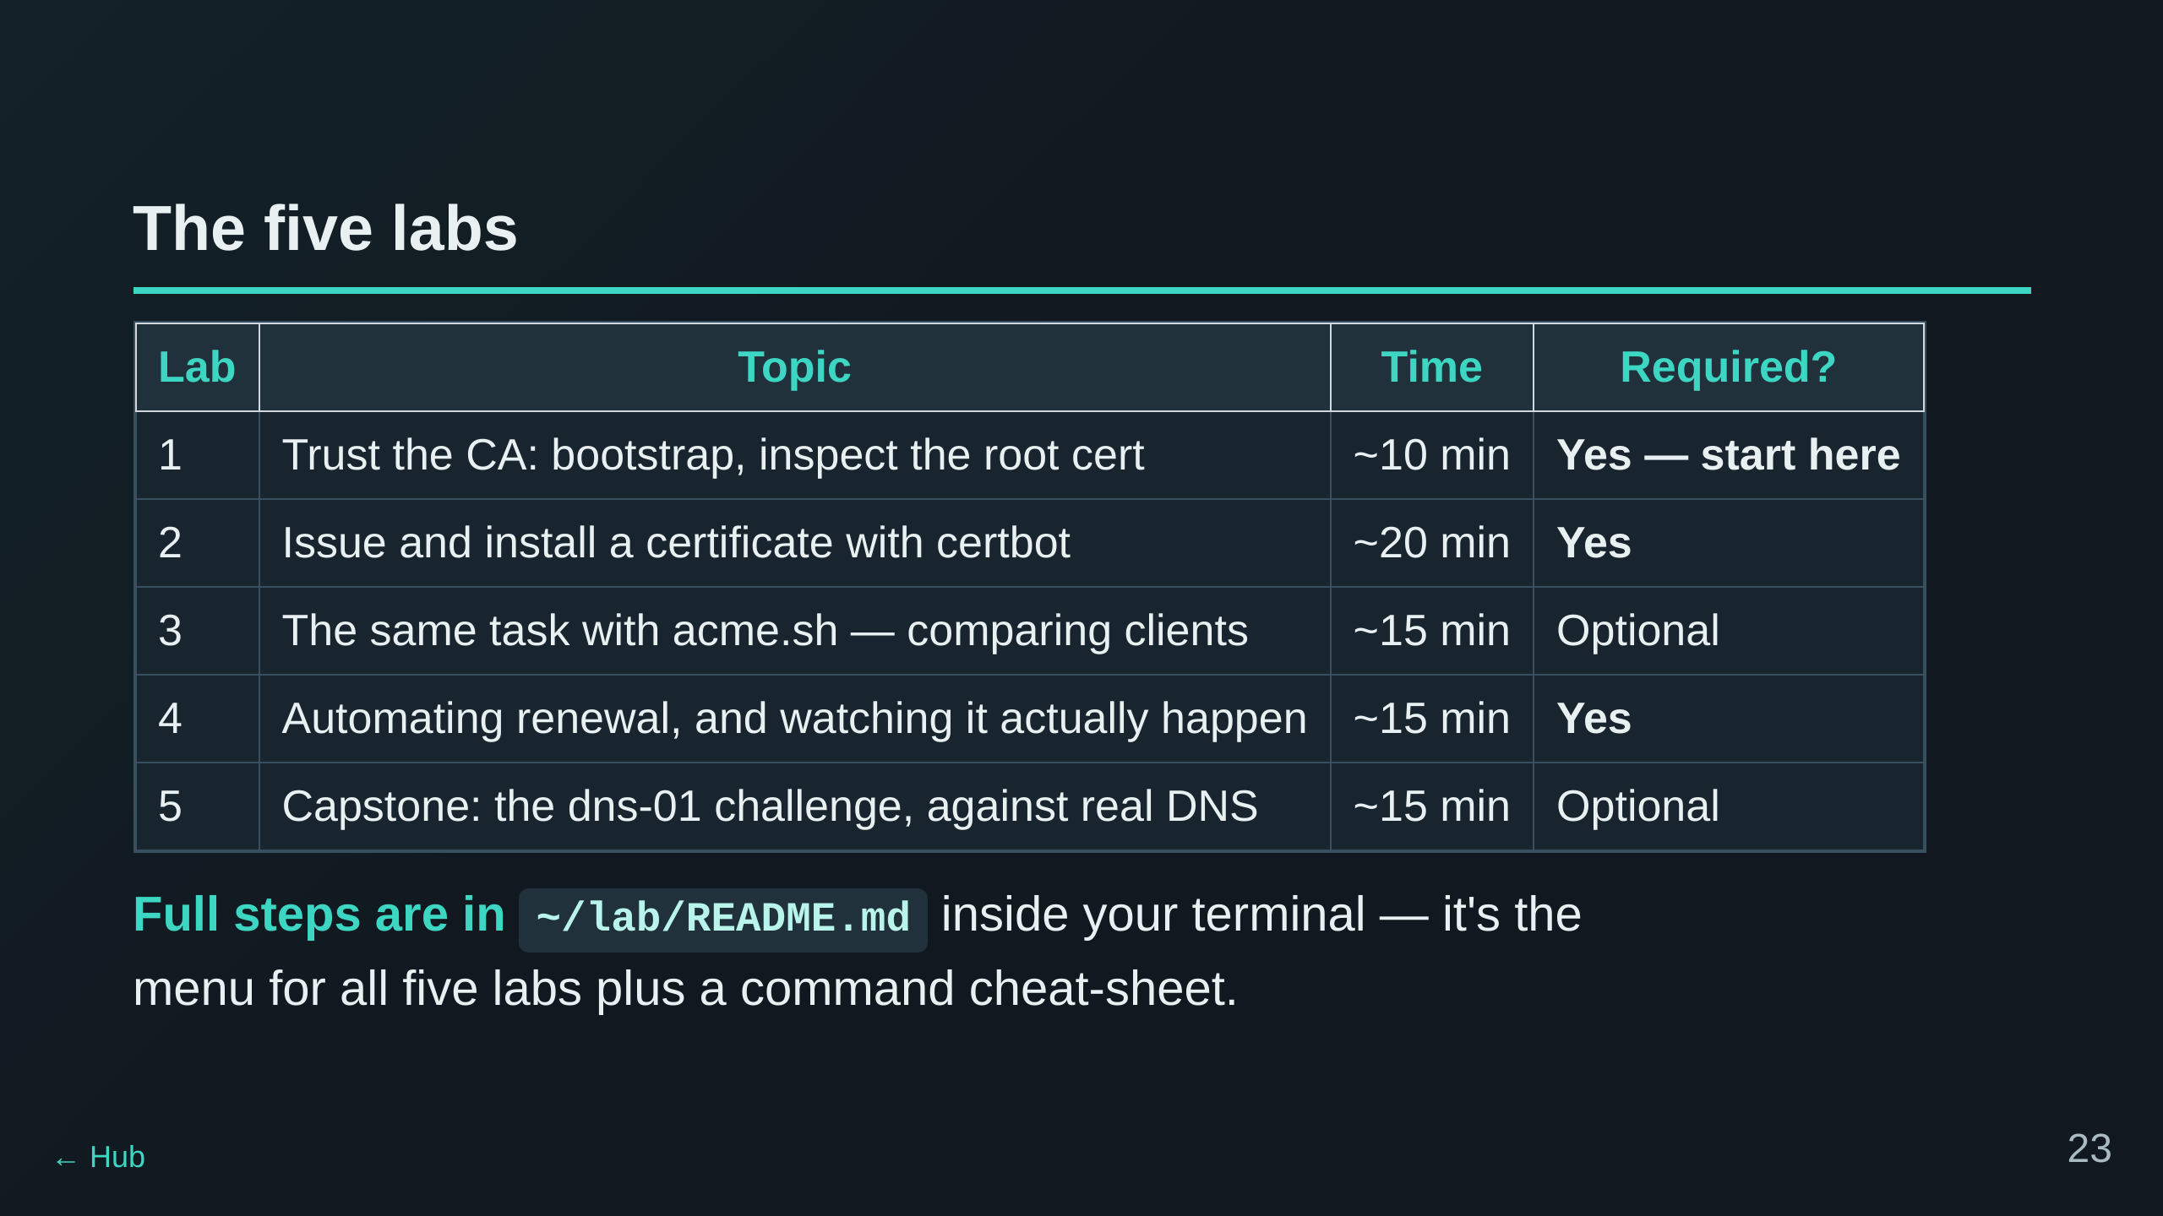

Slide 24


