Slide 1
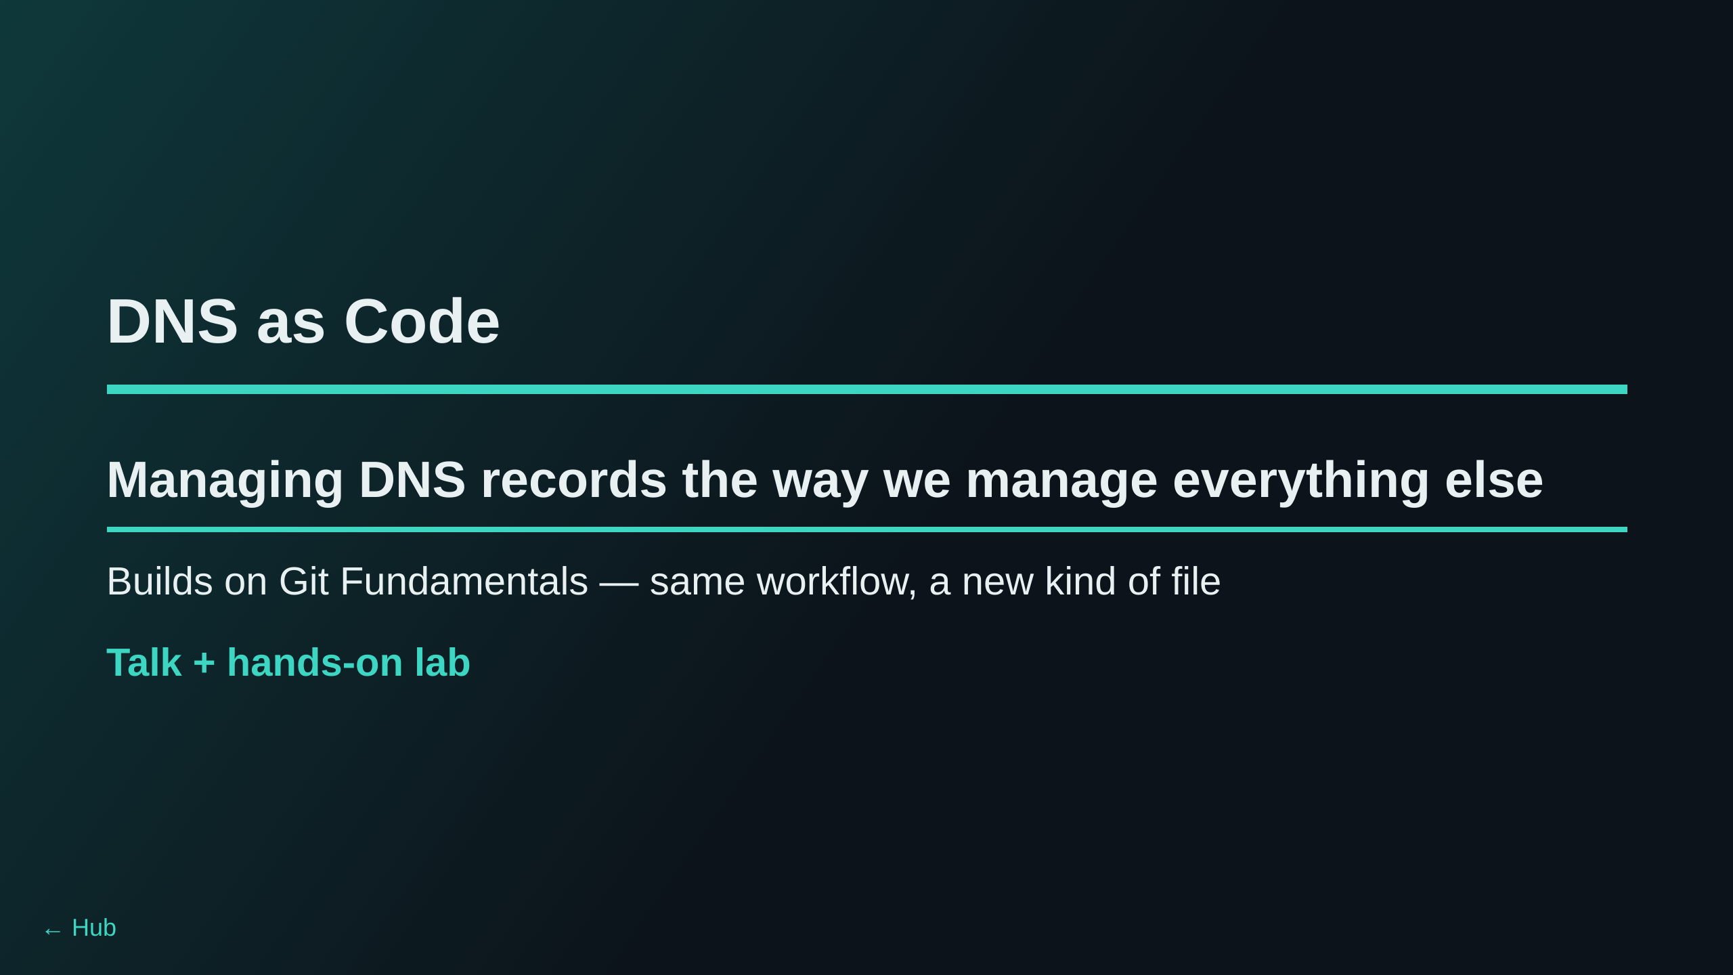
Notes:
Assumes the room already did the Git Fundamentals session (or already
knows clone/branch/commit/push/PR). This is that same muscle memory
applied to a system most attendees currently change by clicking around a
web console.

Slide 2
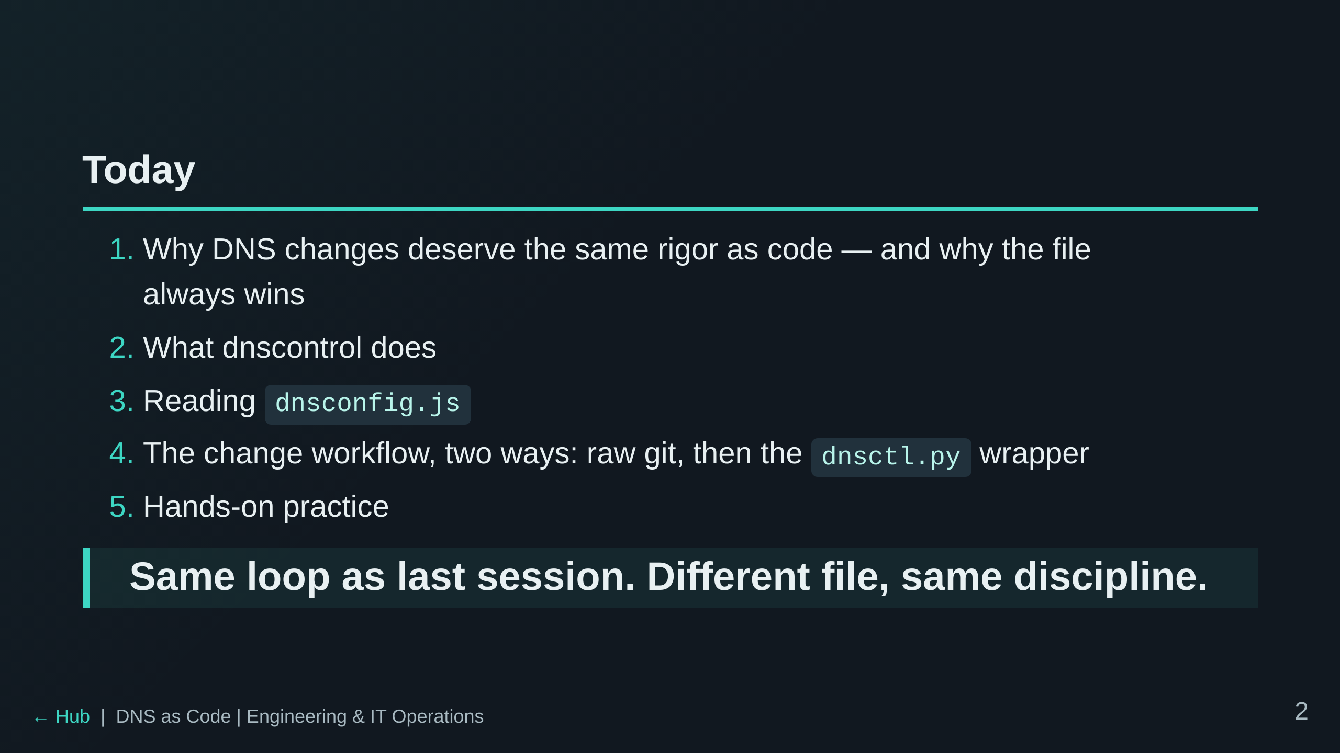

Slide 3
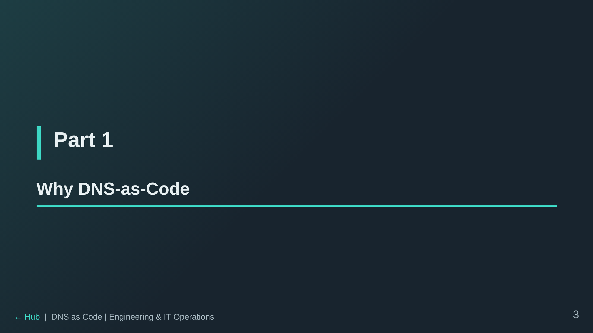

Slide 4
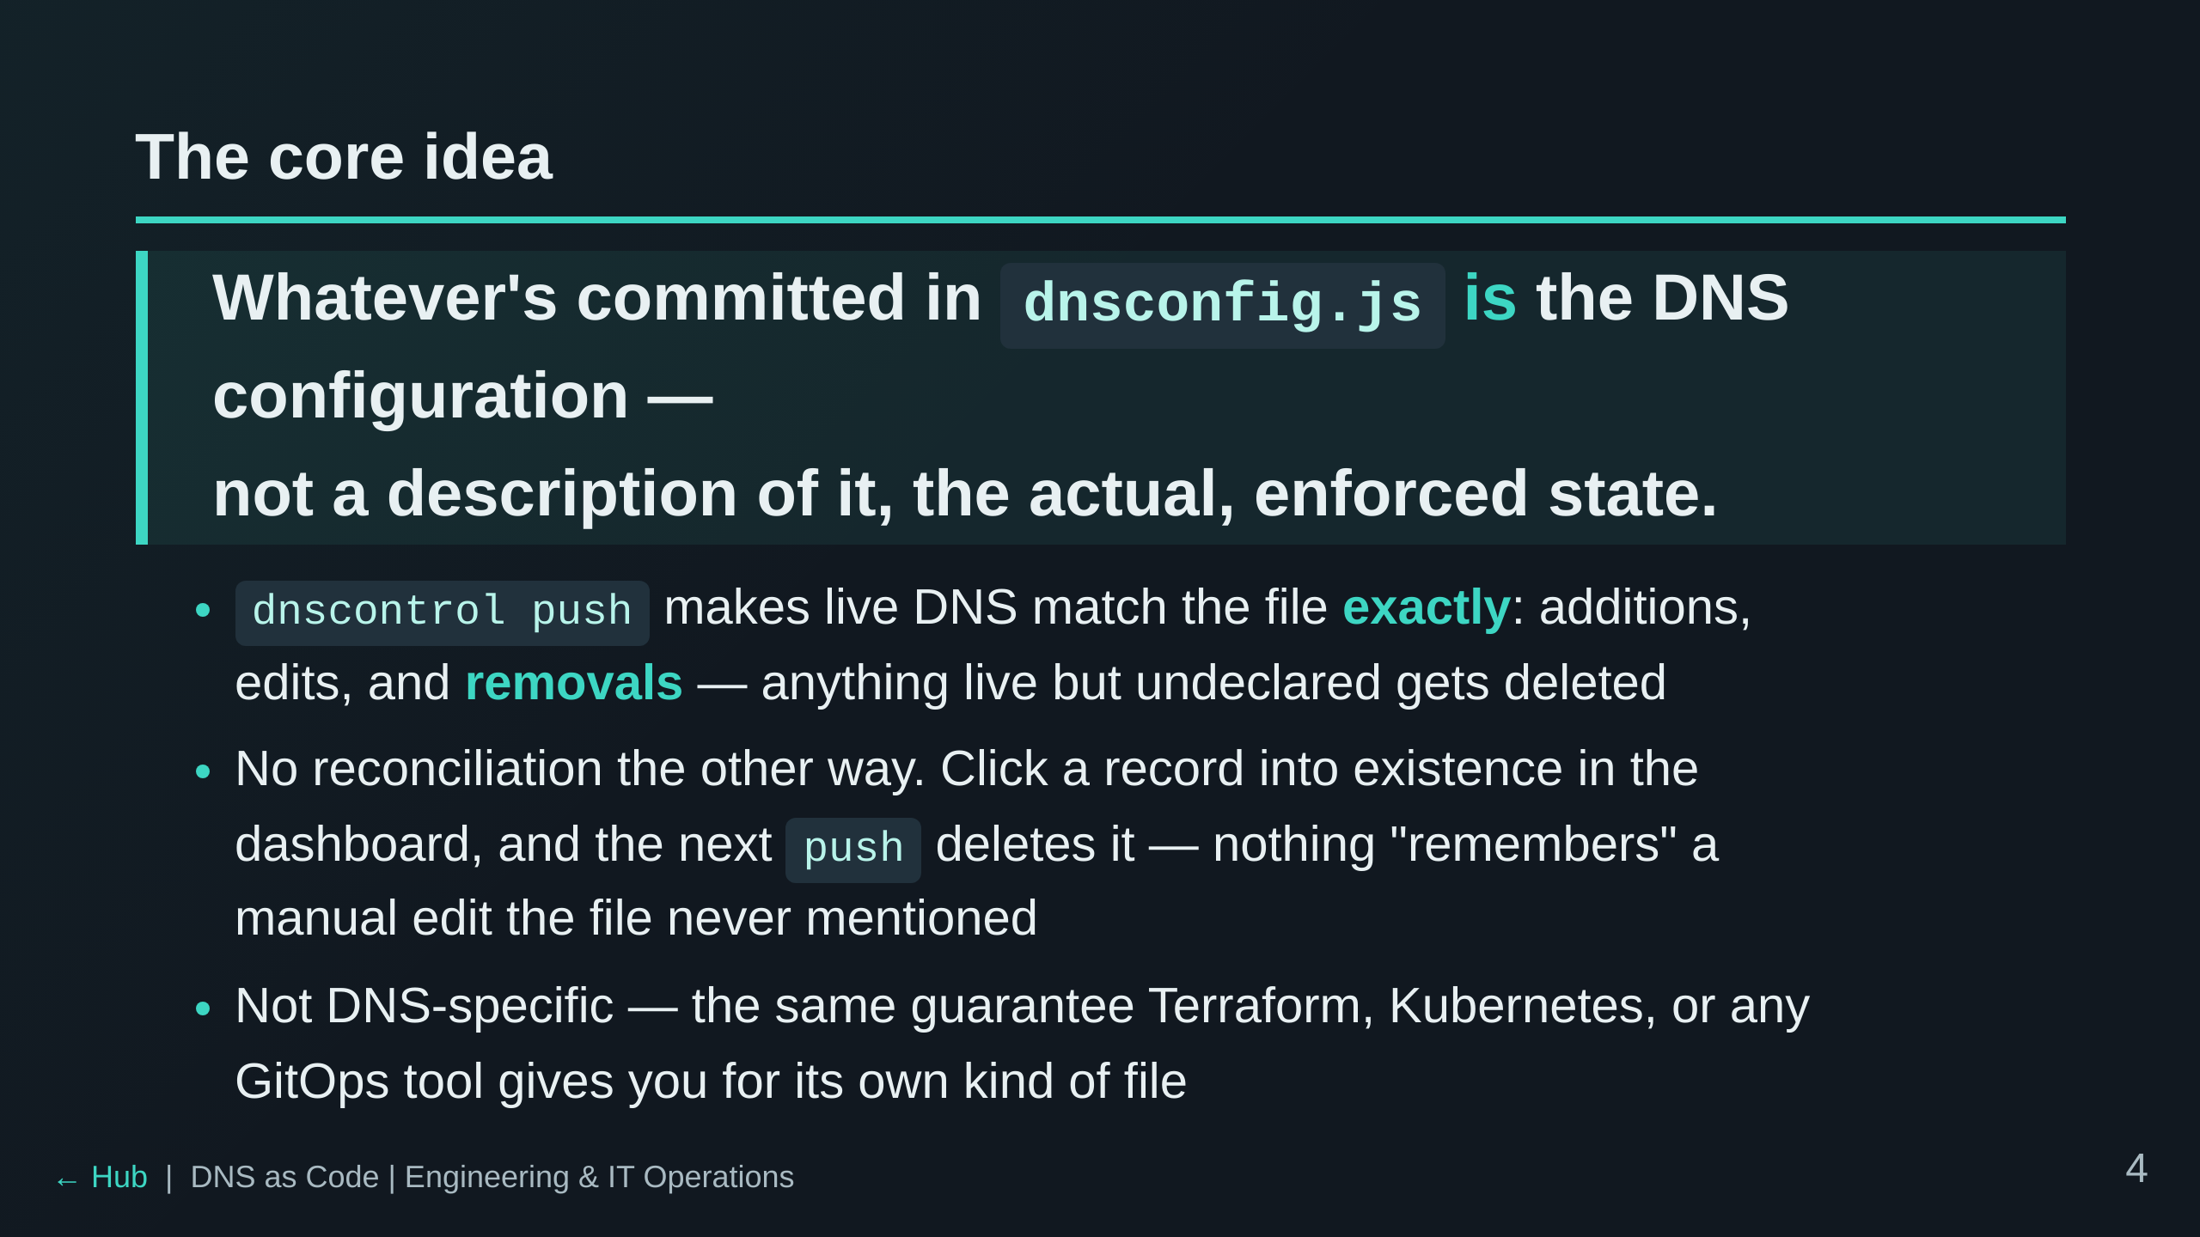
Notes:
The dashboard isn't a second way to make changes anymore. It's not a
way to make changes at all.
This reframes the whole session: everything that follows (preview/push,
PRs, dnsctl.py) is just tooling built on top of this one guarantee. Worth
pausing on questions here if the room has them — this is the idea that
makes "why review every diff" and "why did my dashboard click disappear"
both make sense later.

Slide 5
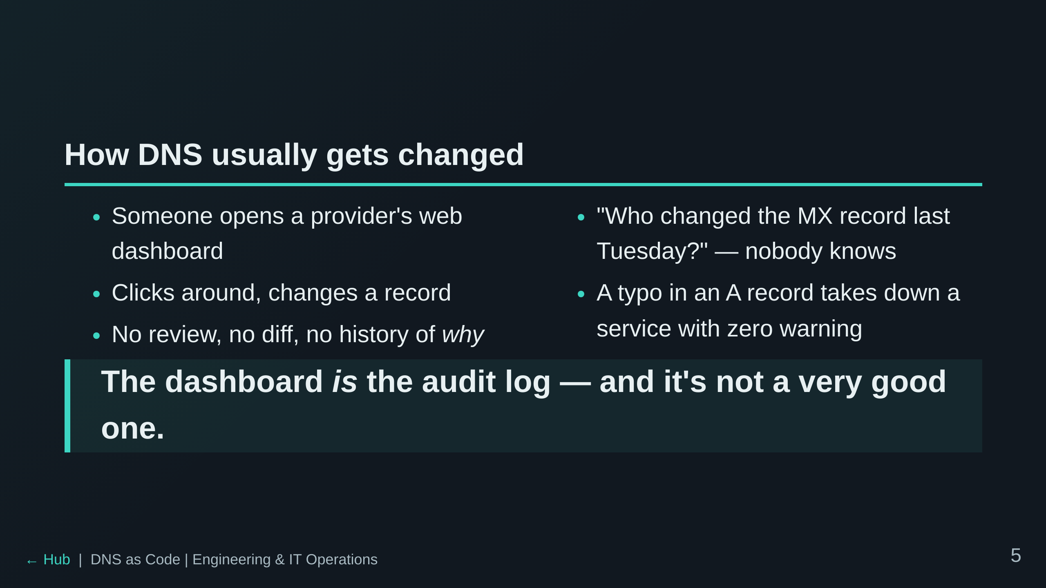

Slide 6
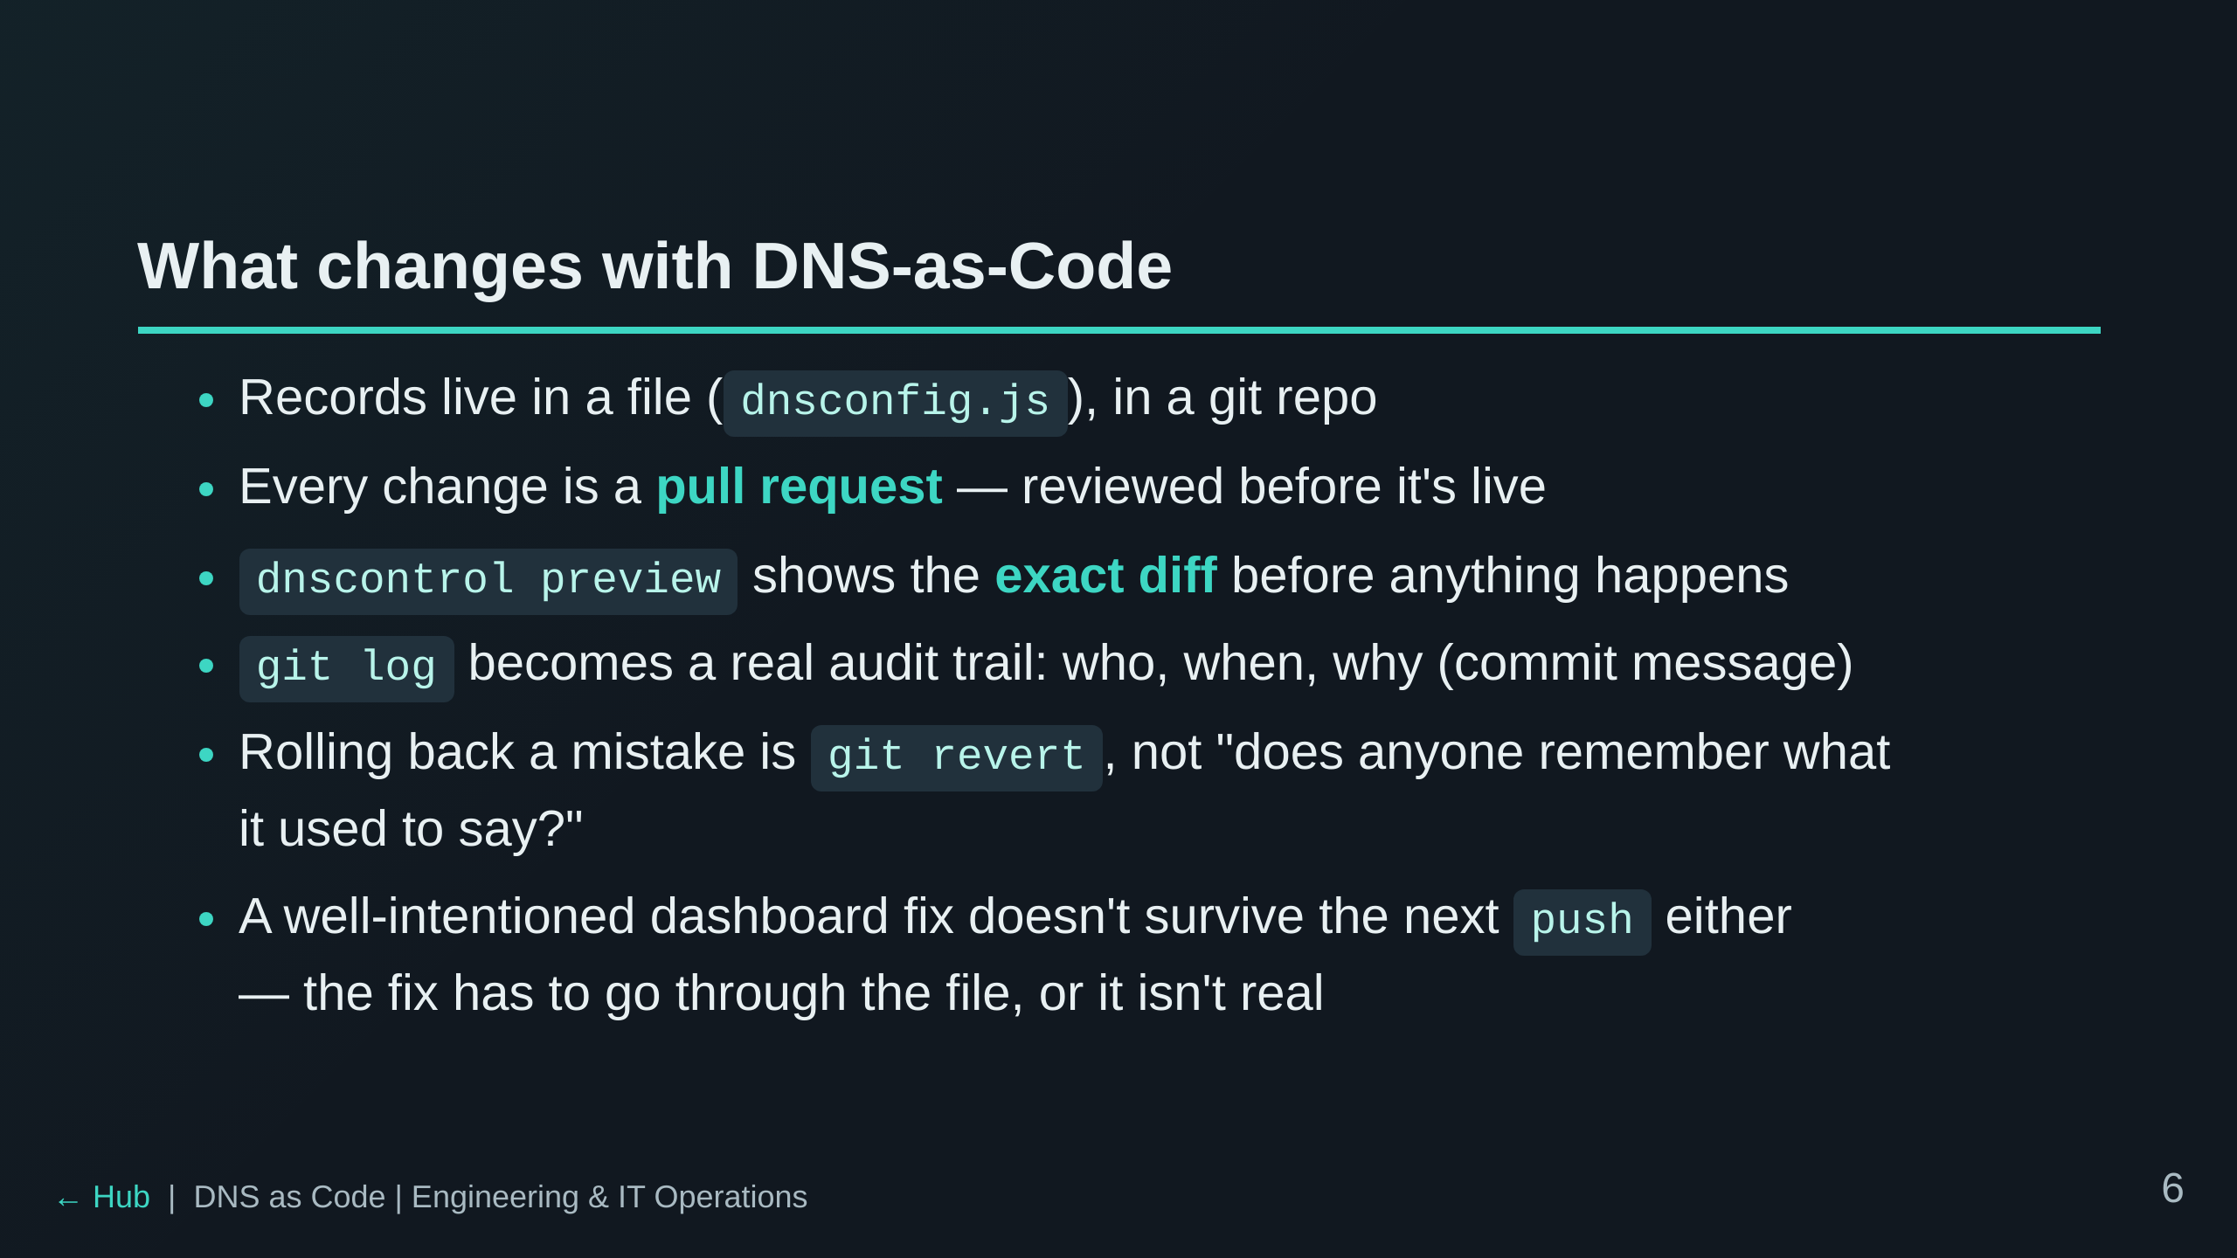
Notes:
This is the same case made for infrastructure-as-code generally, applied
to DNS specifically — DNS is infrastructure, and it's usually the
least-reviewed part of it.

Slide 7
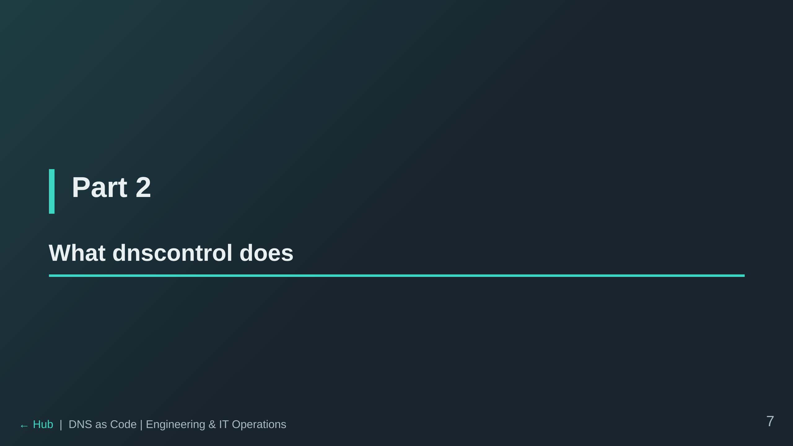

Slide 8
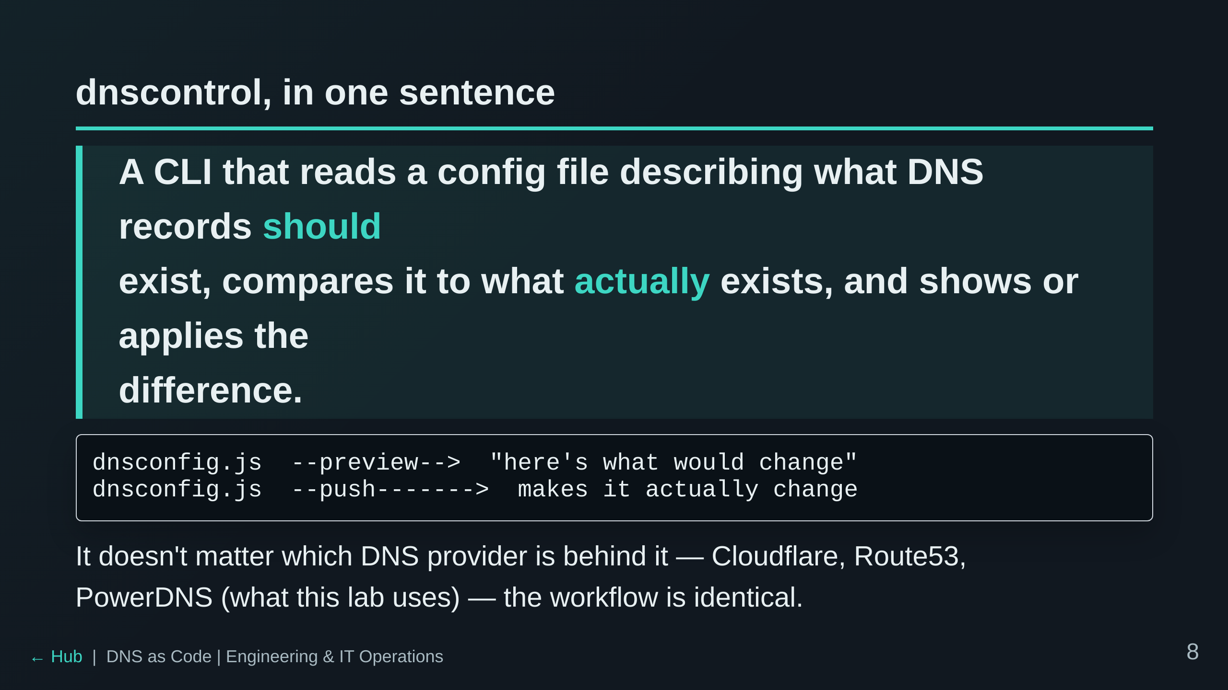

Slide 9
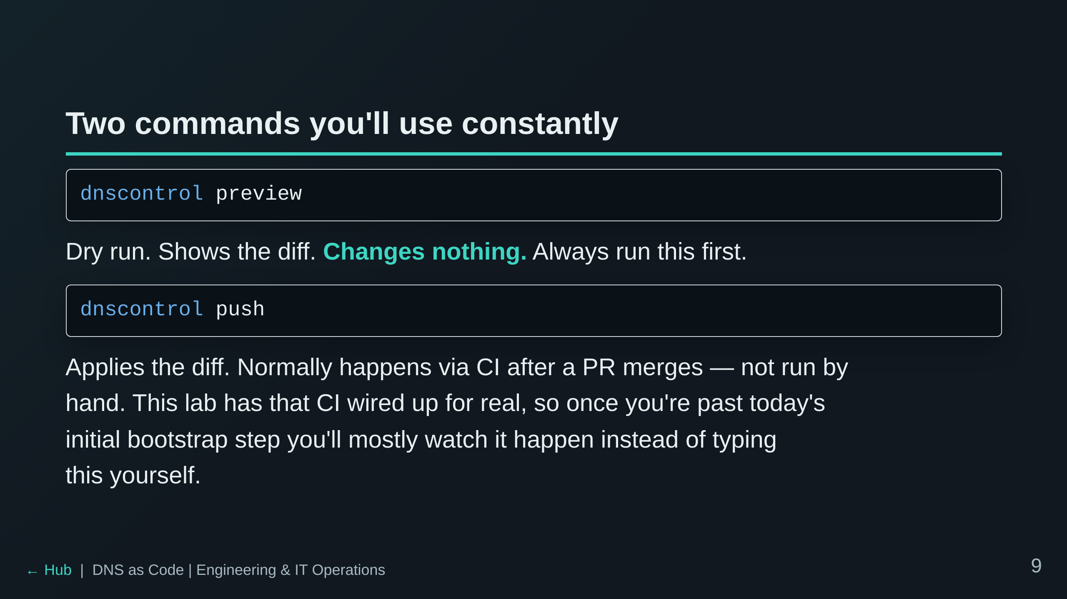

Slide 10
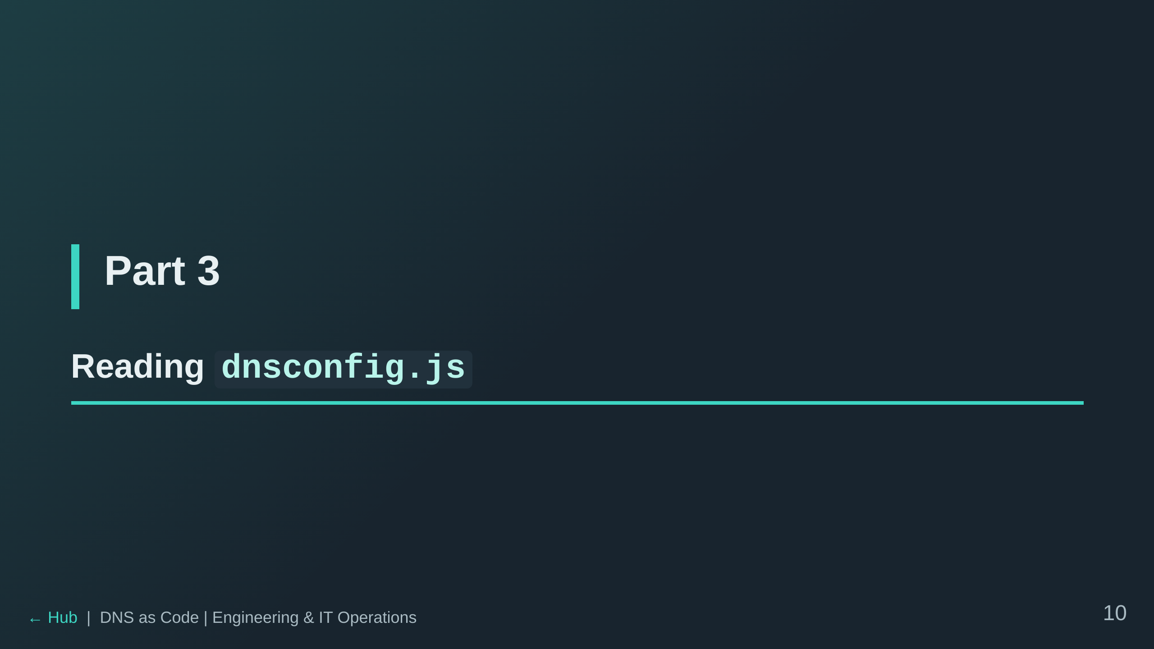

Slide 11
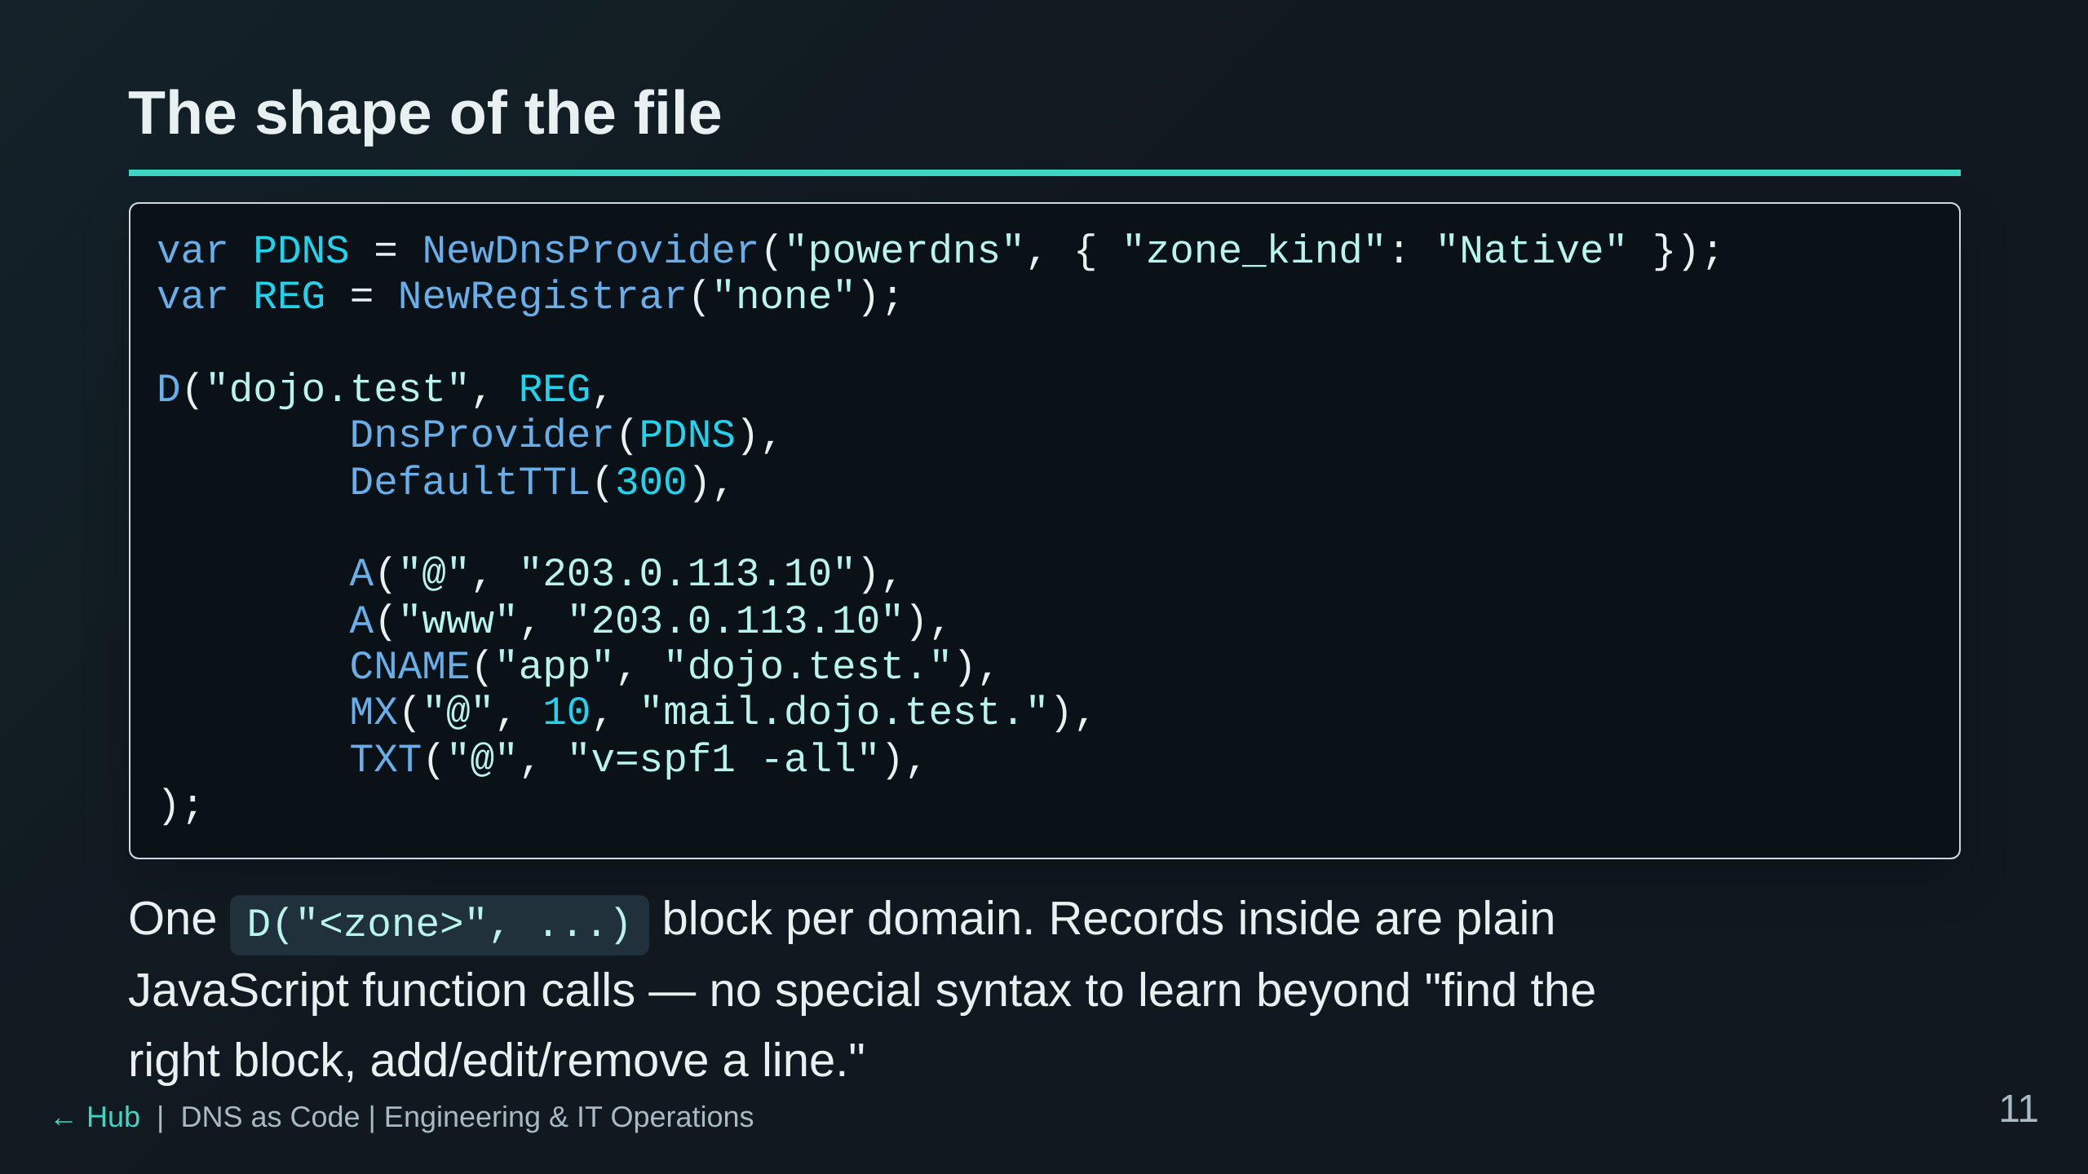

Slide 12
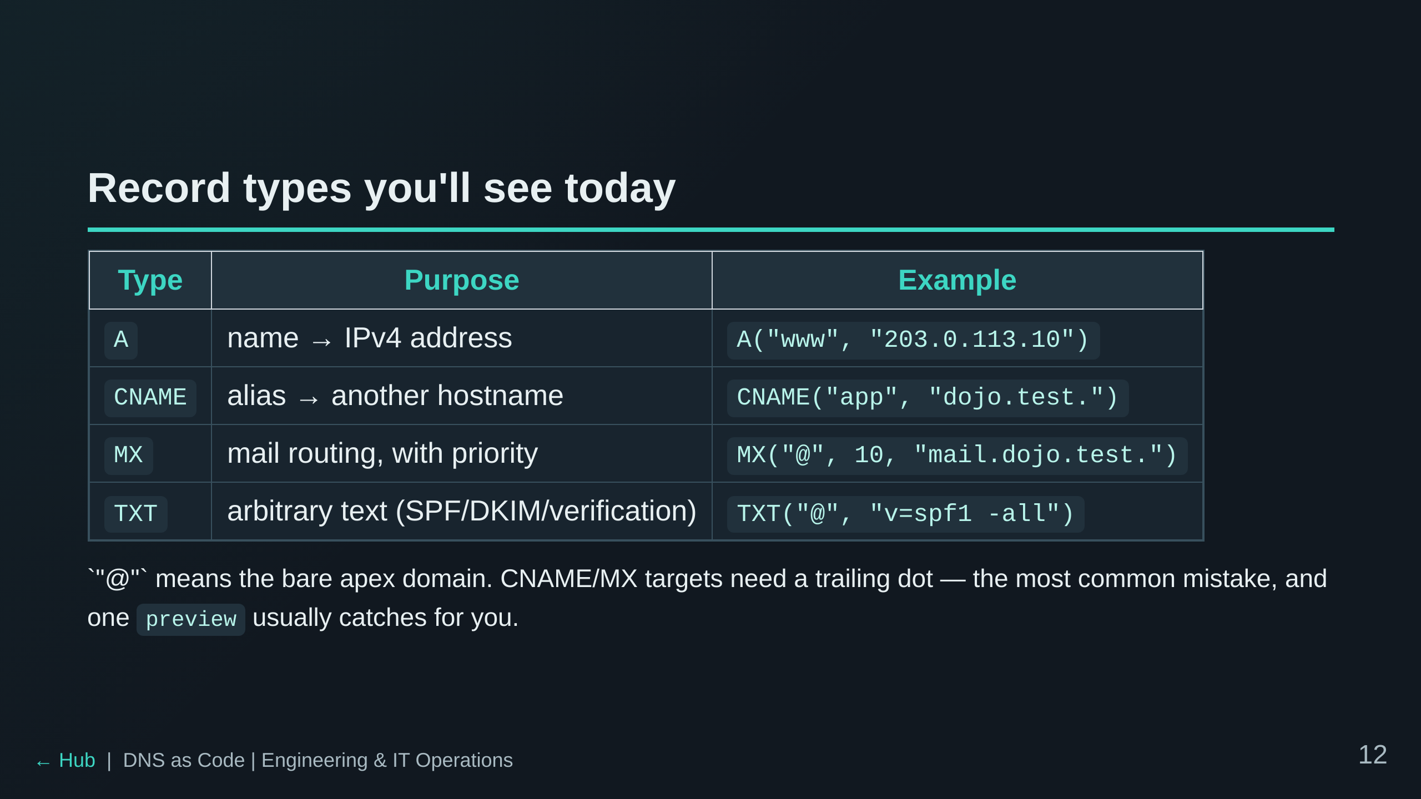

Slide 13
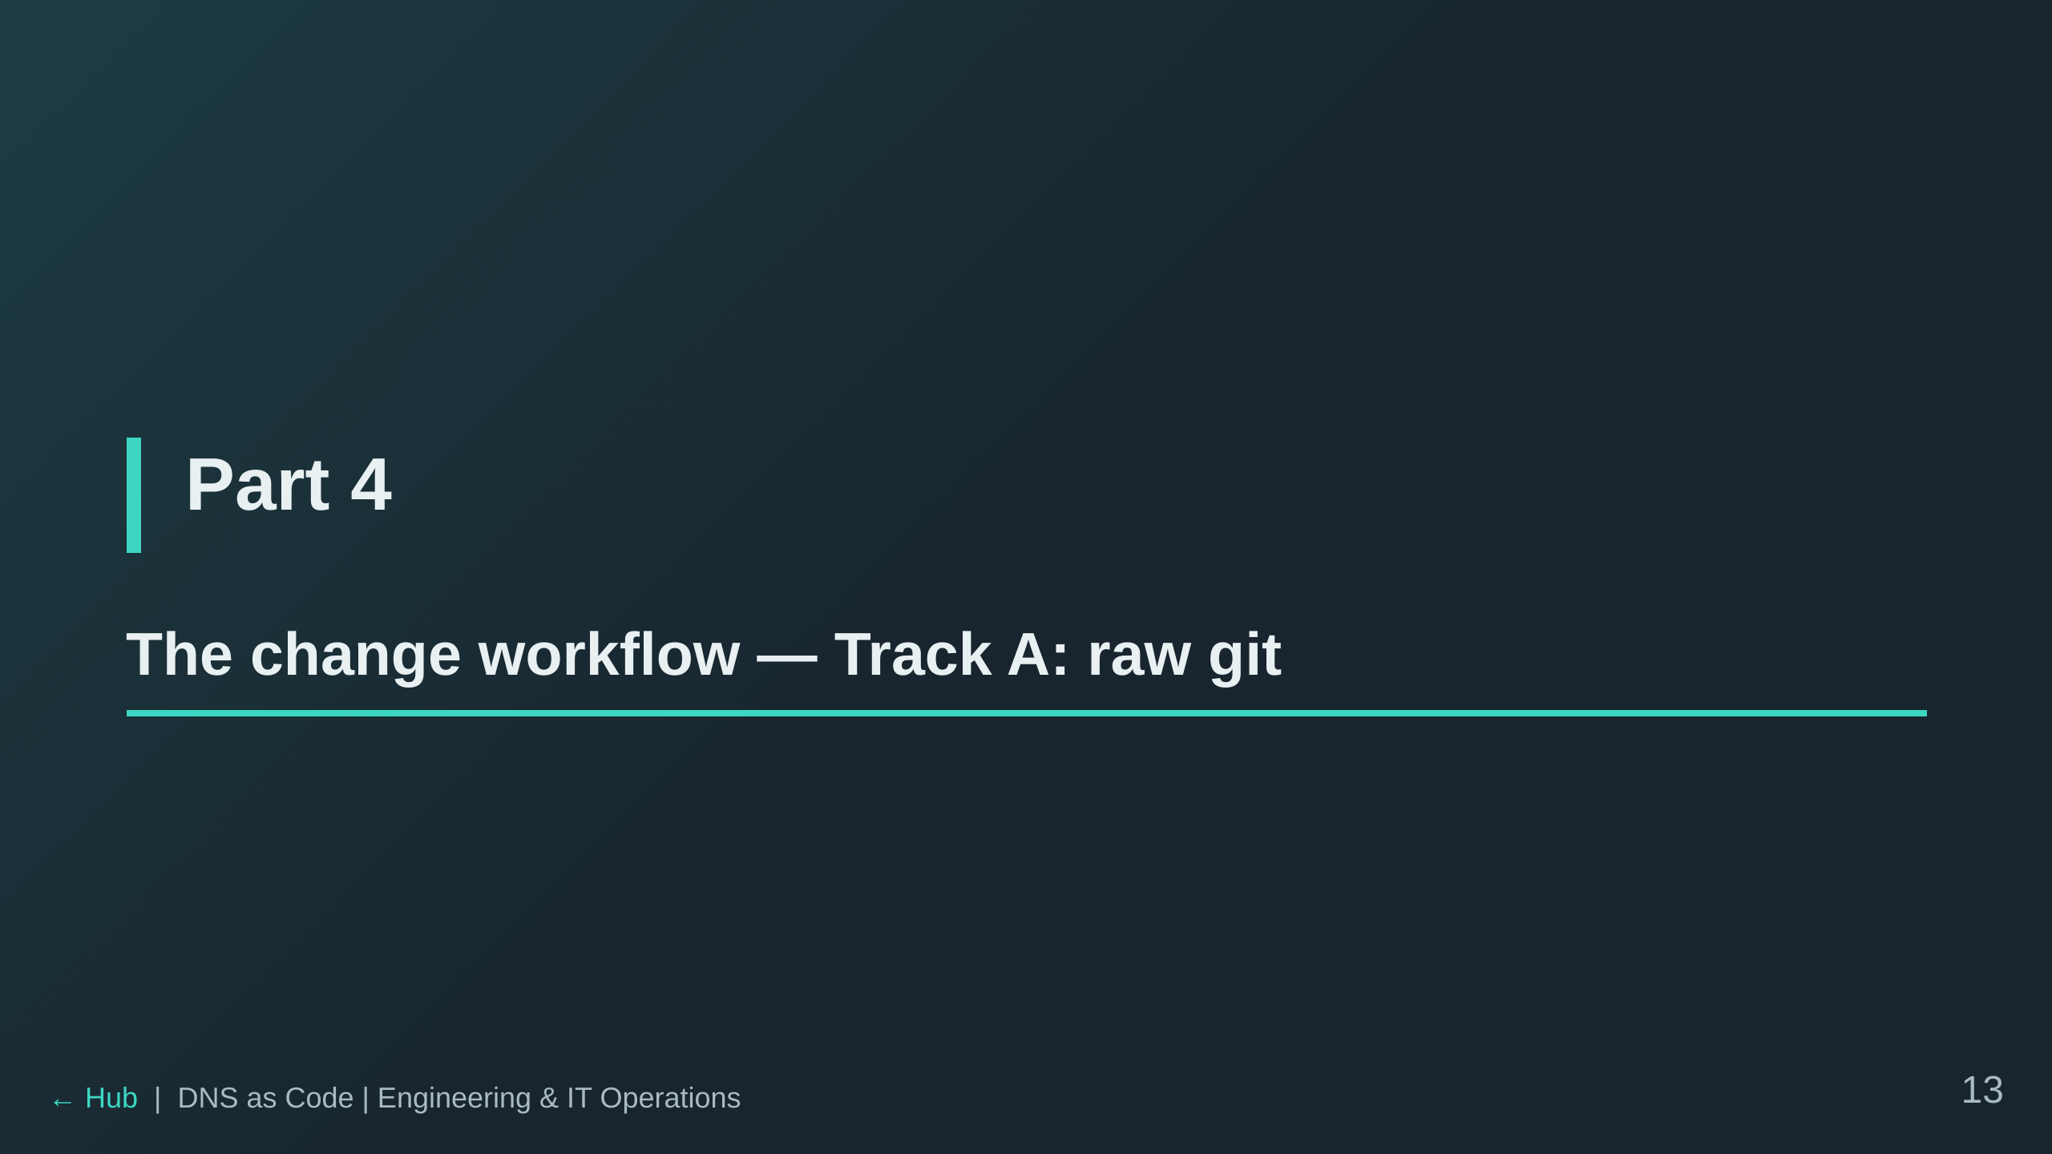

Slide 14
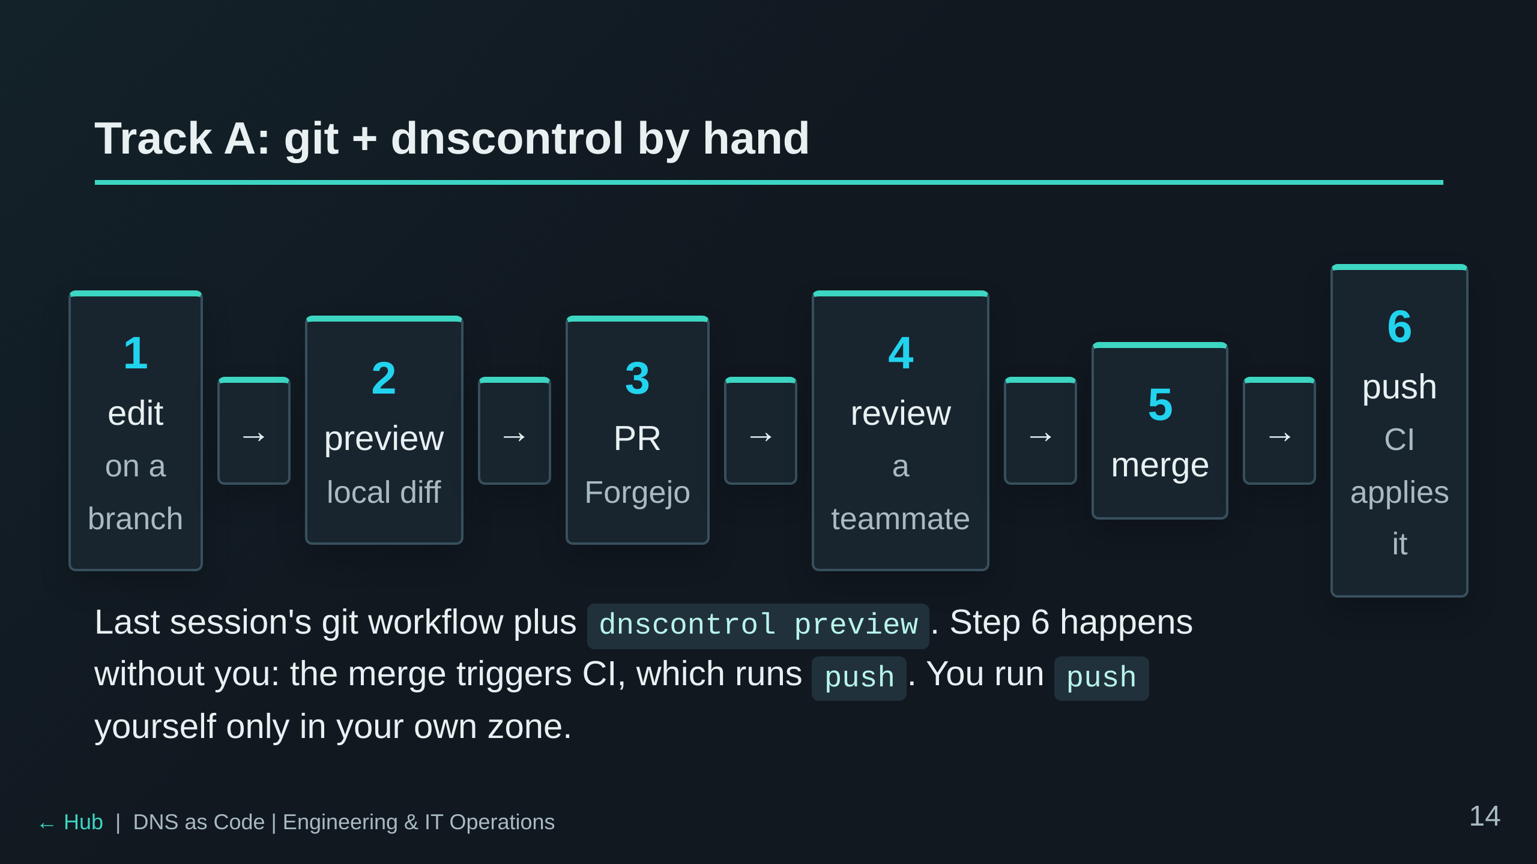

Slide 15
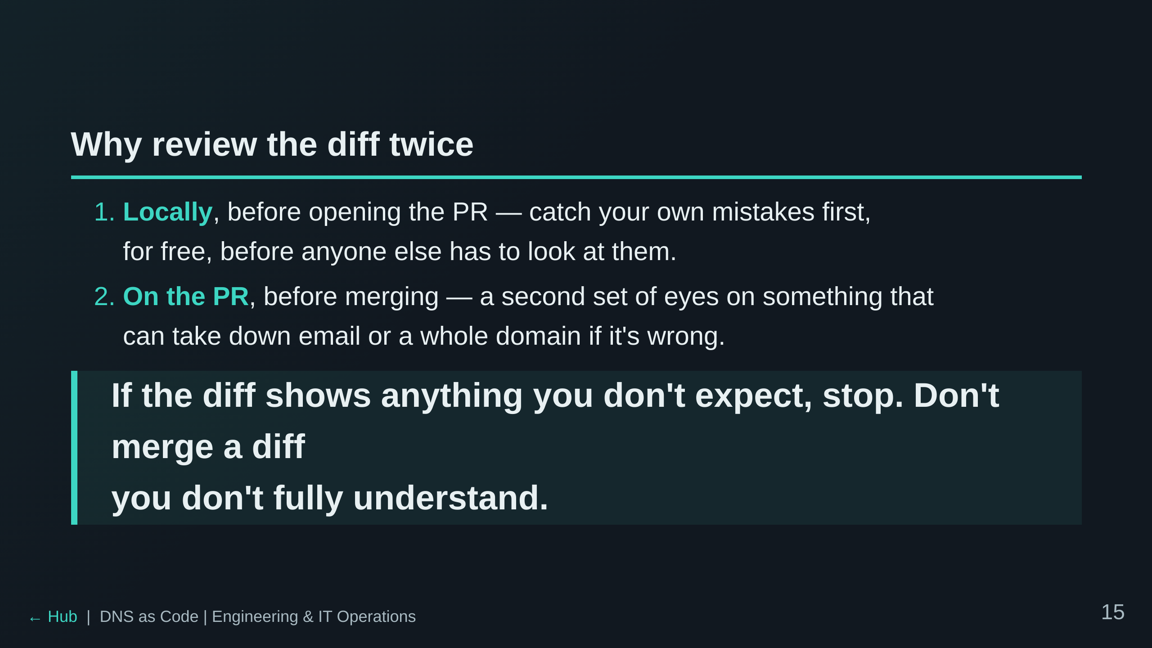

Slide 16
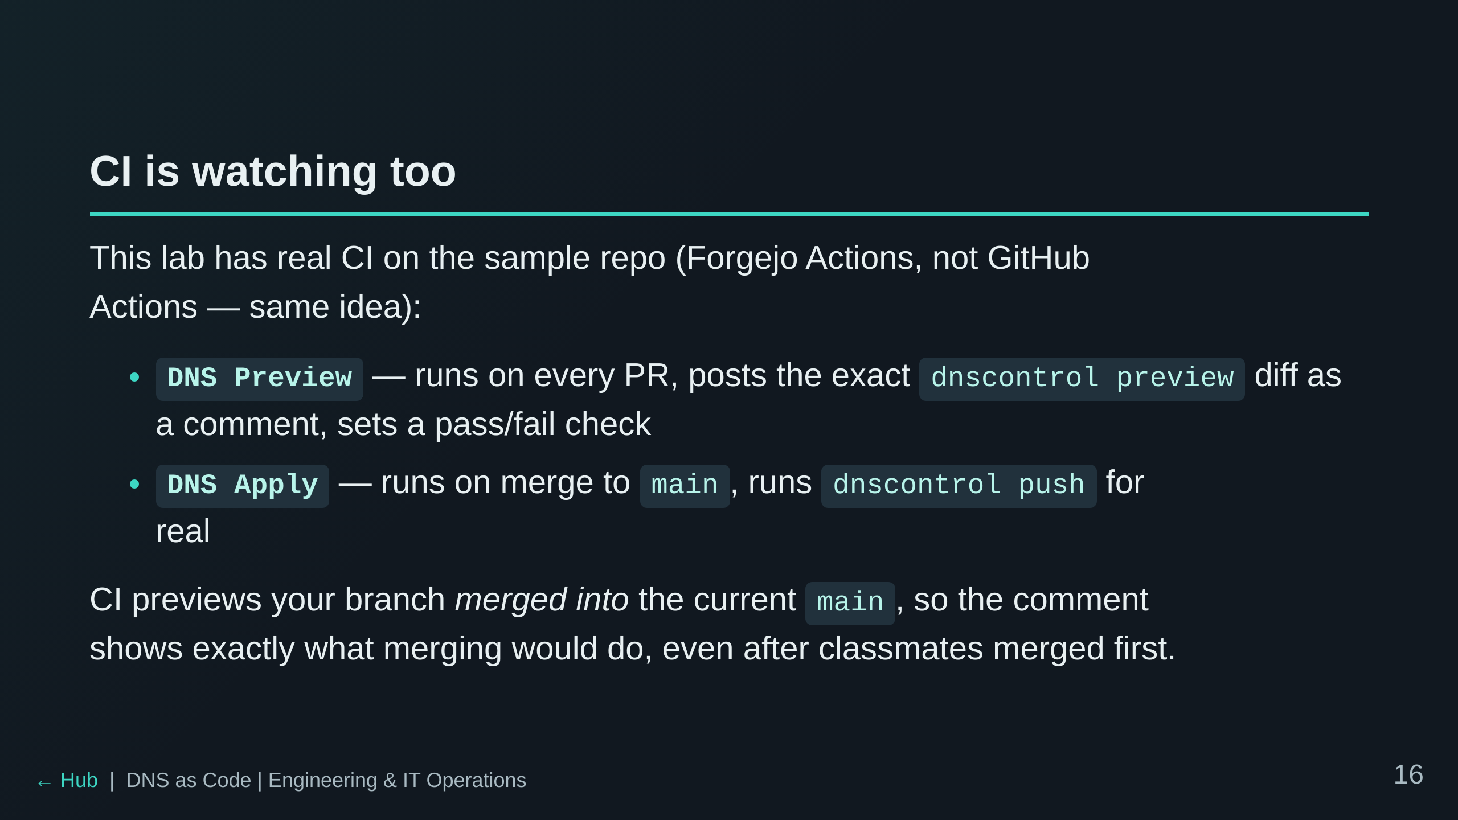

Slide 17
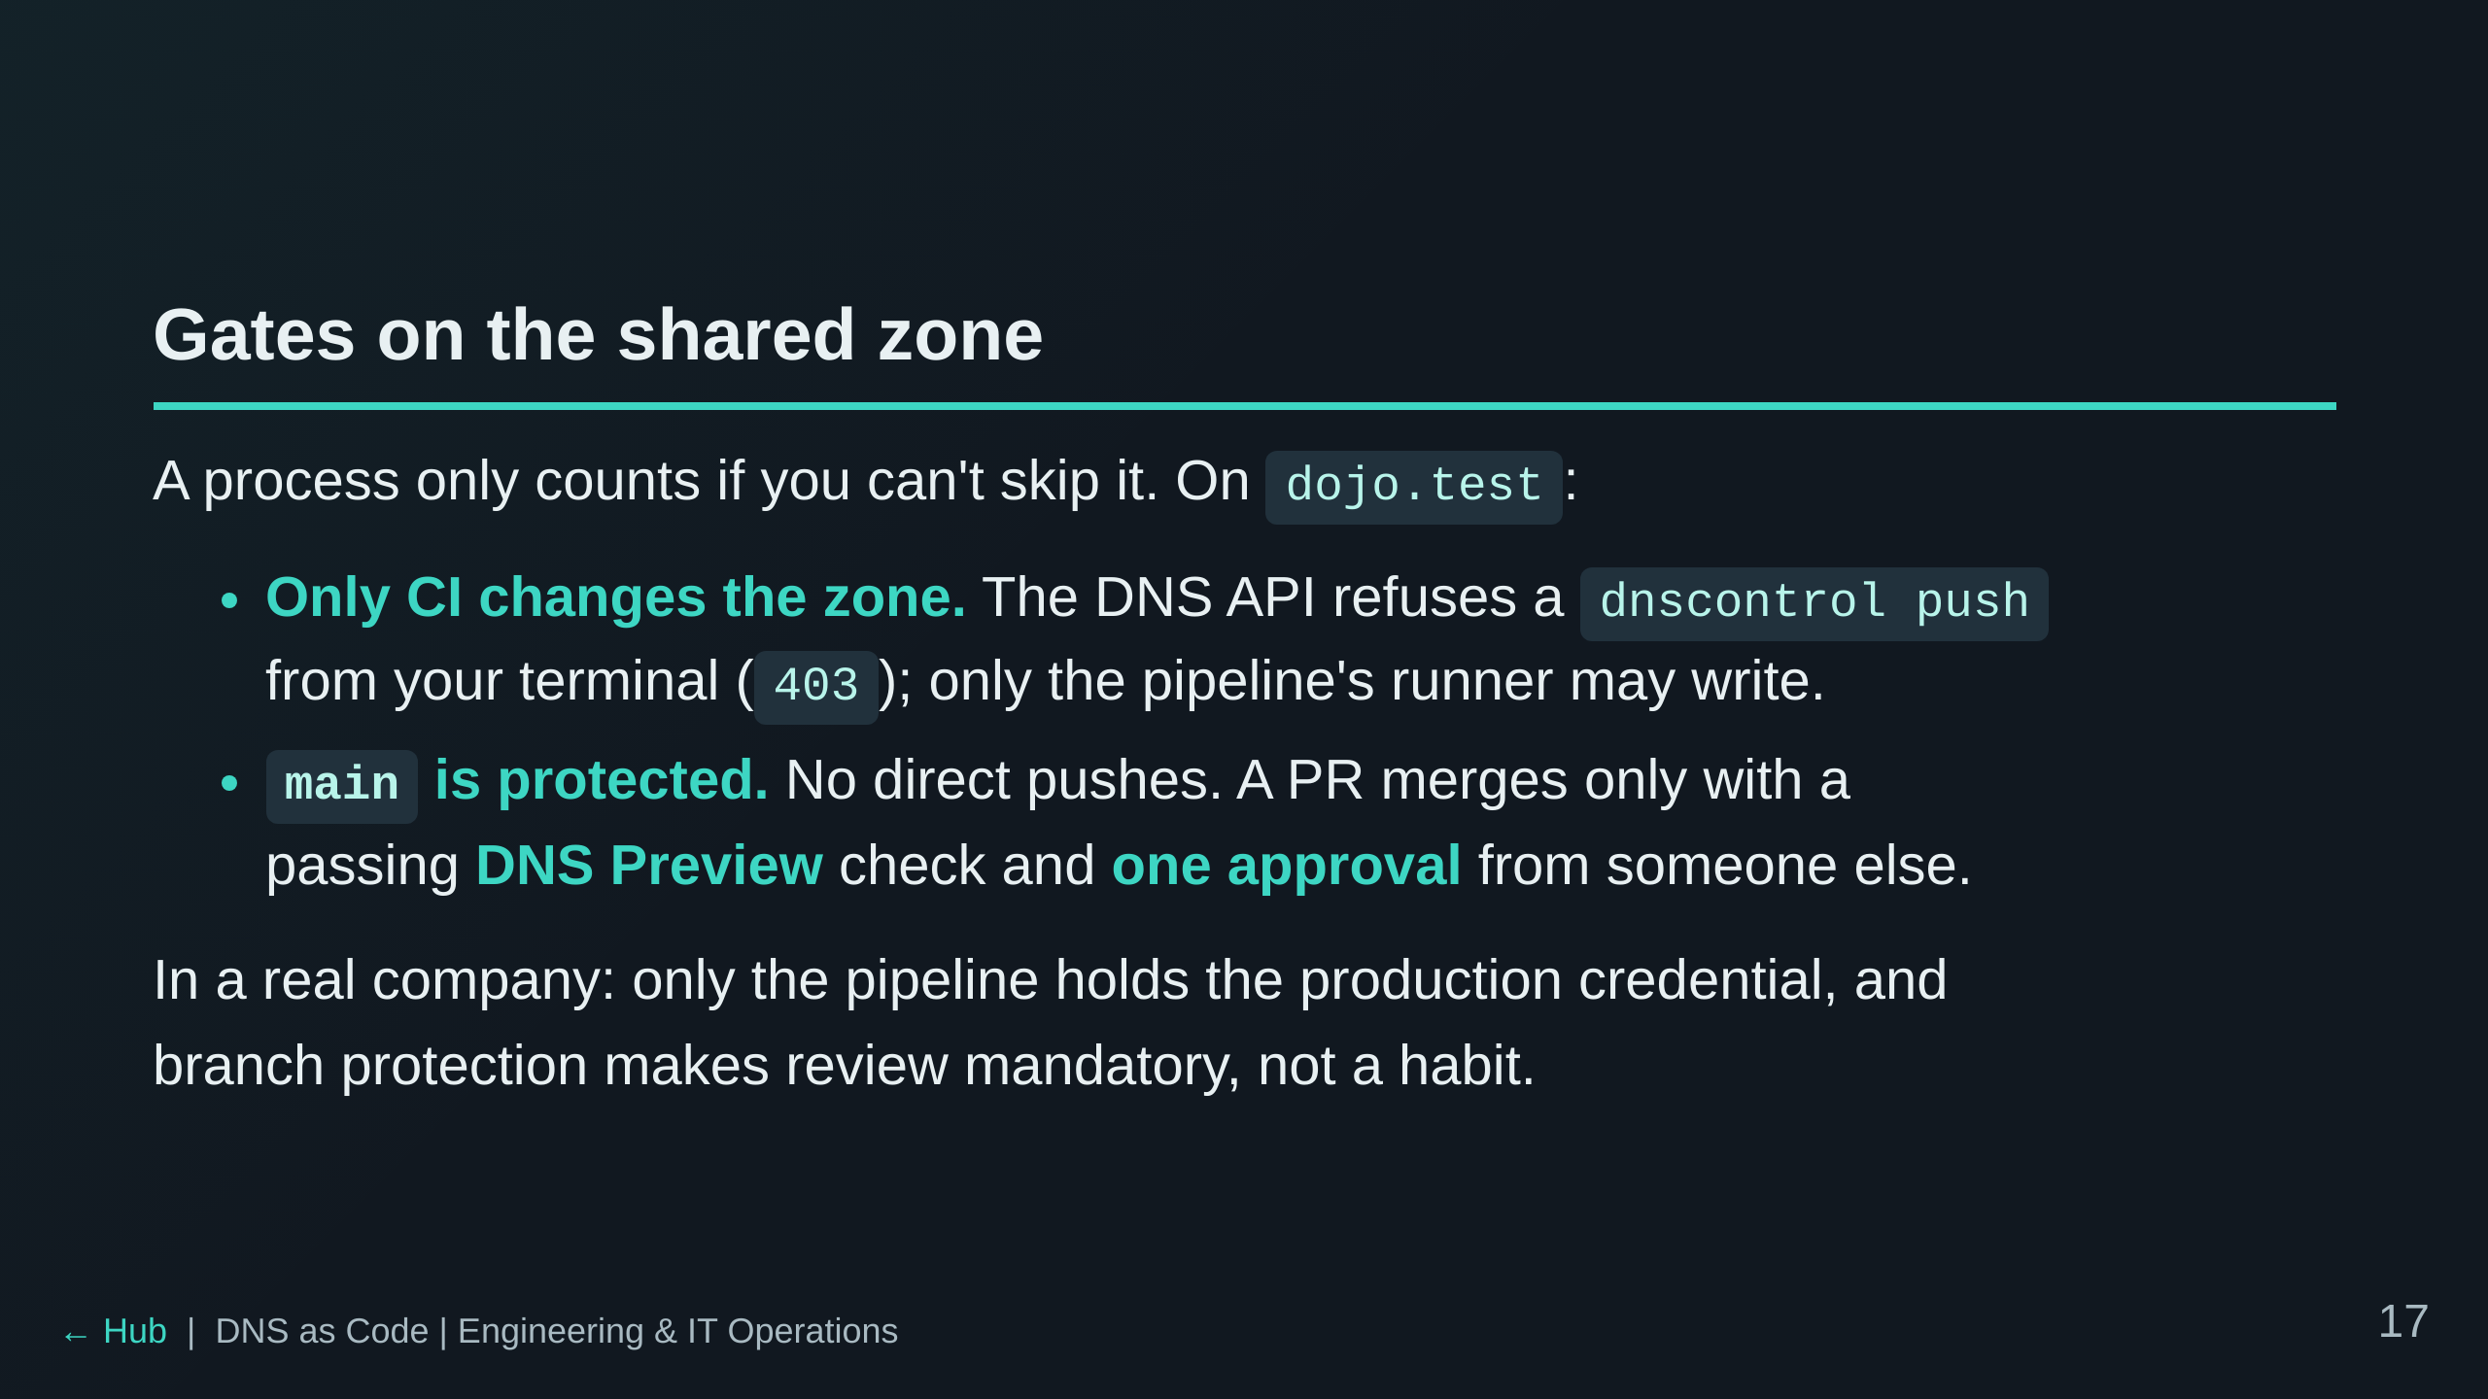

Slide 18
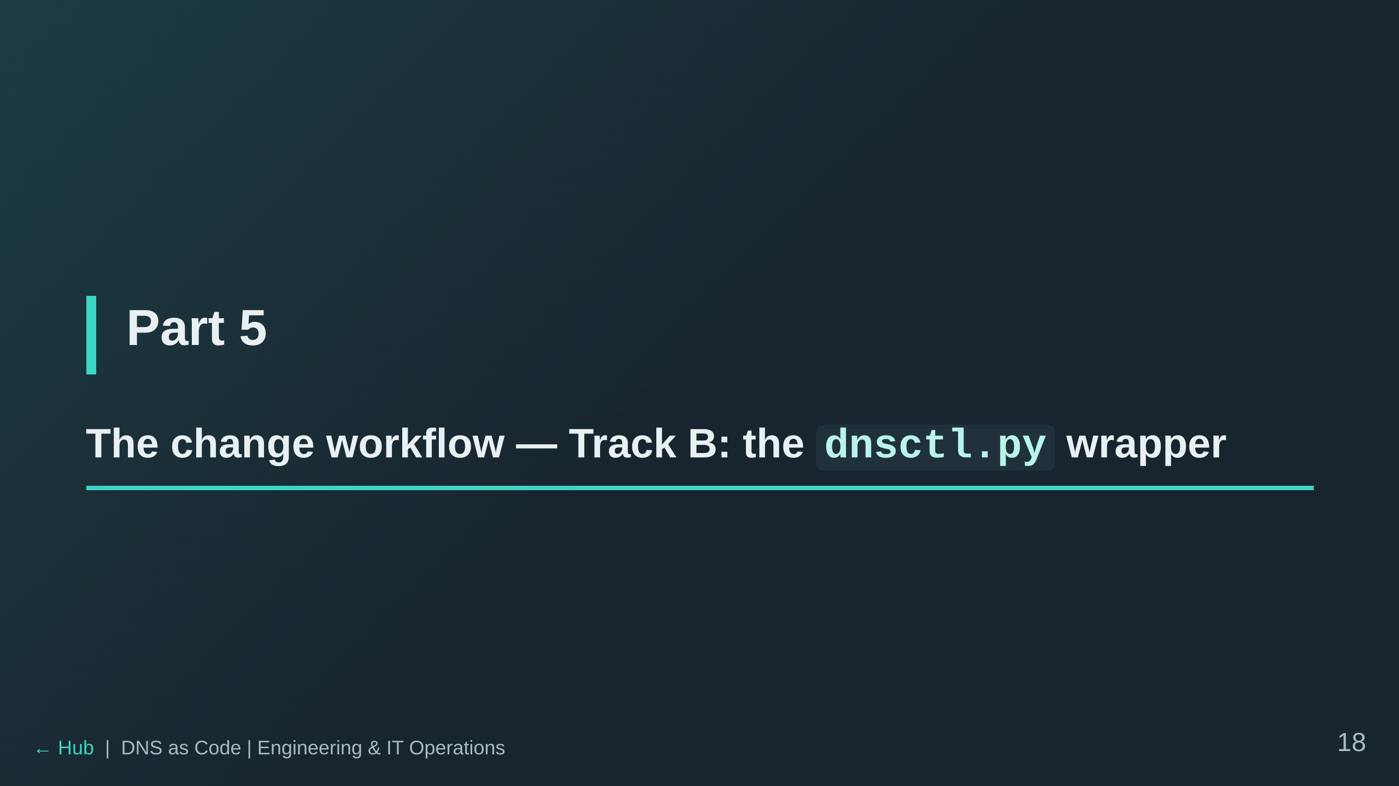

Slide 19
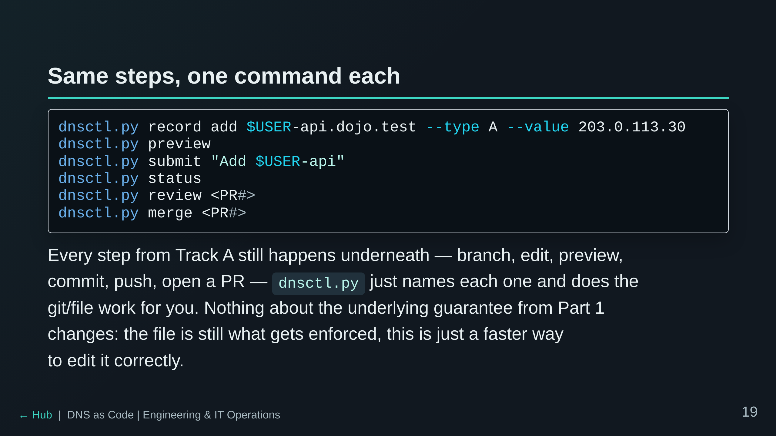

Slide 20
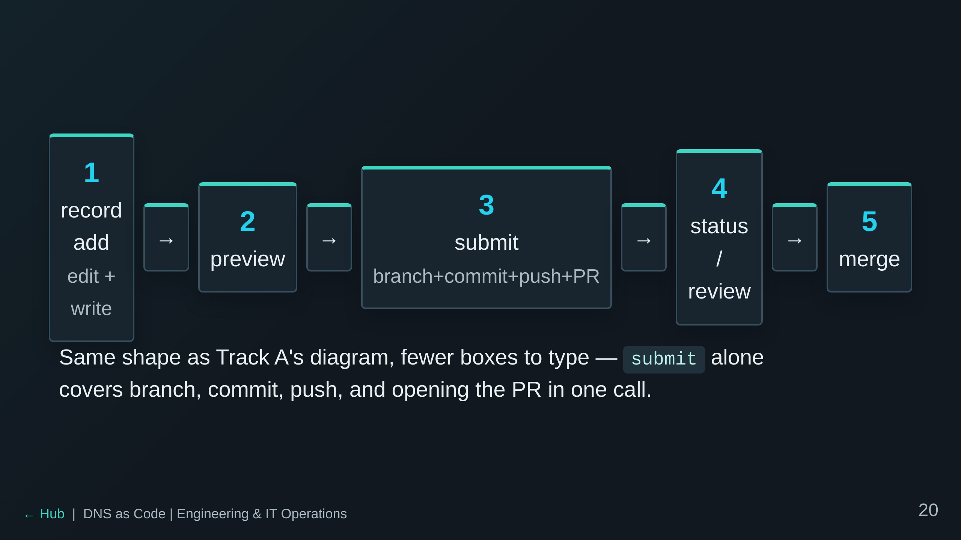

Slide 21
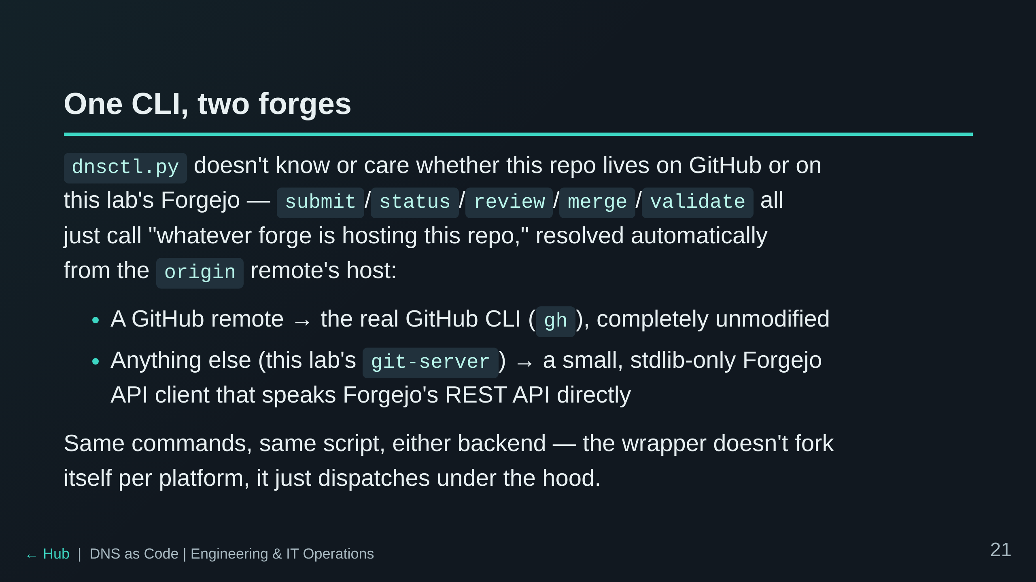
Notes:
This is the piece the real template's docs call out as GitHub-only (`gh
pr create/merge/review`) — this lab adds the Forgejo side rather than
skipping the wrapper entirely, so both tracks are teachable here.

Slide 22
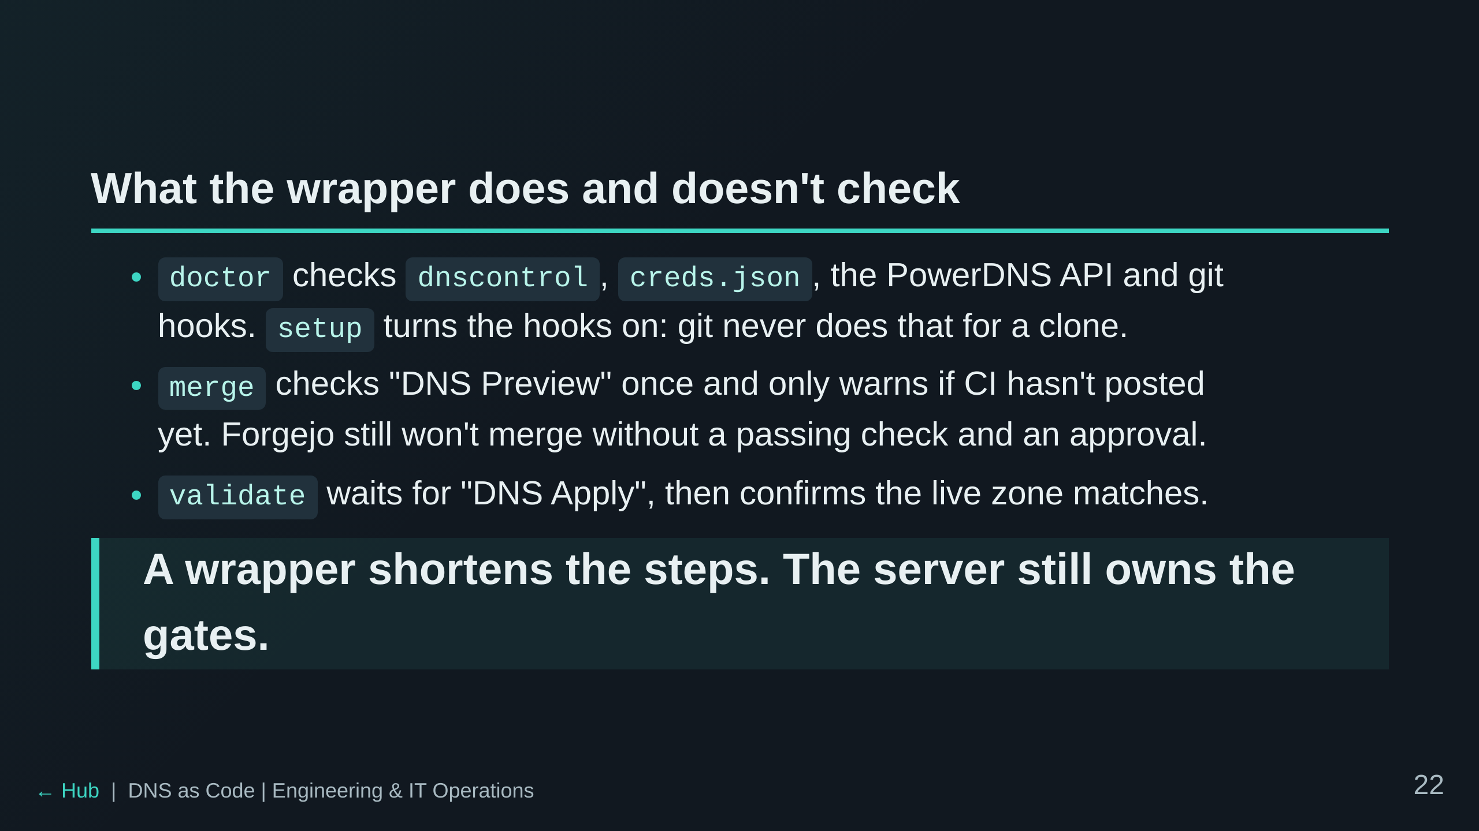

Slide 23
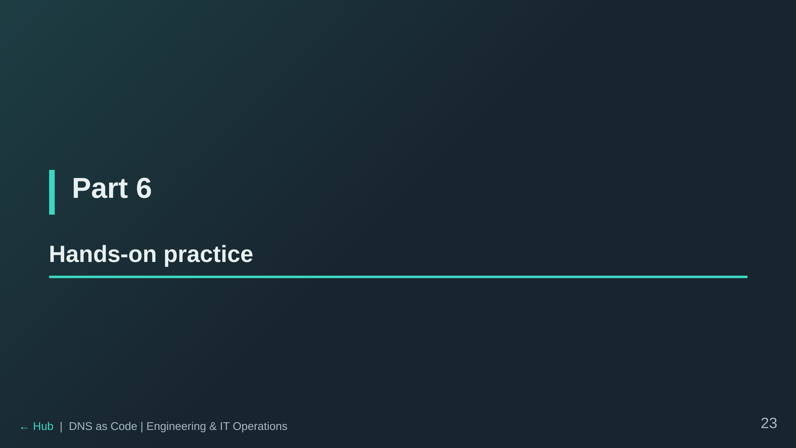

Slide 24
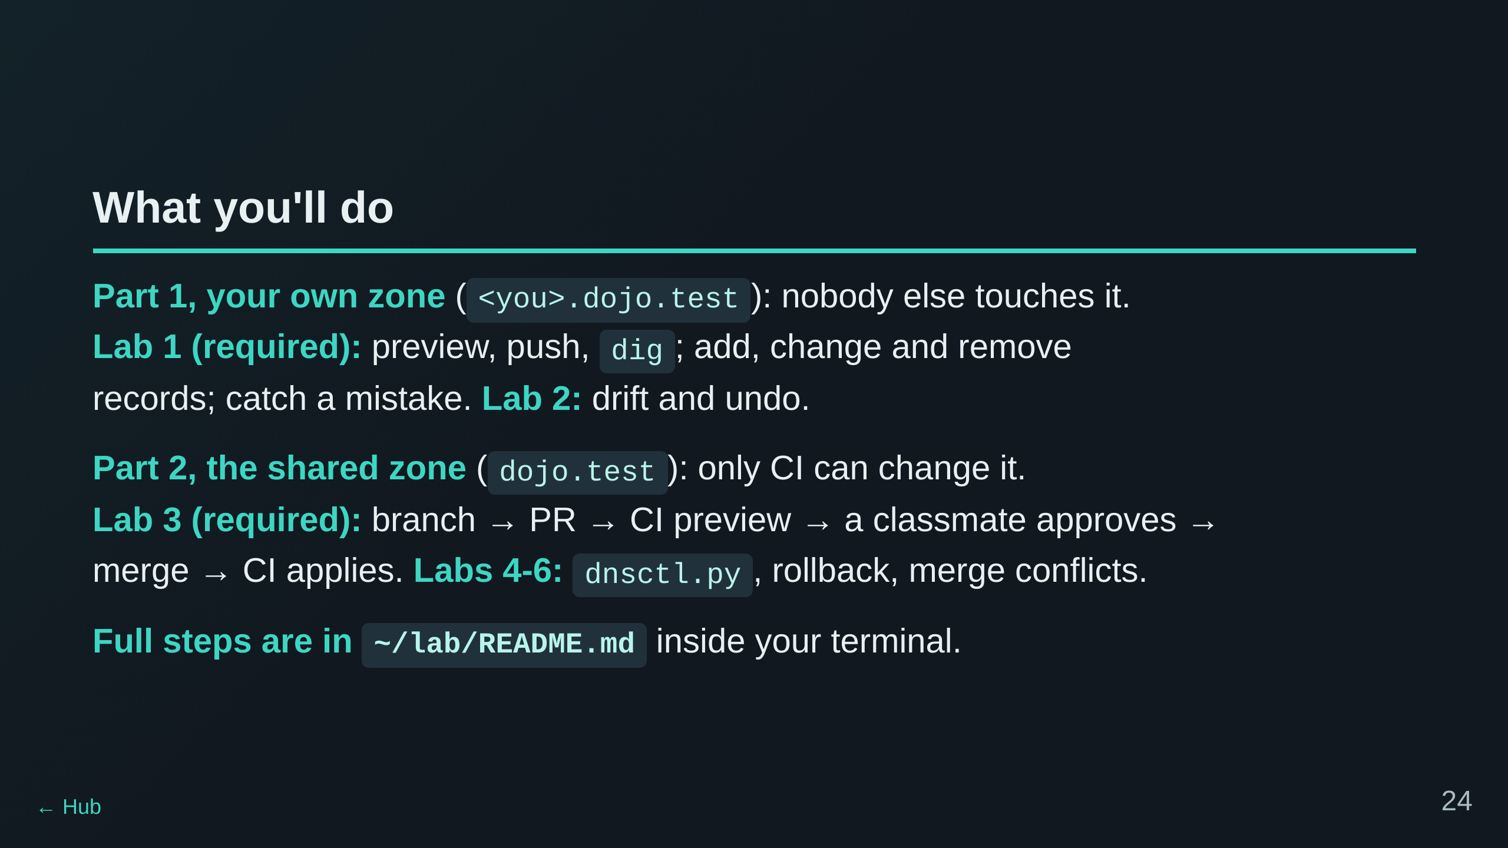

Slide 25
