Slide 1
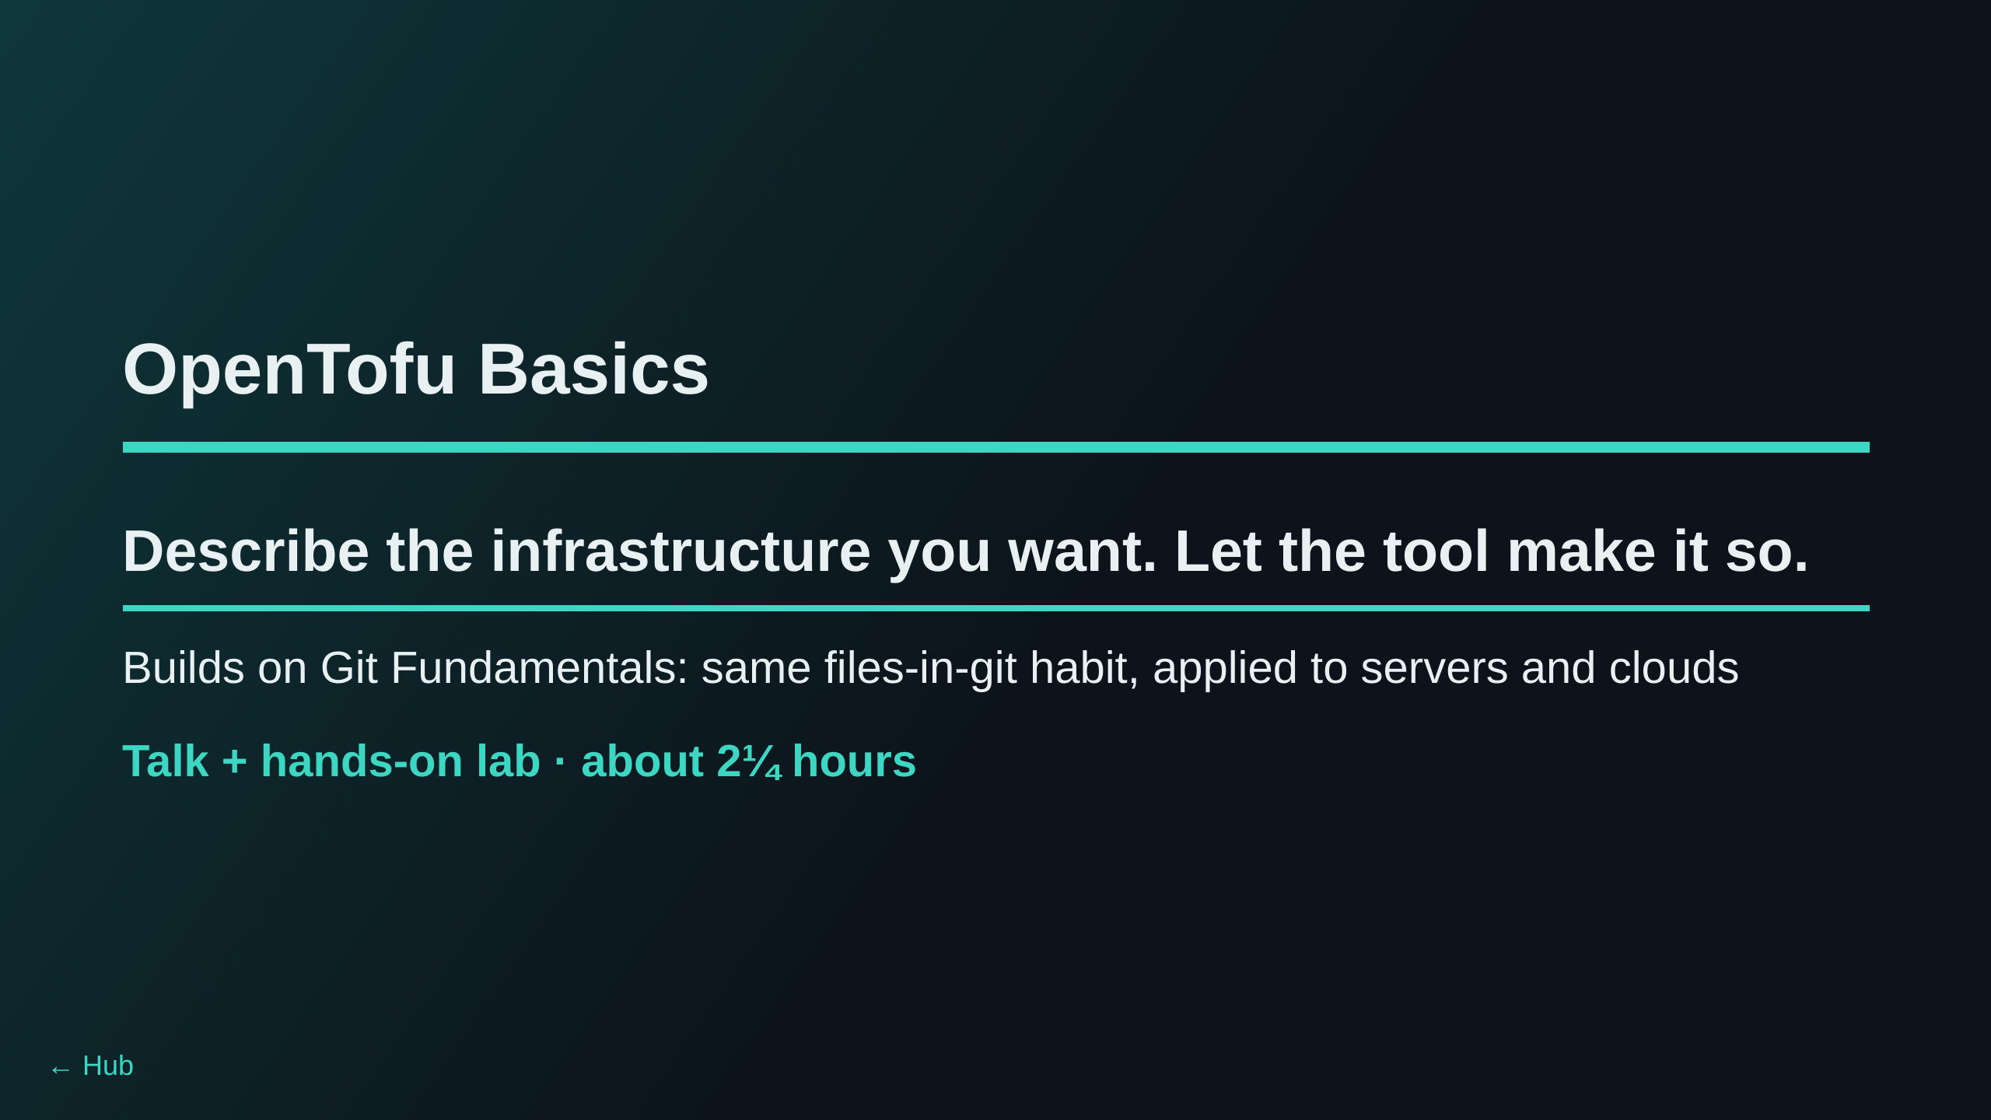
Notes:
TIMING (whole session, ~140 min; the lab times are the estimates in
~/lab/README.md, the talk times are a guess until the dry run, T9.4):
Talk, parts 1-3 ............ ~25 min (slides up to "Track A")
Track A labs 0-3 ........... ~37 min (5 + 12 + 12 + 8)
Dojo Cloud tour ............ ~10 min (part 4, before Track B)
Track B labs 4-10 .......... ~66 min (8 + 10 + 12 + 8 + 12 + 8 + 8)
Recap and questions ........ ~5 min
To fit a 2-hour slot, trim Track B (see the Track B slide notes). If the
talk runs long, the "Variables and outputs" slide can be skipped: Lab 0
and Lab 2 cover the same ground.
Assumes the room did Git Fundamentals (or knows clone/commit/push). The
new idea today is not a new tool for its own sake: it is that the
infrastructure itself becomes a file you review, the same way code is.

Slide 2
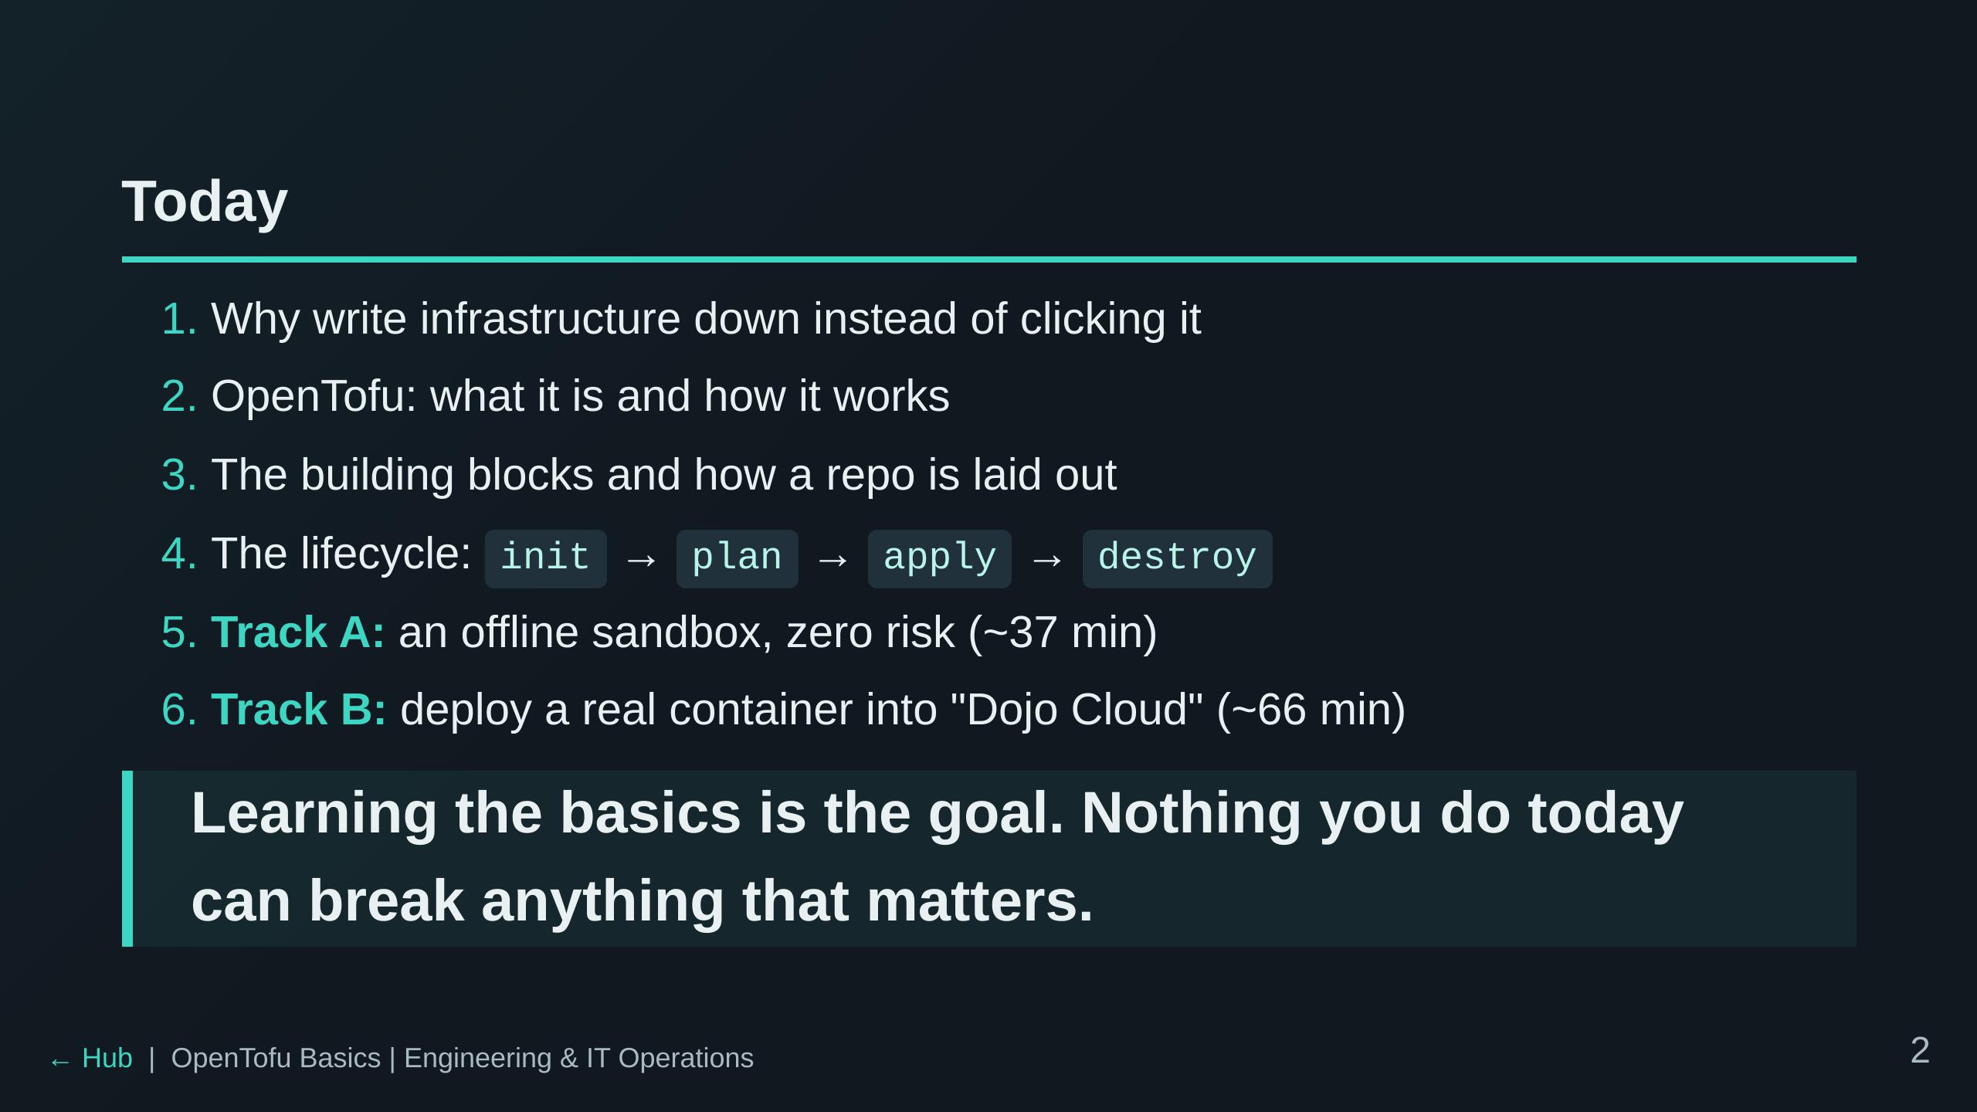
Notes:
Set expectations: the talk is short on purpose. Most of the learning is in
the labs. Track A is the safety net: if Track B has a problem on the day,
everyone still finishes the core loop.

Slide 3
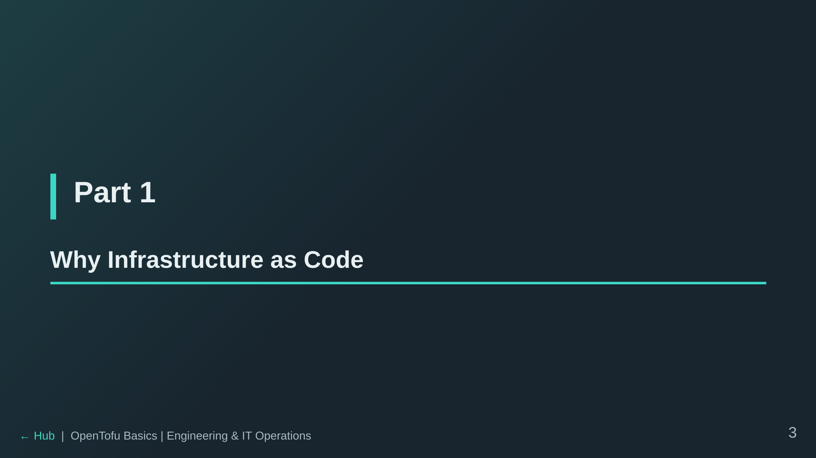

Slide 4
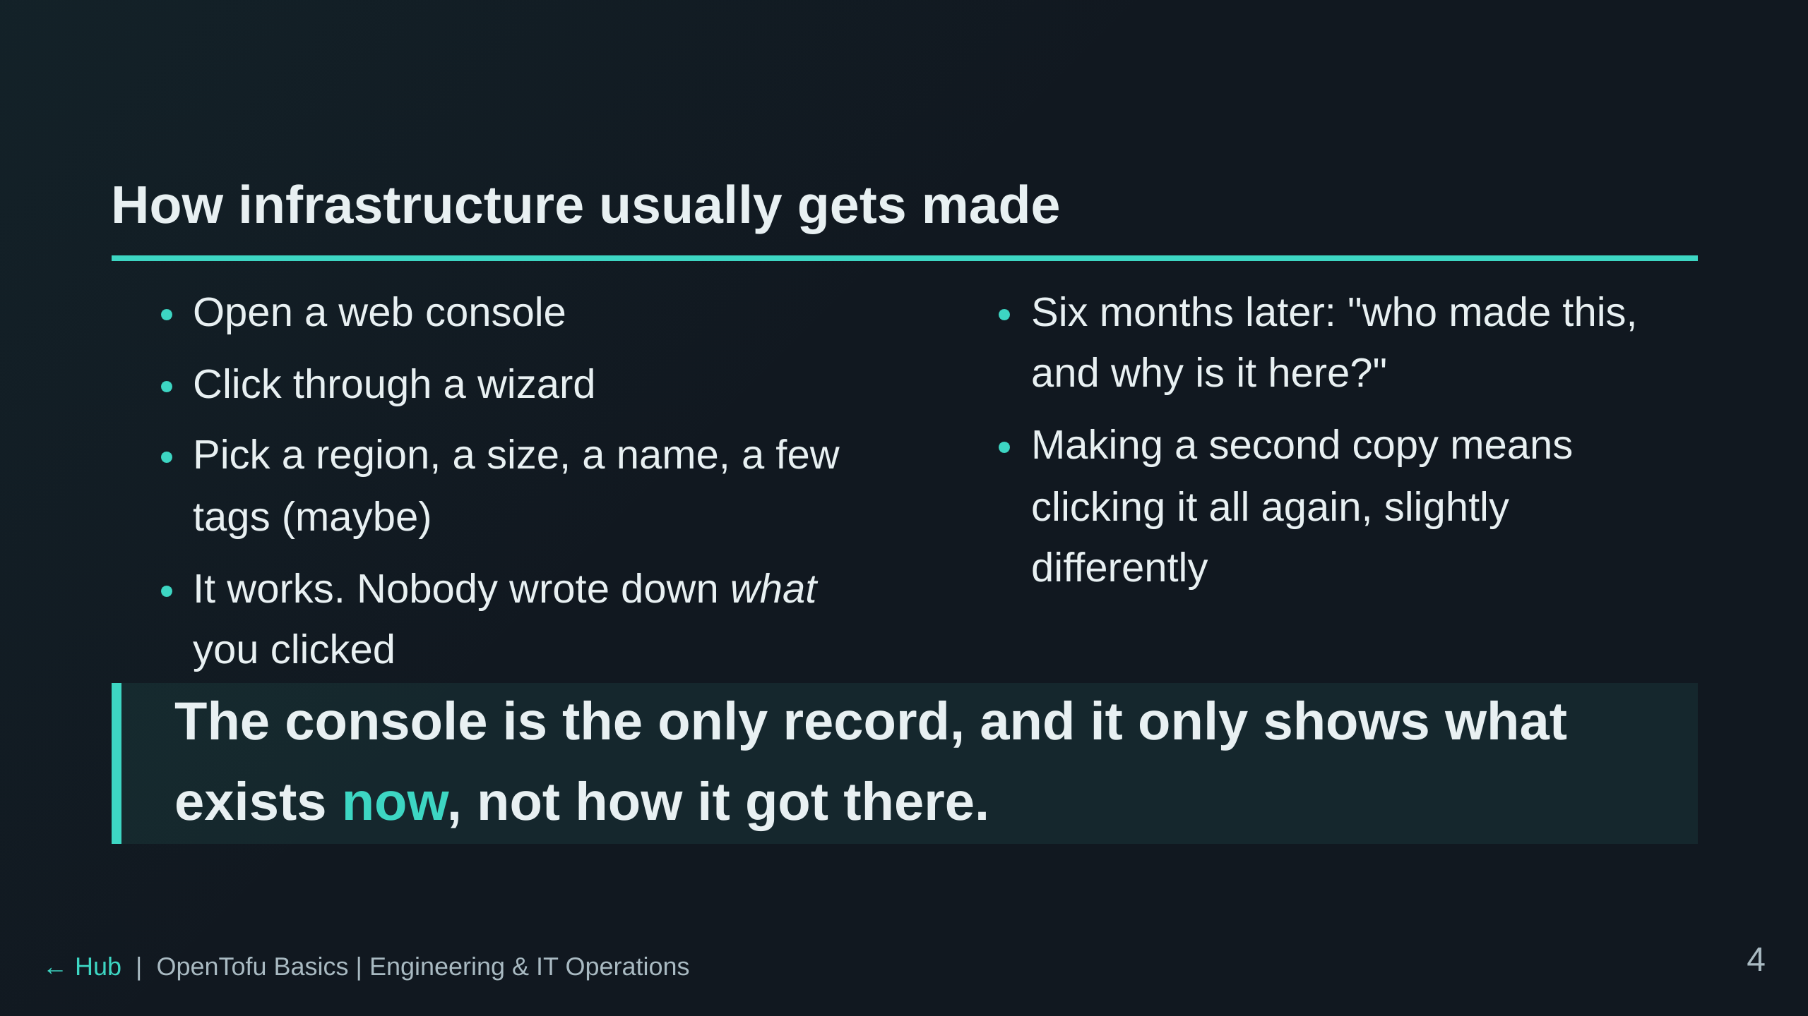
Notes:
Ask the room: who has built something in a cloud console and then had to
rebuild it? What did you forget? That memory is the whole motivation.

Slide 5
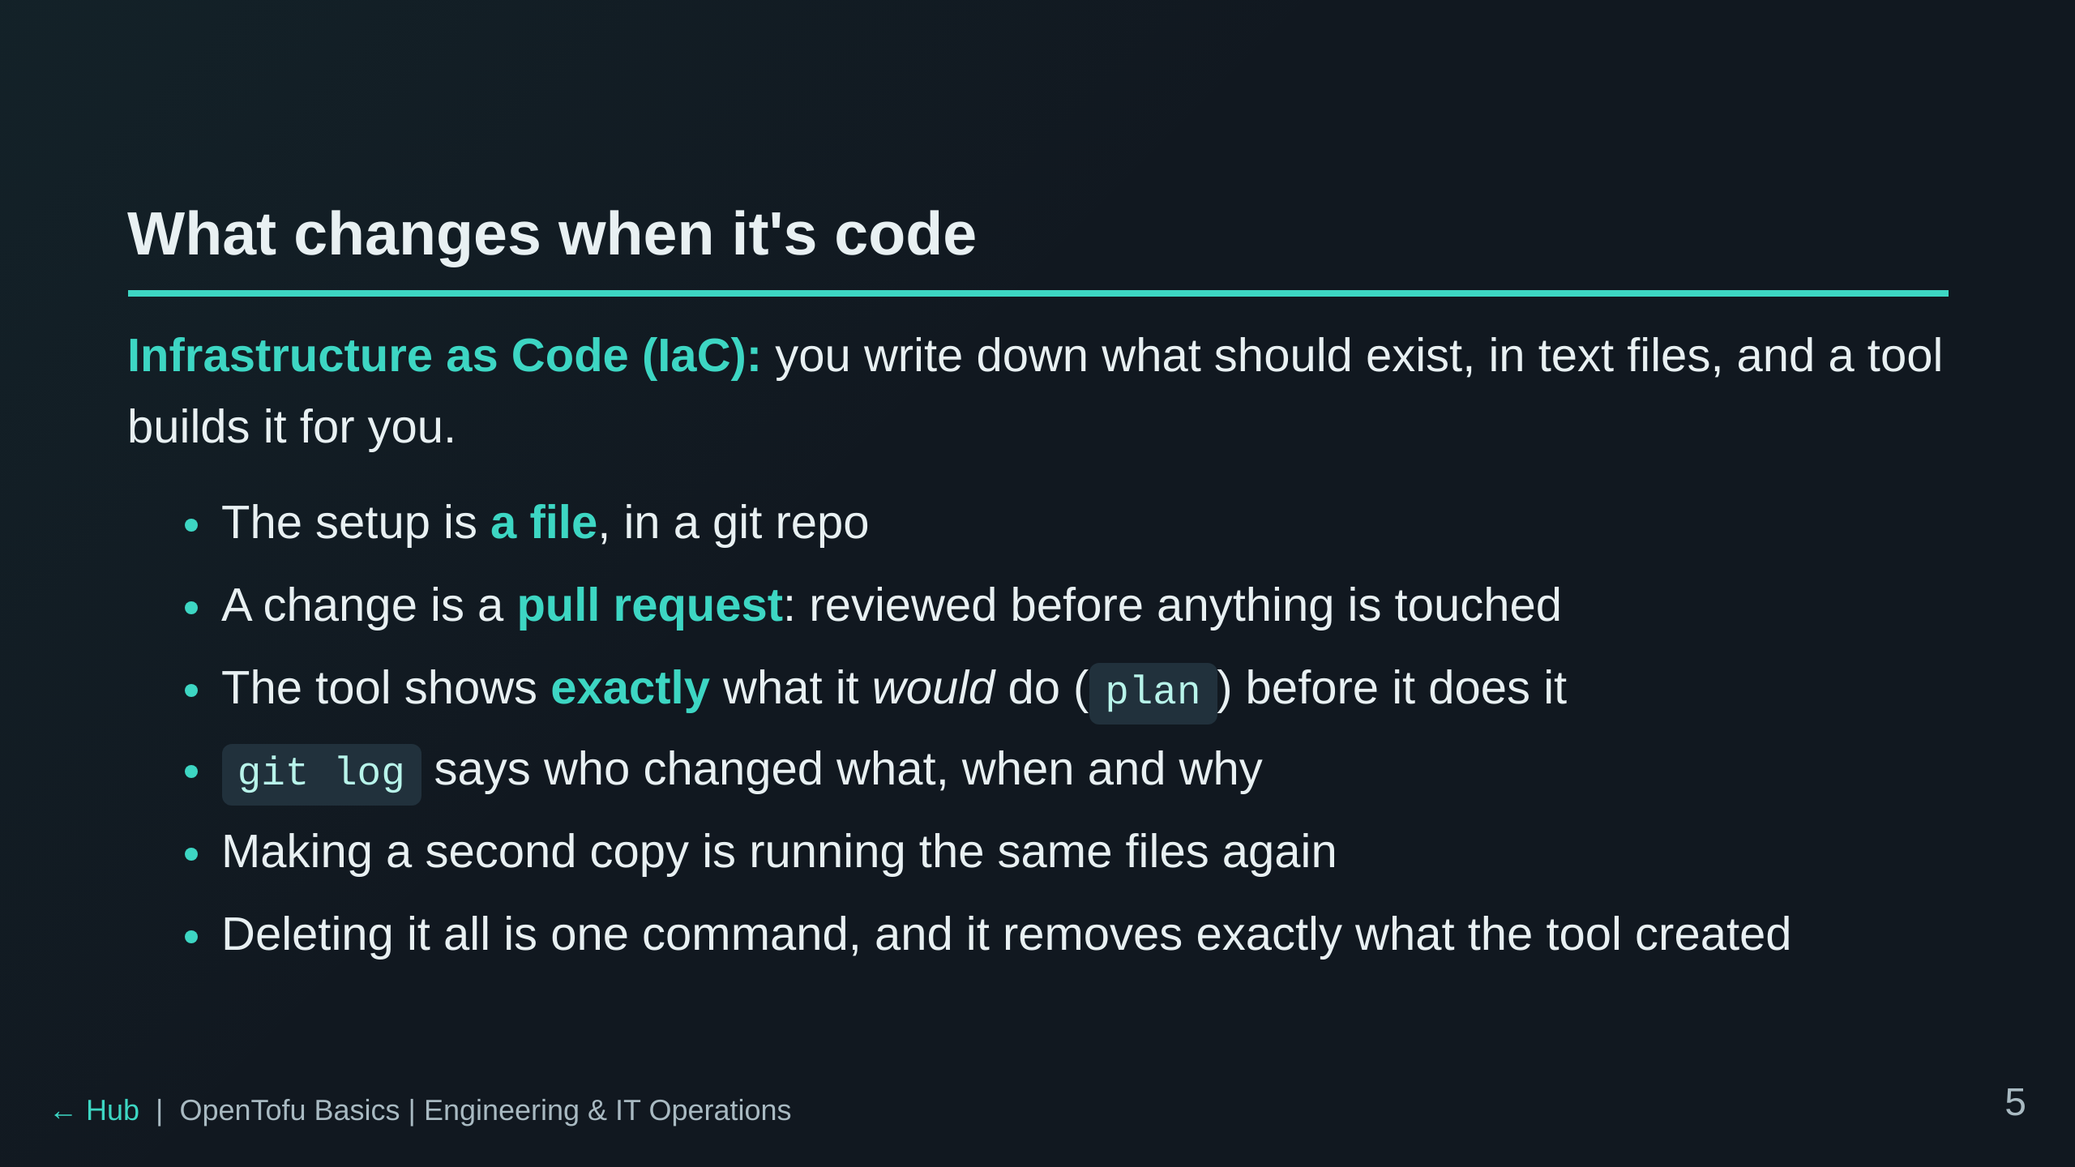
Notes:
Connect back: the file-is-the-truth idea is the same one from the DNS as
Code session, if the room did it. Preview in dnscontrol is plan here.

Slide 6
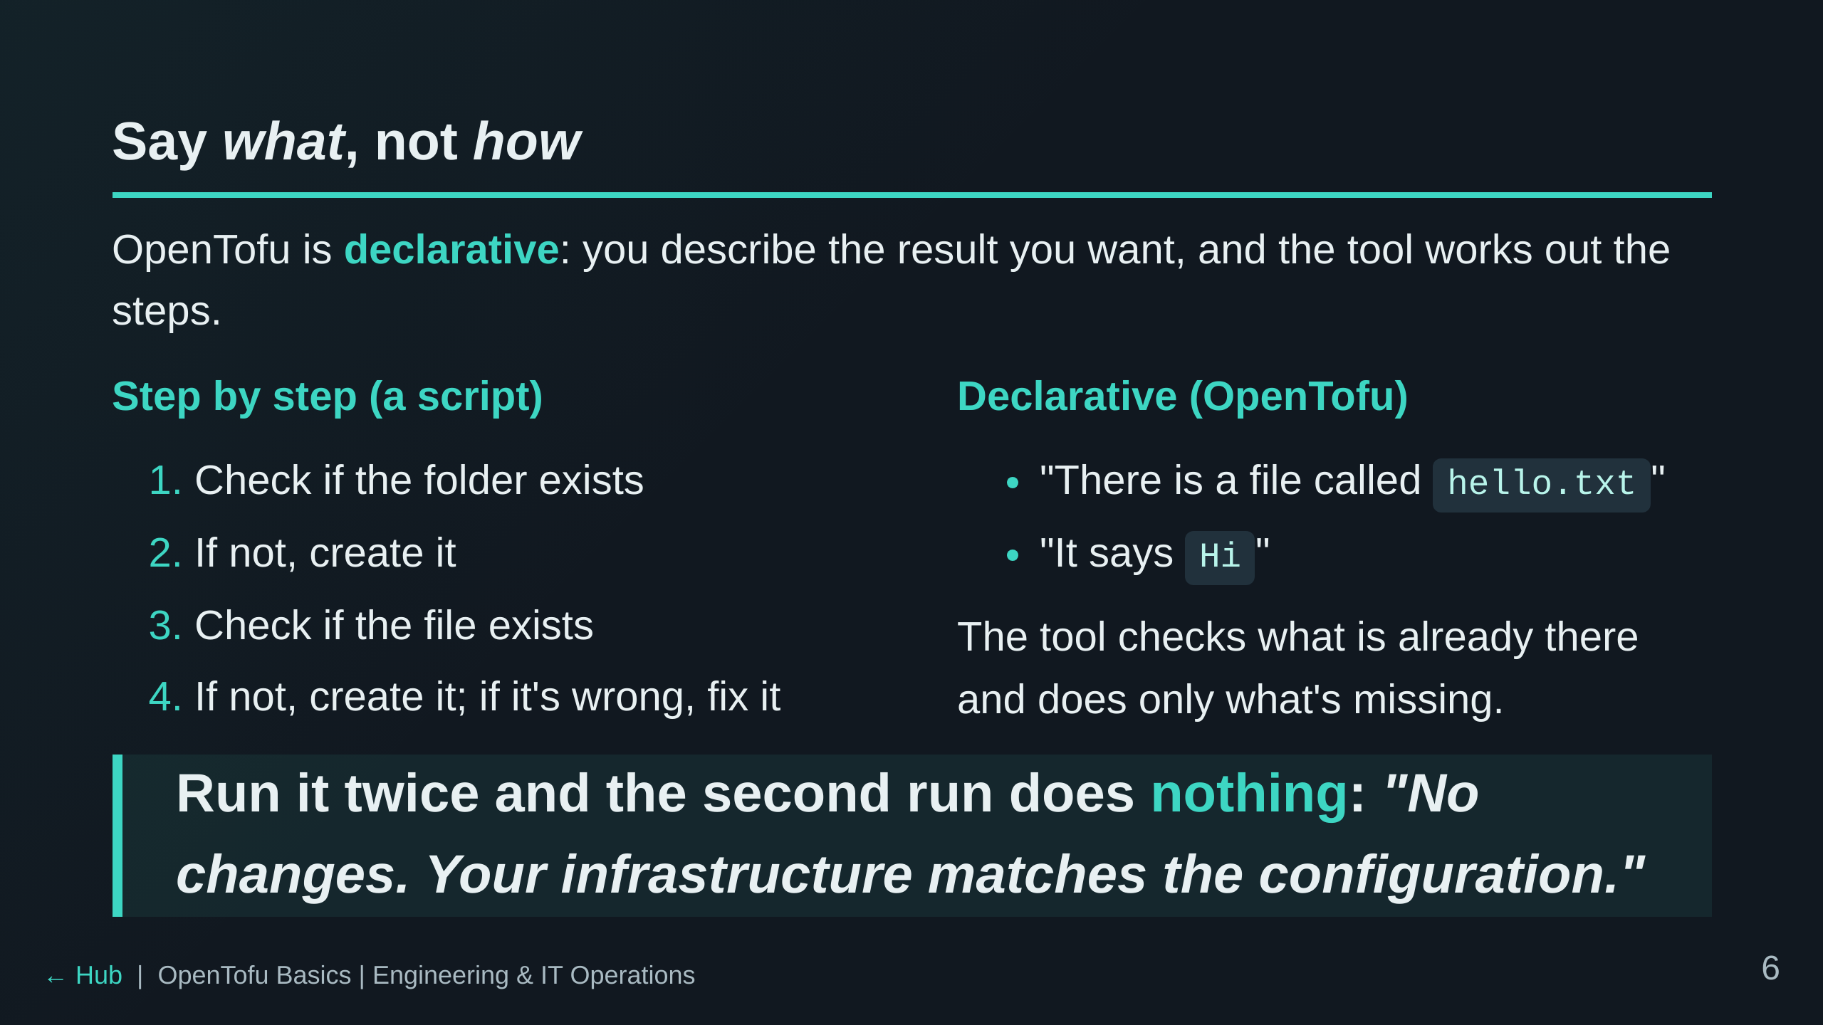
Notes:
Analogy that lands: a script is turn-by-turn directions; declarative is
giving the taxi driver the address. If you're already there, the driver
does nothing.
The quoted line is OpenTofu's real message when there is nothing to do.
The word for "safe to run again" is idempotent; say it once, but don't lean
on it. Lab 2 starts by proving it (apply twice, change once).

Slide 7
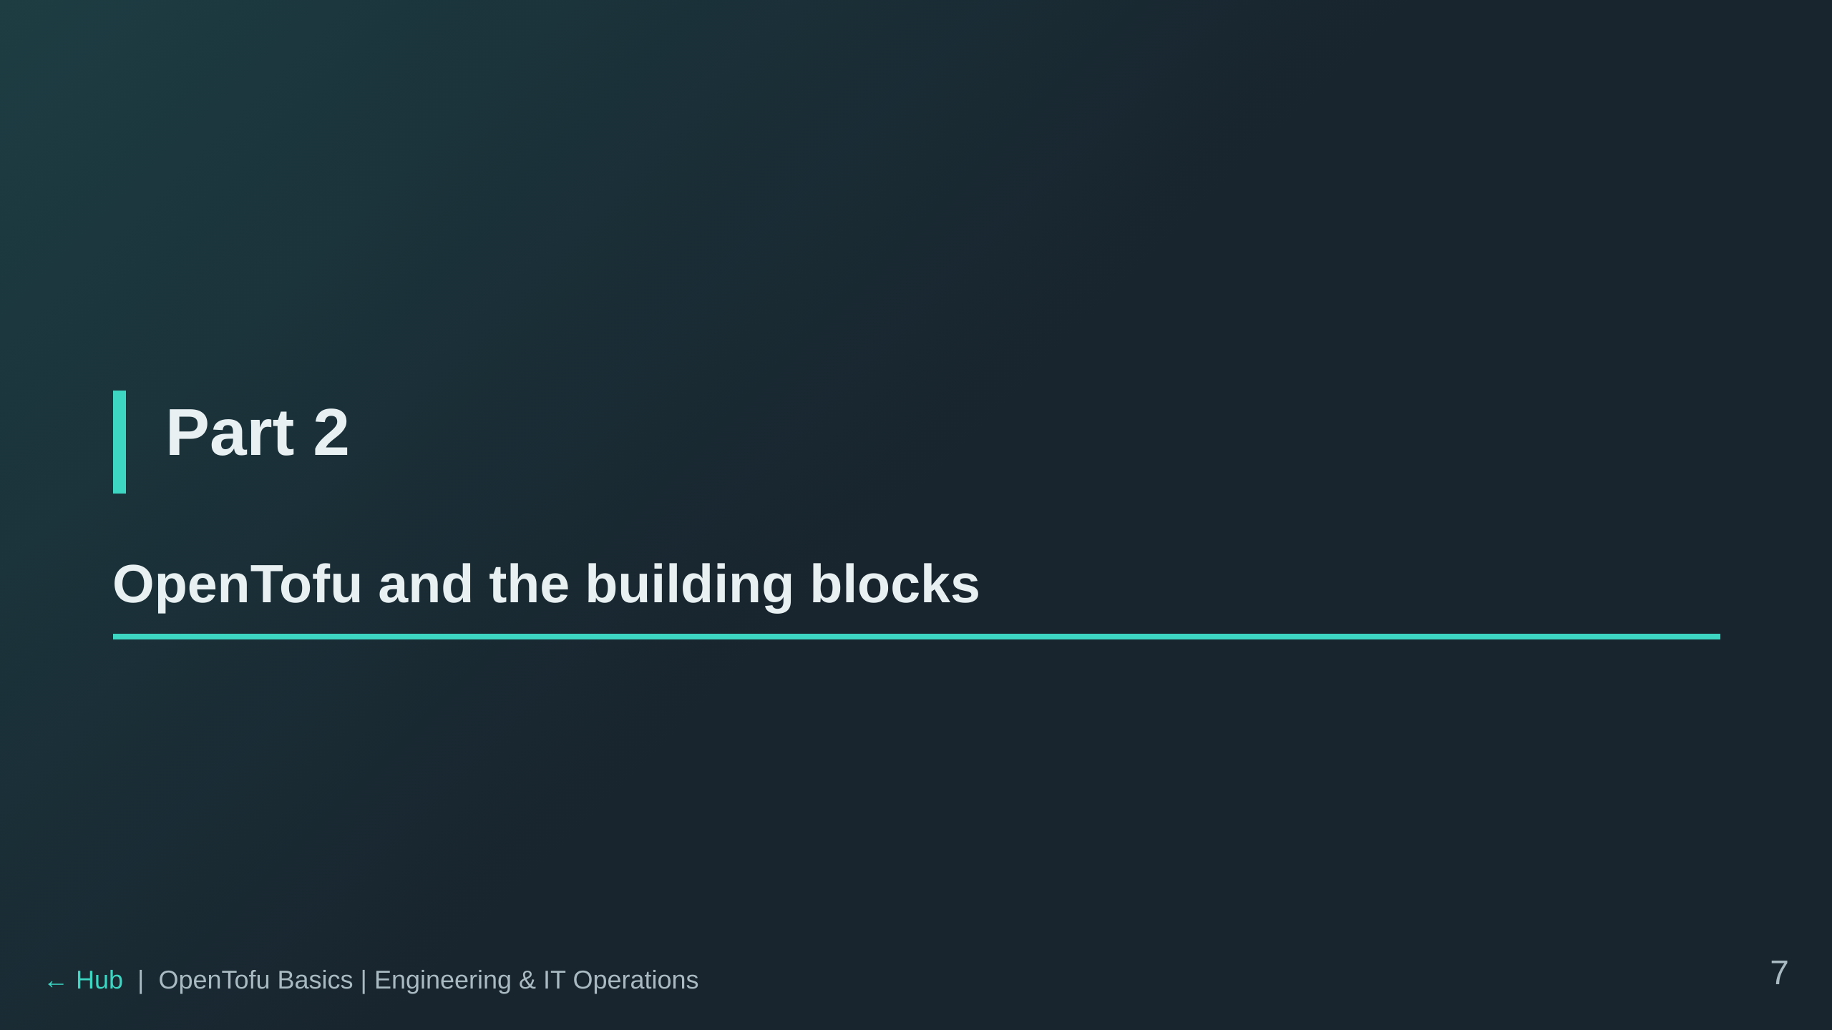

Slide 8
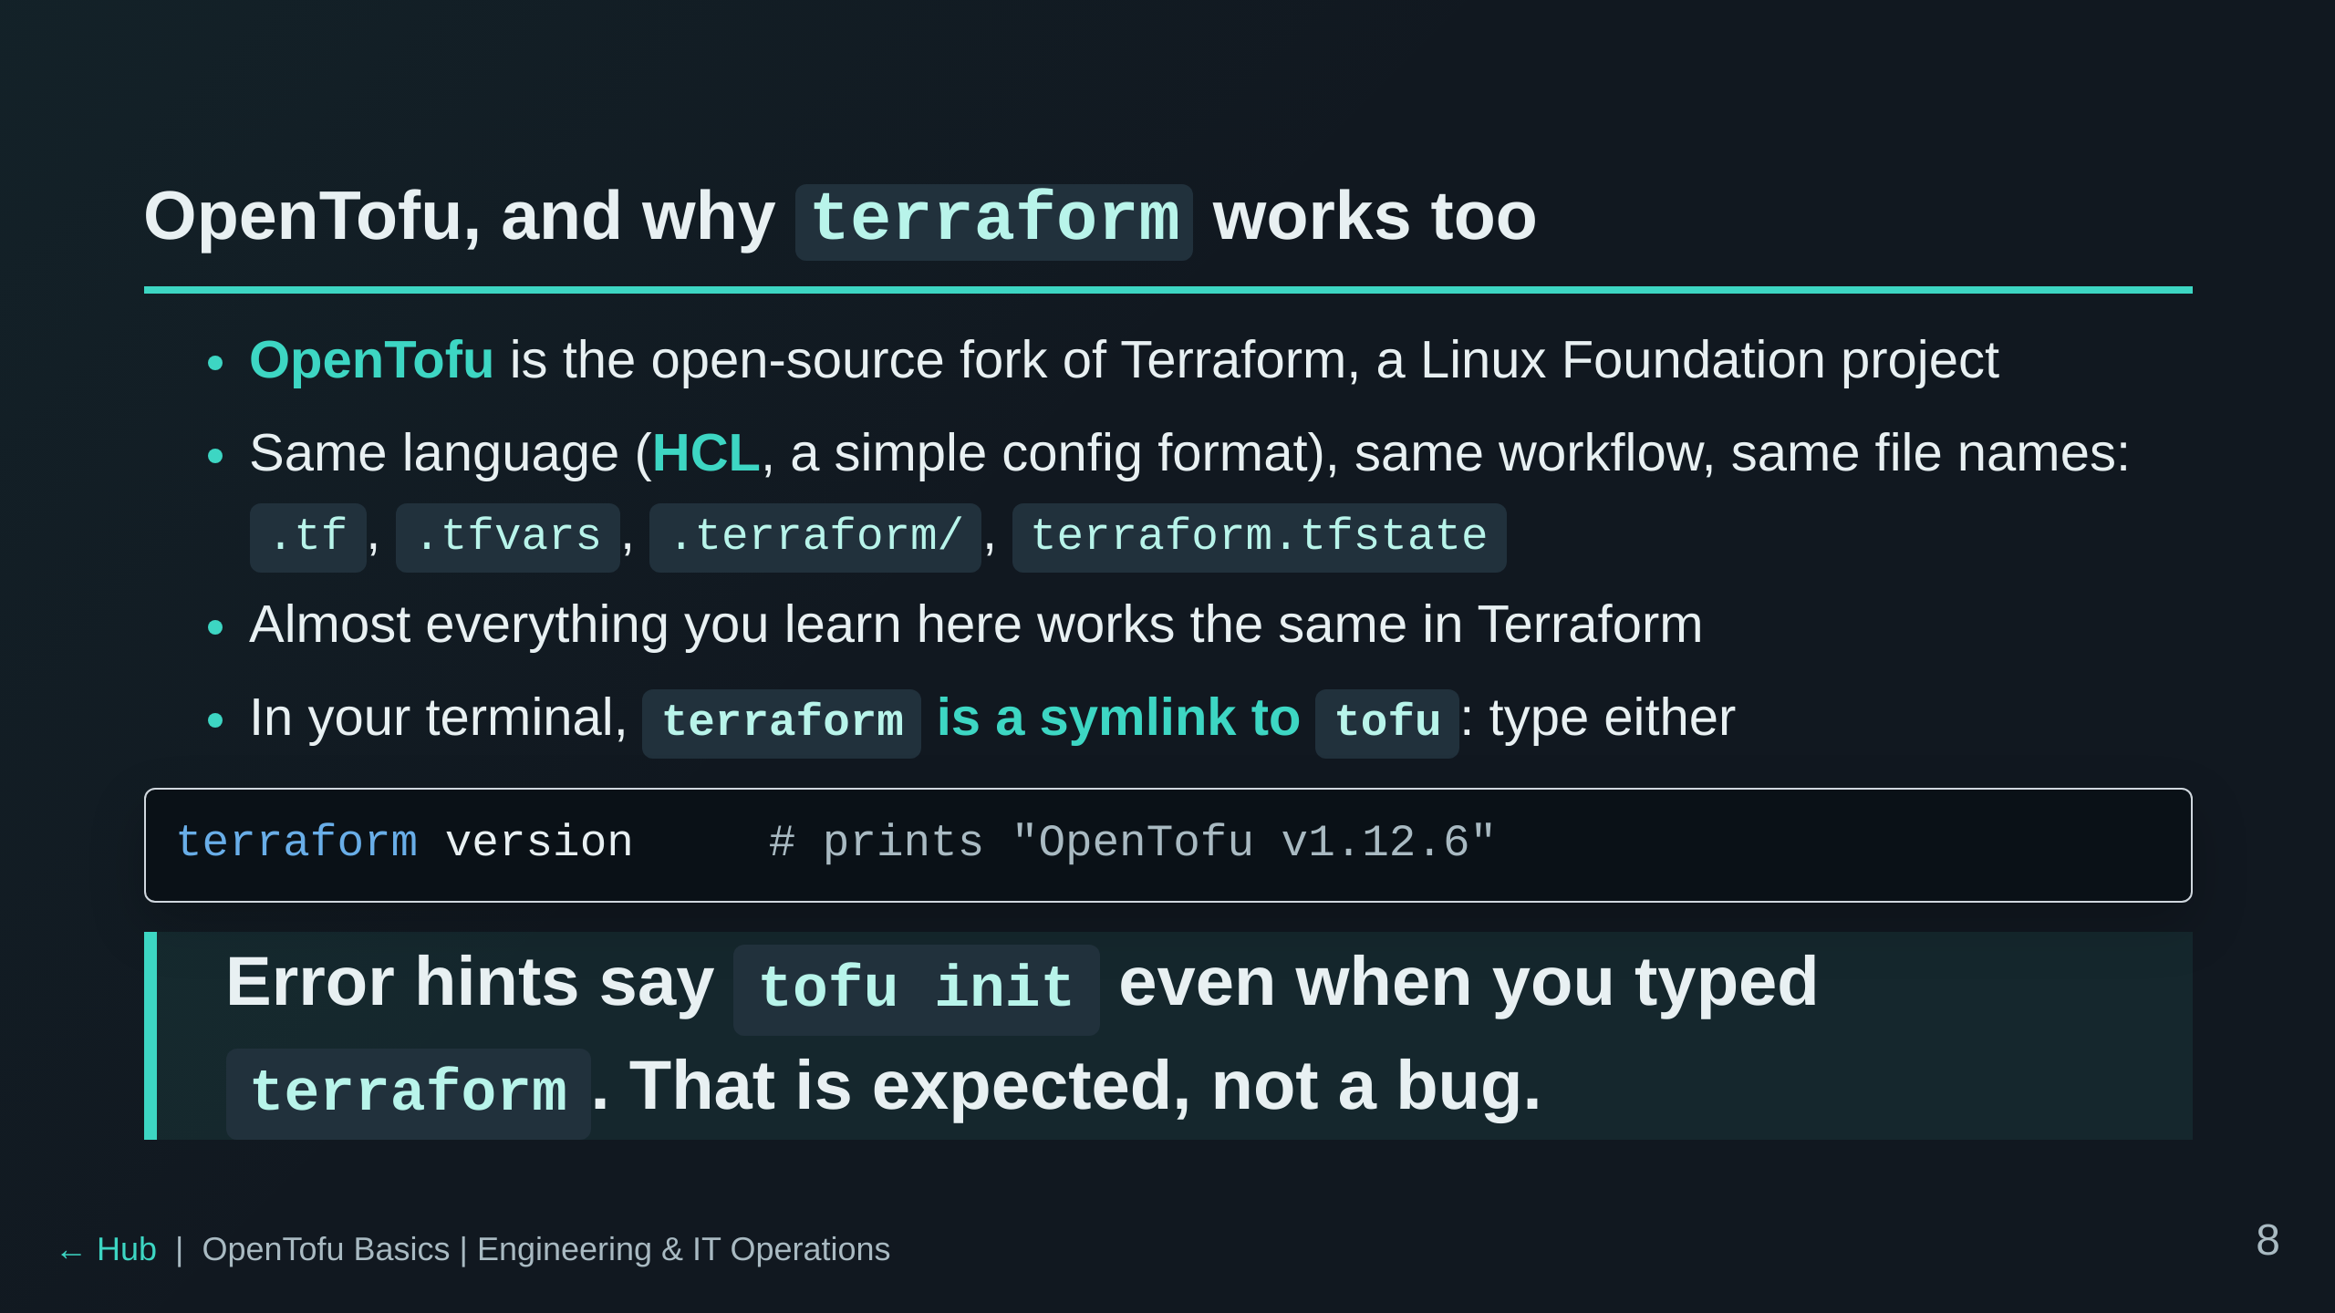
Notes:
Do not get pulled into the licensing history. One line: comparable tool,
open source, drop-in for what we do today. Version is pinned to 1.12.6 in
the image. "Almost": the two projects have added a few different features
since the fork (2023), none of which we use today.

Slide 9
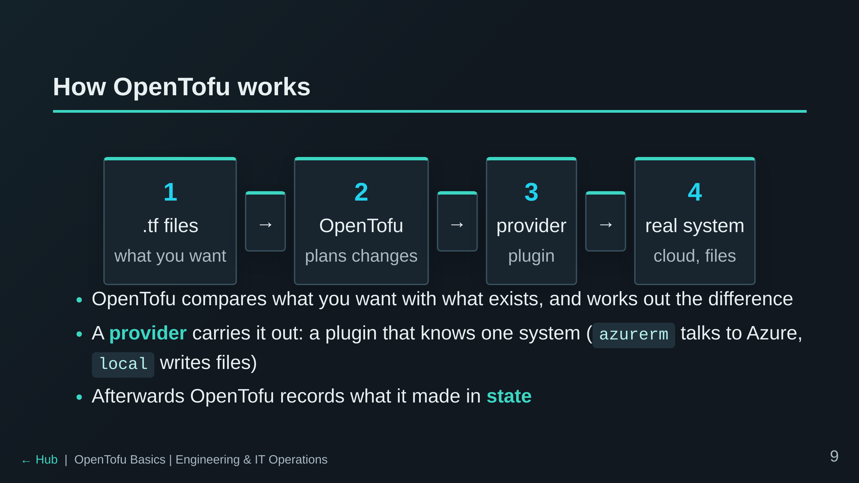
Notes:
This is the mental model for the rest of the day. Every error students see
comes from one of these boxes: a typo in the files (1), a plan they didn't
expect (2), a provider install problem at init (3), or the real system
saying no (4, Dojo Cloud's policy and quota in Track B).

Slide 10
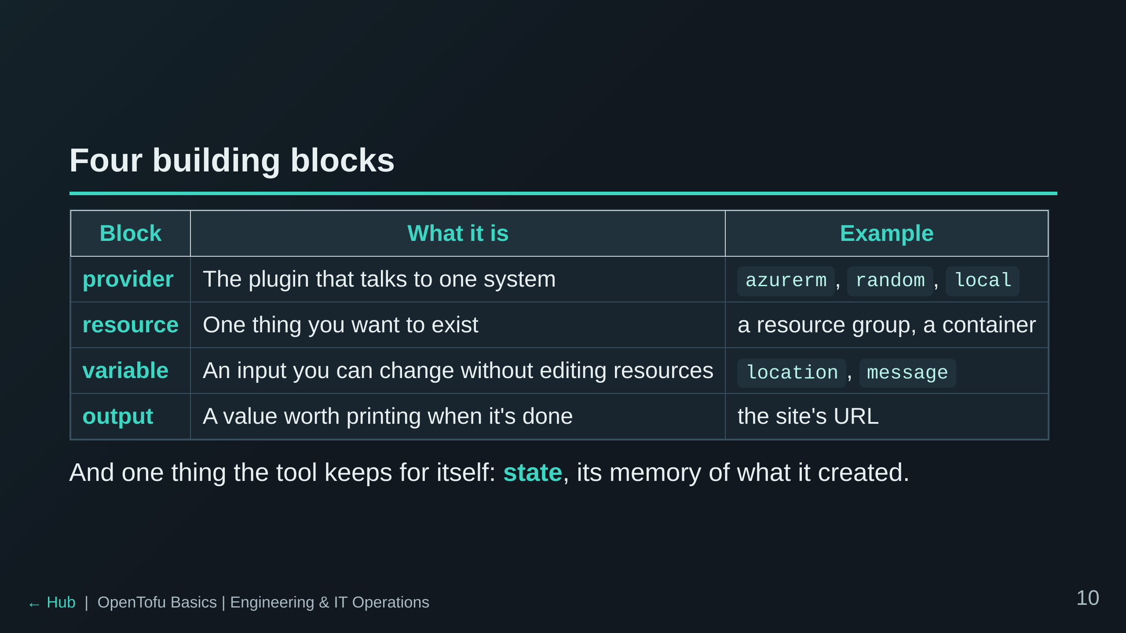
Notes:
Write these four on the board if there is one. Everything in the labs is
one of these. State gets its own slide shortly.

Slide 11
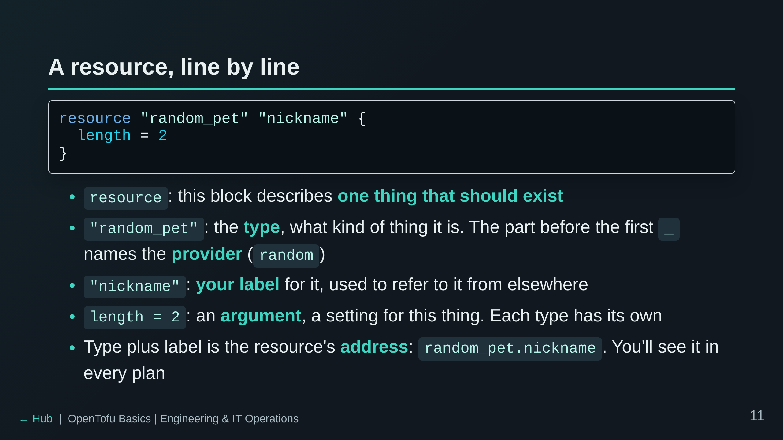
Notes:
random_pet makes a random name like "light-porpoise". It is a good first
resource because it's harmless, and because it only exists in OpenTofu's
state: nothing outside the tool is created. If someone asks "where does the
pet live?", that's the answer.
The label only has to be unique per type in a folder. Renaming it is a
change of address, which OpenTofu reads as delete-and-create.

Slide 12
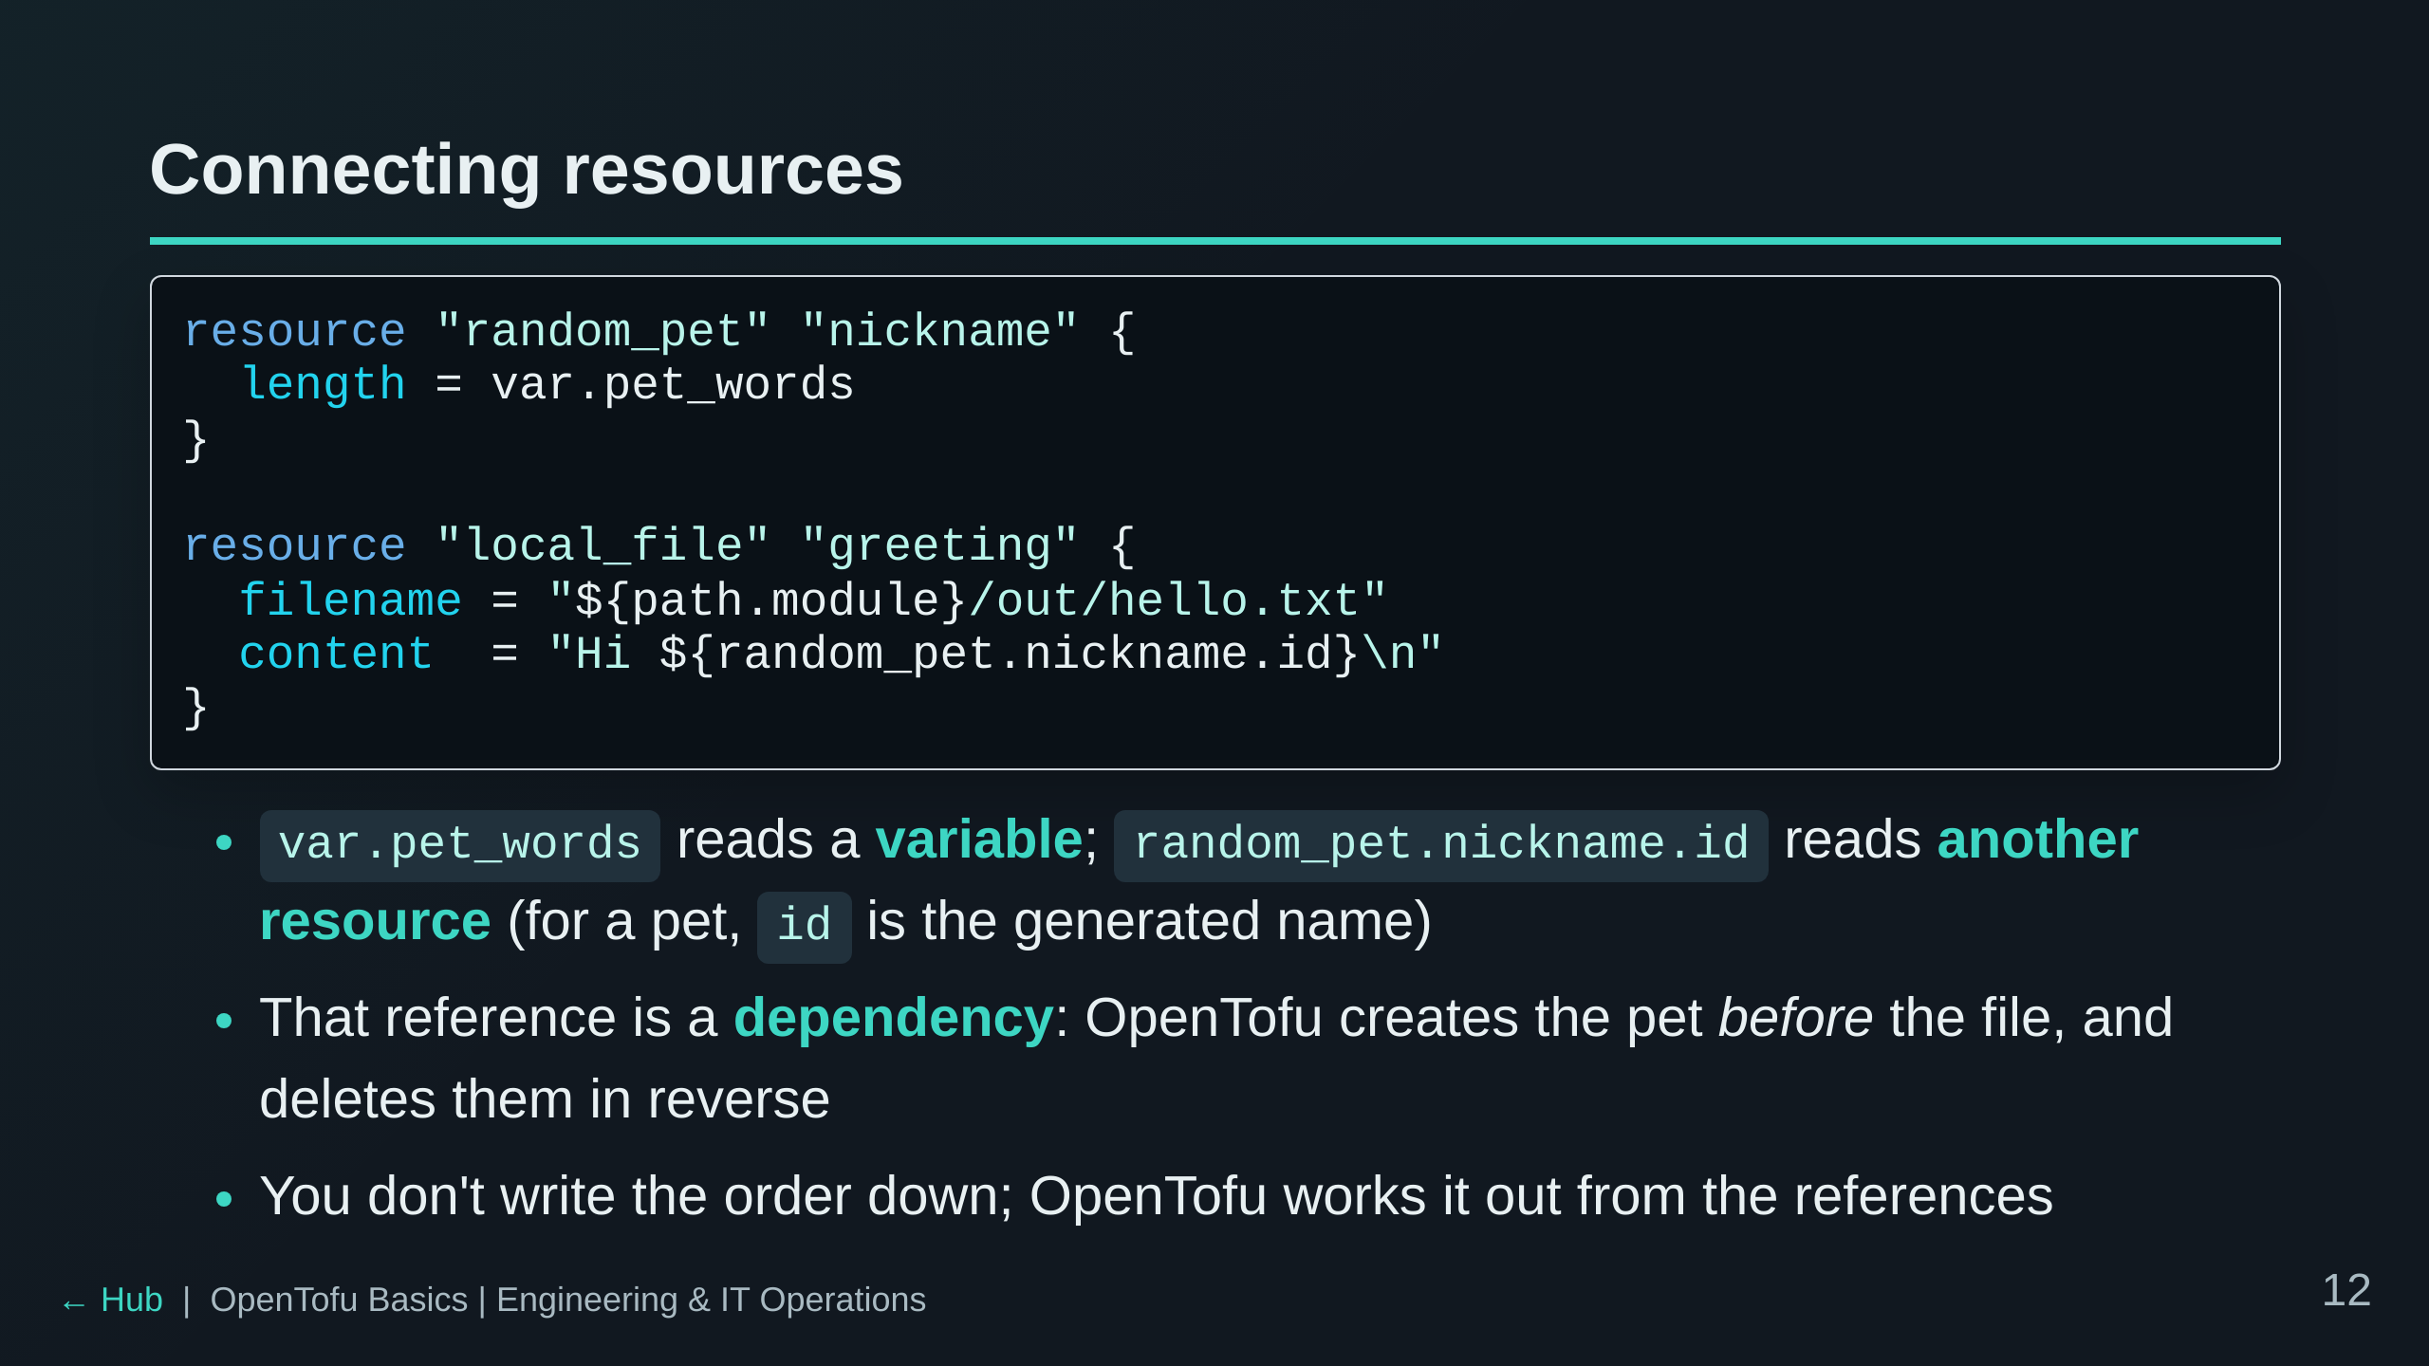
Notes:
This is the sandbox from Track A, simplified. The dependency-by-reference
point is the most important thing on the slide: the order is implicit.
${...} inside a string inserts a value, and path.module means "this
folder". Result: out/hello.txt contains "Hi light-porpoise".
If asked: depends_on exists for the rare dependency OpenTofu can't see from
a reference. You won't need it today.
If asked "can I see the graph?": `terraform graph` prints it as DOT text
(Lab 5 has an optional step). It shows what waits for what, not a fixed
order: independent resources run in parallel (10 at a time by default).
Foreshadow Lab 2: change pet_words and BOTH get replaced, because a new
pet means a new name, which means new file content.

Slide 13
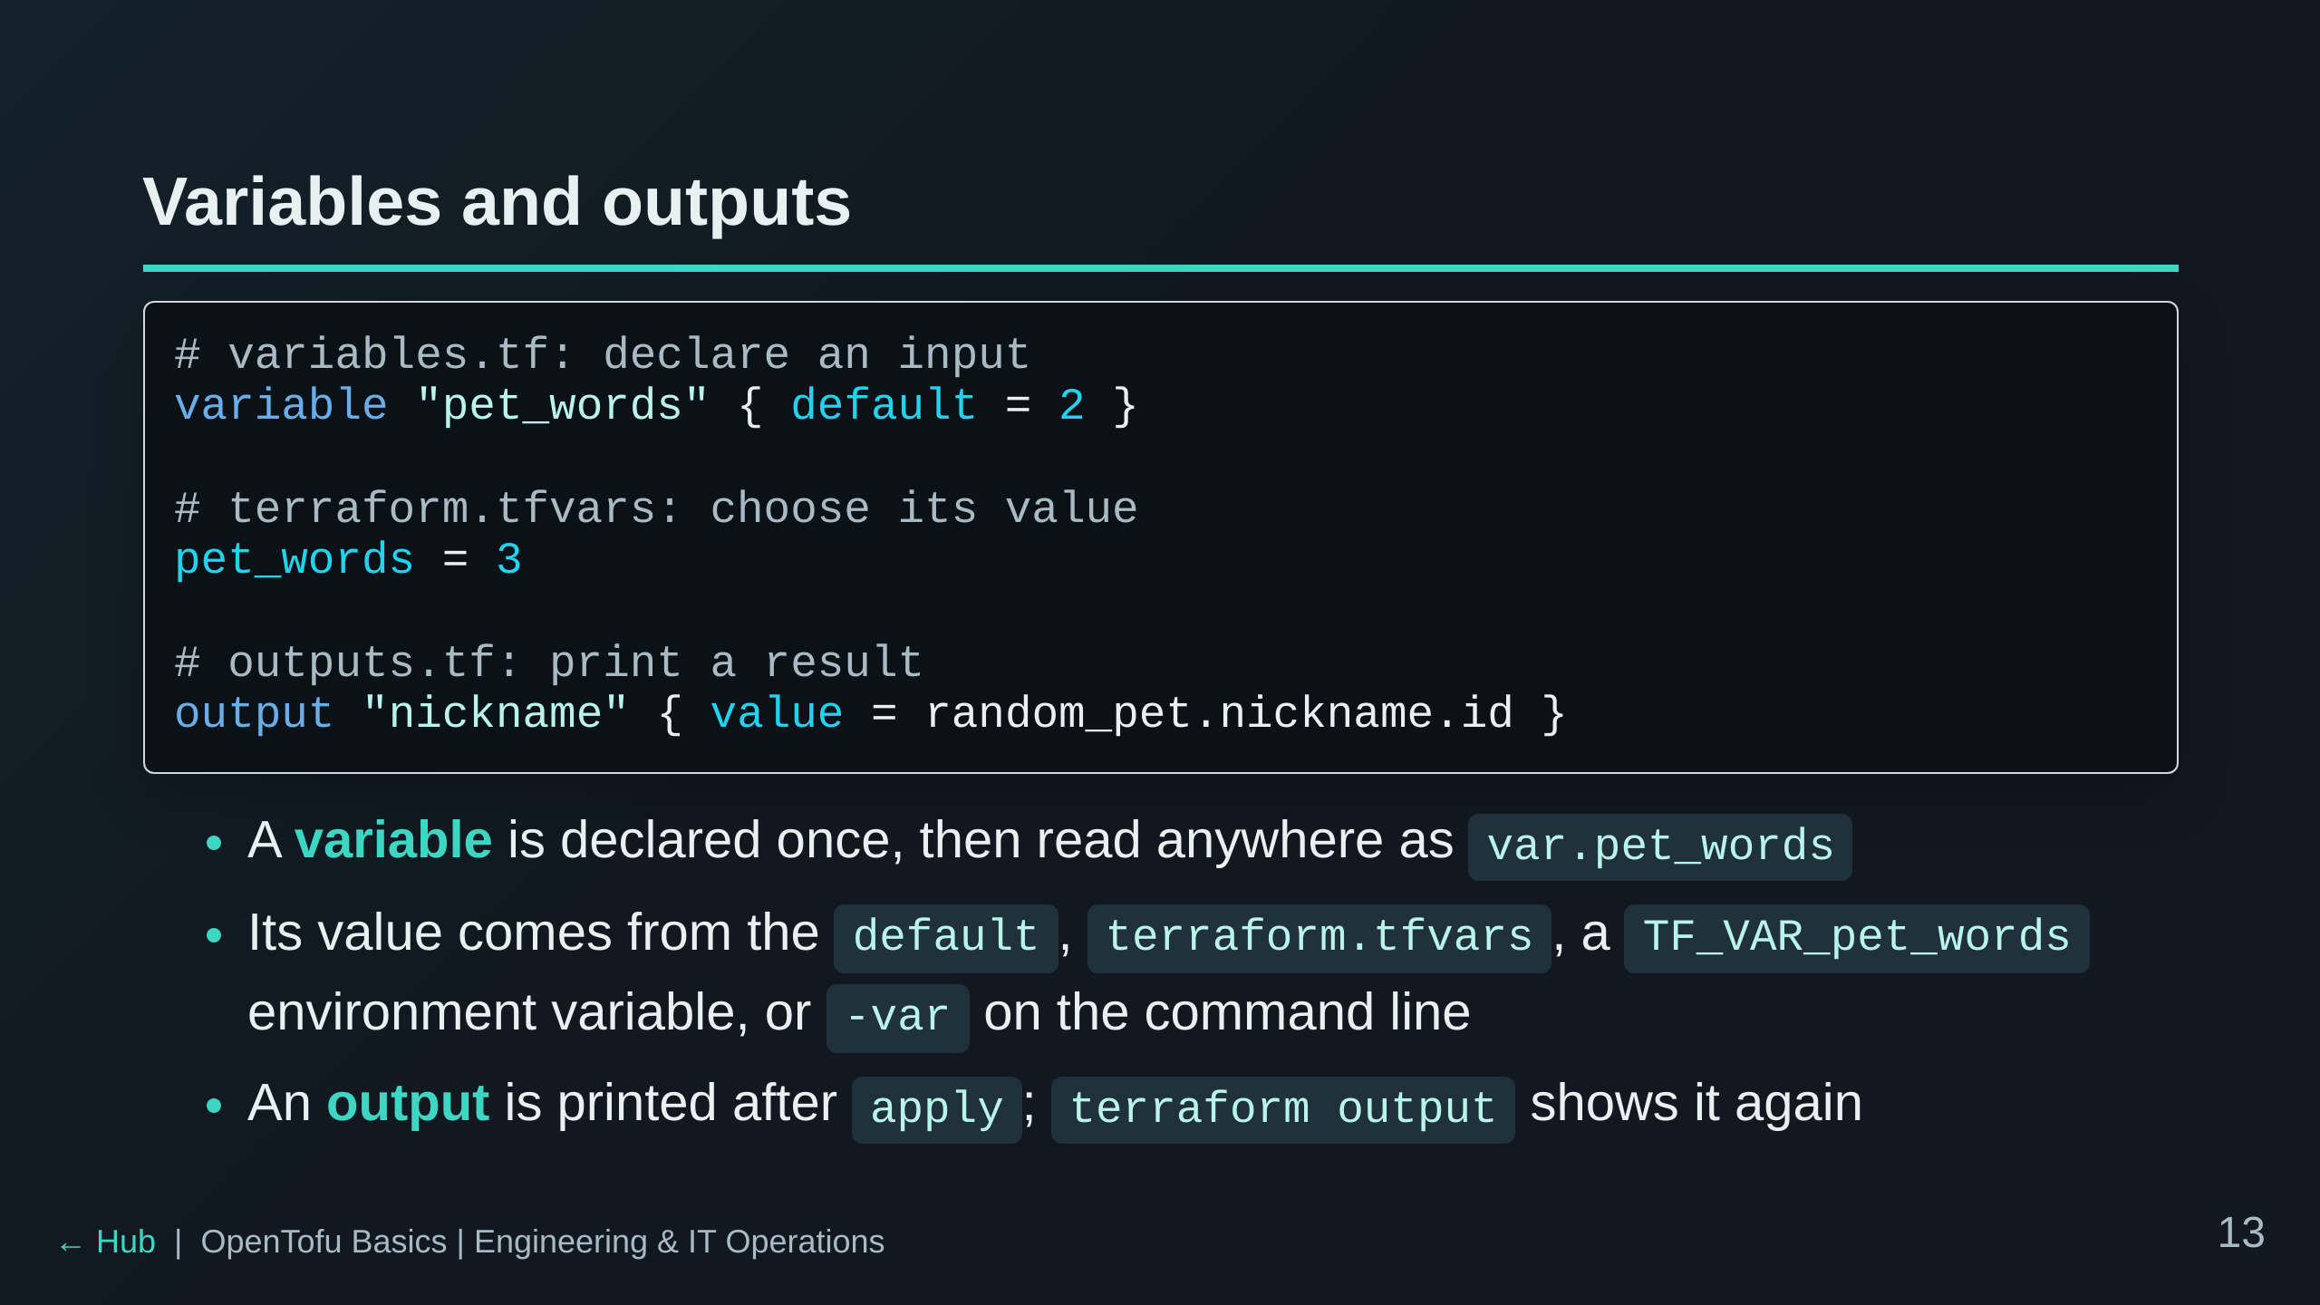
Notes:
The point of variables: the same code, different settings (dev vs prod, a
different region) without touching the resource blocks.
Precedence, if asked: -var wins, then terraform.tfvars, then TF_VAR_, then
the default. Track B uses TF_VAR_owner: your terminal sets your username
for you, which is why variables.tf gives owner no default.

Slide 14
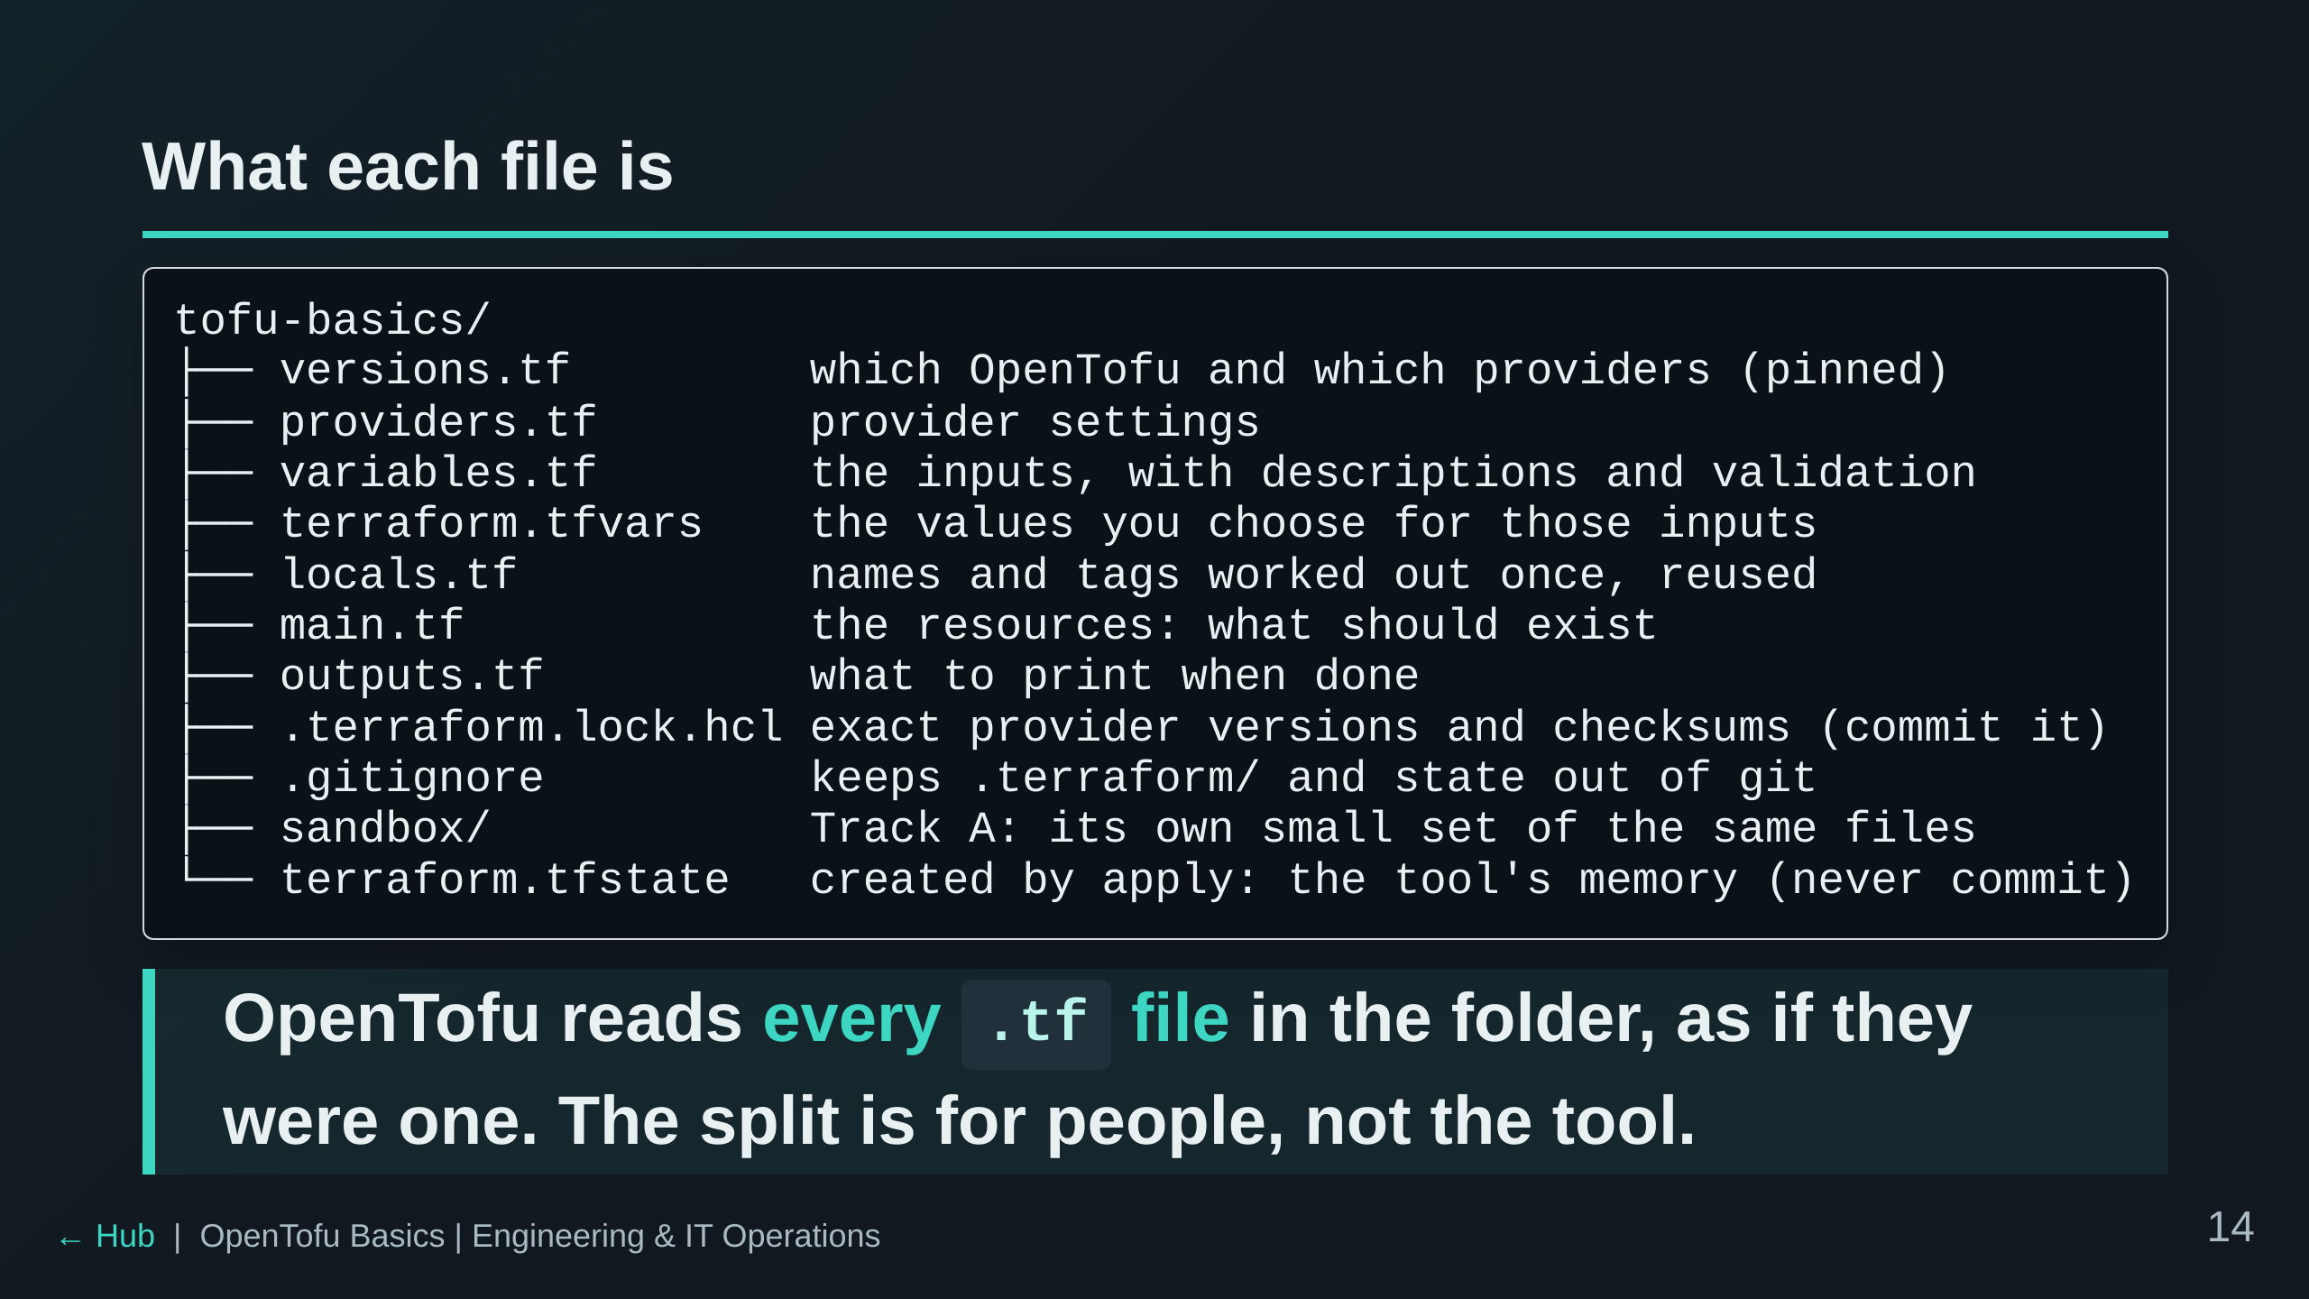
Notes:
The file structure is a stated learning objective. The names are
convention; the tool would work with one giant main.tf. Real repos split
them this way so a reviewer knows where to look. Each folder is its own
separate configuration with its own state: sandbox/ doesn't see the files
above it, and vice versa.

Slide 15
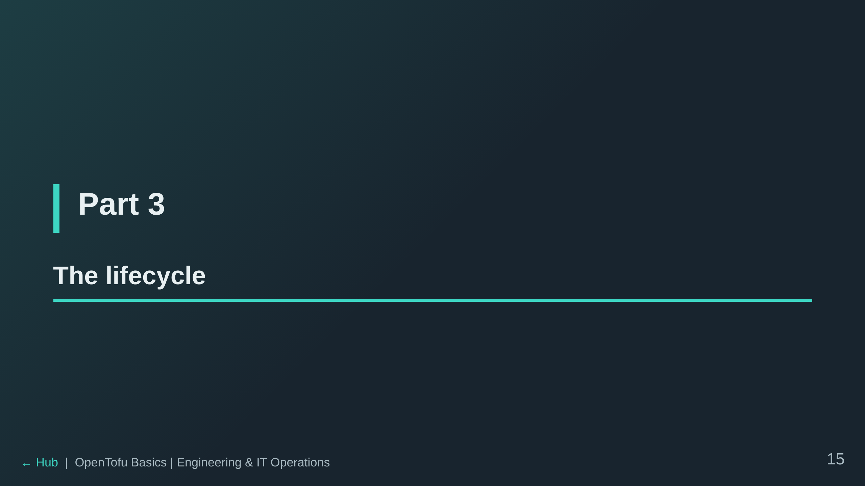

Slide 16
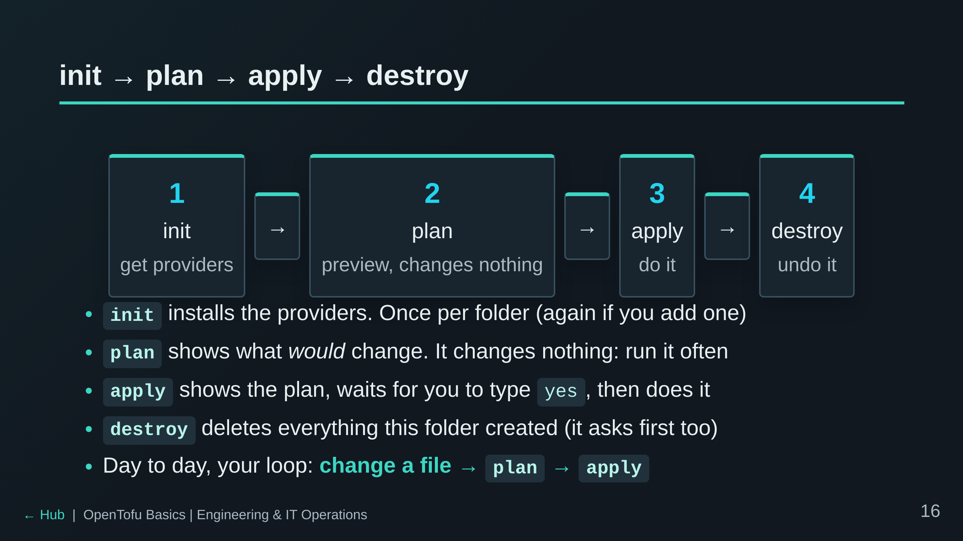
Notes:
Emphasise that plan is safe. People are scared of the tool at first; the
fix is to run plan constantly. Apply and destroy are the only steps with
consequences, and both ask first.

Slide 17
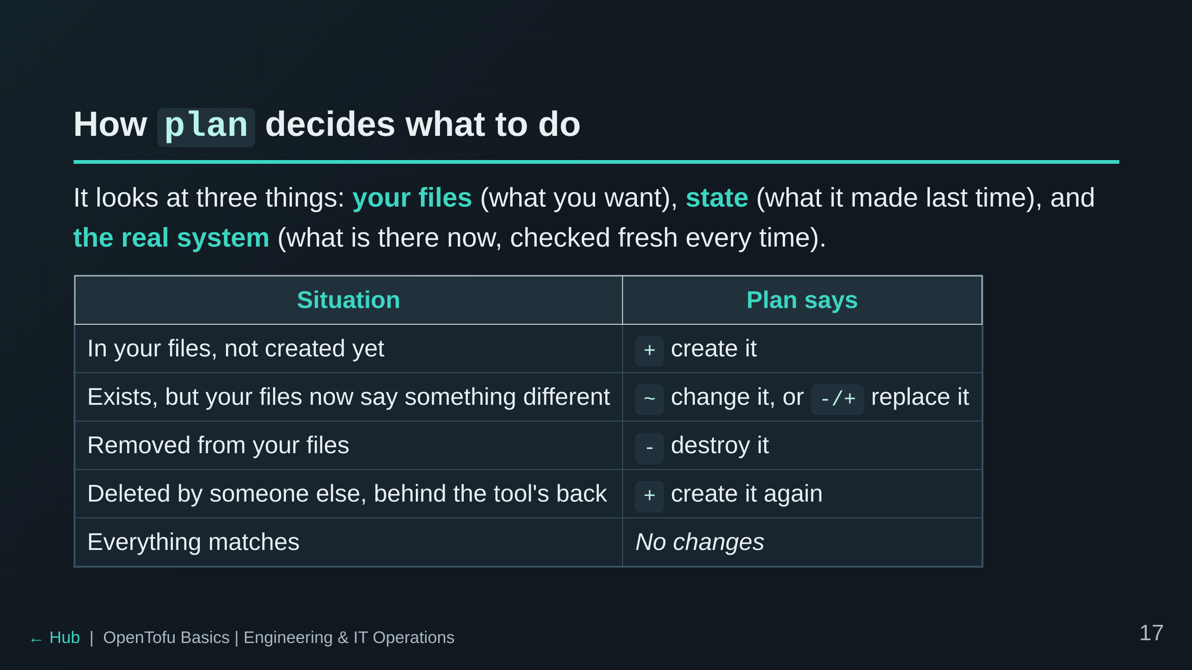
Notes:
This is the heart of how the tool works: it doesn't replay a script, it
compares "wanted" with "is" and plans the difference. The fourth row is
drift, which students will cause on purpose in Lab 7. Whether a change is
~ or -/+ is the next slide.

Slide 18
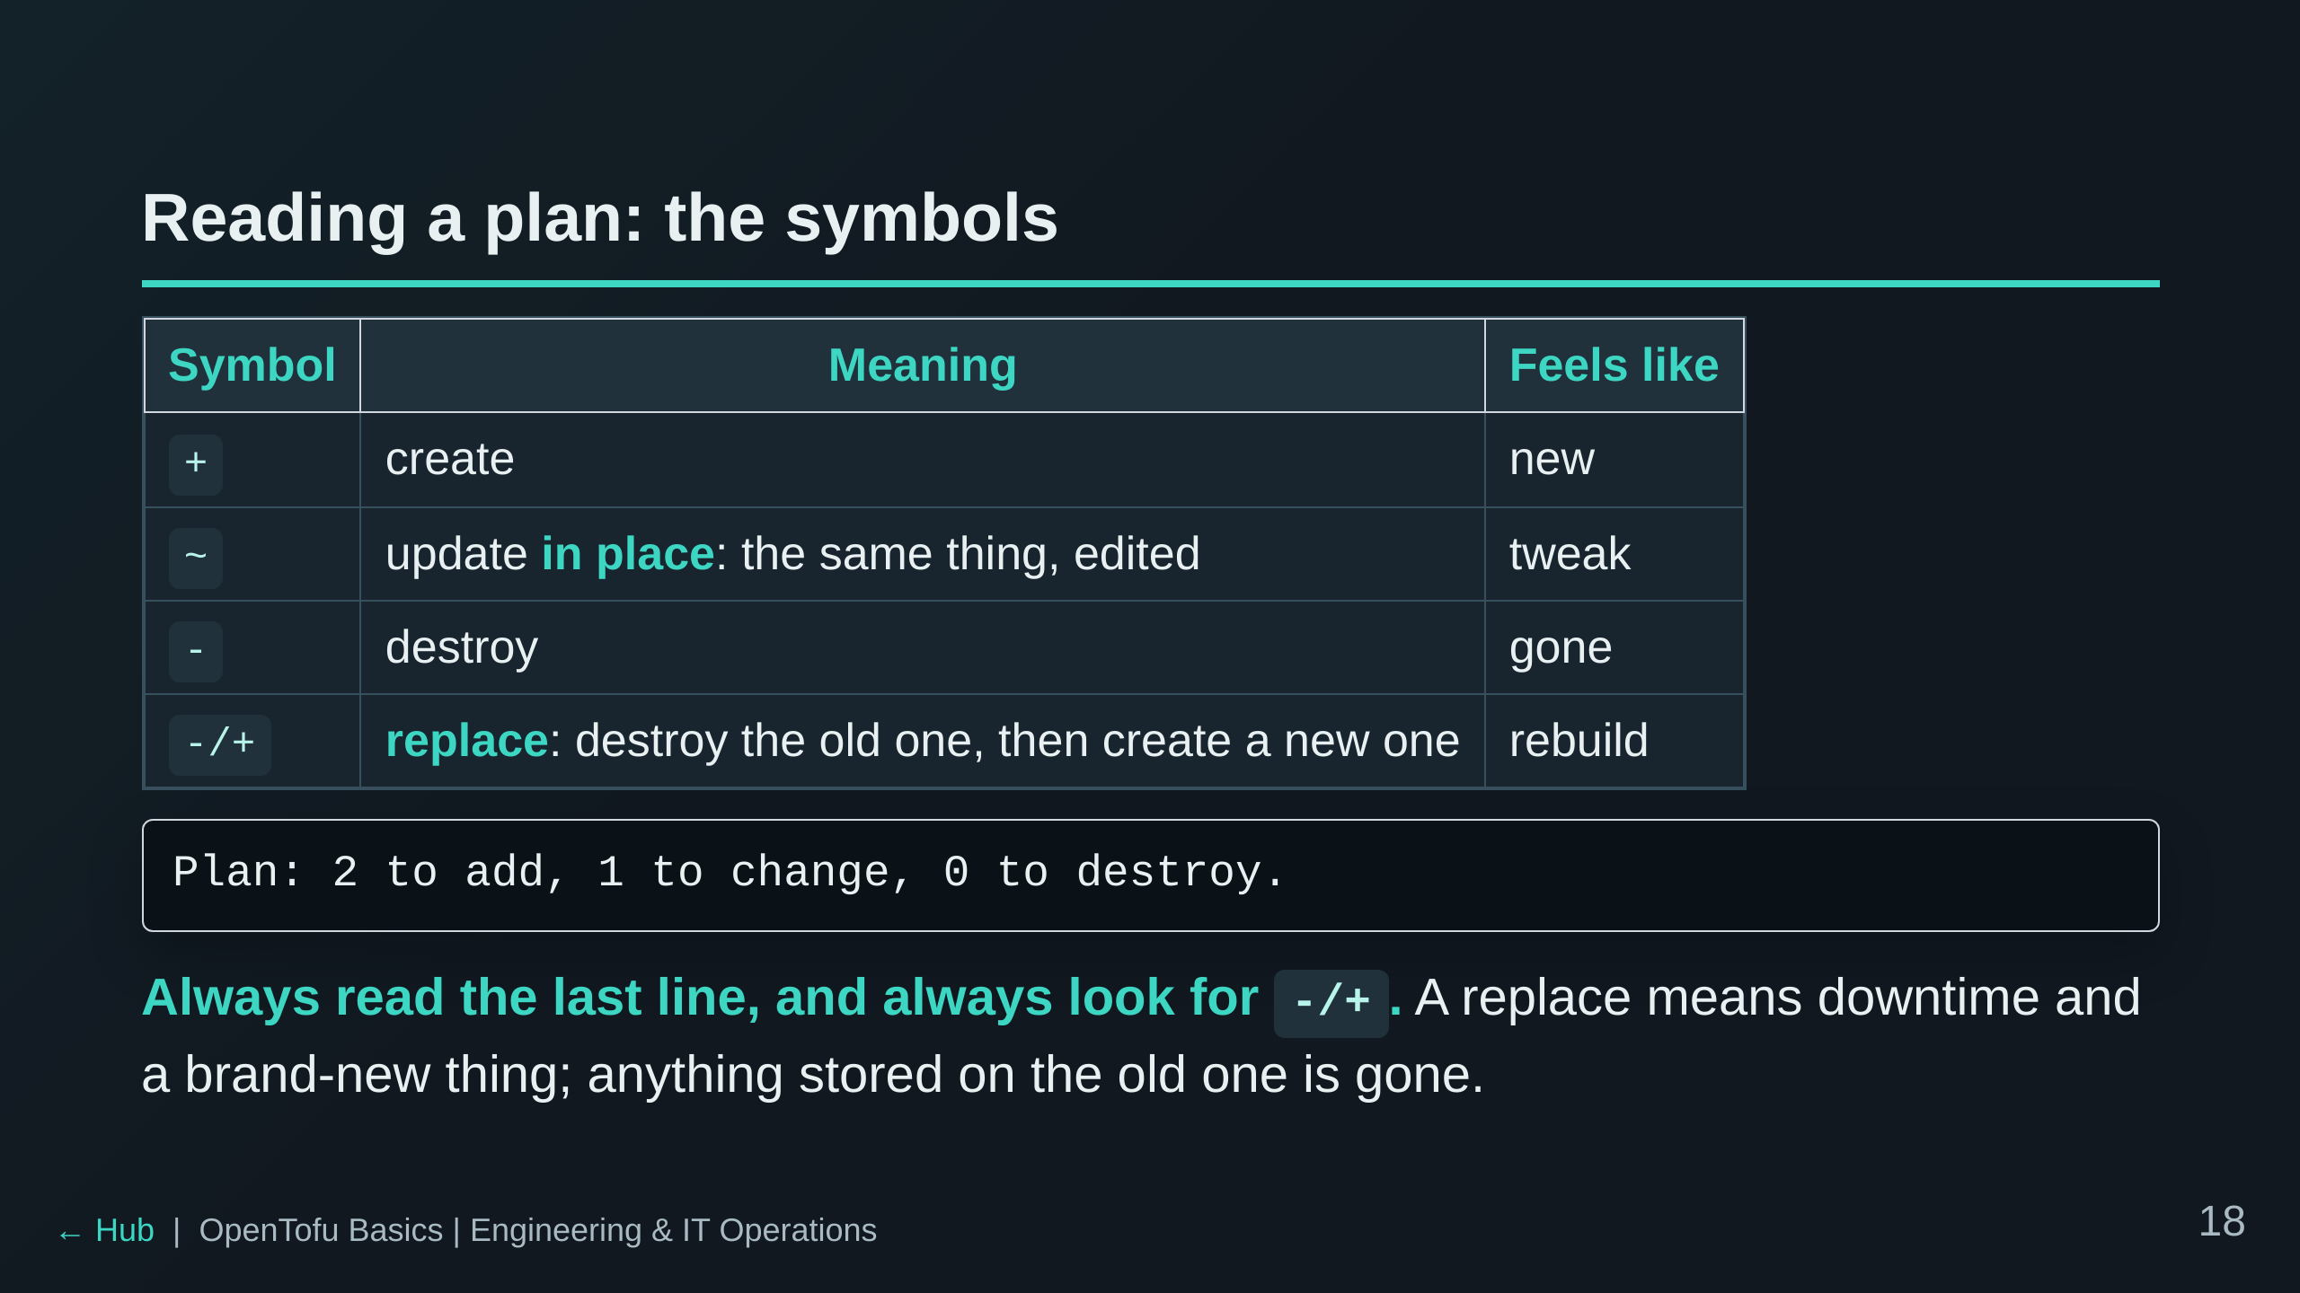
Notes:
Whether an edit is ~ or -/+ is decided by the provider, attribute by
attribute: some settings simply can't be changed on a thing that already
exists. The plan prints "# forces replacement" next to the attribute
responsible: tell people to look for it. Lab 8 measures it on a real resource: a tag is ~, a message or
image is -/+ (and the site is down for ~26 s). Lab 8 also shows +/-, the
reverse order (create the new one first), which you opt into with
create_before_destroy. A replace counts in both "to add" and "to destroy".

Slide 19
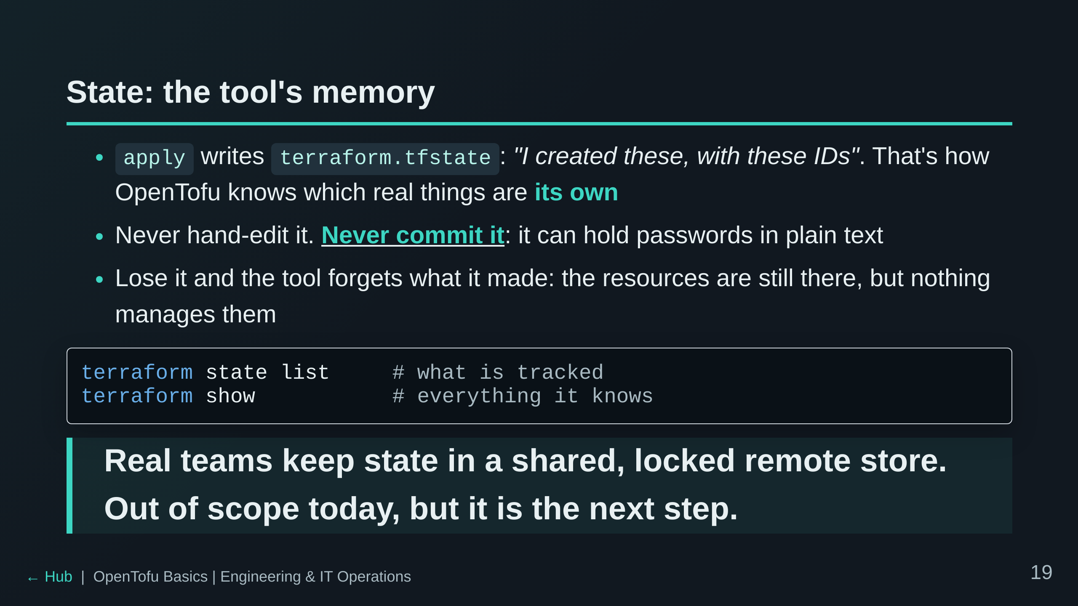
Notes:
The orphaned-resources point pays off in Track B: a student who deletes
their state file has cloud resources they cannot manage. The facilitator
can Purge that student's subscription from the portal. Mention that so
nobody panics.

Slide 20
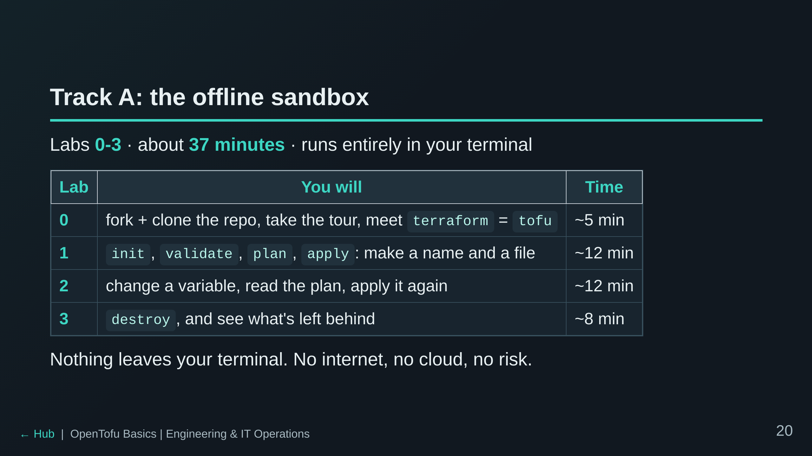
Notes:
Hand over to the room here. Walk to the labs page (labs.md) and point at
~/lab/README.md inside the terminal. Check in at around 15 minutes; Lab 2
is where the ~ vs -/+ mix first shows up.

Slide 21
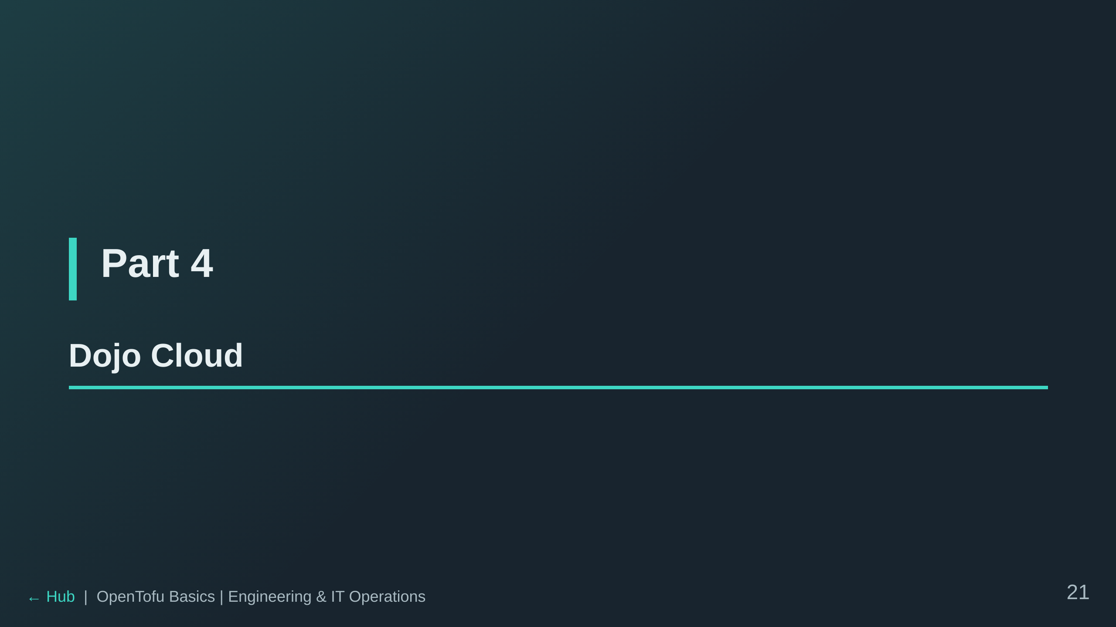

Slide 22
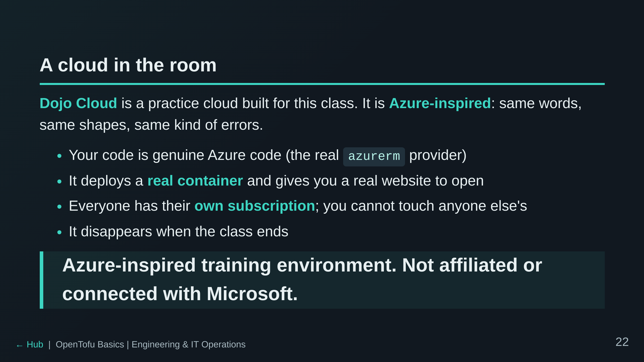
Notes:
Be honest about what it is: a small stand-in that speaks Azure's language.
The provider is the real one, so skills transfer. Do not oversell it as
real Azure, and do not say it is Azure.

Slide 23
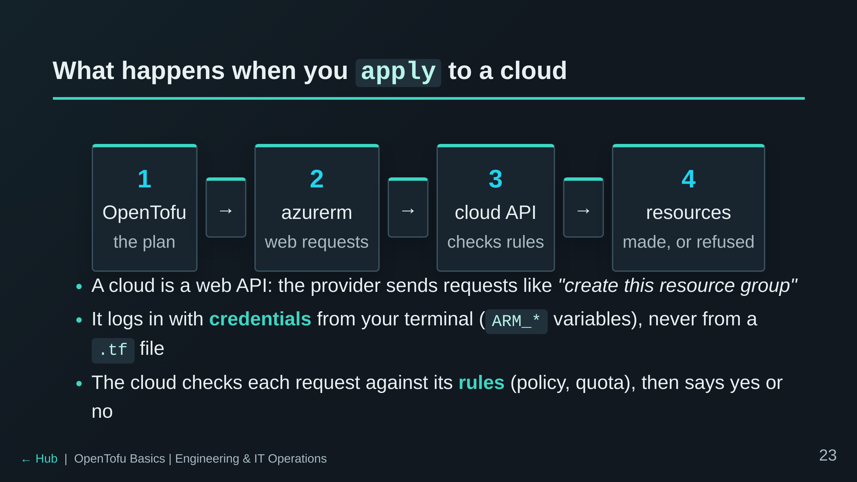
Notes:
Lab 4 shows this for real: students look at their ARM_* variables and
curl the cloud's front door. The takeaway: OpenTofu doesn't do anything a
script couldn't; it just sends the right requests in the right order and
remembers the results.

Slide 24
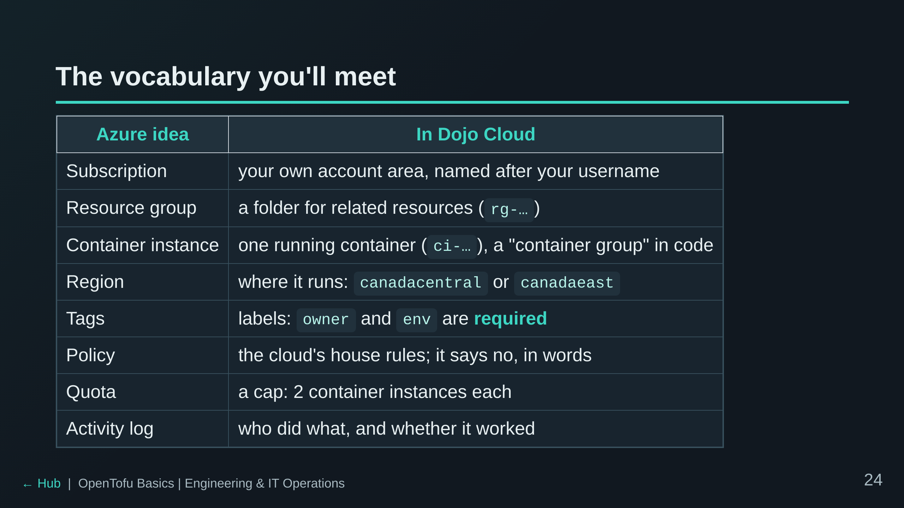
Notes:
Do not read the table out. Point at "Policy" and "Quota": those are the
two that produce errors students will see, on purpose, in Labs 6 and 9.
The portal says "container instance"; Azure's API and the provider say
"container group" (a group can hold several containers; ours hold one).

Slide 25
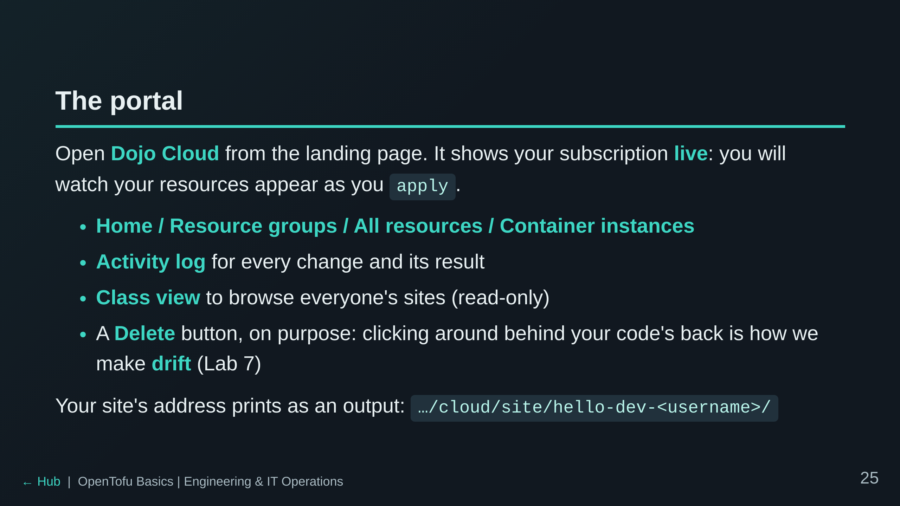
Notes:
The facilitator has the whole class on a Class progress board, so do not
worry about a student getting stuck silently. Say that out loud: it is
reassuring.

Slide 26
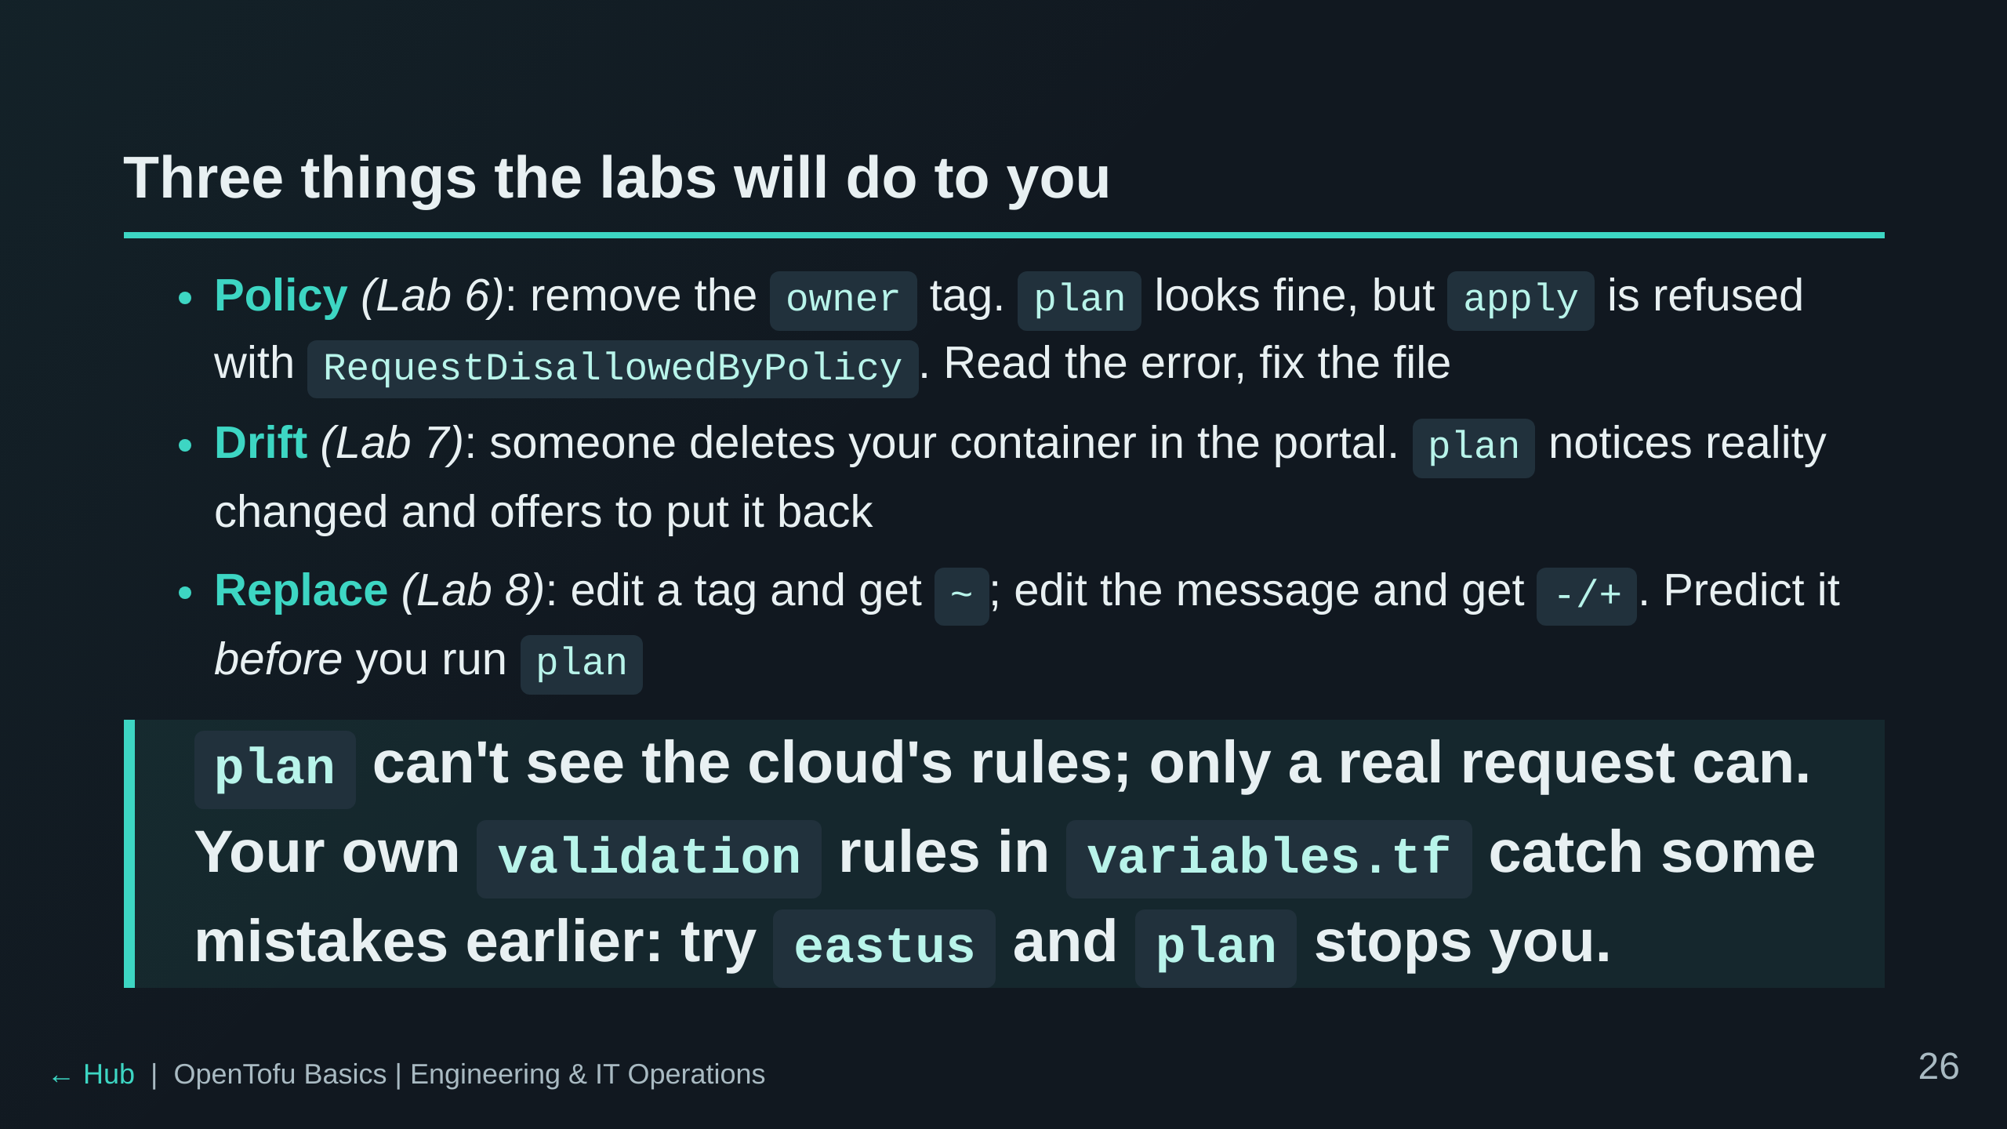
Notes:
This is the foreshadowing slide. The key insight for Lab 6 and Lab 9:
plan computes what to ask for; the cloud decides whether to say yes.
Two layers: validation (your code, at plan, instant) repeats some of the
cloud's rules so you fail fast; policy (the cloud, at apply) is the real
rule and can't be bypassed. Lab 6 shows both.

Slide 27
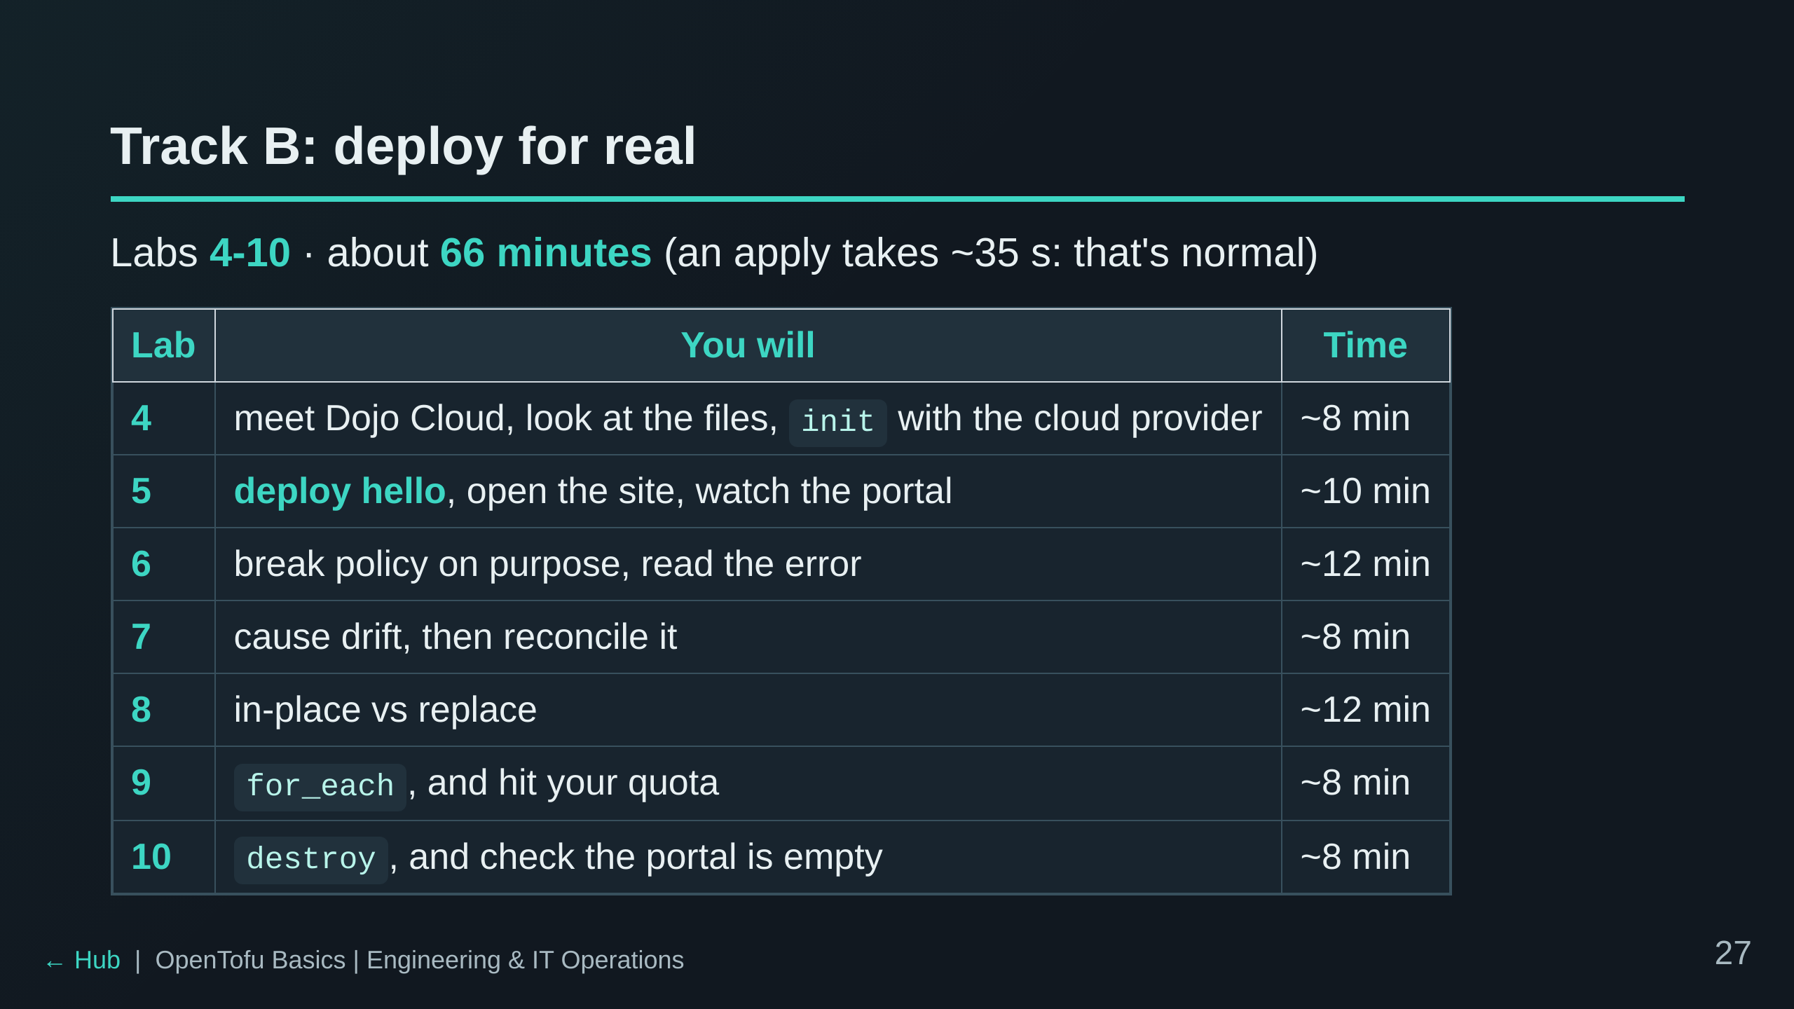
Notes:
Each lab builds on Lab 5's deployment, so keep the order and do not let
anyone destroy before Lab 10. Labs 4, 5 and 10 are the spine. To save time,
drop Lab 9 (Lab 10 copes with or without its extra containers) and/or the
optional last section of Lab 8. Lab 9 half-applies on purpose (the quota
error); make sure people finish its clean-up section before Lab 10.

Slide 28
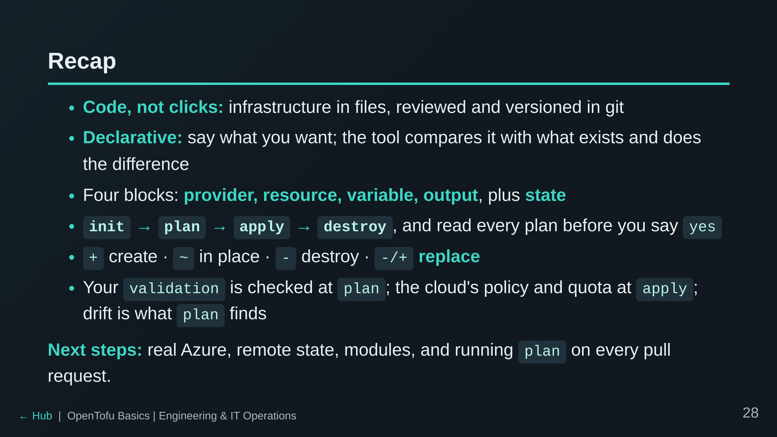
Notes:
Ask each table for one thing that surprised them. Common answers: apply
being slow, plan not catching a policy error, drift.

Slide 29
