Slide 1
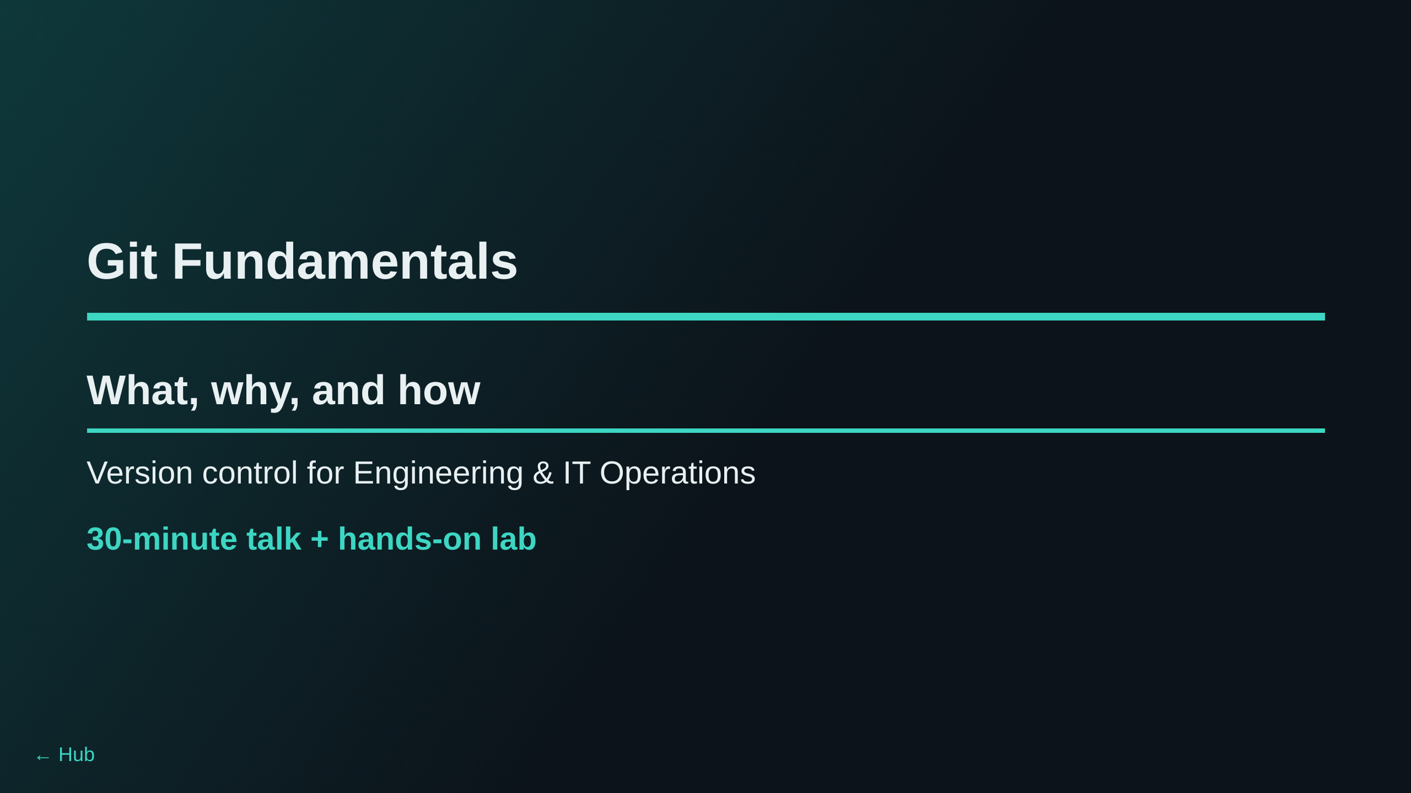
Notes:
Welcome everyone. Cover session logistics. The lab runs entirely in the browser,
so attendees do not need Git or an editor installed locally.

Slide 2
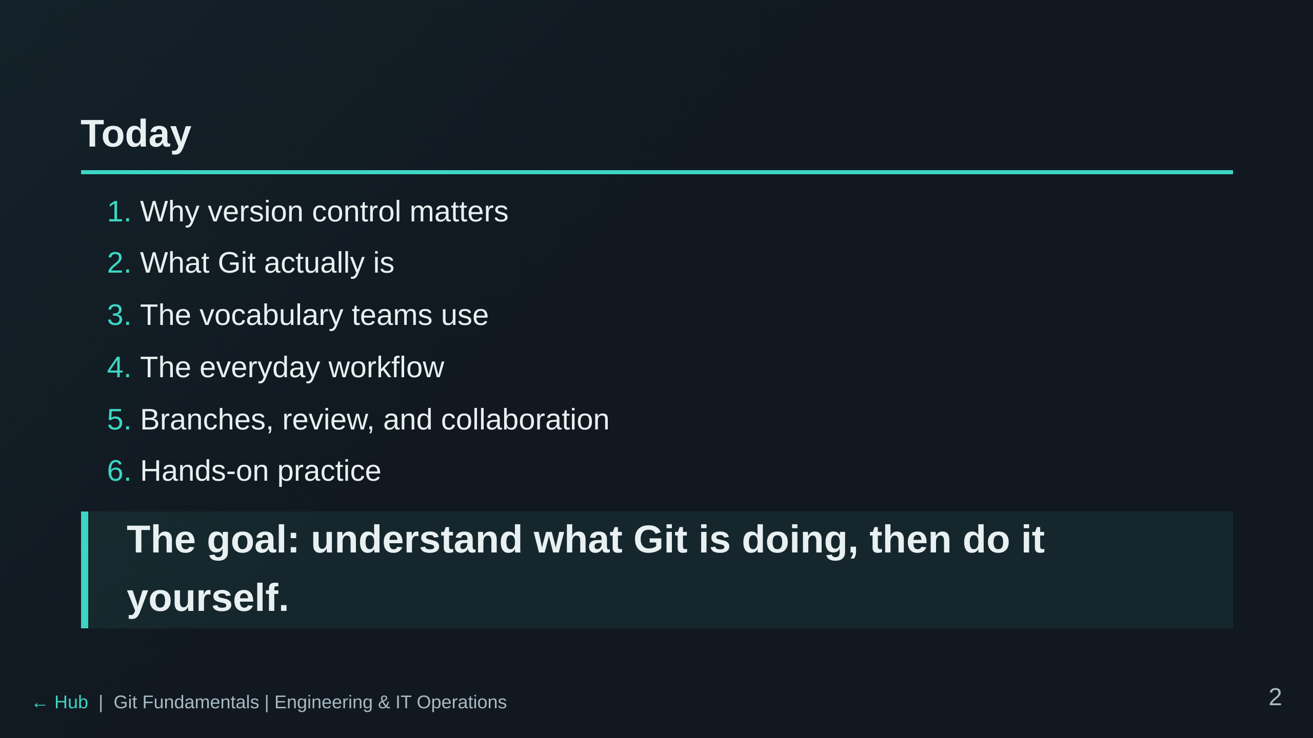
Notes:
Ask for a quick show of hands: who has used Git before?

Slide 3
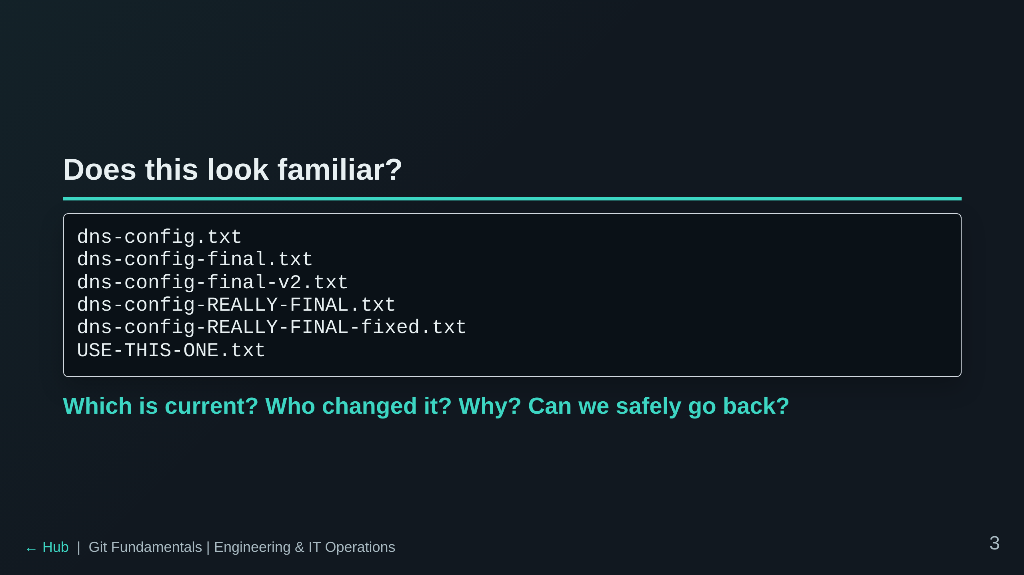
Notes:
Let the room react. This is the problem Git formalizes and solves.

Slide 4
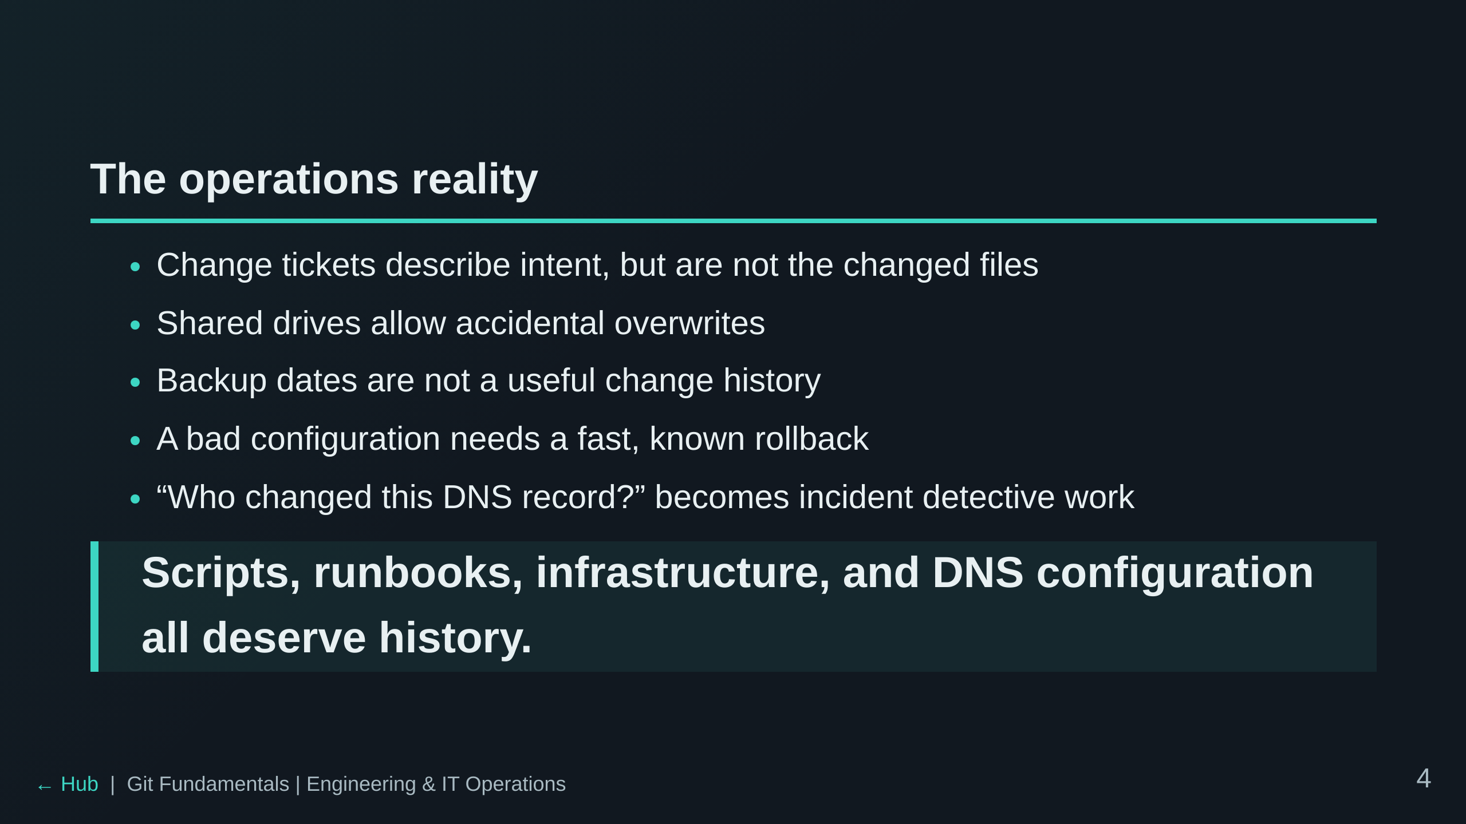

Slide 5
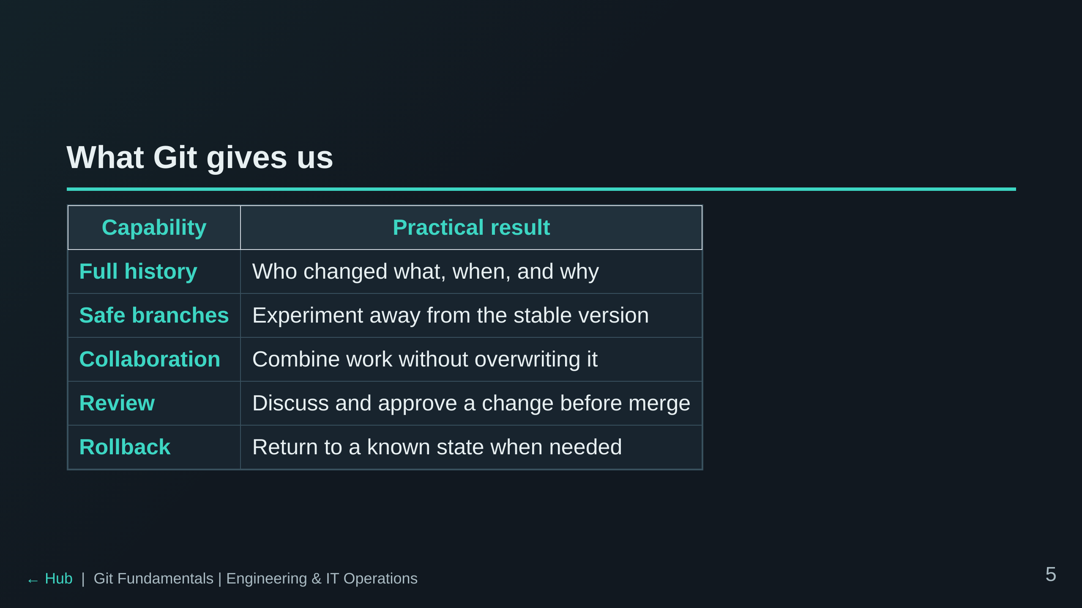

Slide 6
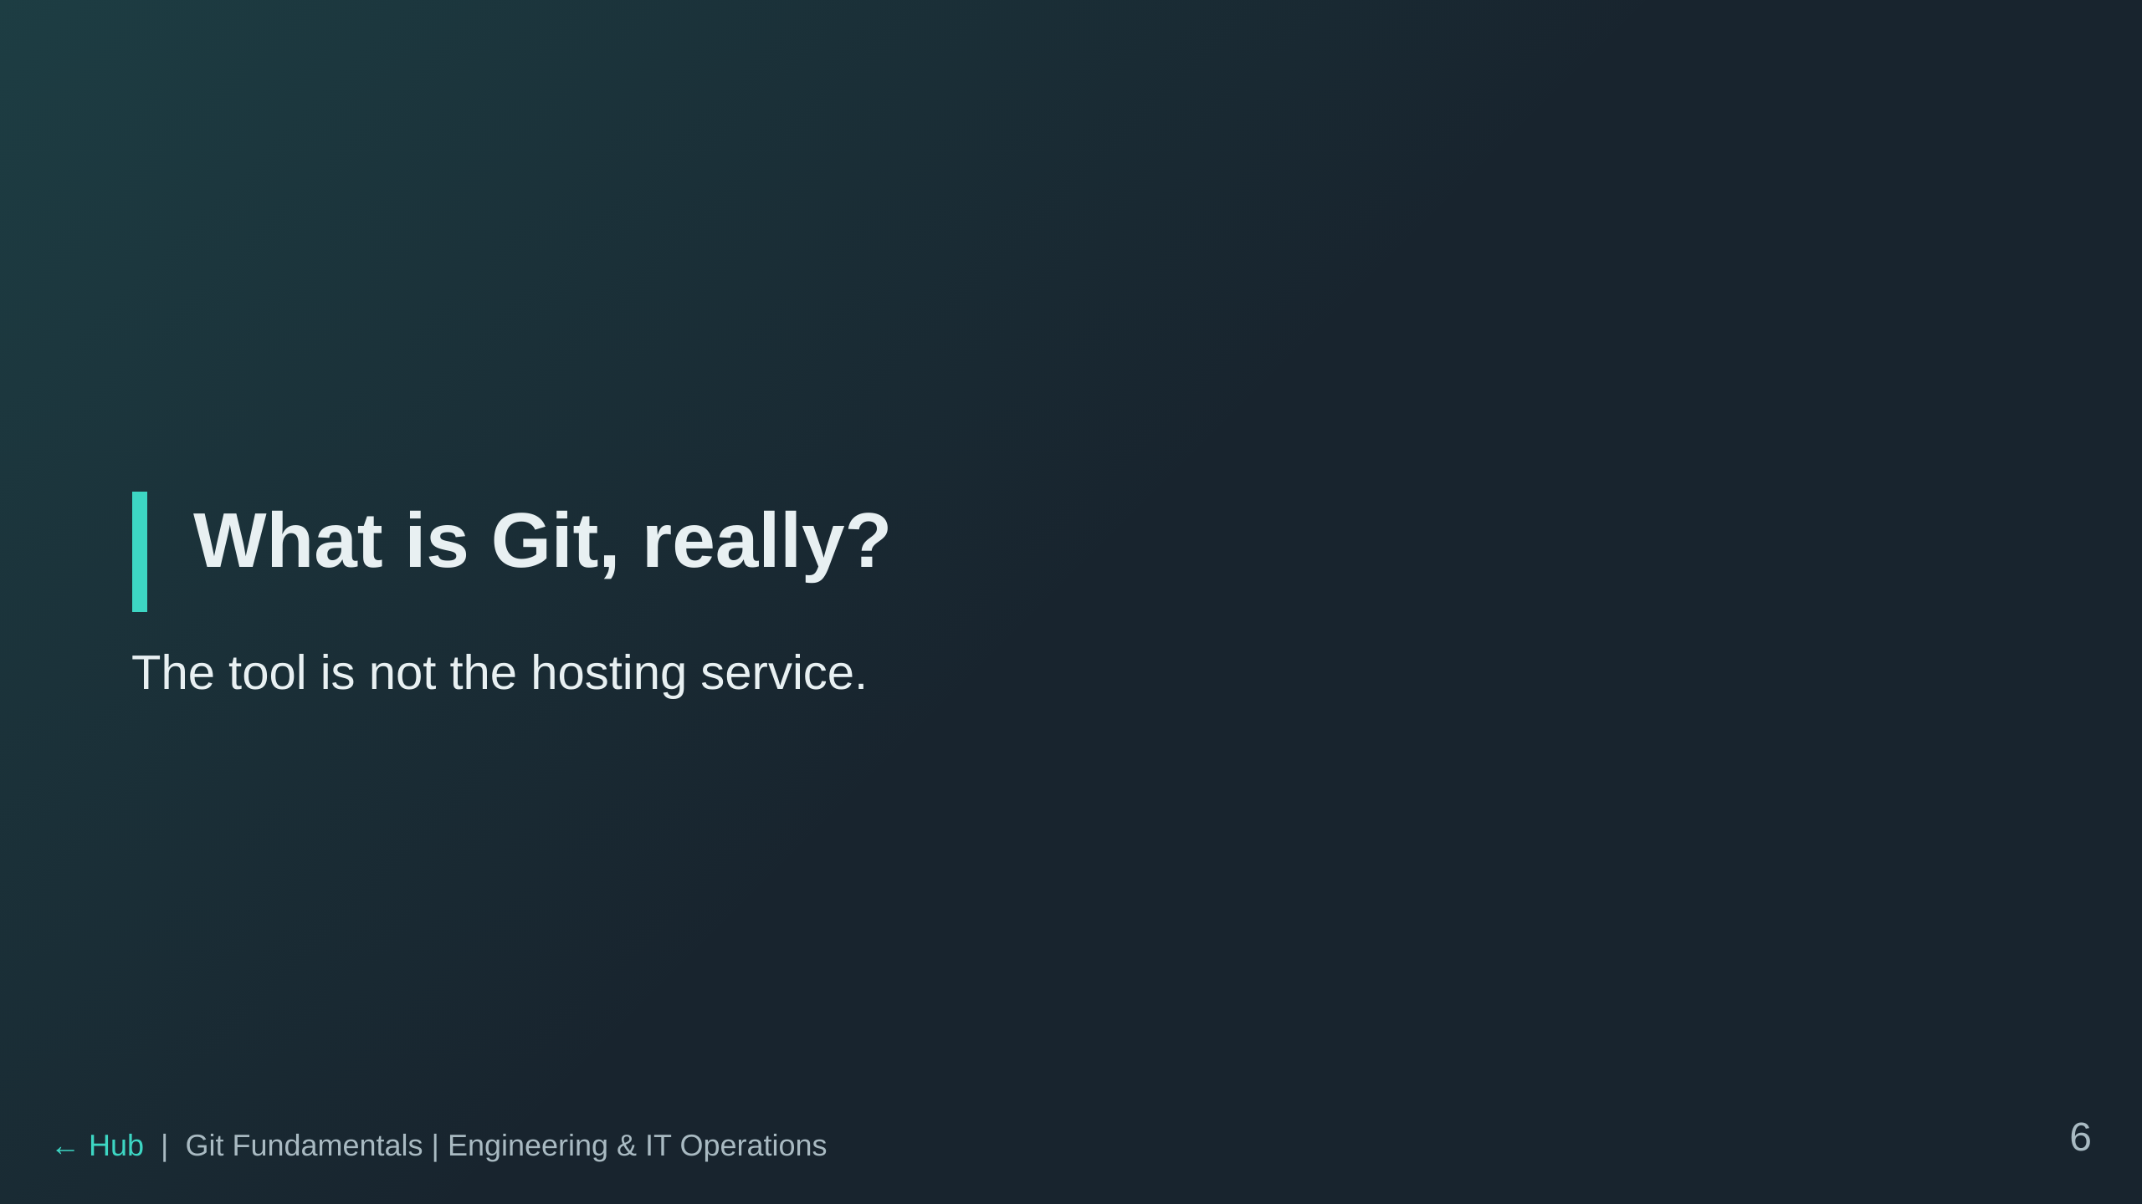

Slide 7
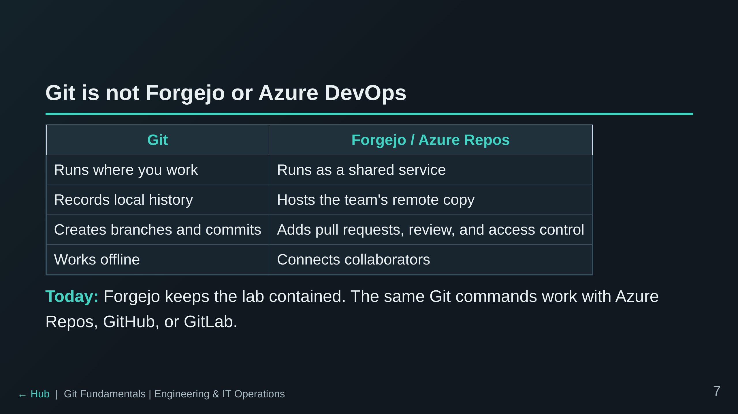

Slide 8
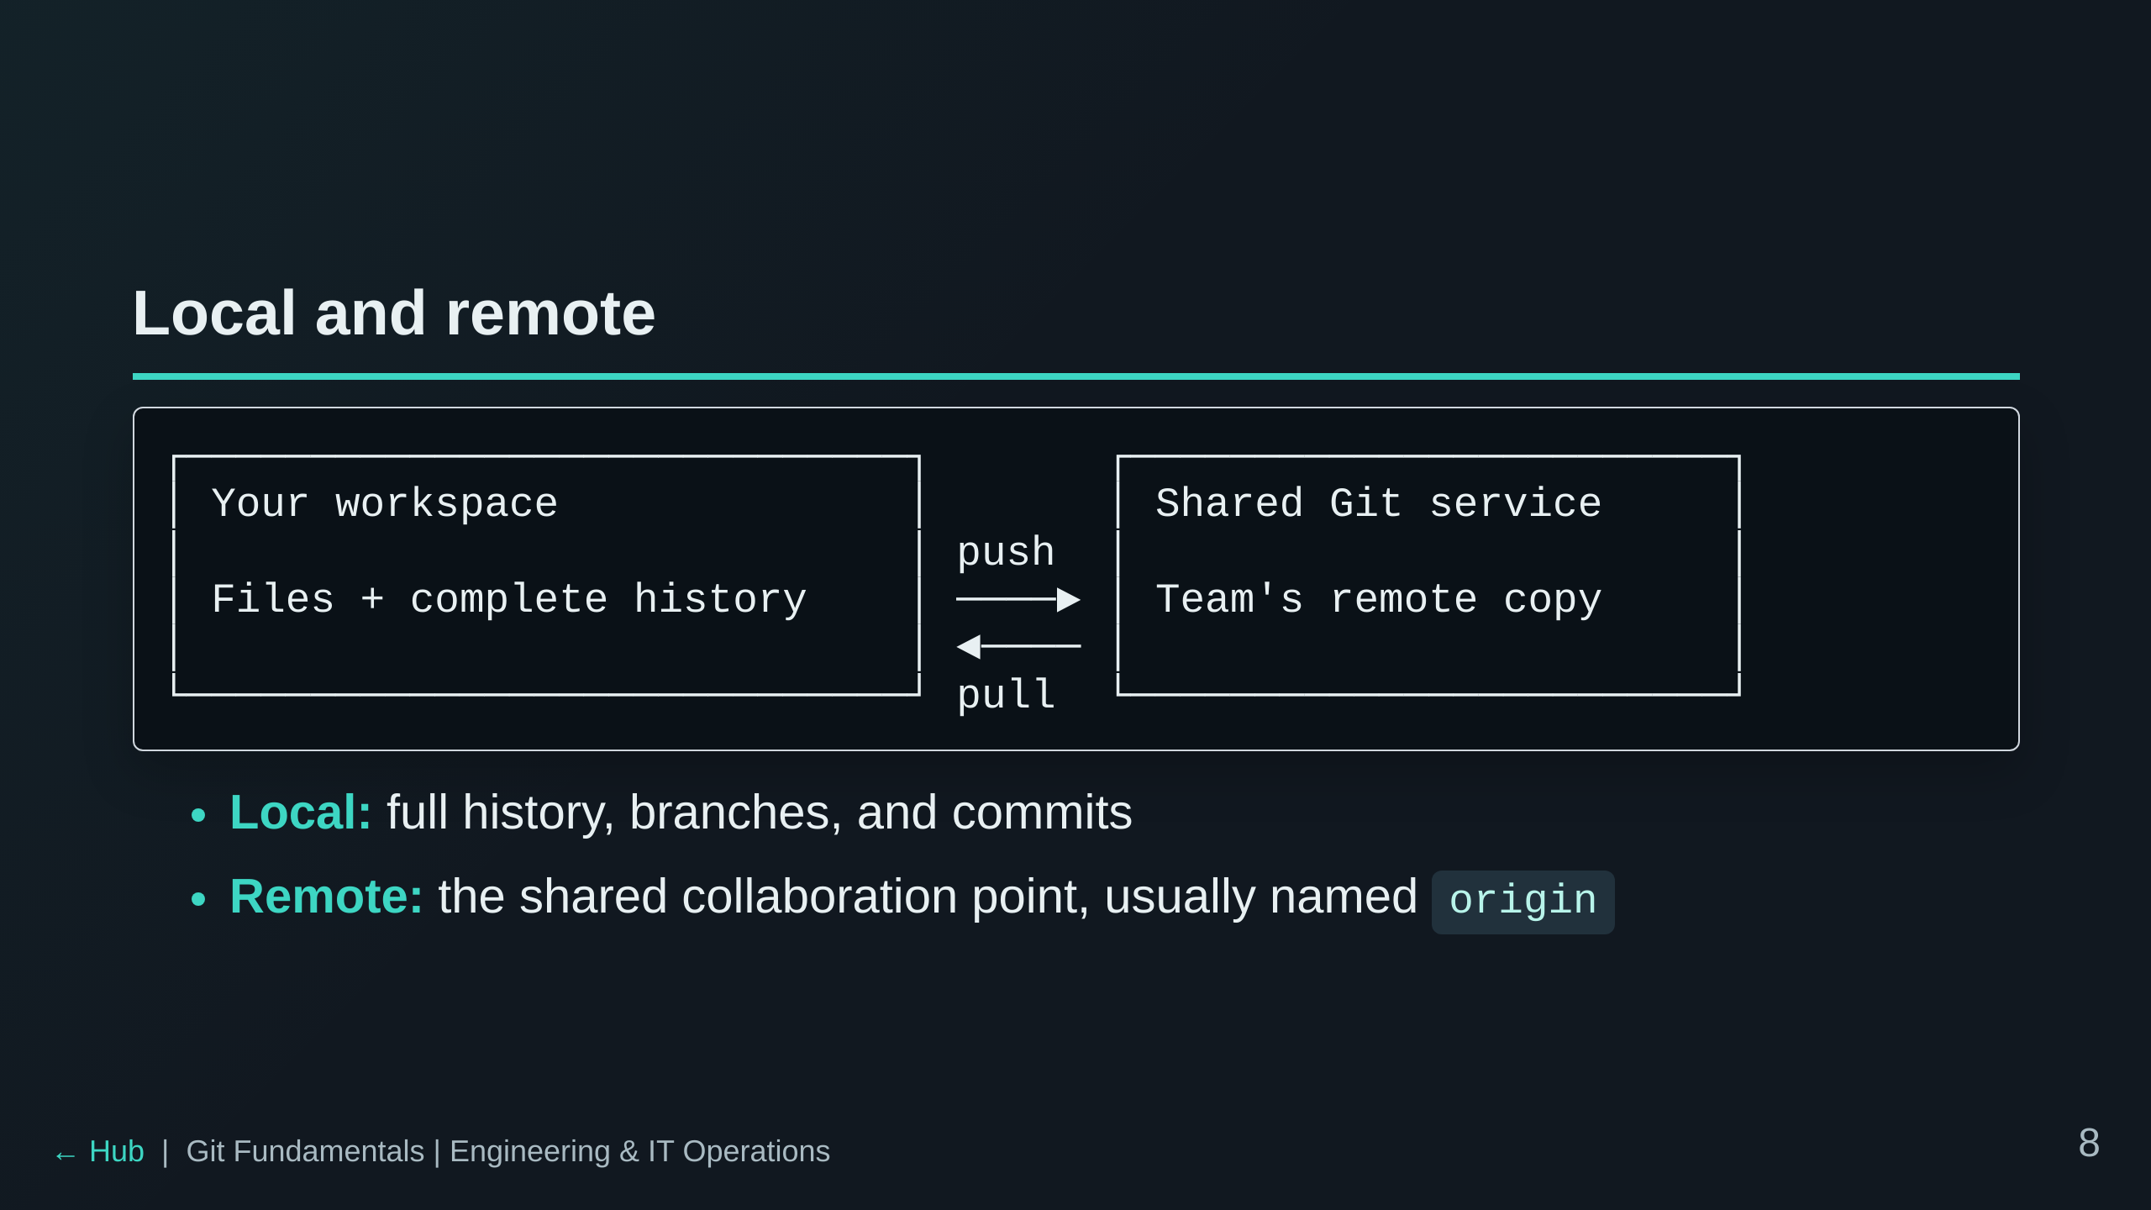

Slide 9
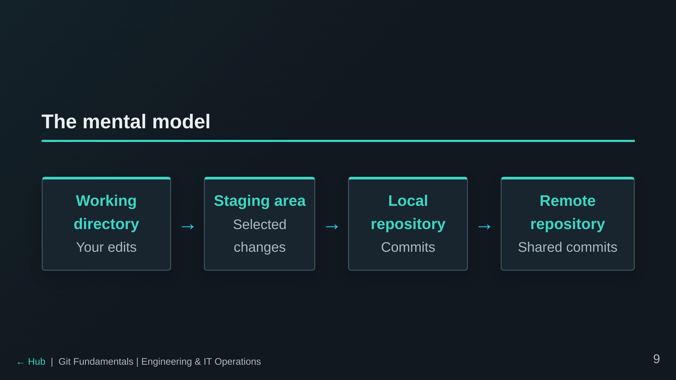
Notes:
This is the anchor diagram. Refer back to these four zones.

Slide 10
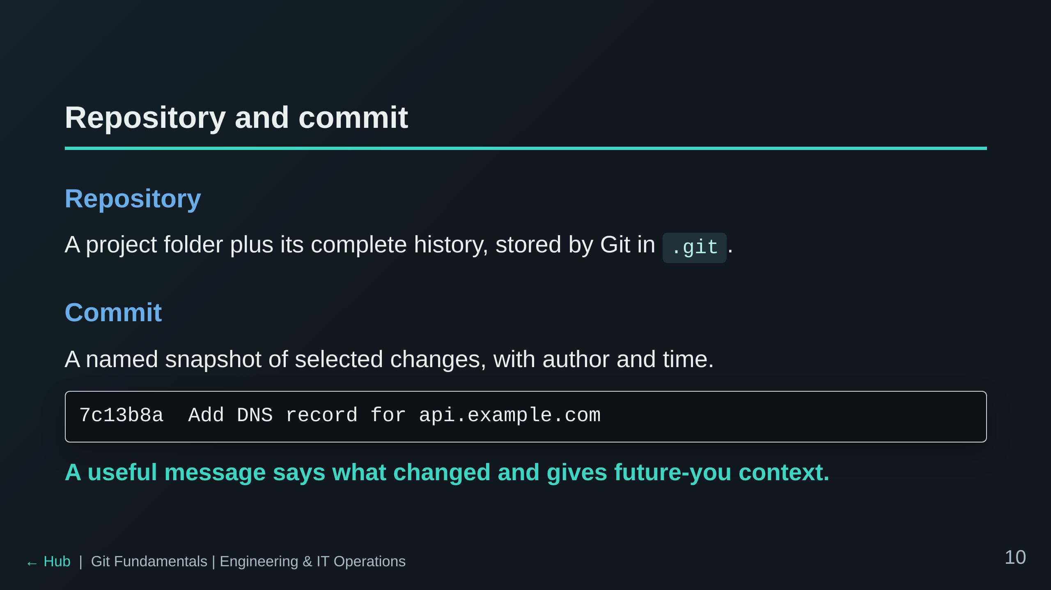

Slide 11
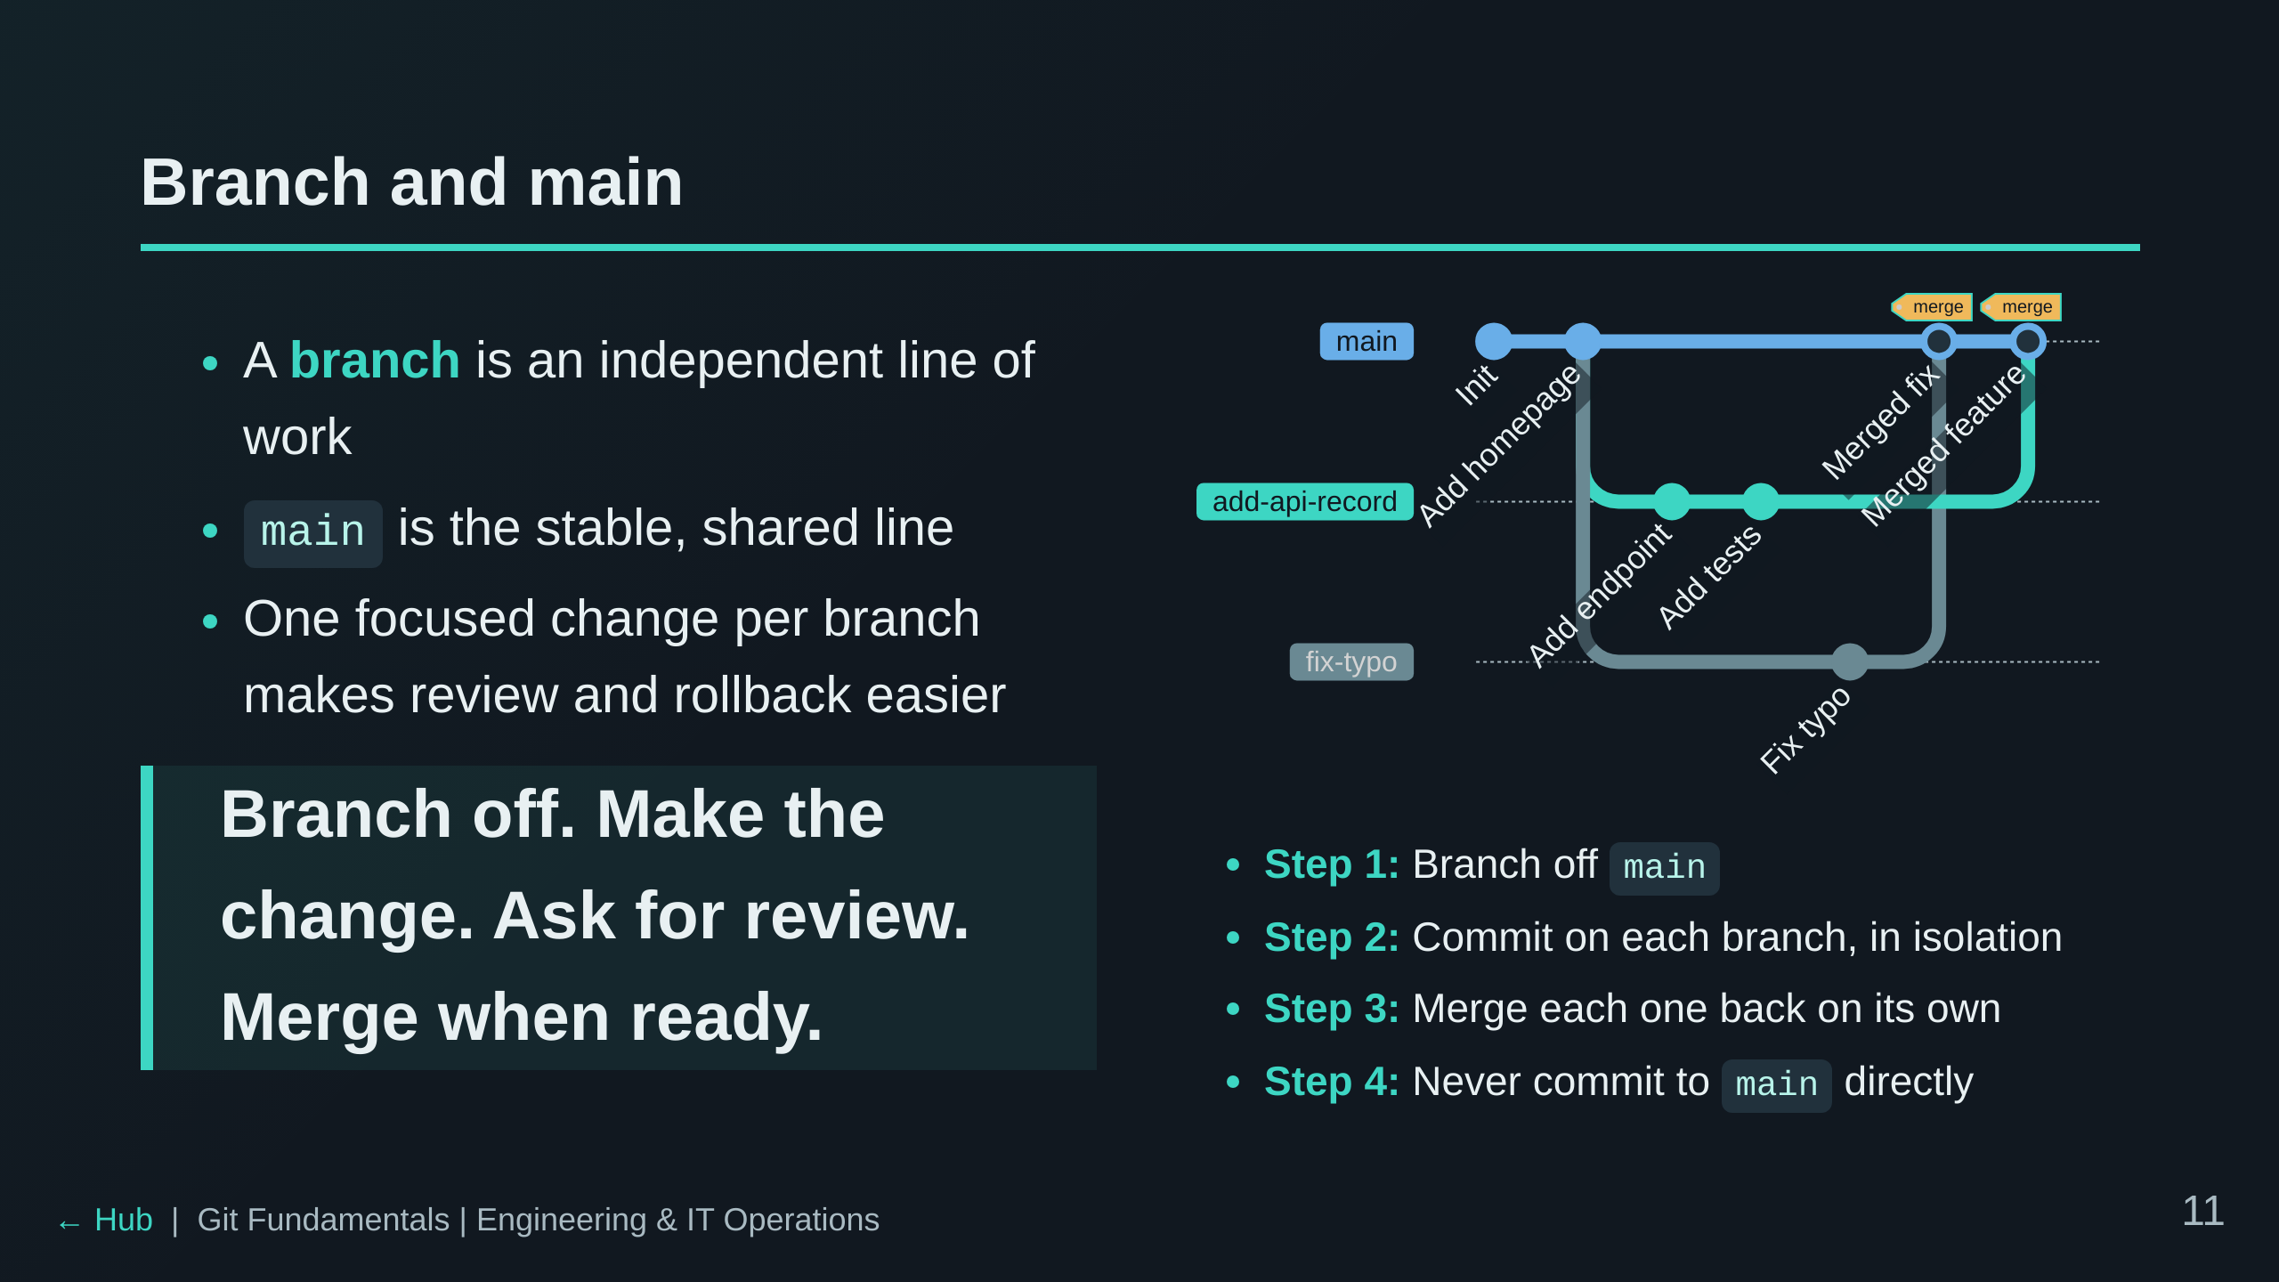

Slide 12
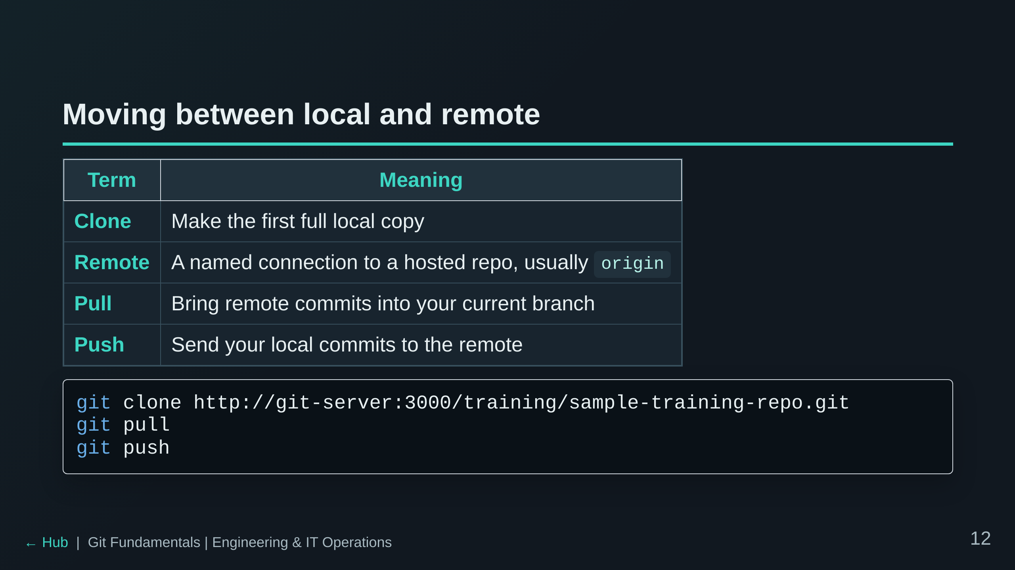

Slide 13
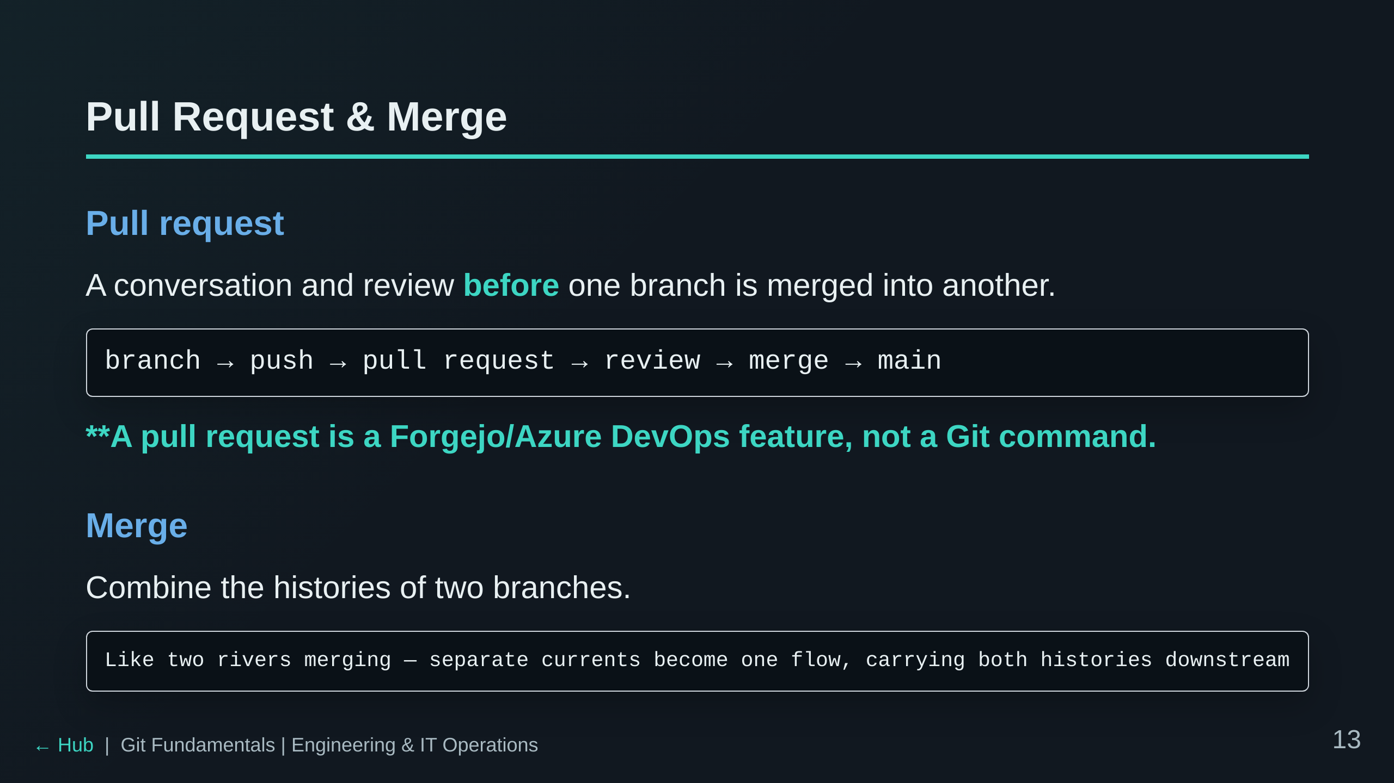

Slide 14
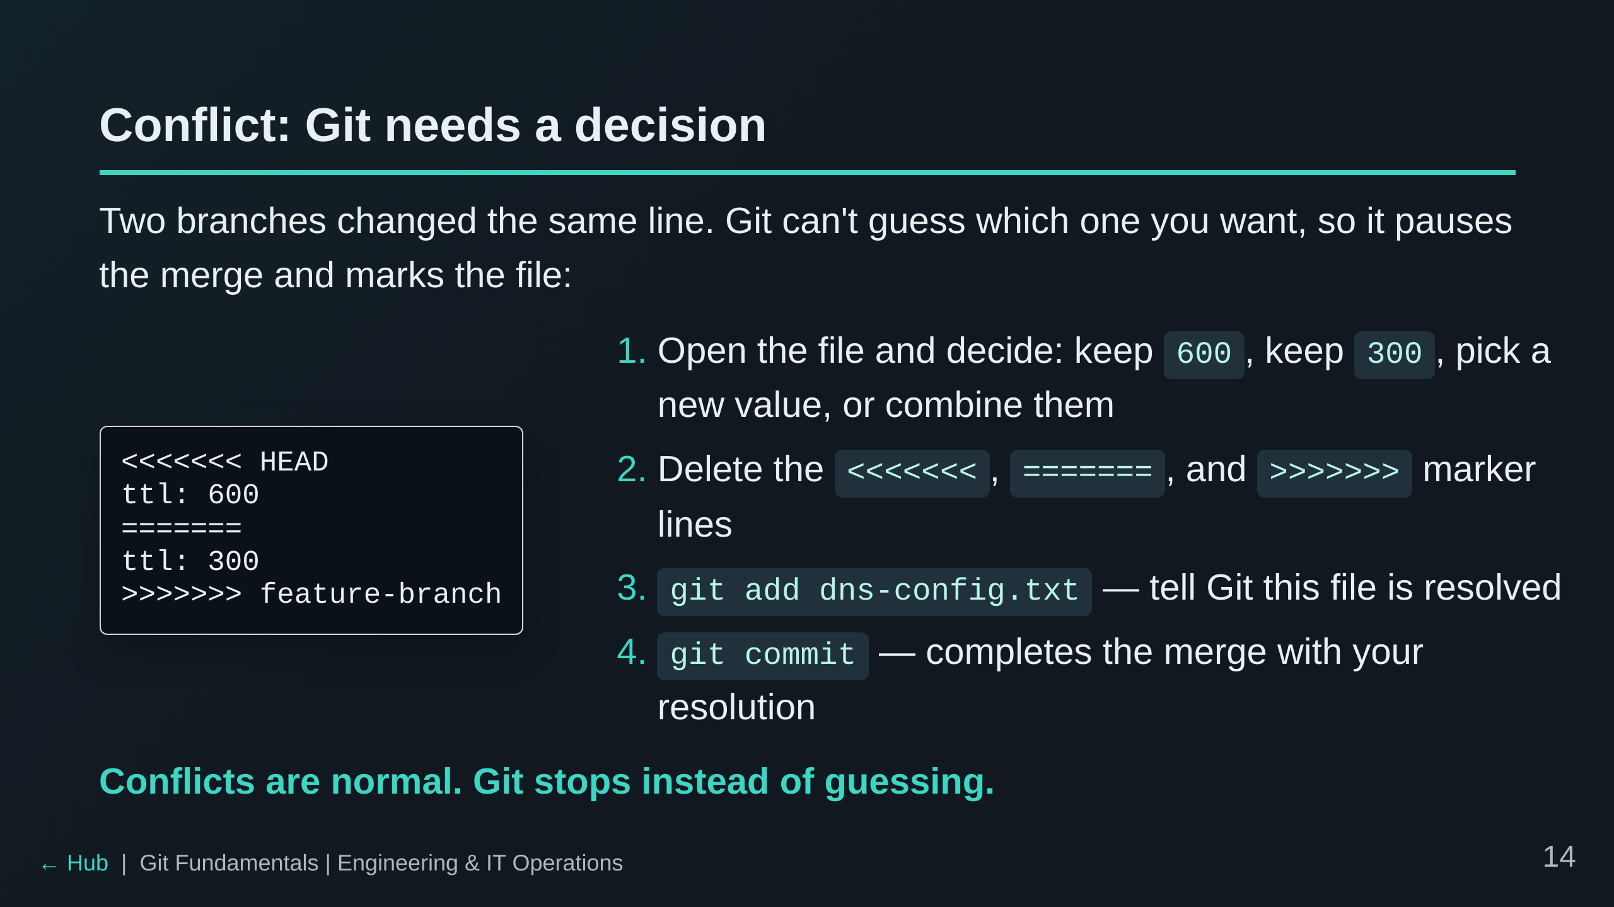

Slide 15
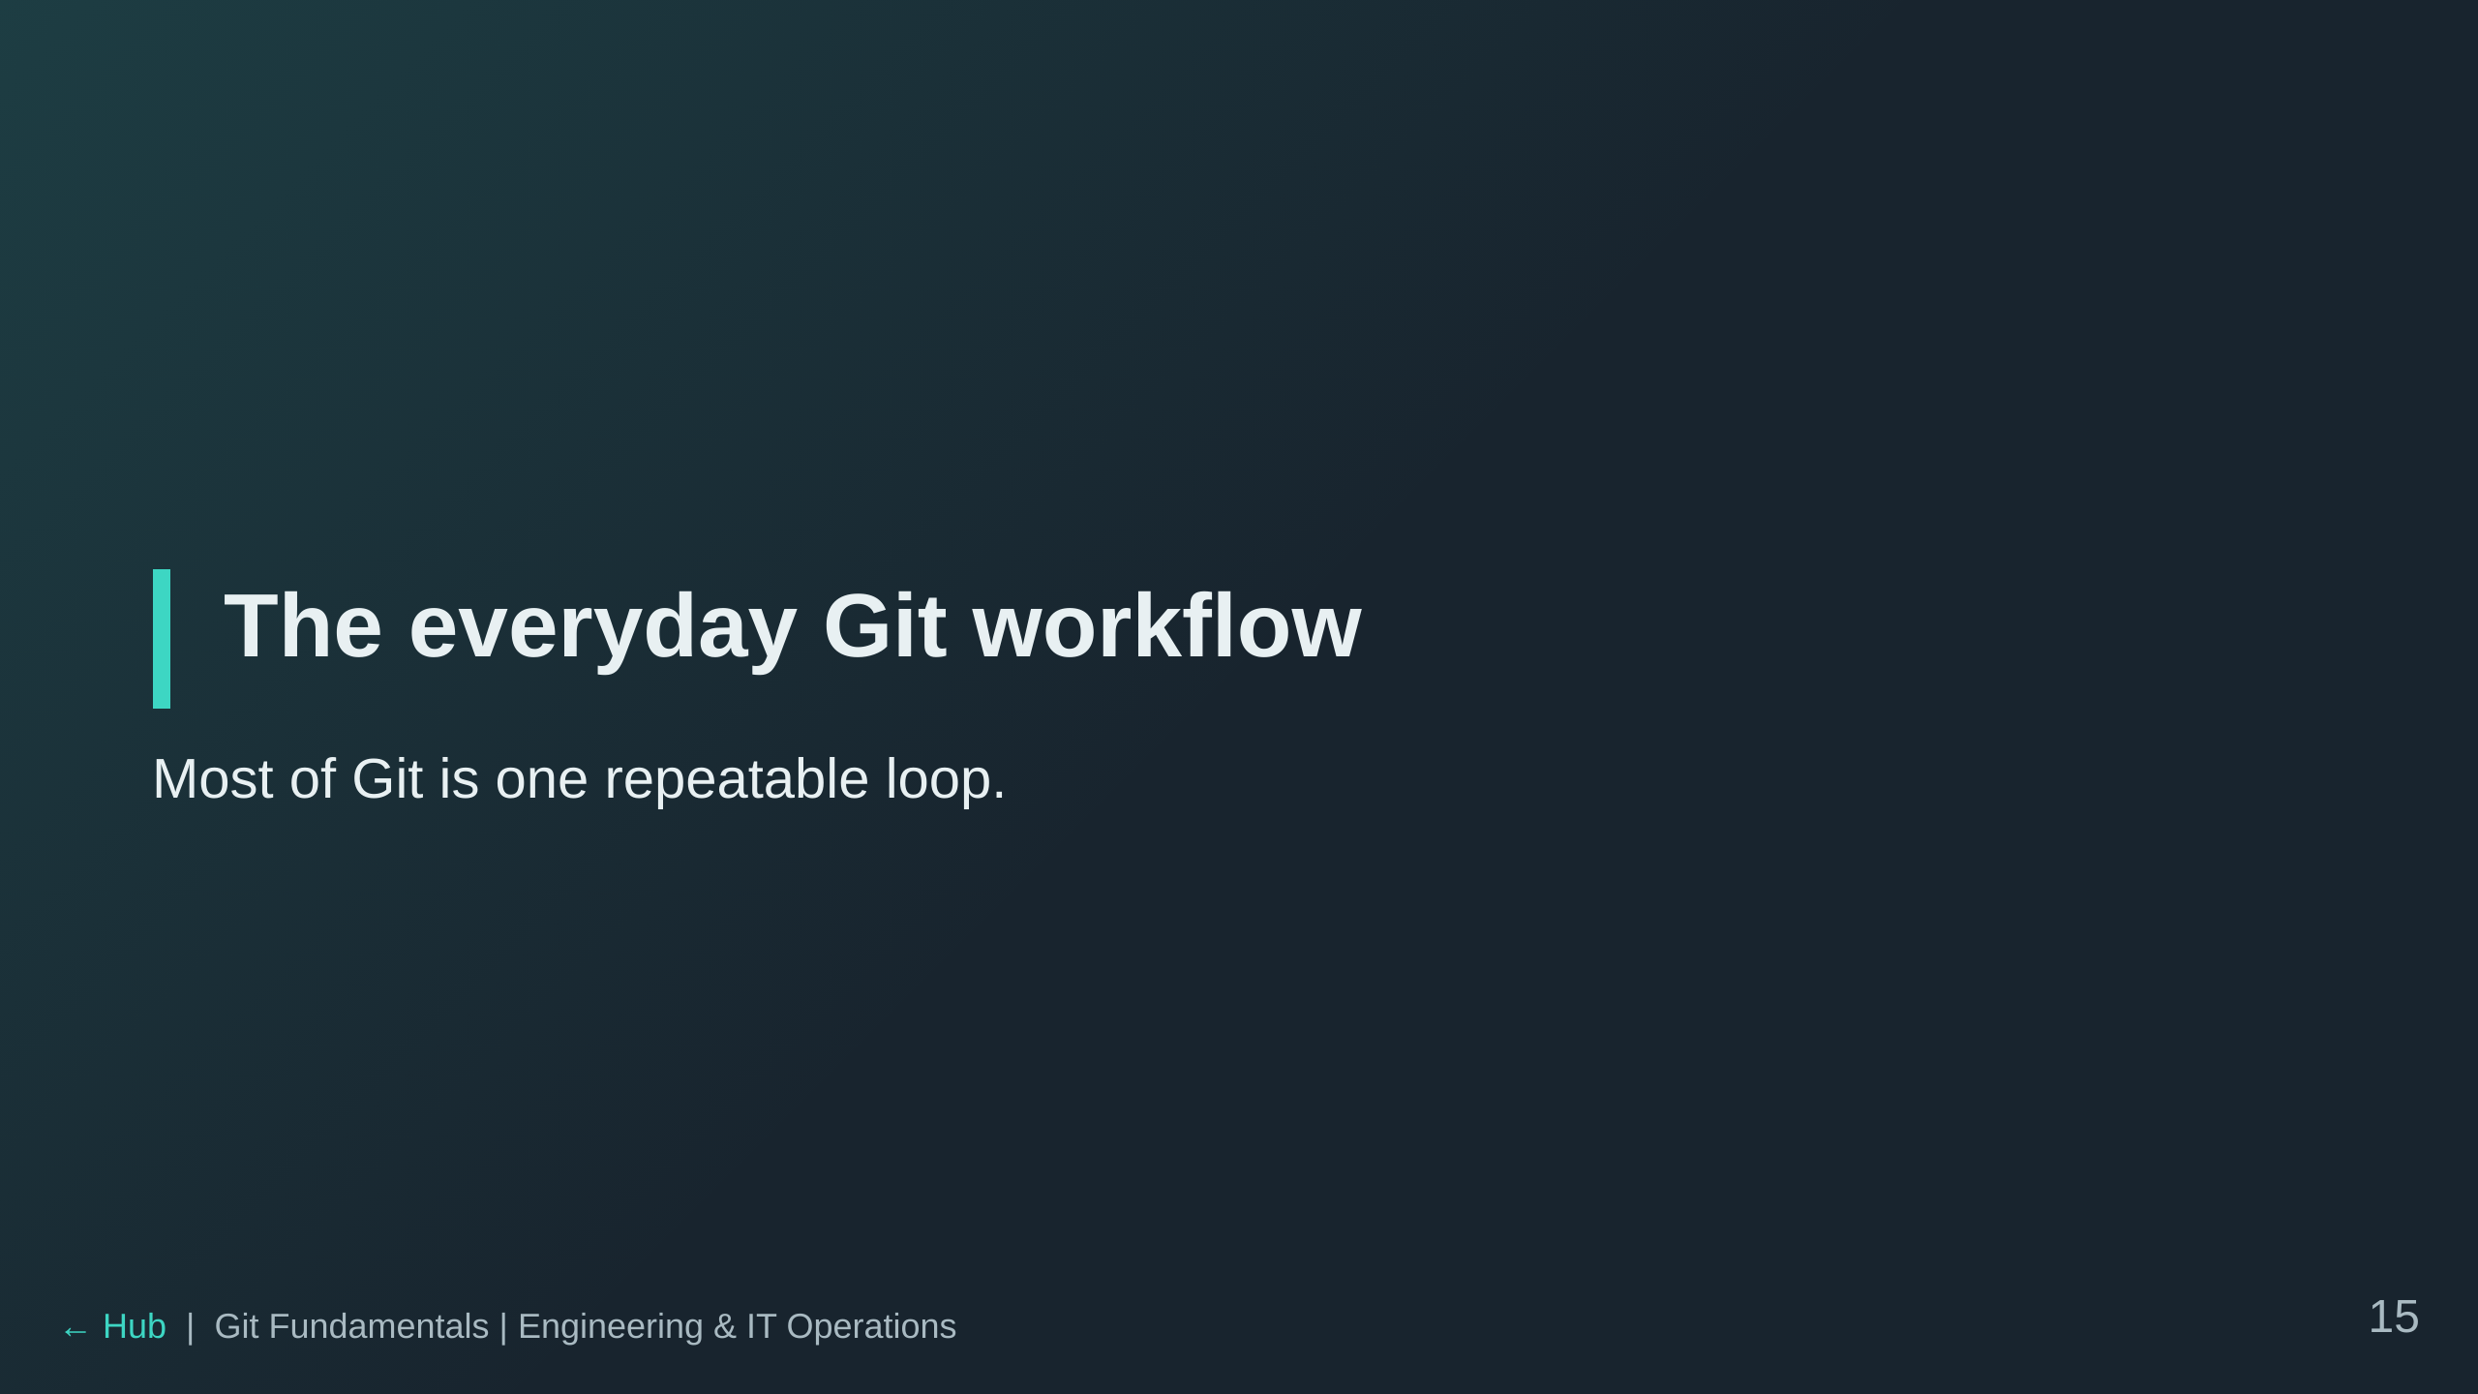

Slide 16
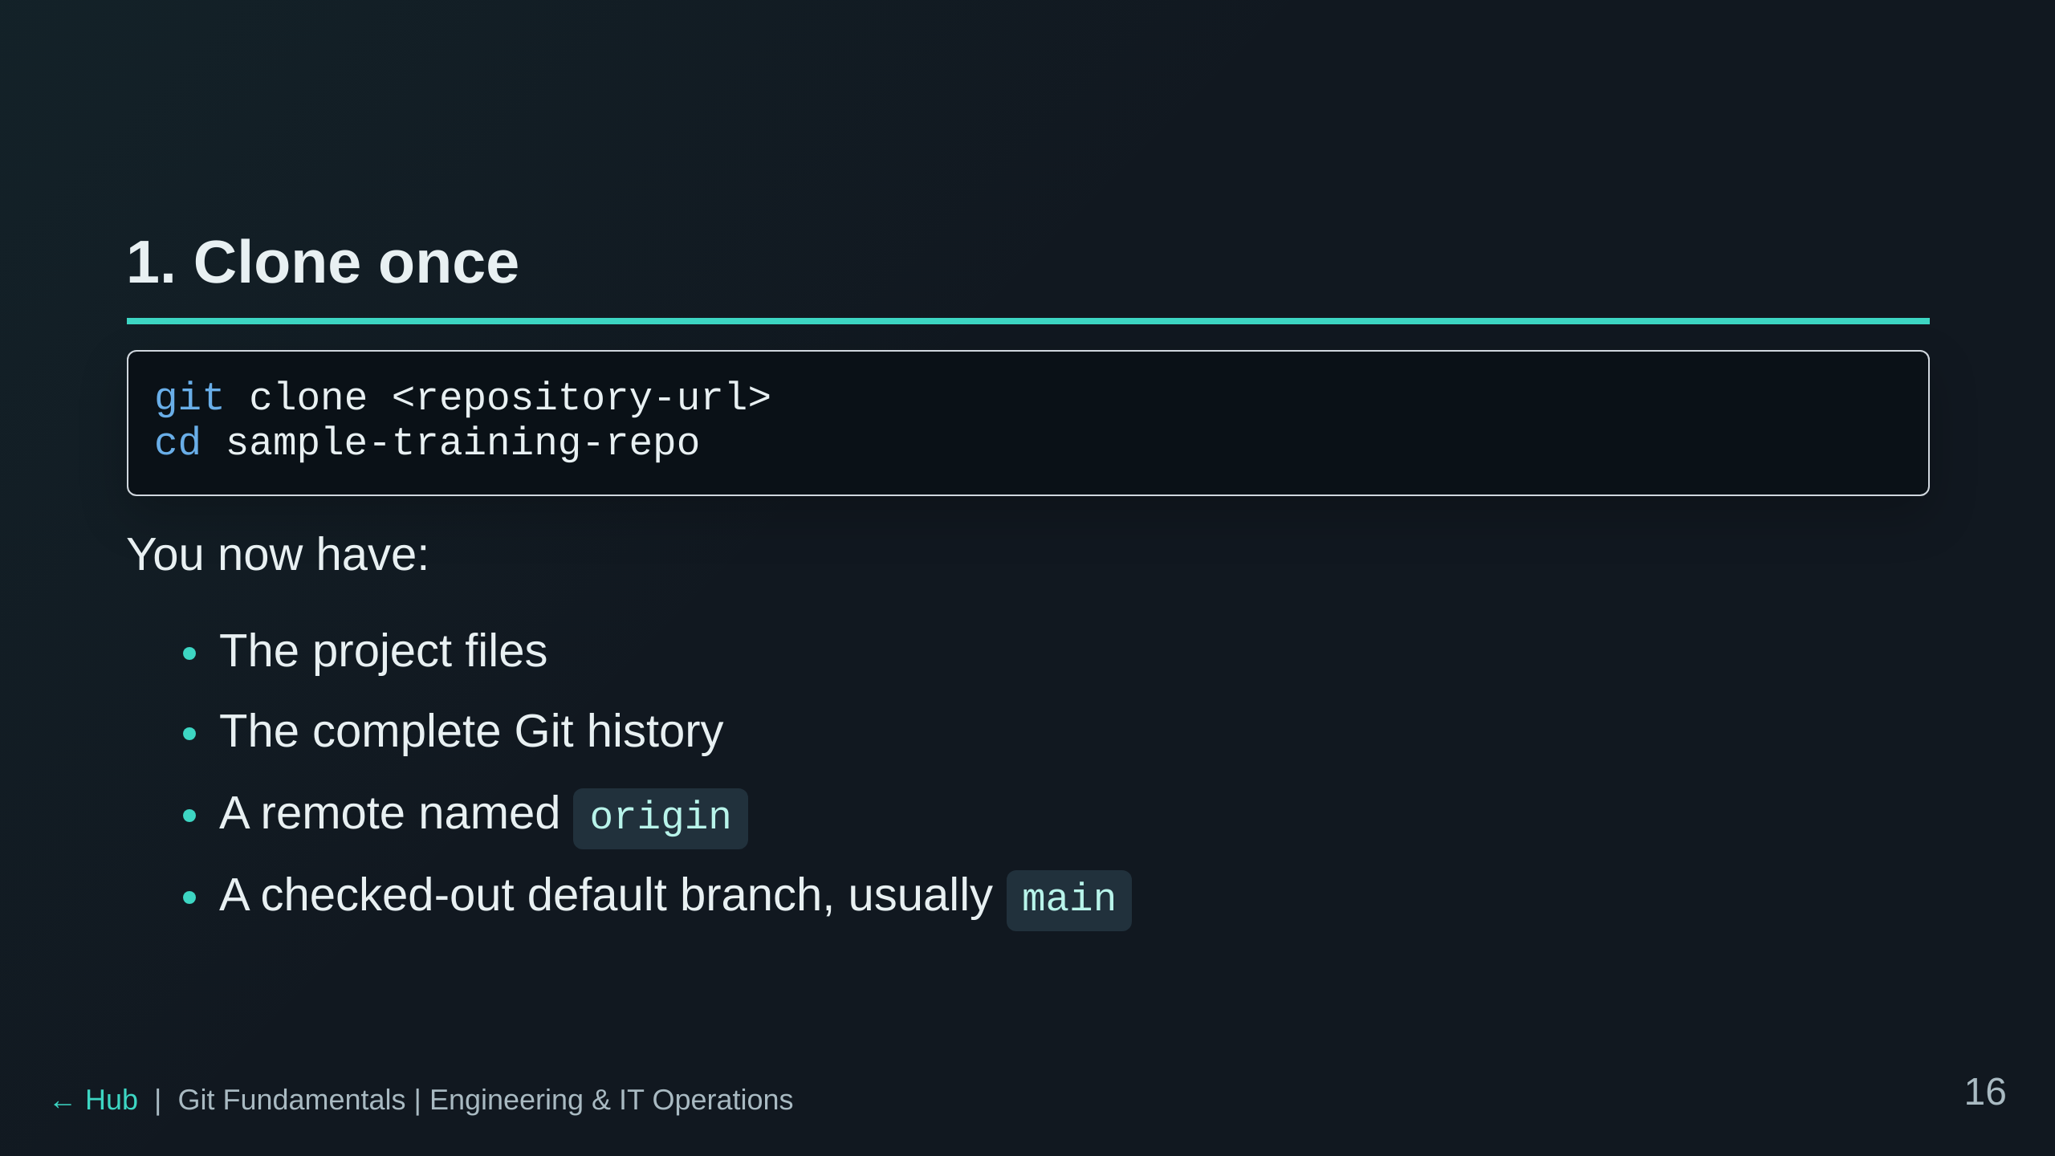

Slide 17
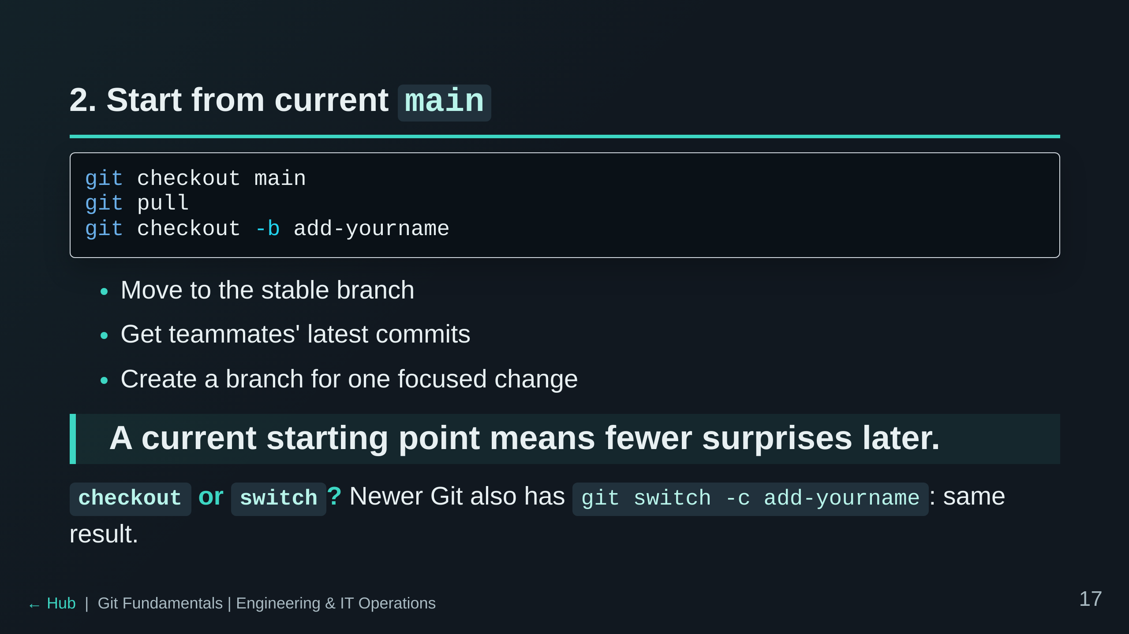
Notes:
checkout vs switch: checkout is the classic do-everything command. It switches branches, but also checks out
individual commits and restores files. Newer Git added git switch (and git restore) to split branch-switching into
its own focused command: `git switch main` / `git switch -c add-yourname` do exactly what the slide does. We teach
checkout because most existing docs, tutorials and scripts use it, but students will see switch too.

Slide 18
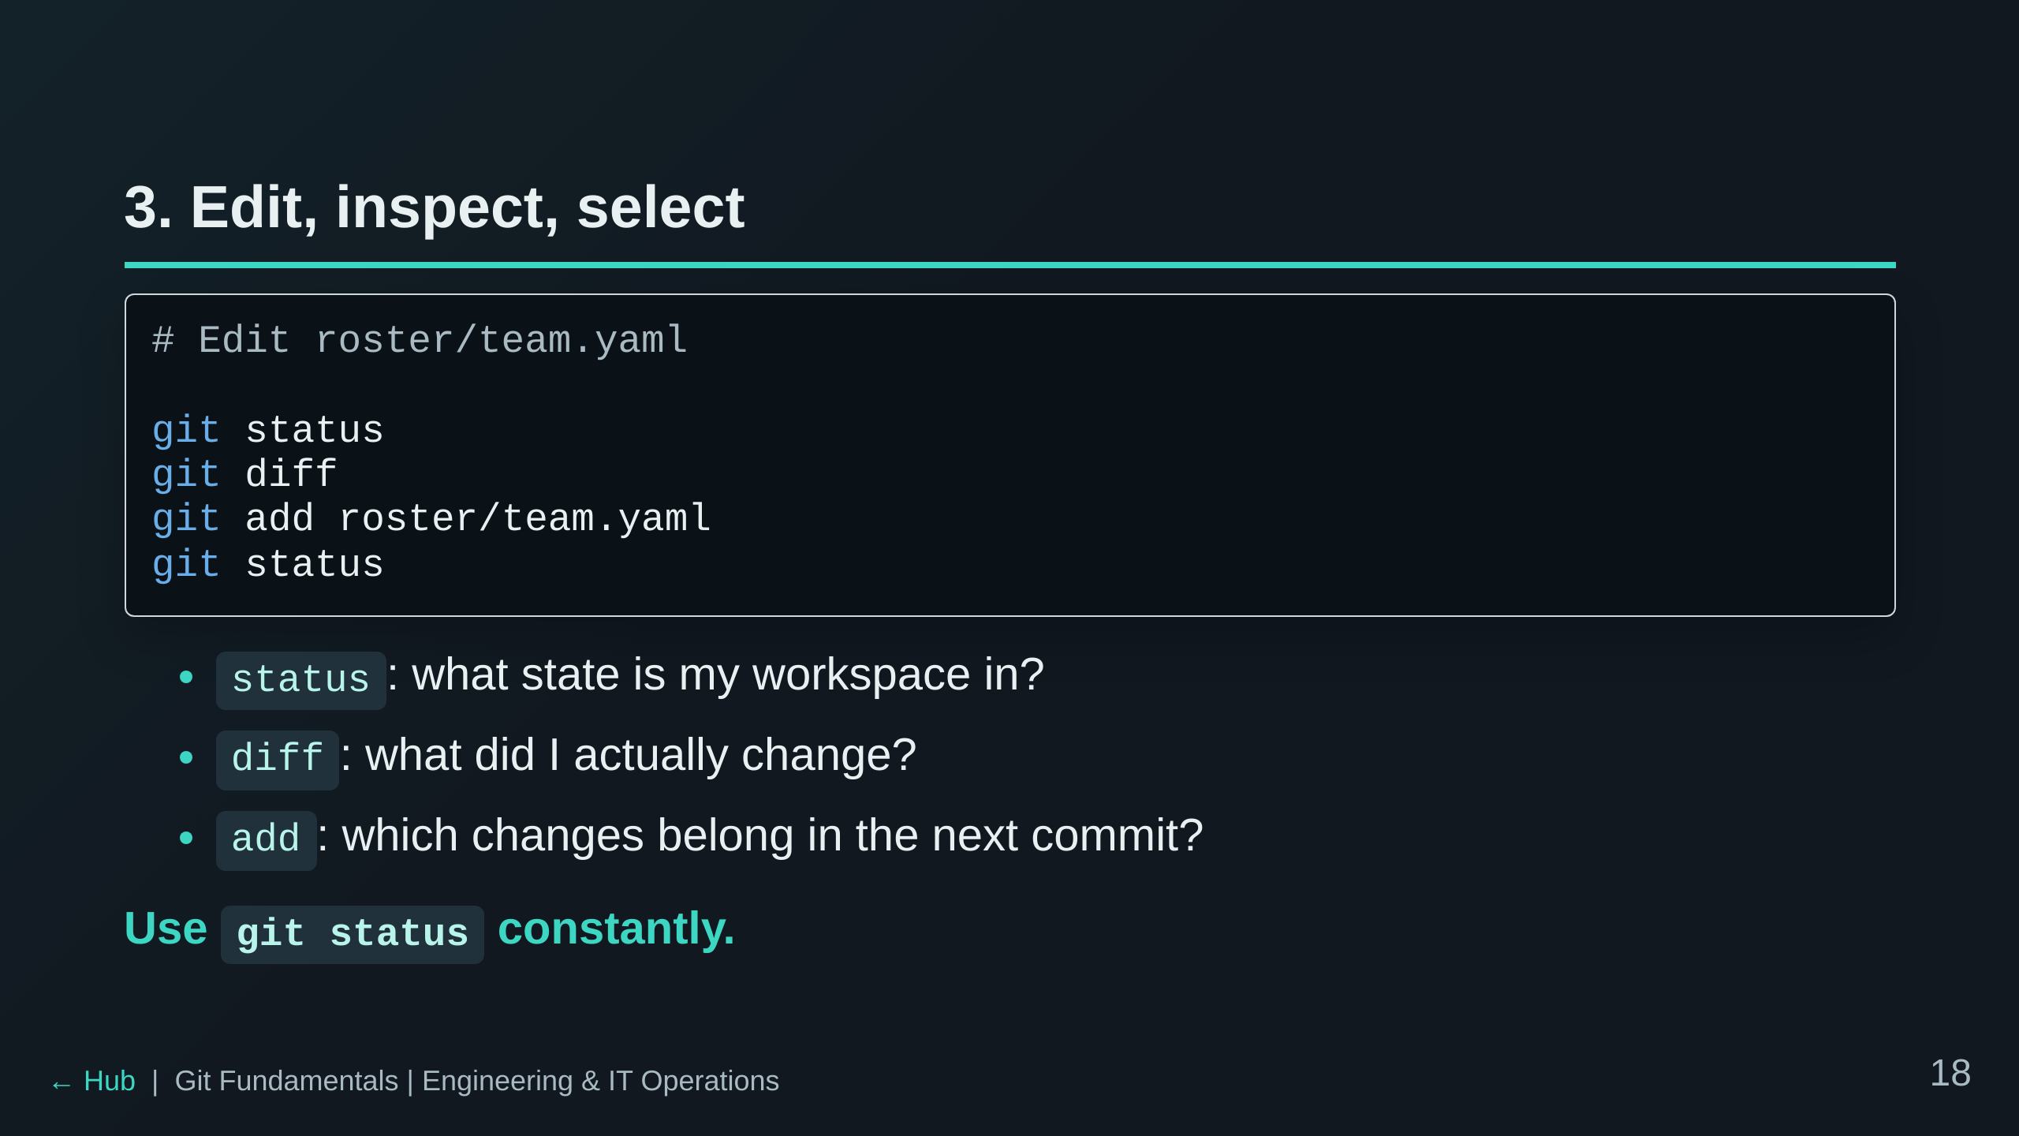

Slide 19
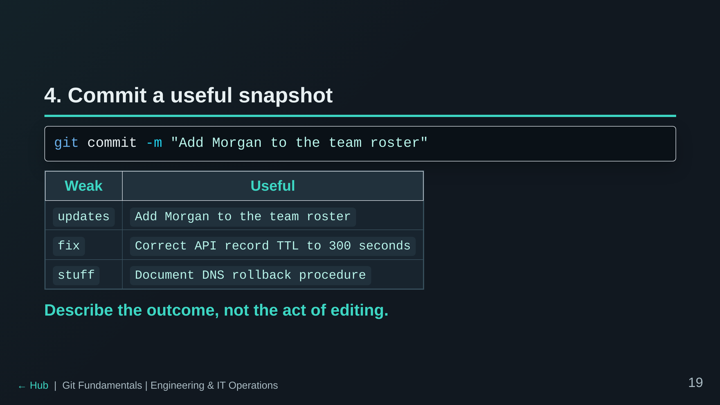

Slide 20
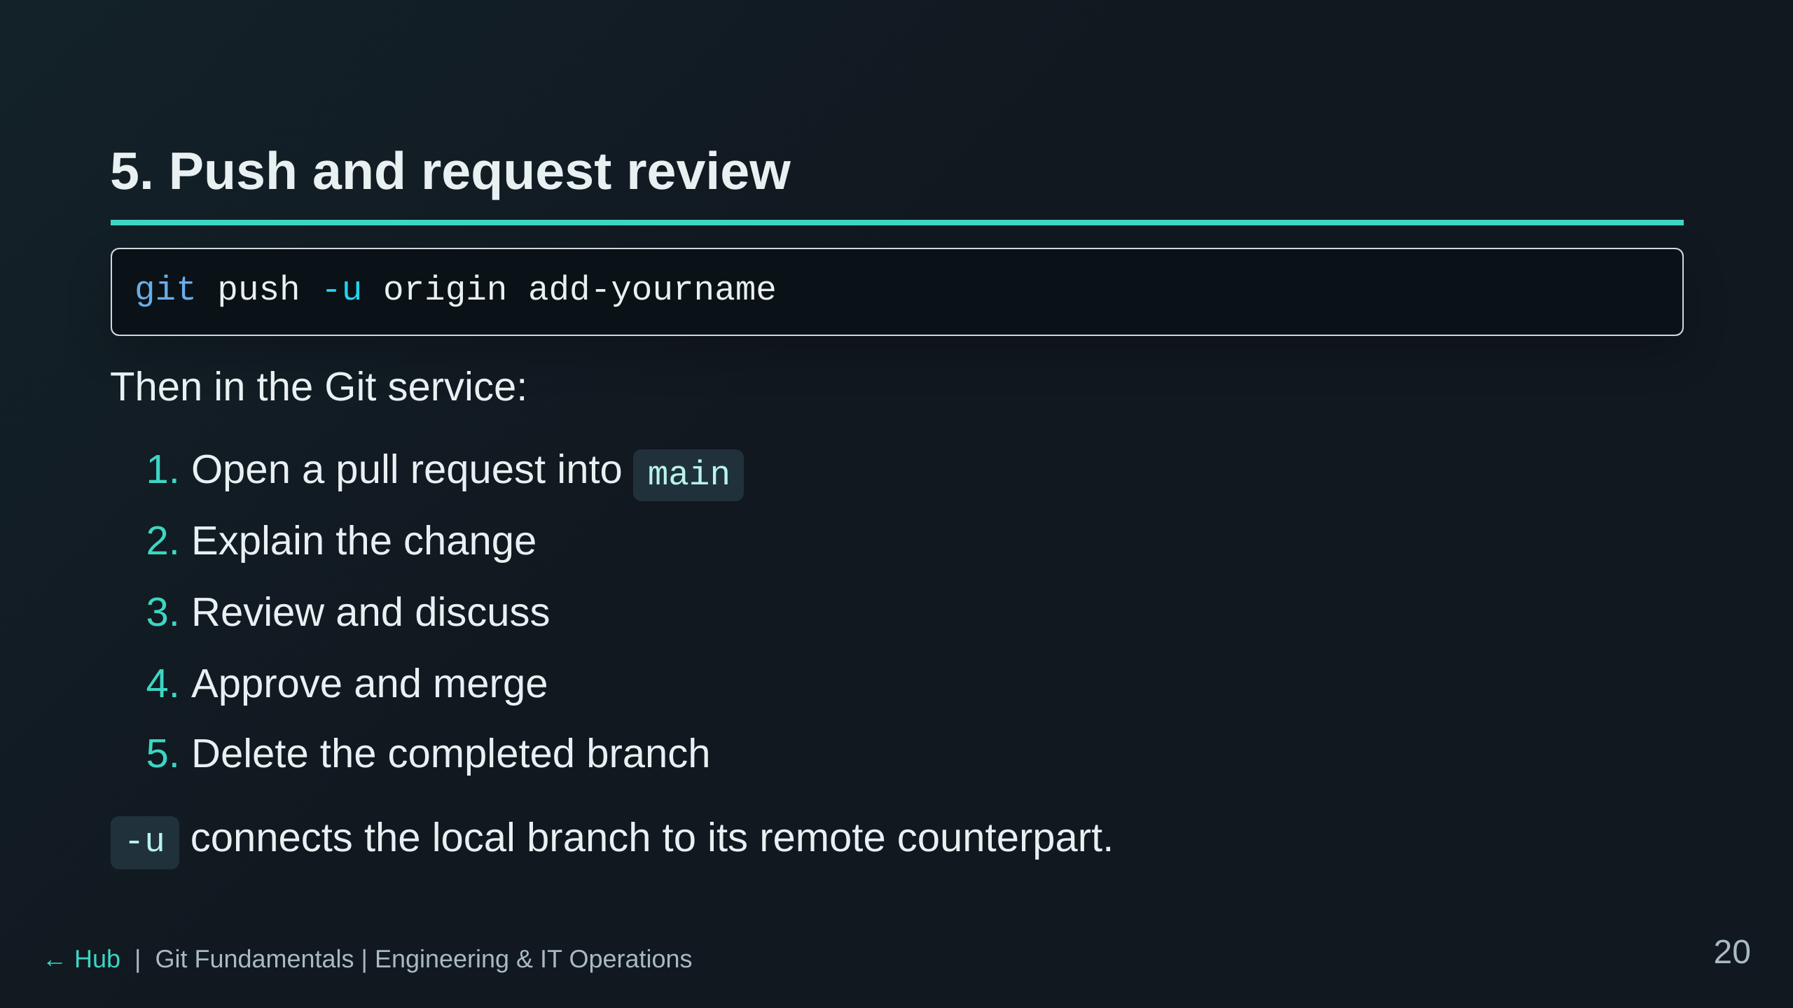

Slide 21
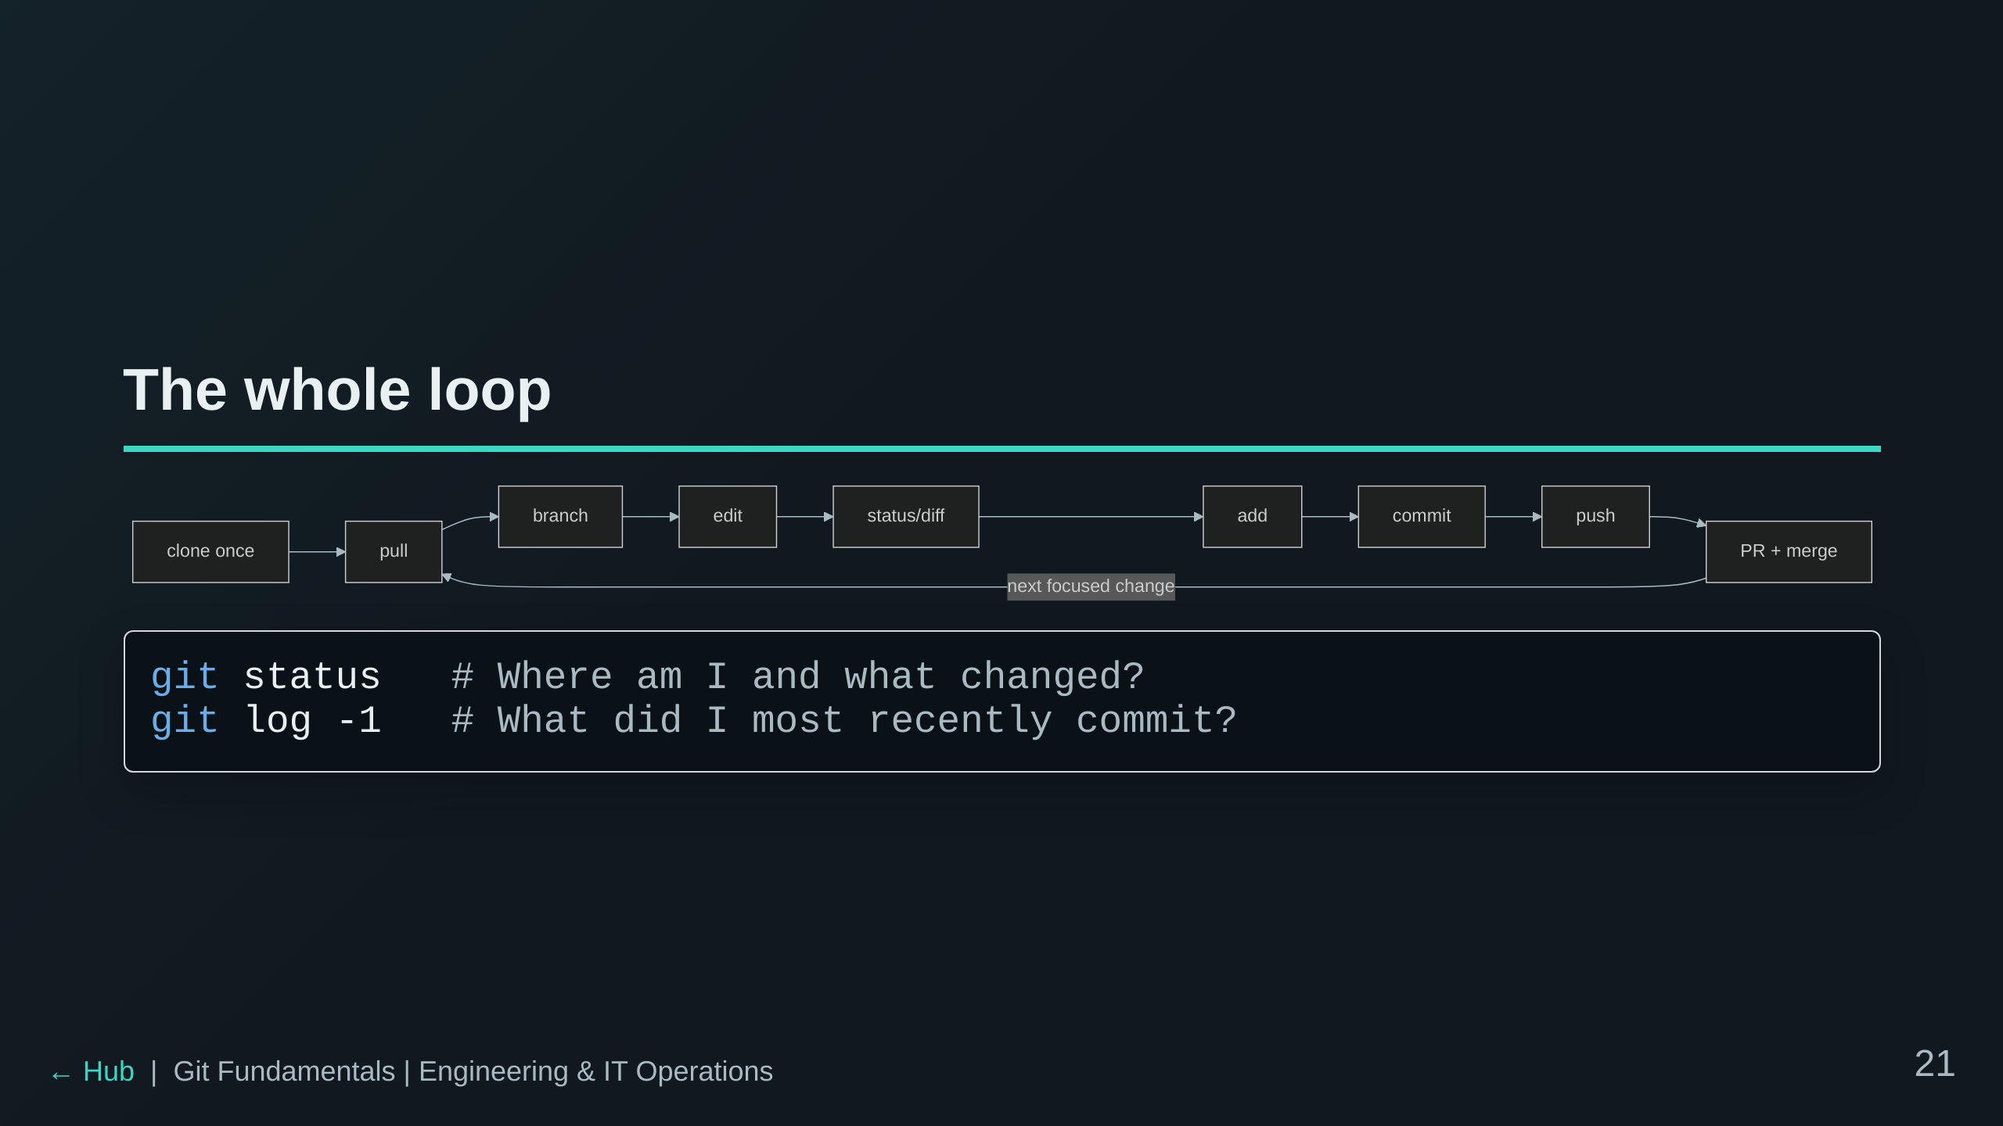

Slide 22
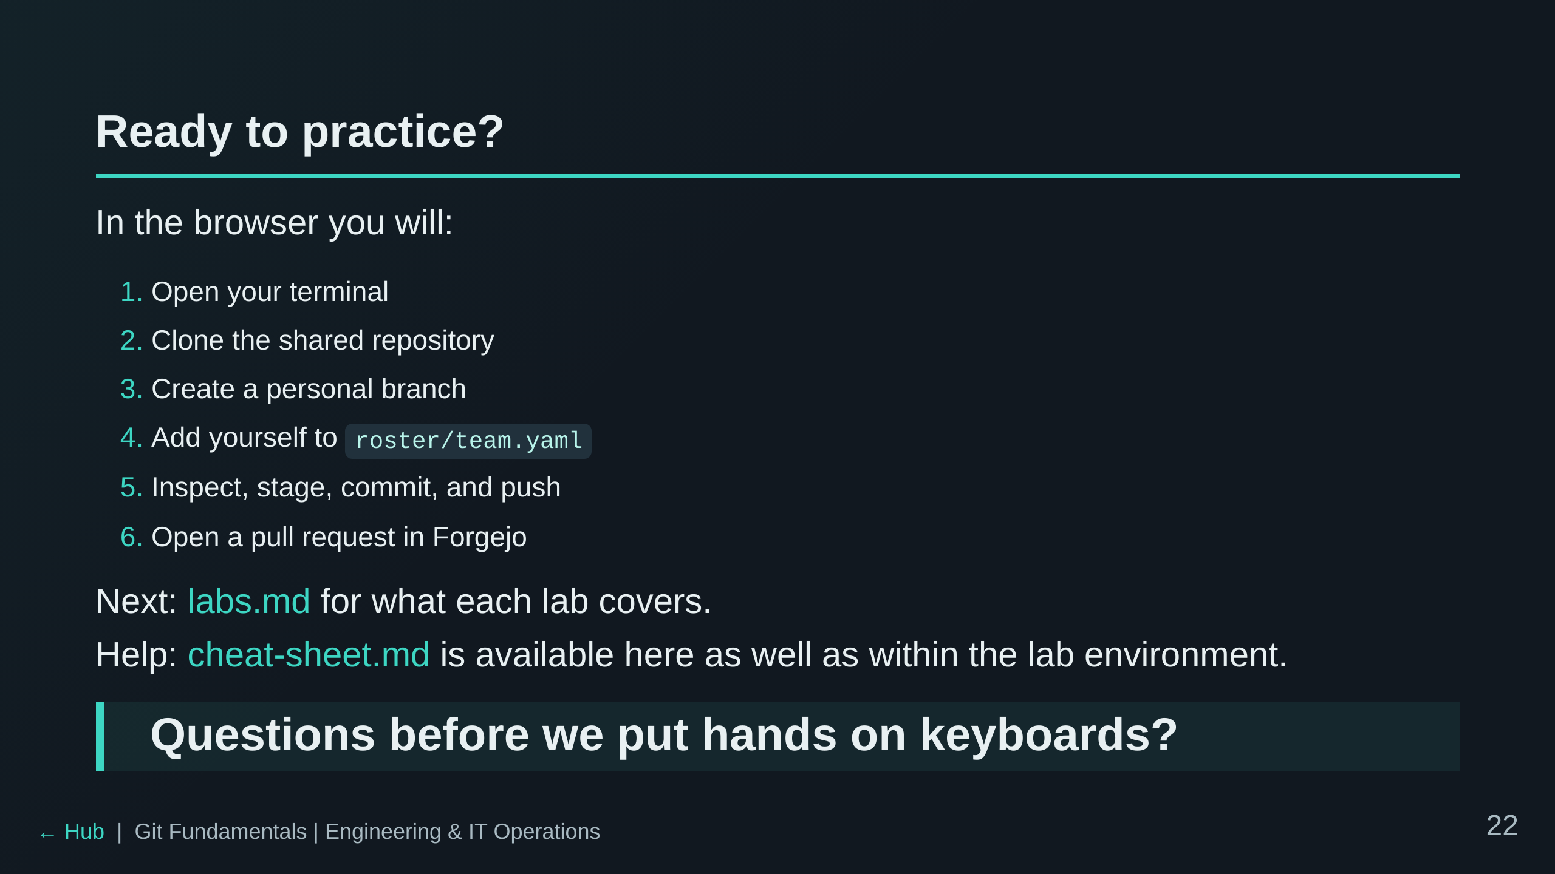

Slide 23
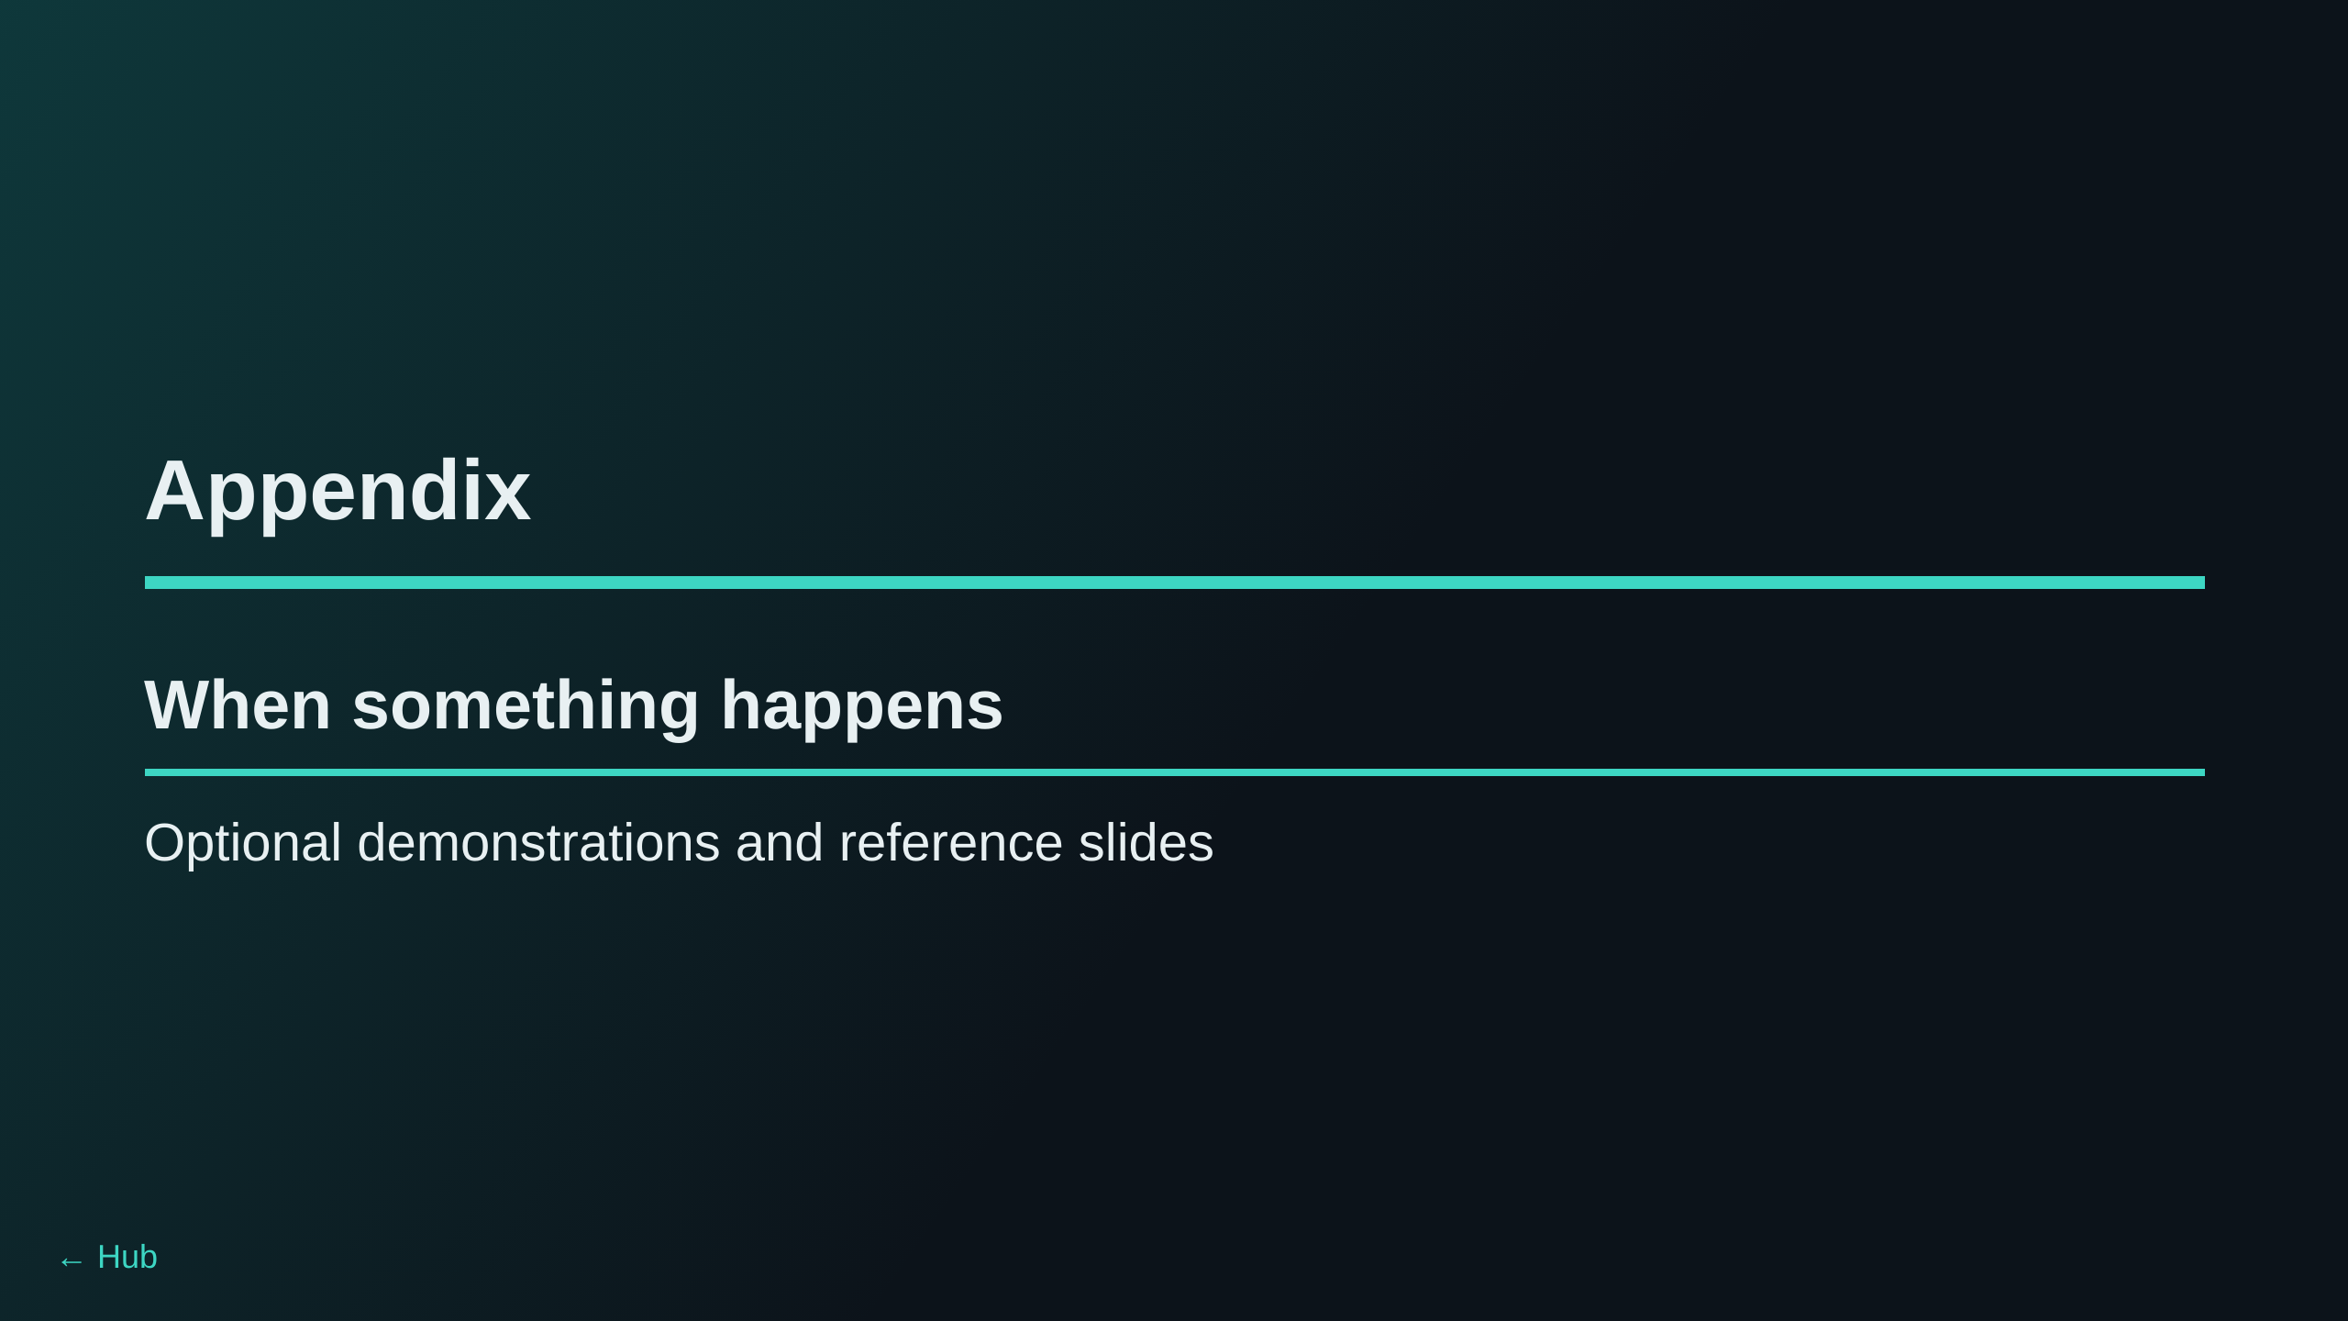

Slide 24
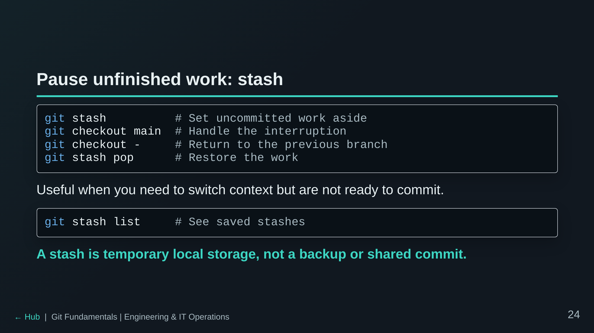

Slide 25
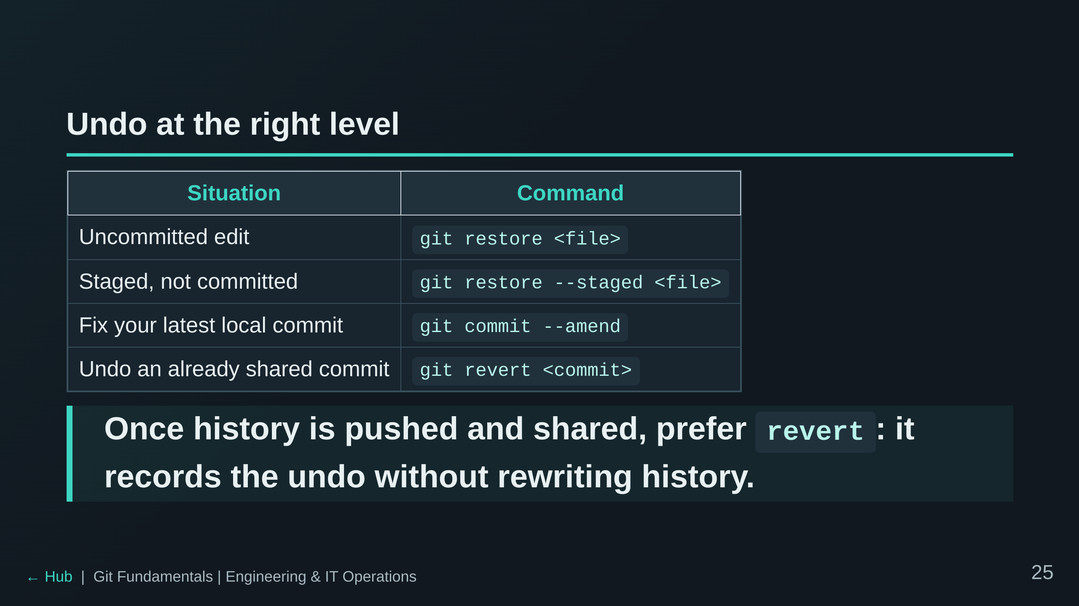

Slide 26
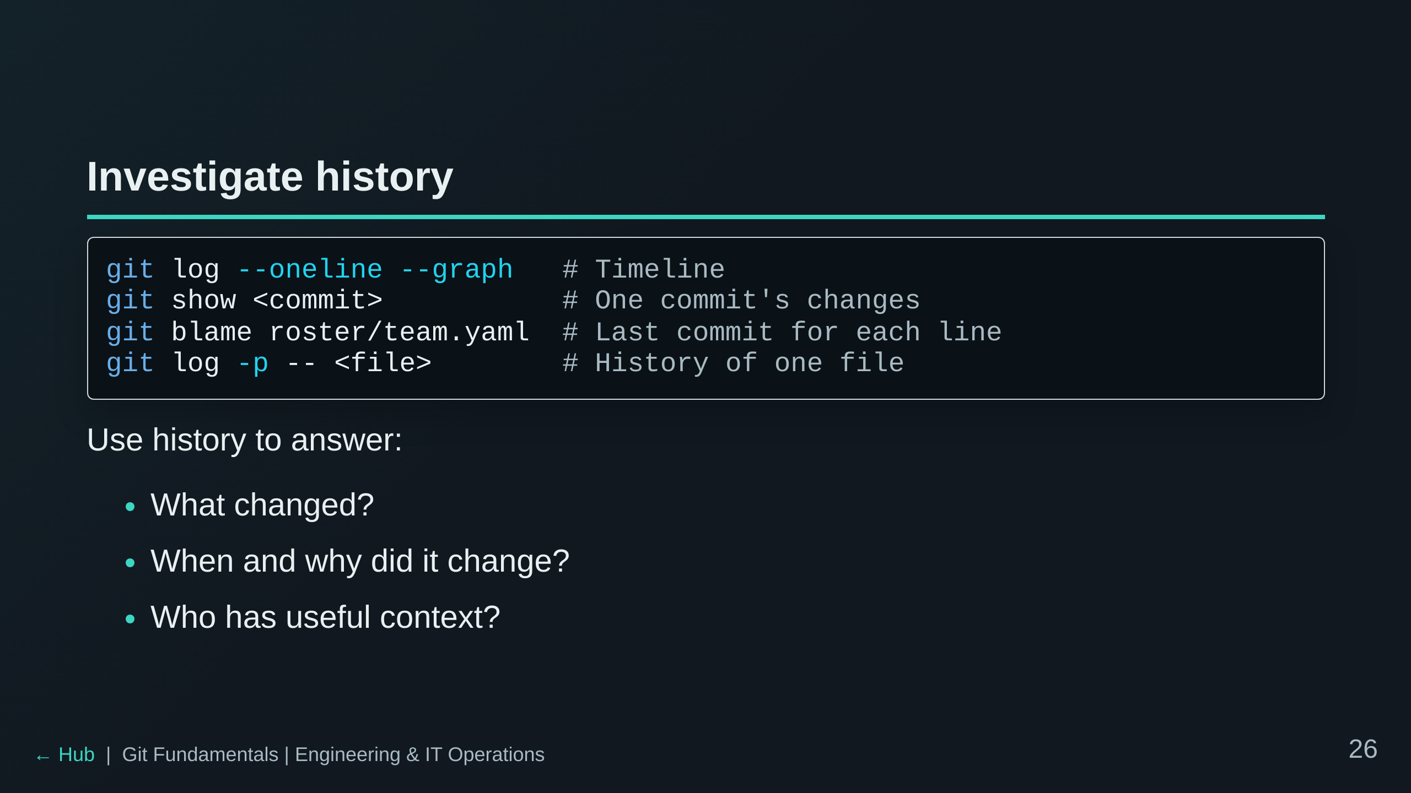

Slide 27
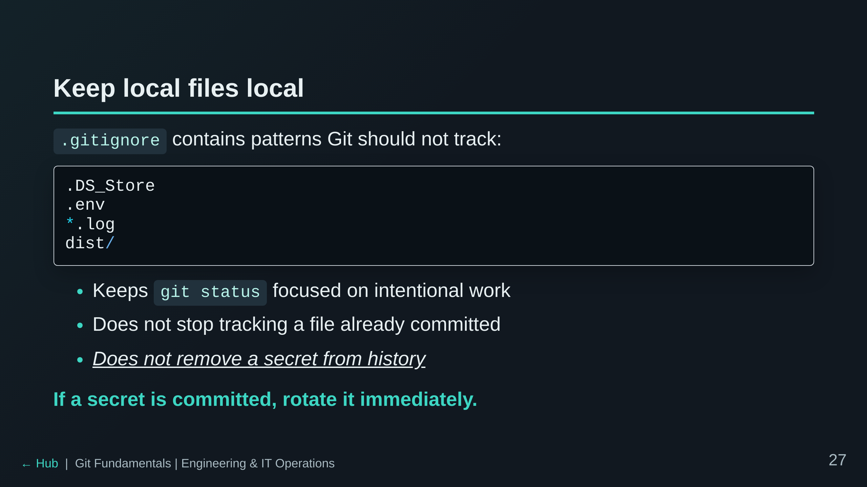

Slide 28
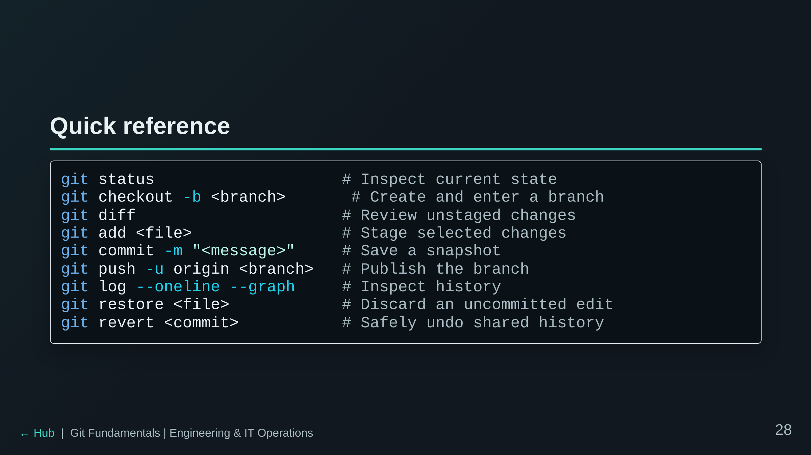

Slide 29
