Slide 1
MSE 213 Mechanics of Materials B Lecture 3
Deformation, Displacement and Strain
Textbook 2.1-2.2
Jiangyu Li

Slide 2
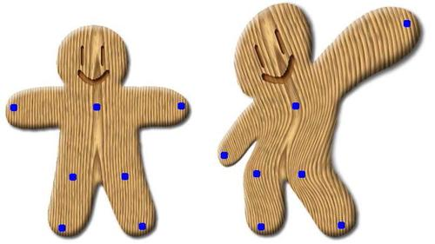
Deformation
Whenever a force is applied to a body, it will tend to change the body’s shape and size. These changes are referred to as deformation.

Slide 3
Strain

Slide 4
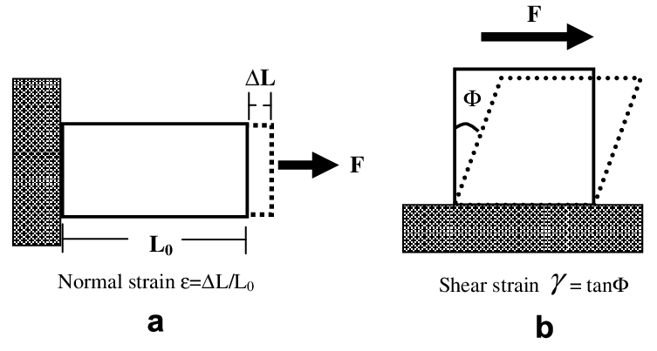
Normal Strain
Quiz

Slide 5
Shear Strain
Quiz

Slide 6
Example

Slide 7
Example

Slide 8
Example
Quiz

Slide 9

Why different definition?

Slide 10
Displacement

Slide 11
Displacement
Uniform and nonuniform

Slide 12
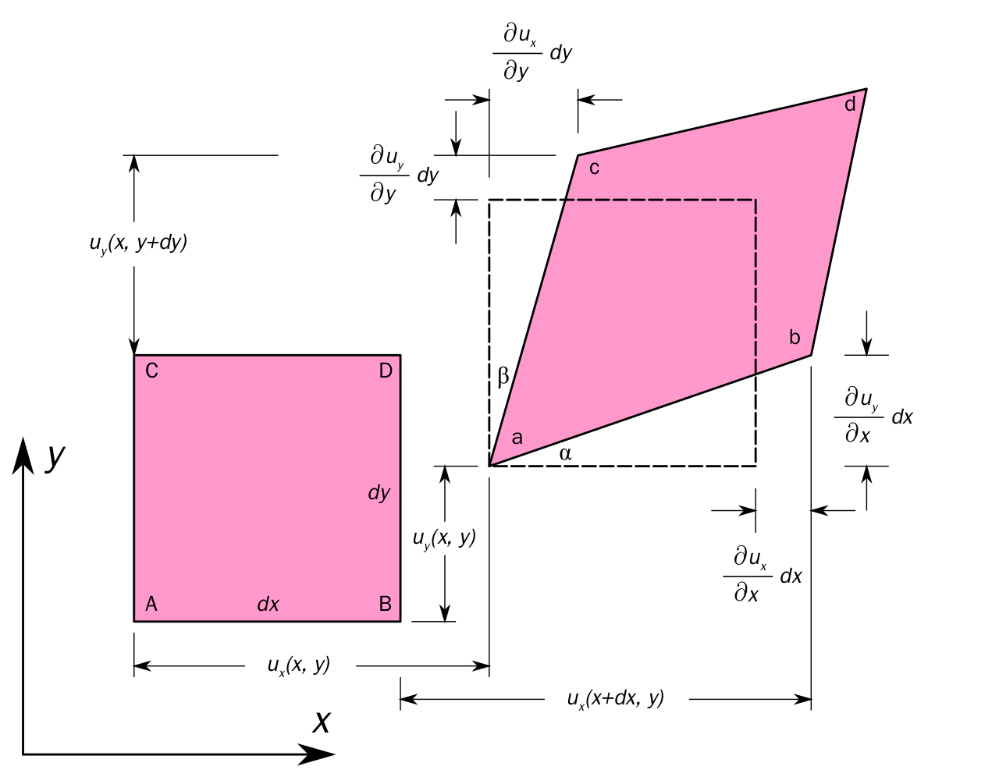
Strain

Slide 13
Strain

Slide 14
Sign Convention

Slide 15
Example
Quiz

Slide 16
Example

Slide 17
Example

Slide 18
Example

Slide 19
Example
Quiz

Slide 20
Example

Slide 21
Example

Slide 22
3D Strain

Slide 23
3D Strain

Slide 24
How about volume change

Slide 25
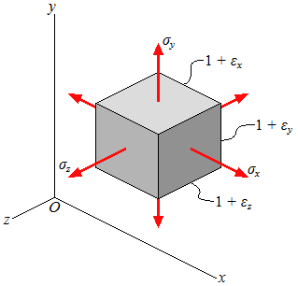
Volume change

Slide 26
How to measure strain?

Slide 27
Resistance

Slide 28
Strain Gage

Slide 29
Wheatstone Bridge

Slide 30
Strain Gage

Slide 31
How to measure displacement?

Slide 32
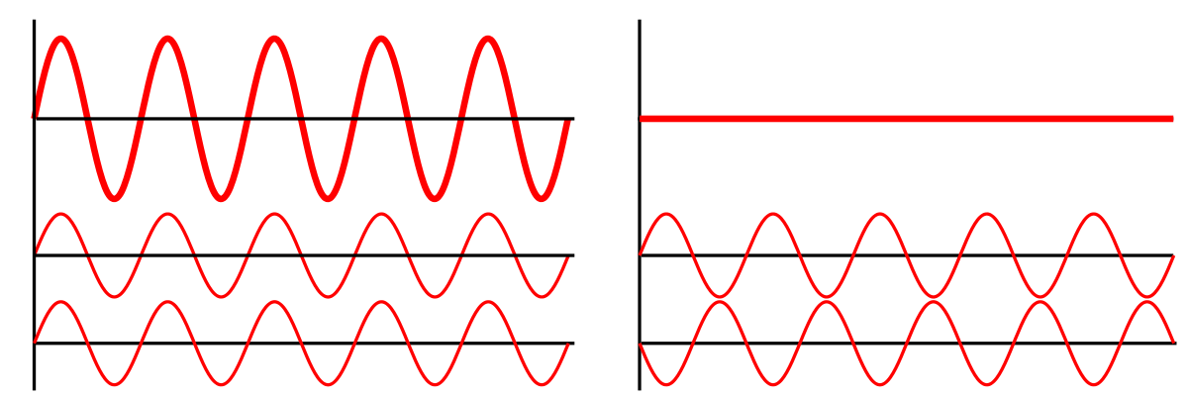
Interference

Slide 33
Interference

Slide 34
Interferometer

Slide 35
Fringe

Slide 36



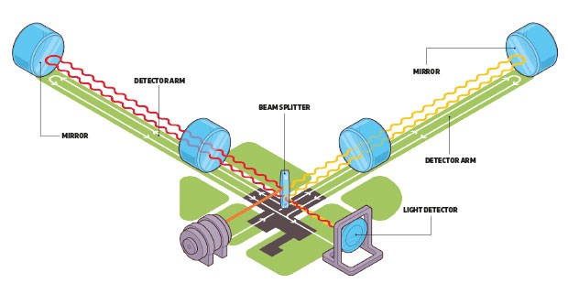
LIGO
10⁻¹⁹m change!
4km
Quiz

Slide 37
Assignment
Textbook
Problem 2-1, 2-3, 2-6, 2-10, 2-28, 2-32

