Slide 1
MSE 213 Mechanics of Materials B Lecture 4
Stress-Strain Curve and Constitutive Equation
Textbook 3.1-3.7
Jiangyu Li

Slide 2
Stress

Slide 3
Strain

Slide 4

What is the relationship between
And how we determine it?

Slide 5
Uniaxial Tensile Test
Quiz

Slide 6
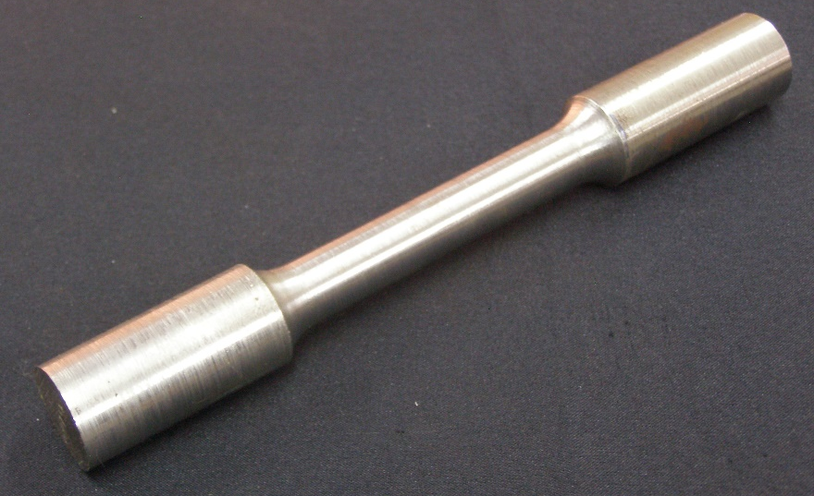
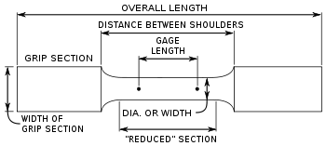
Uniaxial Tensile Test

Slide 7
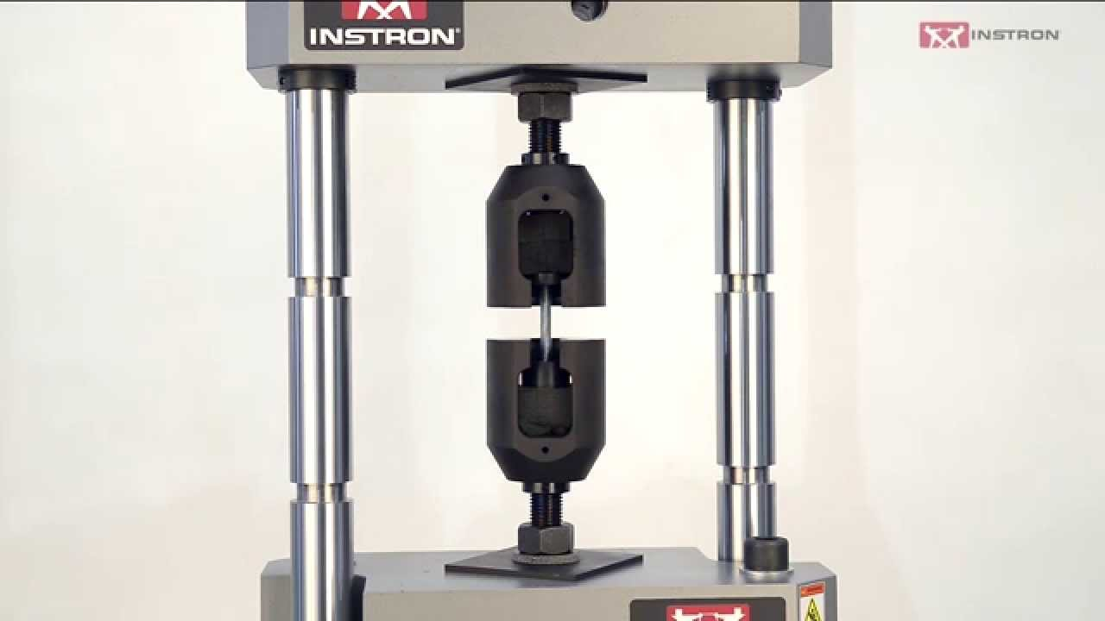
Instron
Quiz

Slide 8
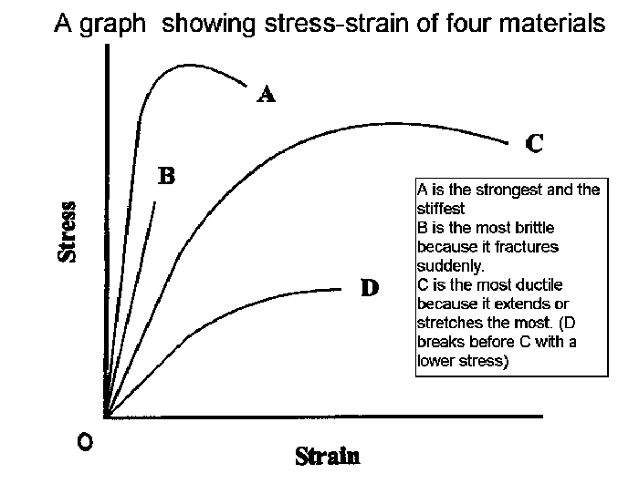
Engineering Stress-Strain Curve

Slide 9
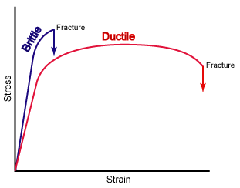
Engineering Stress-Strain Curve

Slide 10
Engineering Stress-Strain Curve
Quiz

Slide 11
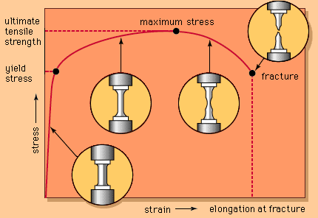
Engineering Stress-Strain Curve

Slide 12
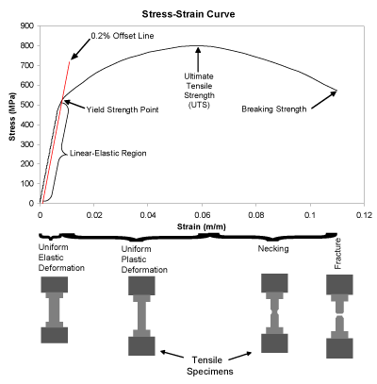
Linear Elastic Regime
Deformation can be fully recovered

Slide 13
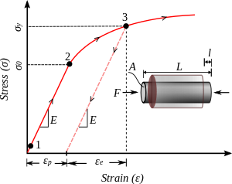
Yielding or Plastic Deformation
Deformation cannot be fully recovered upon unloading

Slide 14
Strain Hardening

Slide 15
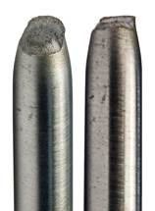
Necking

Slide 16
Reexamining Engineering Stress & Strain

Slide 17
True Stress & Strain
Homogeneous deformation
Constant Volume

Slide 18
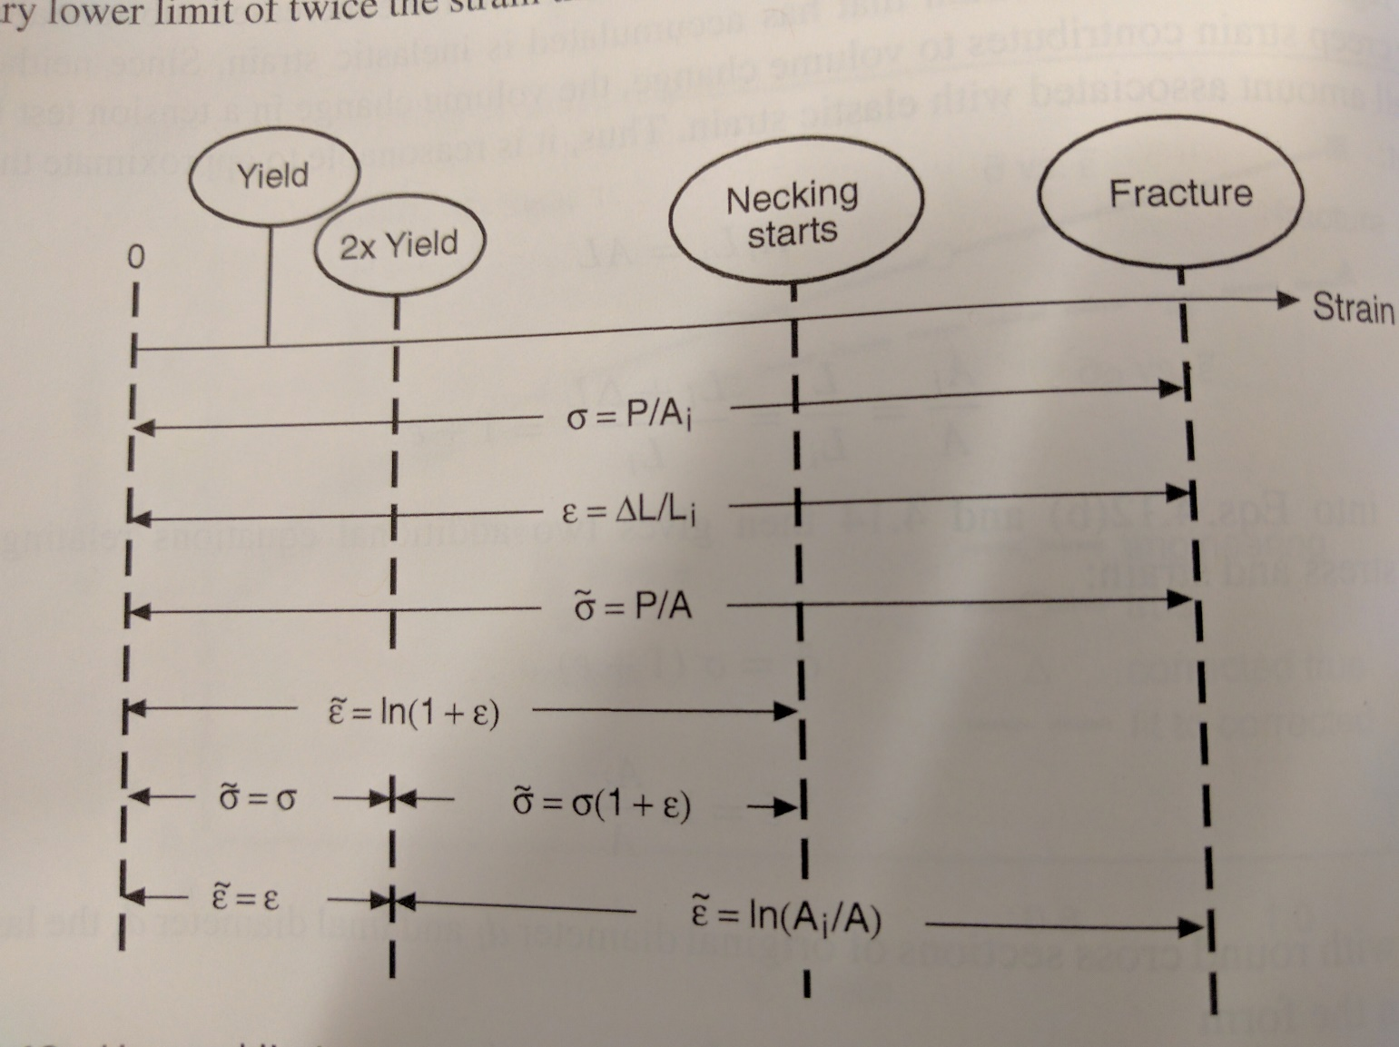
True Stress & Strain

Slide 19
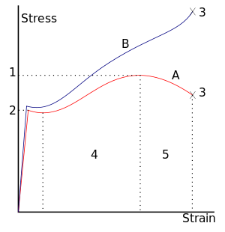
True Stress-Strain Curve

Slide 20
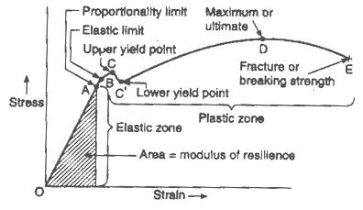
Engineering Stress-Strain Curve

Slide 21
Elastic Regime
Young’s modulus
Poisson’s ratio
Proportional limit
Elastic limit
Modulus of resilience

Slide 22
Work done and Energy stored

Slide 23
Strength: Yielding

Slide 24
Unloading Curve

Slide 25
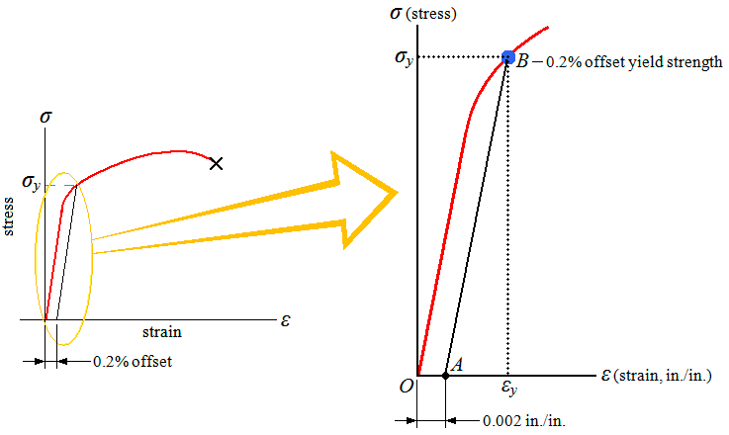
Offset Yield Strength
What is elastic energy stored at B?

Slide 26
Ultimate and Fracture Strength
Quiz

Slide 27
Ductility
Engineering fracture strain: percentage of elongation
Quiz What is the length after fracture?

Slide 28
Mechanics of Graphene

Slide 29
Example 1

Slide 30
Example

Slide 31
Example

Slide 32
Example 2

Slide 33
Example 2

Slide 34
Example 3
E= 200GPa
v= 0.32

Slide 35
Example 3
E= 200GPa
v= 0.32

Slide 36
Example 4

Slide 37
Example 4

Slide 38
Example 5

Slide 39
Example 5

Slide 40
Example 5

Slide 41
Hooke’s Law
Solve for strain

Slide 42
Poisson’s Ratio

Slide 43
Shear Stress and Strain

Slide 44
3D Hooke’s Law

Slide 45
3D Hooke’s Law

Slide 46
3D Hooke’s Law

Slide 47
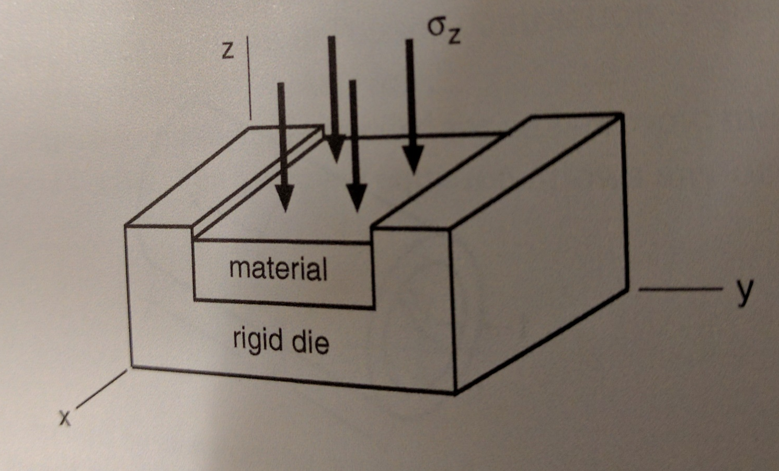
Example
Stress in y, strain in z and x?

Slide 48
Example

Slide 49
How about volume change
Quiz

Slide 50
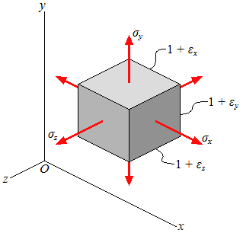
Volume change

Slide 51
Volumetric Strain
Bulk modulus

Slide 52
Matrix Inversion

Slide 53
3D Hooke’s Law

Slide 54
Plane Stress

Slide 55
Plane Stress

Slide 56
Plane Stress

Slide 57
Plane Stress

Slide 58
Example
Constant volume

Slide 59
Plane Strain

Slide 60
Plane Strain

Slide 61
Plane Strain

Slide 62
Plane Strain

Slide 63
Orthotropic Materials

Slide 64
Example

Slide 65
Strain Energy Density

Slide 66
Strain Energy Density

Slide 67
Modulus of Resilience

Slide 68
Modulus of Toughness

Slide 69
Strain Energy Density for 3D?

Slide 70
Thermal Expansion: Additional Term

Slide 71
Assignment
1. Process tensile testing data of Alum2 posted, (1) determine Young’s modulus, Poisson’s ratio, 0.2% offset yield strength, ultimate strength, and fracture strain; (2) plot true stress-strain curve up to necking.
Textbook Problem:
3.11, 3.16, 3.19, 3.27, 3.30

