Slide 1
MSE 213 Mechanics of Materials B Lecture 6
Torsion
Textbook 5.1-5.5; 5.8-5.9
Jiangyu Li

Slide 2
Torsion

Slide 3
Torsion

Slide 4
Angle of Twist

Slide 5
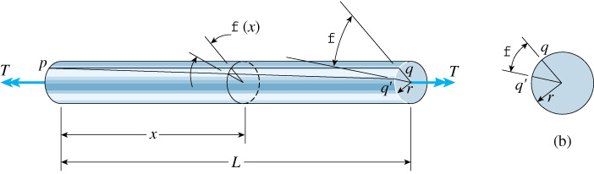
Angle of Twist

Slide 6
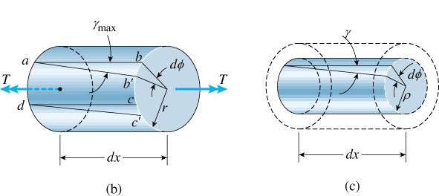
Angle of Twist
©2001 Brooks/Cole, a division of Thomson Learning, Inc. Thomson Learning™ is a trademark used herein under license.
Shear strain, does not depend on constitutive behavior

Slide 7
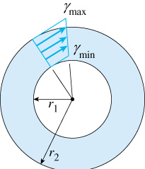
Shear Strain
©2001 Brooks/Cole, a division of Thomson Learning, Inc. Thomson Learning™ is a trademark used herein under license.

Slide 8
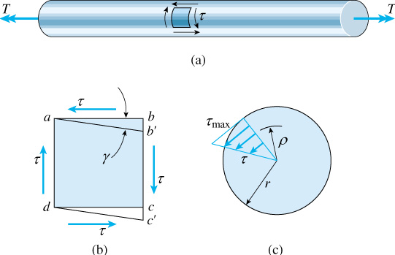
Shear Stress
Elastic only
©2001 Brooks/Cole, a division of Thomson Learning, Inc. Thomson Learning™ is a trademark used herein under license.

Slide 9
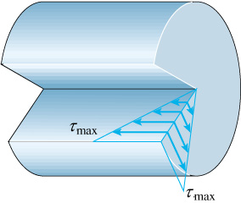
Shear Stress
Elastic only
©2001 Brooks/Cole, a division of Thomson Learning, Inc. Thomson Learning™ is a trademark used herein under license.

Slide 10
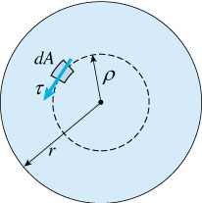
Torque
Elastic only
©2001 Brooks/Cole, a division of Thomson Learning, Inc. Thomson Learning™ is a trademark used herein under license.

Slide 11
Polar Moment of Inertia

Slide 12
Example

Slide 13
Example

Slide 14
Example

Slide 15
Example

Slide 16
Angle of Twist

Slide 17
Constant Torque and Cross-section

Slide 18
Piece-wise Constant

Slide 19
Sign Convention

Slide 20
Example

Slide 21
Example

Slide 22
Example

Slide 23
Statically Indeterminate Shaft

Slide 24
Example

Slide 25
Example

Slide 26
Example

Slide 27
Example

Slide 28
Power Transmission

Slide 29
Shaft Design

Slide 30
Example

Slide 31
Example

Slide 32
Stress Concentration

Slide 33
Example

Slide 34
Example

Slide 35
Inelastic Torsion

Slide 36
Linear Elastic Perfectly Plastic

Slide 37
Torque

Slide 38
Full Plastic

Slide 39
Torque – Angle of Twisting
Elastic only
Elastic zone radius

Slide 40
Example

Slide 41
Example

Slide 42
Example

Slide 43
Example

Slide 44
Residual Stress

Slide 45
Residual Stress

Slide 46
Plastic Torque
Issue with center

Slide 47
Elasto-plastic Torque

Slide 48
Example

Slide 49
Example

Slide 50
Example

Slide 51
Assignment
Textbook
5.2, 5.5, 5.30, 5.38, 5.48, 5.49, 5.78, 5.120, 5.129

Slide 52
Quiz

