Slide 1
Mechanics of Materials
Beam
Reaction, shear force, and bending moment
Stress and Strain
Deflection curve
Chapter 6.1-6.6, 6.9-6.10; 7.1-7.4; 12; 14.2; 14.10

Slide 2
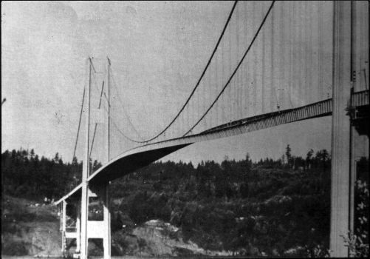
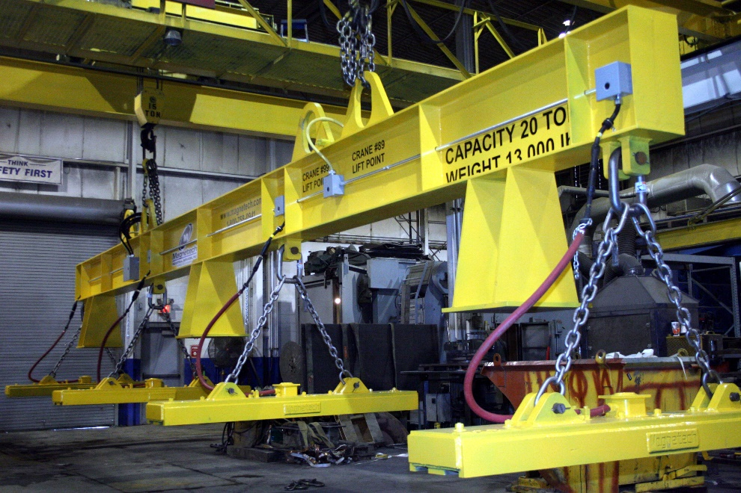
Engineering Structures

Slide 3
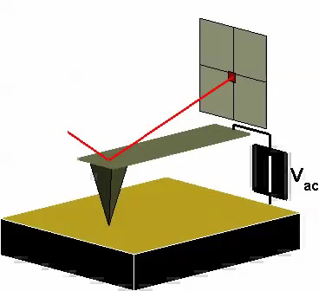
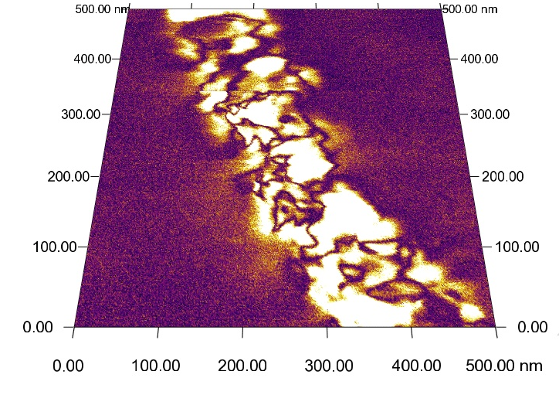
Nanotechnology

Slide 4
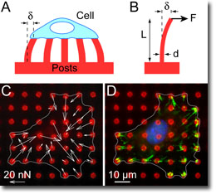
Biotechnology

Slide 5
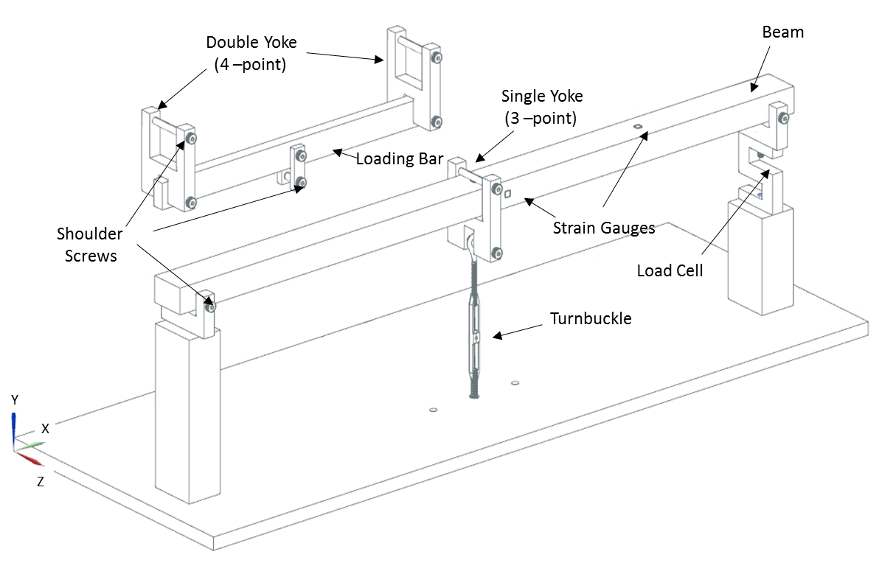
Beam in Bending
Deflection
Reaction
Strain
Stress

Slide 6
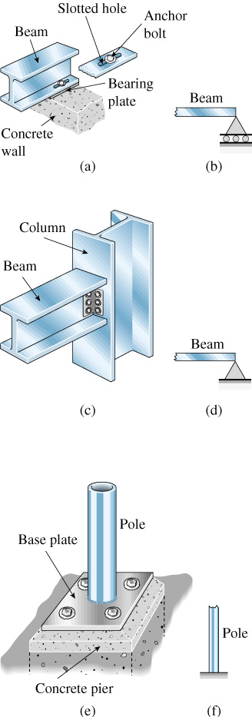
Types of Supports and Reactions
Roller support:
Vertical displacement forbidden
Vertical reaction force
Pin support:
Vertical/lateral displacement forbidden
Vertical/lateral reaction force
Fixed support:
Vertical/lateral displacement forbidden
Vertical/lateral reaction force
Rotation forbidden
Reaction moment

Slide 7
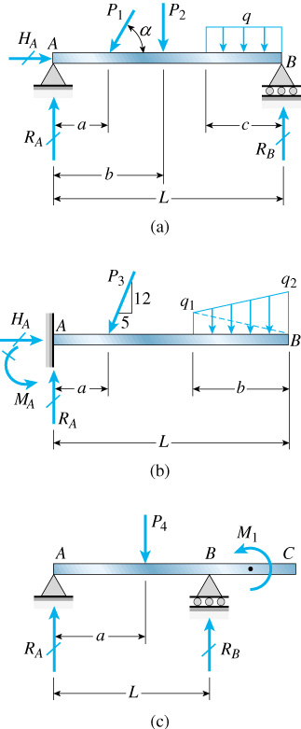
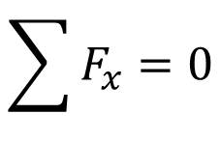
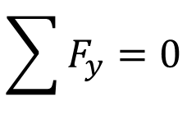
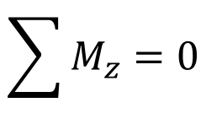
Free Body Diagram and Equilibrium
Simply supported beam
Cantilever beam
Simply supported beam
with overhang

Slide 8
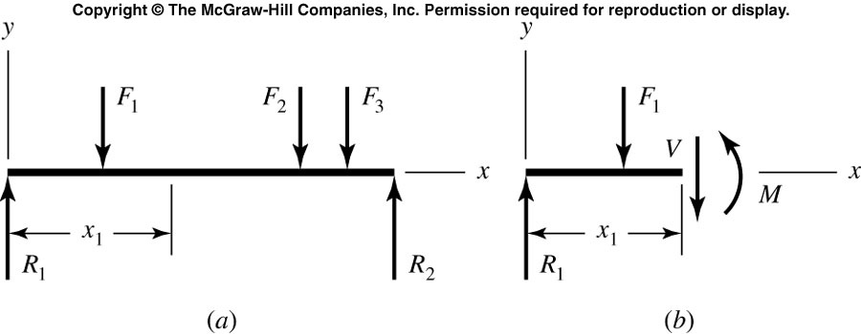
Shear Force & Bending Moment

Slide 9
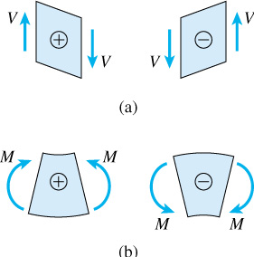
Deformation Sign Convention

Slide 10
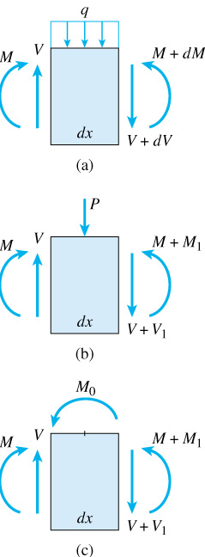
Shear Force & Bending Moment Diagram
Negative q
Sign of q, P, and M determined by static sign convention
Sign of V determined by deformation sign convention
Negative P
Positive M₀

Slide 11
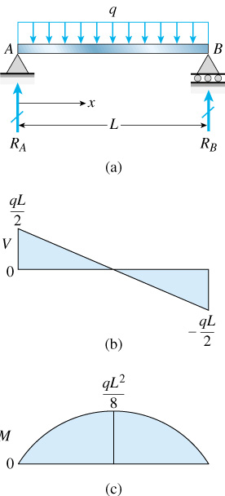
Uniformly Distributed Load

Slide 12
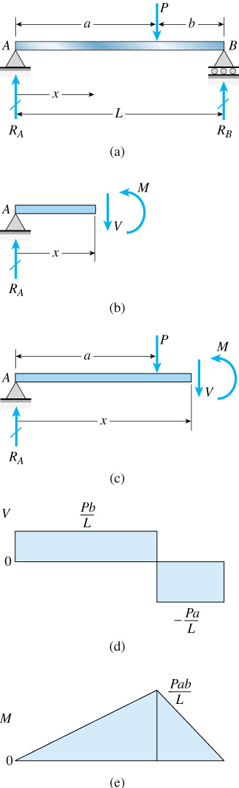
Three-Point Bending

Slide 13
Shear Force & Bending Moment Diagram
Calculate reaction forces and moments at the supports
Draw shear force diagram first
Identify the shear force at origin, based on the reaction force at the left support, with its sign by deformation convention
Draw linear curve, with slope given by q, unless encounter a concentrated load
At the point of concentrate load, have a jump in shear force;
Check consistency at the right support
Draw bending moment diagram next
Identify the bending moment at the origin, based on reaction moment at the left support; deformation sign convention
Draw moment with slope given by V from shear force diagram
At the point of concentrate moment, have a jump
Check consistency at the right support

Slide 14
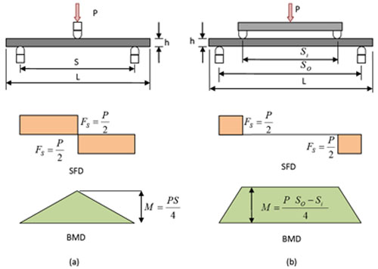
Three- & Four-Point Bending
What is the difference?

Slide 15
Shear Force and Bending Moment Diagram
What is RA, RB?

Slide 16
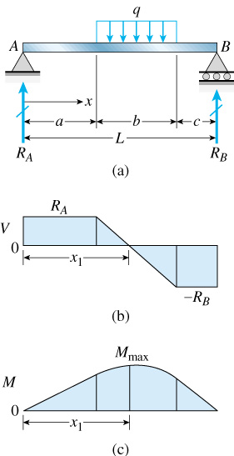
Shear Force and Bending Moment Diagram
Where, and what is maximum M?

Slide 17
Quiz

Slide 18
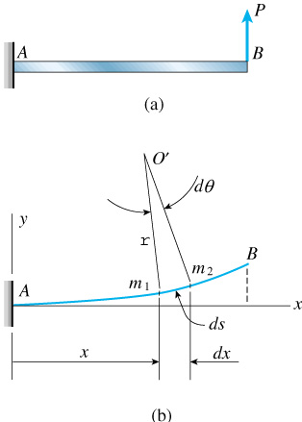
Deflection in Beam

Slide 19
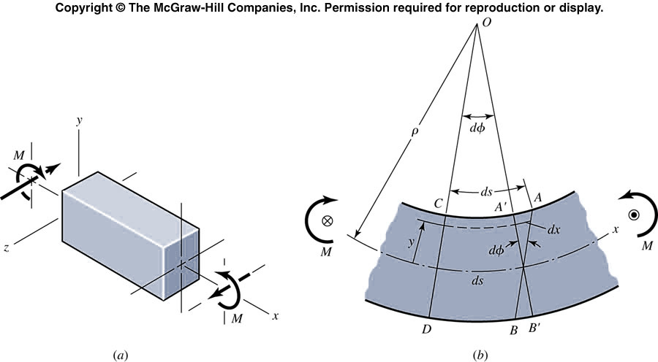
Normal Stress in Beam
How to identify the neutral axis?

Slide 20
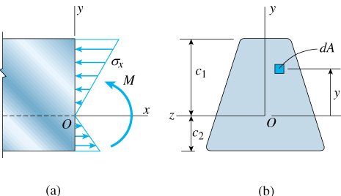
Normal Stress
Go through centroid !

Slide 21
Three- & Four-Point Bending
How stress is varied?

Slide 22
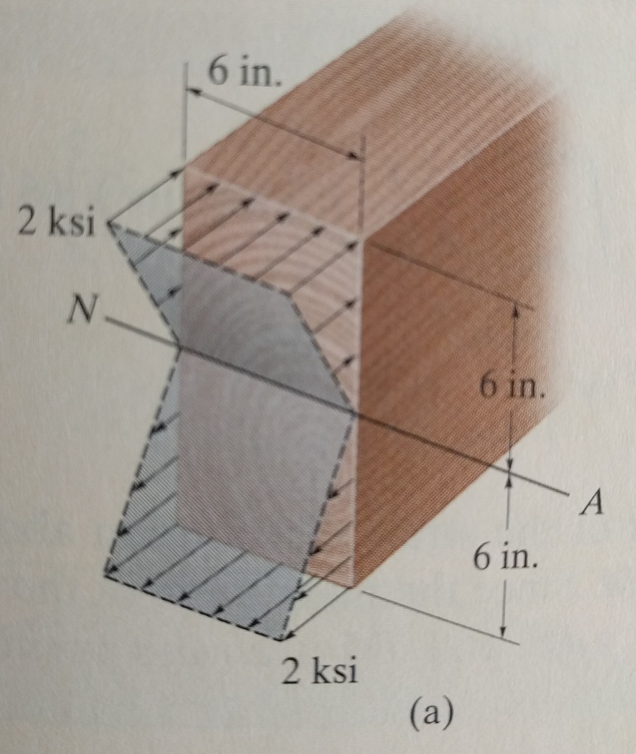
Example
What is bending moment?

Slide 23
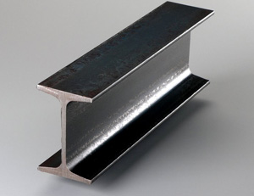
I Beam
Why?

Slide 24
Example

Slide 25
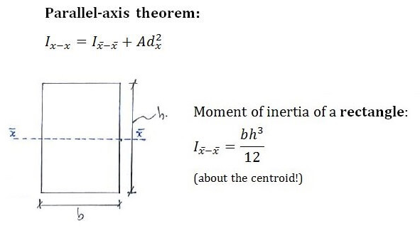
Parallel Axis Theorem

Slide 26
Example

Slide 27
Example

Slide 28
Example
Origin on the top

Slide 29
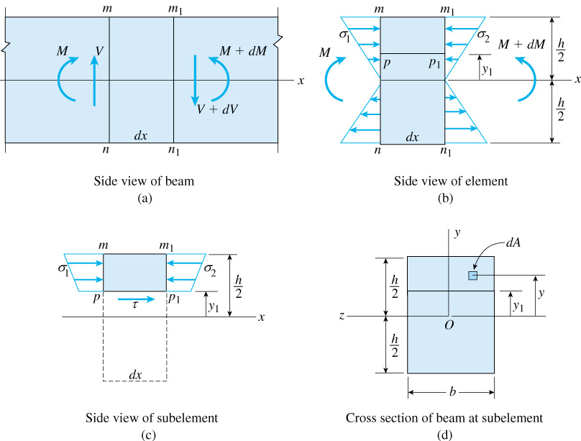
Shear Stress
Magnitude only
Origin at centroid

Slide 30
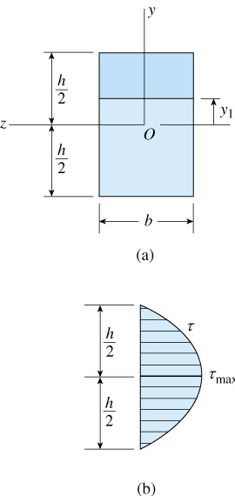
Distribution of Shear Stress

Slide 31
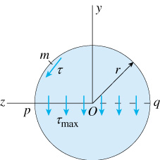
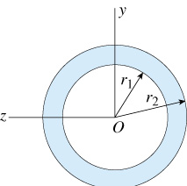
Shear Stress

Slide 32
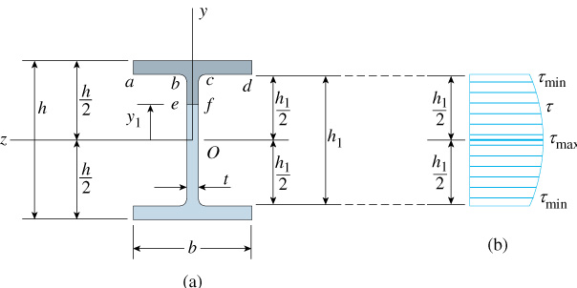
Shear Stress

Slide 33
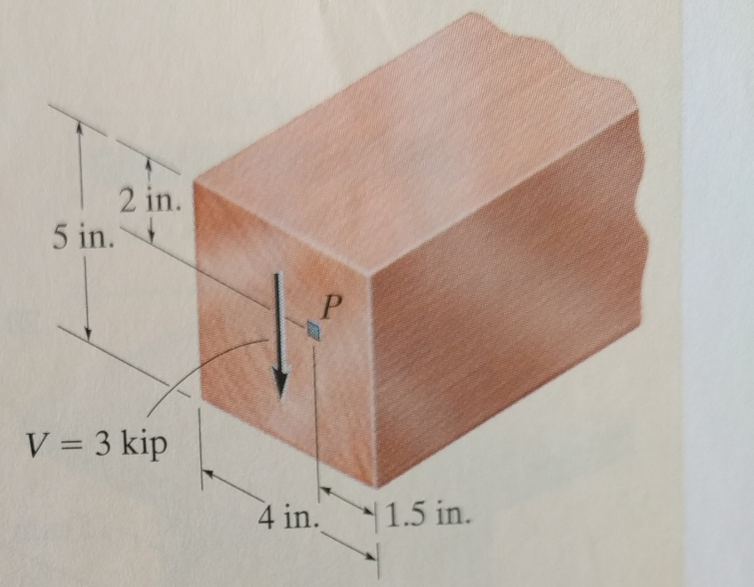
Example
Shear stress at P and maximum shear?

Slide 34
Example

Slide 35
Example

Slide 36
Example
Maximum shear

Slide 37
Example
Origin at bottom

Slide 38
Example

Slide 39
Three- & Four-Point Bending
What is the difference?

Slide 40
Plastic Bending

Slide 41
Plastic Bending

Slide 42
Fully Plastic

Slide 43
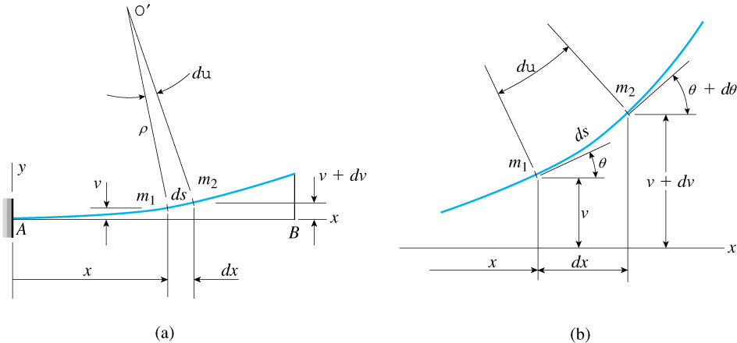
Deflection of Beam

Slide 44
Deflection of Curve

Slide 45
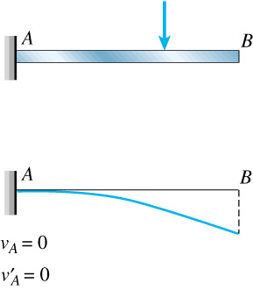
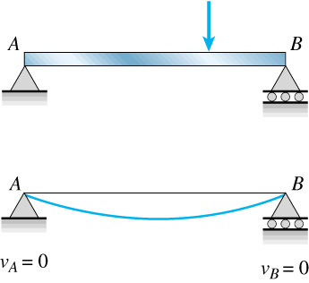
Boundary Condition

Slide 46
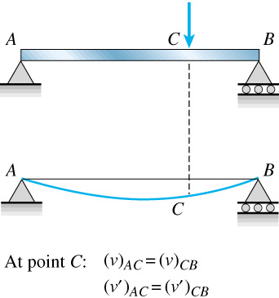
Continuity Condition

Slide 47
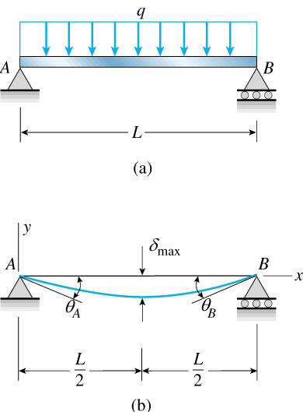
Deflection by Bending Moment Equation

Slide 48
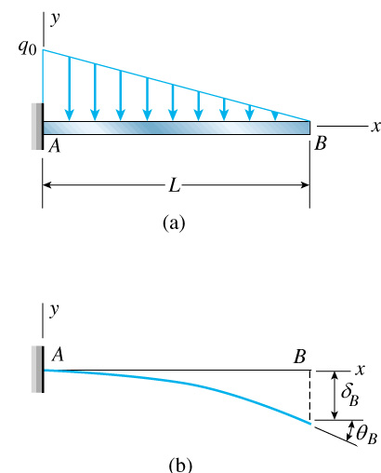
Deflection by Loading Equation

Slide 49
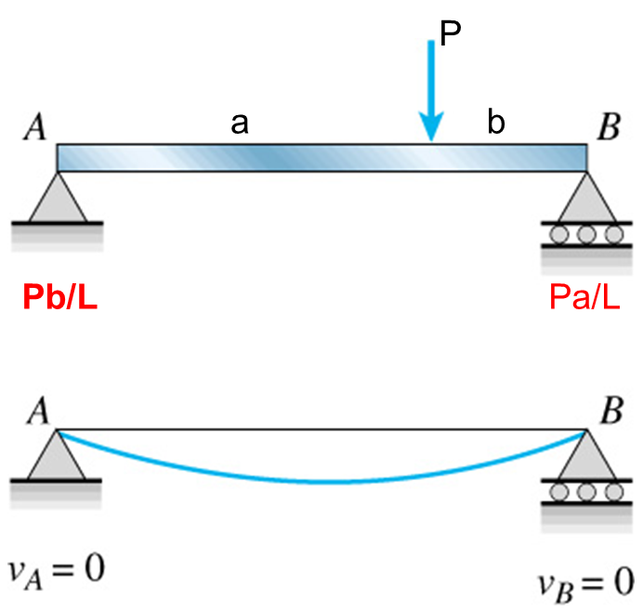
Three-Point Bending
Slope at x=a
Deflection at x=a
Deflection at x=L

Slide 50
Three-Point Bending
a=b:
middle

Slide 51
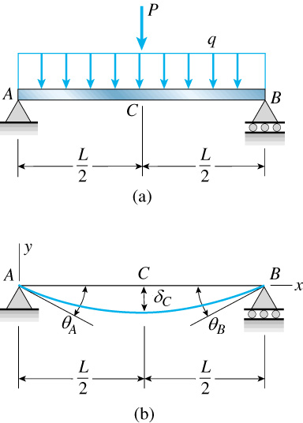
Deflection by Superposition

Slide 52
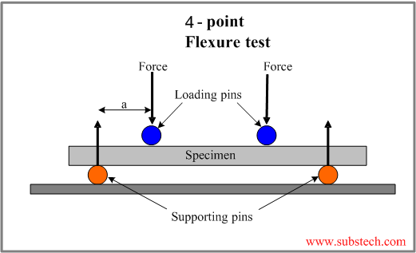
Four-Point Bending
(1)
a
b
(2)
b
a
x

Slide 53
Bonus Quiz
P
a
Determine deflection curve

Slide 54
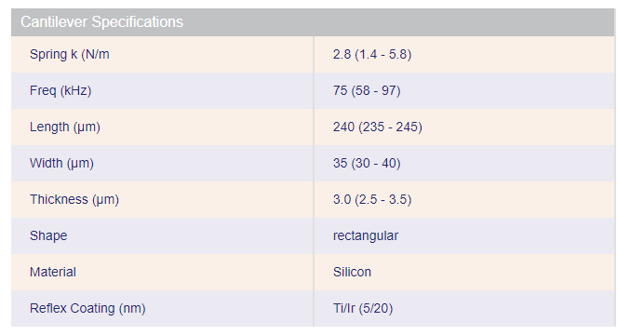
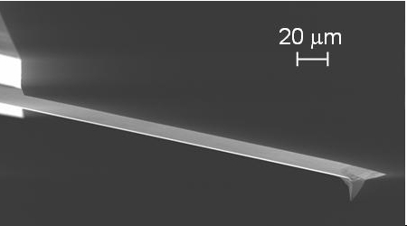
AFM Cantilever
2.73 N/m
69.7 kHz

Slide 55
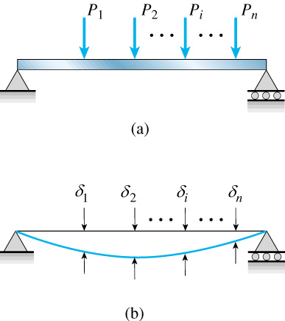
What If?

Slide 56
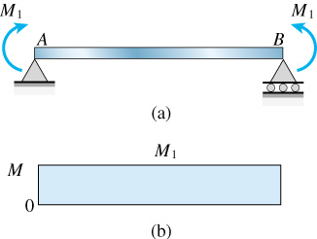
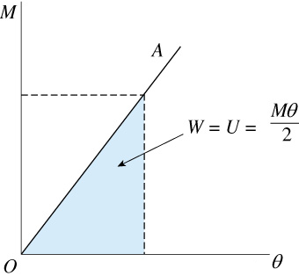
Strain Energy of Pure Bending

Slide 57
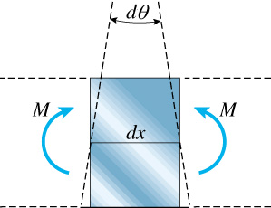
Strain Energy of Bending

Slide 58
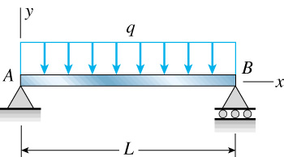
Strain Energy of Bending

Slide 59
Example

Slide 60
Example

Slide 61
Castigliano’s Theorem
When forces act on a elastic system
subject to small displacements, the
displacement corresponding to any
force, collinear with the force, is equal
to the partial derivative of the total
strain energy with respect to that force.

Slide 62
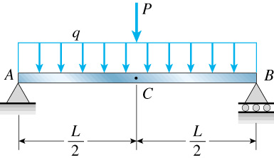
Application
Left half

Slide 63
Modified Castigliano’s Theorem

Slide 64
How about without P?

Slide 65
Example

Slide 66
Three-Point Bending

Slide 67
Example

Slide 68
Example

Slide 69
Statically Indeterminate Beam

Slide 70
Statically Indeterminate Beam

Slide 71
Deflection by Loading Equation

Slide 72
Assignment
Text book
6.2, 6.19, 6.22，6.47, 6.55, 6.69
Due April 22
6.168, 7.3, 7.10, 7.11, 12.10, 12.13, 12.23
Due April 29:
12.89, 12.91, 12.92, 12.103, 12.108, 14.14, 14-18, 14-155, 14-135, 14-138

