Slide 1
Mechanics of Materials
Buckling
Chapter 13
Jiangyu Li
SUSTech

Slide 2
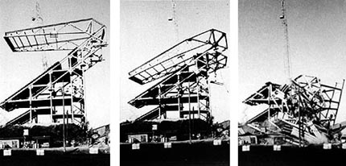
Collapse of Husky Stadium
At 8:30 a.m. there were 40 men working on the structure. 30 minutes later an iron worker spotted a buckle in a 28 inch diameter tube that supported the overhanging roof.
There were 9 guy wires that were used to support the structure during the construction. Six of the guy wires were removed too early which resulted in the structure being unable to resist against lateral forces put on the members
Feb. 25, 1987

Slide 3
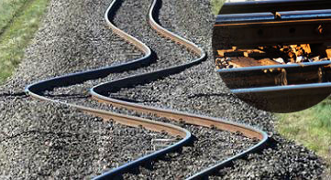
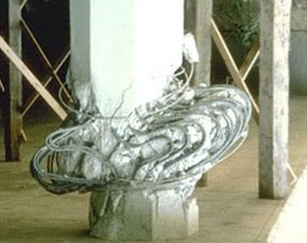
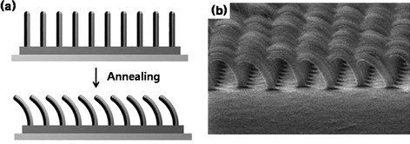
Engineering Example

Slide 4
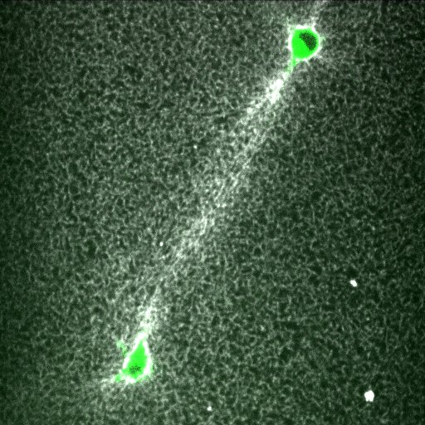
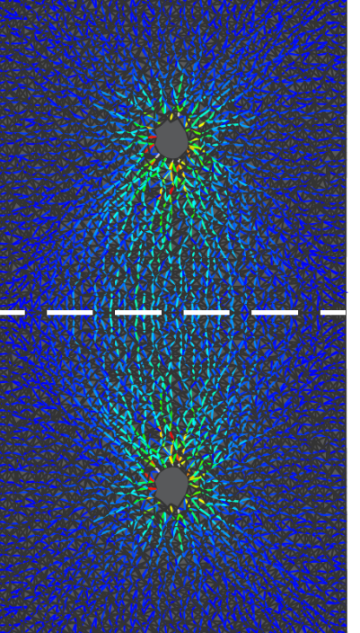
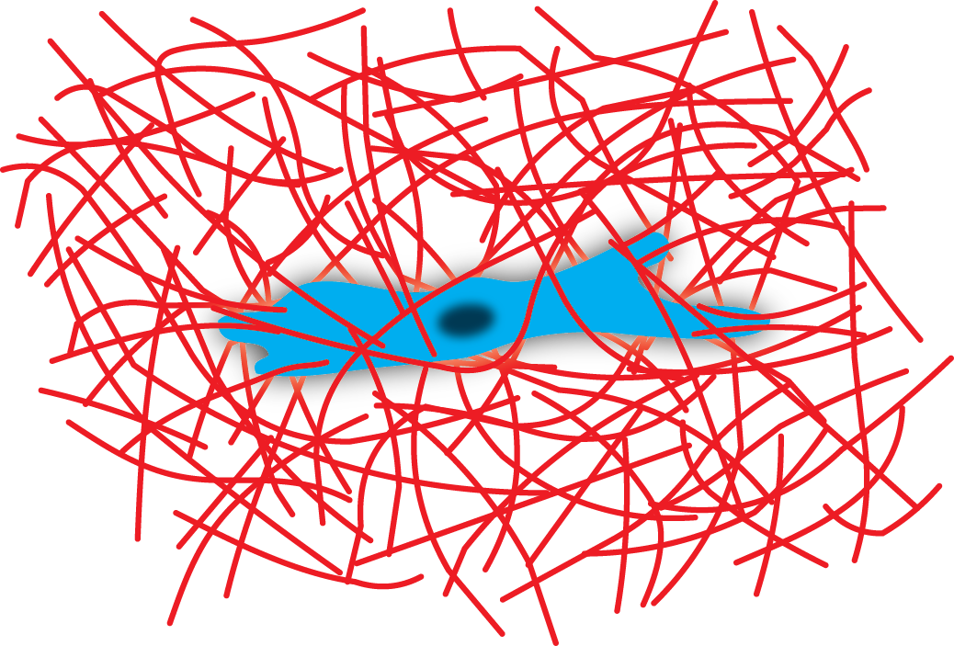
Cell Mechanics
Cells sense one another over long distances
~10 cell diameters.
2. Matrix fiber buckling results in long range (1/r) displacement propagation through the matrix.
50 µm

Slide 5
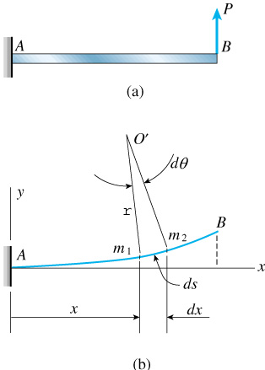
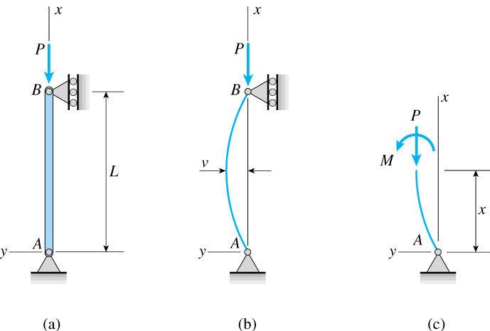
Bending and Buckling

Slide 6
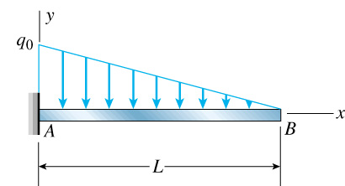
Bonus Quiz
P
a
Which of the following statement is not true
Angle of rotation at point A is zero
Angle of rotation at point where P is applied is continuous
Angle of rotation at point B is zero
Deflection at point B is maximum

Slide 7
Bending Moment

Slide 8
Deflection

Slide 9
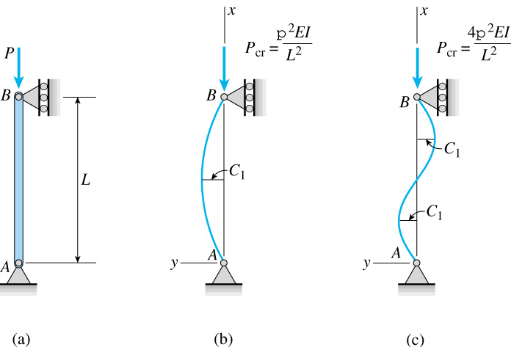
Critical Stress
What if load is smaller than critical one?

Slide 10
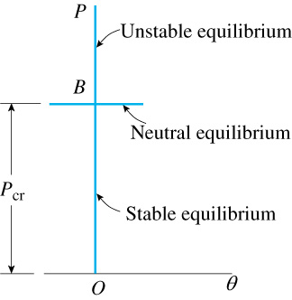
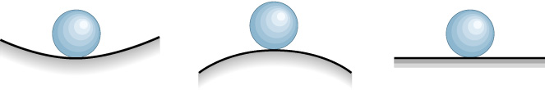
Equilibrium

Slide 11
Understanding Equilibrium

Slide 12
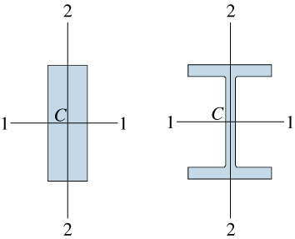
Direction of Buckling

Slide 13
Example
pin-pin support

Slide 14
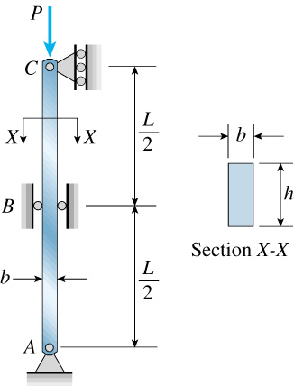
Example
©2001 Brooks/Cole, a division of Thomson Learning, Inc. Thomson Learning™ is a trademark used herein under license.

Slide 15
Fix-free Support

Slide 16
Fix-free Support

Slide 17
Fix-free Support

Slide 18
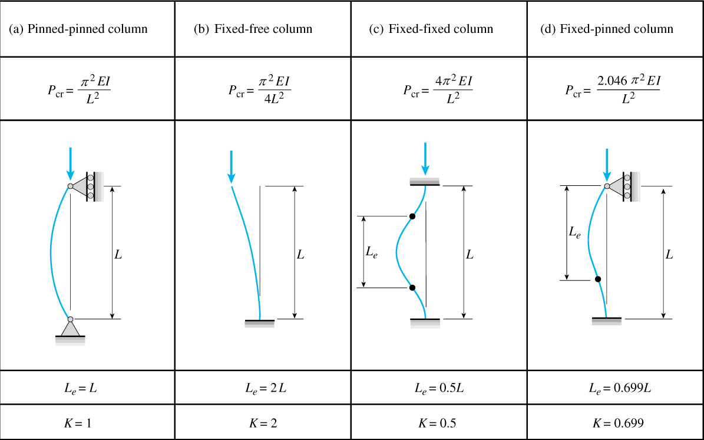
Other Supports

Slide 19
Example

Slide 20
Example

Slide 21
Critical Load
r: radius or gyration
Slenderness ratio

Slide 22
Critical Load

Slide 23
Radius of Gyration

Slide 24
Example

Slide 25
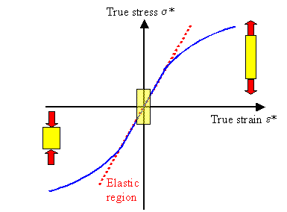
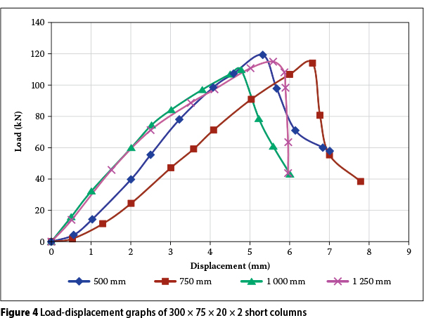
Critical Stress

Slide 26
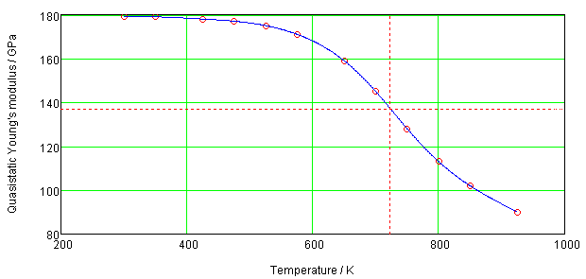
Effect of Temperature

Slide 27
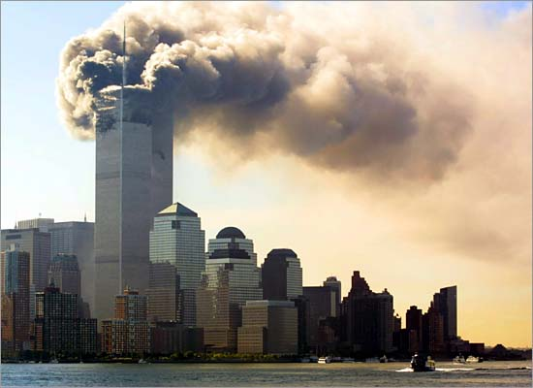
Why did WTC Collapse?

Slide 28
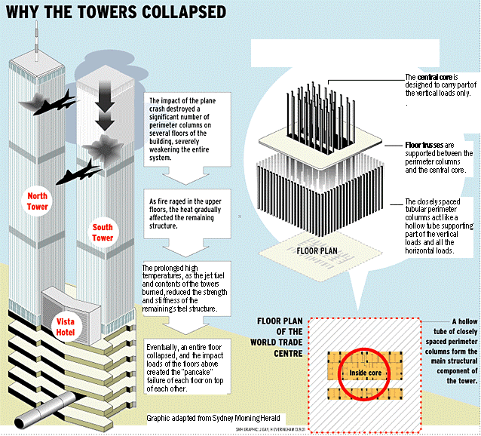

Slide 29
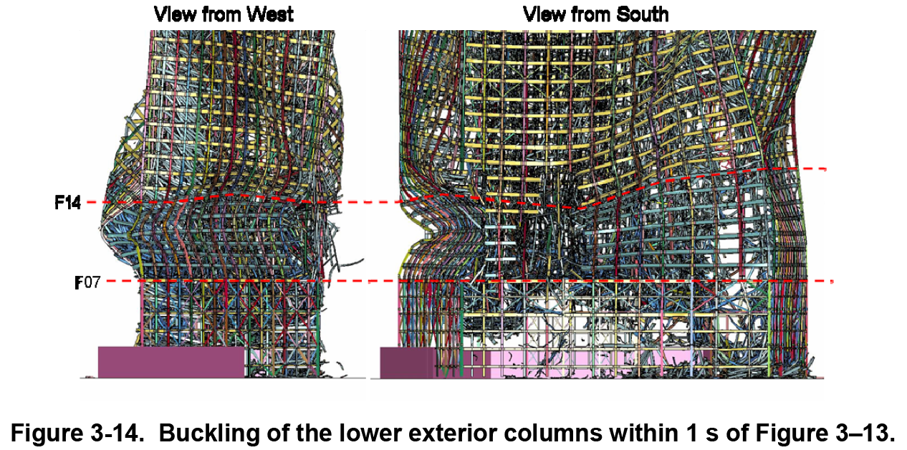

Slide 30
Bonus Quiz
Which of the following column is the easiest to buckle?
(A)
(B)
(C)
(D)

Slide 31
Assignment
Textbook
13-5; 13-12; 13-21;

