Slide 1
Mechanics of Materials
Stress and Strain Transformations
Textbook Chapters 9, 10
Jiangyu Li
SUSTech

Slide 2
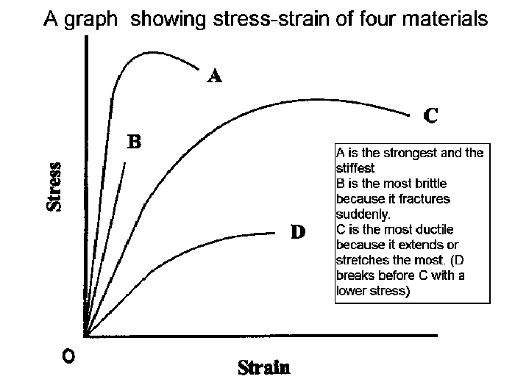
Uniaxial Tensile Test
What can we learn from here?

Slide 3
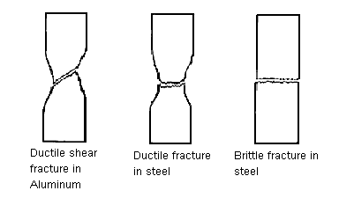
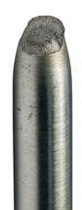
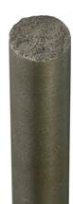
Fracture Surface: Tension
Why is there a difference, and what causes it?

Slide 4
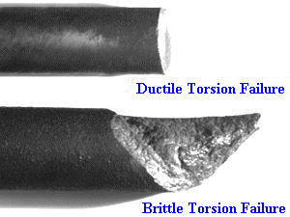
Fracture Surface: Torsion
Why is there a difference, and what causes it?

Slide 5
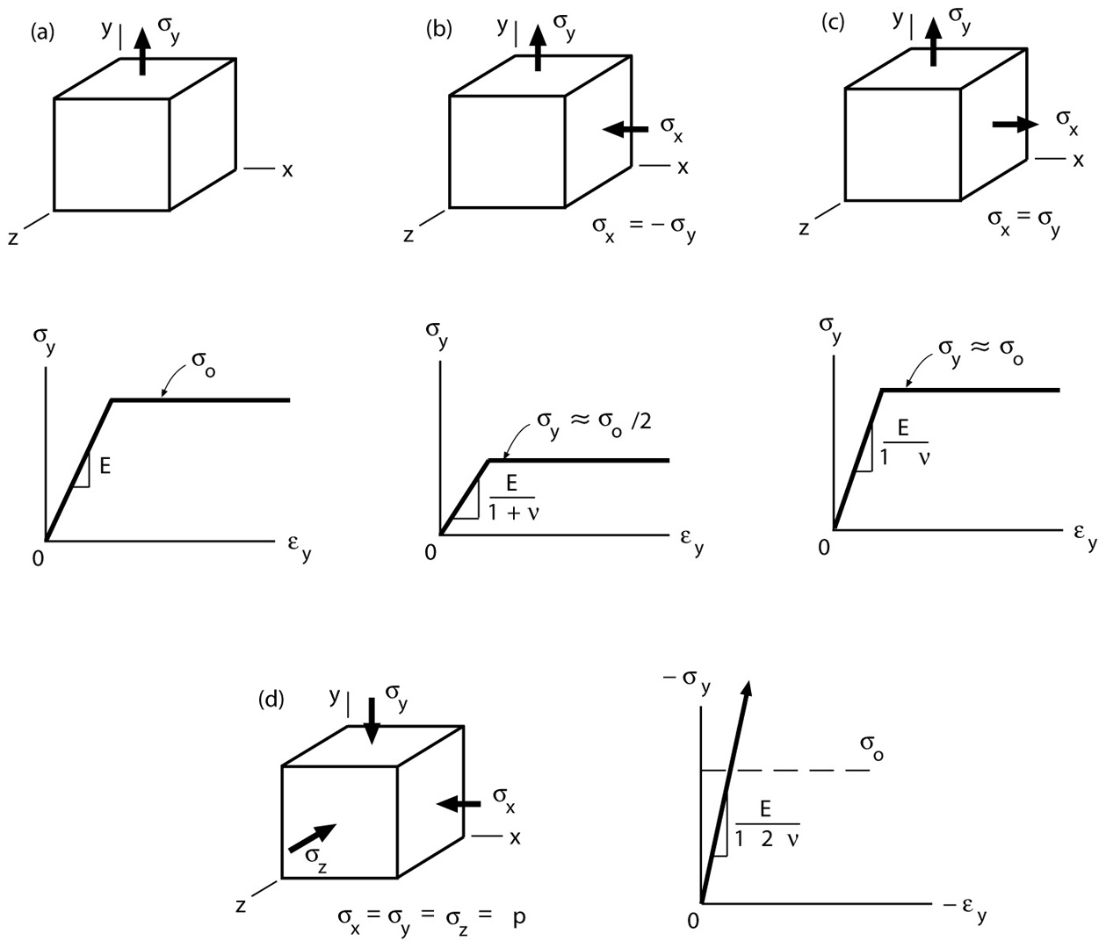
Multi-axial Load: Yielding
-
Why is there a difference, and what causes it?
-

Slide 6
What is Stress?
Force per unit area?
What force? What area?

Slide 7
Effect of Orientation

Slide 8
Effect of Orientation

Slide 9
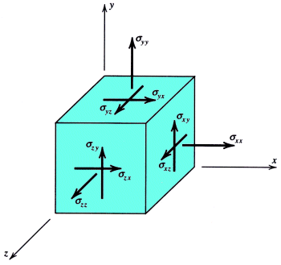
3D Stress
First index: area
Second index: direction

Slide 10
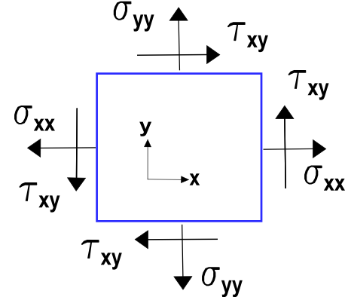
2D Stress

Slide 11
Sign Convention
Positive: acting on positive (negative) plane, along positive (negative) direction

Slide 12
Effect of Orientation

Slide 13
Effect of Orientation

Slide 14
Stress Transformation

Slide 15
Free Body Diagram

Slide 16
Free Body Diagram

Slide 17
Equilibrium

Slide 18
Stress Transformation
Constant trace

Slide 19
Example

Slide 20
Example

Slide 21
Example

Slide 22
Extreme Values

Slide 23
Extreme Values

Slide 24
Example

Slide 25
Example

Slide 26
Example

Slide 27
Example

Slide 28
Example

Slide 29
Example

Slide 30
Extreme Values: Torsion
=0: ductile
= ∞ : brittle

Slide 31
Example

Slide 32
Example

Slide 33
Extreme Values: Uniaxial Tension
=0: brittle
=∞: ductile

Slide 34
Example
Use different coordinate?

Slide 35
Example
Maximum?

Slide 36
Example
Maximum?

Slide 37
Stress Transformation
Constant trace

Slide 38
Mohr’s Circle

Slide 39
Mohr’s Circle

Slide 40
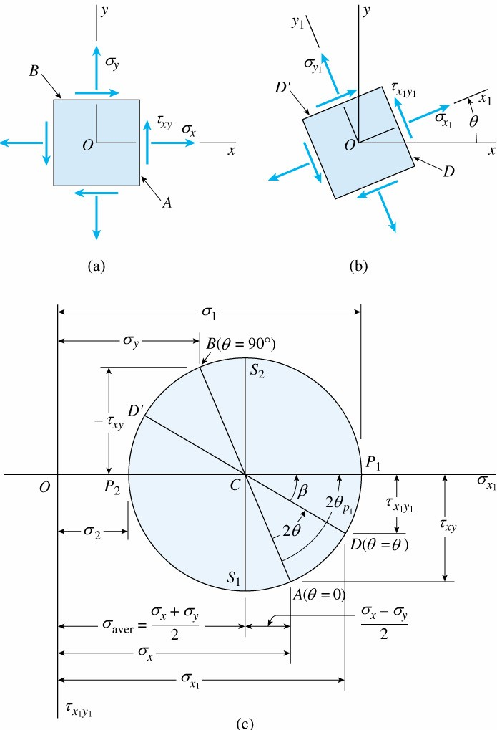
Mohr’s Circle

Slide 41
Example

Slide 42
Example

Slide 43
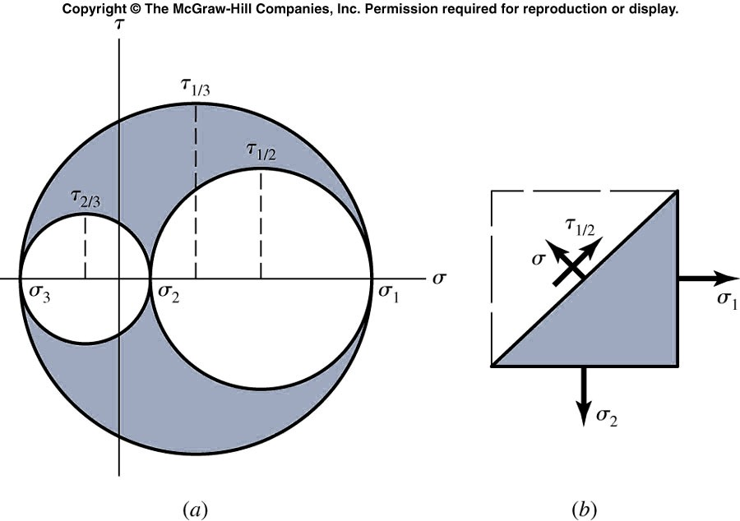
3D Mohr’s Circle
Don’t forget the third dimension

Slide 44
Example
Consider a point where the stress components are indicated in the given stress element in x-y coordinate.
After rotating to x’-y’ coordinate, it is found that normal stress along y’-plane is compressive and its magnitude is 100MPa.
Determine the normal stress acting on x’-plane.

Slide 45
Example

Slide 46
Example

Slide 47
Example

Slide 48
Strain

Slide 49
Normal and Shear Strains

Slide 50
Sign Convention

Slide 51
3D Strain

Slide 52
Plane Strain

Slide 53
Strain Transformation

Slide 54
Stress Transformation
Constant trace

Slide 55
Strain Transformation

Slide 56
Example

Slide 57
Principal Strain

Slide 58
Maximum Shear Strain

Slide 59
Example

Slide 60
Example

Slide 61
Maximum Shear

Slide 62
Maximum Shear

Slide 63
Strain Rosette

Slide 64
Strain Rosette

Slide 65
Strain Rosette

Slide 66
Assignment
Due May 12
Textbook
9.8, 9.13, 9.14, 9.20, 9.51, 9.84, 9.88
10.2, 10.5, 10.26

