Slide 1
Mechanics of Materials
Plasticity and Failure
Mechanical Behavior of Materials
Chapter 12.1-12.3
Chapter 7.1-7.6
1D and 3D
Jiangyu Li

Slide 2
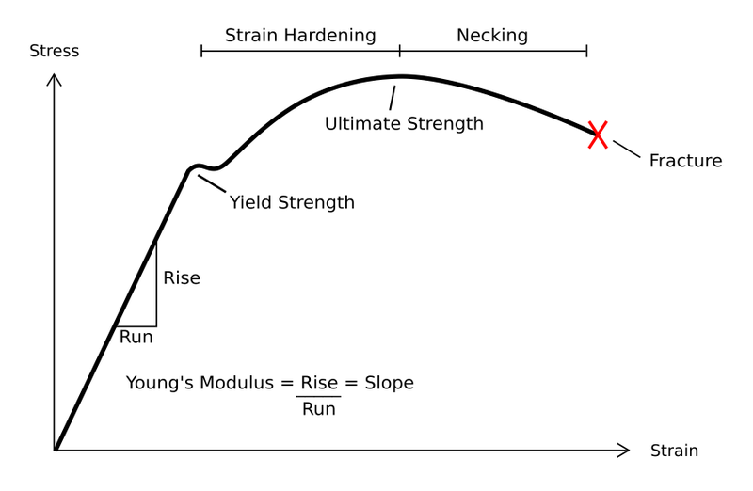
Stress Strain Curve

Slide 3
Engineering/True Stress/Strain
Engineering Stress/Strain
True Stress/Strain

Slide 4
Engineering/True Stress/Strain
Constant Volume

Slide 5
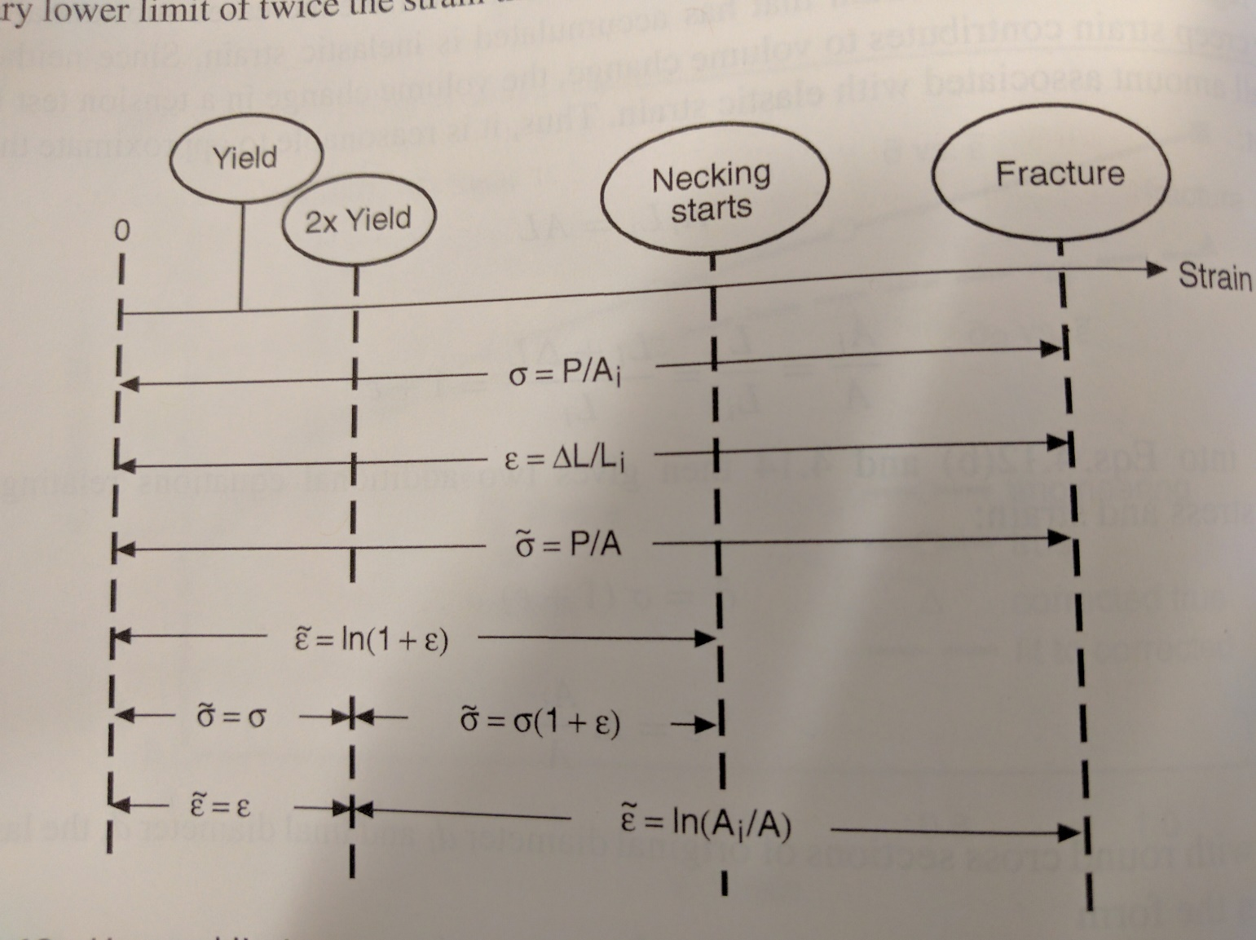
Engineering/True Stress/Strain

Slide 6
Mechanics of Materials Lab
Plasticity and Failure
Mechanical Behavior of Materials
Chapter 12.1-12.3
1D constitutive model
Jiangyu Li

Slide 7
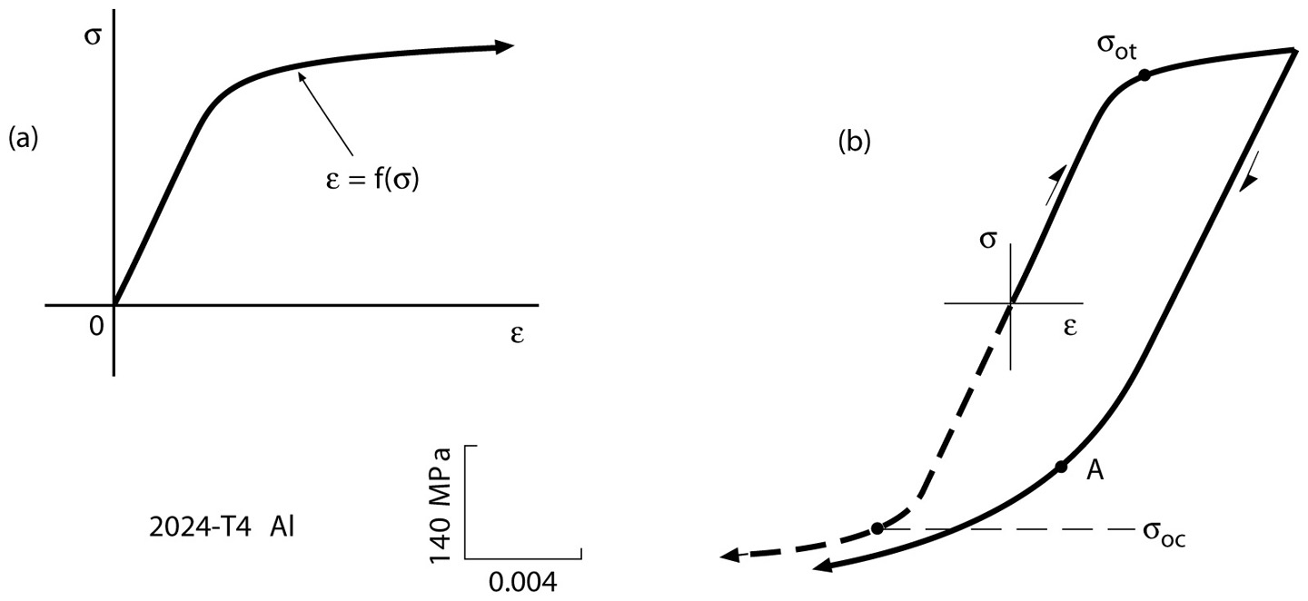
Stress Strain Curve
Bauschinger effect
Notes:
Figure: 12-01a-b

Slide 8
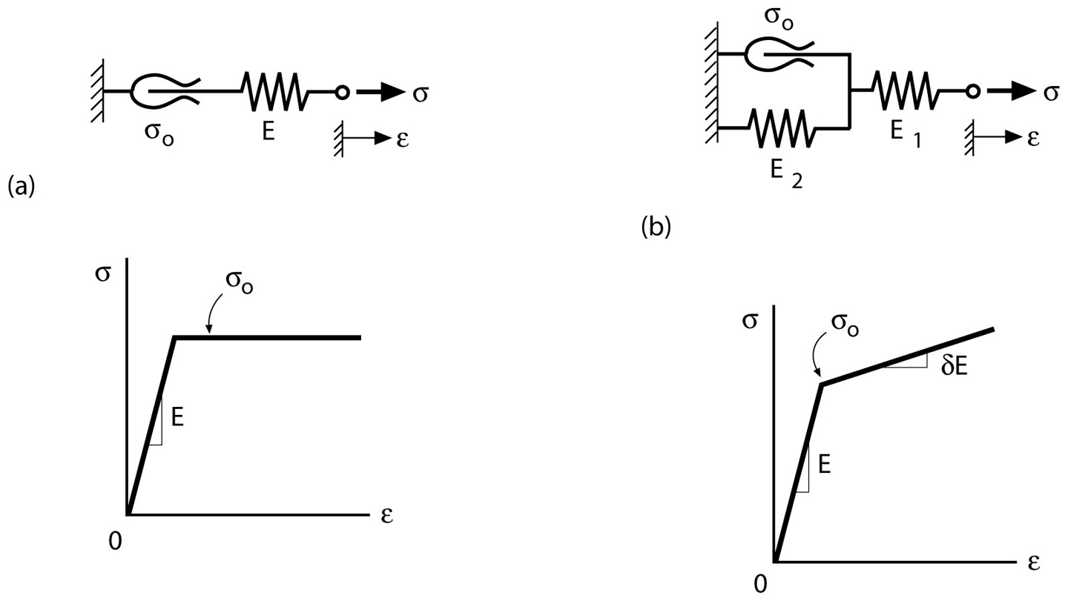
Elastic-Perfect Plastic and Linear Hardening
Summation of strain
Notes:
Figure: 12-04a-b

Slide 9
Example
Notes:
Figure: 12-04a-b

Slide 10
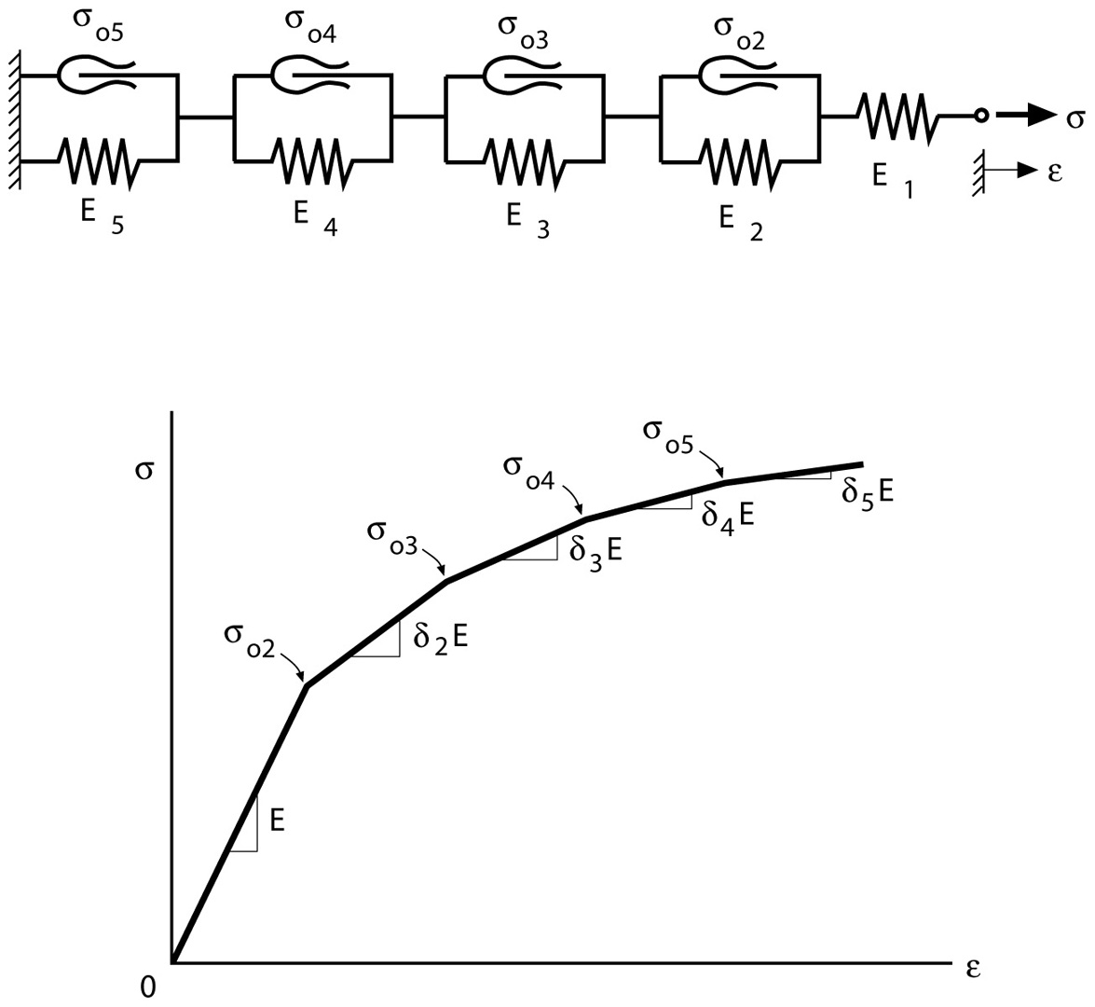
Rheological Modeling of Nonlinear Hardening
Notes:
Figure: 12-06

Slide 11
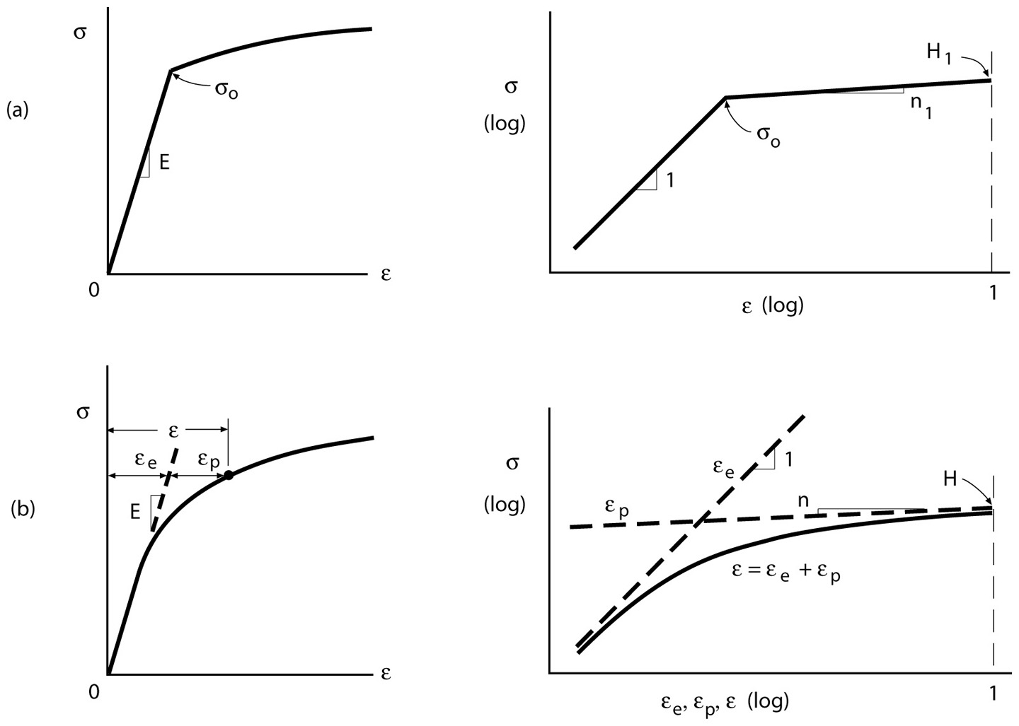
Power Hardening and Ramberg-Osgood Relation
Yielding?
Yielding?
Notes:
Figure: 12-05a-b

Slide 12
Example
Notes:
Figure: 12-05a-b

Slide 13
Example
Notes:
Figure: 12-05a-b

Slide 14
Example
Notes:
Figure: 12-05a-b

Slide 15
Example
Notes:
Figure: 12-05a-b

Slide 16
Example
Notes:
Figure: 12-05a-b

Slide 17
Example
Notes:
Figure: 12-05a-b

Slide 18
Example
Notes:
Figure: 12-05a-b

Slide 19
Example
Notes:
Figure: 12-05a-b

Slide 20
Example
Notes:
Figure: 12-05a-b

Slide 21
Example
Notes:
Figure: 12-05a-b

Slide 22
Example
Notes:
Figure: 12-05a-b

Slide 23
Example
What is yielding?
Notes:
Figure: 12-05a-b

Slide 24
Mechanics of Materials Lab
Plasticity and Failure
Mechanical Behavior of Materials
Chapter 12.1-12.3
Chapter 7.1-7.6
3D Failure Criterion
Jiangyu Li

Slide 25
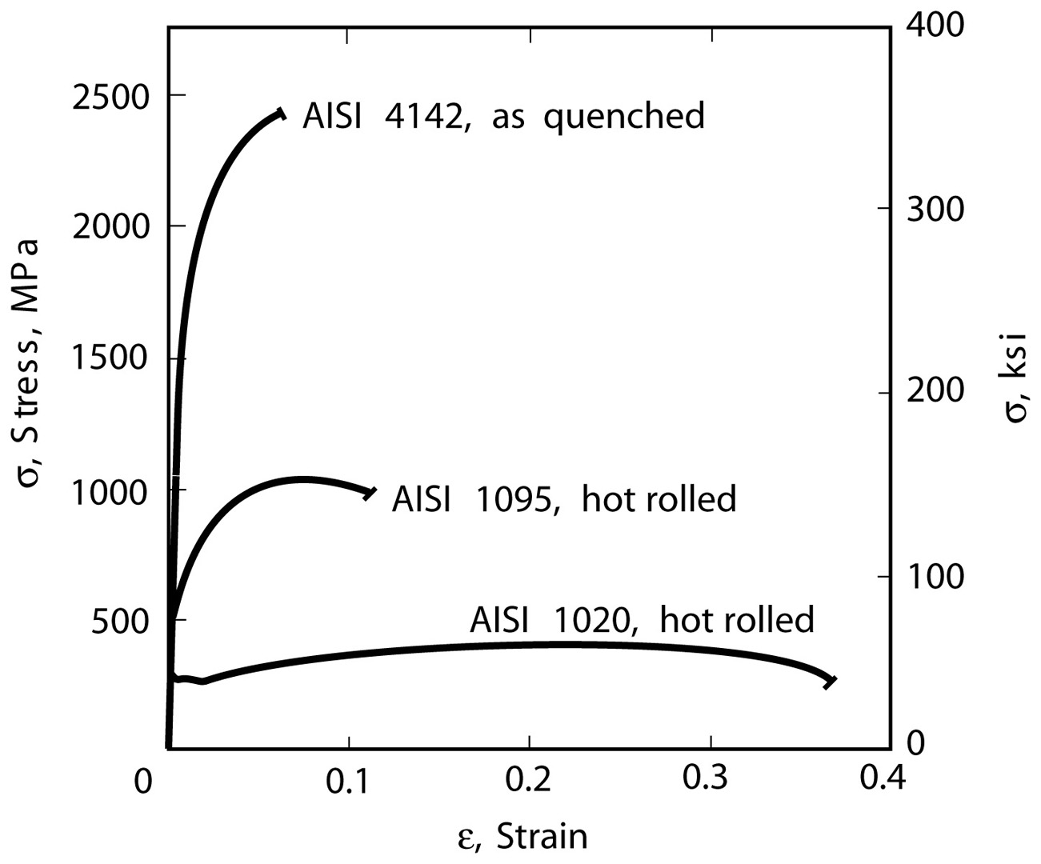
Failure Modes

Slide 26
Failure Mode
Ductile: Yielding
Brittle: Fracture

Slide 27
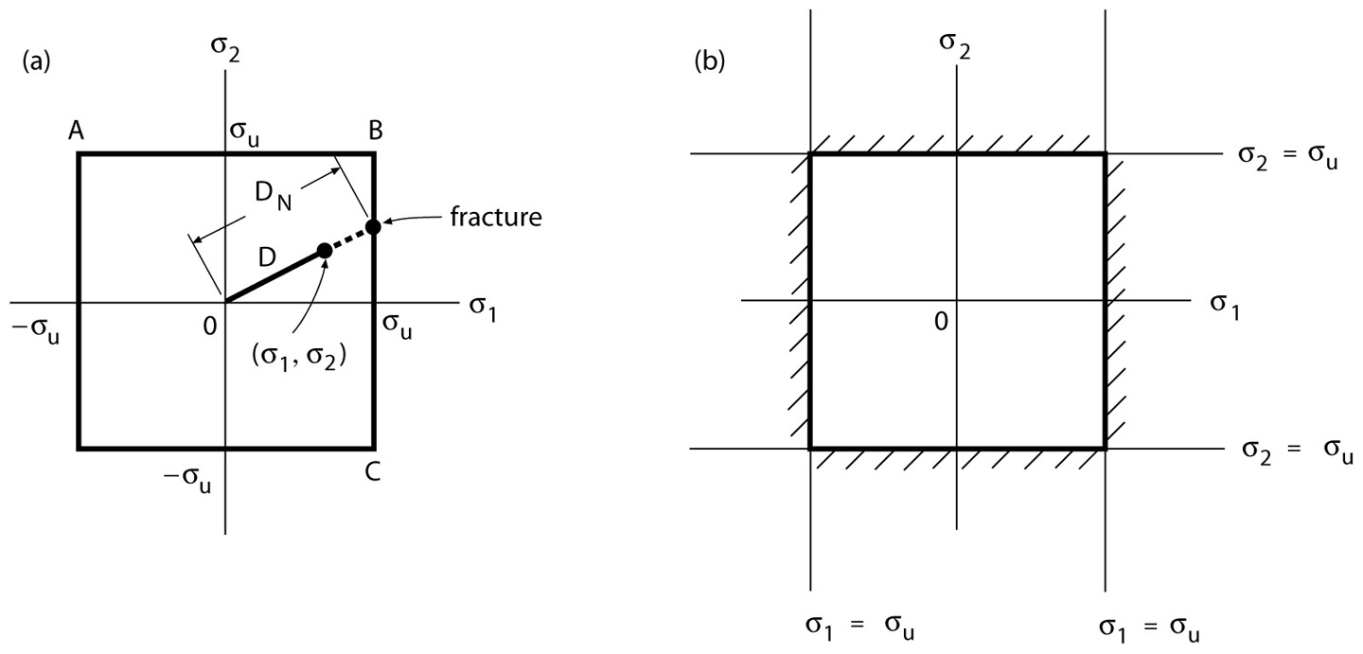
Maximum Normal Stress Fracture Criterion
Notes:
Figure: 07-02a-b

Slide 28
Example
Safety factor against fracture?
Notes:
Figure: 07-02a-b

Slide 29
Example
Notes:
Figure: 07-02a-b

Slide 30
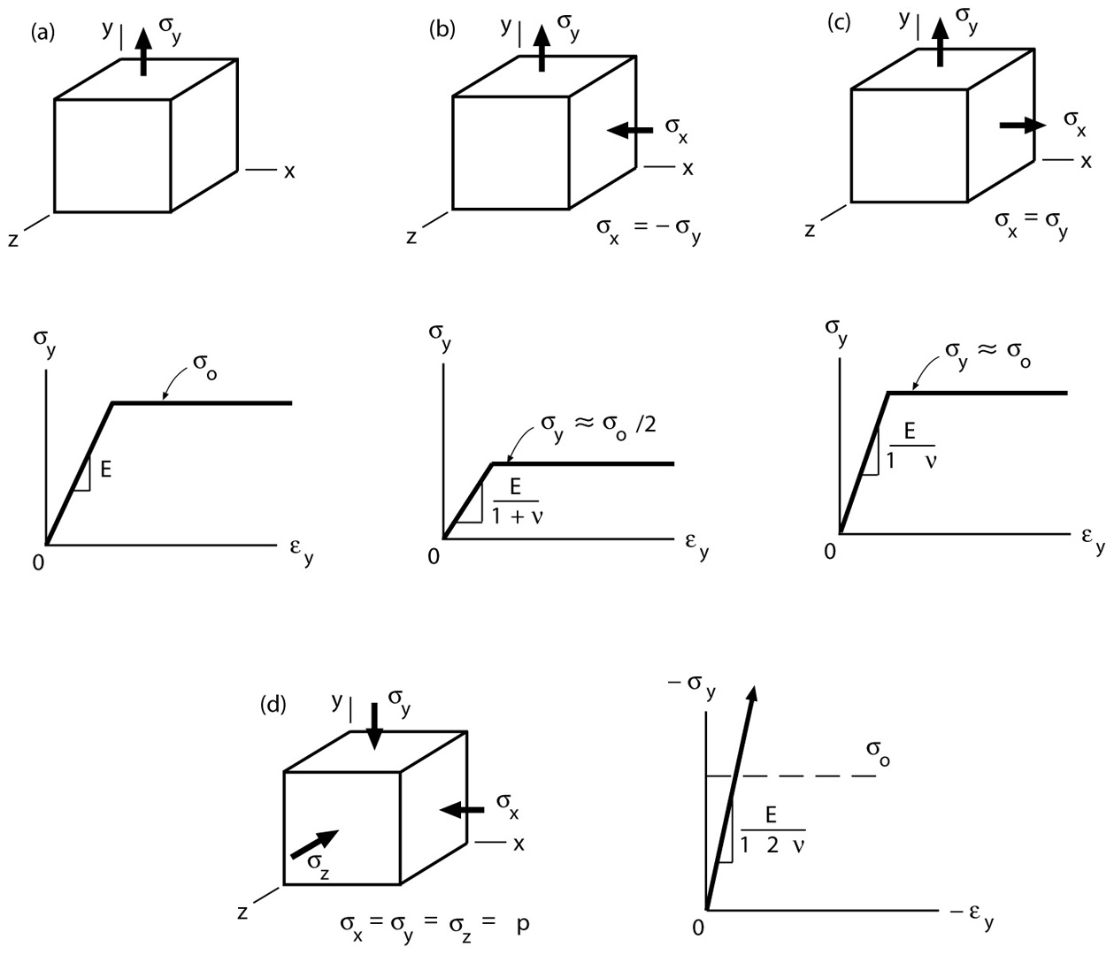
Multi-axial Load: Yielding
-
Why is there a difference, and what causes it?
-

Slide 31
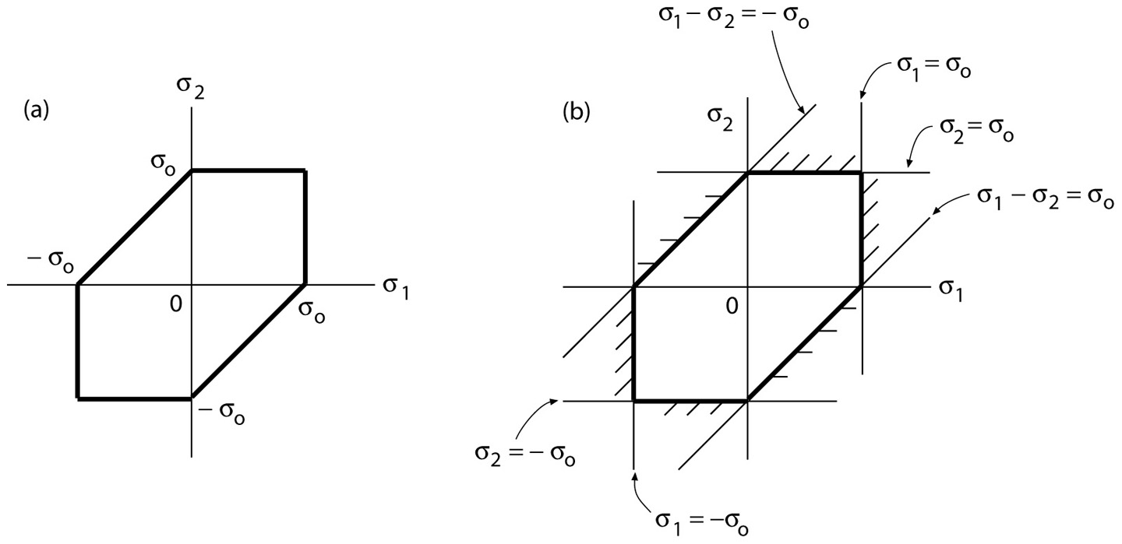
Maximum Shear Stress Yielding Criterion
Notes:
Figure: 07-05

Slide 32
Example
Safety factor against yielding?
Notes:
Figure: 07-05

Slide 33
Example
Notes:
Figure: 07-05

Slide 34
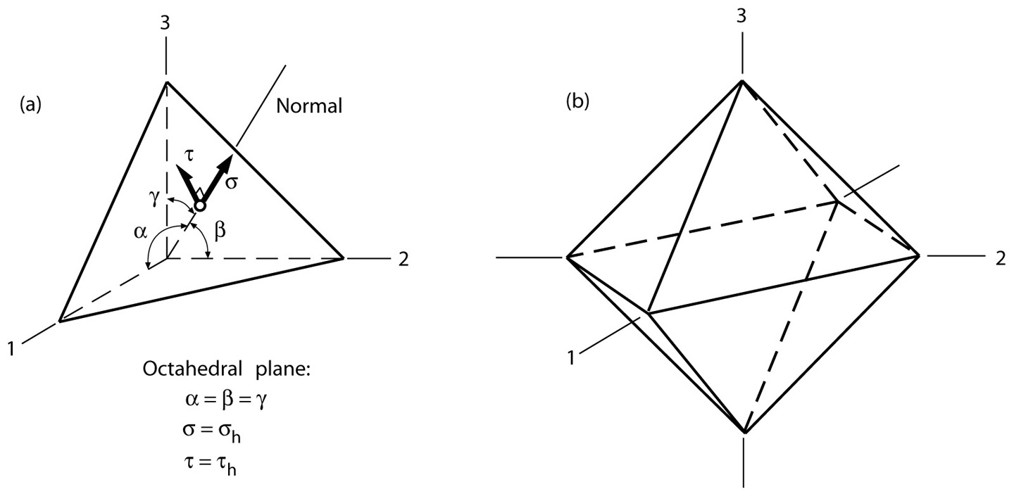
Octahedral Shear Stress

Slide 35
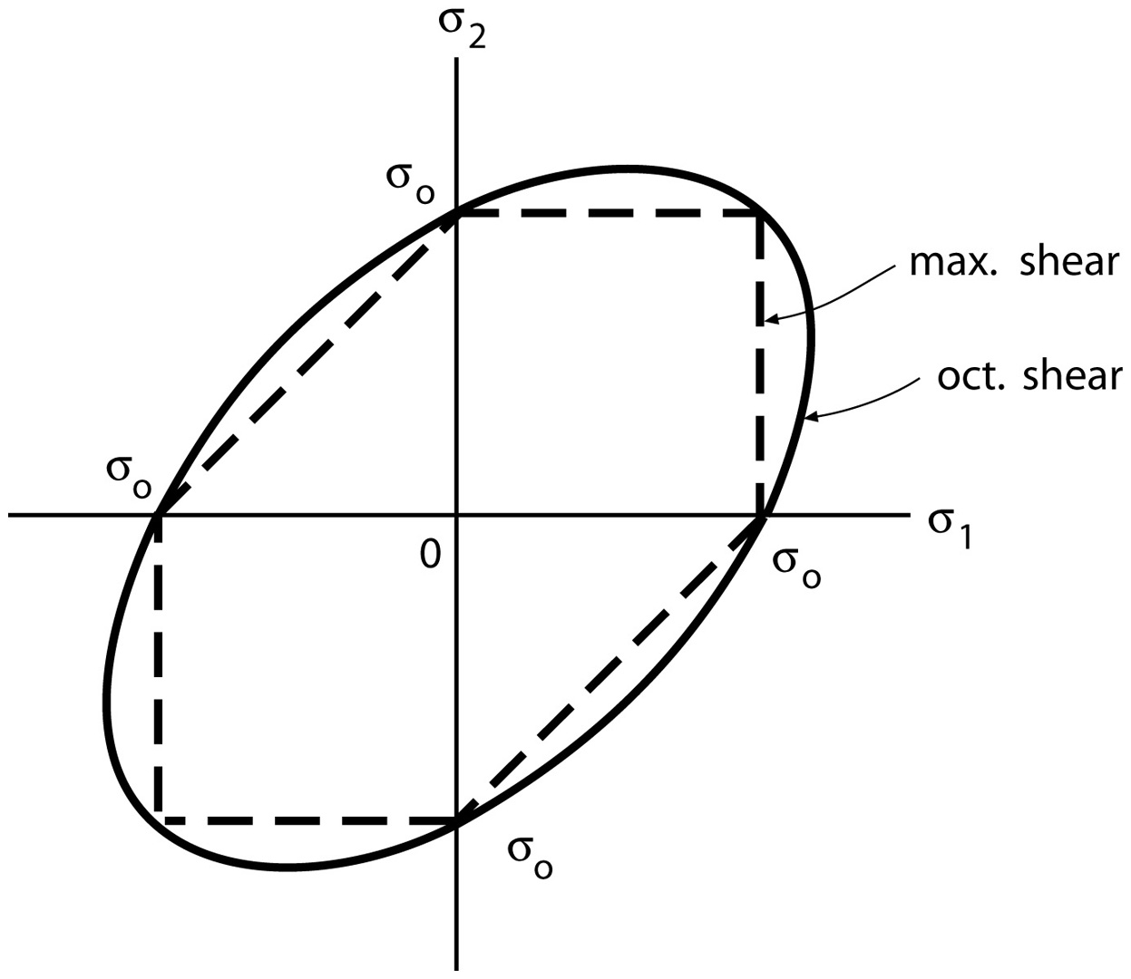
Octahedral Shear Stress Criterion
Notes:
Figure: 07-08

Slide 36
Example
Safety factor against yielding?
Notes:
Figure: 07-05

Slide 37
Example
Notes:
Figure: 07-08

Slide 38
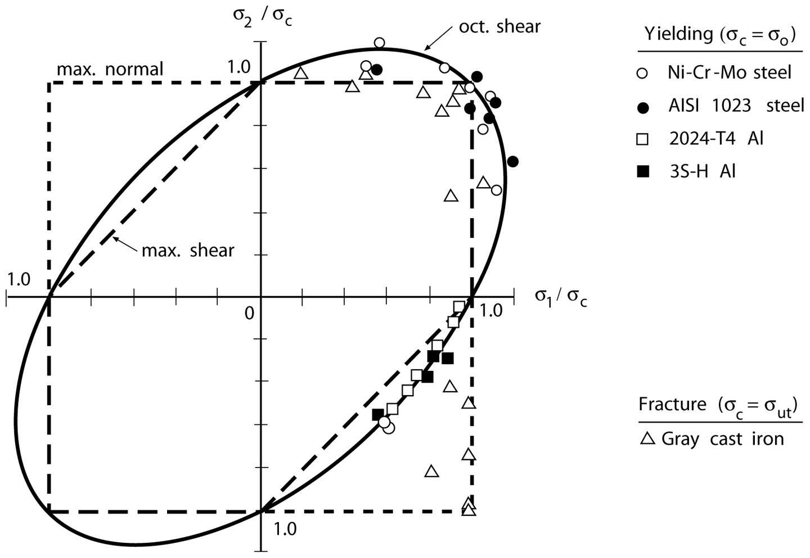
Comparison
Note the difference when stress have opposite sign
Notes:
Figure: 07-11

Slide 39
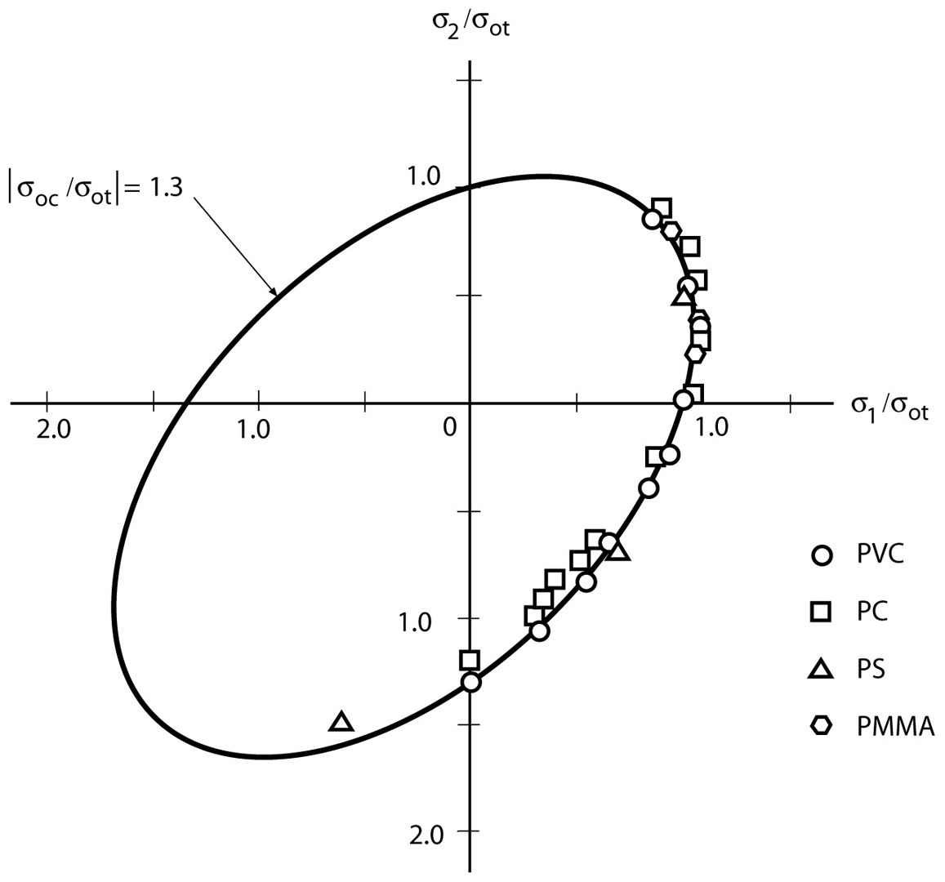
Mechanical Behavior of Materials: Engineering Methods for Deformation, Fracture, and Fatigue, Third Edition,
by Norman E. Dowling. ISBN 0-13-186312-6.
© 2007 Pearson Education, Inc., Upper Saddle River, NJ. All rights reserved.
This material is protected by Copyright and written permission should be obtained from the publisher prior to any prohibited reproduction, storage in a retrieval system, or transmission in any form or by any means, electronic, mechanical, photocopying, recording, or likewise. For information regarding permission(s),
write to: Rights and Permissions Department, Pearson Education Inc., Upper Saddle river, NJ 07458.
Notes:
Figure: 07-12

Slide 40
Example
For a stress state of σx=120, σy=-50, σz=200, τxy=60 Mpa, and a safety factor of 2.0 again yielding, what is the minimum yield strength by (1) maximum shear stress criterion and (2) octahedral shear stress criterion
139, -69

Slide 41
Mechanics of Materials Lab
Plasticity and Failure
Mechanical Behavior of Materials
Chapter 12.1-12.3
3D Constitutive Model
Jiangyu Li

Slide 42
Power Hardening and Ramberg-Osgood Relation
Yielding?
Yielding?
Notes:
Figure: 12-05a-b

Slide 43
3D Constitutive Equation
Elastic
Plastic
Total
Only unknow is E_{p}
Notes:
Figure: 12-05a-b

Slide 44
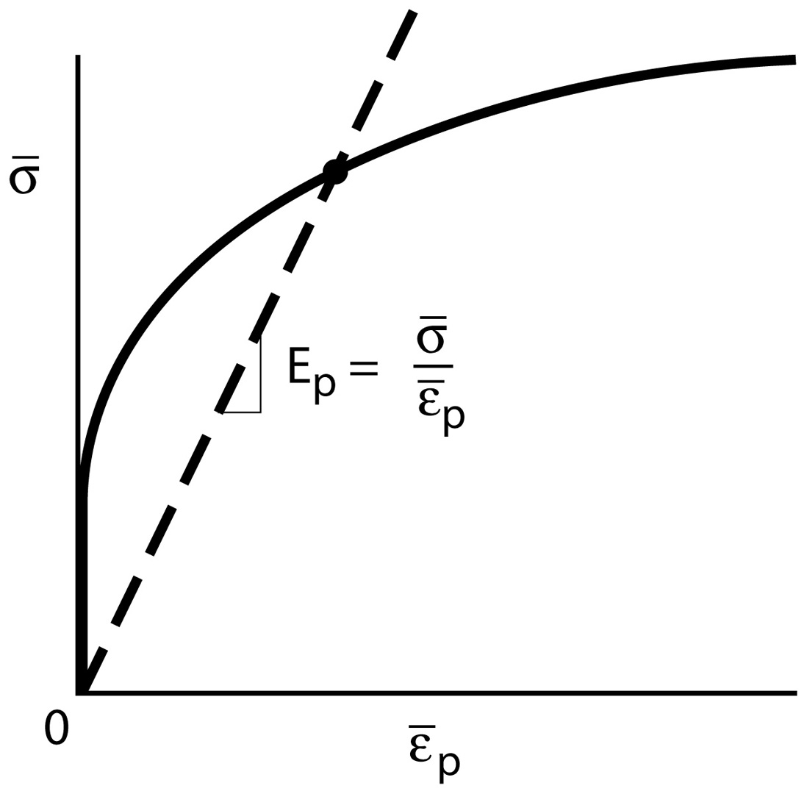
Secant Modulus
Notes:
Figure: 12-08

Slide 45

Effective Stress-Strain Curve
uniaxial
effective
Multi-axial
Notes:
Figure: 12-05a-b

Slide 46
Effective Stress
46
Notes:
Figure: 12-08

Slide 47
Procedure
Evaluate effective stress
Evaluate effective strain using appropriate constitutive equation
Evaluate effective plastic strain
Evaluate Ep
Evaluate plastic strain component
Evaluate total strain component
47
Notes:
Figure: 12-08

Slide 48
Example
Evaluate effective stress
Evaluate effective strain using appropriate constitutive equation
Evaluate effective plastic strain
Evaluate Ep
Evaluate plastic strain component
Evaluate total strain component
Notes:
Figure: 12-08

Slide 49
Example
Notes:
Figure: 12-08

Slide 50
Example
Notes:
Figure: 12-08

Slide 51
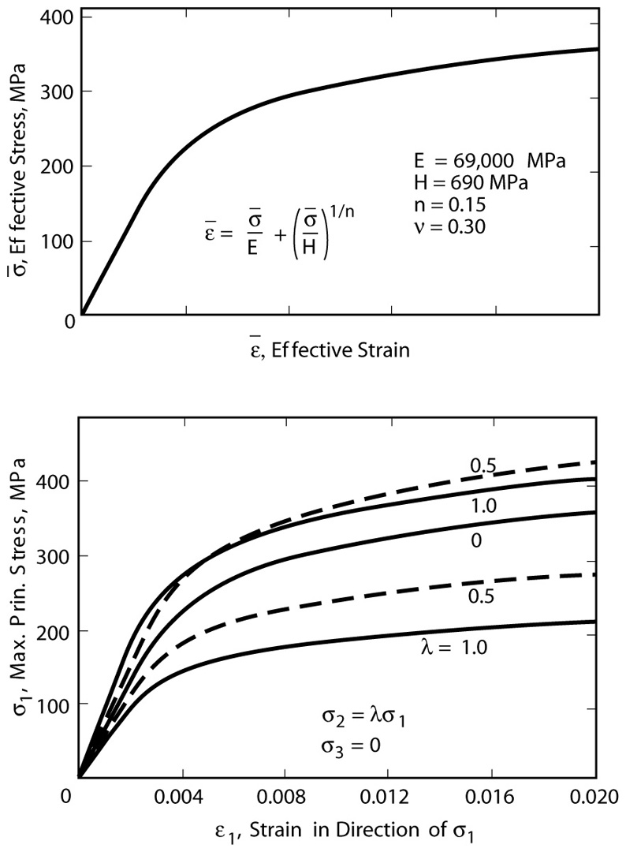
Stress-Strain Curve
Notes:
Figure: 12-09

Slide 52
Example
Notes:
Figure: 12-08

Slide 53
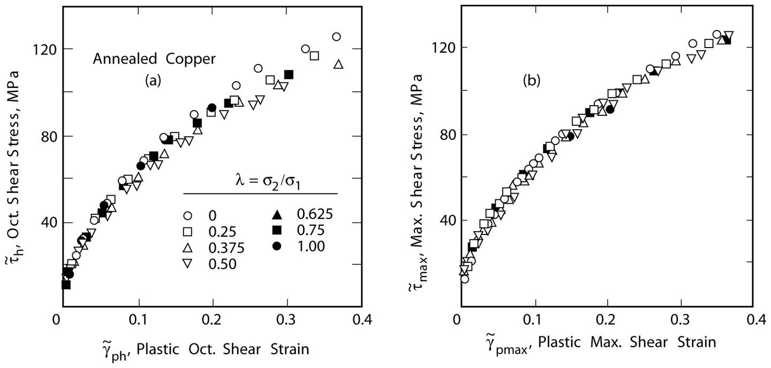
Deformation Plasticity Theory
Axial and torsion
Notes:
Figure: 12-07a-b

