Slide 1
Mechanics of Materials
Fracture Mechanics
Mechanical Behavior of Materials
Chapter 8.1-8.4, 8.7
Jiangyu Li

Slide 2
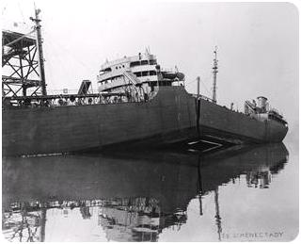

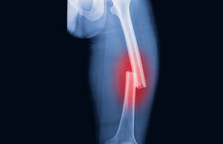
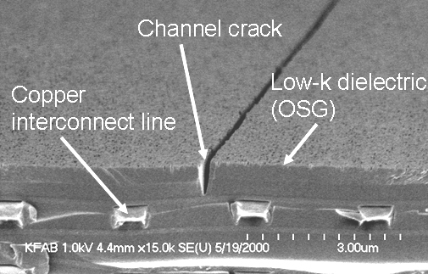
Fracture

Slide 3
Failure Criteria
Materials have flaw or crack in them:
Linear Elastic Fracture Mechanics (LEFM)
Stress intensity factor (K) describes the severity of the existing crack condition
If K exceeds the Critical stress intensity (K_{c}), then failure will occur
Materials assumed to be perfect:
Brittle Materials
Max Normal Stress
Ductile Materials
Max Shear Stress
Octahedral Shear Stress

Slide 4
Stress Intensity Factor

Slide 5
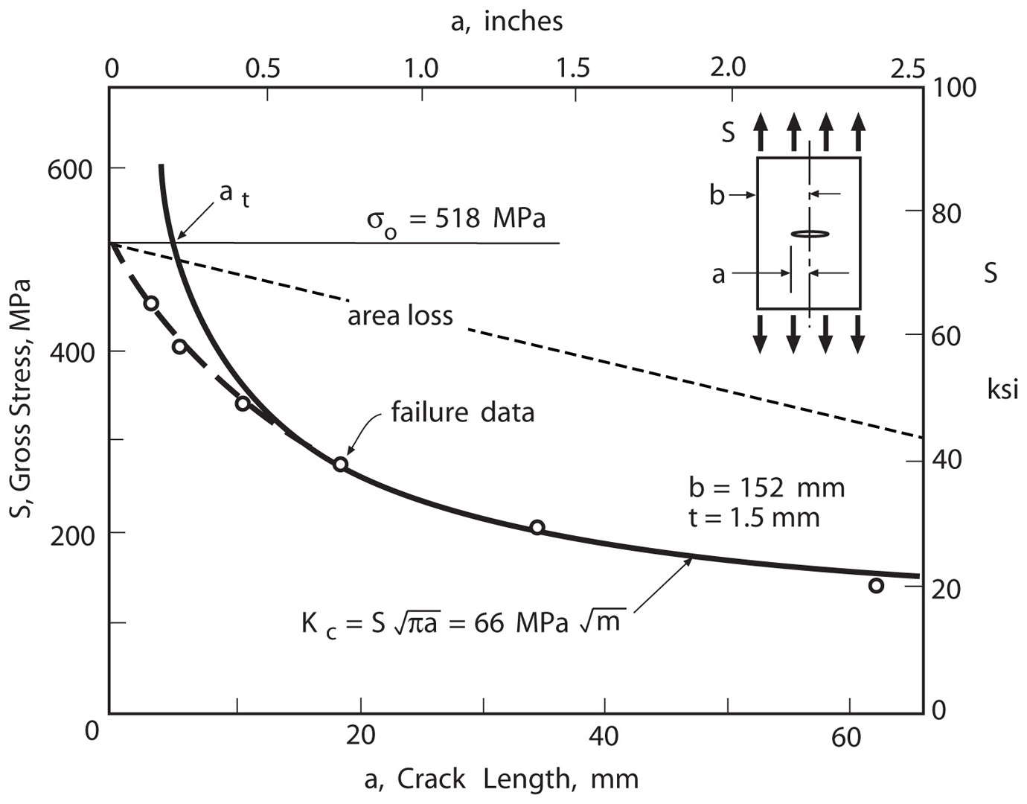
Effect of Crack Length
2014-T6 aluminum

Slide 6
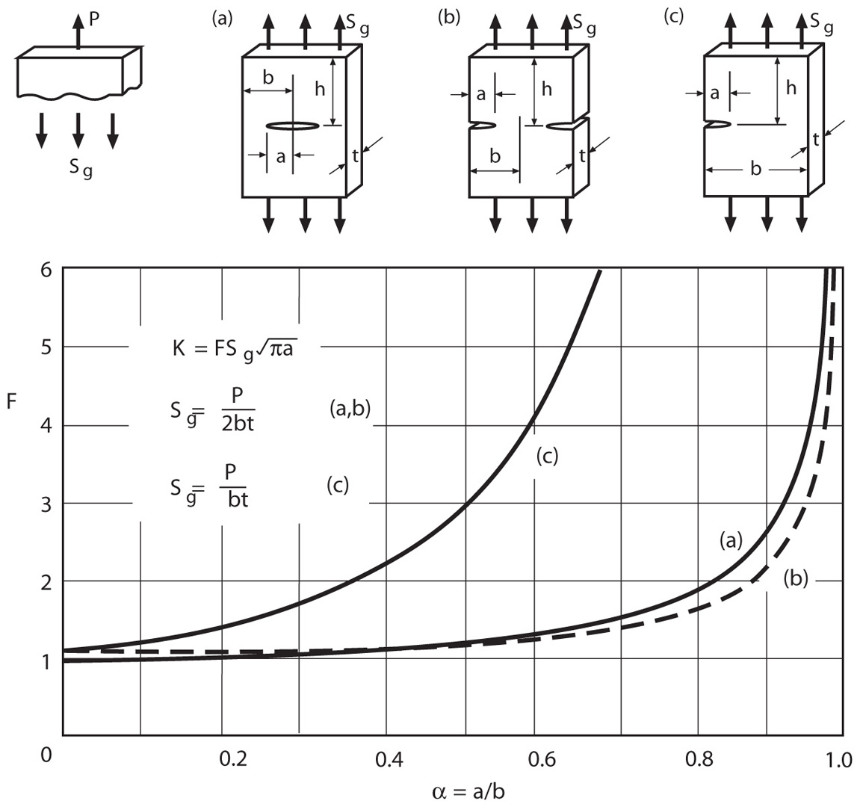
Stress Intensity Factor: Tension

Slide 7
Geometry Factor F

Slide 8
Example
AISI 1144 Steel
Central crack
b=40mm
t=15mm
If a=10mm,
Maximum P with safety factor 3?
How about a=24mm?
At what crack size will yielding occur first? 540MPa
66MPa.m^{0.5}

Slide 9
Example
2014-T651 Aluminum
Central crack
b=50mm
t=5mm
P=50kN
Kic=24MPa m ^{1/2}
At what crack size will fracture occur?

Slide 10
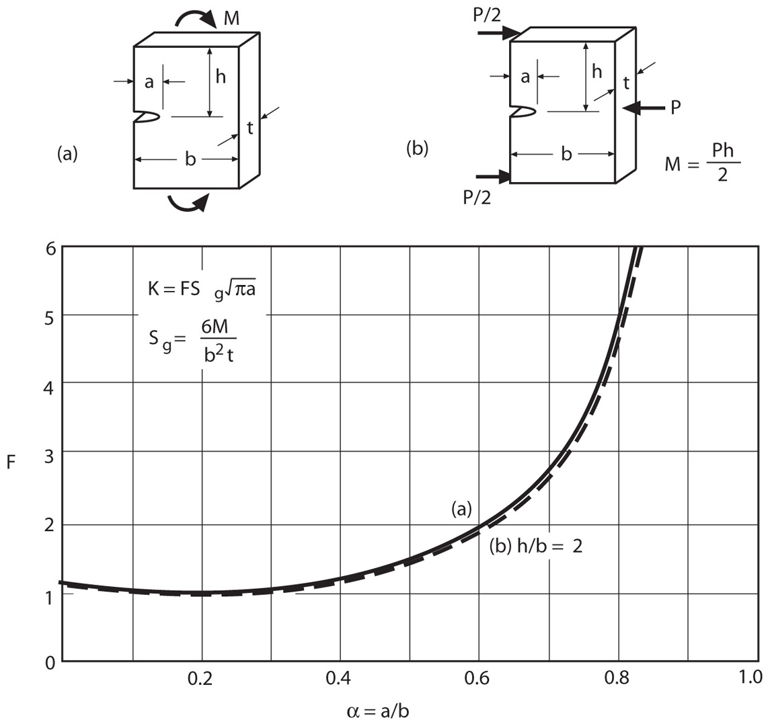
Stress Intensity Factor: Bending

Slide 11
Geometry Factor F

Slide 12
Example
Kc=3.0 Mpa m^{0.5}
b=20mm; t=10mm;
Safety factor 2.5
M=10N.m
What is the largest crack length allowable?

Slide 13
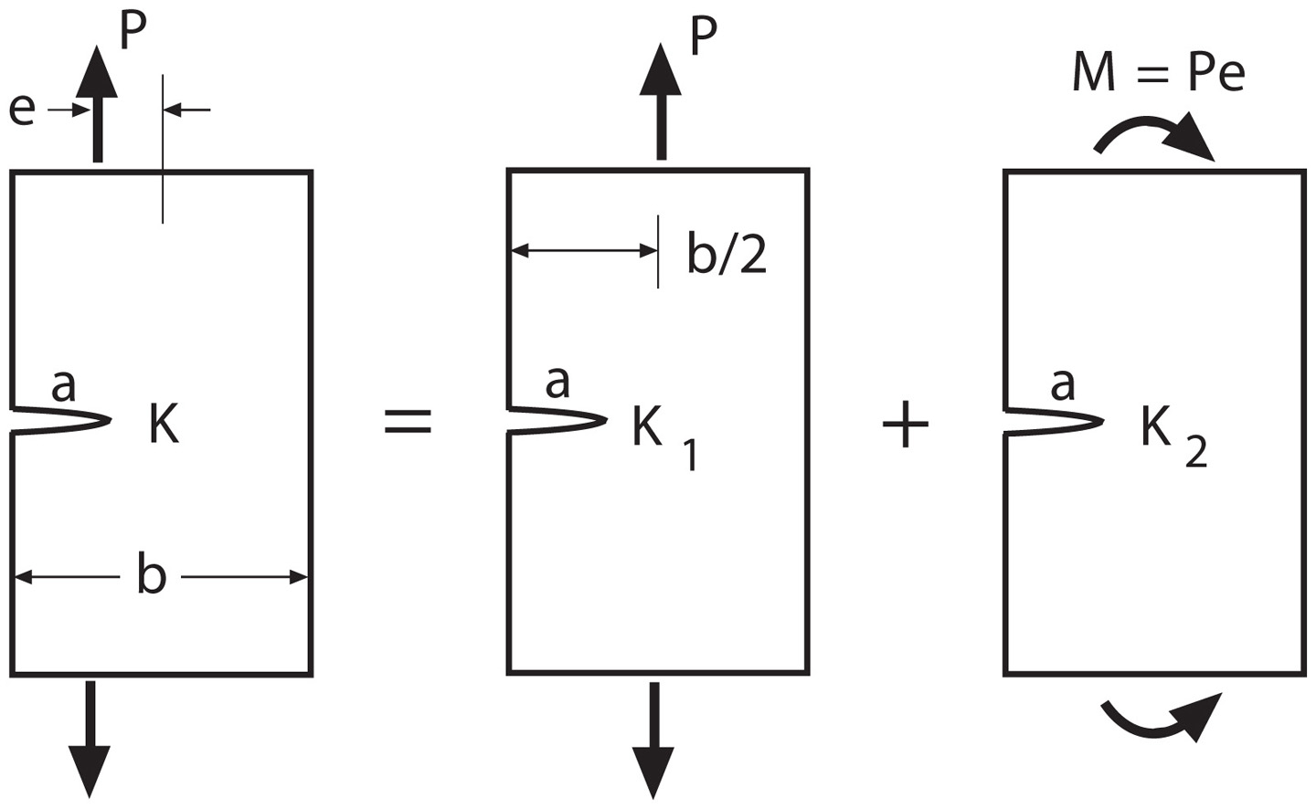
Superposition

Slide 14
Effect of Crack Length
2014-T6 aluminum

Slide 15
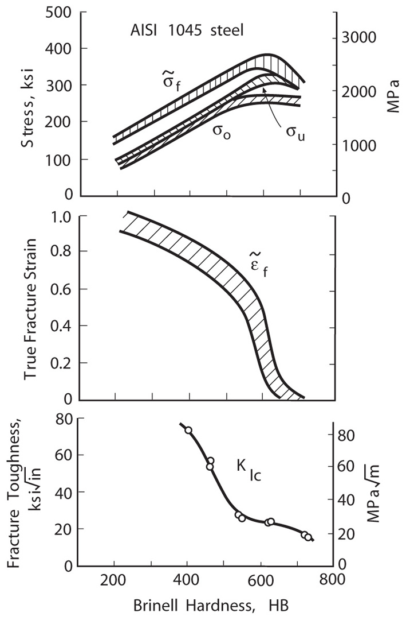

Slide 16
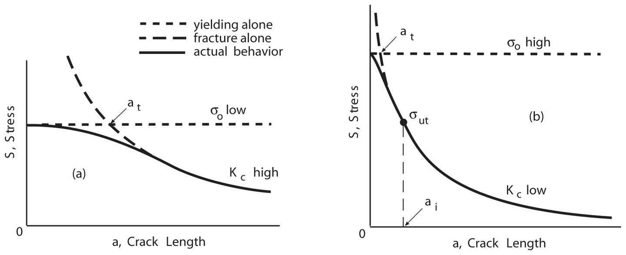
Brittle vs. Ductile Behavior
Steel AISI 1144: 840MPa
300-M: 2010
66 MPa.m^{0.5}
2010 MPa

Slide 17
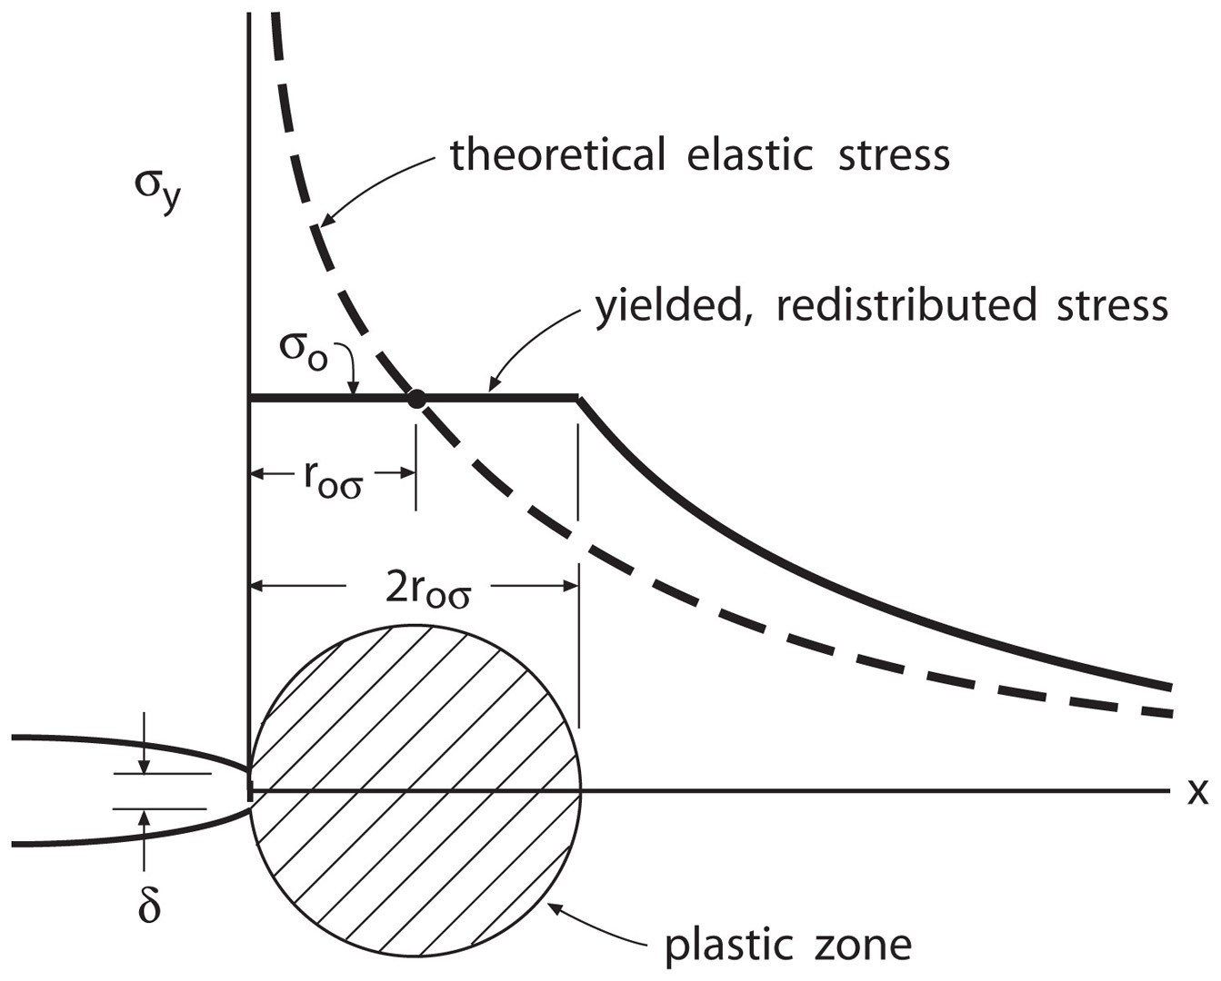
Plastic Zone

Slide 18
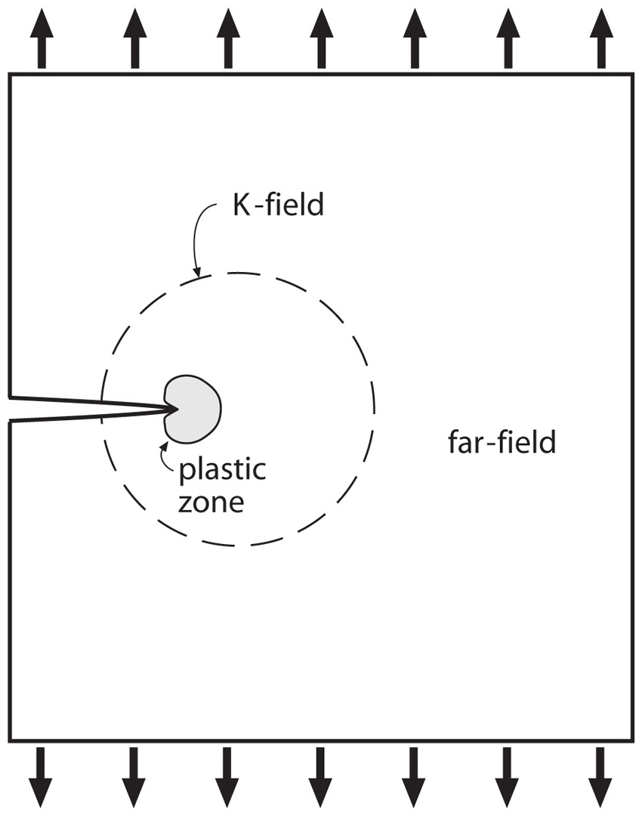
K field
Plane stress
Plane strain

Slide 19
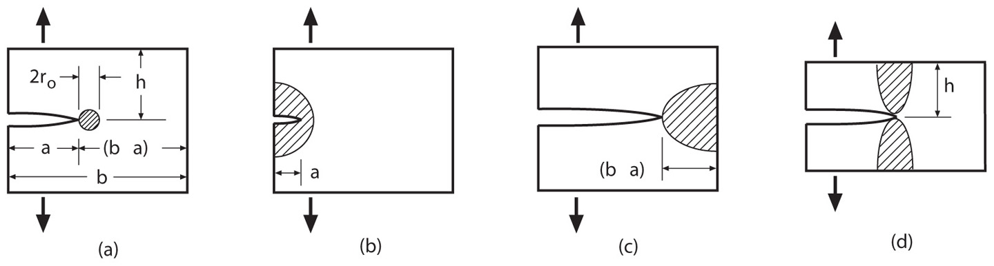
Limitation of LEFM
-
-
Plane strain

Slide 20
Example
Central crack
a=10mm
b=50mm
t=5mm
Large h
P=50 kN
σ_{o}=415 Mpa
Determine whether plane strain or LEFM apply, plastic zone.

Slide 21
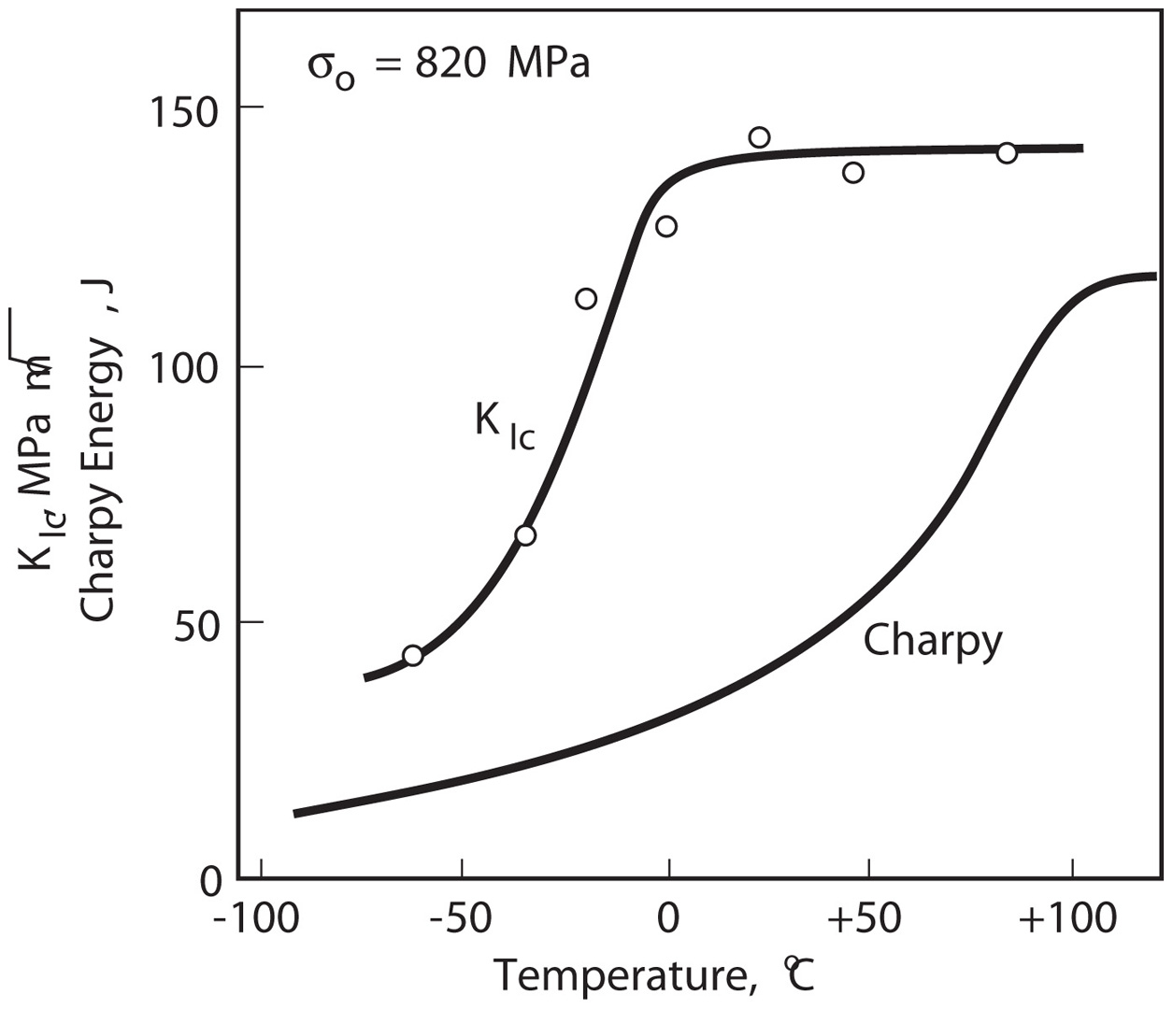
Effect of Temperature and Rate

Slide 22
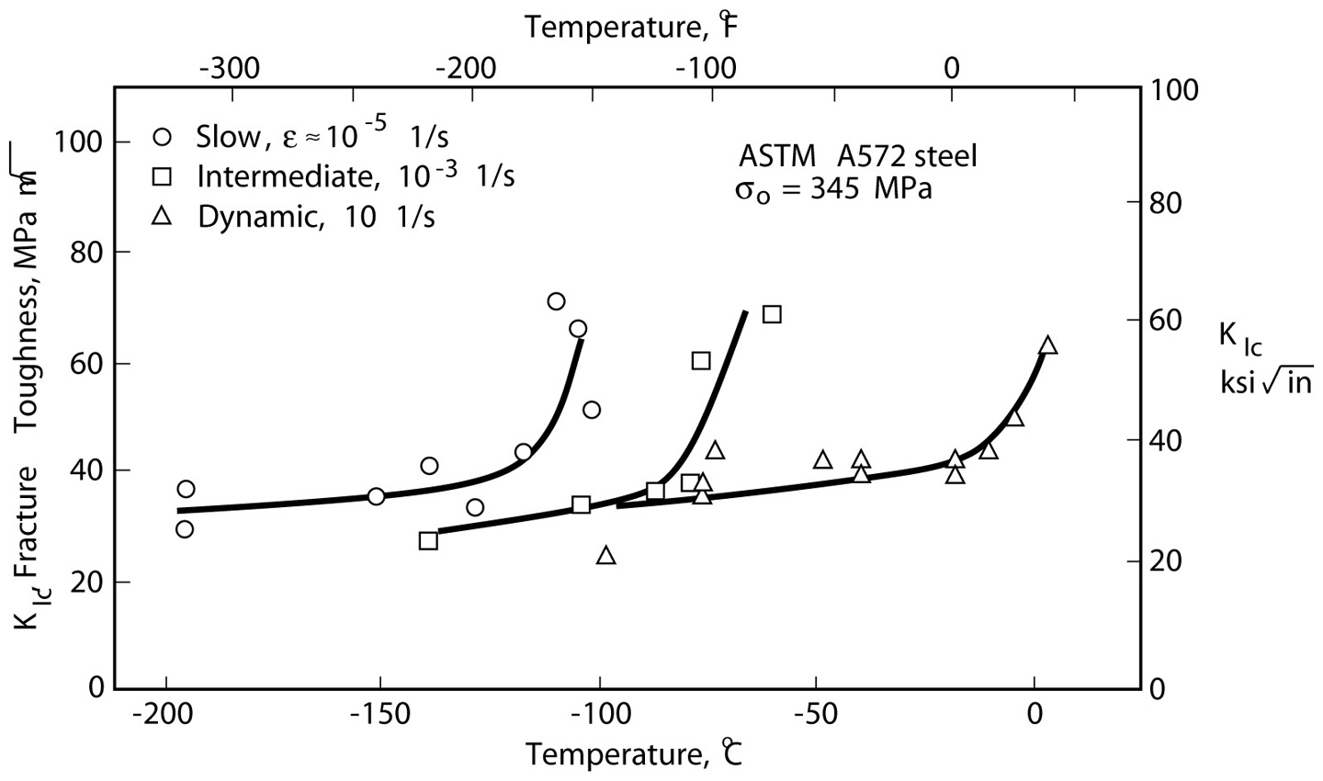
Effect of Temperature and Rate

Slide 23
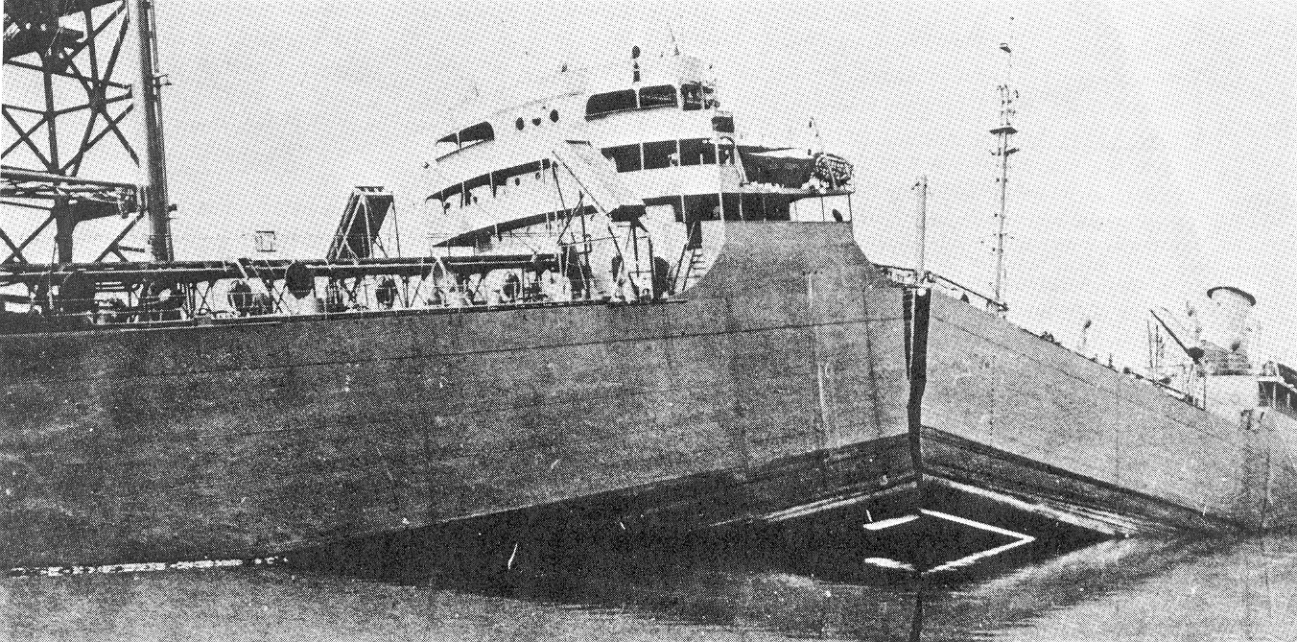
Brittle Failure

Slide 24

Double Bonus Quiz
Which of the following statements are incorrect:
Larger stress leads to longer transition crack length a_{t}
High strength material is more vulnerable to crack
Transition crack length a_{t} does not depend on ultimate strength
Linear elastic fracture mechanics does not apply to cracks shorter than a_{t}

Slide 25
Assignment
Mechanical behavior of materials:
8.4, 8.10, 8.15, 8.47

