Slide 1
Mechanics of Materials
Fatigue
Mechanical Behavior of Materials Sec. 9.1, 9.2, 9.6-9.8
Jiangyu Li

Slide 2
0.2Hz, 6.3M cycles a year!

Slide 3
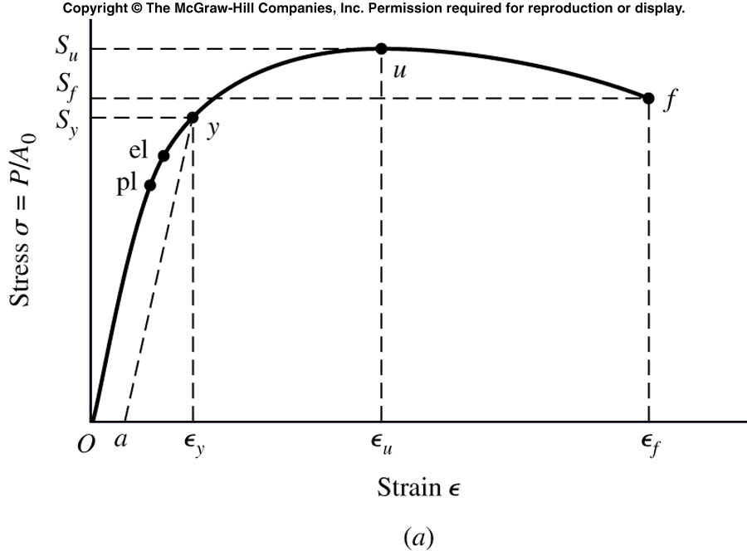
Static Failure
Load is applied gradually
Stress is applied only once
Visible warning before failure

Slide 4
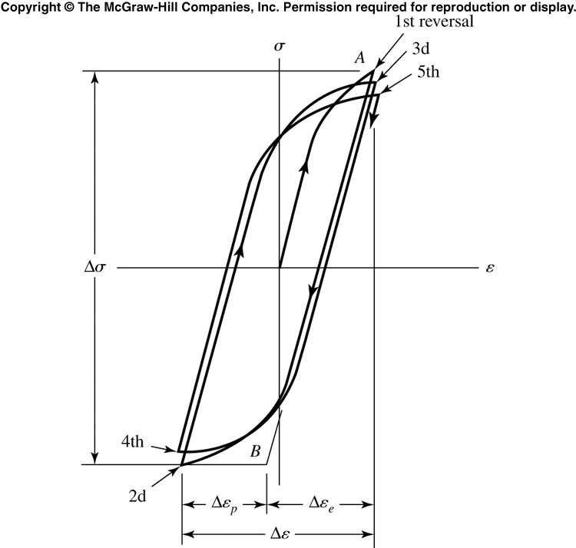
Cyclic Load and Fatigue Failure
Stress varies or fluctuates, and is repeated many times
Structure members fail under the repeated stresses
Actual maximum stress is well below the ultimate strength of material, often even below yield strength
Fatigue failure gives no visible warning, unlike static failure. It is sudden and catastrophic!

Slide 5
Characteristics
Primary design criterion in rotating parts.
Fatigue as a name for the phenomenon based on the notion of a material becoming “tired”, i.e. failing at less than its nominal strength.
Cyclical strain (stress) leads to fatigue failure.
Occurs in metals and polymers but rarely in ceramics.
Also an issue for “static” parts, e.g. bridges.
Cyclic loading stress limit<static stress capability.

Slide 6
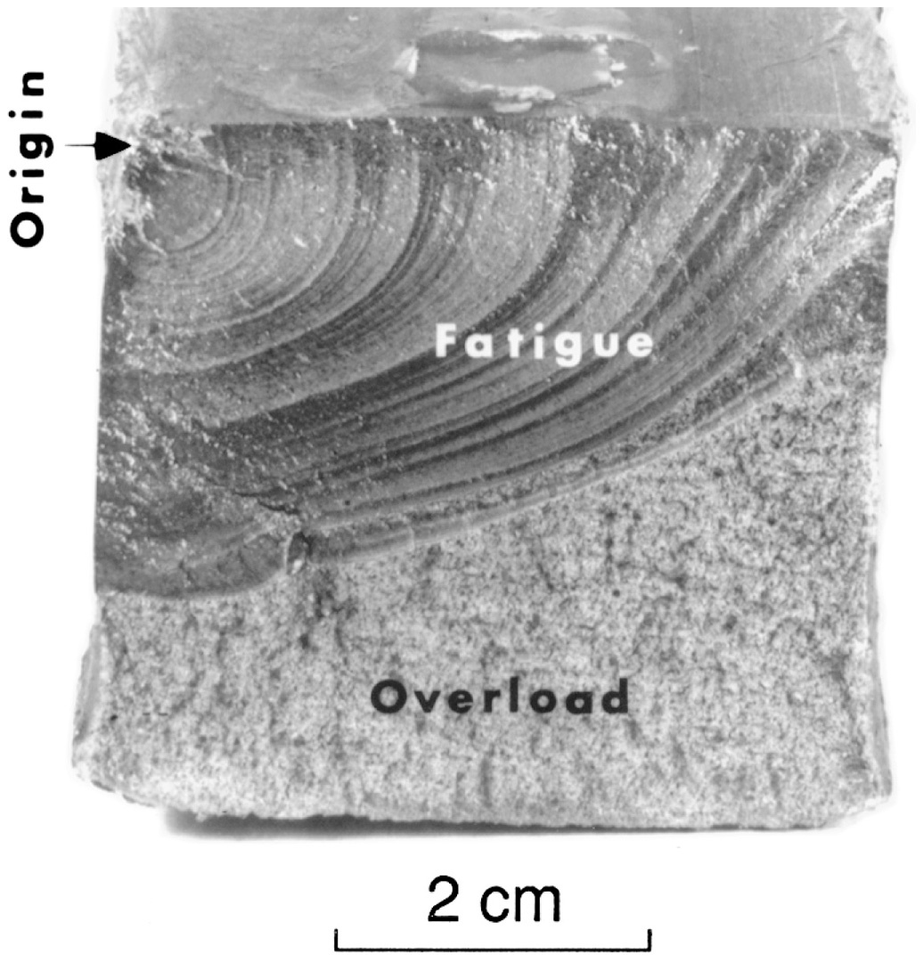
Fatigue Failure Feature
Flat fracture surface, normal to stress axis, no necking
Stage one: initiation of microcracks
Stage two: progress from microcracks to macrocracks, forming parallel plateau-like facture feature (beach marks) separated by longitudinal ridge
Stage three: final cycle, sudden, fast fracture.
Bolt, unidirectional bending

Slide 7
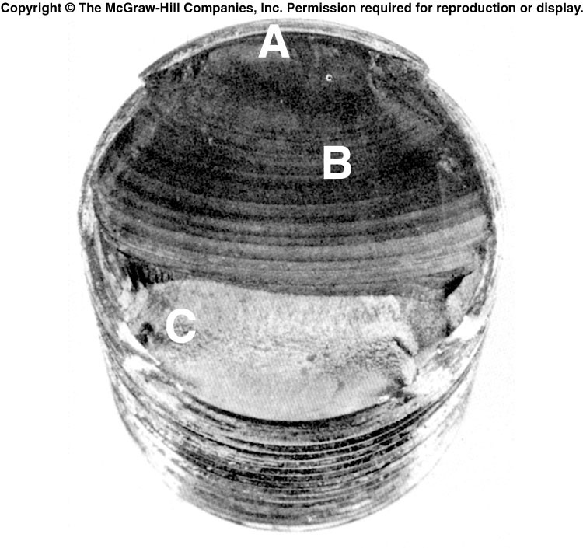
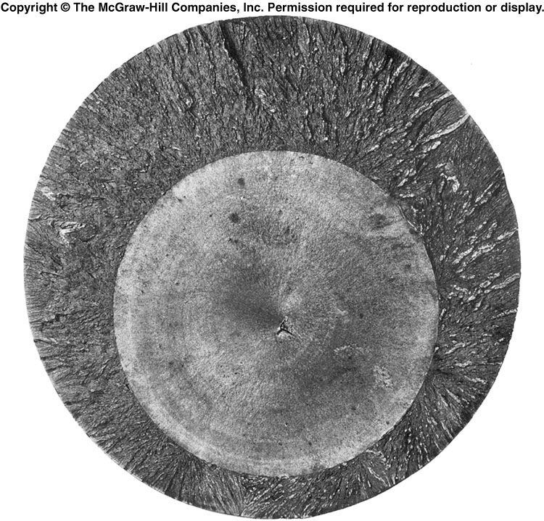
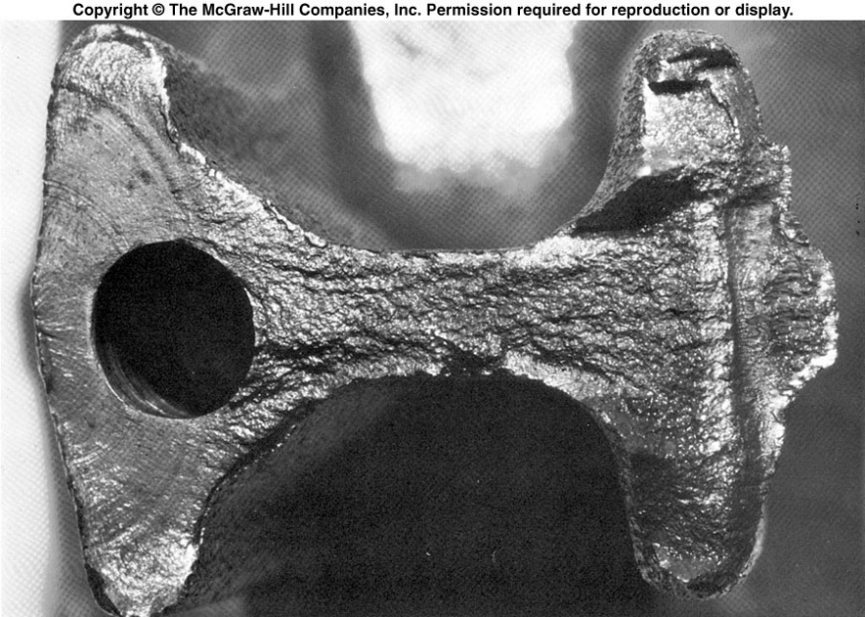
Fracture Surface

Slide 8
Characteristics
Most applications of structural materials involve cyclic loading; any net tensile stress leads to fatigue.
Fatigue failure surfaces have three characteristic features:
A (near-)surface defect as the origin of the crack
Striations corresponding to slow, intermittent crack growth
Dull, fibrous brittle fracture surface (rapid growth).
Life of structural components generally limited by cyclic loading, not static strength.
Most environmental factors shorten life.

Slide 9
Fatigue-Life Method
Stress-life method
Facture mechanics method

Slide 10
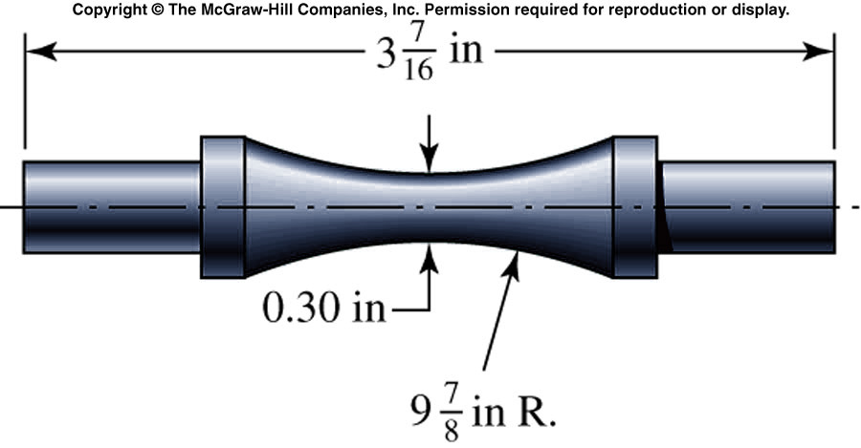
Stress-Life Method
Specimen are subjected to repeated forces of specified magnitudes while the cycles are counted until fatigue failure

Slide 11
Stress Cycle
A stress cycle (N=1) constitute a single application and removal of a load, and then load and unload in the opposite direction

Slide 12
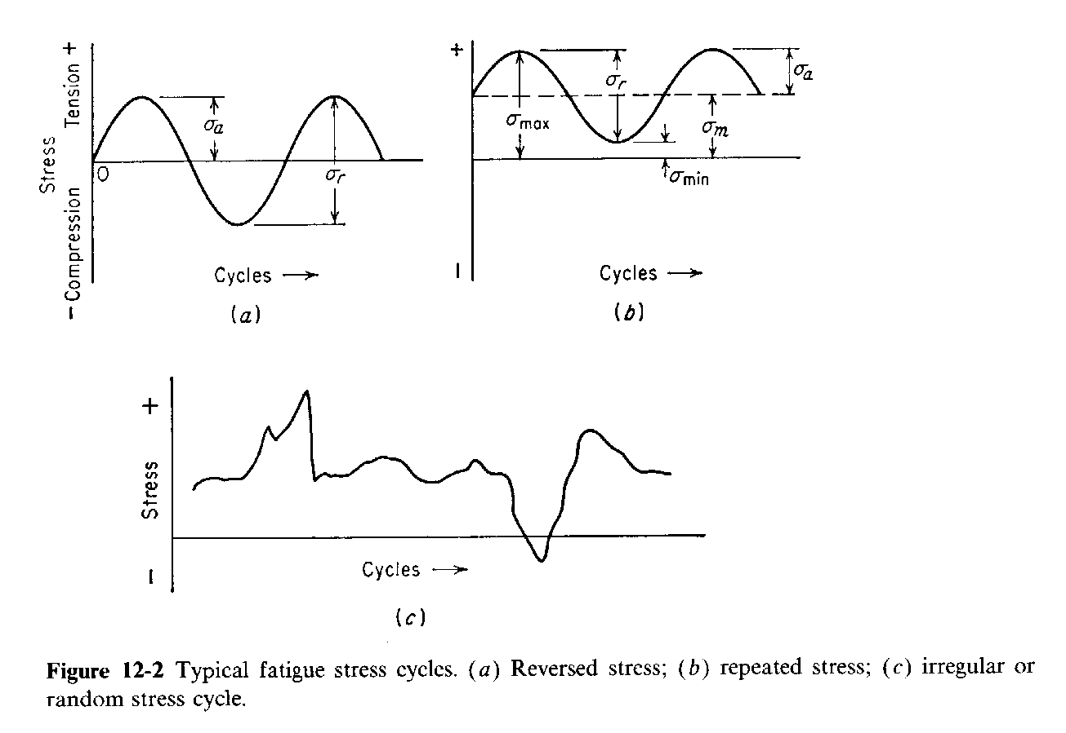
Alternating Stress
σa = (σmax-σmin)/2
σm = (σmax+σmin)/2

Slide 13
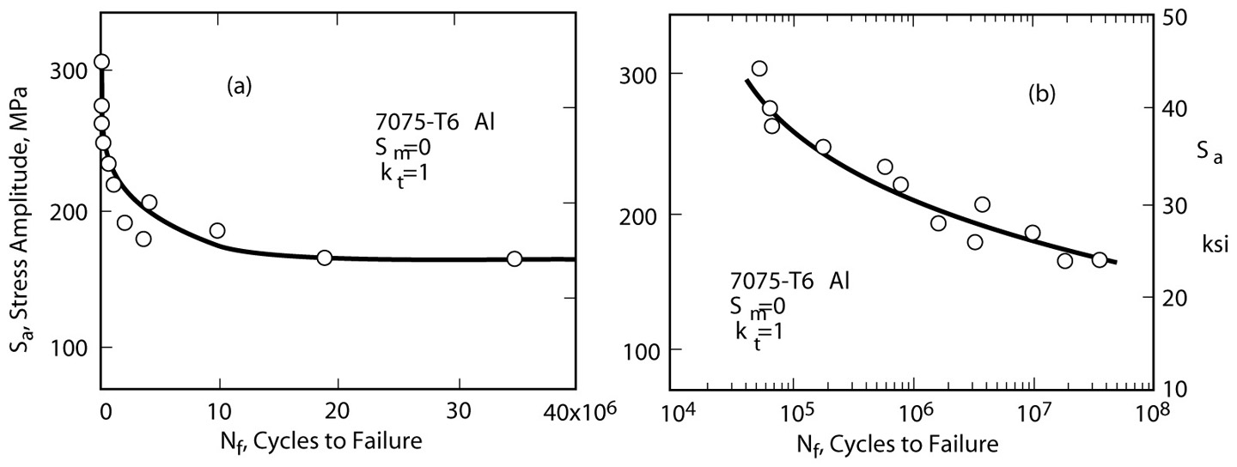
S-N Diagram
The greater the number of cycles in the loading history, the smaller the stress that the material can withstand without failure.

Slide 14
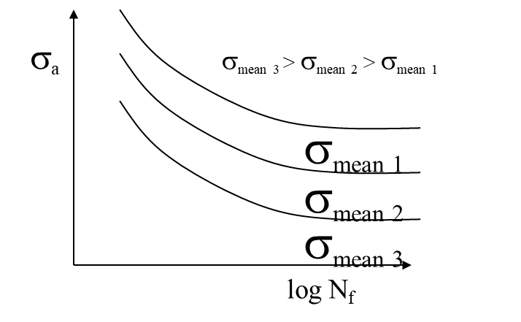
S-N Diagram
The higher the mean stress, the shorter the fatigue life.

Slide 15
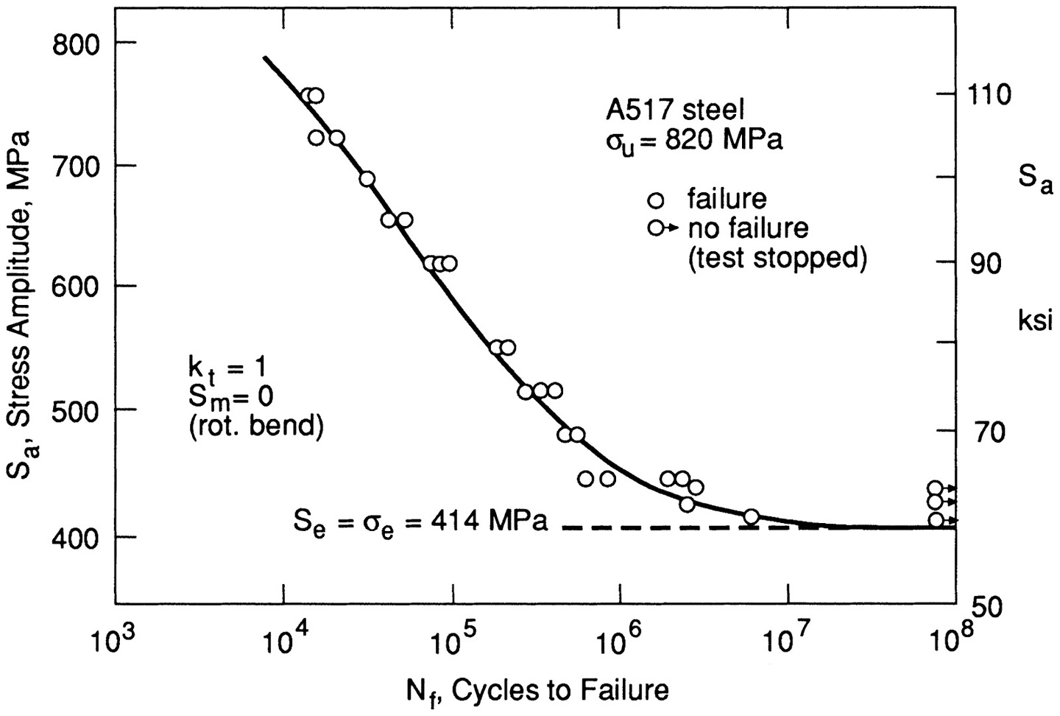
S-N Diagram

Slide 16
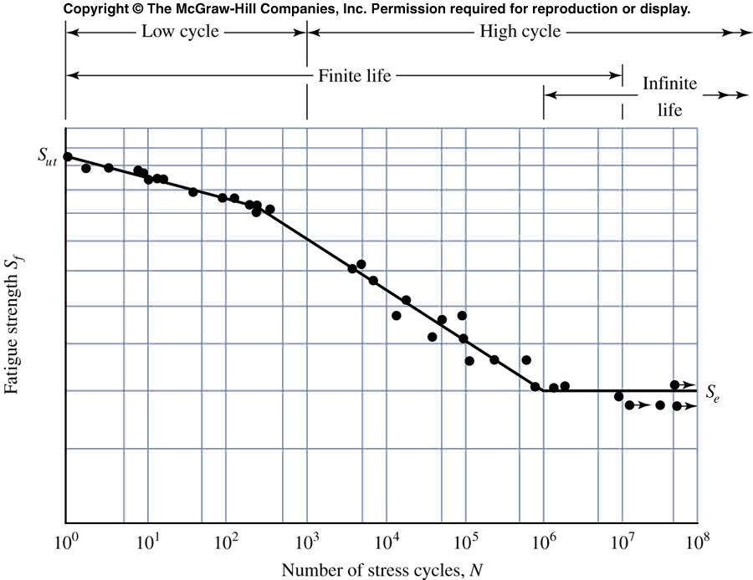
S-N Diagram
Endurance limit

Slide 17
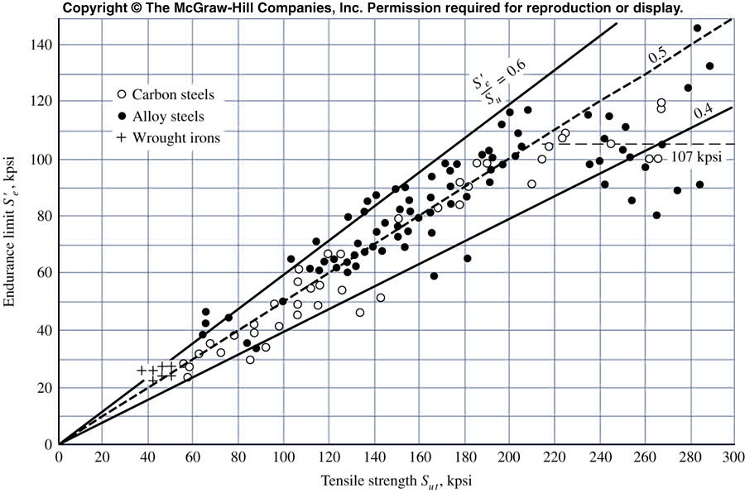
Endurance Limit
Table A-24
For steel

Slide 18
S-N Diagram
Aluminum

Slide 19
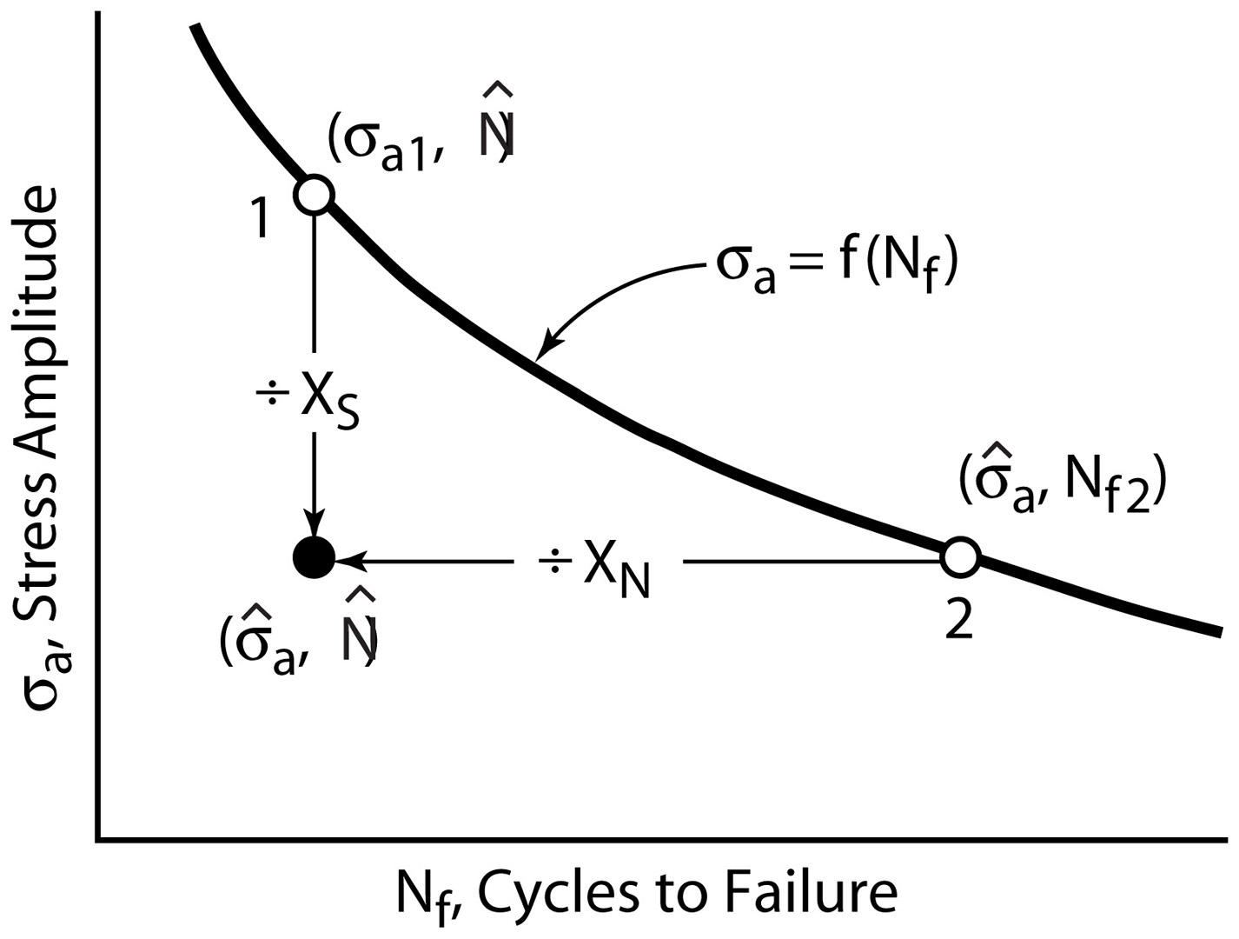
Fatigue Life

Slide 20
Safety Factor

Slide 21
Example
9.10 For AISI 4340 steel in Table 9.1, a life of 1.94x10⁵ cycles to failure is calculated for the stress amplitude of σ_{a}=500 Mpa. Suggestion is made that parts of this type be replaced when the number of cycles applied reach 1/3 of the life.
What is the safety factors in life and in stress
Is the suggestion good?
With safety factor in stress of 2, when should it be replaced
A=1643, b=-0.0977

Slide 22
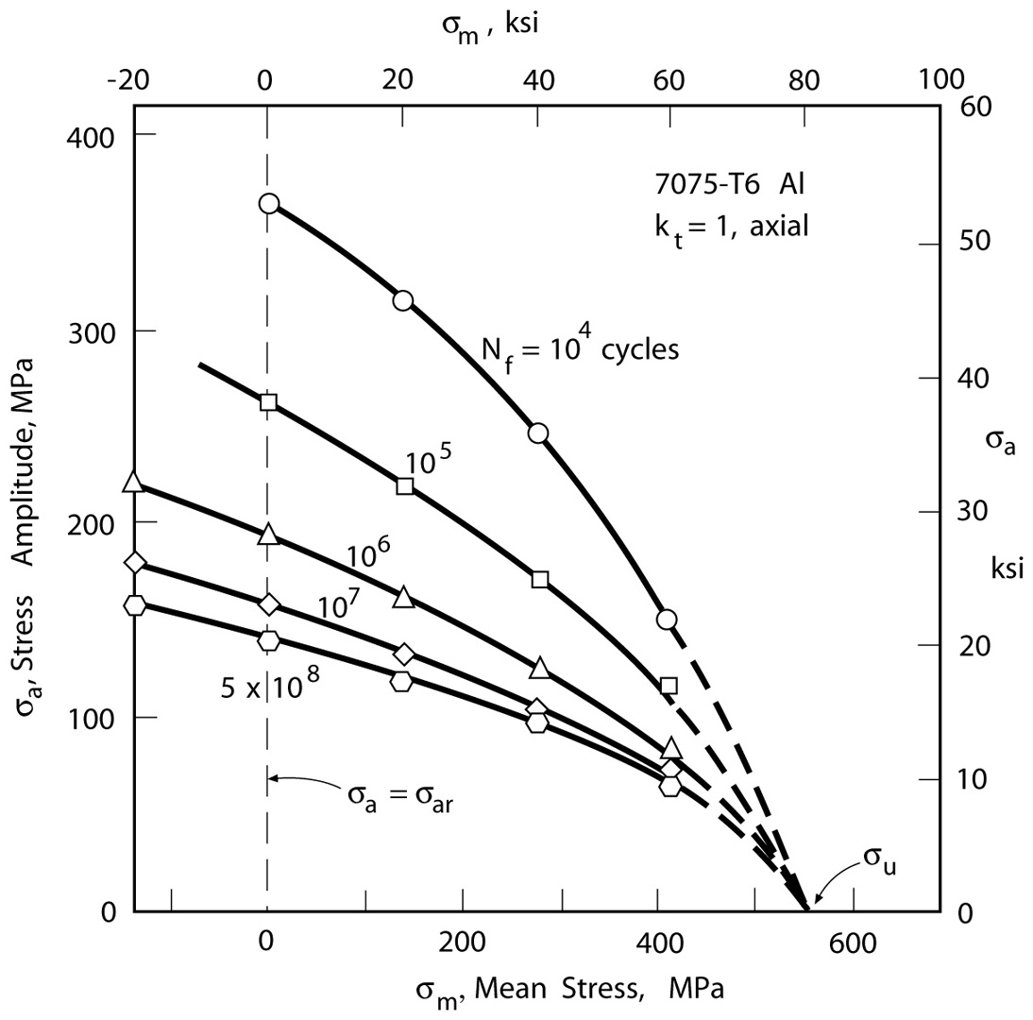
Effect of Mean Stress

Slide 23
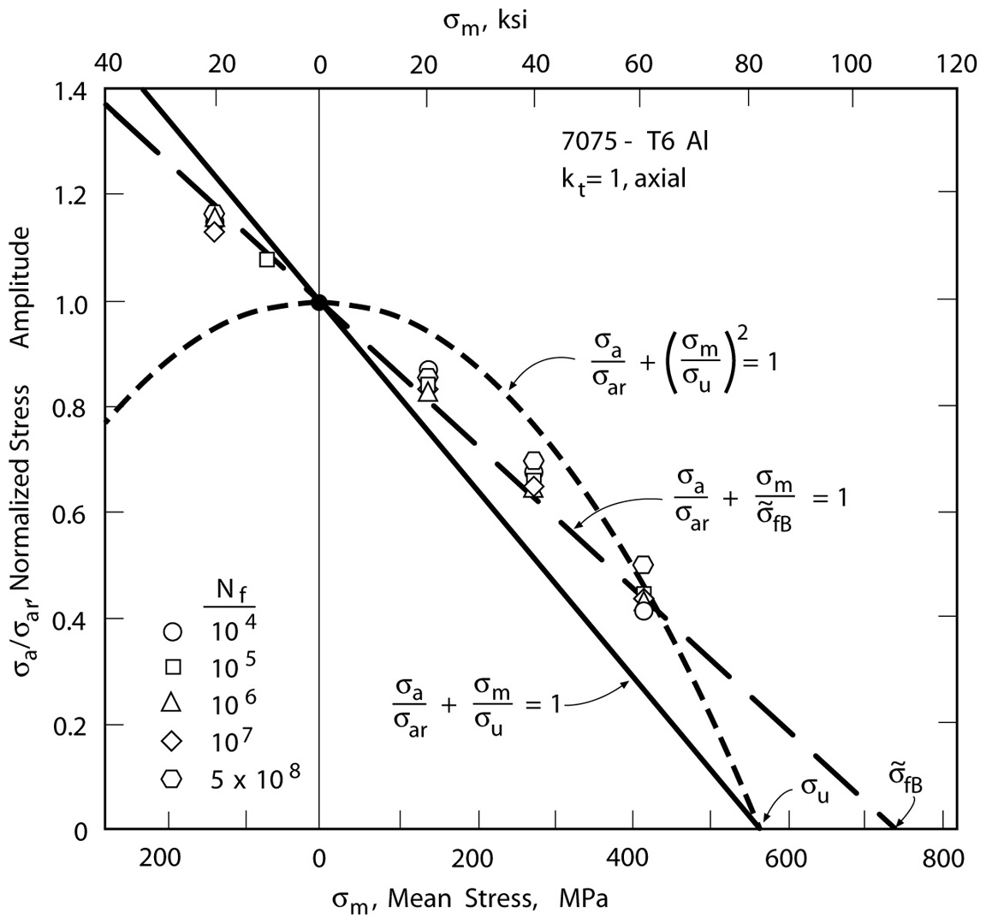
Effect of Mean Stress
Gerber
Morrow
Goodman

Slide 24
Example
AISI 4340 steel is subjected to cyclic load with a tensile mean stress of 200 MPA
What is the fatigue life for stress amplitude of 450 MPA
How significant is the effect of mean stress?
Estimate the relationship between stress amplitude and fatigue life for this mean stress
A=1643, b=-0.0977
σ_{f}’=1758
f'

Slide 25
Safety Factor with Mean Stress

Slide 26

Example
Man-Ten steel (σ_{f}’=1089MPa, b=-0.115) subject to stress amplitude of 180 Mpa and mean stress of 100PMa for 20000 cycles
What is the safety factor in life and stress?
When to replace if safety factor of 2 in stress?
f'

Slide 27
Bonus Quiz
Identify where the fatigue crack initiates:
A
B
C
D
D

Slide 28
Assignment
Mechanical behavior of materials:
9.10, 9.11, 9.21, 9.37
D

Slide 29
Mechanics of Materials
Fracture Mechanics based Fatigue Analysis
Mechanical Behavior of Materials Sec. 9.1, 9.2, 9.6-9.8
Jiangyu Li

Slide 30
Fatigue Failure Feature
Flat fracture surface, normal to stress axis, no necking
Stage one: initiation of microcracks
Stage two: progress from microcracks to macrocracks, forming parallel plateau-like facture feature (beach marks) separated by longitudinal ridge
Stage three: final cycle, sudden, fast fracture.
Bolt, unidirectional bending

Slide 31
Paris Law
D

Slide 32

Airplane Disaster
D
In January 1954, a de Havilland Comet, an early commercial jet airliner, broke up in flight and crashed into the Mediterranean Sea. In April of the same year, another Comet crashed in the waters near Naples, Italy.

Slide 33
Airplane Disaster
D
Stresses in the metal skin had concentrated at the corners of square “windows,” and, following repeated cycling of cabin pressure, these stress concentrations opened cracks that suddenly grew the length of the fuselage, and the whole aircraft came apart.

Slide 34
Paul Paris
Trained at Lehigh University in applied mechanics, Paris became a faculty associate at the Boeing Co. in the summer of 1955. Because Boeing was developing the first American commercial jet, Paris was asked to look into the Comet failures.
“I was scared to death,” he says. “I had never been in industry before, and they handed me this enormous task. I didn’t have the courage to tell them I didn’t know anything about fracture.”
D

Slide 35
Paris Paper

Slide 36
Paris Paper

Slide 37
Paris Paper

Slide 38
Paris Paper

Slide 39
Paris Paper

Slide 40
Fatigue Crack Growth
D

Slide 41
Periodic Inspection
D

Slide 42
Key Parameter
D

Slide 43
Paris Law
D

Slide 44
Effect of R
D

Slide 45
Application
D

Slide 46
Testing
D

Slide 47
Testing
D

Slide 48
Testing
D

Slide 49
Effect of R: Walker Equation
D

Slide 50
Effect of R: Walker Equation

Slide 51
Life Estimate

Slide 52
Paris Law

Slide 53
Crack Length at Failure

Slide 54
Example

