Slide 1
SenseEdge
Predictive Maintenance ASIC with Hardware FFT & Neural Network
Open-Source Custom Silicon on SkyWater SKY130
Fidel Makatia
PhD Student, Analog & Mixed-Signal IC Design
ChipFoundry Reference Application Design Contest 2026

Slide 2
The Problem
Unplanned equipment downtime costs $50B/year
Commercial vibration sensors: $500 - $5,000 per node
Cloud-dependent ML adds latency & recurring costs
Fixed-threshold alerting = excessive false alarms
90% of factories can't afford predictive maintenance
Market Opportunity
$50B
Annual downtime cost
$30B
Predictive maintenance market by 2028

Slide 3
The Solution: Full Pipeline in Silicon
SPI ADC Interface
64-Point FFT Engine
Feature Extraction
Neural Net Inference
Alarm Logic
→
→
→
→
12-bit 100 kSPS
Radix-2 DIT 24-bit internal
8 spectral features
8→16→4 FC INT8, ReLU
GPIO + IRQ to RISC-V
< 10 μs inference latency (192 MACs at 20 MHz)
Zero CPU intervention — fully autonomous pipeline
212 runtime-loadable INT8 weights (field-updateable)
< 5 mW total power at 1.8V
Cost Comparison
Commercial $500-$5,000
vs
SenseEdge ~$13
20-300x cost reduction

Slide 4
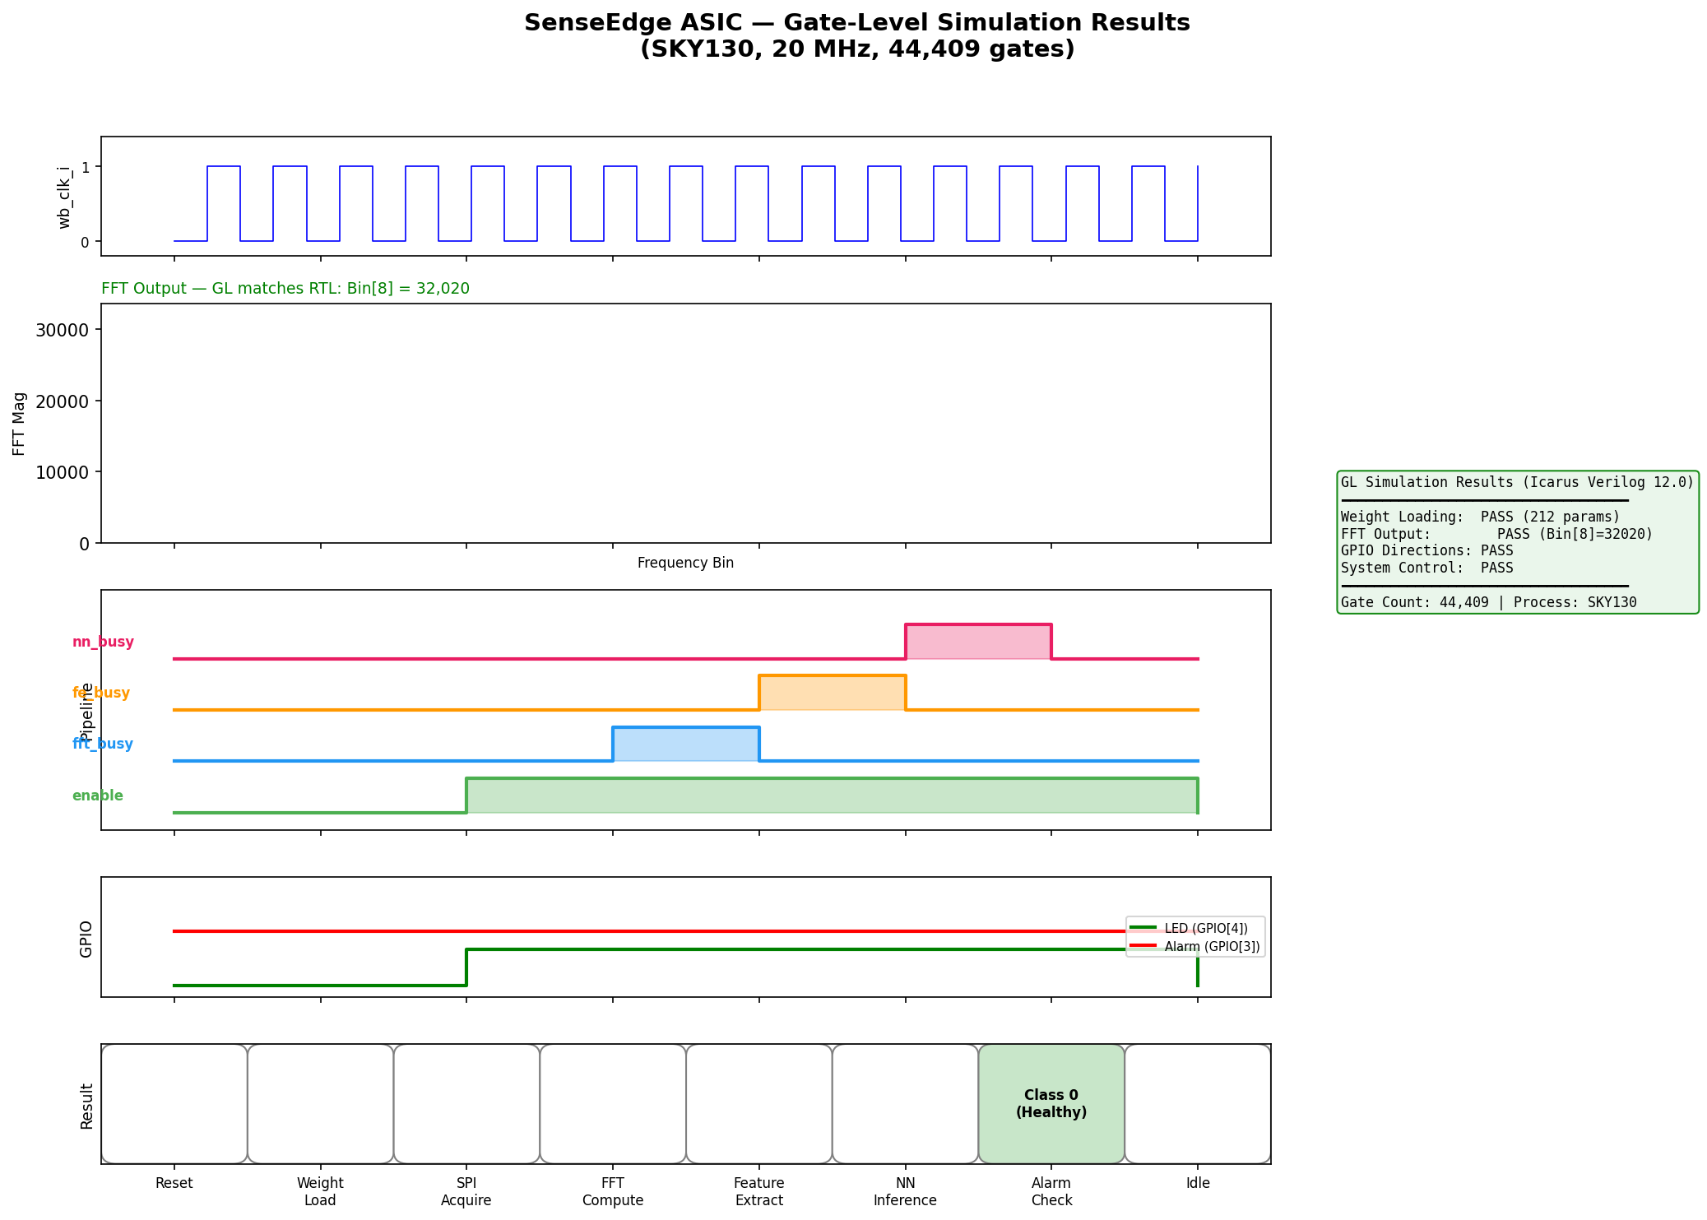
Silicon Design & Verification
Hardening Results (LibreLane 2.4.6)
Verification (46 assertions, 0 failures)
Process: SkyWater SKY130 (130nm)
Gate count: 44,409
Die area: 2920 × 2500 μm
Clock: 20 MHz (50ns period)
DRC: CLEAN | LVS: CLEAN
Setup slack (typical): +6.66 ns PASS
SPI ADC Interface — PASS
64-Point FFT Engine — PASS
Feature Extraction — PASS
Neural Network Engine — PASS
Alarm Logic — PASS
Wishbone Interface — PASS
Full Integration — PASS

Slide 5
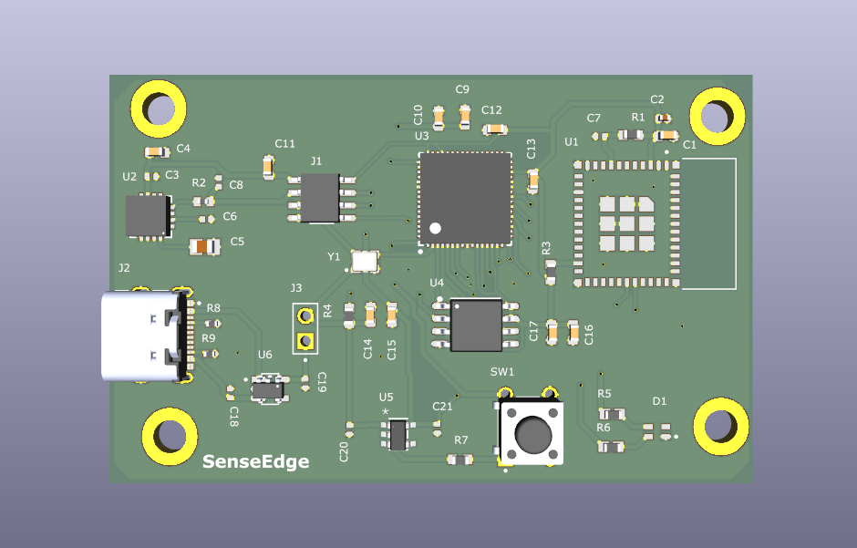
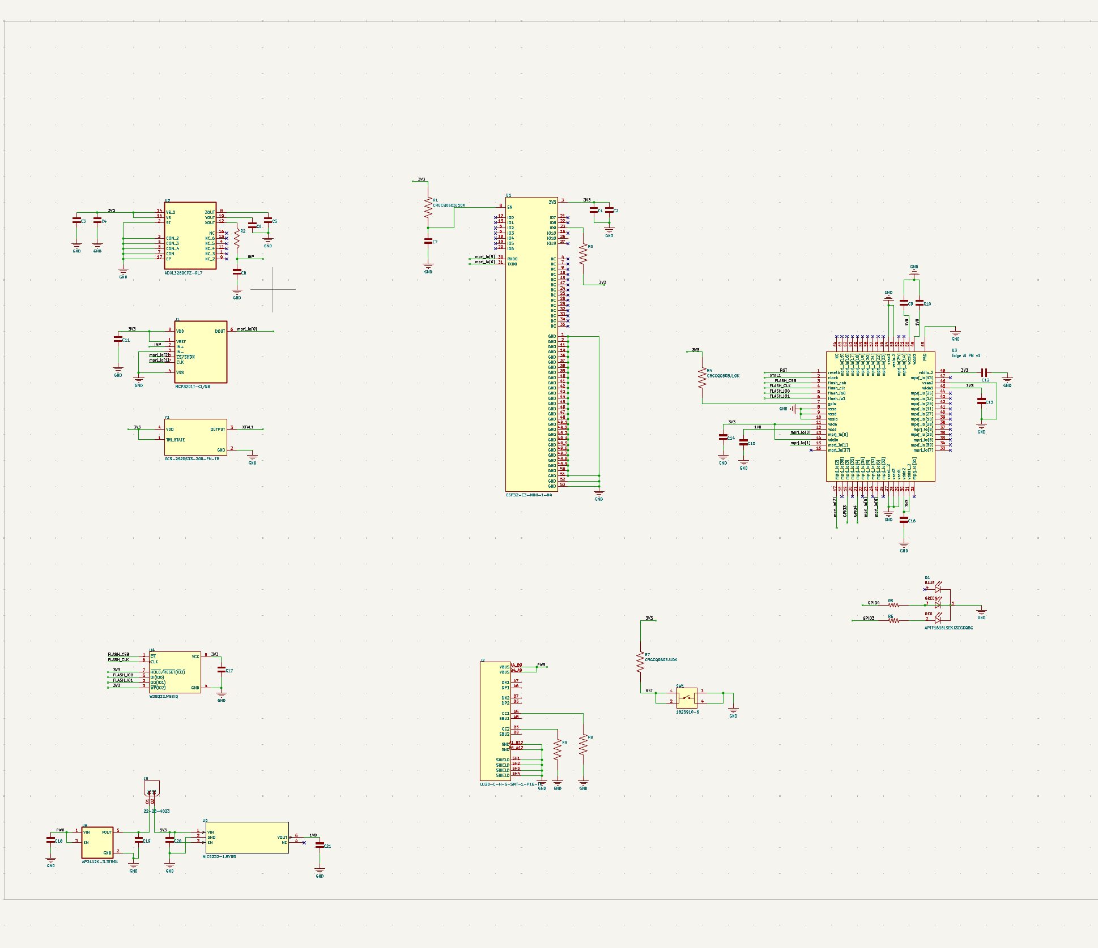
PCB Design
Key Components
U3: Caravel ASIC (QFN-64)
U2: ADXL326 3-axis accelerometer
J1: MCP3201 12-bit SPI ADC
U1: ESP32-C3 WiFi/BLE
U4: W25Q32 SPI Flash
Y1: 20 MHz CMOS oscillator
J2: USB-C power input
Board Specifications
65mm × 45mm, 2-layer FR4
Total BOM: ~$13.15 at 100 units
Gerbers ready for fabrication
USB-C powered (5V input)

Slide 6
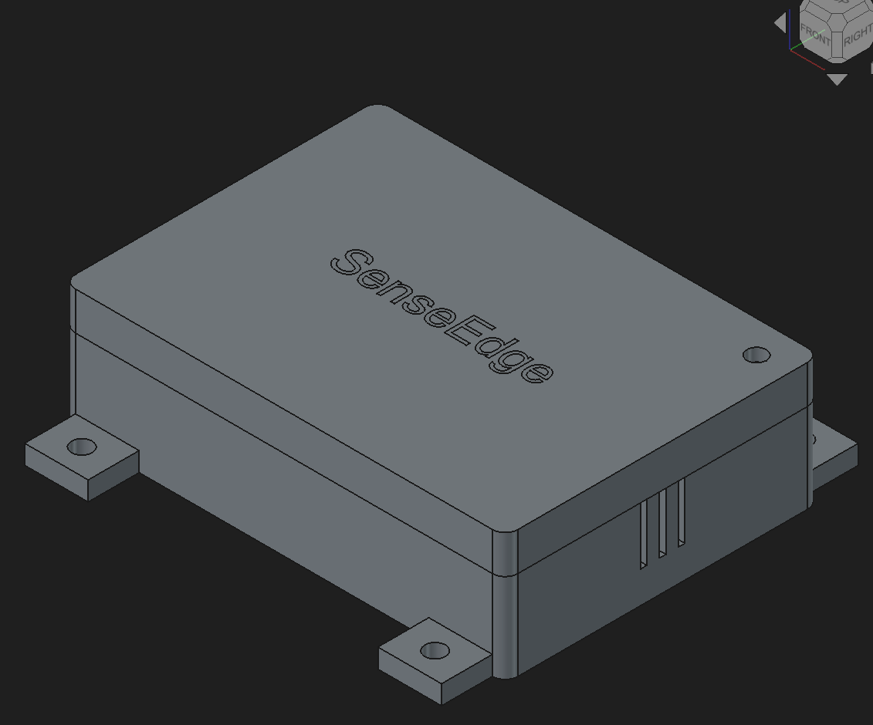
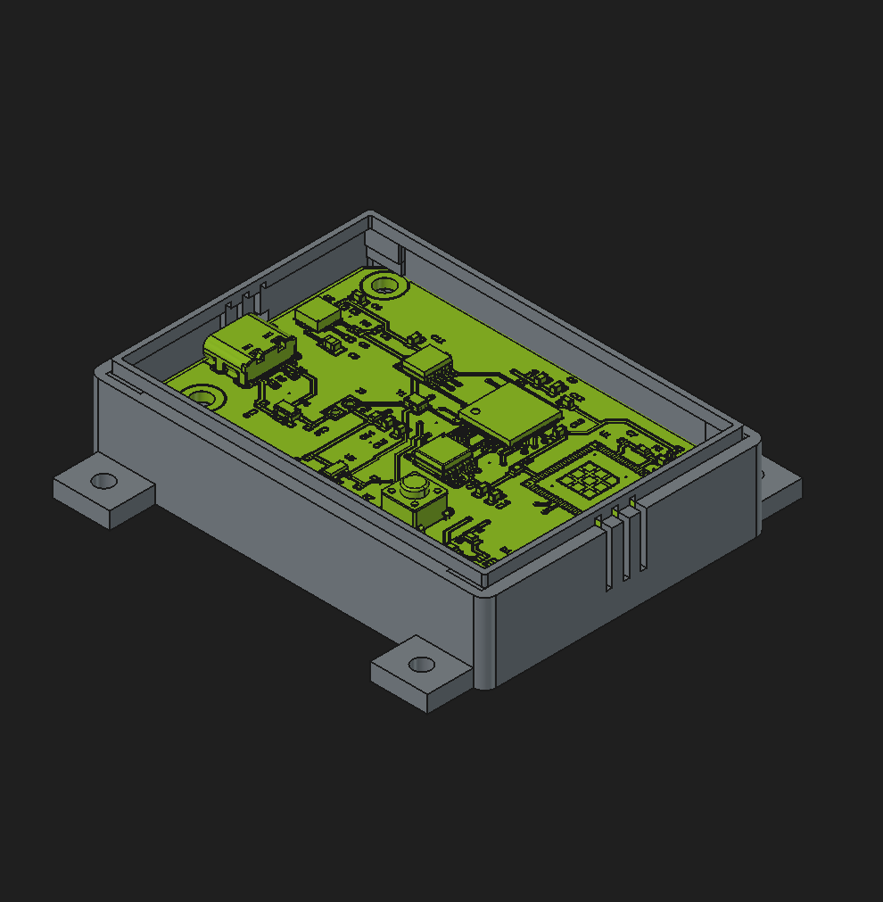
Mechanical Enclosure
69.5 × 49.5 × 20mm — snap-fit design
IP54-rated dust & splash protection
3D printed ASA/PETG — industrial temp range
M3 mounting ears for equipment attachment
USB-C port cutout aligned to PCB
LED light pipe, ventilation slots

Slide 7
Applications & Impact
Manufacturing
HVAC
Energy
Motor, pump, compressor monitoring
Fan & compressor health in buildings
Wind turbine gearbox monitoring
Structural Health
Transportation
Oil & Gas
Bridge & infrastructure vibration
Rail wheel & axle bearing diagnostics
Downhole pump monitoring
One Silicon, Every Application
Field-updateable neural network — 212 bytes of new weights transforms the sensor from motor monitoring to bridge health to HVAC diagnostics. No hardware changes, no re-tapeout.

Slide 8
SenseEdge — Complete Reference Design
Custom ASIC
Verification
PCB Design
44K gates, DRC/LVS clean SKY130, 20 MHz
7 testbenches, 46 assertions GL simulation confirmed
65×45mm, 2-layer FR4 Gerbers ready, ~$13 BOM
Enclosure
Firmware
ML Pipeline
3D printable, IP54 Snap-fit, USB-C cutout
RISC-V C firmware UART reporting, weight loading
TensorFlow QAT 212 INT8 parameters
Thank You
Fidel Makatia | ChipFoundry Reference Application Design Contest 2026
github.com/fidel-makatia/senseedge-asic

