Slide 1
Global sensitivity analysis
E. Padonou, Mines St-Etienne
18, 19 décembre 2017

Slide 2
Outline
Motivation
The Morris method
The Sobol-Hoeffding (ANOVA) decomposition
Ressources

Slide 3
MOTIVATION

Slide 4
The aim
y = f(x₁, ..., x_{d})
Questions :
  Which variables x_{i} are the most influential on y ?
  Which one(s) have no influence ?
  Are there interactions ?
  Can we quantify the effects ?
    x_{i} alone,
    x_{i} with others
Question : ideas ?

Slide 5
Local sensitivity analysis
Computation of finite differences:
[f(x₁, ..., x_{i-1}, x_{i0}+h, ..., x_{d}) - f(x₁, ..., x_{i-1}, x_{i0}, ..., x_{d})] / h
  Question : advantages and drawbacks …
Limitations:
  Gives a good idea of the effect of x_{i} ...
    ...at the neighborhood of x_{i0}
  Restricted to main effects

Slide 6
The Morris Method

Slide 7

OAT
(The method)
OAT design (One-At-a-Time)
  Choose a nominal value X₀
  Move one coordinate at-a-time, and compute a finite difference:
  Δ_{i}(X₀, h) = [ f(X₀ + h E_{i}) – f(X₀) ] / h
C
X₀
B
A

Slide 8
OAT
(The drawbacks)
Strengths (?)
  Easy to run
  Cheap (d+1 function evaluations)
Drawbacks (many!)
  Correct interpretation only for a 1st order polynomial!
  This is a pure local sensitivity analysis
    High dependence to the nominal point
  Poor exploration of the space
    Included in the unit sphere x₁² + ... + x_{d}² = 1 !!!

Slide 9
The Morris method
Idea: From local to global
  Do several OAT with different initial points & random paths
Description
  Choose a number of repetitions r
  Simulate a starting point X₀*, and a permutation s*
  Compute the finite differences successively:
  Δ_{s*(1)}(h) = [ f(X₀* + h E_{s*(1)}) – f(X₀*) ] / h
  Δ_{s*(2)}(h) = [ f(X₀* + h E_{s*(1)} + h E_{s*(2)}) – f(X₀* + h E_{s*(1)}) ] / h
  ...

Slide 10
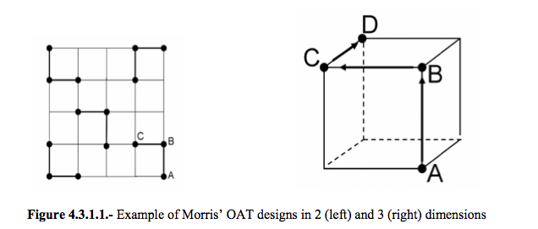
The Morris method
Path visualization for d=2 and d=3
  See [Badea and Bolagno, 2008], page 18

Slide 11
The Morris method
Outputs:
  μ_{i}* : The average of the r absolute values |Δ_{i}(h)|
  σ_{i} : The standard deviation of the r values Δ_{i}(h)
Interpretation:
  IF μ_{i}* is large, THEN X_{i} is influent
  IF X_{i} has no interaction with other variables
  AND IF the output is linear / X_{i}, THEN σ_{i} = 0

Slide 12
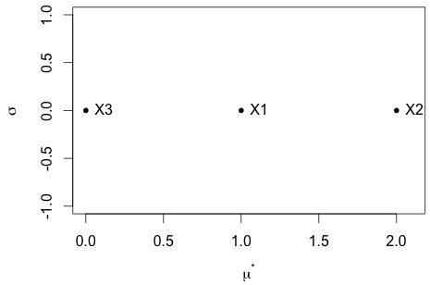
The Morris method
Illustration with the toy function defined over [-0.5, 0.5]³ :
f(x₁, x₂, x₃) = x₁ - 2x₂ + b₁₂x₁x₂ + b₁₁x₁²
b₁₂ = 0
b₁₁ = 0

Slide 13
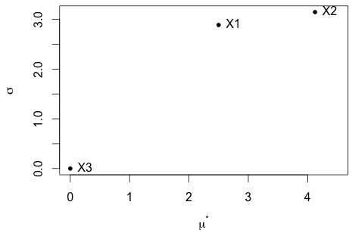
The Morris method
Illustration with the toy function defined over [-0.5, 0.5]³ :
f(x₁, x₂, x₃) = x₁ - 2x₂ + b₁₂x₁x₂ + b₁₁x₁²
b₁₂ = 10
b₁₁ = 0

Slide 14
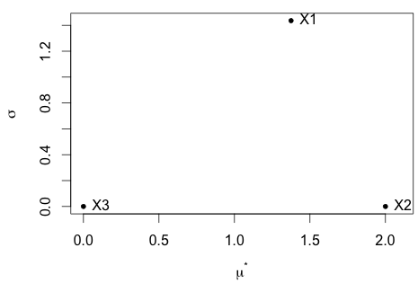
The Morris method
Question (with the same function)
b₁₂ = ??
b₁₁ = ??

Slide 15
The Morris method
Question: What do you obtain, still over [-0.5, 0.5]² with
f(x₁, x₂) = |x₁|
??

Slide 16
Conclusions
(Please...) NEVER USE OAT !
The MORRIS method is a much better alternative:
  Has the same advantages of OAT
    Easy to run, easy to interpret
    Low cost: r*(d+1) function evaluations
  The drawbacks of OAT are avoided
    No dependence to the starting point
    Interactions & Non-linearities are accepted
    Domain exploration

Slide 17
The Sobol-Hoeffding decomposition

Slide 18


Sobol-Hoeffding decomposition
(Efron and Stein, 1981, Hoeffding 1948, Sobol 1993)
Assume that X₁, …, X_{d} are independent random variables. Let f be a function defined on D in R^{d} . Then f is uniquely decomposed as:
Under centering conditions:
And non-simplification conditions (implying orthogonality):

Slide 19



Sobol-Hoeffding decomposition
(main effects, interactions)
The terms are obtained recursively:
  Mean, Main effects
  2nd order interactions
  And more generally:

Slide 20
An example
Ishigami function, with uniform measure on [-π,π]³
f(x) = sin(x₁) + 7sin²(x₂) + 0.1(x₃)⁴sin(x₁)
= 7a + sin(x₁)(1+0.1b) + 7(sin²(x₂)-a) + 0.1[(x₃)⁴-b]sin(x₁)
μ₀
μ₁(x₁)
(main effect)
μ₂(x₂)
(main effect)
μ_{1,3}(x₁,x₃)
(2nd order interaction)

Slide 21
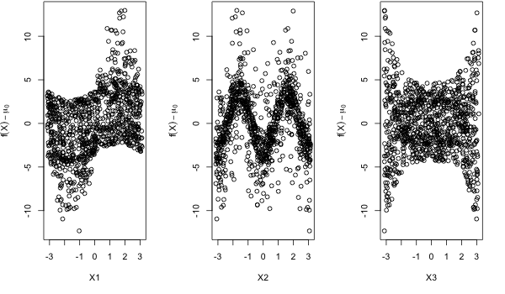
An example
Estimation of the main effects :
  Simulate a sample for X = (X₁, X₂, X₃) and compute z = f(X)
  Estimate the global mean μ₀ by the mean of z
  Estimate the conditional expectation E(f(X) | X_{i}) - μ₀ : Idea ?

Slide 22
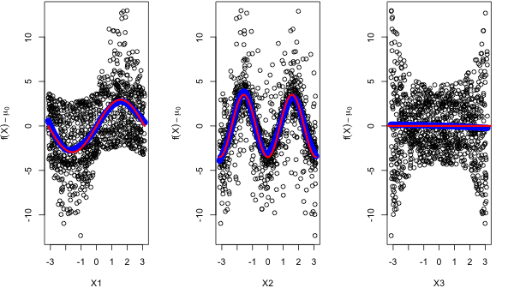
Estimation of the main effects
  Estimate the conditional expectation E(f(X) | X_{i}) - μ₀
  Use a smoother: Local polynomials, smoothing splines, etc.

Slide 23
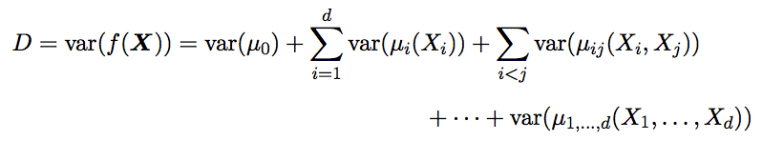

ANOVA (Sobol indices)
The name “ANOVA” (ANalysis Of VAriance) comes from the relation on variances implied by orthogonality:
(Unnormalized) Sobol indices:

Slide 24


FANOVA decomposition
(Total indices)
The total index of one variable X_{i} implies all the subsets J containing {i}
Extension for a group of variables X_{I}: implies all the subsets J that contain at least one element in I

Slide 25
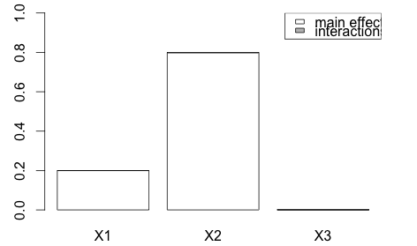
Take again our toy 3D function
f(x₁, x₂, x₃) = x₁ - 2x₂ + b₁₂x₁x₂ + b₁₁x₁²
with x₁, x₂, x₃ i.i.d. from U([-0.5, 0.5])
b₁₂ = 0
b₁₁ = 0

Slide 26
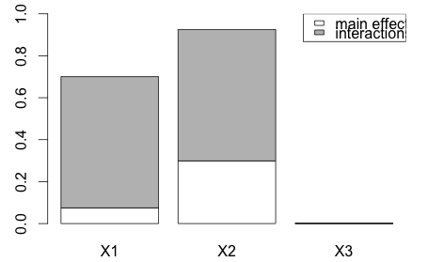
f(x₁, x₂, x₃) = x₁ - 2x₂ + b₁₂x₁x₂ + b₁₁x₁²
with x₁, x₂, x₃ i.i.d. from U([-0.5, 0.5])
b₁₂ = 10
b₁₁ = 0

Slide 27
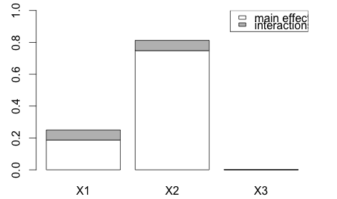
f(x₁, x₂, x₃) = x₁ - 2x₂ + b₁₂x₁x₂ + b₁₁x₁²
with x₁, x₂, x₃ i.i.d. from U([-0.5, 0.5])
b₁₂ = 2
b₁₁ = 0

Slide 28
Question
Same function, with the same assumptions
??
b₁₂ = 0
b₁₁ = 3

Slide 29
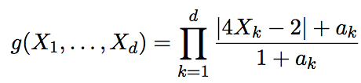

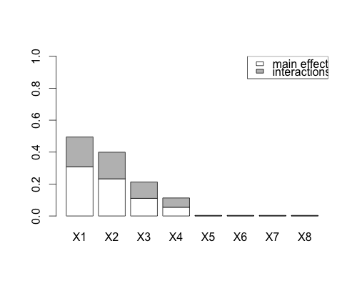

Total indices and screening
If D_{i}^{T}=0, the variable X_{i} is removed (no terms containing X_{i})
  Remark: A condition is required on the probability measure
Total indices of the g-Sobol function:
X₅, X₆, X₇, X₈
can be removed
a = (0, 1, 4.5, 9, 99, 99, 99, 99)
[package
sensitivity]

Slide 30


Sobol-Hoeffding decomposition
(Closed indices)
The closed index of a group of variables X_{I} implies all subsets J contained in I
The D_{J}^{C} are obtained recursively from the D_{I}, and vice-versa
  This is exactly what slide 19 says!

Slide 31
Flash-back to slide 19
(main effects, interactions)
The terms are obtained recursively:
  Mean, Main effects
  2nd order interactions
  And more generally:

Slide 32





Link between closed and total indices
For any subset I, we have:
- I
J
I

Slide 33
To be continued...
Estimation
  Pick-freeze formula
  FAST approach
Further developments
  Extension of Morris method: Derivative-based global sensitivity measures, and their link to Sobol indices
And of course: Practical case studies!

Slide 34
Sobol-Hoeffding decomposition
(History and aliases)
Pioneering work of [Hoeffding, 1948]
Presented as above by [Efron and Stein, 1981]
Reintroduced by [Sobol, 1993], in the context of sensitivity analysis, who defined the Sobol indices
  First alias: Sobol (-Hoeffding) decomposition
The total effects were introduced by [Homma and Saltelli, 1996]
In the book of [Saltelli, Chan, Scott, 2000]:
  Second alias: HDMR decomposition (High Dimensional Model Representation)

Slide 35
RESSOURCES

Slide 36
Books of review articles
Badea A. et Bolado R., Review of sensitivity analysis methods and experience. PAMINA 6th FPEC Project, European Commission, 2008. http ://www.ip-pamina.eu/downloads/pamina.m2.1.d.4.pdf
Iooss B. (2011), Revue sur l’analyse de sensibilité globale de modèles numériques, Journal de la Société Française de Statistique, 152 (1), 1-23, http://www.sfds.asso.fr/journal
Saltelli A., Chan K. et Scott E.M., editeurs (2000), Sensitivity analysis. Wiley Series in Probability and Statistics.

Slide 37
More specific articles
  B. Efron, C. Stein (1981), The jackknife estimate of variance, The Annals of Statistics, 9, 586–596.
  Hoeffding, W. (1948). A class of statistics with asymptotically normal distributions. Annals of Mathematical Statistics,19, 293–325.
  Kuo F.Y., Sloan I.H., Wasilkowski G.W., Wozniakowski H. (2010), On de-compositions of multivariate functions, Mathematics of computation, 79 (270), 953-966.
  Morris M. (1991), Factorial sampling plans for preliminary computational experiments. Technometrics, 33, p. 161-174.
  I. Sobol (1993), Sensitivity estimates for non linear mathematical models, Mathematical Modelling and Computational Experiments, 1, 407– 414.

Slide 38
Software
Pujol G., Iooss B. et Janon A. (2013), sensitivity: Sensitivity Analysis. R package version 1.7
http://CRAN.R-project.org/package=sensitivity

