Slide 1
Containers
Would be updated as Class progresses

Slide 2
(Docker) Containers
Deep Dive Series

Slide 3
Why?
Ease of use
Isolated Processes
Non interference between processes
Docker & Containers

Slide 4
What are containers?
Special programs that can isolate processes in it.
They can assign resources to an app and hold its dependencies (libraries etc) at once

Slide 5
What are containers?
Sandboxed process on your machine that is isolated from other processes on the host machine
Is a runnable instance of an image

Slide 6
Container Requirements?
A builder - a tool to build a container image
An engine - a technology to run a container
Orchestration - a technology used for managing multiple containers

Slide 7
FAQs
Package Managers?
Dependencies?
Libraries?
Program/Application vs Processes?
Server vs Client?
CLI (Command Line interface)?

Slide 8
MicroServices
An architectural pattern that structures an application as a collection of services.

Slide 9
Microservices?
Independently deployable
Loosely coupled
Organized around the business capability or function
Owned by much smaller teams
Highly maintainable and easily tested
Features

Slide 10
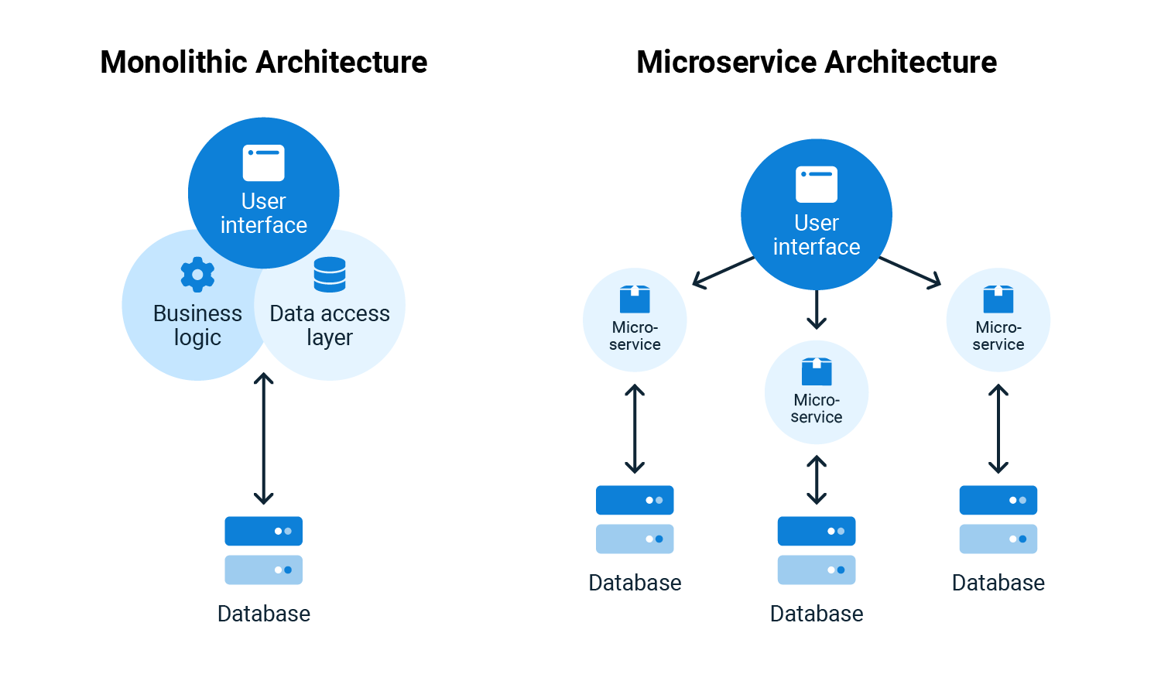
Monoliths vs MicroServices

Slide 11
MicroServices
Pros
Cons
Small footprint & easy to manage
Easy to deploy & fast startup times
Easy to onboard new team members
Independently scalable
Each microservice could use a different technology based on the business need
Complex
Requires extra skills to understand the architecture and inter-communications
Deployment could be complex
Less secure
Complex debugging

Slide 12
Monoliths
Pros
Cons
Easy to develop and deploy
Easy to architect relative to microservices
Minimal network latency & security issues
Eventually becomes large and difficult to manage
Entire app needs to be redeployed for a minor change
Delayed startup and deployment time
Cannot scale a part of the app, entire app needs to be scaled
Less reliable, a single bug could bring down the entire app
Less agile and flexible

Slide 13
Docker?
A platform for container management that runs enclosed environments on an existing host
What is it?

Slide 14
Virtual Machines Vs Docker (Containers)
Applications
Applications
Applications
Applications
System
System
System
System
Client Kernel
Client Kernel
?
Hypervisor
Docker
Host Kernel
Host Kernel
Host Hardware
Host Hardware
Virtual Machines
Docker

Slide 15
Virtual Machines vs Docker
VM
Docker (MicroServices)
Slice of hardware through virtualization (hardware virtualization)
Has its own OS
Longer boot times
Larger footprint
Slice of host OS (kernel) through the container runtime
Uses host’s OS
Start up time in seconds
Lightweight - packages only what’s needed

Slide 16
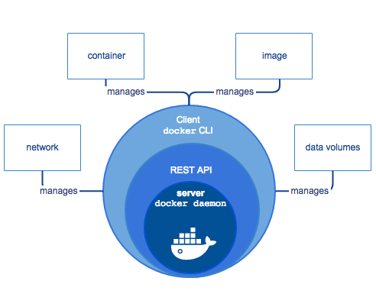
Architecture (Docker)
Docker Client
Docker Server (daemon) - dockerd
Docker - REST API
Above components make up the Docker Engine which is a server-client application
Docker Registries

Slide 17
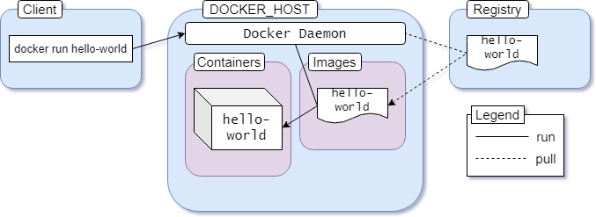
Architecture (Docker)

Slide 18
A service that stores artifacts (docker images)
Running instantiation of an image
Registry
Image
Container
Files + Metadata

Slide 19
Docker Installation
Docker Desktop
Linux
Script
Windows
MacOS
Ubuntu (Multipass)
Docker-ce
Docker-ce-cli
Docker-buildx-plugin
Docker compose plugin
Post Installation steps
Curl -fsSL get.docker.com | sh

Slide 20
Docker Desktop vs Docker Engine
Docker Desktop
VM + Graphical UI + extra features (single node K8s engine)
Docker engine resides inside the VM
Access network resources easily
Docker Engine
Dockerd (daemon/server)
API
CLI - docker client

Slide 21
Docker Inc Packages Vs Distribution Packages
Docker inc releases new versions monthly (edge) and quarterly (stable)
Releases are immediately available on docker inc’s package repositories
Linux distros don’t always update to the latest docker version
Sometimes, some distributions have carried packages with custom patches
Sometimes, these patches added critical security bugs
The hard-work of installing docker through docker inc’s repositories is worth it

Slide 22
First Container
Docker container run hello-world
Docker container run busybox
Docker container run ubuntu
Docker container run -it ubuntu

Slide 23
CLI - Command Line Interface
A text based interface used to run programs, manage computer files and interact with computers
DOCKER CE - CLI
Docker <noun> <verb> [OPTIONS]
Nouns
Container, Image, Volume, Network, System, Plugin etc
Verbs
Attach, start, rename, pause
Commit, restart, kill, unpause
Stop, list, inspect, export/import
Options
–interactive, –publish, –publish-all, –quiet, –privileged, –tty etc

Slide 24
Pets
Vs
Cattle
A metaphor that refers to two types of servers
Pet
Distinct names + unique configs
Not (easily) replaceable and must be fixed during an outage
Cattle
Generic names and configs
Easily replaceable, especially during an outage

Slide 25
Docker Images

Slide 26
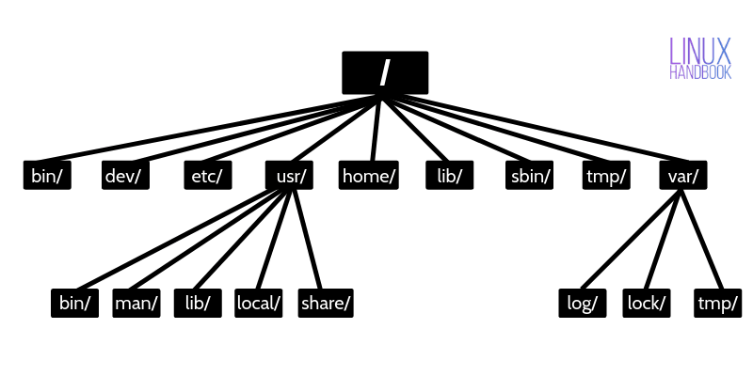
What is an Image?
Image = Files + metadata
These files form the root filesystem of our linux container
Metadata includes:
Author of image
Command to execute in the container
ENV variables etc

Slide 27
What is an Image
Images are made up of layers
Each layer can add, change and remove files or metadata
Images could share layers to optimize disk usage, transfer times and memory use.
A specialised storage backend is needed to communicate with the linux filesystem to combine multiple layers into a single usable image.
This is made possible via a “Union Filesystem”
Docker storage plugins which support these are:
Overlay2
Btrfs
Device-mapper
Supports CoWS (Fast copy on write system)

Slide 28
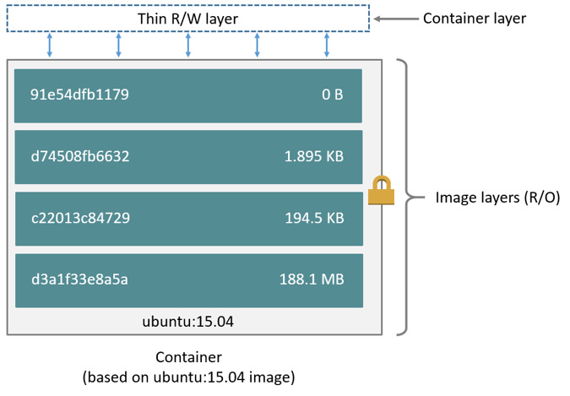
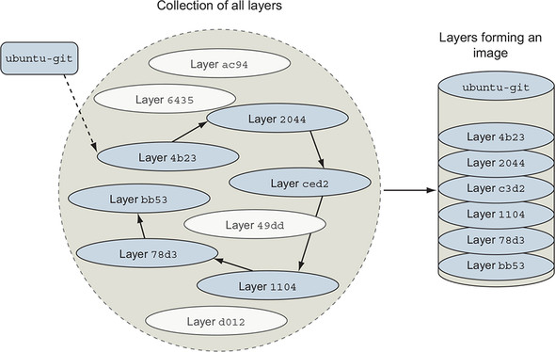
What is an Image?

Slide 29
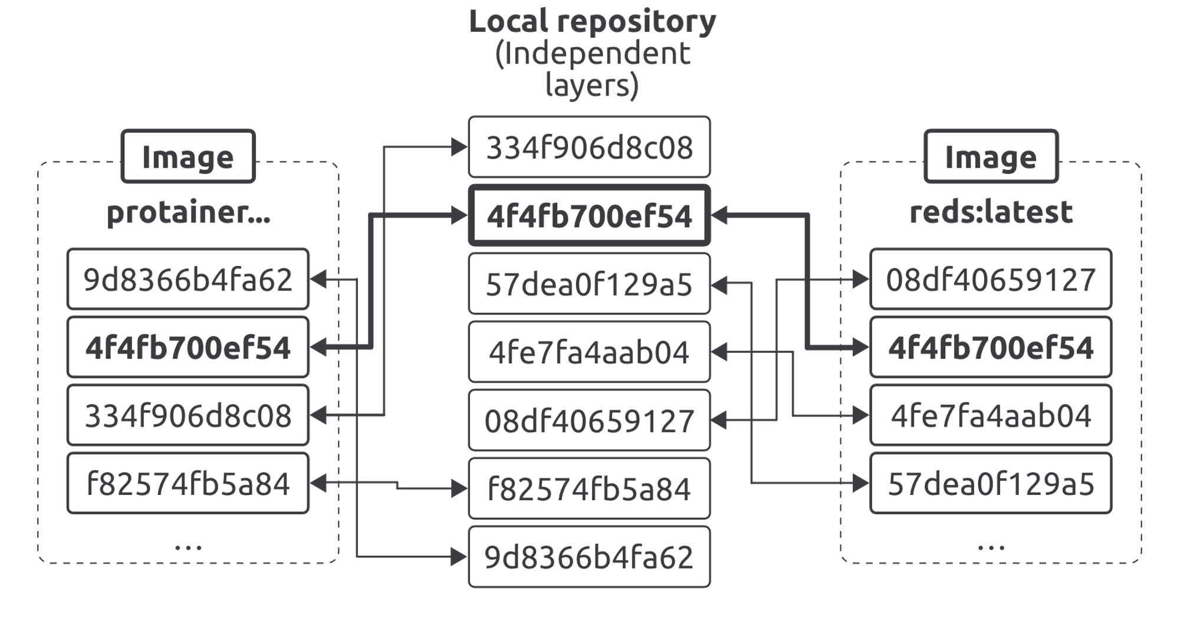
What is an Image?

Slide 30
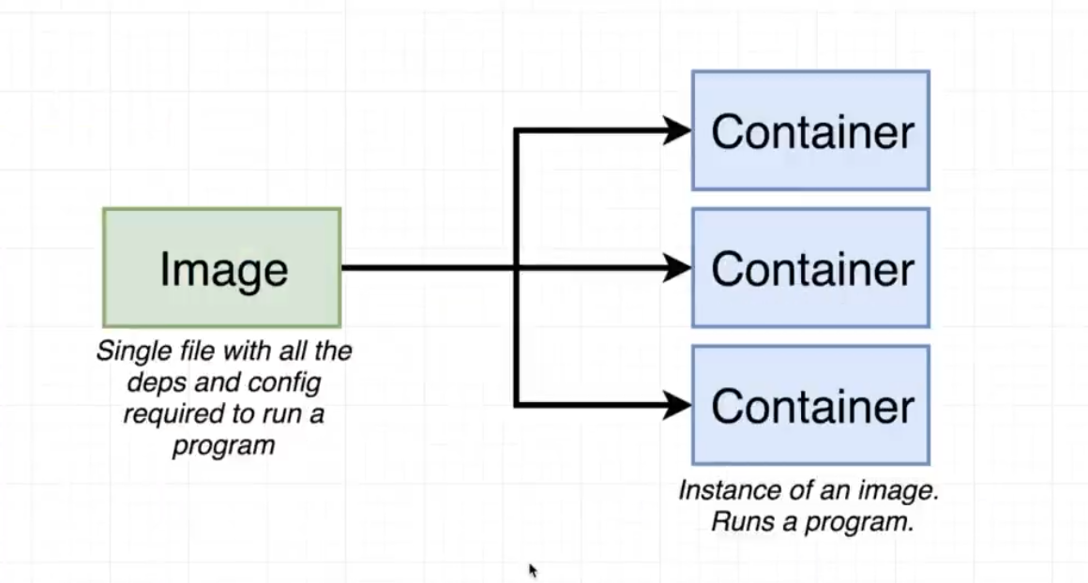
What is an Image

Slide 31
Containers vs Images
Image - immutable and read-only filesystem
Container - set of encapsulated processes running in a read write copy of the filesystem aka image
CoWS Optimizes container boot time instead of regular copy
‘docker container run’ starts a container from a given image
Multiple containers share the same image

Slide 32
Image Creation
docker container commit
Saves all container changes into a new layer
Creates a new image (a copy of container)
docker image build
Performs a repeatable build sequence
Utilizes a Dockerfile
Preferred

Slide 33
Dockerfile
A text file that contains a series of commands for building a docker image
FROM - Base Image (Generates a layer)
ARG - Defines a build time variable (No Layer)
LABEL - Provides metadata like maintainer (No Layer)
USER
ENV - sets environment variables (No Layer)
RUN - Runs Commands on the base image (Generates a layer)
COPY - used to copy files from the local filesystem (Generates a layer)
WORKDIR -changes your working directory in the image for the remaining build instruction (Generates a layer)
CMD - defines what options to run when you start the container (when used with Entrypoint). Can be overridden.
ENTRYPOINT - Define the base(default) command to execute in the container
EXPOSE - expose ports
ADD - Copies files and directories (Generates a layer)
VOLUME - Create volume mounts (Generates a layer)

Slide 34
Dockerfile - Preferred Commands
ADD vs COPY
Use COPY
ENTRYPOINT vs CMD
Preferably use CMD
EXEC vs SHELL
Use Shell
Best Practices and More Examples

Slide 35
Dockerfile Guidelines
Define Base Image - FROM
Create application Directory - WORKDIR
Copy Dependency definitions - COPY
Install application dependencies - Use programming lang package manager
Copy application source code - COPY
RUN other commands (optional)
Build Application Binary (Compiled language)
Specify container start-up command (ENTRYPOINT or CMD)

Slide 36
Dockerfile Base Images
Full Base Images
Debian based images and large in size
Bookworm/Bullseye/Buster etc
Codenames for various debian releases
Slim
Paired down version of full image
Contains minimal packages
Scratch?
Alpine
Based on the Alpine Linux Project
An OS made specifically for containers
docker image pull python:3.11
docker image pull python:3.11.4
docker image pull python:3.11.4-slim
docker image pull python:3.11.4-slim-bookworm
docker image pull python:3.11.4-alpine
docker image ls

Slide 37
Languages - Compiled vs Interpreted
Feature | Compiled | Interpreted
Translation | The source code is translated into machine code all at once. | The source code is translated into machine code line by line.
Speed | generally faster | generally slower
Memory Usage | typically use less memory | typically use more memory
Debugging | Debugging errors in compiled languages is typically done during the compilation step. | Debugging errors in interpreted languages is typically done during the execution step.
Examples | C, C++, C#, Java, Golang, Rust | Python, JavaScript, Perl, PHP, Ruby

Slide 38
Image Layers
A sample Java Web Applications layers/steps:
Linux Base Layer
Packages and Configs
JRE
Tomcat
App Dependencies
App Code and Business Logic
App Configuration
A sample Python Web application layers/steps:
Linux Base Layer
Packages and Configs
Python3 + Package Manager
WebServer Framework (FastAPI or Flask or Django etc)
App Dependencies
App Code and business logic

Slide 39
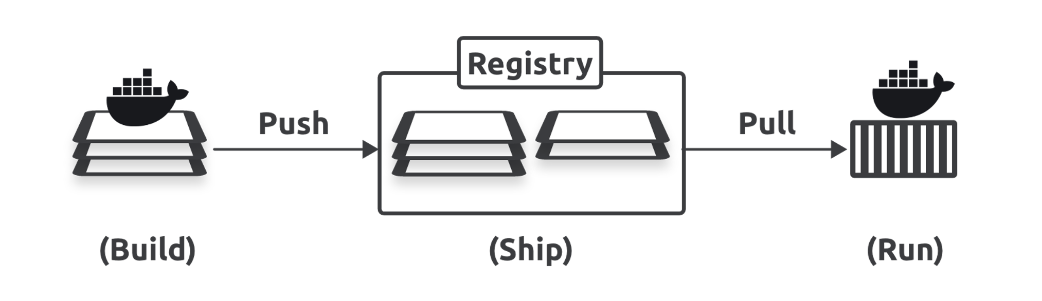
Registry (OCI Registries)
A service that hosts and distributes build artifacts (docker images)
Image Namespaces (3 types)
Official Images (Root Namespace - docker.io or hub.docker.com)
User Images (User Namespace - docker.io or hub.docker.com)
Self Hosted Images (3rd Party Registries)

Slide 40
Registry - Root Namespace(Official Registries)
Official Images - Ubuntu, busybox, nginx, alpine etc
Image simply has a name, not prefixed by a user namespace
Managed by Docker Inc
Authored and Managed by 3rd party
Recommended for use

Slide 41
Registry - Userspace
Holds images for docker hub users and orgs
Image name prefixed by username or org name
Example - bitnami/etcd
Bitnami == Org
Etcd == Image name

Slide 42
Registry - Self Hosted Namespace
3rd Party Registries
Contains Hostname and optional port
Egs - quay.io/coreos/etcd, localhost:5000

Slide 43
Image Tags
Mutable named references to docker images
Default == latest (avoid using latest)
Multiple images can have same tag
Immutable identifier for an image == sha256 reference
Tagging format:
<registry_url>/<username>/<repo_name>:<tag>

Slide 44
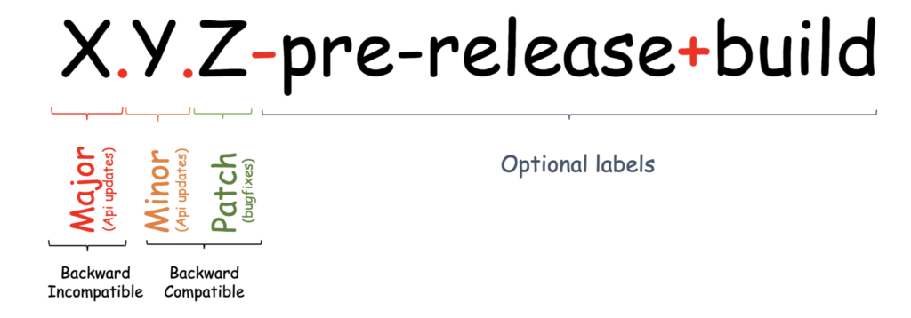

Versioning
Semantic Versioning:
MAJOR.MINOR.PATCH
Eg 1.23.4
Major - could contain incompatible changes
Minor - New functionality added with backwards compatibility
Patch - backward compatible bug fixes
Used by kubernetes
Calendar Versioning:
MAJOR.MINOR.PATCH
YYYY.MM.PATCH
Ubuntu is known for using this versioning system

Slide 45
Containers

Slide 46
Containers - What are they?
Special programs that can isolate processes in it.
They can assign resources to an app and hold all dependencies(libraries etc) at once.
Containers require the following:
A Builder - a tool to build a image
An Engine - a technology used for running a container
Orchestration - A technology used for managing multiple containers
Definitions
a sandboxed process on your machine that is isolated from all other processes on the host machine
is a runnable instance of an image

Slide 47
Containers - Docker/Linux Signals
SIGTERM
A polite shutdown with a grace period of 10 seconds
Docker container stop <container_id>
SIGINT
Interruption Signal
Ctrl + C
SIGKILL
A hard and immediate shutdown
Docker container kill <container_id>
Further Reading
https://www.kaggle.com/code/residentmario/best-practices-for-propagating-signals-on-docker/notebook

Slide 48
Containers - CMD vs Entrypoint
Used to specify programs to run when the container starts up
CMD - can be ignored when there are parameters stated within docker container run command
ENTRYPOINT - not ignored by docker container run, but the parameters are rather appended as arguments

Slide 49
Containers - Shell vs Exec (CMD & Entrypoint)
SHELL
ENTRYPOINT/CMD <default_commands>
The Shell spins up the actual command
The Shell is PID 1
Does not handle Docker Signals Effectively
EXEC
ENTRYPOINT/CMD exec <default_command> OR [" <default_command>"] (Best Practice)
The default_command spins up without the SHELL
<default_command> is PID 1
Usually handles docker signals effectively

Slide 50
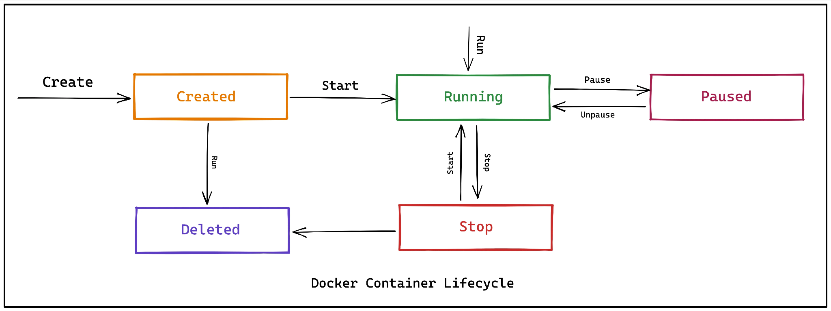
Container Lifecycle
Create, Run, Pause, Stop, Kill

Slide 51
Container Lifecycle
Create
docker container create --name <custom_name> <image_name>
Start
docker container start <container_id>
docker container run <container_id>
Pause
docker container pause <container_id>
docker container unpause <container_id>
Stop
docker container stop <container_id> {SIGTERM}
Delete
docker container stop <container_id> + docker container rm <container_id>
Stops container and removes/deletes all resources associated with container
docker container rm --force <container_id>
docker container rm $(docker container ls -a -q)
docker system prune
docker system prune -a

Slide 52
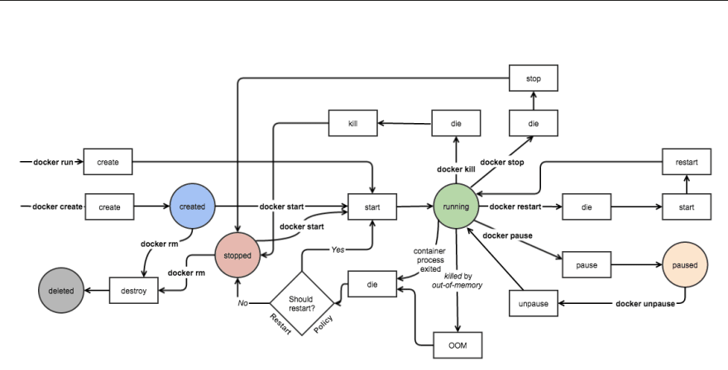
Container Lifecycle

Slide 53
Self Healing Containers with Restart Policies
Always
docker container run --name always --restart always alpine sleep 1d
Restarts when the container is exited
A docker container stop will actually stop the container
A restart of the docker server will start the container again
Unless-Stopped
docker container run -d --name unless-stopped --restart unless-stopped alpine sleep 1d
Would not
On-Failure
docker container run -d --name on-failure --restart unless-stopped alpine sleep 1d
Only restarts if the container exits in error (ie a non-zero exit code)
Exit Codes

Slide 54
Containers - Background & Interactive
Background
Docker container run -d <image_id>
ForeGround
Docker container run <image_id> OR <image_tag>
Interactive
Docker container run -it <container_id> <sh>
SHELLs:
Alpine: sh
Ubuntu/Debian: bash

Slide 55
Inspecting Containers
docker container inspect <container_id>

Slide 56
Docker Networks

Slide 57
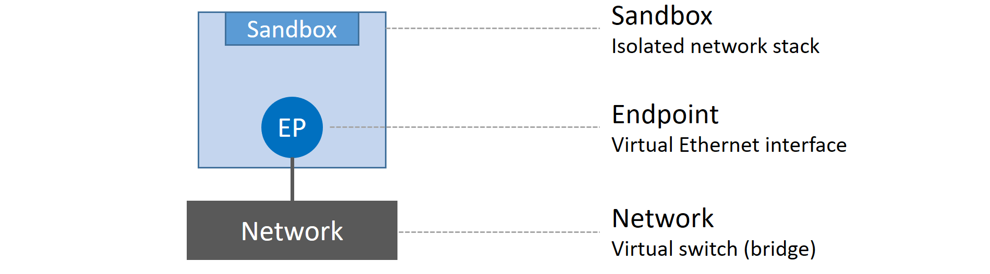
Docker Network
Uses CNM
CNM alternatives?
Docker CNM implementation == libnetwork
Sandboxes
Endpoints
Networks
Libnetwork Implements
Native Service Discovery
Ingress based load balancing

Slide 58
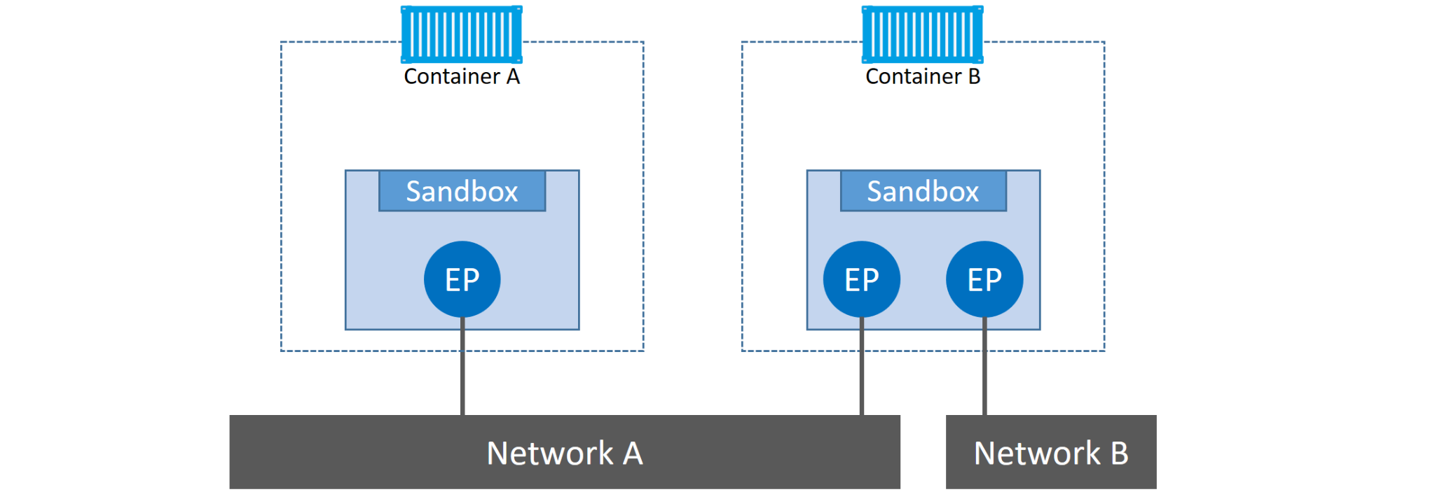
Docker Network

Slide 59
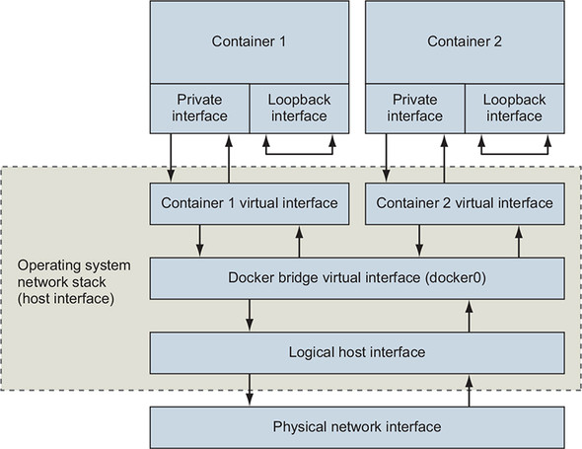
Docker Network

Slide 60
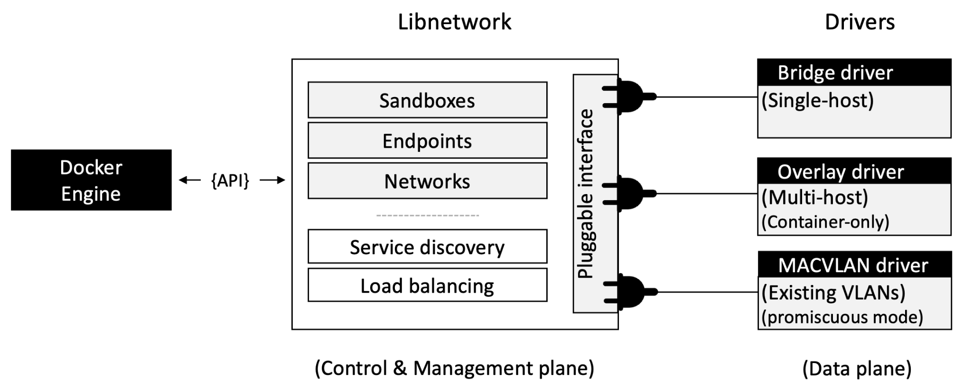
Docker Network

Slide 61
Docker Network
Underlay Network
Bridge (default)
Host
None
Overlay Network
Used to create a mesh network
Used for Docker Swarm
Created in top of a physical network

Slide 62
Docker Network - Bridge
Default
Associated with uses docker0
Default subnet CIDR - 172.17.0.0/16
Containers on the same network can communicate with each other
Non-Default
Needs to be manually created
Creates virtual interface that starts with br-*
DNS translation is done using container id or container name or network alias

Slide 63
Docker Network - Host
Has direct access to all physical and virtual interfaces running on the host

Slide 64
Docker Network - None
Used for Containers that do not require network connectivity.

Slide 65
PlaceHolder Summary

Slide 66
Docker Storage

Slide 67
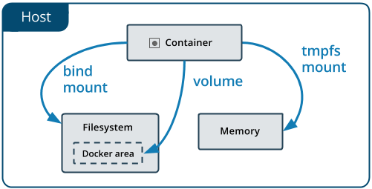
Docker Storage
Types:
Ephemeral
Tightly coupled with container lifecycle
This is storage associated with the top read write layer
Implemented by the docker storage driver
Persistent
Named volumes
Anonymous volumes
Bind mounts (not recommended)

Slide 68
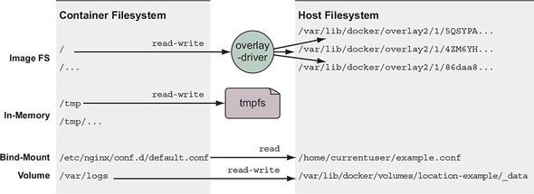
Mount Points

Slide 69
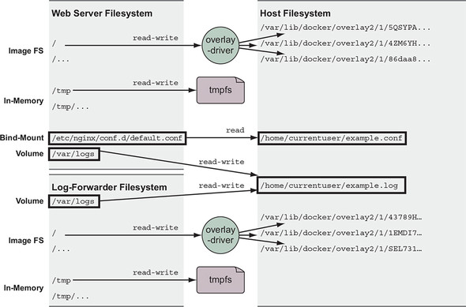
Mount Points

Slide 70
Bind Mounts
Limited functionality compared to named volumes
Is tethered to a host machine and requires specifying a file or directory on the host machine
Should only be used if the given host directory structure is guaranteed
Very Performant
docker run -d \
-it \
--name devtest \
--mount type=bind,source="$(pwd)"/target,target=/app \
nginx:latest
docker run -d \
-it \
--name devtest \
--mount type=bind,source="$(pwd)"/target,target=/app,readonly \
nginx:latest

Slide 71
Docker Volumes Advantages over Bind Mounts
Easier to backup and migrate
Managed using docker cli or API.
Works on linux and windows containers
Can be safely shared among multiple containers
Can utilize different storage backends by using a specific volume driver. Enables added functionality like encryption etc
Volumes on Docker Desktop have much higher performance than bind mounts from Mac and Windows hosts

Slide 72
Read Only Volumes
The container only needs read access to the data
Add ‘ro’ as an option to the mount
docker run -d \
--name=nginxtest \
-v my-vol:/usr/share/nginx/html:ro \
nginx:latest

Slide 73
Named Volumes
Docker volume create <volume_name>
Docker volume inspect <volume_name>
Docker volume rm <volume_name>

Slide 74
Docker Internals & Security

Slide 75
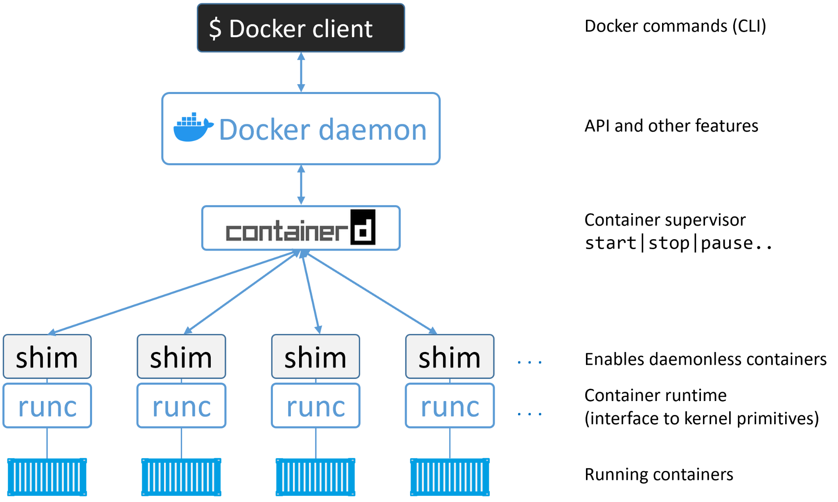
Docker Internals

Slide 76
OCI - Open container initiative
Defines:
Image Spec (docker, buildkit, buildah, crane)
Container runtime spec - (docker, containerd/runc, podman)
Distribution spec - dockerhub, ecr, acr, gcr, crane, ghcr
Docker on Linux
Dockerd (daemon)
Docker-containerd (containerd)
Docker-containerd-shim (shim)
Docker-runc (runc)
Runc - creates containers
Containerd - container lifecycle
Start
Stop
Pause
Remove etc

Slide 77
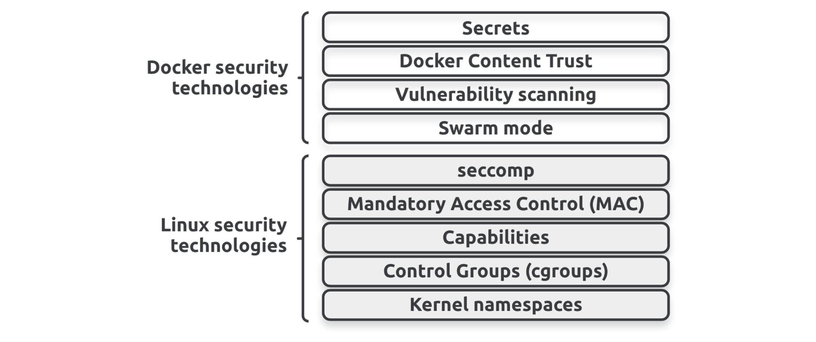
Docker Security
Container Scanning
Linux Security Features
Kernel Namespaces
Control Groups
Capabilities
Trusted Images
App Armor
Secomp PRofile

Slide 78
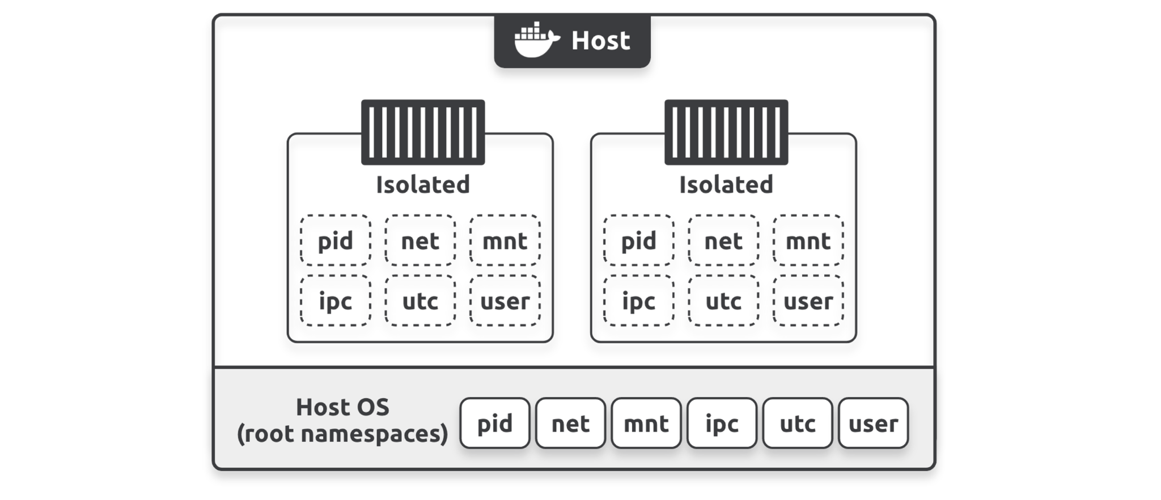
Container Scanning - Tools
Trivy
Anchore (grype)
Snyk
Docker Scout
Sysdig
Twistlock

Slide 79
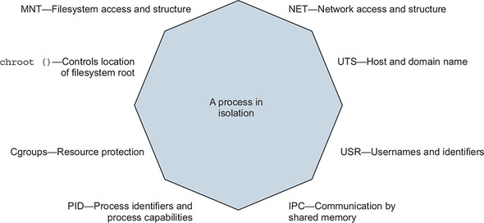
Linux/Docker Namespaces

Slide 80
Linux/Docker Namespaces
Cgroups - Resource protection
PID - Process identifiers and process capabilities
IPC - Communication by shared memory
USR - usernames and identifiers
NET - Network access and structure
UTS - Host and domain name
MNT - Filesystem access and structure

