Slide 1
Frito-Lay Attrition EDA Fidel Tamares, SMU 2021
GitHub Repo: https://github.com/fideltamares/CaseStudy2DDS
GitHub Website: https://fideltamares.github.io/
Fidel Tamares Youtube: https://www.youtube.com/watch?v=uXAGDhGvZ7A

Slide 2

Dataset Review and Assumptions
Question of Interest: What are the top 3 factors that are influencing attrition?
Dataset review:
870 Observations and 36 Variables (1 of them being the ID identifier)
We identified the top 3 influencers on attrition in you company: Age, Monthly Income and OT
Assumptions:
2 columns removed, StandardHours and EmployeeCount
Retirement and Quitting are part of the attrition numbers
Data was reliably collected (no missing data found)
Everyone can get OT

Slide 3
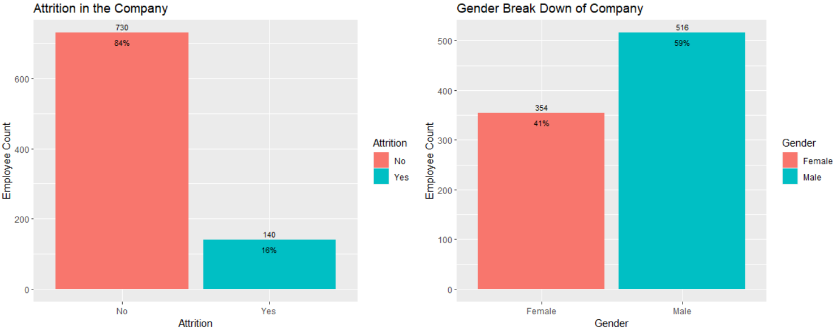
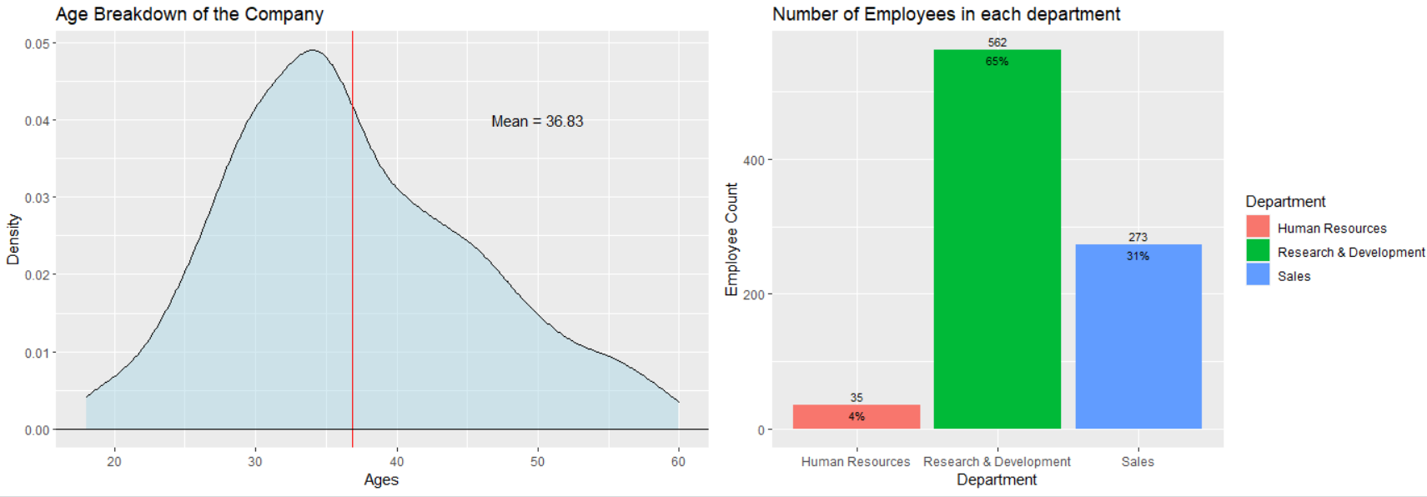
Company Breakdown
General Information:
2:1 ratio for males to females
Right Skewed quitting Age
Largest department is R&D, high educational influence
Strategy
Overall Attrition
Age impact
Influence of Income
Job and Environmental Satisfaction
Gender will be evaluated in each section as needed

Slide 4
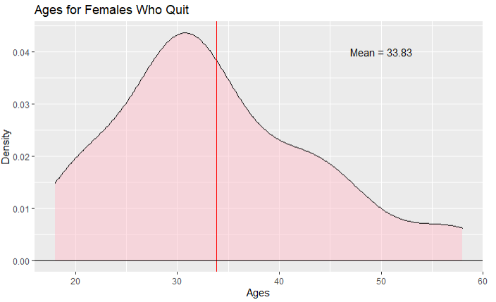
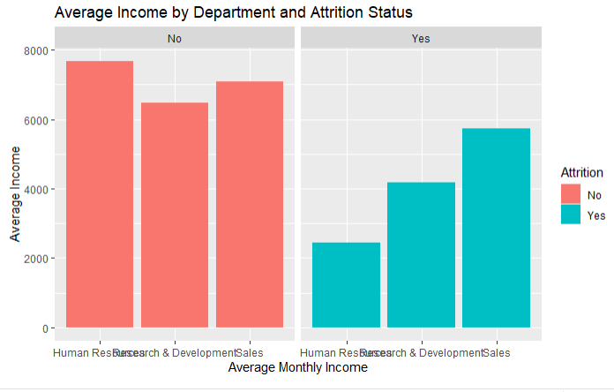
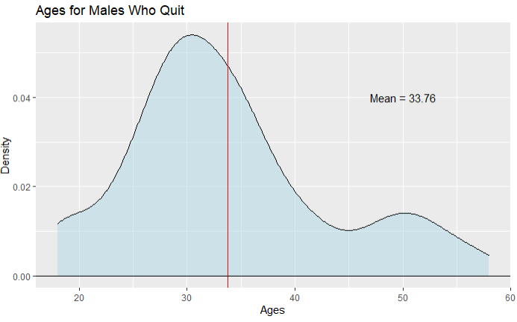
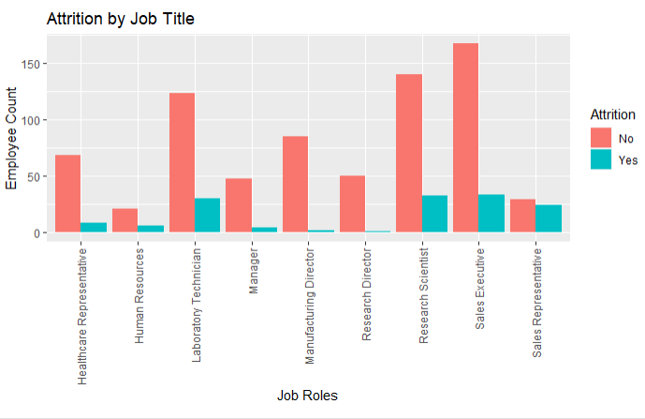
Attrition Analysis
1.
3.
2.
4.
Notes:
Right skewed for age, may be impacted by retirement
Most happening actually in the 30’s Age is important
HR was making the lower of the 3 departments who quit, significantly lower than who stayed, suggests pay is important
HR related jobs low due to smaller portion of the company, 4% of company.
Largest proportion is Sales to size in company, RD and Sales are similar in number of attrition, but sales is half the size of RD, environment is important

Slide 5
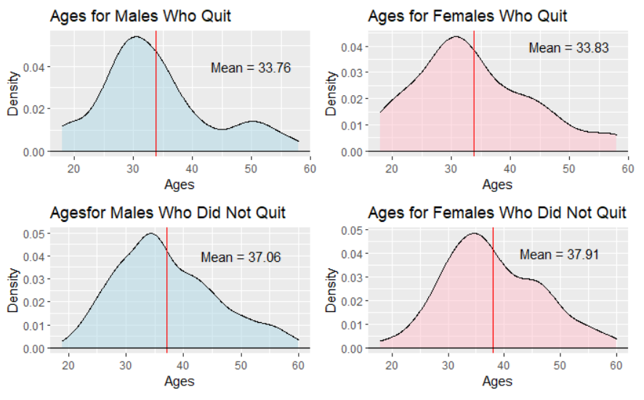
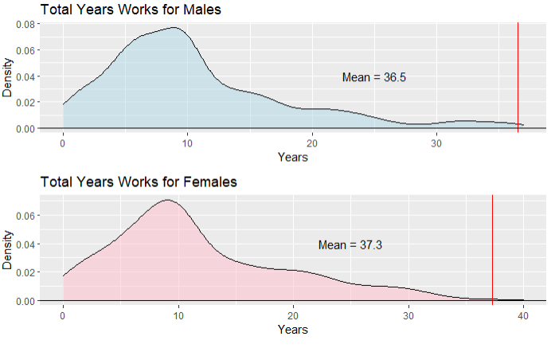
Age Analysis
General Information:
Quitting age is about 4-5 years younger
Right Skewed *, retirement influence
Skewed by a few, moving data point
10 years is the highest frequency for total years worked
About 75 year age range
Unaddress generational concerns

Slide 6
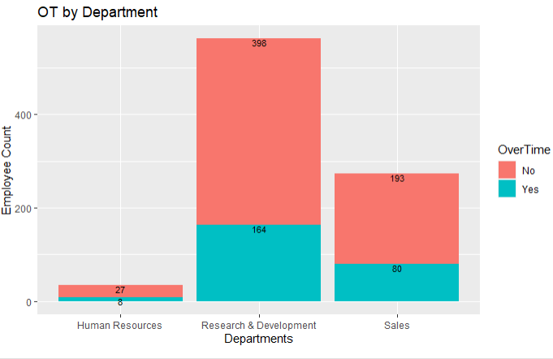
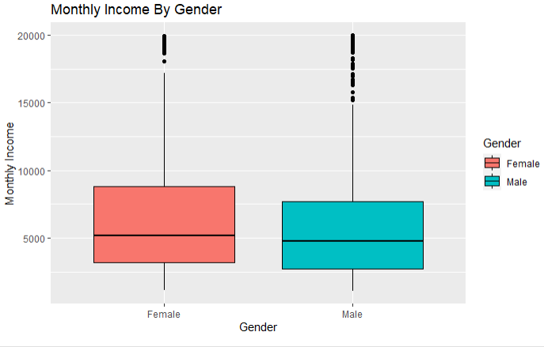
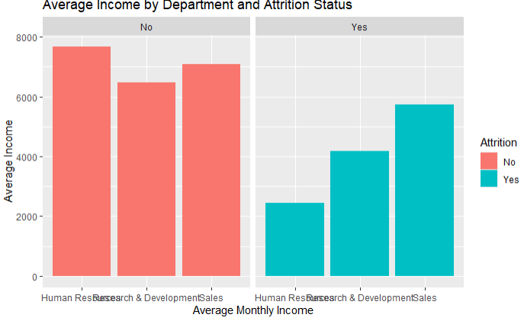
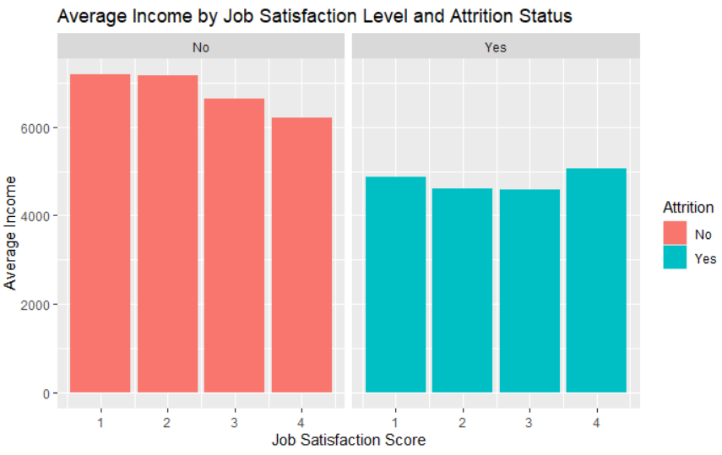
Income Analysis
1.
3.
2.
4.
Notes:
General Information:
Pay is similar between genders
Females have a larger pay range
Significant Pay different in all Departments
Larger portion of each department can/cannot get OT
Consider OT more than job role/ level because the later usually does not happen immediately and at will. This makes it hard to impact income with job levels and roles with out inflexible they are. OT can happen rapidly and at will.

Slide 7
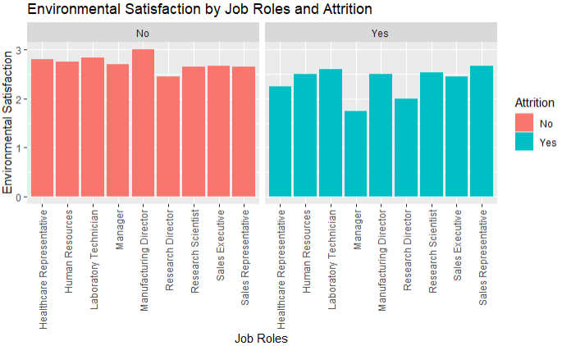
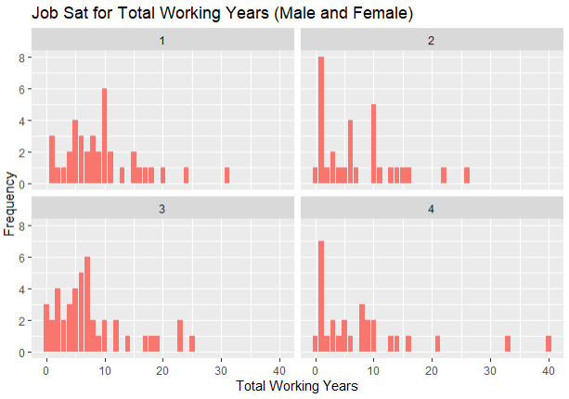
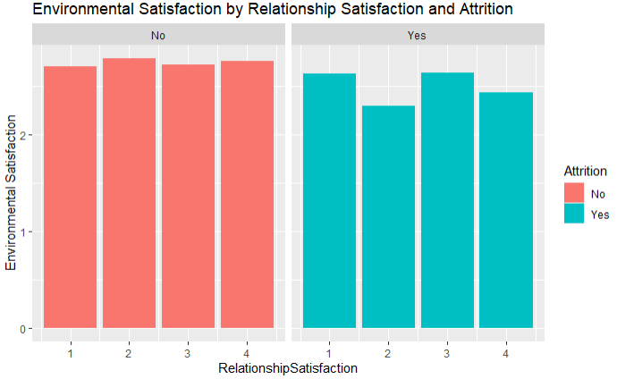
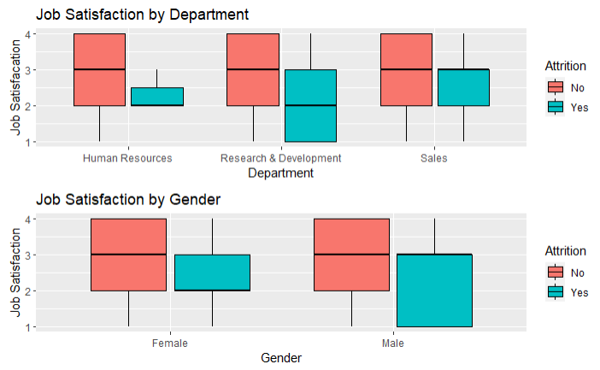
Job and Environmental Satisfaction Analysis
1.
3.
2.
4.

Slide 8
Conclusion
Recap
We have identified 3 variables that may be contributing to your attrition, and they are:
Monthly Income
Overtime
Age
Other takeaways:
Managers have a low satisfaction level and may be contributing negatively to the employee climate
With data spanning almost 75 years, generational quirks will play a role in employee engagement
Separate retirement from attrition numbers
No evidence of gender discrimination
Additional requests for attrition classification
KNN
84.86% accuracy
Additional request for salary estimates
Multiple Linear Regression using Age, JobLevel and TotalWorkingYears

Slide 9
Questions or Comments?

