Slide 1


APEX · BRAIN CONNECTS HACKATHON · UT AUSTIN
IMPACT
Registration on segmentation-model representations
with KonfAI: elastix · FireANTs · ConvexAdam · out of core · OME-Zarr RFC-5
Valentin Boussot — Fideus Labs
September 16th, 2026
Notes:
(about 25 s)
Hi everyone, I'm Valentin, from Fideus Labs. Today I want to show you IMPACT: registration that compares what segmentation models see, instead of raw intensities. And we run it with KonfAI, so it works on volumes that don't fit in memory, and it writes its results as OME-Zarr.
Two parts. First, how it works: I'll walk you through the pipeline step by step, from the volume to the field, and then the loss. Second, what we got when we applied it to the hackathon data.

Slide 2

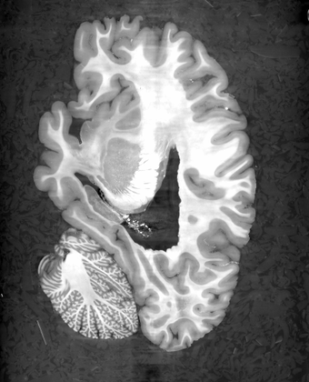
1 · how it works
STEP 1 the volume, cut into patches
The volume never loads: one region at a time
1 · cut into patches
2 · the backend
3 · blend
4 · write the field
+ the loss
908 GiB
the volume on disk, in OME-Zarr, local or on S3. It is never loaded.
1 region
read at a time: the patch and its halo, only the chunks it touches.
2 settings
patch_size and overlap. No patch size: one pass on the whole volume.
Patch:
patch_size: [256, 256, 256]
overlap: 128
the patch
its halo (the overlap)
memory follows the patch, not the volume
Fideus Labs · KonfAI · impact-reg-konfai
2
Notes:
(about 35 s)
Step one. Here's the volume: the LINC hemisphere, 908 gigabytes, sitting in an OME-Zarr store, on disk or on S3. KonfAI never loads it. It cuts it into patches, and reads one region at a time: the patch, plus a halo around it, which is the overlap with its neighbours. And it only decodes the chunks that region touches.
That's two settings in the preset: patch size and overlap. Leave the patch size out, and you get one pass on the whole volume, if it fits. Put one in, and you get tiles. Same command. So memory follows the patch, not the volume.

Slide 3
1 · how it works
STEP 2 the backend
Patches in, a displacement patch out
1 · cut into patches
2 · the backend
3 · blend
4 · write the field
+ the loss
fixed
patch
moving
patch
elastix · FireANTs · ConvexAdam
the backend, chosen by the preset
one patch of displacement
same contract, different memory: one 512² tile of the 3 µm section
elastix
1.9 GB
ConvexAdam
15.1 GB
FireANTs
> 24 GB · out of memory
one 24 GB card
same patches in, same field out: the backend is a preset name, nothing else changes
Fideus Labs · KonfAI · impact-reg-konfai
3
Notes:
(about 40 s)
Step two, the backend. The contract is simple: a fixed patch and a moving patch go in, one patch of displacement comes out.
And behind that contract you can plug in different engines. elastix, the classic B-spline with mutual information and a bending penalty. FireANTs, a diffeomorphic SyN on the GPU. ConvexAdam, block matching refined with Adam. Same patches in, same field out, so they're interchangeable: you just change the preset name.
What differs is memory. On the same tile, elastix needs about two gigabytes, ConvexAdam fifteen, and FireANTs doesn't even fit on a 24-gig card. With tiling, that's a one-line fix: you make the tile smaller.

Slide 4
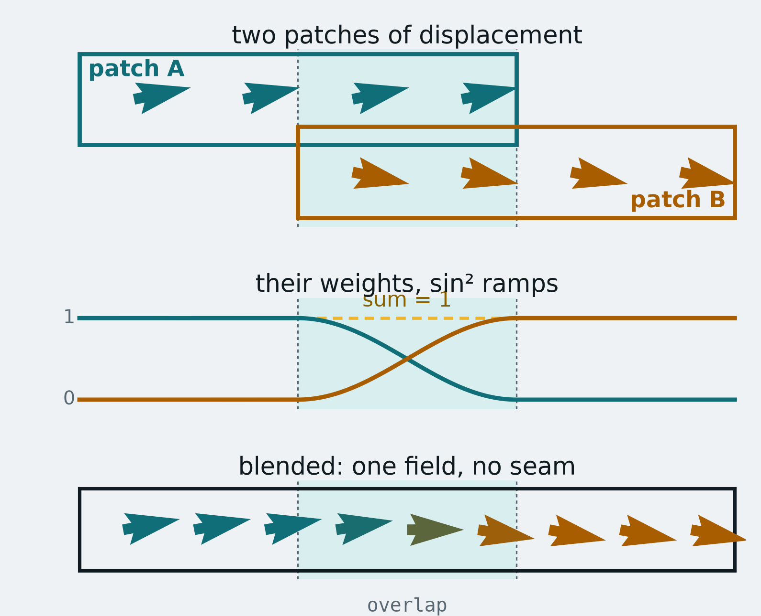
1 · how it works
STEP 3 blend the overlaps
A partition of unity: no seam between tiles
1 · cut into patches
2 · the backend
3 · blend
4 · write the field
+ the loss
A patch is right in its centre and worst at its edges: that is what the halo is for. Its weight fades to zero before its edge while the neighbour's rises, and at every voxel the weights sum to one.
DOES THE TILING LEAVE A SEAM?
A known deformation of the light-sheet section, 512² tiles:
20.8 → 5.6 µm residual over the tissue
1.08× / 1.13× the field's step at tile planes, against its step anywhere else
patch_combine: Cosinus · Mean · Gaussian · Trim
every voxel's weights sum to one: the tiles leave no seam
Fideus Labs · KonfAI · impact-reg-konfai
4
Notes:
(about 35 s)
Step three, blending. A patch is right in its centre and worst at its edges, and that's what the halo is for. So we don't cut and paste tiles. Each patch gets a weight that fades out before its edge, while its neighbour's weight rises, and at every voxel the weights sum to one: a partition of unity.
Top row, two patches of displacement that don't quite agree in the overlap. Middle, their weights. Bottom, the blended field: one continuous field.
And we checked that. On a known deformation, tiled registration brings the error from 21 to 6 microns, and the field's step at the tile planes is the same as anywhere else. No seam.

Slide 5
1 · how it works
STEP 4 write the field
Many formats in, the field out as OME-Zarr RFC-5
1 · cut into patches
2 · the backend
3 · blend
4 · write the field
+ the loss
IN
OUT
ITK images
.mha · .nii.gz · .nrrd
KonfAI
reads one region
at a time, and writes
slab by slab as the
tiles complete
displacement field
OME-Zarr store · NGFF RFC-5 displacements
DICOM
series
transform file
ITK .h5 / .itk.txt · opens in 3D Slicer
HDF5
.h5
moved image
in the moving image's own format
OME-Zarr
local, or read straight from s3://
the same command whatever the format; a remote store is read where it lives
Fideus Labs · KonfAI · impact-reg-konfai
5
Notes:
(about 30 s)
Step four, writing. The blended field is written slab by slab, as the tiles complete, so the output never has to exist in memory either.
On the way in, KonfAI reads ITK formats like NIfTI or MetaImage, DICOM, HDF5, and OME-Zarr, local or straight from S3. On the way out, the field is an OME-Zarr store with an NGFF RFC-5 displacements transform, so any NGFF-aware tool can apply it; or a plain ITK transform that opens in 3D Slicer. And the moved image comes back in the same format as your moving image.

Slide 6
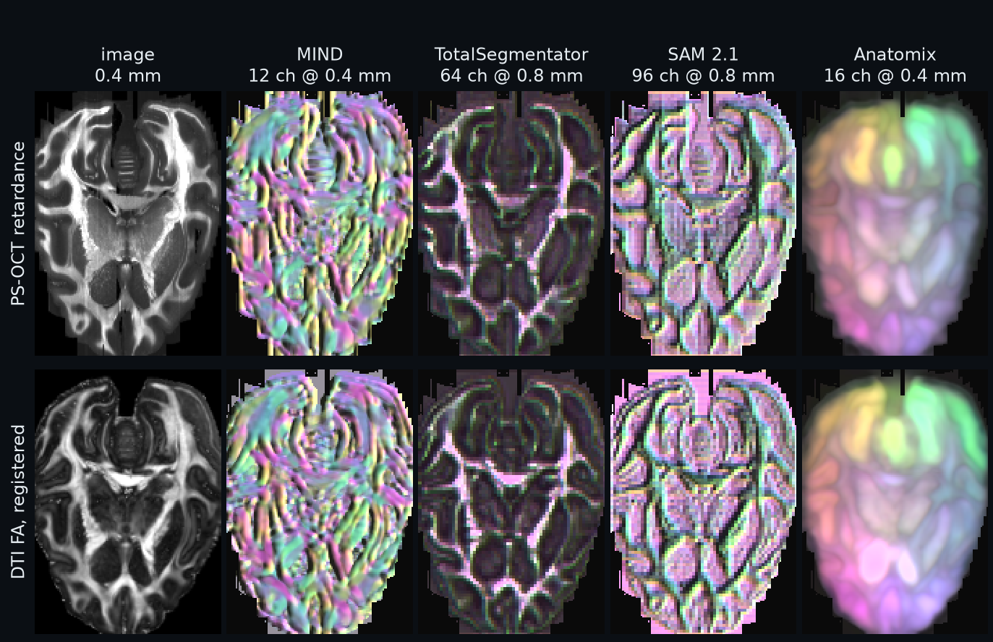
1 · how it works
THE LOSS for every backend, choose what is compared
IMPACT: register on a segmentation model's feature maps
1 · cut into patches
2 · the backend
3 · blend
4 · write the field
+ the loss
THE PROBLEM two modalities share no intensity. THE IDEA the features a segmentation network computes, they do share.
MIND
handcrafted descriptor, no training
TotalSegmentator
3D segmentation network · the default · radiotherapy
SAM 2.1
2D foundation model
Anatomix
3D anatomy foundation features
Static maps computed once · Jacobian gradients through the network
subject_v · itk-impact ImageToFeaturesMap · one colour basis for both rows: same colour, same features
Learn2Reg: 3rd CT lung (2021) · 2nd abdomen MR→CT (2023) · top-6 thorax CBCT (2023)
Fideus Labs · KonfAI · impact-reg-konfai
6
Notes:
(about 50 s)
And now the loss. For every backend, you choose what is compared. The usual choice is intensity: mutual information, cross-correlation. IMPACT is the other choice: it compares feature maps from a pretrained segmentation model.
Why? Because two modalities share no intensity, but the features a segmentation network computes, they do share. Here are our two images, the retardance on top and the registered FA below, through four extractors: MIND, TotalSegmentator, SAM and Anatomix. The colours use the same basis in both rows, so the same colour means the same features, even though the images look nothing alike.
TotalSegmentator is our default. It's what we use in radiotherapy, CT to CBCT and MR to CT, and IMPACT placed well in several Learn2Reg challenges. You can use the maps as they are, that's Static mode, or backpropagate through the network, that's Jacobian mode.

Slide 7
PART 2
Applied to the hackathon data
the BRAIN CONNECTS / LINC hemisphere · 908 GiB of synchrotron X-ray
diffusion MRI onto that X-ray, down to 20 µm
the competition pair · DTI FA onto PS-OCT retardance
Notes:
(about 10 s)
So that's the pipeline. Part two: we applied it to the hackathon data. The LINC hemisphere, the MRI-to-X-ray registration on it, and then the competition pair.

Slide 8
2 · on the hackathon data
THE LINC HEMISPHERE BRAIN CONNECTS · dandiset 001278 · level by level
908 GiB on one 24 GB card
level 4
321 µm
0.22 GiB
whole hemisphere · 2 min 06 s
level 3
161 µm
1.78 GiB
125 tiles · 8 min 27 s
level 2
80 µm
14.2 GiB
zoom, rigid · 17 s
level 1
40 µm
113.6 GiB
294 tiles · 35 min
level 0
20 µm
908.5 GiB
125 tiles, 15 mm window · 14 min
one 24 GB card
fits in memory: one pass
tiled: the same command · log scale
the first stages run in memory, the fine ones in tiles
down the ladder: more tiles, more time; the command and the memory never change
Fideus Labs · KonfAI · impact-reg-konfai
8
Notes:
(about 40 s)
The LINC hemisphere is 908 gigabytes at 20 microns. At level 4 it's small enough to fit in memory, so the affine and the first deformable run on the whole hemisphere in about two minutes. Every level down is eight times bigger, and we run the exact same command with tiles: 125 tiles at level 3, 294 for the zoom, and 125 tiles of level 0 for a fifteen-millimetre window.
The runtime goes up. The command doesn't change, and neither does the memory: one 24-gig GPU.

Slide 9
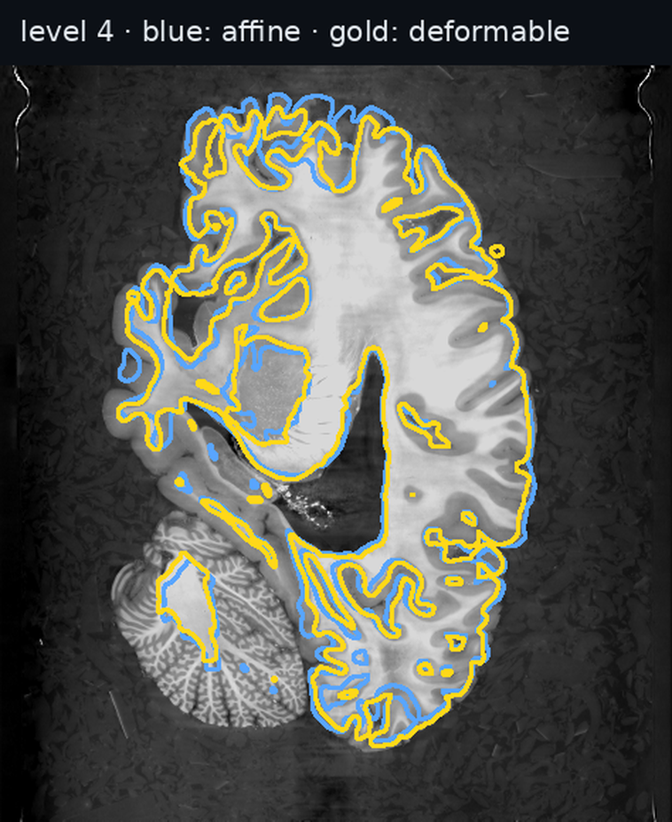
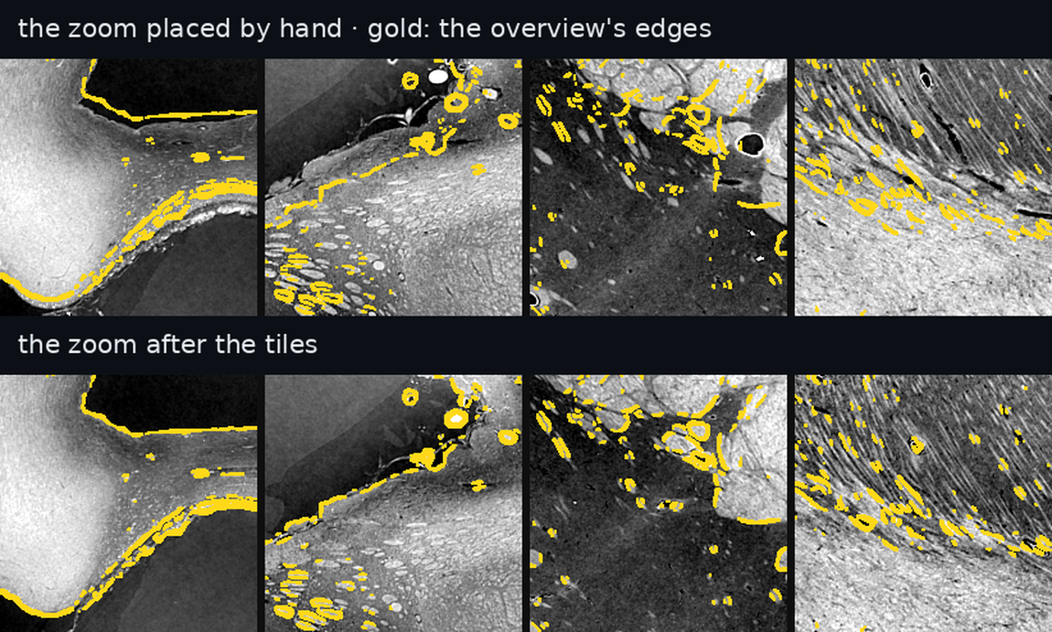
2 · on the hackathon data
THE LINC HEMISPHERE diffusion MRI onto synchrotron X-ray
From the whole hemisphere to 20 µm
level 4 · blue: affine · gold: deformable
zoom 1 on the overview · top: placed by hand · bottom: after 294 tiles
~1 mm → 0
level 4 residual shift
0.45 → <0.02 mm
zoom 1 median residual
19 % → 87 %
zoom edges within one 20 µm voxel
Fideus Labs · KonfAI · impact-reg-konfai
9
Notes:
(about 40 s)
What it looks like. We're bringing ex vivo diffusion MRI, at 0.4 millimetres, onto the X-ray.
On the left, level 4: the MRI contour, in blue after the affine, in gold after the deformable. The residual shift goes from about a millimetre down to basically zero.
On the right, we place a 4.3-micron zoom scan onto the 20-micron overview. On top, the placement by hand: look, the edges sit next to the gold lines. At the bottom, after 294 tiles, they sit right on them. The median error drops from 0.45 millimetres to under one voxel.

Slide 10
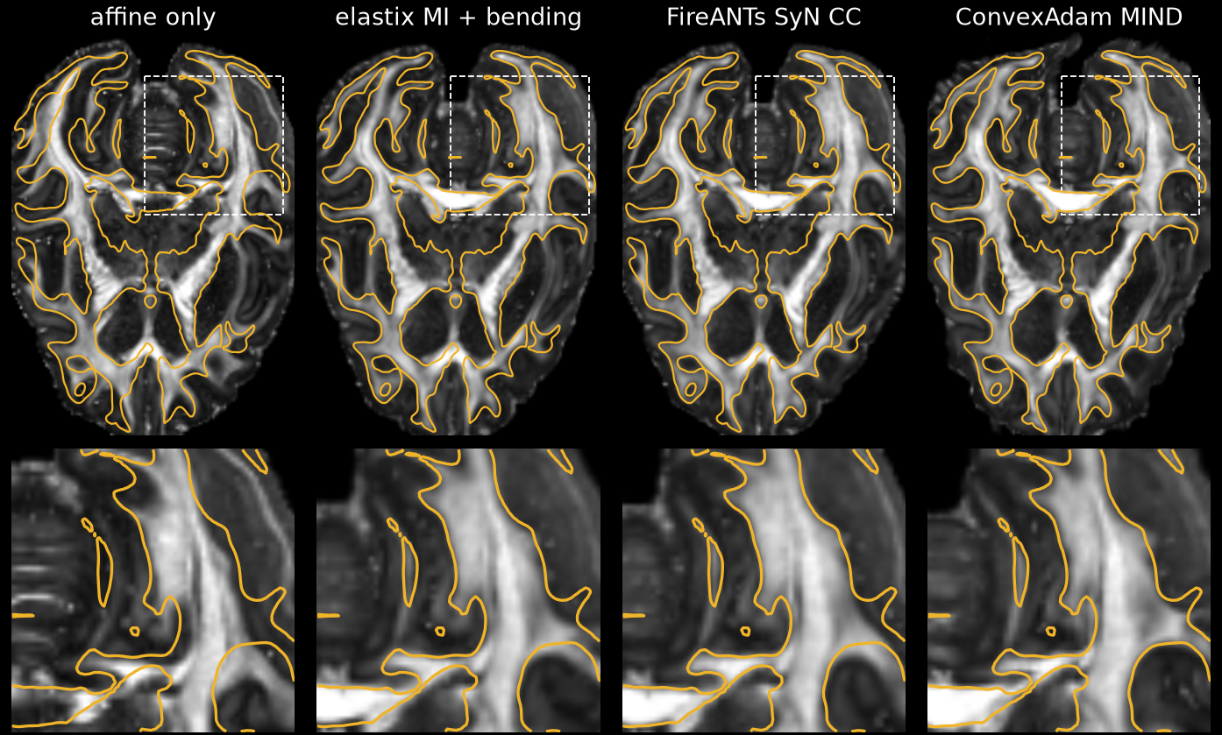
2 · on the hackathon data
THE COMPETITION PAIR DTI FA onto PS-OCT retardance · 0.4 mm grid
Three engines, two subjects
elastix MI + bending
0.40 / 0.40 mm
0 % folded · max 5.0 mm
subject_m: 0.57 / 0.40 mm · 0 % · max 3.8 mm
FireANTs SyN CC
0.40 / 0.40 mm
0 % folded · max 2.7 mm
subject_m: 0.40 / 0.40 mm · 0 % · max 2.1 mm
ConvexAdam MIND
0.57 / 0.40 mm
1.6 % folded · max 13.5 mm
subject_m: 0.57 / 0.40 mm · 1.6 % · max 14.5 mm
subject_v shown; residual = median best shift in 12 mm windows (MI / gradients). Affine alone: 1.26 mm (v), 1.13 mm (m). Our measures, no official criterion.
the retardance's white-matter outline, the same in every panel · grey: the FA after each stage · aligned = the bright tracts lie under the gold lines · bottom: 24 mm zoom
Fideus Labs · KonfAI · impact-reg-konfai
10
Notes:
(about 50 s)
And the competition pair: DTI FA onto PS-OCT retardance, on a 0.4-millimetre grid, with the three backends through the same pipeline.
The gold line is the retardance's white matter, the same in every panel; the grey image is the FA, moving. After the affine alone, look at the zoom: the tract sits next to the gold line. After elastix and FireANTs, it sits right under it.
In numbers, elastix and FireANTs both get down to one voxel with zero folding, and FireANTs does it with the smallest deformation. ConvexAdam aligns the inside too, but it folds a bit of tissue and stretches the edges.

Slide 11
3 · wrap-up
TAKE-AWAYS
One command, any engine, any loss, any size
4 steps
one command
patches, backend, blend, write; and the loss you choose
908 GiB
on one 24 GB card
memory follows the patch, not the volume
OME-Zarr
fields as RFC-5 transforms
or ITK transforms; images from ITK, DICOM, HDF5 or OME-Zarr
pip install impact-reg-konfai "konfai[omezarr,monitoring,s3]" itk-impact
impact-reg-konfai register FireANTs_SyN -f Fixed.ome.zarr -m Moving.ome.zarr -o out --gpu 0
Thank you
Fideus Labs · KonfAI · impact-reg-konfai
11
Notes:
(about 25 s)
To wrap up. Four steps and one command: patches, backend, blend, write, and the loss you choose, with IMPACT comparing what a segmentation model sees. Memory follows the patch, so 908 gigabytes runs on a single 24-gig card. And every field comes out as an OME-Zarr RFC-5 transform, or an ITK transform.
It's all a pip install away, and all the fields from today are shared. Thank you, and I'm happy to take questions.

Slide 12
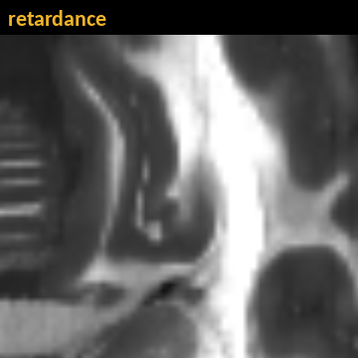
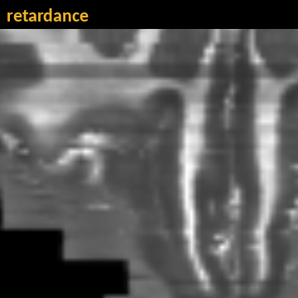
backup
BACKUP for questions
Flicker: retardance and FA on the 24 mm box
affine only
FireANTs SyN CC
subject_v
subject_m
retardance and FA alternate every 0.7 s (plays in slideshow mode) · aligned = the tracts stay put when the image switches
Fideus Labs · KonfAI · impact-reg-konfai
12
Notes:
Only if someone asks. Each box alternates between the retardance and the FA, before and after FireANTs, for both subjects. When the registration is right, the tracts stay put as the image switches; after the affine alone you can see them jump.

