Slide 1
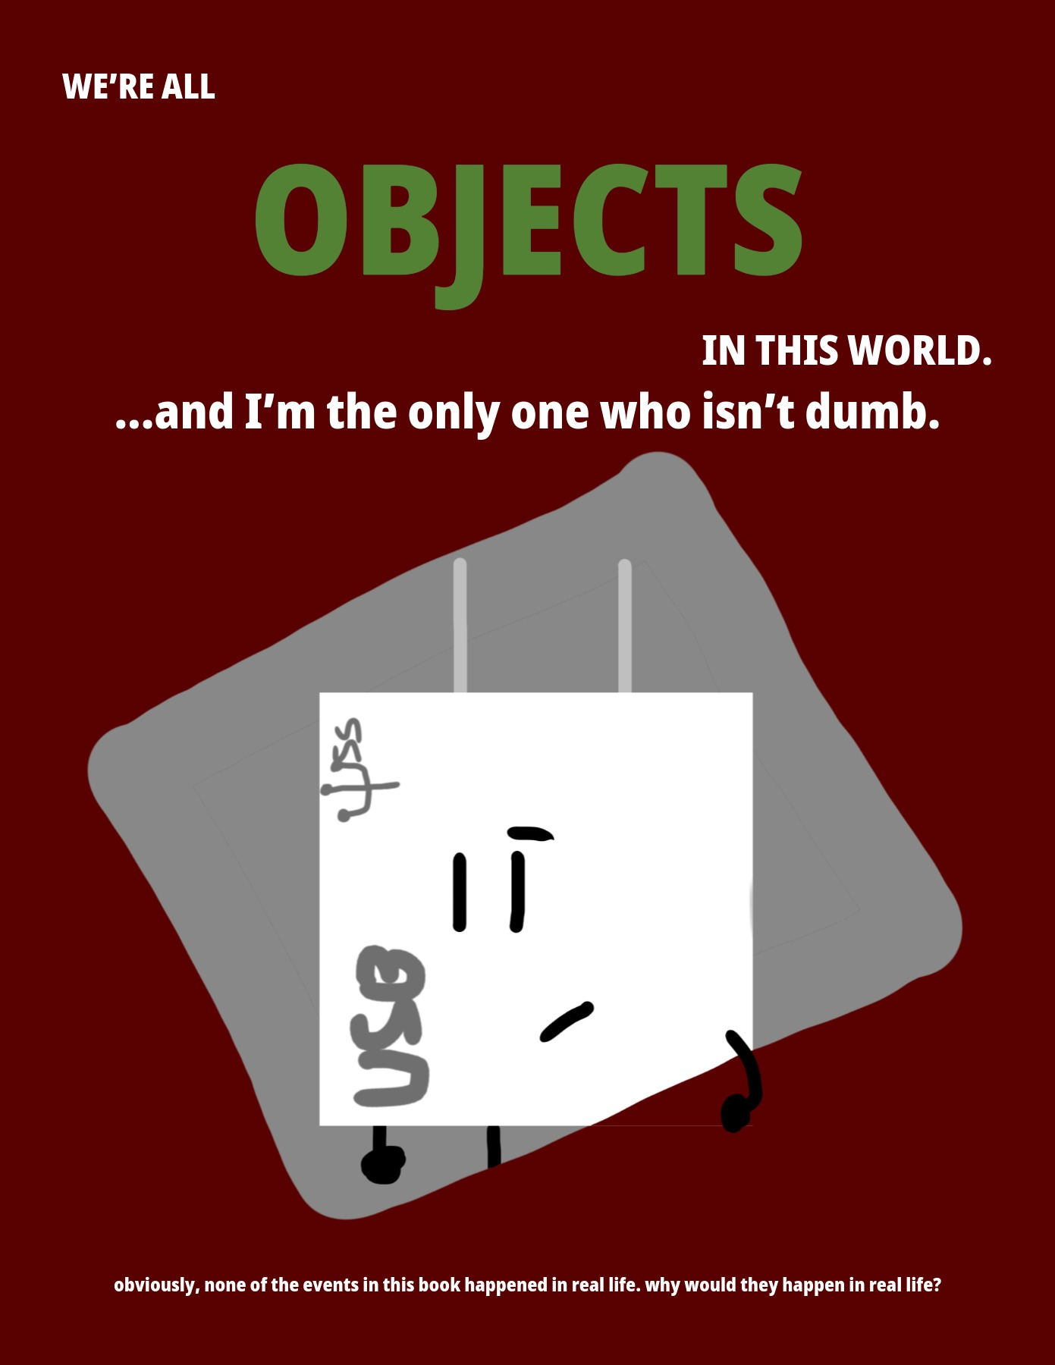
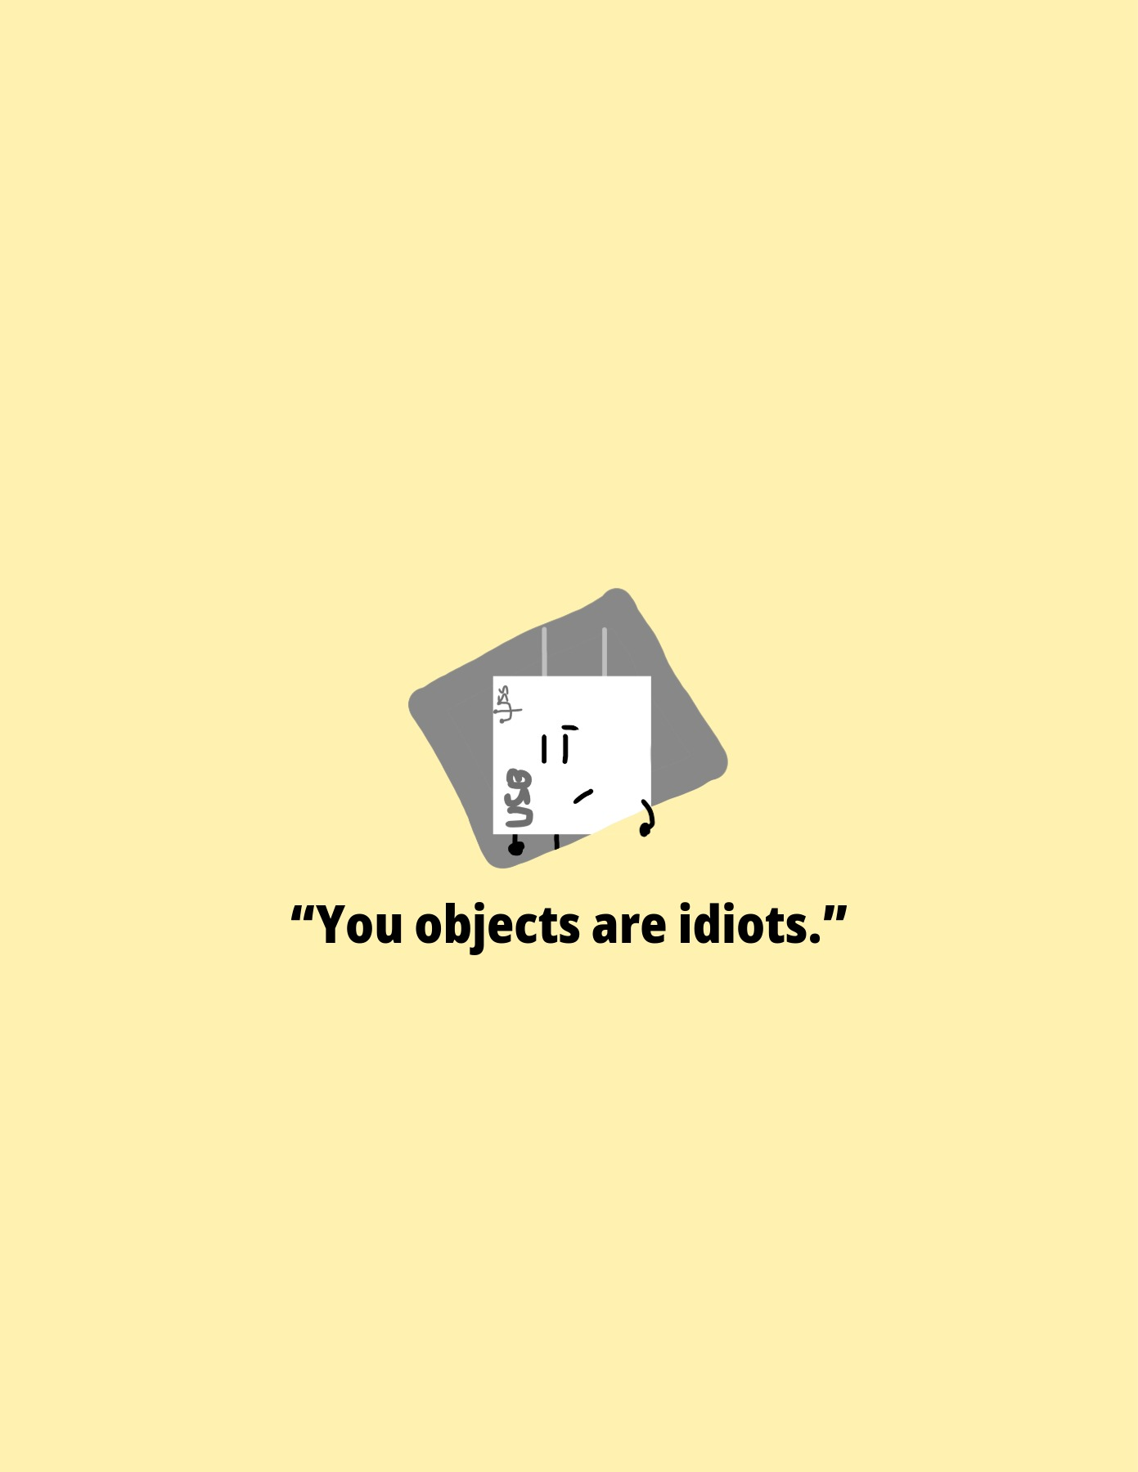
One of my own works, constantly updated
Notes:
--- Page 1 ---
WE’RE ALL
OBJECTS
IN THIS WORLD.
...and I’m the only one who isn’t dumb.
obviously, none of the events in this book happened in real life. why would they happen in real life?
--- Page 2 ---
“You objects are idiots.”

Slide 2
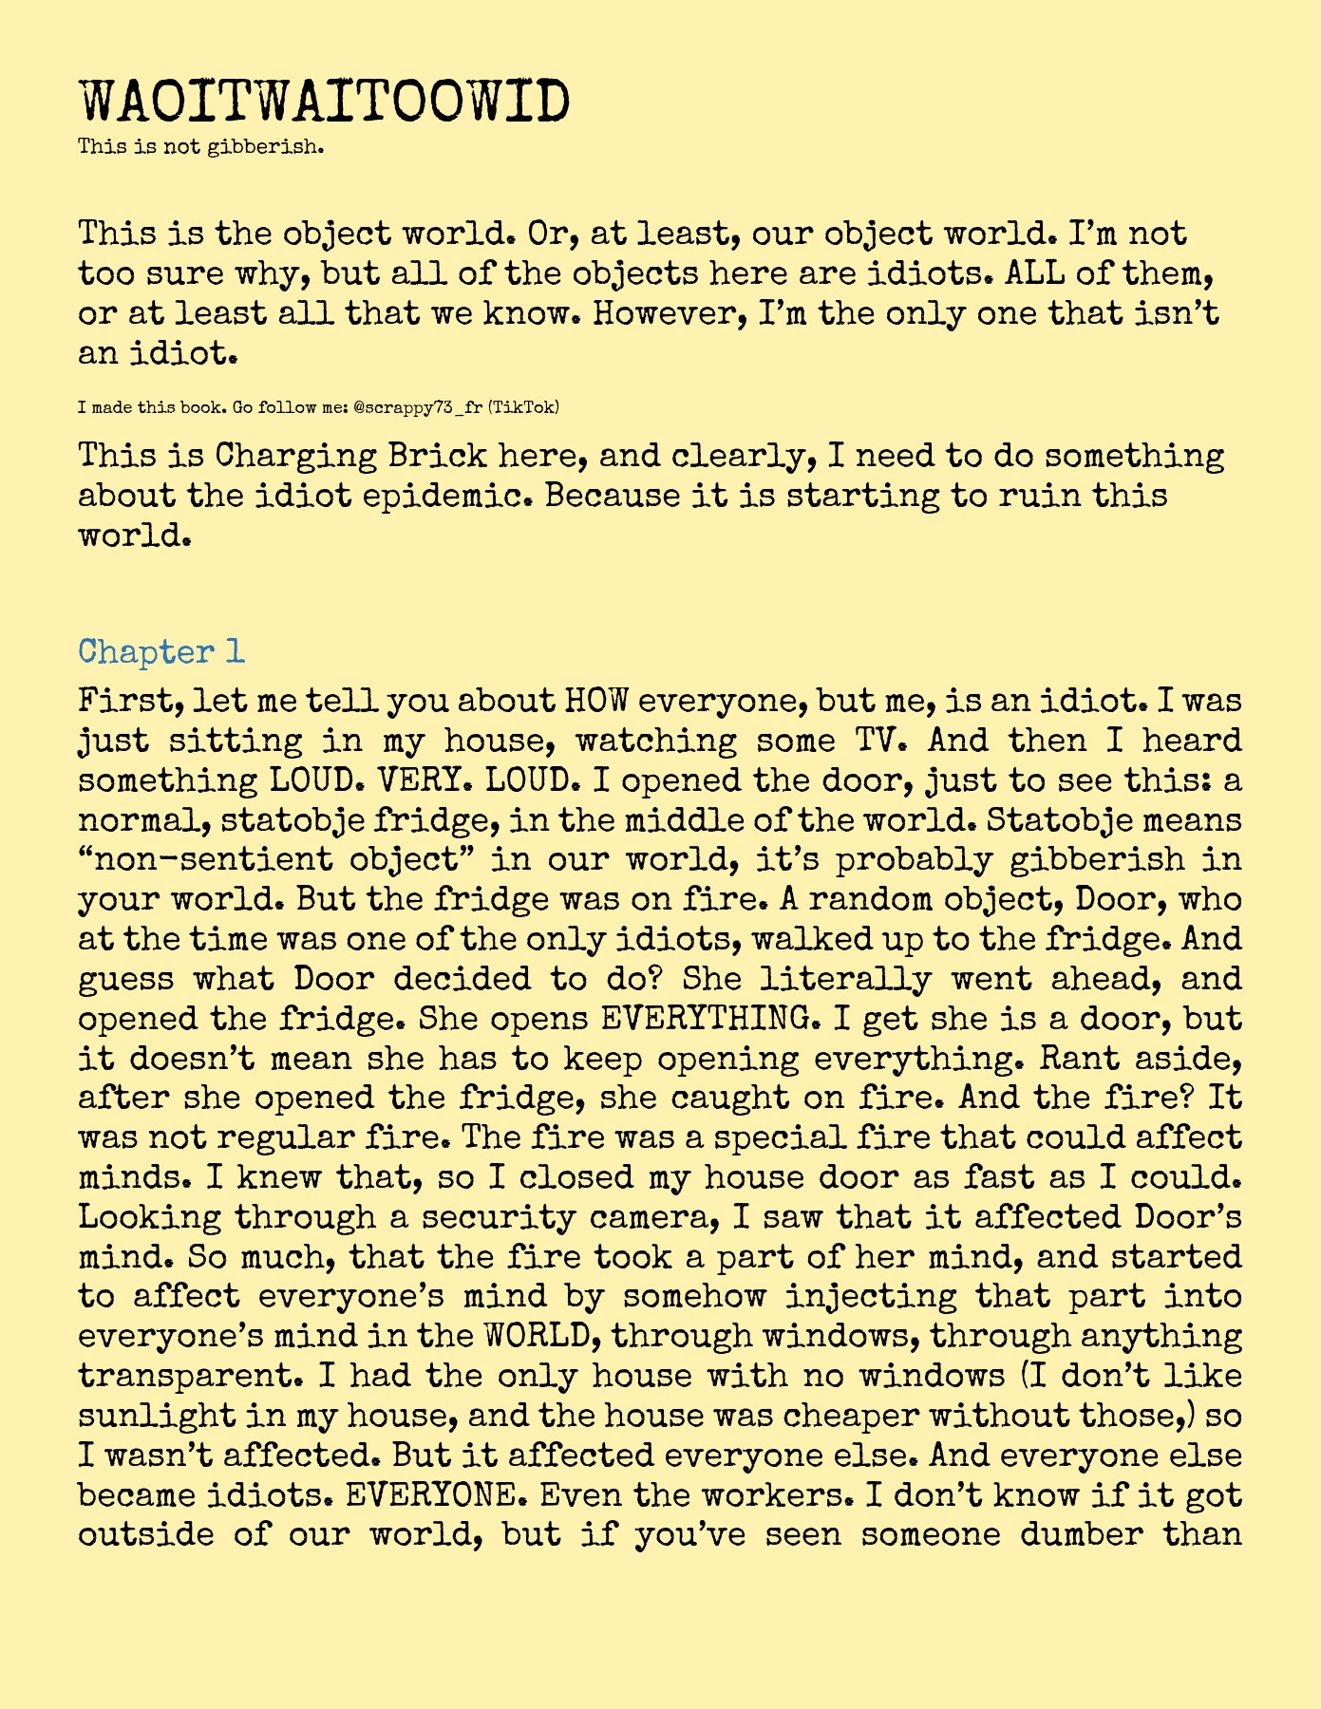
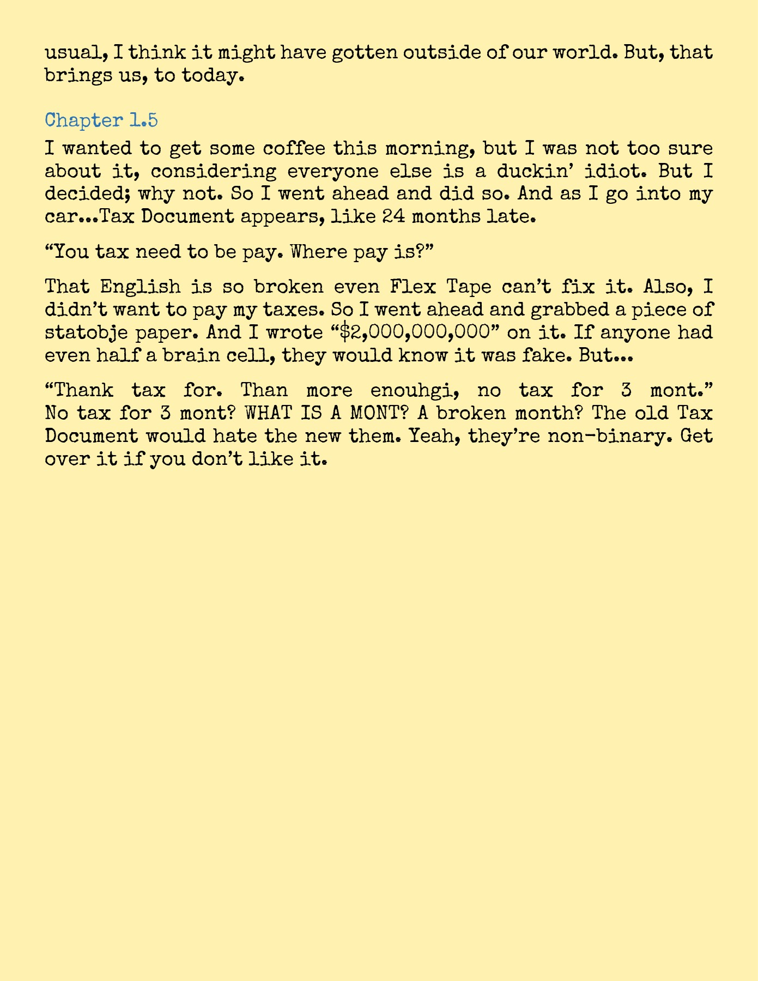
Notes:
--- Page 3 ---
WAOITWAITOOWID
This is not gibberish.
This is the object world. Or, at least, our object world. I’m not
too sure why, but all of the objects here are idiots. ALL of them,
or at least all that we know. However, I’m the only one that isn’t
an idiot.
I made this book. Go follow me: @scrappy73_fr (TikTok)
This is Charging Brick here, and clearly, I need to do something
about the idiot epidemic. Because it is starting to ruin this
world.
Chapter 1
First, let me tell you about HOW everyone, but me, is an idiot. I was
just sitting in my house, watching some TV. And then I heard
something LOUD. VERY. LOUD. I opened the door, just to see this: a
normal, statobje fridge, in the middle of the world. Statobje means
“non-sentient object” in our world, it’s probably gibberish in
your world. But the fridge was on fire. A random object, Door, who
at the time was one of the only idiots, walked up to the fridge. And
guess what Door decided to do? She literally went ahead, and
opened the fridge. She opens EVERYTHING. I get she is a door, but
it doesn’t mean she has to keep opening everything. Rant aside,
after she opened the fridge, she caught on fire. And the fire? It
was not regular fire. The fire was a special fire that could affect
minds. I knew that, so I closed my house door as fast as I could.
Looking through a security camera, I saw that it affected Door’s
mind. So much, that the fire took a part of her mind, and started
to affect everyone’s mind by somehow injecting that part into
everyone’s mind in the WORLD, through windows, through anything
transparent. I had the only house with no windows (I don’t like
sunlight in my house, and the house was cheaper without those,) so
I wasn’t affected. But it affected everyone else. And everyone else
became idiots. EVERYONE. Even the workers. I don’t know if it got
outside of our world, but if you’ve seen someone dumber than
--- Page 4 ---
usual, I think it might have gotten outside of our world. But, that
brings us, to today.
Chapter 1.5
I wanted to get some coffee this morning, but I was not too sure
about it, considering everyone else is a duckin’ idiot. But I
decided; why not. So I went ahead and did so. And as I go into my
car...Tax Document appears, like 24 months late.
“You tax need to be pay. Where pay is?”
That English is so broken even Flex Tape can’t fix it. Also, I
didn’t want to pay my taxes. So I went ahead and grabbed a piece of
statobje paper. And I wrote “$2,000,000,000” on it. If anyone had
even half a brain cell, they would know it was fake. But...
“Thank tax for. Than more enouhgi, no tax for 3 mont.”
No tax for 3 mont? WHAT IS A MONT? A broken month? The old Tax
Document would hate the new them. Yeah, they’re non-binary. Get
over it if you don’t like it.

Slide 3
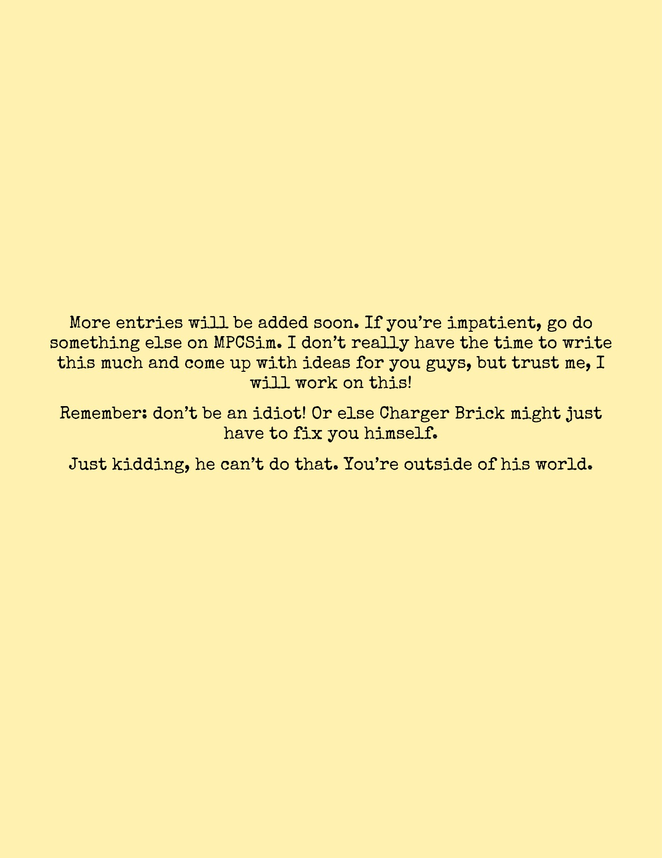
Notes:
--- Page 5 ---
More entries will be added soon. If you’re impatient, go do
something else on MPCSim. I don’t really have the time to write
this much and come up with ideas for you guys, but trust me, I
will work on this!
Remember: don’t be an idiot! Or else Charger Brick might just
have to fix you himself.
Just kidding, he can’t do that. You’re outside of his world.

