Slide 1
Cracking the Coding Interview
Diego Aguirre

Slide 2
Problem Solving
IDEAL is nice and helpful, but is that all we need to solve hard programming problems?
What’s missing?

Slide 3
Problem Solving
Remember the E in IDEAL?

Slide 4
Problem Solving
Explore possible strategies or solutions
Nice…, but HOW?
It would be nice to have a sub-framework here for coding problems

Slide 5
Problem Solving
If we were to come up with a framework to solve coding questions, what MUST be in it?
Teams … Discuss

Slide 6
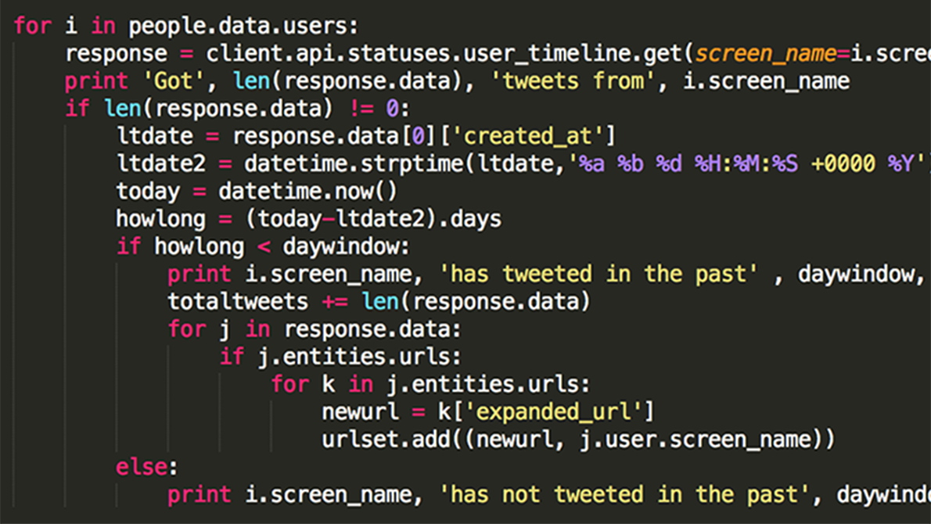

Duke’s 7 steps

Slide 7
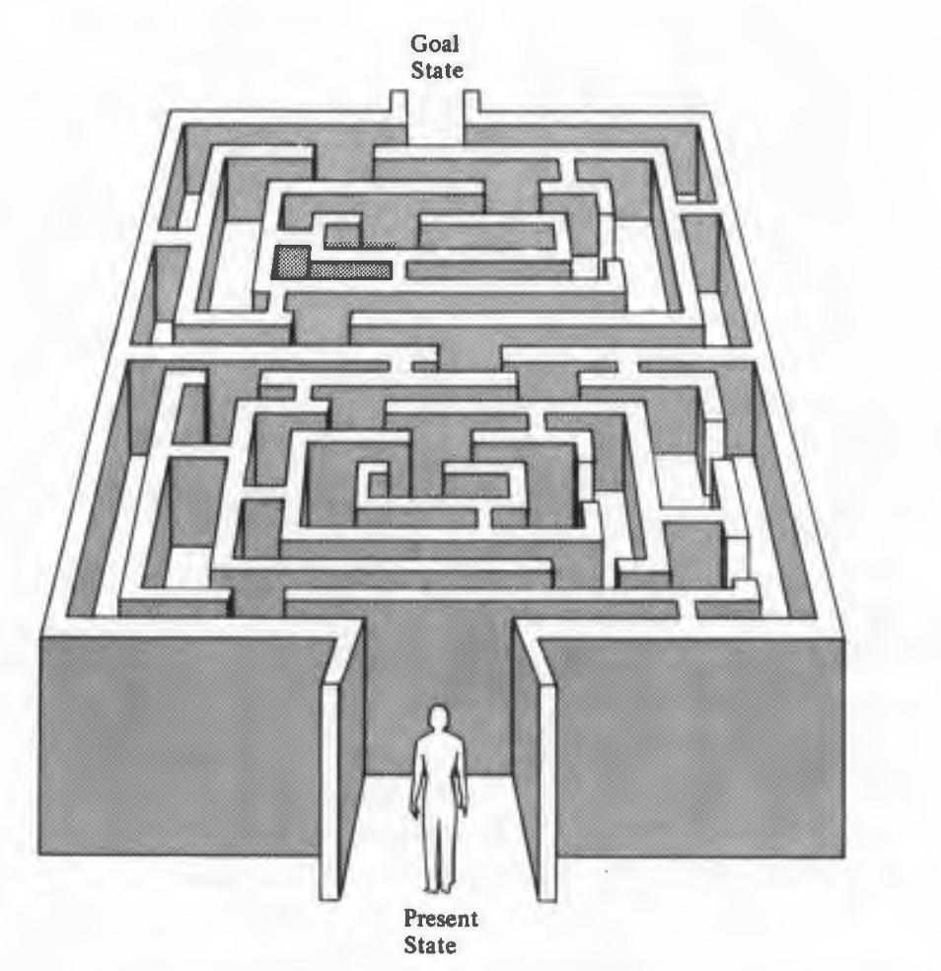
I D E A L
Source: The IDEAL Problem Solver

Slide 8
Duke’s 7 steps
There is a huge gap!
How do we approach it?
With practice, everything is going to feel more natural

Slide 9
Duke’s 7 steps
Step 1 … Any guesses?

Slide 10
Duke’s 7 steps
Step 1: Work some small instances by hand
Remember the TwoSum problem?
String representation problem?
hello -> h3o
problem -> p5m
solving -> s5g

Slide 11
Duke’s 7 steps
Step 1: Work some small instances by hand
Unclear problem?
Ask clarification questions!

Slide 12
Duke’s 7 steps
Step 1: Work some small instances by hand
What if you are doing a simulation?
… and you need to know some physics?
Get all the external/domain knowledge you need

Slide 13
Duke’s 7 steps
Step 2: Write down what you did
You don’t have to solve the general problem
Write down the steps you followed to solve the small instances of the problem

Slide 14
Duke’s 7 steps
Step 2: Write down what you did
Tricky part/potential pitfall:
We, humans, do a lot of things without really thinking about them consciously. We just naturally do them…
Chess vs. Go?
Can you come up with some examples of this?

Slide 15
Duke’s 7 steps
Step 2: Write down what you did
Tricky part/potential pitfall:
The computer doesn’t have common sense… We have to be super specific

Slide 16
Duke’s 7 steps
Step 3: Find Patterns
Look at the steps we wrote in step 2 and find patterns
Repetition -> loops
Conditions -> if statements / case analysis?
Do we need to store the data? Access it? Manipulate it? -> data structures
Generalize and write down the algorithm that solves the general problem

Slide 17
Duke’s 7 steps
Step 3: Find Patterns
If this is too difficult, go back to steps 1 and 2.
Remember, building an algorithm is like building a house, you need to know what tools are available and how to use them.
Solving a lot of other problems will help you solve new ones!

Slide 18
Duke’s 7 steps
Step 3: Find Patterns
Similar patters appear in many different programming questions (even though they might seem very different to each other at the beginning).

Slide 19
Duke’s 7 steps
Step 4: Check by hand
We now have an algorithm to solve the general problem
Trace it using some small instances of the problem
Some people can do this in their heads for simple algorithms. If you can’t, that’s fine, take a piece of paper and trace it there. Excellent problem solvers have excellent tracing skills… You might think that tracing is not that important, but it’s extremely important!
You DON’T HAVE to do everything in your head. We have limited short-term memory, use a whiteboard / piece of paper, etc
The more you do this, the easier it will become to visualize/understand algorithms

Slide 20
Duke’s 7 steps
Step 5: Translate to Code
Confident in your algorithm, translate it to code
Code depends on programming language, so make sure you know how to translate the algorithm to that language. If you don’t know something (syntax), Google it!
Then…. Execute it multiple times! Use interesting inputs

Slide 21
Duke’s 7 steps
Step 6: Run Test Cases
Execute it multiple times! Use interesting inputs
How do we pick interesting inputs?
Teams... Discuss..

Slide 22
Duke’s 7 steps
Step 6: Run Test Cases
Execute it multiple times! Use interesting inputs
How do we pick interesting inputs?
Try to break your own code!
Think about edge cases

Slide 23
Duke’s 7 steps
Step 7: Debug Failed Test Cases
How do you debug code?
Teams… discuss..

Slide 24
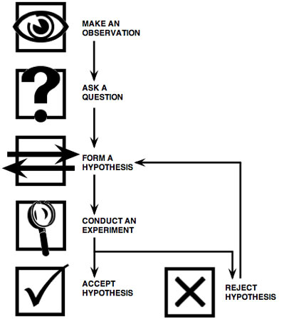
Duke’s 7 steps
Step 7: Debug Failed Test Cases
Apply scientific method

Slide 25
Duke’s 7 steps
Step 7: Debug Failed Test Cases
What types of problems can cause a program to crash/fail?
Let’s try to generalize and group the types of errors we have encountered
Teams… Discuss..

Slide 26
Duke’s 7 steps
Step 7: Debug Failed Test Cases
Syntax errors
Runtime errors
Logical errors

Slide 27
Duke’s 7 steps
Step 7: Debug Failed Test Cases
Syntax errors
Runtime errors
Logical errors

Slide 28
Duke’s 7 steps
Step 7: Debug Failed Test Cases
Syntax errors
leaving out a keyword
putting a keyword in the wrong place
leaving out a symbol, such as a colon, comma or brackets
misspelling a keyword
incorrect indentation
empty block

Slide 29
Duke’s 7 steps
Step 7: Debug Failed Test Cases
Runtime errors
a problem which was not detected when the program was parsed, but is only revealed when a particular line is executed. When a program comes to a halt because of a runtime error, we say that it has crashed.

Slide 30
Duke’s 7 steps
Step 7: Debug Failed Test Cases
Runtime errors
division by zero
performing an operation on incompatible types
using an identifier which has not been defined
accessing a list element, dictionary value or object attribute which doesn’t exist
trying to access a file which doesn’t exist

Slide 31
Duke’s 7 steps
Step 7: Debug Failed Test Cases
Logical Errors
Most difficult to fix.
The program runs without crashing, but produces an incorrect result.
Error in the program’s logic

Slide 32
Duke’s 7 steps
Step 7: Debug Failed Test Cases
Logical Errors
using the wrong variable name
indenting a block to the wrong level
using integer division instead of floating-point division
getting operator precedence wrong
making a mistake in a boolean expression
off-by-one, and other numerical errors

Slide 33
Duke’s 7 steps
Step 7: Debug Failed Test Cases
Syntax or Runtime error -> Back to Step 5
Logical error -> Back to Step 3

