Slide 1
Cracking the Coding Interview
Diego Aguirre

Slide 2
Problem Solving
There is little consensus in how to organize concepts, techniques, approaches, etc. in problem solving.
Different people have come up with different strategies. Some may categorize methods as separate while others may see them as sub-categories.

Slide 3
Problem Solving
Can we use the same framework to solve hard physics problems and hard computer science problems?
What’s different?

Slide 4
Problem Solving
Abstract / Generalize what is common
Specialized sub-categories for domain-dependent problems

Slide 5
Problem Solving
If we were to come up with a general problem-solving framework, what MUST be in it?
Teams … Discuss

Slide 6
Problem Solving
How many of you have heard about IDEAL?

Slide 7
Strategy
We are going to start with a simple problem-solving strategy or framework
IDEAL

Slide 8
I D E A L
Can you guess what the I stands for?

Slide 9
I D E A L
Identify the Problem

Slide 10
I D E A L
Let’s define the word Problem
What does the word Problem mean?

Slide 11
I D E A L
Problem:
A matter or situation regarded as unwelcome or harmful and needing to be dealt with and overcome.
The difference between what is observed and what is expected.
The discrepancy between “what we get and what we want.”

Slide 12
I D E A L
Problem:
A problem exists when there is a discrepancy between an initial state and a goal state

Slide 13
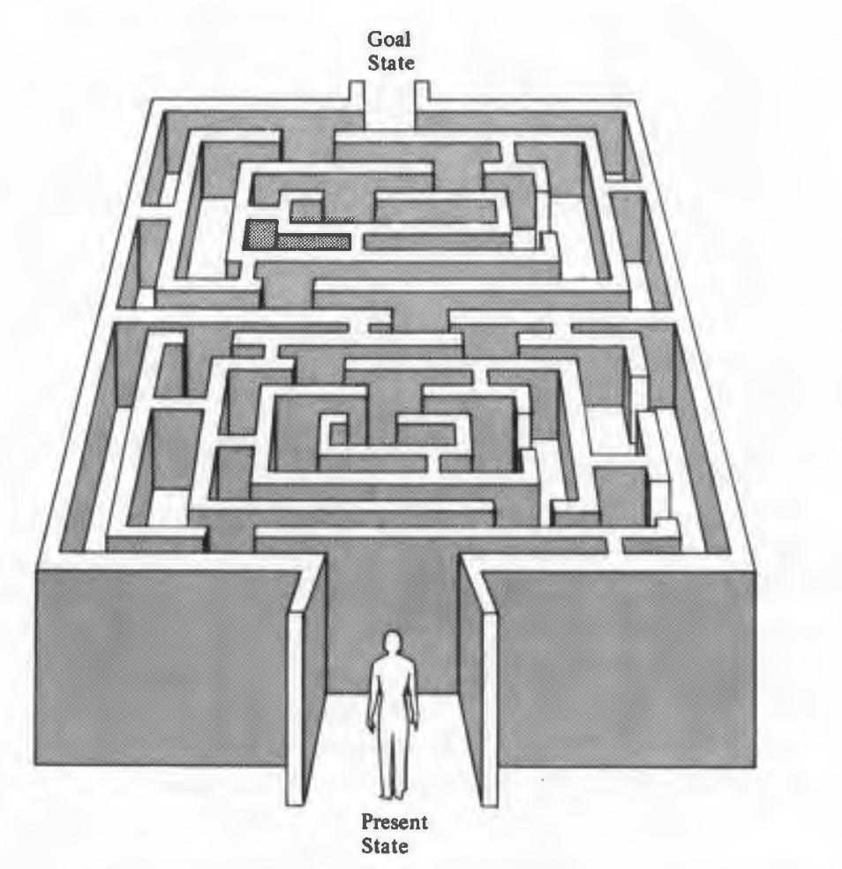
I D E A L
Source: The IDEAL Problem Solver

Slide 14
I D E A L
Identify the Problem
Problems are often
ill-stated
unclear
understated

Slide 15
I D E A L
Before solving a problem, we need to understand it!
What does it mean to understand a problem?

Slide 16
I D E A L
Before solving a problem, we need to understand it!
What does it mean to understand a problem?
Implications
Understanding a problem -> Understanding what factors/components make it harmful/unwelcomed

Slide 17
I D E A L
In this stage, we sense the existence of a problem

Slide 18
I D E A L
Can you guess what the D stands for?

Slide 19
I D E A L
Define your goals

Slide 20
I D E A L
Define your goals
Once you understand the problem, you need to think about the format of the solution.
How does a solution look like?
What do you want to happen?

Slide 21
I D E A L
Traveling Salesman Problem?
What is your goal?
How does the solution look like?

Slide 22
I D E A L
Source: The IDEAL Problem Solver

Slide 23
I D E A L
Can you guess what the E stands for?

Slide 24
I D E A L
Explore possible strategies or solutions

Slide 25
I D E A L
Source: The IDEAL Problem Solver

Slide 26
I D E A L
This often involves a reanalysis of your goals
options or strategies to achieve those goals

Slide 27
I D E A L
Good problem solvers break problems into smaller ones…
Teams: Come up with a CS related example

Slide 28
I D E A L
Some times, we cannot do everything in our heads!
What day follows the day before yesterday if two days from now will be Sunday?
Need external tools

Slide 29
I D E A L
A man had four chains, each three links long. He wanted to join the four chains into a single, closed chain. Having a link opened cost 2 cents and having a link closed cost 3 cents. The man had his chains joined into a closed chain for I 5 cents. How did he do it?

Slide 30
I D E A L
Another general strategy that good problem solvers often use is to work out a complex or abstract problem by focusing on a simpler, specific situation.
Can you give me a CS related example? Teams

Slide 31
I D E A L
You are the director for an upcoming racquetball tournament, and I03 people have entered the open single-elimination tournament (after losing once, the player is eliminated).
If you need a score card for each match, how many cards will you need if each player shows up?

Slide 32
I D E A L
So far we have seen general strategies, like working out small examples or using external resources. However, good problem solvers use specialized knowledge.
Example:
How does Google Maps know what the best route is?
How do physicists solve complex problems?
How do doctors diagnose patients?

Slide 33
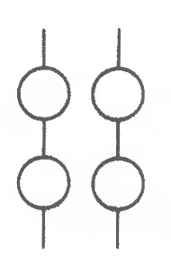
I D E A L

Slide 34
I D E A L
The main point here is:
Good problem-solvers must become effective at learning about relevant conceptual tools

Slide 35
I D E A L
A?

Slide 36
I D E A L
Anticipate Outcomes and Act

Slide 37
I D E A L
Once a strategy is selected, it is important to anticipate possible outcomes and then act on that strategy.
Does my code work for interesting inputs?
Whiteboard example

Slide 38
I D E A L
L?

Slide 39
I D E A L
Look and learn

Slide 40
I D E A L
Look at the actual effects of your strategy and learn from the experience.

