Slide 1
A.Rundgren 2022-11-08
Combining FIDO®/CTAP2 with a Payment Wallet
This presentation outlines how the FIDO®/CTAP2 API and the W3C WebAuthn
standard could be augmented with meta data holding virtual payment cards.
The authorization system builds on an enhanced EMV® concept, where a card can represent any account based payment scheme, including the international card networks and SEPA, as well as national networks.
Although not shown here, a card is after registration, also intended to be usable
for payments at the counter (POS). P2P payment support is also in scope.
A detailed description of the actual data exchanges and wallet data is available at:
https://fido-web-pay.github.io/
Anders Rundgren 2022-11-16
FIDO and EMV are registered trademarks of the FIDO alliance and EMVCo respectively

Slide 2
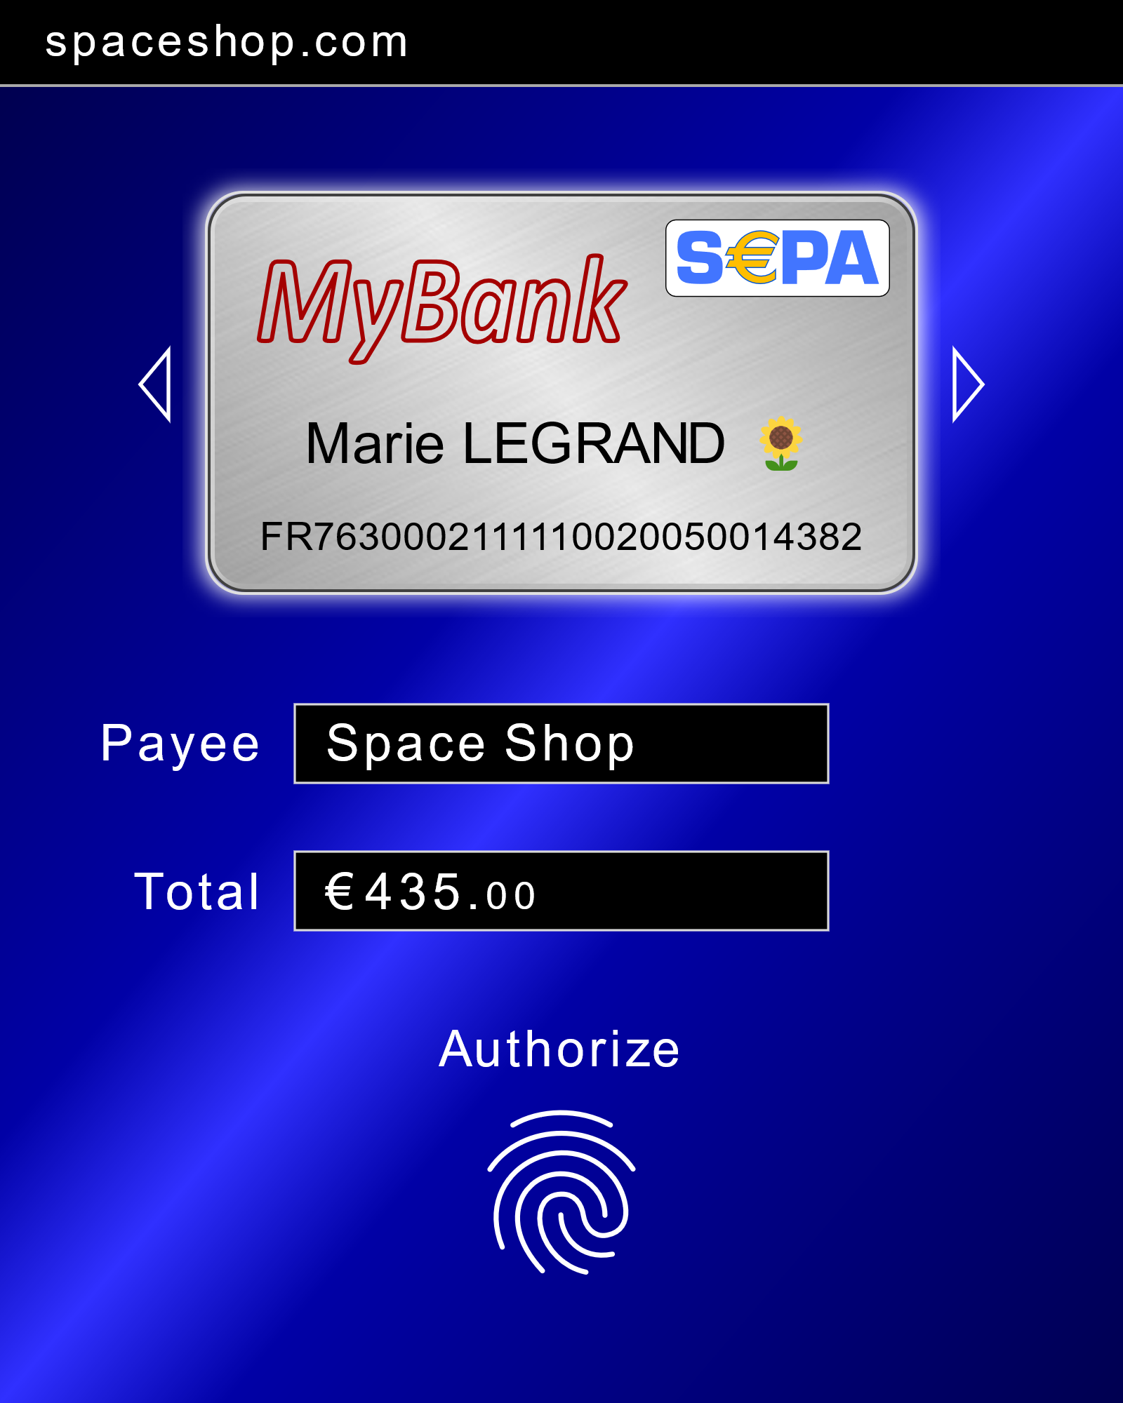
Wallet – Non-normative UI Sample
Merchant host name
Swipeable list of virtual cards *
Integrated payment experience extending the UI compared to current payment terminals.
The very same UI and security solution is used regardless if
paying online or locally.
Merchant common name
Amount to pay
Activates the authorization key
* Only cards matching the payment networks supported by the merchant will be shown

Slide 3
Wallet – Enhancement of EMV Card Data
EMV Account ID (PAN)
nnnnnnnnnnnnnnnn
FIDO Web Pay “Decomposed” Counterpart
Payment network compatible account identifier. Examples: FR7630004003200001019471656 for a French IBAN and 4111111111111111 for a VISA card.
Account ID
Account Identifier String
Payment network identifier. Examples: https://banknet2.org for a hypothetical bank network and visa for the VISA network.
Payment Network ID
URL or Specfic String
Issuer ID
URL String
URL to an issuer endpoint like: https://mybank.fr/payment.
This solution eliminates Account ID to issuer URL lookup databases.
That is, the only thing that separates card authorizations from authorizations of account-to-account payments are the variables above. However, from the users’ perspective, only card images differ.

Slide 4




Wallet – Virtual Card Enrollment
Wallet with Virtual Cards
Client Platform
User
Signature Keys
Browser
Issuer
Credential
database
Signup
Web code
Issuer specific signup application
W3C
WebAuthn
"register"
Authorize
CTAP2
Result (attestationObject)
credentialId, publicKey,
…
Store credential data
store()
Wallet Web API (TBD)
Provides rpId, filtering issuers
from each other
Create virtual card(s)
Store virtual card data and
associate each card with a credentialId and rpId
[{
credentialId: …, cardData: {
encryptionKey: …,
other data
}
}]
Lookup of credentialId/rpId
CTAP2
Result
Result
Success or failure

Slide 5


Wallet – Online Payment Authorization
Wallet with Virtual Cards
Client Platform
User
Signature Keys
Browser
Merchant
PSP
Issuer
Pay!
Web code
Merchant specific shopping application
W3C PaymentRequest API
Result
Credential
database
show()
AuthZ
PSP request
Wallet UI
AuthZ
Issuer request
Select card
(optional)
AuthZ
Authorize
Decrypt and validate authorization
Retrieve associated credentialId/rpId
End-to-end security and confidentiality
Perform payment
Collect payment data to sign
CTAP2
Status
getAssertion()
AuthZ
Status
Status (to user)
Encrypt authorization

