Slide 1
RepVGG: Making VGG-style ConvNets Great Again
Xiaohan Ding, Xiangyu Zhang, Ningning Ma, Jungong Han, Guiguang Ding, Jian Sun
Conference on Computer Vision and Pattern Recognition 2021
Last revised on arXiv on: 29 March 2021
Repository: https://github.com/DingXiaoH/RepVGG
Notes:
Visual Geometry Group, Department of Engineering Science, University of Oxford
This paper originates from Beijing, Hong Kong, UK

Slide 2
Agenda
Motivation
Fundamentals
Approach
Experiments
Highlights and Weaknesses
Conclusion

Slide 3
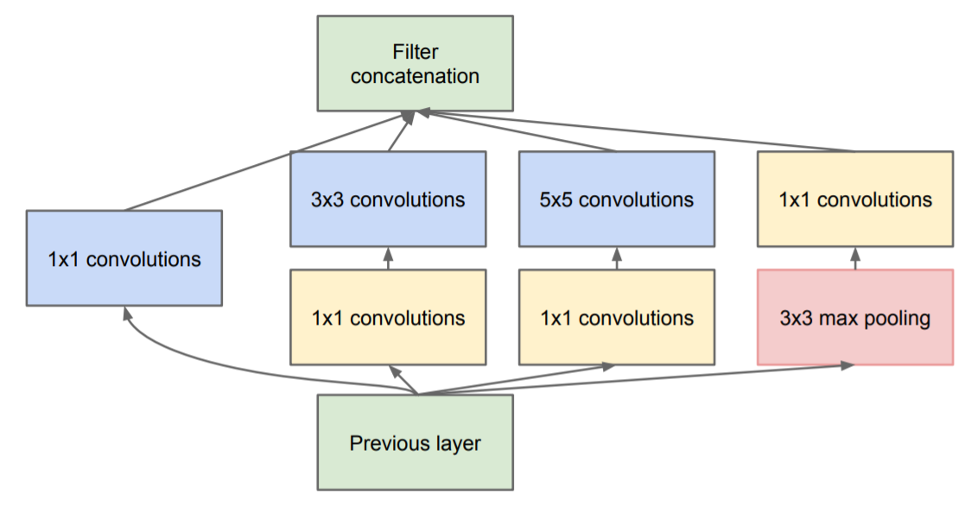
Motivation
VGG [1]
Inception (GoogLeNet) [2]
Prefer deep CNNs with small receptive fields over shallow CNNs with bigger receptive fields
Uses only simple convolutional, max-pooling and fully-connected layers
ImageNet top-5 test error: 7.32
ImageNet top-5 test error: 6.67
Notes:
VGG (2014):
Strenghten the discriminative character of the network as the non-linear activation function ReLU is applied more often
Number of parameters to train is lower
Inception(2014):
Inception modules:
1x1 convolutions for dimension reduction over the channel size
Detect cross-channel correlations
Better detect spatial correlations and objects at various scales, apply kernels of various scales simultaniously
Branch concatenation
Split-Transform-Merge

Slide 4
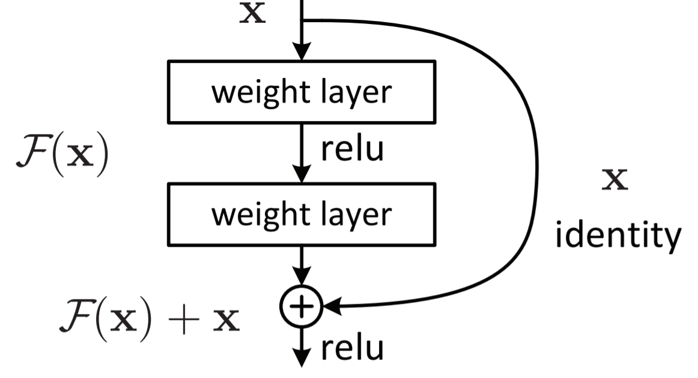
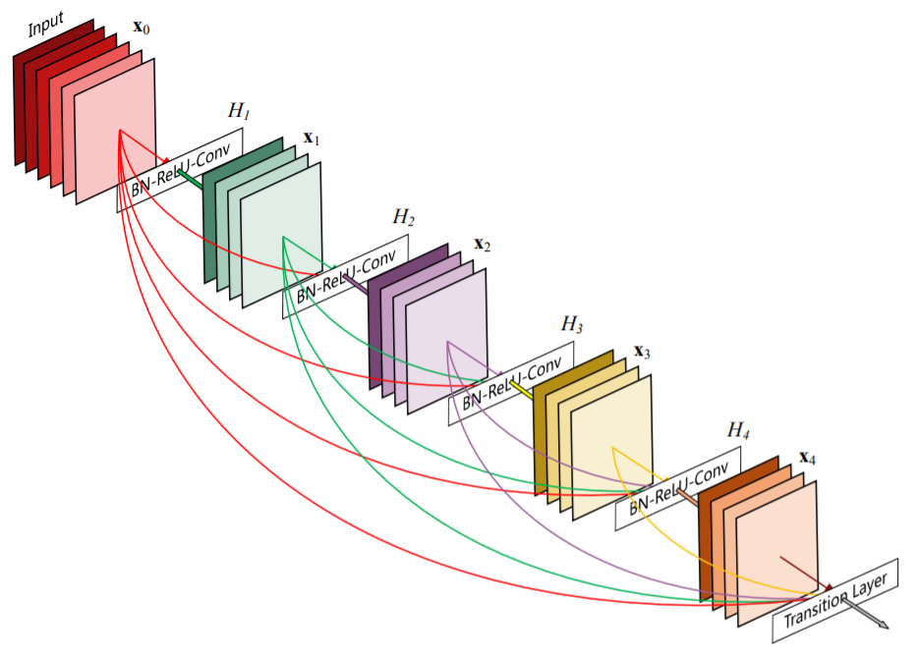
Motivation
ResNet [3]
DenseNet [4]
Solved the degradation problem by introducing shortcut connections
ImageNet top-5 test error: 3.57
Stronger feature propagation through densely connected layers
Outperforms ResNet on ImageNet val. dataset
Notes:
ResNet (2015):
Degradation problem: Ideal mapping was learned up until a certain depth by shallow layers, remaining layers struggle to learn implicit identity mapping through several non-linearity steps =>Loss curve during training ascents again
Set weights of residual components to zero and realize an identity function
Early layers receive much more training signal (solves vanishing gradient problem)
Implicit ensemble of multiple smaller networks
Many paths through the network, but only 0.45% are valid ones (contribute much to the gradient), predominantly short paths
Still keeps complexity eight times lower than VGG for a single net
DenseNet (2016)

Slide 5
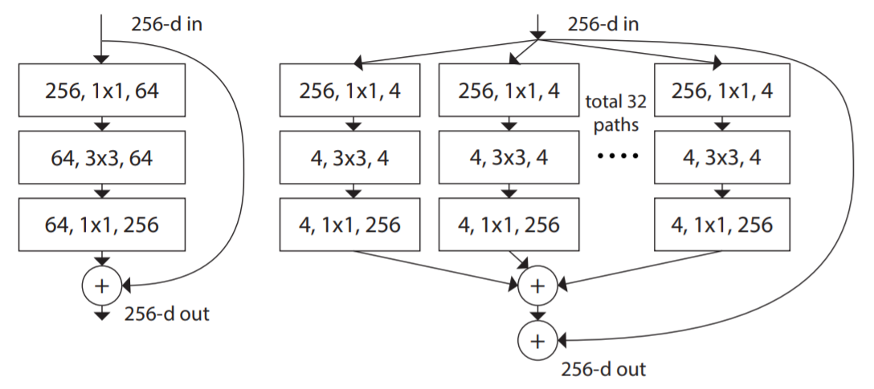
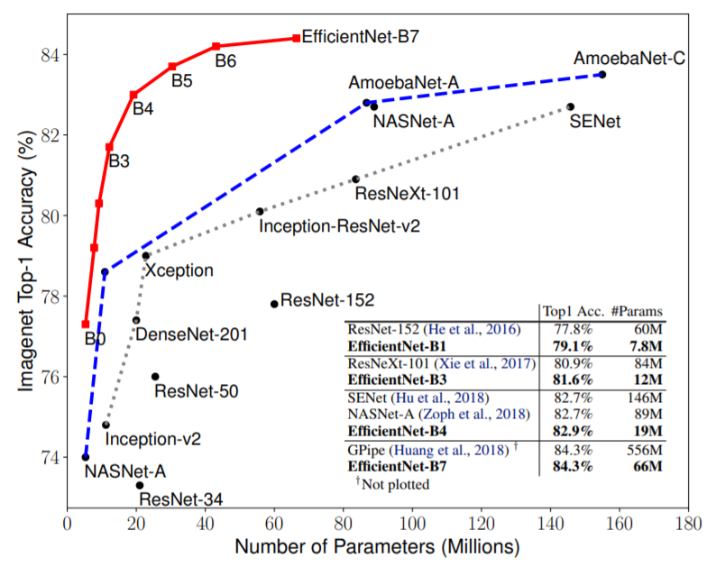
Motivation
ResNeXt [5]
EfficientNet [6]
Cardinality dimension: size of the set of transformations
Increase cardinality instead of depth or width
Compound scaling method: uniform scaling in depth, width and resolution
ImageNet top-1 accuracy: 84.3 (B7)
Notes:
ResNeXt (2016):
Much more efficient
EfficientNet (2019):
Again fewer parameters to train

Slide 6
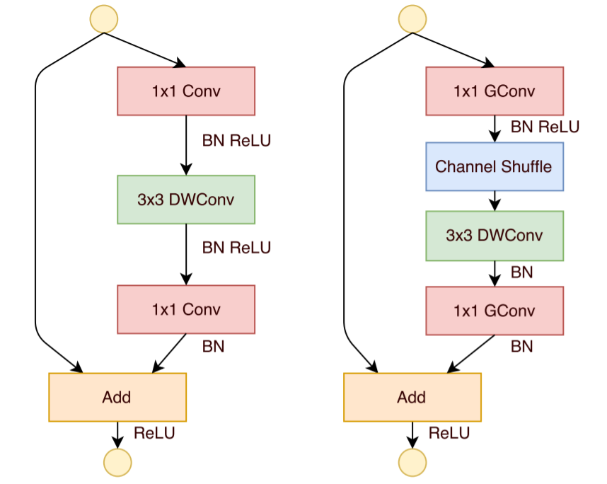
Motivation
Xception [7]: depthwise separable convolutional layers
MobileNet [8]: depthwise separable convolutional layers using pointwise convolutions, width multiplier, resolution multiplier
ShuffleNet [9]: depthwise separable convolutional layers, pointwise group convolution, channel shuffling
NASNet [11]: utilize neural architecture search
RegNet [12]: design network design spaces
Evolutionary algorithms [13]
…
Notes:
Xception (2016):
Similar to inception modules, but first convolutes spatially and afterwards the channels using poitwise 1x1 convolution without using non-linearity in between
Maps spatial and cross-channel correlations completely separately
Stack several depthwise separable convolutional layers with residual connections
Only negligible improvements compared to Inception v3
MobileNet (2017):
Use depthwise separable convolutional layers in their nature of data reduction (1x1 conv) to make CNNs accessible for mobile devices and embedded systems
Width (channels), resolution multiplier: achieve better accuracy-speed tradeoff (latency vs. size)
In terms of accuracy MobileNet can be compared to VGG16 while being 32 times smaller and 27 times less computationally expensive (measured by the Mult Adds)
ShuffleNet (2017):
Possible information bottlenecks by the pointwise group convolution are tackled by using subsequent channel shuffeling to keep the information flow entropy of channels the same
NASNet (2017):
Run NAS for single convolutional cell on CIFAR-10, then stacked to whole CNN
NASNet is actually the design space
RegNet (2020):
Search for suitable design spaces in order to derive a common understanding about important design principles
https://towardsdatascience.com/a-comprehensive-introduction-to-different-types-of-convolutions-in-deep-learning-669281e58215

Slide 7
Motivation
Drawbacks - Speed
Memory Access Costs (MAC) high for branch additions/concatenations, groupwise convolutions, depthwise separable convolutions and channel shuffling
Degree of parallelism measured by the number of fragmented operators introduces synchronization overheads
FLOPs cannot be used as a measure for speed [10]
Notes:
Fragmented operators: number of individual convolution or pooling operations in one building block
FLOPs cannot be used as a measure for speed: also because of I/O operations, optimized runtime target platforms and elementwise operations not considered
NAS, designing design spaces: high performance networks, but very high computing costs and slow down degree of parallelism, not trainable on normal GPUs

Slide 8
Motivation
Drawbacks – Memory Efficiency
Multi-branch topology like residual architectures keep results of every branch until addition/concatenation
Less computing units to be integrated onto the chip

Slide 9
Motivation
Drawbacks – Flexibility
Introduce architectural constraints: shape matching within residual blocks for final branch addition
Limit the application of channel pruning
Difficult to implement and customize
Notes:
Channel pruning: removal of unimportant channels by sparse parameter tensors, then drop unnecessary filters for better performance-efficiency tradeoff
Automatic discovery of appropriate layer width cannot be applied

Slide 10
Motivation
Idea: RepVGG
Multi-branch topology during training
VGG-like plain inference-time architecture
Transformation by structural re-parameterization
Advantages:
VGG-like plain feed-forward topology using only 3x3 conv and ReLU
No automatic search, manual refinement, compound scaling or other heavy design methods
Fewer types of operators enable more computing units integrated onto the chip
Good accuracy-speed trade-off
Notes:
Training a plain CNN without shortcut connections is possible (references in paper), but certainly difficult (vanishing gradient problem)
Training-time RepVGG: indentity, 1x1 conv and 3x3 conv branches (inspired by ResNet)
Identity = degraded 1x1 conv, 1x1 conv = degraded 3x3 conv
3x3 conv constructed from trained parameters form 3x3 conv, 1x1 conv, identity and batch normalization => used for test and deployment
Chips specialized for RepVGG can have an enormous number of 3x3-ReLU units and fewer memory units (as being memory economical) => higher speed

Slide 11
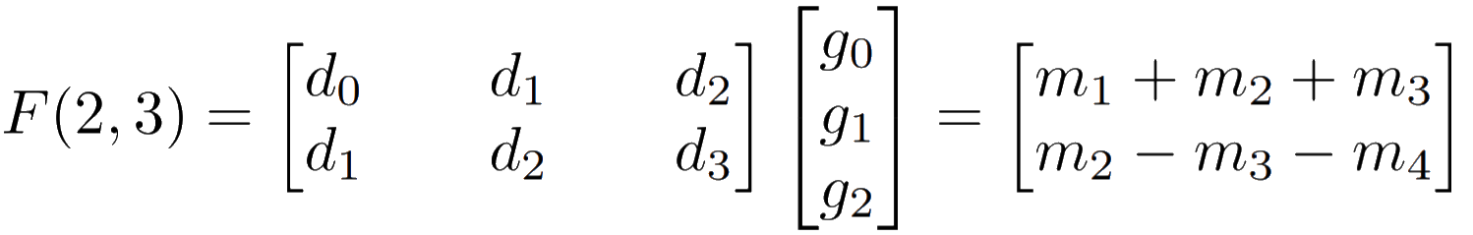
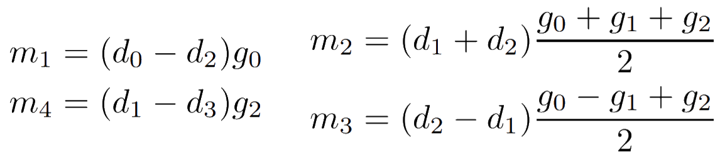
Fundamentals
Winograd‘s minimal filtering algorithm [14]:
Notes:
4 multiplications instead of using 6 multiplications as originally
4 additions involving the data
3 additions and 2 multiplications by a constant involving the filter => can be done in preprocessing
4 additions to reduce the products to the final result

Slide 12
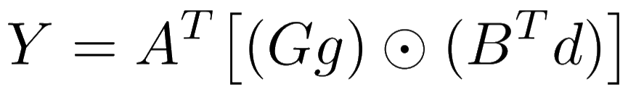
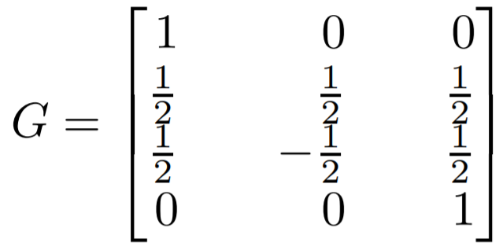
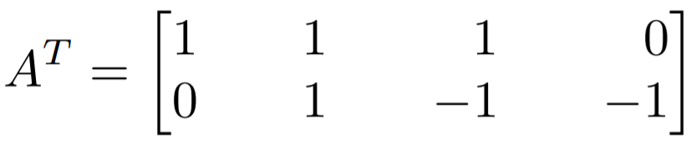
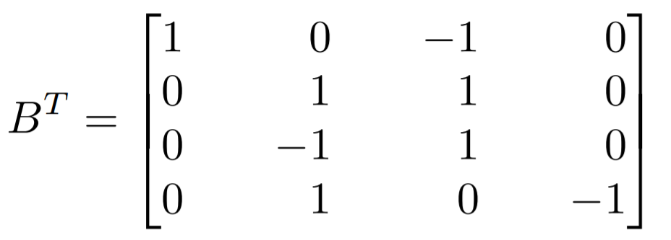


Fundamentals
Winograd‘s minimal filtering algorithm [14]:

Slide 13
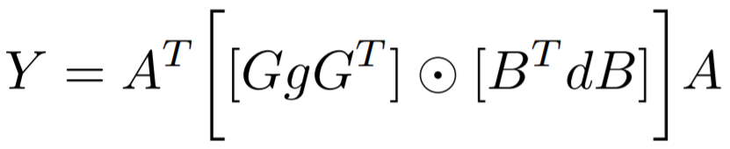
Fundamentals
Winograd‘s minimal filtering algorithm [14]:
F(2x2,3x3) uses 16 mults, whereas normal convolution takes 36 mults
Speedup by factor 2.25
3x3 concolutions highly optimized by modern computing libraries like cuDNN (by using Winograd‘s algorithm)

Slide 14
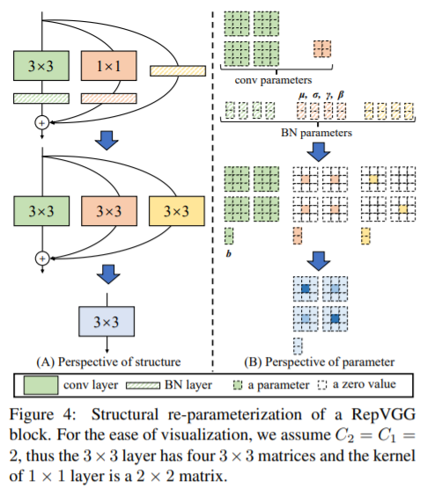
Training-Time Model
y = x + g(x) + f(x)
x: ResNet-like identity (dimensions must match)
g(x): 1x1 convolution (dimensions do not need to match)
f(x): residual function
Notes:
Here: Would have the mentioned drawbacks during inference, therefore only training time model
Inspired by ResNet: multi-branch architecture makes the model an implicit ensemble of numerous shallower models (n block => 2^n models)
Stack several x + g(x) + f(x) blocks to an ensemble (3^n models)
Apply batch normalization before the addition (output channel wise)
Omit identity branch in case the channel dimensions do not match

Slide 15
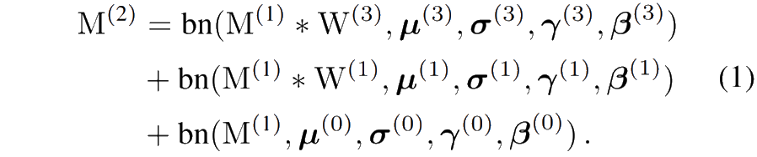
Structural Re-Parameterization
Notes:
Convert every BN and its preceding convolutional layer into a convolutional layer with a bias vector
W‘, B‘: new kernel and bias vector
Identity: 1x1 conv with identity matrix as kernel
Add up three bias vectors, zero-pad the 1x1 conv to 3x3 and add all three 3x3 together
But: all layers need to have the same stride, padding configuration of 1x1 one pixel less than 3x3

Slide 16
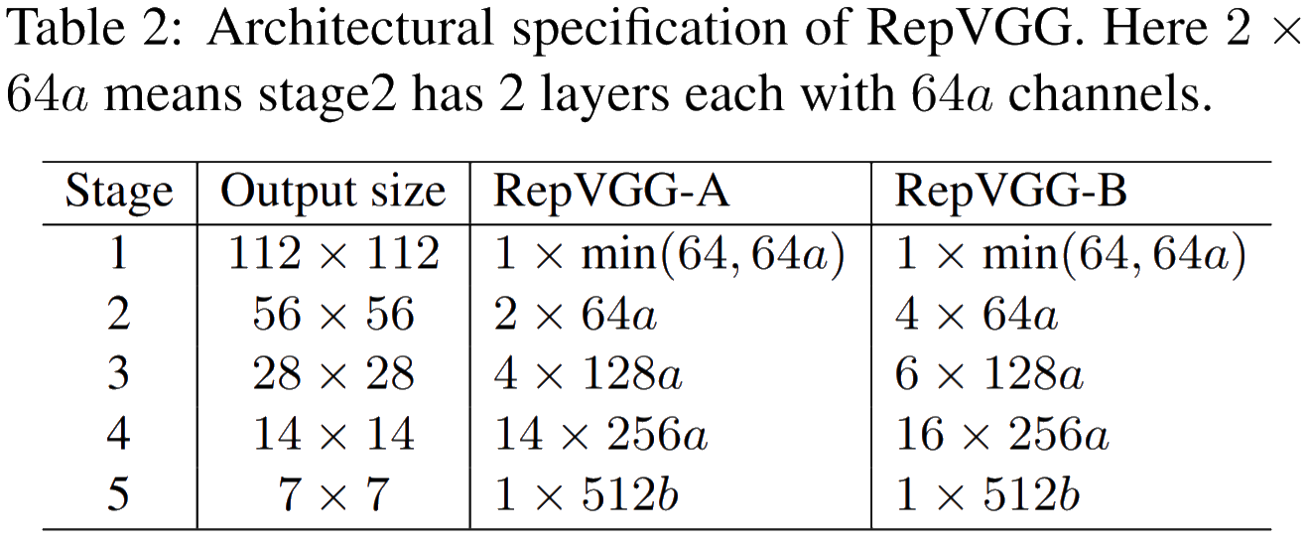
Architectures
Interleave groupwise 3x3 convolution layer every two layers
trade accuracy for efficiency but still maintain inter-channel information exchange
Group factor: 1,2 or 4
Notes:
VGG-style: adopts plain topology and heavily uses 3x3 conv, no max pooling like VGG as body should only have one type of operator
1st layer of each stage downsamples with stride 2
First stage has only one layer: lower latency as operates with high resolutions
Avoid large scale conv in first layer
Last stage should have more channels => use only one layer to save the parameters
Most layers in stage 4 following ResNet and its variants
Groupwise conv every two layers to ensure inter-channel exchange: otherwise channel output only derived from fraction of input channels
Task specific heads
RepVGG-A vs lightweight/middleweight models (ResNet-18/34/50)
RepVGG-B vs high performance models
Width setting from VGG and ResNet (uniform scaling)
Sacling factors b>a (richer features for the classification or other downstream tasks)
As last stage has only one layer: large b does not introduce much latency or far more amount of parameters

Slide 17
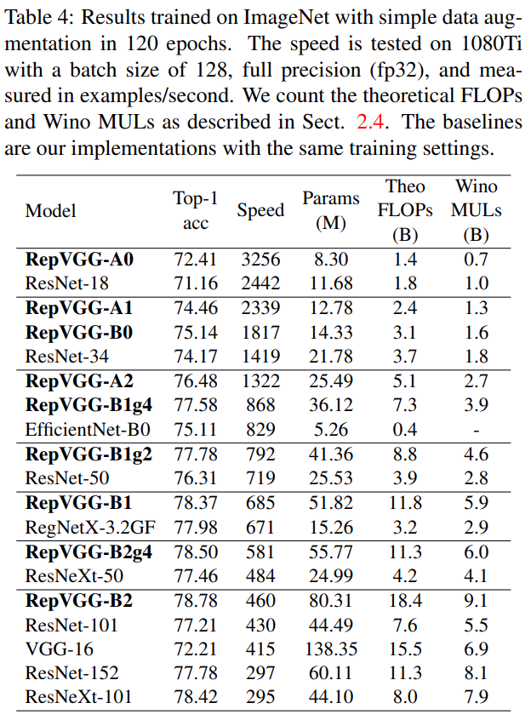
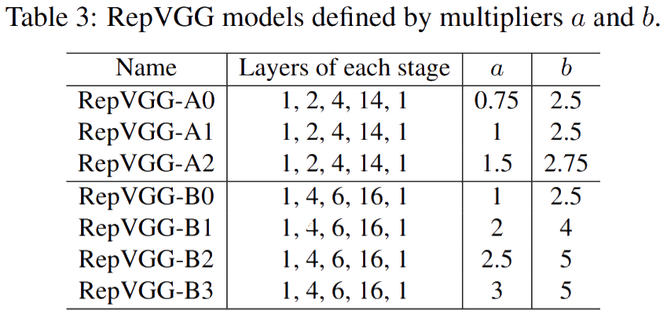
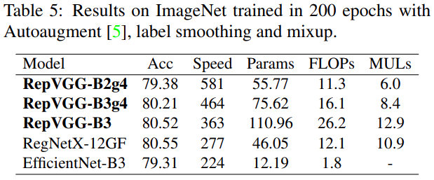
Experiments
Notes:
RepVGG models with interleaved groupwise layers: postfix g2/g4
Training the leight/middleweight models: random cropping, left-right flipping, B=256, 8 GPUs, lr=0.1, cosine annealing=120, SGD, momemtum=0.9, weight decay^=10^-4
Training the heavyweight models: 5-epoch warmup, cosine-annealing: 200, label smoothing, mixup, random cropping, flipping, data augmentation pipeline
All models tested on the same GPU
All conv-BN sequences of the baselines are also converted into a conv with bias
Comparison against EfficientNet-B0/B3 (middleweight) and RegNet-3.2GF/12GF (heavyweight)
RepVGG-A models are more accurate and faster than their ResNet competitors
Interleaved groupwise layer models: reasonable accuracy decrease
Impressive improvements in speed (RepVGG-B1g4 is 101% faster than ResNet-101, RepVGG-B1g2 is 2.66 times faster than ResNet-152 (while having the same accuracy))
More parameter efficient: RepVGG-B2 has only 58% parameters compared to VGG-16, 10% faster, 6.57% higher accuracy
Can even hold up with RegNetX-12GF and even runs 31% faster! (without designing network design spaces, architectural hyper-parameters are set casually)
Over 80% accuracy with plain models reached (for the first time)
FLOPS vs Winograd MULTs: VGG-16 vs ResNet-152 -> Proofs thesis!

Slide 18
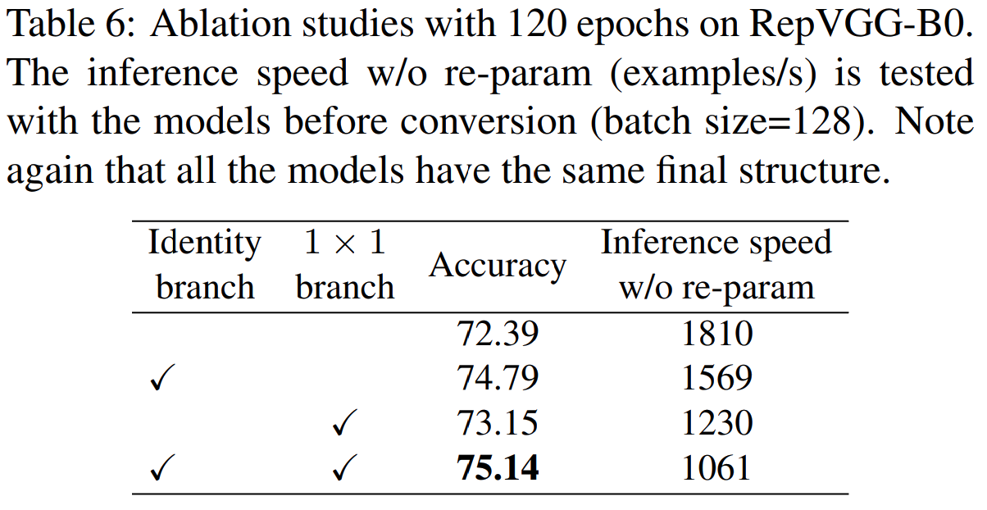
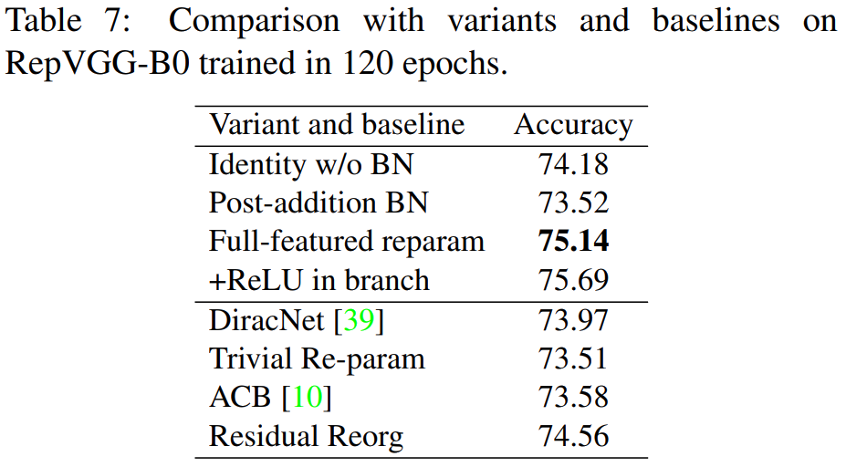
Experiments
Notes:
Strutural Re-parameterization is key!:
Full featured RepVGG-B0 is 75.14%, 2.75% higher than ordinary plain model (without 1x1 conv and identity)
ReLU after BN and before addition: Such a block cannot be converted into a single block anymore!
Trivial Re-param: Trivial DiracNet: W’ = I + W
ACB: Do improvements come from component-level over-parameterization? 3x3,3x1,1x3 kernels added back together
RepVGG: concrete structure with nonlinear behavior, DiracNet uses another mathematical expression of conv kernels (“using the params of a structure to parameterize another structure” vs. “computing the params first with another set of params, then using them for other computations”)
RepVGG does not perform well only because of over parameterization (even better than ACB, which has even more parameters, ResNet-50 gives same performance with RepVGG-blocks) => methodology critical to train plain networks
Residual Reorg: same amount of 3x3 conv + additional shortcuts: RegVGG still outperforms because of more branches (bigger ensemble)
Similar results in semantic segmentation on Cityscapes: minor accuracy increases, but much faster (Exchange ResNet-50/101 backbone with RepVGG-B1g2/B2)

Slide 19
Excursus
Dirac weight parameterization [15]:
No real multi-branch model during training-time
Does not outperform ResNet
Notes:
Previous work:
Make plain models converge but do not outperform multi-branch models
New theoretical initialization method, LReLU, max-norm and careful initialization
This paper: simple model with reasonable depth and favorable accuracy-speed trade-off, which can be simply implemented
Model Re-parameterization:
DiracNet:
a and b are scaling vectors learned during training, W_norm is the normalized weight matrix
achieve deep network performances close to residual networks without actual skip-connections
DiracNet was able to closely match 1001-layer ResNet with only 28 layers on CIFAR-10 as well as ResNet-18 and ResNet-34 on ImageNet wile having the same amount of parameters (27.79% vs. 27.17% top-1 error with 34-layer depth configuration)
Similar to actual ResNet layer: only differ in the order of non-linearities

Slide 20
Experiments
Notes:
Strutural Re-parameterization is key!:
Full featured RepVGG-B0 is 75.14%, 2.75% higher than ordinary plain model (without 1x1 conv and identity)
ReLU after BN and before addition: Such a block cannot be converted into a single block anymore!
Trivial Re-param: Trivial DiracNet: W’ = I + W
ACB: Do improvements come from component-level over-parameterization? 3x3,3x1,1x3 kernels added back together
RepVGG: concrete structure with nonlinear behavior, DiracNet uses another mathematical expression of conv kernels (“using the params of a structure to parameterize another structure” vs. “computing the params first with another set of params, then using them for other computations”)
RepVGG does not perform well only because of over parameterization (even better than ACB, which has even more parameters, ResNet-50 gives same performance with RepVGG-blocks) => methodology critical to train plain networks
Residual Reorg: same amount of 3x3 conv + additional shortcuts: RegVGG still outperforms because of more branches (bigger ensemble)
Similar results in semantic segmentation on Cityscapes: minor accuracy increases, but much faster (Exchange ResNet-50/101 backbone with RepVGG-B1g2/B2)

Slide 21
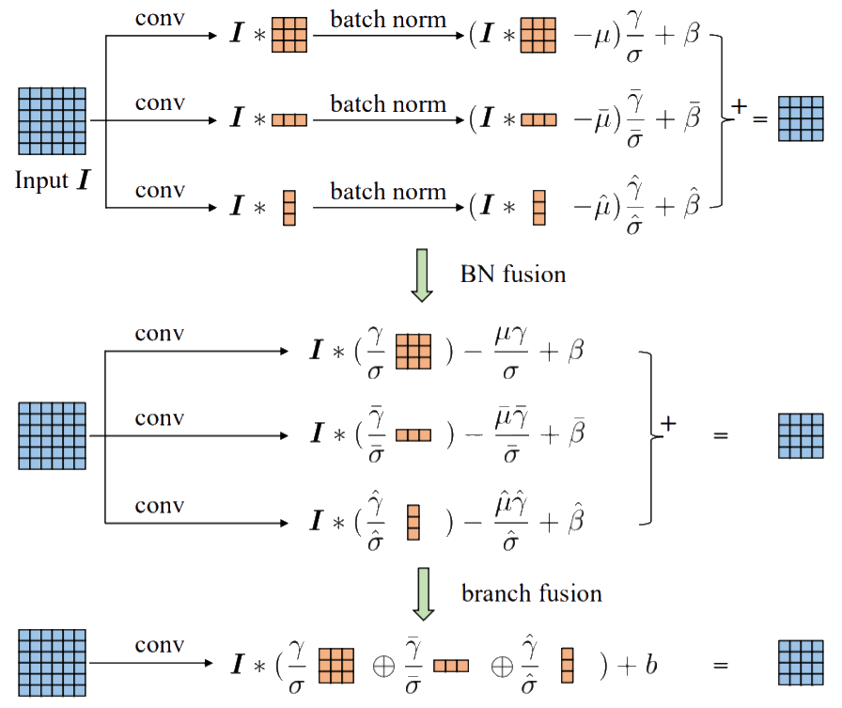
Excursus
Asymmetric Convolution Block (ACB) [16]:
Notes:
Model Re-parameterization:
ACNet:
During training time a normal squared 3x3 convolutional kernel is replaced by multi-branch 3x3, 3x1 and 1x3 kernels that are added back together after batch normalization
ACBs are architecture-neutral meaning they can replace normal 3x3 conv layers without having additional hyperparameters to tune, without further assumptions to take about the model and without additional computational complexity induced
Strengthens the skeletons of squared convolutional kernels, but in practice only leads to few but consistent performance improvements
DO-Conv (depthwise over-parameterized) layers
ExpandNet: additional consecutive linear layers without further non-linearity in between
All architectures can also be folded back into the same structure as the original for the inference time (can be used as drop-in replacement, component level improvement)

Slide 22
Experiments
Notes:
Strutural Re-parameterization is key!:
Full featured RepVGG-B0 is 75.14%, 2.75% higher than ordinary plain model (without 1x1 conv and identity)
ReLU after BN and before addition: Such a block cannot be converted into a single block anymore!
Trivial Re-param: Trivial DiracNet: W’ = I + W
ACB: Do improvements come from component-level over-parameterization? 3x3,3x1,1x3 kernels added back together
RepVGG: concrete structure with nonlinear behavior, DiracNet uses another mathematical expression of conv kernels (“using the params of a structure to parameterize another structure” vs. “computing the params first with another set of params, then using them for other computations”)
RepVGG does not perform well only because of over parameterization (even better than ACB, which has even more parameters, ResNet-50 gives same performance with RepVGG-blocks) => methodology critical to train plain networks
Residual Reorg: same amount of 3x3 conv + additional shortcuts: RegVGG still outperforms because of more branches (bigger ensemble)
Similar results in semantic segmentation on Cityscapes: minor accuracy increases, but much faster (Exchange ResNet-50/101 backbone with RepVGG-B1g2/B2)

Slide 23
Highlights and Weaknesses
Highlights:
Proof that plain ConvNets can outperform ResNet-like architectures
Novel re-parameterization technique based on parameters of a structure to parameterize another structure
Accuracy-speed trade-off
Optimized for GPUs and other specialized hardware
Simple to implement

Slide 24
Highlights and Weaknesses
Weaknesses:
Parameter inefficient compared to modern architectures like EfficientNet or RegNetX (less favored than mobile-regime MobileNets and ShuffleNets for low-power devices)
Models they compare with are biased for better positioning
Additional restrictions: 3x3 convolutions, equal stride, padding

Slide 25
Conclusion
Making VGG-style ConvNets Great Again?
Notes:
Own thoughts:
In terms of introducing a simple to implement model with a good accuracy-speed tradeoff very well done
Gives another point of view into image classification networks (hardware support, re-parameterization techniques, training-time/inference-time separation)
As it is clearly positioned and did not have the intention to provide another state-of-the-art, it is a very important contribution into this specific field of research
„Great again“: In the end it convinces with its speed gain instead of its accuarcy gain!

Slide 26
Bibliography
[1] Andrew Zisserman, Karen Simonyan. „Very Deep Convolutional Networks for Large-Scale Image Recognition”, 2014. https://arxiv.org/pdf/1409.1556.pdf.
[2] Christian Szegedy, Wei Liu, Yangqing Jia, Pierre Sermanet, Scott Reed, Dragomir Anguelov, Dumitru Erhan, Vincent Vanhoucke, Andrew Rabinovich. „Going Deeper with Convolutions“, 2014. https://arxiv.org/pdf/1409.4842.pdf.
[3] Kaiming He, Xiangyu Zhang, Shaoqing Ren, Jian Sun. „Deep Residual Learning for Image Recognition”, 2015. https://arxiv.org/pdf/1512.03385.pdf.
[4] Gao Huang, Zhuang Liu, Laurens van der Maaten, Kilian Q. Weinberger. „Densely Connected Convolutional Networks”, 2016. https://arxiv.org/pdf/1608.06993.pdf.
[5] Saining Xie, Ross Girshick, Piotr Dollár, Zhuowen Tu, Kaiming He. „Aggregated Residual Transformations for Deep Neural Networks”, 2016. https://arxiv.org/pdf/1611.05431.pdf.
[6] Quoc V. Le Mingxing Tan. „EfficientNet: Rethinking Model Scaling for Convolutional Neural Networks”, 2019. https://arxiv.org/pdf/1905.11946.pdf.

Slide 27
Bibliography
[7] Franc¸ois Chollet. „Xception: Deep Learning with Depthwise Separable Convolutions”, 2016. https://arxiv.org/pdf/1610.02357.pdf.
[8] Andrew G. Howard, Menglong Zhu, Bo Chen, Dmitry Kalenichenko, Weijun Wang, Tobias Weyand, Marco Andreetto, Hartwig Adam. „MobileNets: Efficient Convolutional Neural Networks for Mobile Vision Applications“, 2017. https://arxiv.org/pdf/1704.04861.pdf.
[9] Xiangyu Zhang, Xinyu Zhou, Mengxiao Lin, Jian Sun. „ShuffleNet: An Extremely Efficient Convolutional Neural Network for Mobile Devices“, 2017. https://arxiv.org/pdf/1707.01083.pdf.
[10] Ningning Ma, Xiangyu Zhang, Hai-Tao Zheng, Jian Sun. „ShuffleNet V2: Practical Guidelines for Efficient CNN Architecture Design“, 2018. https://arxiv.org/pdf/1807.11164.pdf.
[11] Barret Zoph, Vijay Vasudevan, Jonathon Shlens, Quoc V. Le. „Learning transferable architectures for scalable image recognition”, 2017. https://arxiv.org/pdf/1707.07012.pdf.
[12] Ilija Radosavovic, Raj Prateek Kosaraju, Ross Girshick, Kaiming He, Piotr Dollar. „Designing network design spaces”, 2020. https://arxiv.org/pdf/2003.13678.pdf.

Slide 28
Bibliography
[13] Esteban Real, Alok Aggarwal, Yanping Huang, Quoc V Le. „Regularized evolution for image classifier architecture search”, 2018. https://arxiv.org/pdf/1802.01548.pdf.
[14] Andrew Lavin, Scott Gray. „Fast Algorithms for Convolutional Neural Networks”, 2015. https://arxiv.org/pdf/1509.09308.pdf.
[15] Nikos Komodakis Sergey Zagoruyko. „Diracnets: Training very deep neural networks without skip-connections”, 2017. https://arxiv.org/pdf/1706.00388.pdf.
[16] Xiaohan Ding, Yuchen Guo, Guiguang Ding, Jungong Han. „Acnet: Strengthening the kernel skeletons for powerful cnn via asymmetric convolution blocks”, 2019. https://arxiv.org/pdf/1908.03930.pdf.

