Slide 1
RepVGG: Making VGG-style ConvNets Great Again
Xiaohan Ding, Xiangyu Zhang, Ningning Ma, Jungong Han, Guiguang Ding, Jian Sun
Conference on Computer Vision and Pattern Recognition 2021
Last revised on arXiv on: 29 March 2021
Repository: https://github.com/DingXiaoH/RepVGG

Slide 2
Agenda
Motivation
Fundamentals
Approach
Experiments and results
Highlights and weaknesses
Own thoughts and conclusion

Slide 3
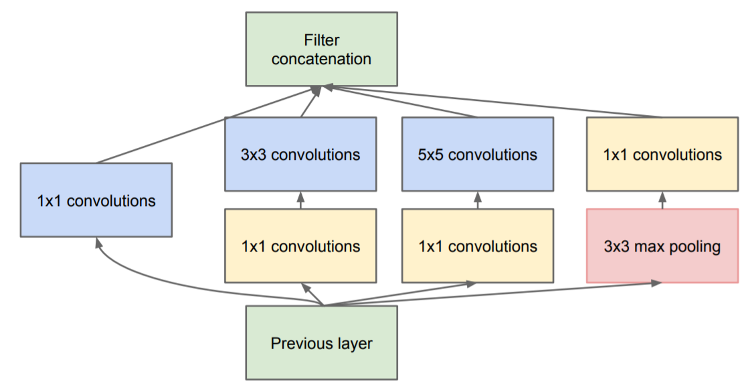
Motivation
VGG [1]
Inception (GoogLeNet) [2]
Prefer deep CNNs with small receptive fields over shallow CNNs with bigger receptive fields
Uses only simple convolutional, max-pooling and fully-connected layers
ImageNet top-5 test error: 7.32
ImageNet top-5 test error: 6.67
Notes:
VGG (2014):
Strenghten the discriminative character of the network as the non-linear activation function ReLU is applied more often
Number of parameters to train is lower
Inception(2014):
Inception modules:
1x1 convolutions for dimension reduction over the channel size
Detect cross-channel correlations
Better detect spatial correlations and objects at various scales, apply kernels of various scales simultaniously
Branch concatenation

Slide 4
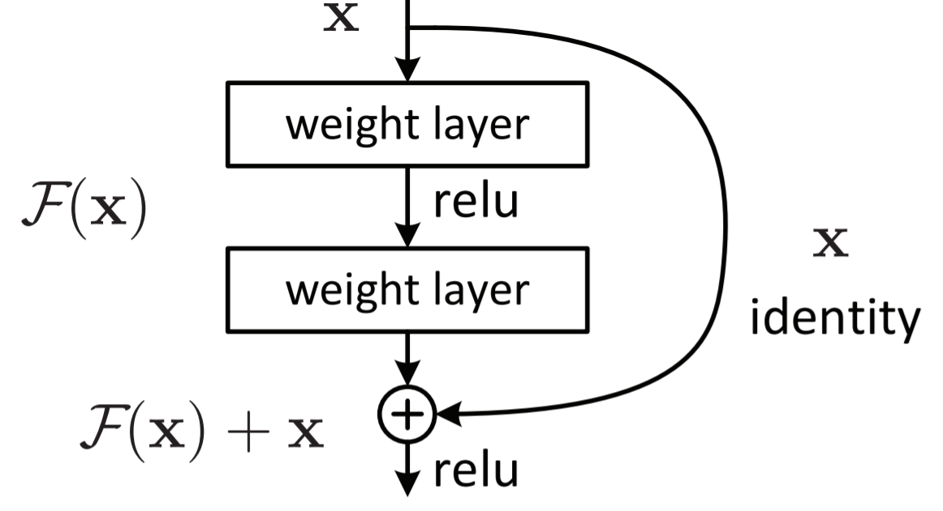
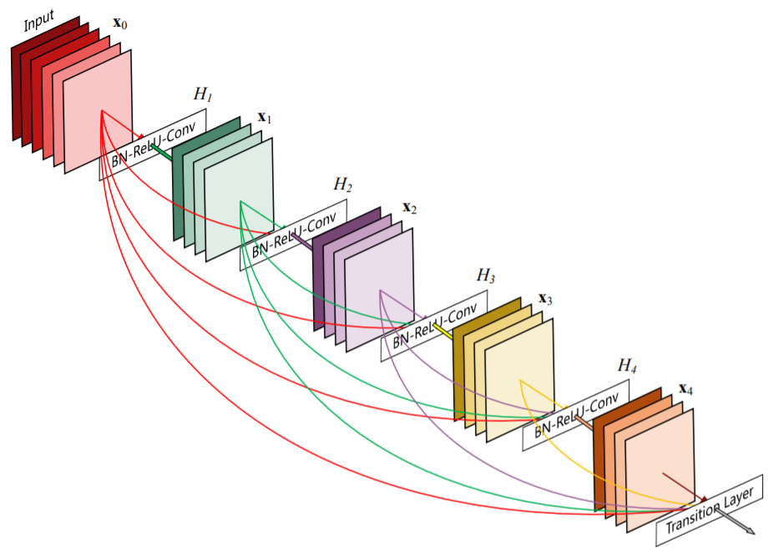
Motivation
ResNet [3]
DenseNet [4]
Solved the degradation problem by introducing shortcut connections
ImageNet top-5 test error: 3.57
Stronger feature propagation through densely connected layers
Outperforms ResNet on ImageNet val. dataset
Notes:
ResNet (2015):
Degradation problem: Ideal mapping was learned up until a certain depth by shallow layers, remaining layers struggle to learn implicit identity mapping thorugh several non-linearity steps =>Loss curve during training ascents again
Set weights of residual components to zero and realize an identity function
Early layers receive much more training signal (solves vanishing gradient problem)
Implicit ensemble of multiple smaller networks
Many paths through the network, but only 0.45% are valid ones (contribute much to the gradient), predominantly short paths
Still keeps complexity eight times lower than VGG for a single net
DenseNet (2016)

Slide 5
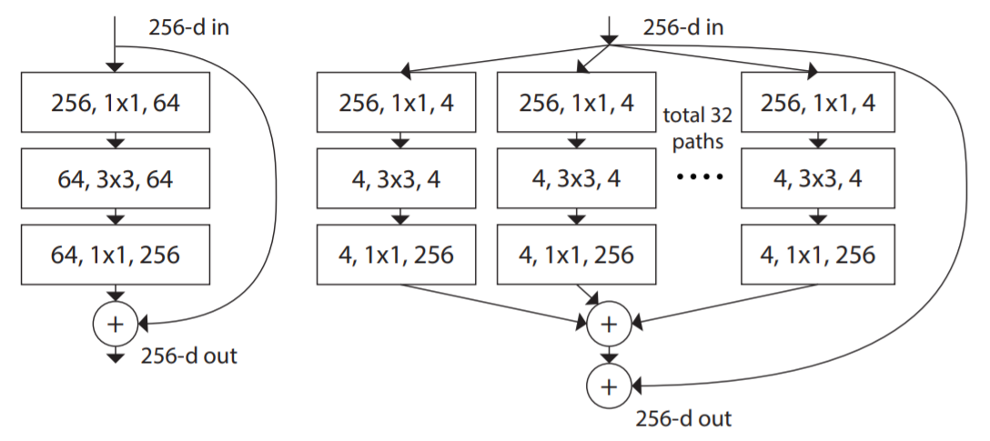
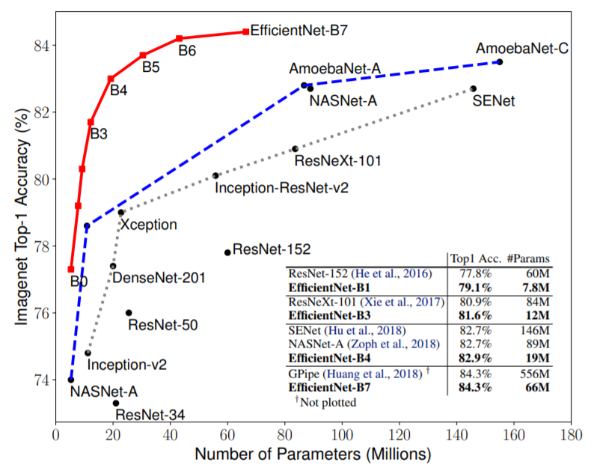
Motivation
ResNeXt [5]
EfficientNet [6]
Cardinality dimension: size of the set of transformations
Increase cardinality instead of depth or width
Compound scaling method: uniform scaling in depth, width and resolution
ImageNet top-1 accuracy: 84.3 (B7)
Notes:
ResNeXt (2016):
Much more efficient
EfficientNet (2019):
Again fewer parameters to train

Slide 6
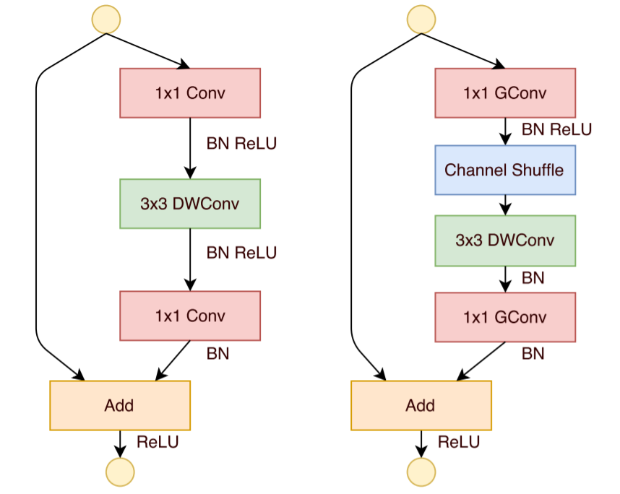
Motivation
Xception [7]: depthwise separable convolutional layers
MobileNet [8]: depthwise separable convolutional layers using pointwise convolutions, width multiplier, resolution multiplier
ShuffleNet [9]: depthwise separable convolutional layers, pointwise group convolution, channel shuffling
NASNet [11]: utilize neural architecture search
RegNet [12]: design network design spaces
Evolutionary algorithms [13]
…
Notes:
Xception (2016):
Similar to inception modules, but first convolutes spatially and afterwards the channels using poitwise 1x1 convolution without using non-linearity in between
Maps spatial and cross-channel correlations completely separately
Stack several depthwise separable convolutional layers with residual connections
Only negligible improvements compared to Inception v3
MobileNet (2017):
Use depthwise separable convolutional layers in their nature of data reduction (1x1 conv) to make CNNs accessible for mobile devices and embedded systems
Width (channels), resolution multiplier: achieve better accuracy-speed tradeoff (latency vs. size)
In terms of accuracy MobileNet can be compared to VGG16 while being 32 times smaller and 27 times less computationally expensive (measured by the Mult Adds)
ShuffleNet (2017):
Possible information bottlenecks by the pointwise group convolution are tackled by using subsequent channel shuffeling to keep the information flow entropy of channels the same
NASNet (2017):
Run NAS for single convolutional cell on CIFAR-10, then stacked to whole CNN
NASNet is actually the design space
RegNet (2020):
Search for suitable design spaces in order to derive a common understanding about important design principles
https://towardsdatascience.com/a-comprehensive-introduction-to-different-types-of-convolutions-in-deep-learning-669281e58215

Slide 7
Motivation
Drawbacks:
Multi-branch design: memory inefficient, slower inference (additional branch addition/concatenation latency), difficult to implement and customize
Depthwise separable convolution/channel shuffling: memory access costs (MAC)
FLOPs cannot be used as a metric for speed! [10]
Degree of parallelism, MACs, I/O operations, optimized runtime target platforms, data shuffling and elementwise operations not considered
Notes:
NAS, designing design spaces: high performance networks, but very high computing costs and slow down degree of parallelism, not trainable on normal GPUs

Slide 8
Motivation
Idea: RepVGG
Multi-branch topology during training
VGG-like plain inference-time architecture
Transformation by structural re-parameterization
Advantages:
VGG-like plain feed-forward topology using only 3x3 conv and ReLU
No automatic search, manual refinement, compound scaling or other heavy design methods
Fewer types of operators enable more computing units integrated onto the chip
Good accuracy-speed trade-off
Notes:
Training a plain CNN without shortcut connections is possible (references in paper), but certainly difficult (vanishing gradient problem)
Training-time RepVGG: indentity, 1x1 conv and 3x3 conv branches (inspired by ResNet)
Identity = degraded 1x1 conv, 1x1 conv = degraded 3x3 conv
3x3 conv constructed from trained parameters form 3x3 conv, 1x1 conv, identity and batch normalization => used for test and deployment
Chips specialized for RepVGG can have an enormous number of 3x3-ReLU units and fewer memory units (as being memory economical) => higher speed

Slide 9
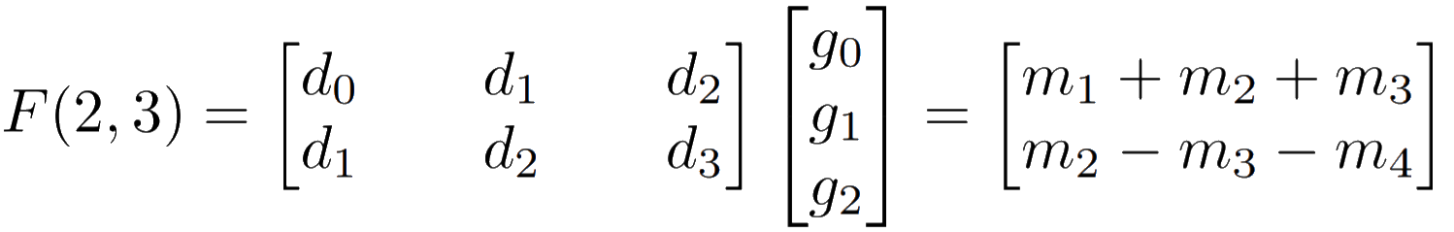
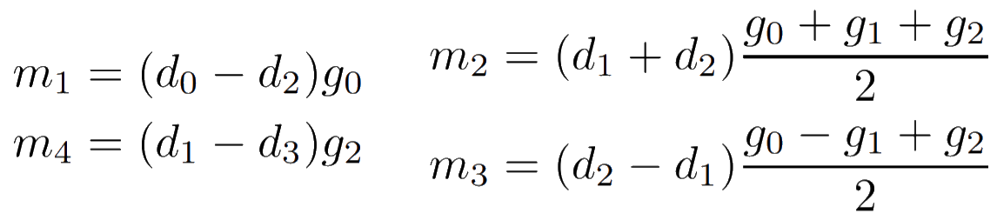
Fundamentals
Winograd‘s minimal filtering algorithm [14]:
Notes:
4 multiplications instead of using 6 multiplications as originally
4 additions involving the data
3 additions and 2 multiplications by a constant involving the filter => can be done in preprocessing
4 additions to reduce the products to the final result

Slide 10
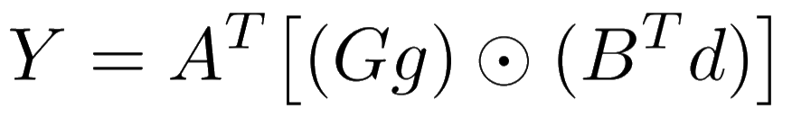
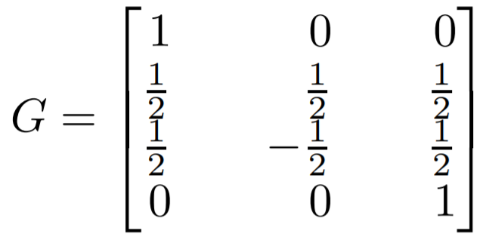
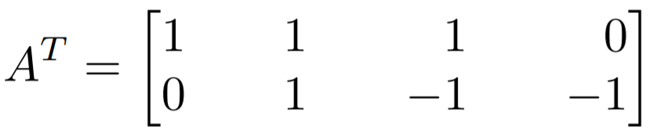
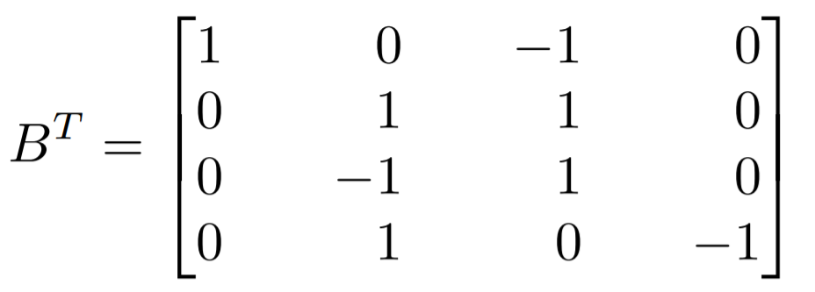


Fundamentals
Winograd‘s minimal filtering algorithm [14]:

Slide 11
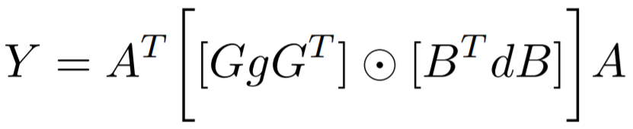
Fundamentals
Winograd‘s minimal filtering algorithm [14]:
F(2x2,3x3) uses 16 mults, whereas normal convolution takes 36 mults
Speedup by factor 2.25
3x3 concolutions hughly optimized by modern computing libraries like cuDNN (by using Winograd‘s algorithm)

Slide 12
Fundamentals
Dirac weight parameterization [15]:
No real multi-branch model during training-time
Does not outperform ResNet
Notes:
Previous work:
Make plain models converge but do not outperform multi-branch models
New theoretical initialization method, LReLU, max-norm and careful initialization
This paper: simple model with reasonable depth and favorable accuracy-speed trade-off, which can be simply implemented
Model Re-parameterization:
DiracNet:
a and b are scaling vectors learned during training, W_norm is the normalized weight matrix
achieve deep network performances close to residual networks without actual skip-connections
DiracNet was able to closely match 1001-layer ResNet with only 28 layers on CIFAR-10 as well as ResNet-18 and ResNet-34 on ImageNet wile having the same amount of parameters (27.79% vs. 27.17% top-1 error with 34-layer depth configuration)
Asym Conv Block, DO-Cov and EpandNet: convert block to conv: used as drop-in replacement for conv layers in any architecture

Slide 13
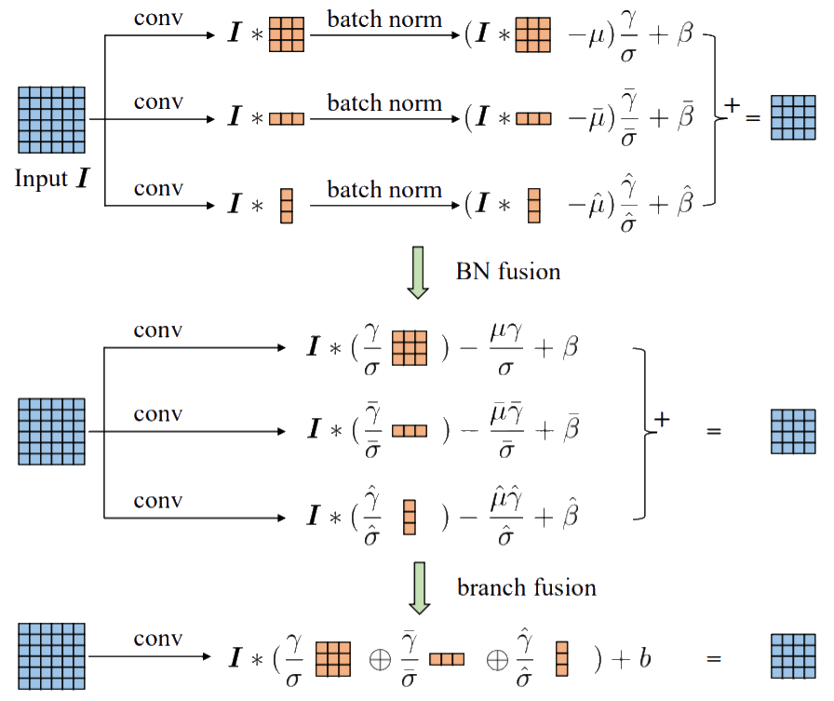
Fundamentals
Asymmetric Convolution Block (ACB) [16]:
Notes:
Model Re-parameterization:
ACNet:
During training time a normal squared 3x3 convolutional kernel is replaced by multi-branch 3x3, 3x1 and 1x3 kernels that are added back together after batch normalization
ACBs are architecture-neutral meaning they can replace normal 3x3 conv layers without having additional hyperparameters to tune, without further assumptions to take about the model and without additional computational complexity induced
Strengthens the skeletons of squared convolutional kernels, but in practice only leads to few but consistent performance improvements
DO-Conv (depthwise over-parameterized) layers
ExpandNet: additional consecutive linear layers without further non-linearity in between
All architectures can also be folded back into the same structure as the original for the inference time (can be used as drop-in replacement, component level improvement)

Slide 14
Approach
Notes:
Three reasons for using simple and plain convolutional networks:
Fast:
Speed cannot be approximated with FLOPS: (Winograd conv (reduces flops))
Memory Access Cost (MAC): high for branch additions/concatenations, groupwise convolution
Degree of parallelism: high number of fragmented operators (i.e. number of individual conv or pooling operations in one building block) introduces extra overheads like kernel launching and synchronization
Memory-economical:
Multi-branch topology like residual architectures: keep results of every branch until addition/concatenation
Plain ConvNet: allows deep memory optimizations and reduces memory costs => more computing units onto the chip
Flexible:
Multi-branch architectures
introduce architectural constraints: residual block need to produce tensors of the same shape for the addition
limit the application of channel pruning (removal of unimportant channels by sparse parameter tensors, then drop unnecessary filters)
Automatic discovery of appropriate layer width cannot be applied
Plain architectures do not have such constraints -> freely configure everything, channel pruning (better performance-efficiency tradeoff)

Slide 15
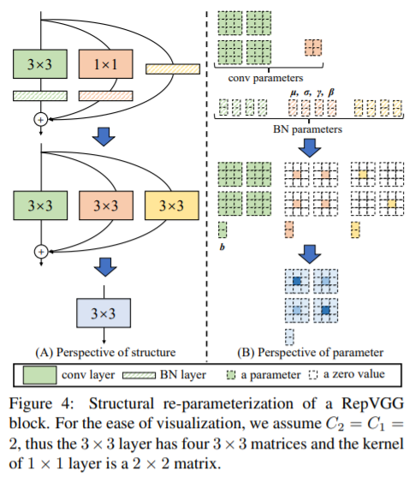
Training-time model
y = x + g(x) + f(x)
Notes:
Training-time Multi-branch Architecture
Inspired by ResNet: multi-branch architecture makes the model an implicit ensemble of numerous shallower models (n block => 2^n models)
Here: Would have the mentioned drawbacks during inference, therefore only training time model
Stack several x + g(x) + f(x) blocks to an ensemble (3^n models) (x: ResNet like identity in case dimensions match, g(x): 1x1 conv in case dimensions do not match, f(x): residual function)
Apply batch normalization before the addition (output channel wise)
Omit identity branch in case the channel dimensions do not match

Slide 16
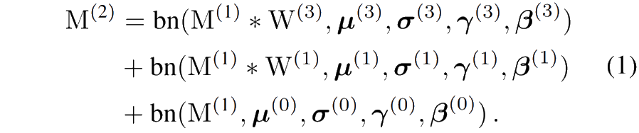
Structural re-parameterization
Notes:
Convert every BN and ist preceding conv layer into a conv with a bias vector
W‘, B‘ new kernel and bias vector
Identity: 1x1 conv with identity matrix as kernel
Add up three bias vectors, zeo-pad the 1x1 conv to 3x3 and add all three 3x3 together
But: all layers need to have the same stride, padding configuration of 1x1 one pixel less than 3x3.

Slide 17
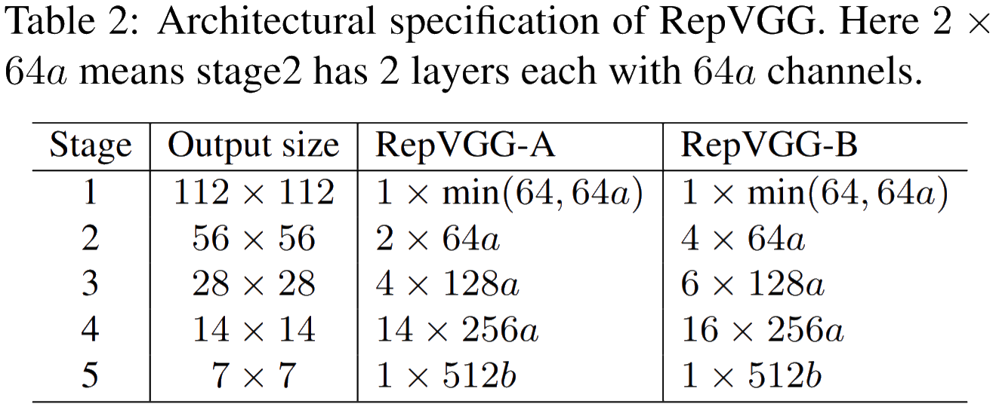
Architectures
Notes:
VGG-style: adopts plain topology and heavily uses 3x3 conv, no max pooling like VGG as body should only have one type of operator
1st layer of each stages downsamples with stride 2
Task specific heads
First stage has only one layer: lower latency as operates with high resolutions
Last stage should have more channels => use only one layer to save the parameters
Most layers in stage 4 following ResNet and ist variants
RepVGG-A vs lightweight/middleweight models (ResNet-18/34/50)
RepVGG-B vs high performance models (ResNet-18/34/50)
Width setting from VGG and ResNet (uniform scaling)
Sacling factors b>a (richer features for the classification or other downstream tasks)
As last stage has only one layer: large b does not introduce much latency orfar more amount of parameters
Avoid large scale conv in first layer
Interleave groupwise 3x3 conv layers every two layers: trade accuracy for efficiency but still maintain inter-channel information exchange (otherwise channel outout only derived from fraction of input channels) (g factor: 1,2 or 4)

Slide 18
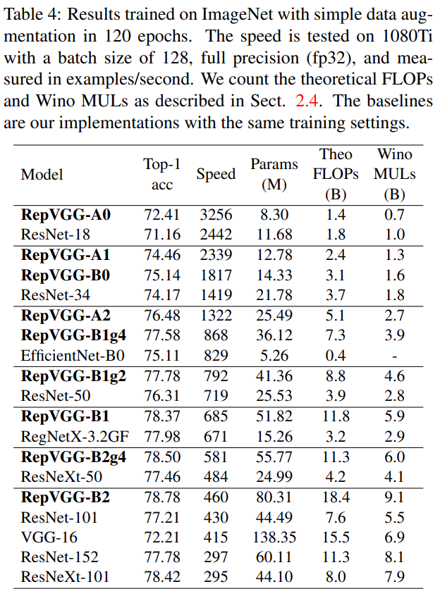
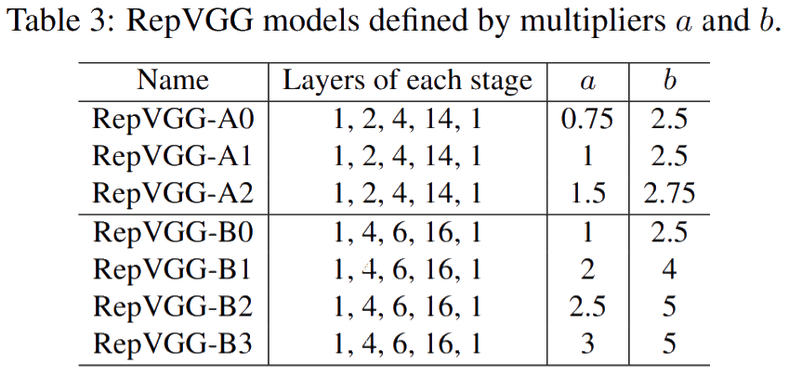
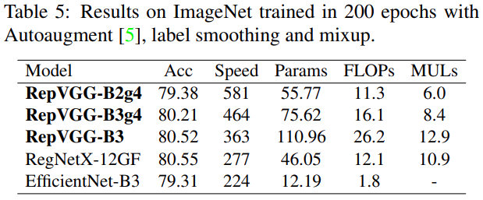
Experiments
Notes:
From introduction: 80% top-1 accuracy on ImageNet, 83% faster than ResNet-50 or 101% faster than ResNet-101 with higher accuracy
RepVGG models with interleaved groupwise layers: postfix g2/g4
Training the leight/middleweight models: random cropping, left-right flipping, B=256, 8 GPUs, lr=0.2, cosine annealing=120, SGD, momemtum=0.9, weight decay^=10^-4
Training the heavyweight models: 5-epoch warmup, cosine-annealing: 200, label smoothing, mixup, radnom cropping, flipping, data augmentation pipeline
All conv-BN sequences of the baselines are also converted into a conv with bias
Comparison against EfficientNet-B0/B3 (middleweight) and RegNet-3.2GF/12GF (heavyweight)
Impressive improvements in speed (RepVGG-B1 g4 is 101% faster than ResNet-101, RepVGG-B1g2 is 2.66 times faster than ResNet-152)
More parameter efficient: RepVGG-B2 has only 58% parameters compared to VGG-16, 10% faster, 6.57% higher accuracy
Can even hold up with RegNetX-3.2GF! (without designing network design spaces, architectural hyper-parameters are set casually)
Over 80% accuracy with plain models reached (for the first time)
FLOPS vs Winograd MULTs: VGG-16 vs ResNet-152 -> Proofs thesis!

Slide 19
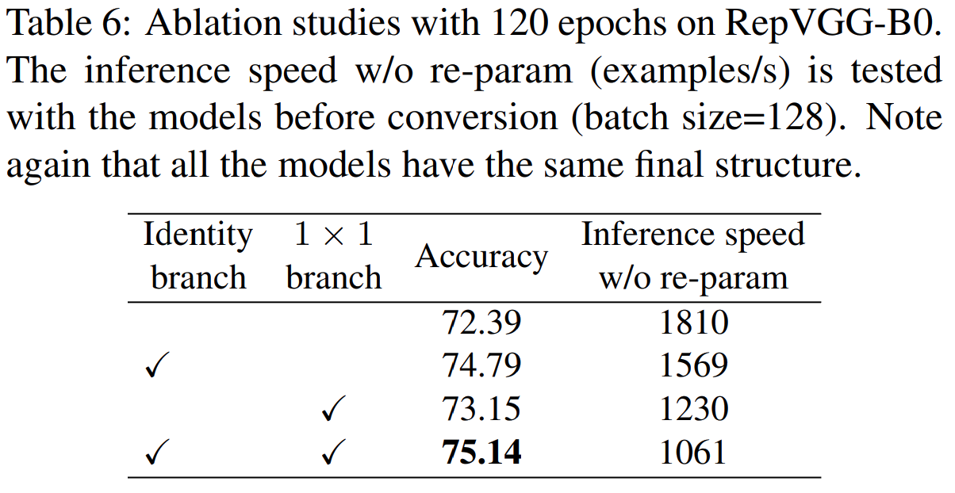
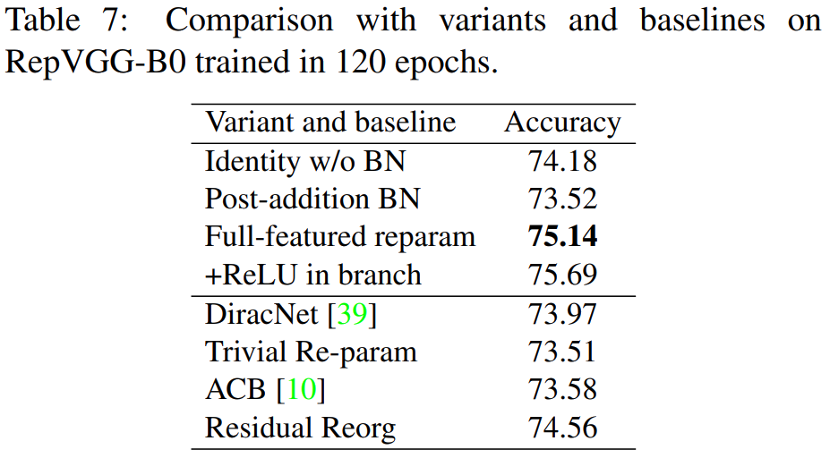
Experiments
Notes:
ReLU after BN and before addition: Such a block cannot be converted into a single block anymore!
DiracNet: Having a closer look one recognizes that the Dirac weight parameterization and residual networks approximately only differ in the order of non-linearities: y = sigmoid((diag(y)I+diag(b)Wnorm)X) === sigmoid(X + W’X) // y = X + sigmoid(WX)
Trivial Re-param: Trivial DiracNet: W’ = I + W
ACB: Do improvements come from component-level over-parameterization? 3x3,3x1,1x3 kernels added back together
RepVGG: concrete structure with nonlinear behavior, DiracNet uses another mathematical expression of conv kernels
RepVGG does not perform well because of over parameterization (even better than ACB, which has even more parameters, ResNet-50 gives same performance with RepVGG-blocks) => methodology critical to train plain networks
Residual Reorg: same amount of 3x3 conv + additional shortcuts: RegVGG still outperforms because of more branches (bigger ensemble)
Similar results in semantic segmentation on Cityscapes: minor accuracy increases, but much faster (Exchange ResNet-50/101 backbone with RepVGG-B1g2/B2)

Slide 20
Evaluation
Konkurrenzpaper?
Notes:
Limitations: optimized for GPU and specialized hardware, less concerning the number of parameters, also less favored then mobile-Regime MobileNets and ShuffleNets for low-power devices.
Also has restrictions: only 3x3 conv, equal stride, padding restruction
Models they compare with an not really state of the art

Slide 21
Conclusion

Slide 22
Bibliography
[1] Andrew Zisserman, Karen Simonyan. „Very Deep Convolutional Networks for Large-Scale Image Recognition”, 2014. https://arxiv.org/pdf/1409.1556.pdf.
[2] Christian Szegedy, Wei Liu, Yangqing Jia, Pierre Sermanet, Scott Reed, Dragomir Anguelov, Dumitru Erhan, Vincent Vanhoucke, Andrew Rabinovich. „Going Deeper with Convolutions “, 2014. https://arxiv.org/pdf/1409.4842.pdf.
[3] Kaiming He, Xiangyu Zhang, Shaoqing Ren, Jian Sun. „Deep Residual Learning for Image Recognition”, 2015. https://arxiv.org/pdf/1512.03385.pdf.
[4] Gao Huang, Zhuang Liu, Laurens van der Maaten, Kilian Q. Weinberger. „Densely Connected Convolutional Networks”, 2016. https://arxiv.org/pdf/1608.06993.pdf.
[5] Saining Xie, Ross Girshick, Piotr Dollár, Zhuowen Tu, Kaiming He. „Aggregated Residual Transformations for Deep Neural Networks”, 2016. https://arxiv.org/pdf/1611.05431.pdf.
[6] Quoc V. Le Mingxing Tan. „EfficientNet: Rethinking Model Scaling for Convolutional Neural Networks”, 2019. https://arxiv.org/pdf/1905.11946.pdf.

Slide 23
Bibliography
[7] Franc¸ois Chollet. „Xception: Deep Learning with Depthwise Separable Convolutions”, 2016. https://arxiv.org/pdf/1610.02357.pdf.
[8] Andrew G. Howard, Menglong Zhu, Bo Chen, Dmitry Kalenichenko, Weijun Wang, Tobias Weyand, Marco Andreetto, Hartwig Adam. „MobileNets: Efficient Convolutional Neural Networks for Mobile Vision Applications“, 2017. https://arxiv.org/pdf/1704.04861.pdf.
[9] Xiangyu Zhang, Xinyu Zhou, Mengxiao Lin, Jian Sun. „ShuffleNet: An Extremely Efficient Convolutional Neural Network for Mobile Devices“, 2017. https://arxiv.org/pdf/1707.01083.pdf.
[10] Ningning Ma, Xiangyu Zhang, Hai-Tao Zheng, Jian Sun. „ShuffleNet V2: Practical Guidelines for Efficient CNN Architecture Design“, 2018. https://arxiv.org/pdf/1807.11164.pdf.
[11] Barret Zoph, Vijay Vasudevan, Jonathon Shlens, Quoc V. Le. „Learning transferable architectures for scalable image recognition”, 2017. https://arxiv.org/pdf/1707.07012.pdf.
[12] Ilija Radosavovic, Raj Prateek Kosaraju, Ross Girshick, Kaiming He, Piotr Dollar. „Designing network design spaces”, 2020. https://arxiv.org/pdf/2003.13678.pdf.

Slide 24
Bibliography
[13] Esteban Real, Alok Aggarwal, Yanping Huang, Quoc V Le. „Regularized evolution for image classifier architecture search”, 2018. https://arxiv.org/pdf/1802.01548.pdf.
[14] Andrew Lavin, Scott Gray. „Fast Algorithms for Convolutional Neural Networks”, 2015. https://arxiv.org/pdf/1509.09308.pdf.
[15] Nikos Komodakis Sergey Zagoruyko. „Diracnets: Training very deep neural networks without skip-connections”, 2017. https://arxiv.org/pdf/1706.00388.pdf.
[16] Xiaohan Ding, Yuchen Guo, Guiguang Ding, Jungong Han. „Acnet: Strengthening the kernel skeletons for powerful cnn via asymmetric convolution blocks”, 2019. https://arxiv.org/pdf/1908.03930.pdf.

Slide 25
TODO
Link to background work
Small introductions of techniques/methods which are key for the paper
Further explanatory figures
Highlight achievements in experiments with rectangles
Citing
Agenda on the bottom?
Send to tutor
ResNext, PSPNet lesen
Bibliography dates?

