Slide 1
Hate speech detection
Felix Hausberger, Christopher Klammt, Nils Krehl
Project presentation for the lecture Text Analytics at Heidelberg University
Winter Semester 2020/21
Prof. Dr. Michael Gertz
Mentor: John Ziegler
Notes:
Legal implementations on handling hate speech is different from one country to another.
While hate speech is not prohibited in the United States due to the freedom of speech, other countries - especially in the European Union can sue hate speech actors for either offending the public order or human dignity.
While being able to prosecute actors in public without much effort, the internet and especially social media platforms provide an easy and anonymous way to practice hate speech without legal consequence enforcements.

Slide 2

Motivation
„@TreTyler_108 That's actually non-English. Because #okiecops are filthy white trash who are all criminals.“
„@elchavaloko who cares tbh ones a shitty dirty Argentino &amp; the other is a feather fisted nigger.“
„@RickiRoma bitch watch ya tone before I drag you to the recycling bin you bitch ass nigga. You gon end up like limewire ol .exe ass nigga.“
„@Twofifs And youre a fucking loudmouth ignorant redneck fuck. You still tryin to suck your own dick? You cant you dumbfuck...its too short.“
Notes:
Several steps were taken to tackle hate speech online, one of them being the code of conduct on countering illegal hate speech online, an initiative of the european commission in close collaboration with major IT companies like Facebook, Microsoft, Twitter and YouTube.
While respecting the freedom of speech, these companies commit to delete hate speech contributions within 24 hours of the initial deletion request.

Slide 3



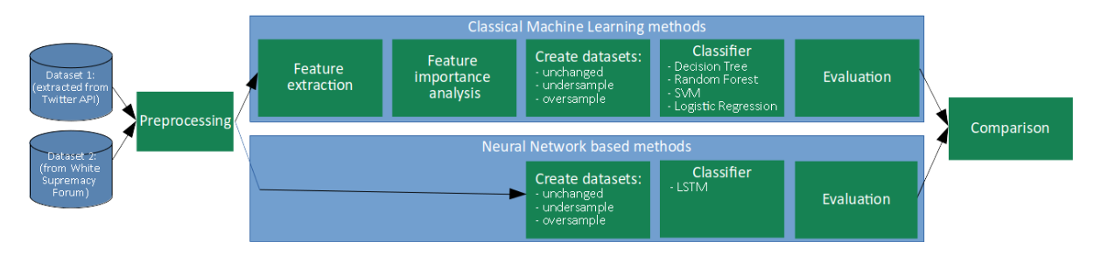
Can conventional Machine Learning approaches combined with suitable features outperform Neural Network based approaches?
Logistic Regression SVM
Decision Forest Random Forest
Holistic, hand-crafted feature set based on recent publications
Preprocessed Training Corpus
vs.
LSTM
Hate Speech Detection
Hate Speech Statictics
Classification Metrics
Feature Importances
Notes:
To further automize the process of detecting hate speech contributions, several text analytics approaches have been evaluated in the recent past.
Many of them are using methods of natural language processing and deep learning for hate speech detection and rely on meaningful features being learned automatically by deep neural networks instead of using hand-crafted features (uni- and bidirectional LSTMs, RNNs, GRUs, BERT, CNNs or even Deep Belief Networks).
Different papers use manually extracted features. But none of them combines the results of recent research and compares it to a baseline neural network architecture, which is what this work is dedicated to.

Slide 4
Holistic, hand-crafted feature set based on recent publications
Conventional Classifier
Preprocessed Training Corpus
Neural Network Classifier
Preprocessing
Notes:
To further automize the process of detecting hate speech contributions, several text analytics approaches have been evaluated in the recent past.
Many of them are using methods of natural language processing and deep learning for hate speech detection and rely on meaningful features being learned automatically by deep neural networks instead of using hand-crafted features (uni- and bidirectional LSTMs, RNNs, GRUs, BERT, CNNs or even Deep Belief Networks).
Different papers use manually extracted features. But none of them combines the results of recent research and compares it to a baseline neural network architecture, which is what this work is dedicated to.

Slide 5
Holistic, hand-crafted feature set based on recent publications
Preprocessed Training Corpus
Logistic Regression SVM
Decision Forest Random Forest
vs.
LSTM
Notes:
To further automize the process of detecting hate speech contributions, several text analytics approaches have been evaluated in the recent past.
Many of them are using methods of natural language processing and deep learning for hate speech detection and rely on meaningful features being learned automatically by deep neural networks instead of using hand-crafted features (uni- and bidirectional LSTMs, RNNs, GRUs, BERT, CNNs or even Deep Belief Networks).
Different papers use manually extracted features. But none of them combines the results of recent research and compares it to a baseline neural network architecture, which is what this work is dedicated to.

Slide 6
Datasets
„Hate speech is commonly defined as any communication that disparages a target group of people based on some characteristic such as race, colour, ethnicity, gender, sexual orientation, nationality, religion, or other characteristic.“
- Gibert et al. (“Hate Speech Dataset from a White Supremacy Forum”)
„A language that is used to expresses hatred towards a targeted group or is intended to be derogatory, to humiliate, or to insult the members of the group.“
- Davidson et al. (“Automated Hate Speech Detection and the Problem of Offensive Language”)

Slide 7
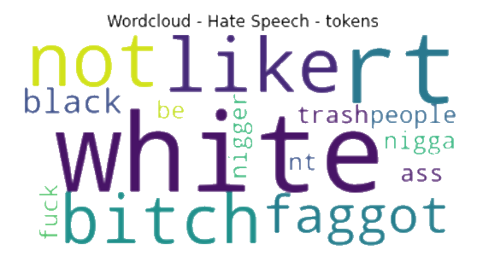
Datasets
Automated Hate Speech Detection and the Problem of Offensive Language [1]
1.430 hate speech, 4.175 neutral, 19.196 offensive language
Hate Speech Dataset from a White Supremacy Forum [2]
1.119 hate sentences, 8.537 non hate sentences
Resulting common dataset after preprocessing
2.491 hate speech documents, 13.336 non hate speech documents
Apply undersampling and oversampling using SMOTE [3]
80% training set, 20% test set
Dataset statistics see report
Notes:
Drop retweets, offensive language, stop words, whitespaces, punctuation, emojis and other irrelevant characters
Stemming and lemmatization

Slide 8
Feature Extraction [4, 6]
Unigram features [1, 5, 6, 7, 8]:
N-grams
Dictionaries based on TF-IDF scores
Semantic features [1, 4]:
#Exclamation marks
#Capitalized words
#Laughing expressions
etc…
Holistic, hand-crafted feature set based on recent publications
Pattern features [5, 6]:
PoS-tag patterns
Topic classification [6]:
Latent Dirichlet Allocation
Sentiment-based features [5, 6]:
Polarity scores based on Vader
Notes:
Only inspired by the papers

Slide 9
Results
Classification metrics:
 | F1-score (in %) unbalanced | F1-score (in %) undersampled | F1-score (in %) oversampled
Decision Tree | 92,58 | 74,48 | 79,46
Random Forrest | 93,20 | 76,32 | 86,98
SVM | 92,72 | 77,39 | 78,59
Logistic Regression | 93,05 | 77,10 | 78,19
LSTM baseline | 93,90 | 93,90 | not measured
SMOTE for oversampling
Classifiers taken from sklearn
LSTM build with Keras
RandomizedSearchCV for hyperparameter tuning
Notes:
When using enough training data classical Machine Learning methods are as good as our neural network baseline (unbalanced vs undersampled)
The classical methods are highly optimized and have little room for further improvement, whereas neural network based approaches have more room for improvement
The creation of artificial instances in oversampling leads to worse results

Slide 10
Results
Classification metrics:
 | F1-score (in %) unbalanced | F1-score (in %) undersampled | F1-score (in %) oversampled
Decision Tree | 92,58 | 74,48 | 79,46
Random Forrest | 93,20 | 76,32 | 86,98
SVM | 92,72 | 77,39 | 78,59
Logistic Regression | 93,05 | 77,10 | 78,19
LSTM baseline | 93,90 | 93,90 | not measured
SMOTE for oversampling
Classifiers taken from sklearn
LSTM build with Keras
RandomizedSearchCV for hyperparameter tuning
Notes:
When using enough training data classical Machine Learning methods are as good as our neural network baseline (unbalanced vs undersampled)
The classical methods are highly optimized and have little room for further improvement, whereas neural network based approaches have more room for improvement
The creation of artificial instances in oversampling leads to worse results

Slide 11
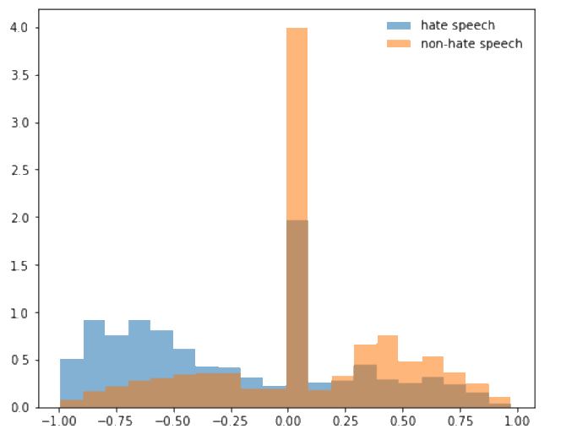
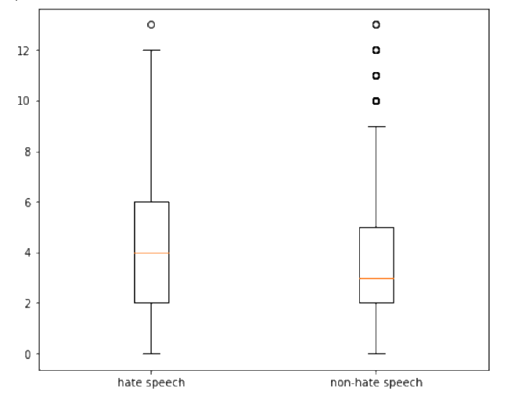
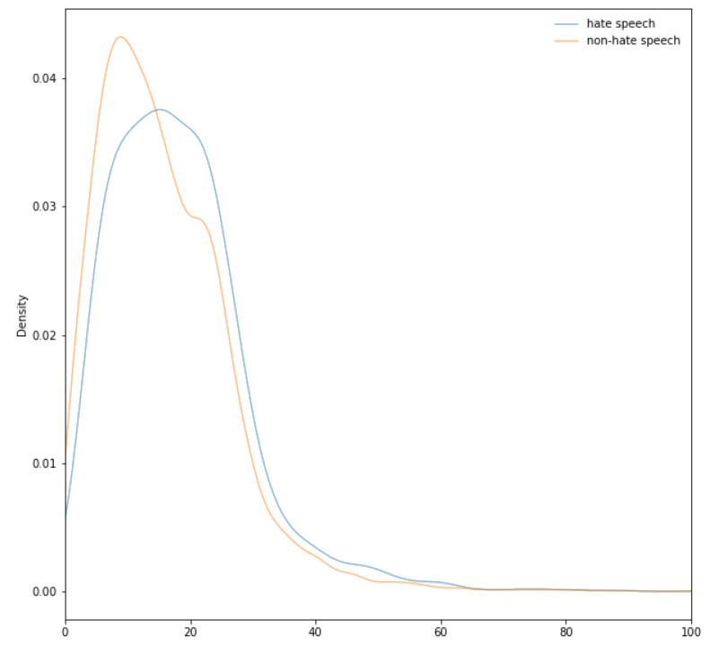
Results
Hate Speech Statictics
Normalized distribution of sentiment score for hate speech vs. non-hate speech
Number of patterns occurring in hatespeech vs. non-hate speech
Sentence length hate speech vs non-hate speech
Notes:
Viele hate speech patterns existieren ebenso in non-hate speech
Semantic features do not signify whether a post is hate speech or not, only maybe the total number of words (hate speech contains more words per sentence)
Tendency for hate speech to contain more laughing expressions
Topic analysis almost not important at all
Strongest feature is the sentiment

Slide 12
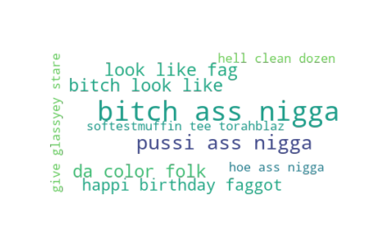
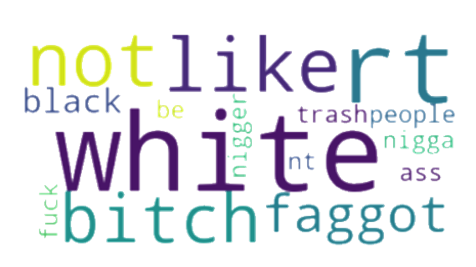
Results
Hate Speech Statictics
Hate Speech Unigrams
Hate Speech Trigrams
Notes:
Unigrams: see word cloud
Bigrams: white trash, look like, ass nigga
Trigrams: Bitch ass nigga, pussi ass nigga

Slide 13
Conclusion
Achievements
Construction of a holistic, hand-crafted feature set based on recent publications
Building and preprocessing of a training corpus
Training of conventional Machine Learning classifiers and a neural network classifier
Evaluation of feature importances and typical hate speech statistics
Results
Classical Machine Learning methods were able to compete with our neural network baseline
Sentiment and unigrams features were the most important features

Slide 14
Conclusion
Improvements
Expansion for ternary classification to further evaluate the boundaries of conventional ML classifiers compared to neural network approaches
Further inspection of hate speech patterns to form a better dictionary
Include Google’s bad word list into hate speech dictionary

Slide 15
Related Work
[1] Thomas Davidson, Dana Warmsley, Michael Macy, Ingmar Weber, Automated hate speech detection and the problem of offensive language, 2020. [Online]. Available: https://arxiv.org/pdf/1703.04009.pdf (visited on 02/20/2021).
[2] Ona de Gibert, Naiara Perez, Aitor Garcia-Pablos, Montse Cuadros, Hate speech dataset from a white supremacy forum, 2020. [Online]. Available: https://arxiv.org/pdf/1809.04444.pdf (visited on 02/20/2021).
[3] Nitesh. V. Chawla, Kevin. W. Bowyer, Lawrence. O. Hall, W. Philip. Kegelmeyer, SMOTE: Synthetic Minority Over-sampling Technique, 2011. [Online]. Available: https://arxiv.org/pdf/1106.1813.pdf (visited on 02/20/2021).
[4] Hajime Watanabe, Mondher Bouazizi, Tomoaki Ohtsuki, Hate Speech on Twitter: A Pragmatic Approach to Collect Hateful and Offensive Expressions and Perform Hate Speech Detection, 2018. In: IEEE Access, Volume 6, doi: 10.1109/ACCESS.2018.2806394.
Notes:
[4] is an important one as it introduces the four feature groups

Slide 16
Related Work
[5] Oluwafemi Oriola, Eduan Kotzé, Evaluating Machine Learning Techniques for Detecting Offensive and Hate Speech in South African Tweets, 2020. In: IEEE Access, Volume 8, doi: 10.1109/ACCESS.2020.2968173.
[6] Paula Fortuna. Sérgio Nunes, A Survey on Automatic Detection of Hate Speech in Text, 2018. In: ACM Computing Surveys, doi: 10.1145/3232676.
[7] Aditya Gaydhani, Vikrant Doma, Shrikant Kendre, Laxmi Bhagwat, Detecting Hate Speech and Offensive Language on Twitter Using Machine Learning: An N-Gram and TFIDF Based Approach, 2018. [Online]. Available: https://arxiv.org/pdf/1809.08651.pdf (visited on 02/20/2021).
[8] Shervin Malmasi, Marcos Zampieri, Detecting Hate Speech in Social Media, 2017. In: Proceedings of the International Conference Recent Advances in Natural Language Processing (RANLP), doi: 10.26615/978-954-452-049-6_062.
Notes:
[5] is an important one as it gives an overview over different features used so far

