Slide 1

E2M2: R basics
Fidisoa Rasambainarivo
Mahaliana Labs
fidy@Mahaliana.org
www.mahaliana.org

Slide 2
Objectif a la fin du cours #3

Slide 3
Agenda
Séance 1:
Introduction a R et R studio
Syntaxe DplyR pour resume et sommaires
Séance 2:
Figures et cartes avec ggplot
Séance 3:
Dashboard et rapport avec Rmarkdown

Slide 4
Objective
To teach the basic knowledge necessary to use R.
What is R?
Why use R?
How R works?
Your environment in R and R studio
Experience R

Slide 5
1. Introduction

Slide 6
What is R?
R is a language and environment for statistical computing and graphics. It is used for
Data management
Statistical analysis
Scientific programming and simulation
Interfacing with other programs (GIS…)

Slide 7
What is R?
R is a language and environment for statistical computing and graphics. It is used for
Data management
Statistical analysis
Scientific programming and simulation
Interfacing with other programs (GIS…)
Language because it allows you to communicate flexibly with your computer.
Like any other language:
Learning R will be easier for some than for others AND it is okay!!!
Learning R takes work and practice

Slide 8
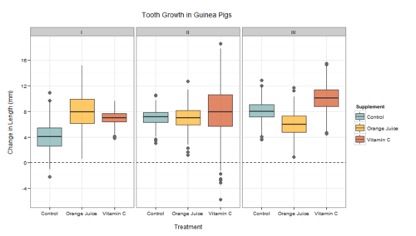
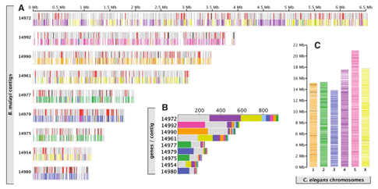
Why use R?
R is free!!!!
SPSS $99/month
SAS $2,500/year
Notes:
R is a statistical computing environment for statistical computation and graphics, and it is a computer language designed for typical and possibly very specialized statistical and graphical applications. The software is available for unix/linux, Windows, and Macintosh platforms
under general public license, and the program is available to download from www.r-project.org. Thousands of contributed packages are also available as well as utilities for easy installation.

Slide 9
Why use R?
R is free!!!!
SPSS $99/month
SAS $2,500/year
Excellent at making figures
Thousands of tools for statistical analysis (packages).
Notes:
R is a statistical computing environment for statistical computation and graphics, and it is a computer language designed for typical and possibly very specialized statistical and graphical applications. The software is available for unix/linux, Windows, and Macintosh platforms
under general public license, and the program is available to download from www.r-project.org. Thousands of contributed packages are also available as well as utilities for easy installation.

Slide 10
Why use R?
R is free!!!!
SPSS $99/month
SAS $2,500/year
Excellent at making figures
Thousands of tools for statistical analysis (packages).
Many recently developed tools available immediatly
Freedom to develop your own tools
Notes:
R is a statistical computing environment for statistical computation and graphics, and it is a computer language designed for typical and possibly very specialized statistical and graphical applications. The software is available for unix/linux, Windows, and Macintosh platforms
under general public license, and the program is available to download from www.r-project.org. Thousands of contributed packages are also available as well as utilities for easy installation.

Slide 11
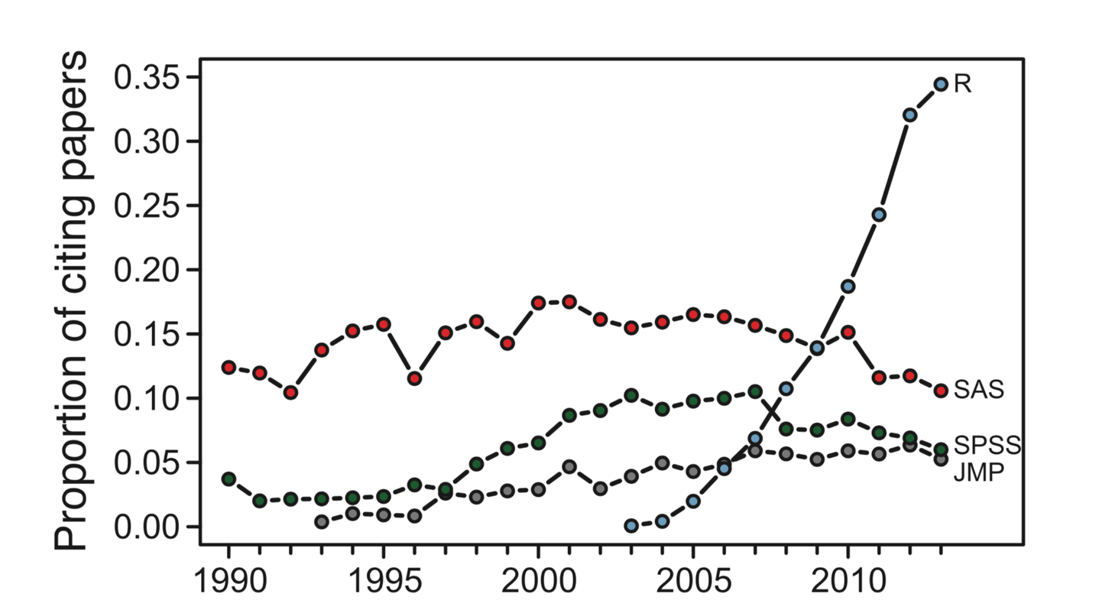
Why use R?
Software of reference in ecology

Slide 12
Why use R and how does it work?
The base program is very small (~65 mb)
Designed to have task-specific packages downloaded and added to it. There is probably a package that is designed to do the analysis that you want to do
A package is a collections of functions, data, and help files generally centered around certain themes of analyses.
10,000+ packages are currently available to download (you will never need most of these)

Slide 13
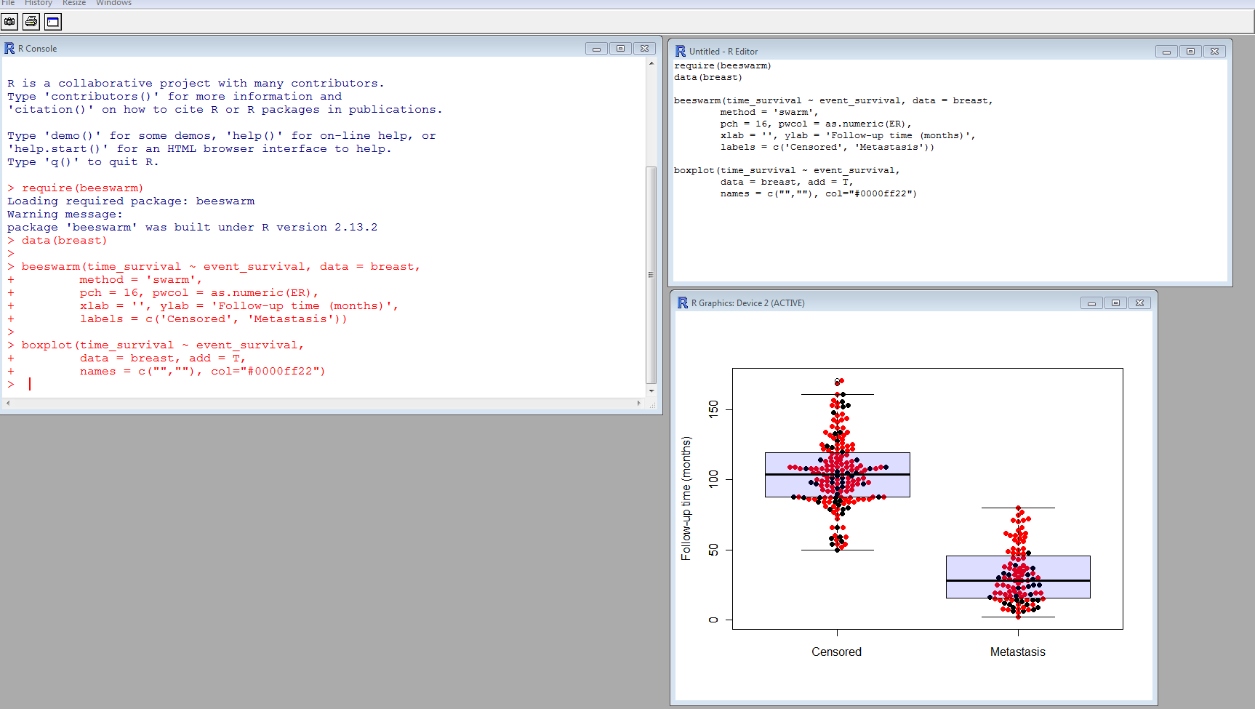
Your environment in R
Graphics
Console
Editor

Slide 14
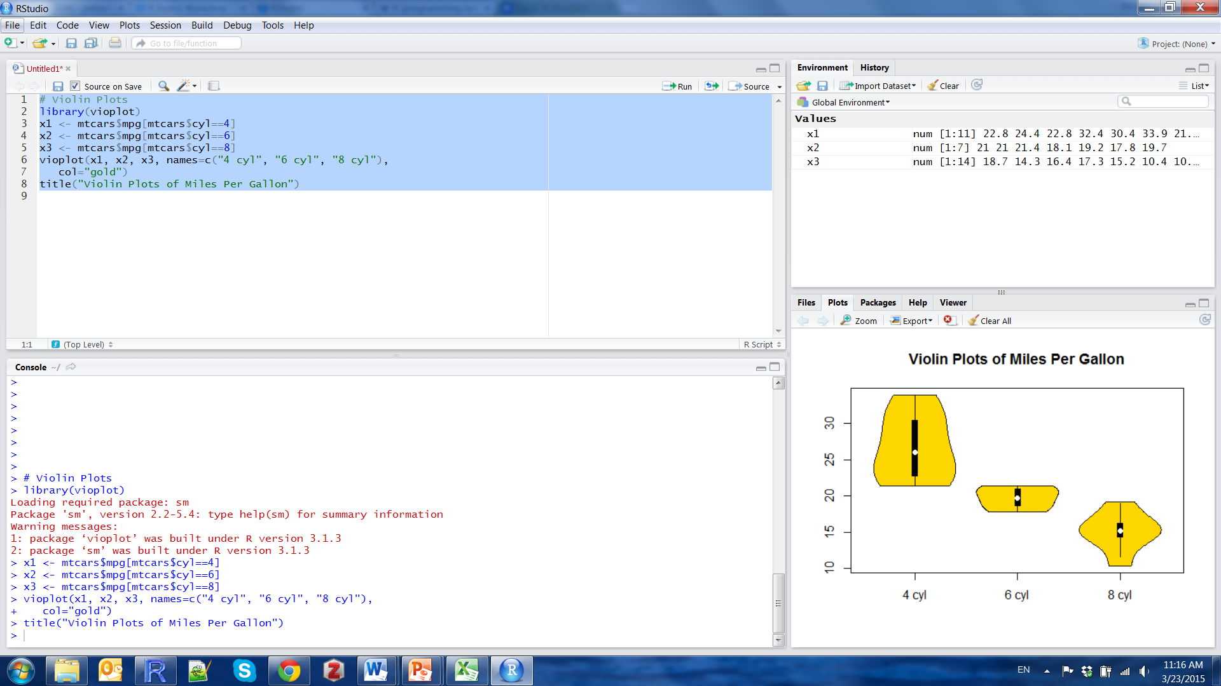
Main windows in R Studio
Console
Editor
Graphics

Slide 15
Working in R/R Studio
Always use a text editor to save your work
Allows for repeatability when you save your code.
Allows you to add comments to scripts to remember what you have done.
Use # to make comments that won’t be executed
Makes it easy to share code with collaborators
When you type things into the console and execute them,
they are run but they are not saved.
To execute commands:
Mac: ⌘↵, PC: CTRL-R
Can highlight multiple lines of code and run at once

Slide 16
Exercise 1: a first session in R
Objective: experiencing R/R studio

Slide 17
2. Enter and Import your data

Slide 18
Objective
To teach the basic knowledge necessary to use R.
How to record your data?
How do you import them into R?
Experience R: live coding

Slide 19
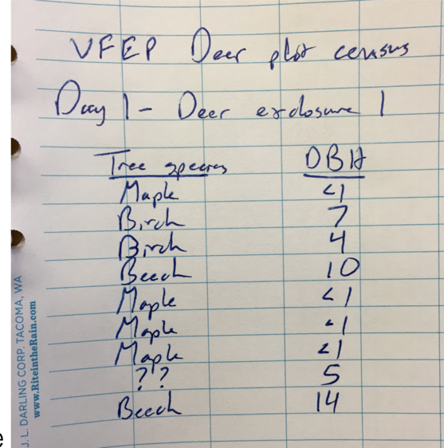
Record your data
Hypothetical data on sizes of trees in deer exclosures
Most of the time have a data book where you write down your data, observations, etc.
Most people use MS Excel to enter and store data from the notebook on the computer.
But… BEWARE of how data is recorded on excel

Slide 20
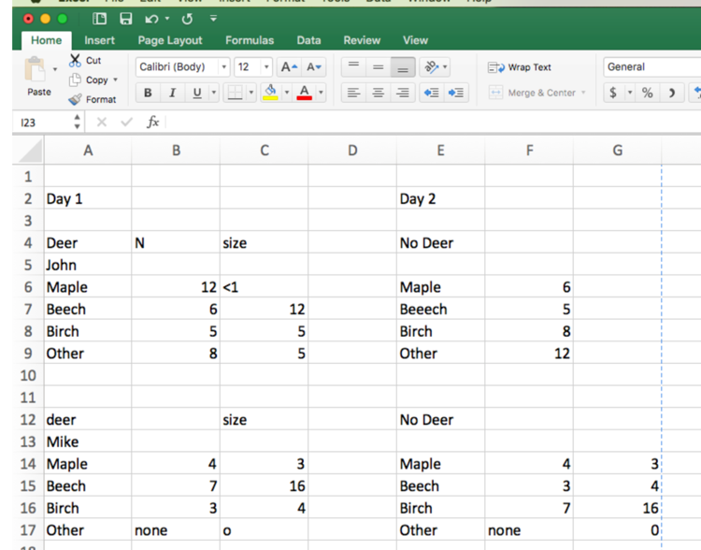
Record your data
Hypothetical data on sizes of trees in deer exclosures
Most of the time have a data book where you write down your data, observations, etc.
Most people use MS Excel to enter and store data from the notebook on the computer.
But… BEWARE of how data is recorded on excel

Slide 21
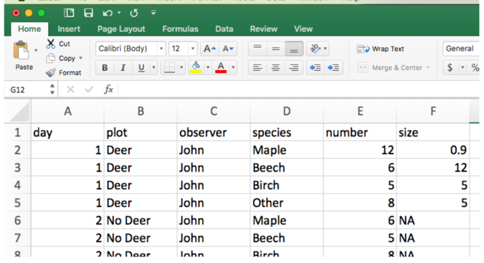
Record your data: general rules
Avoid spaces: use period “.” or underscore “_”.
Keep column names short, simple and unique.
Be very careful of typos.

Slide 22
Record your data: general rules
Avoid spaces: use period “.” or underscore “_”.
Keep column names short, simple and unique.
Be very careful of typos.
One variable per column (no merged column, no more than one).
Consistent unit throughout observations
One observation per cell.
Save as csv file

Slide 23
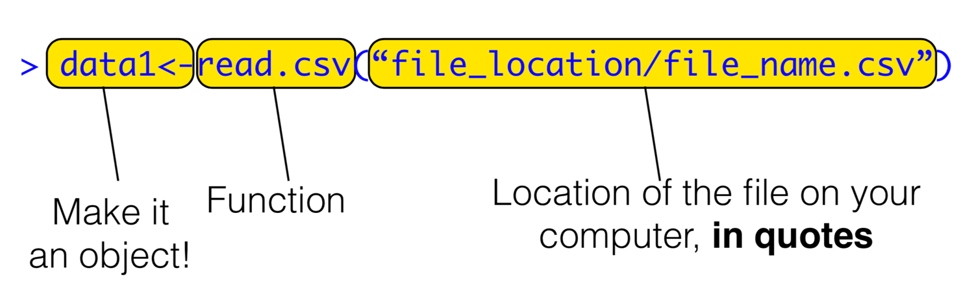
Import data in R

