Slide 1
Novel dan Penulis
Muhammad Ofie
What
Aplikasi CRUD untuk daftar novel dan daftar penulisnya .
When
Dapat digunakan jika server berjalan .
Where
Aplikasi berjalan di localhost:3000 .
Who
Disajikan untuk umum .
Why
Media pameran karya novel dan penulisnya .
How
Dibangun dengan sejumlah library .

Slide 2
Technology Stack
Functional | Technology
Package manager | Node.js
Server | ExpressJs
Database Management System | Postgres
Table Relation | Many-to-many
Object Relational Mapper | Sequelize
CSS Framework | Tailwind

Slide 3
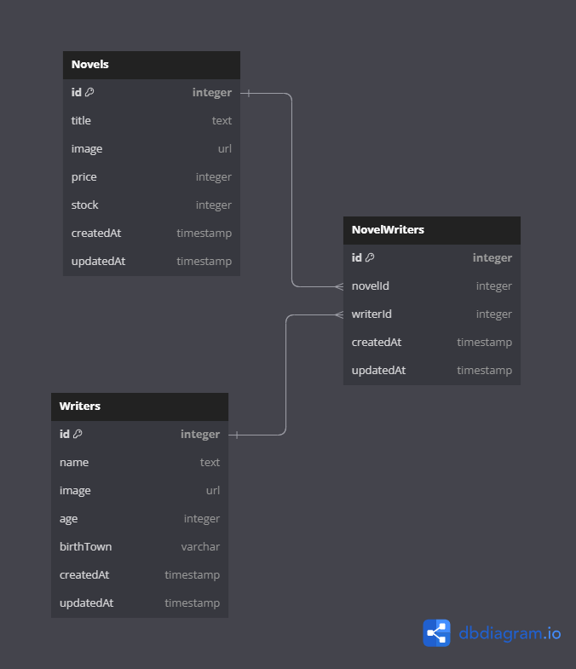
Entity Relational Diagram

Slide 4
API documentation
Method - Route | Method - Route
GET - / | GET - /novels/delete/:id
GET - /novels | GET - /writers/delete/:id
GET - /writers | GET - /novels/update/:id
GET - /novels/add | GET - /writers/update/:id
GET - /writers/add | POST - /novels/update/:id
POST - /novels/add | POST - /writers/update/:id
POST - /writers/add

