Slide 1
School of CIS Windows Store App
It’s in the Code
Jason Tierney | Chris Field | Eric Foertsch

Slide 2
Thank you to Our sponsor
Eric Maino + Microsoft
Eric worked with us throughout the entire semester
Access to Microsoft Tools & Technologies
Always around for discussion / Questions

Slide 3
Introduction
Task: Create a Windows Store App that Reimagines the School of CIS through Windows 8.

Slide 4
Purpose
Design a Windows Store app the reimagines the School of CIS
Experiment with Microsoft Technologies
Learn Scrum development

Slide 5



The Frameworks
We utilize the following Microsoft frameworks
.NET 4.5
Windows Store Libraries
JSON.NET
Windows Azure Libraries
MyToolkit – For YouTube videos
And Many More…

Slide 6
Features – Front End
Our app provides:
Professor information
RSS Feeds for GVSU News / Events
Twitter feeds
YouTube Video Feed from the School of CIS

Slide 7
Design
Focused on making app look/feel like a true Windows Store app
Simplicity > Complexity
Images / Graphics add to the elegance and simplicity of “Metro” design
Easy to update for future functionality

Slide 8

(METRO) UI Design – Home Screen

Slide 9
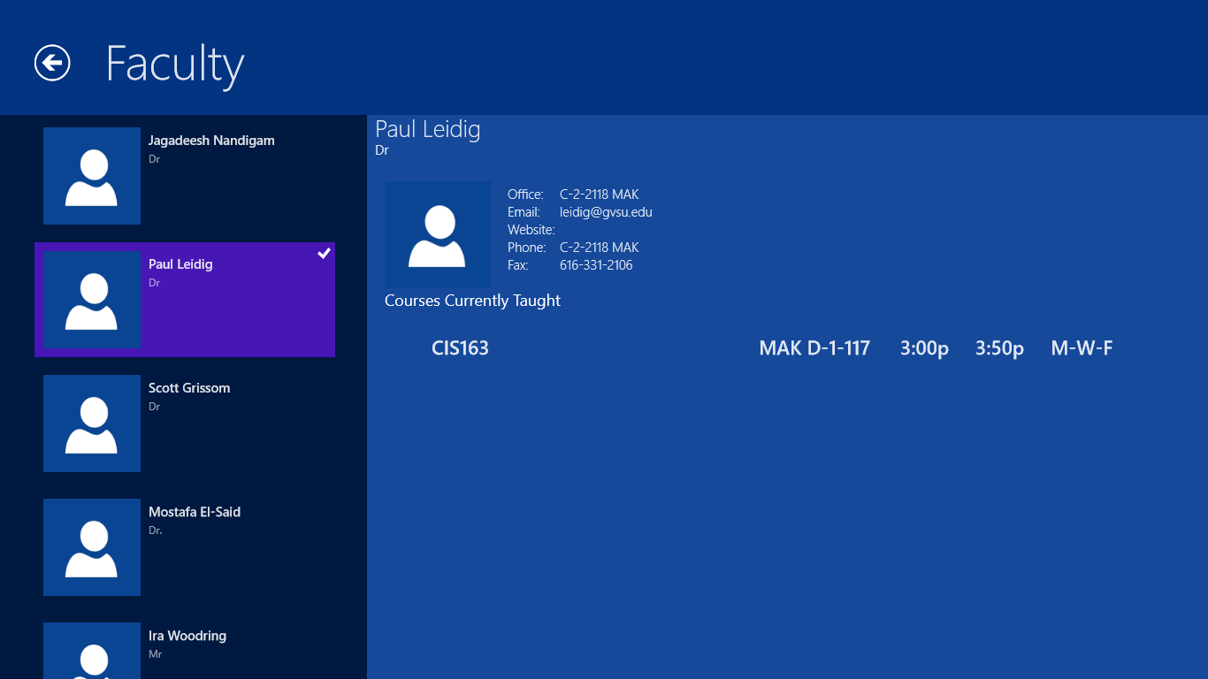
(METRO) UI Design – Typical Pages

Slide 10

Features - Backend
backend features include:
Azure Backend Data Feeds
Custom Web Site / UI for updating backend data

Slide 11
Windows Azure - WebService
Features:
Table storage for storing raw data
Blob storage for storing Images
JSON data used as communication method
Efficiency increased through LINQ functions

Slide 12
Custom MVC Web Site
Adheres to the MVC architecture Microsoft offers
Standard layouts / coding – decreases amount of effort to add future functionality
CRUD pages for all the basic functionality of the app

Slide 13
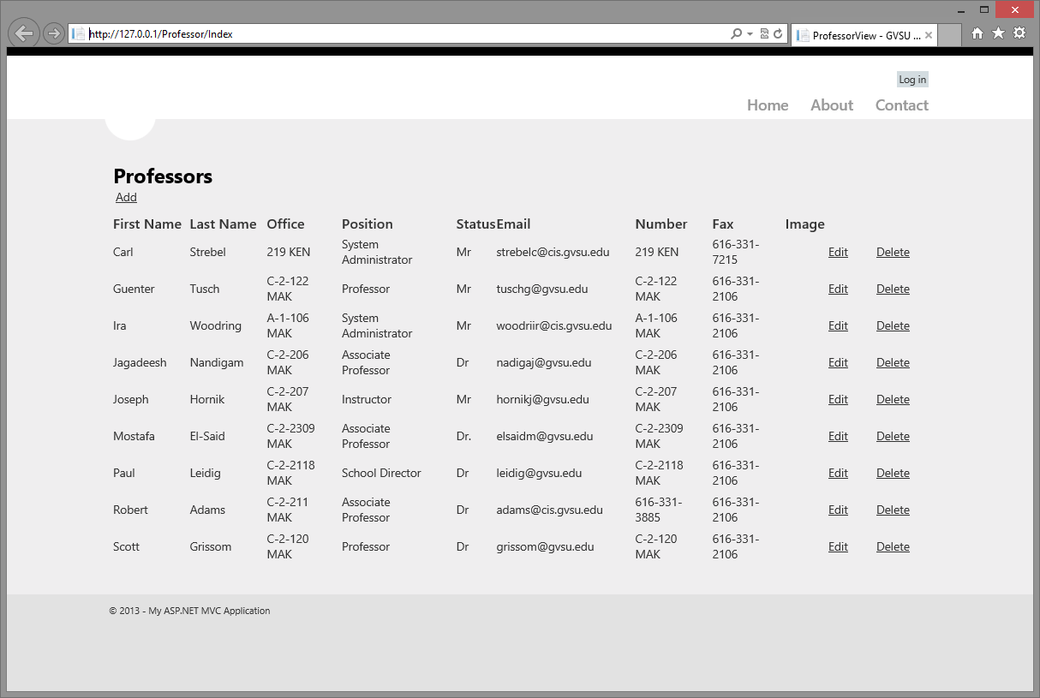
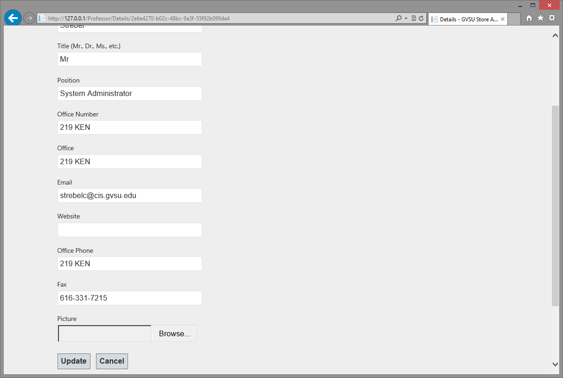
MVC – CRUD Pages

Slide 14
DEMO
We will now provide a live 2-3 minute Demo
Windows Store app
Windows Azure BackEnd

Slide 15
Questions / Comments?

