Slide 1
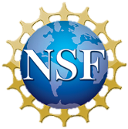



AtomTouch
Learning about atom behavior through molecular simulation
A.L. Gillian-Daniel, B. L. Taylor
Materials Research Science and Engineering Center (MRSEC)
University of Wisconsin-Madison

Slide 2
What is nanotechnology?
Nanotechnology is the understanding and control of matter 1 to 100 nanometers in size.
. . . But what does that mean?

Slide 3
What is nanotechnology?
The nanometer is extremely small.
At the nanometer scale, many materials behave differently.
We can harness this new behavior to make new materials.
…How small is extremely small?

Slide 4
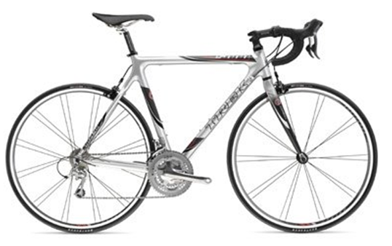

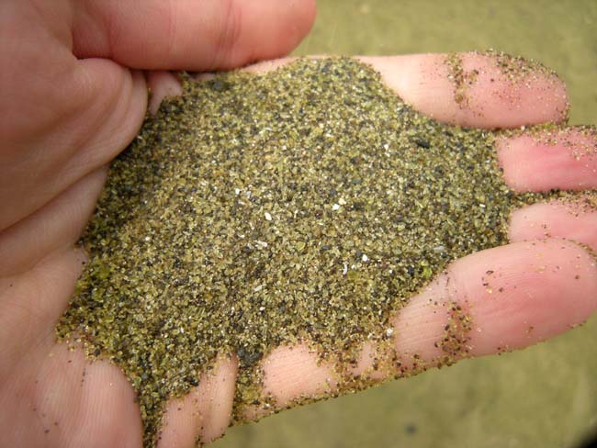
Exactly how small is a nanometer?
1/100th of a meter
(centimeter)
meter
1/1000th of a meter (millimeter)
All these are still visible with your eyes.

Slide 5
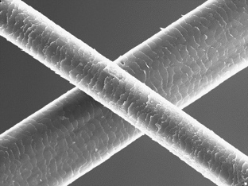
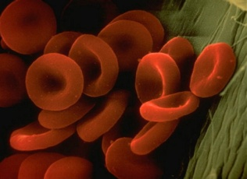
How small can you see?
A human hair is ~40 µm
One red blood cell is 6-8 µm
A micrometer (µm) is one-millionth of a meter
Nanoscale objects are 1,000 times smaller!!!

Slide 6
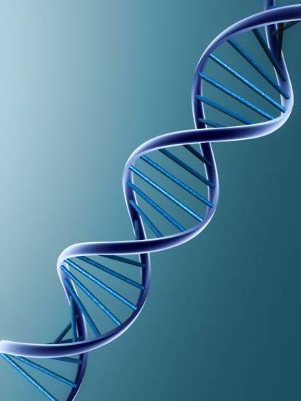
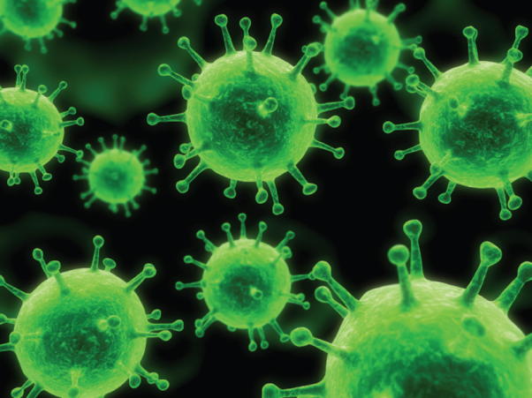
. . . Smaller than you can see!
A nanometer (nm) is one billionth of a meter!!
Viruses
3-50 nm
DNA
1-2 nm

Slide 7
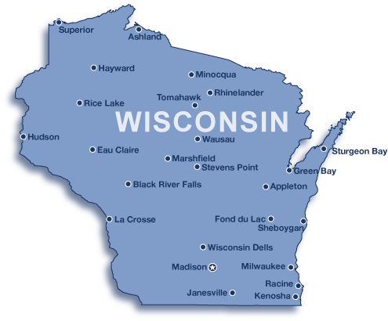
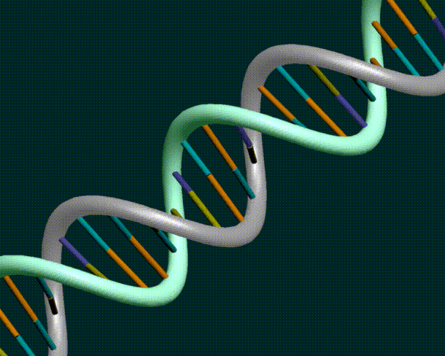
Nanometer: Part of the Metric System
kilometer | km | 1,000 | 1X10³
meter | m | 1 | 1X10⁰
millimeter | mm | 1/1,000 | 1X10⁻³
micrometer | μm | 1/1,000,000 | 1X10⁻⁶
nanometer | nm | 1/1,000,000,000 | 1X10⁻⁹
picometer | pm | 1/1,000,000,000,000 | 1X10⁻¹²
WI is 420 km wide
11-year-old human
~ 1.4 m
Hair: ~40μm
DNA: 1-2 nm
Notes:
Kermin

Slide 8

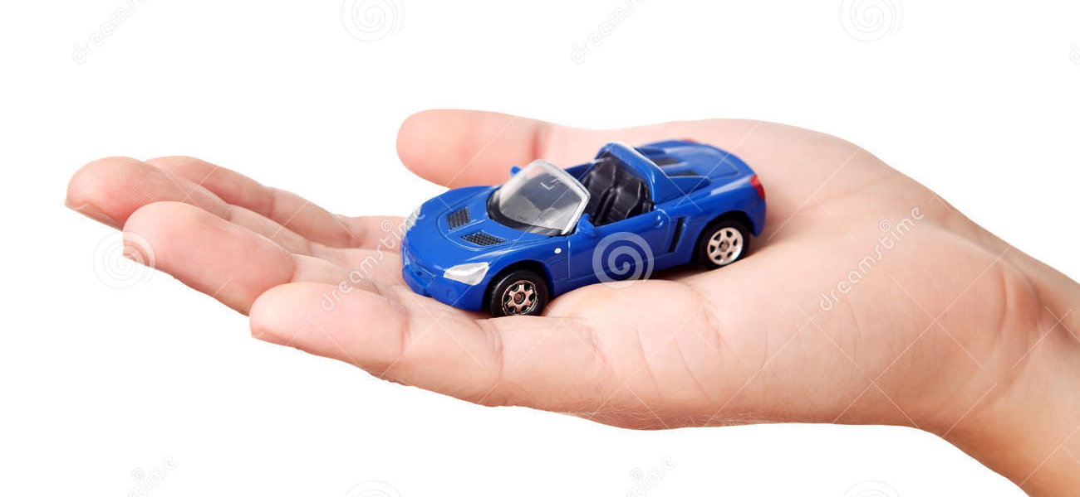
Nano Fun Facts
In the time it takes to read this sentence, your fingernails will have grown approximately one nanometer (1 nm).
If everyone on earth was 1 nm, we would all fit into a Matchbox car.
Notes:
Tracy

Slide 9
Let’s explore AtomTouch https://mobile.wisc.edu/mli-projects/project-atomtouch/
Tip
Tunable bond
Atom
Surface
Notes:
SPMs can also be used to move individual atoms. When used this way, the tip forms a bond – called a tunable bond – with an atom on the surface. The researcher is then able to drag the atom around on the surface and put it where s/he wants. By tuning the bond between the tip and the atom, the researcher is able to pick up, drag, and let go of the atom.

Slide 10
What is a simulation?
AtomTouch is a molecular dynamics simulation
The imitation of how a real-world process or system operates over time.
Simulations are used to study, understand, and predict how something works
Notes:
Have teachers play with AtomTouch here.

Slide 11
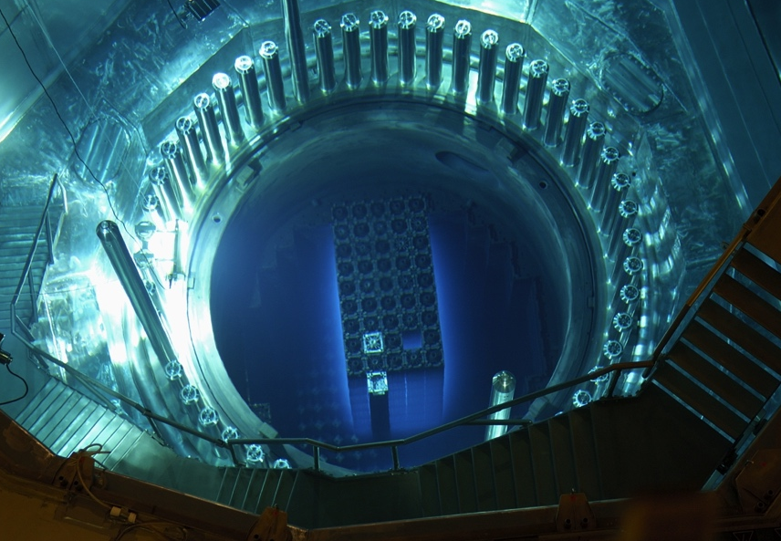
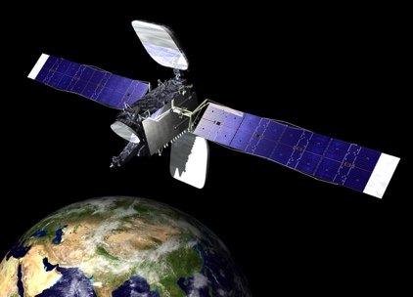

Simulations are used to investigate things that are too expensive, difficult or dangerous to study in the real-world
Nuclear Reactor Core
Satellite Launches
Flight Simulator
http://www.space.com/23722-spacex-satellite-rocket-launch-florida-webcast.html
http://dic.academic.ru/pictures/wiki/files/75/KKG_Reactor_Core.jpg
http://www.riftenabled.com/admin/app/108

Slide 12
We use Molecular Dynamics Simulations to study materials at the nano- and atomic scales
Molecular Dynamics simulations allow us to predict how atoms will interact, what materials they will form, and what properties those materials will have

Slide 13
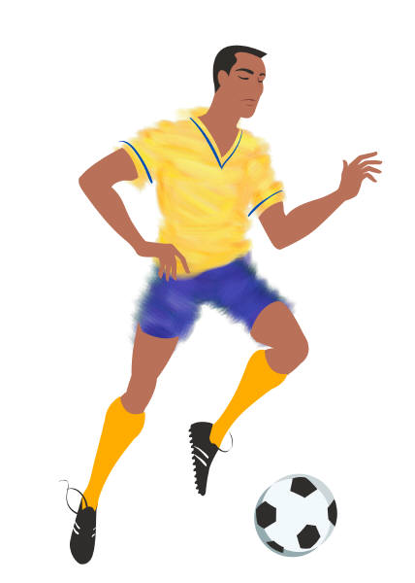
What is Molecular Dynamics?
A technique to move objects along the paths they should follow according to F=ma (This is called integrating the equations of motion over time)
All systems evolve by F=ma (Newton’s law of motion)
F is specific to a specific system (ex. bat hitting a ball, gravity working on planets)

Slide 14
What is MD Good For?
Trajectories of objects
pool games and planetary orbitals
Trajectories of atoms
during collisions, reactions, diffusion paths
Thermodynamic averages
basic macroscopic properties (e.g., energy, pressure, volume)

Slide 15
How do you create a MD simulation
Develop a potential (mathematical expression) that describes how the atoms behave and interact
The potential you develop gives you F in F=ma
Potentials are:
Based on Coulombs law – attractive forces between 2 charged particles
And based on a repulsive term that keeps atoms from collapsing on each other

Slide 16
The Idea of Potentials
Idealized potential energy curve for a typical bond, e.g., H₂
Sharp repulsion due to electrons overlapping
Weak long-range attraction
due to Van der Waals forces
r₀= equilibrium bond distance
Energy
Separation r
Ε₀= equilibrium bonding energy
Binding due to electron hybridization
forming bonding orbitals
We can fit the E(r) curve to a practical functional form = the Potential
Once you create a potential, it may not apply in other environments (ex. other atoms)

Slide 17

Objectives and Standards
Objectives:
Observe atom behavior under different conditions
Determine how atoms behave as materials change state
Figure out the most stable structure for a molecule
Science Standards:Structure and Properties of Matter
MS-PS1-4. Develop a model that predicts and describes changes in particle motion, temperature, and state of a pure substance when thermal energy is added or removed. Figure out the most stable structure for a molecule
HS-PS2-6. Communicate scientific and technical information about why the molecular-level structure is important in the functioning of designed materials.

Slide 18
Simulations are Models
NGSS Crosscutting Concept- “Developing and Using Models”
Essential Practices of Science and Engineering
Develop and/or use a model to predict and/or describe phenomena.
Develop a model to describe unobservable mechanisms
Models bring certain features into focus while obscuring others
Models are evaluated and refined - “It is important for students to recognize their limitations.”

Slide 19
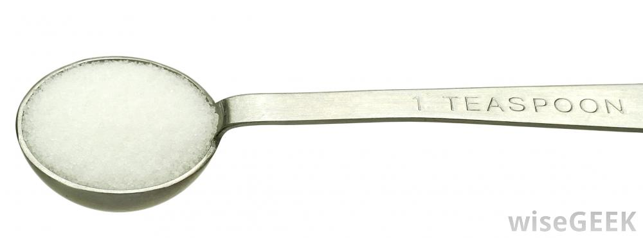
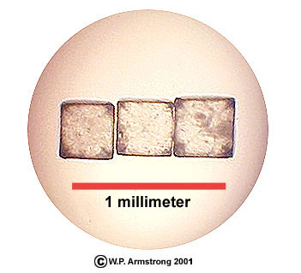
Size and Scale
The molecular mass of NaCl = 58.44 g/mol
1 teaspoon of NaCl weighs 5.69 g.
Therefore, there are 5.86x10²² molecules of NaCl in a teaspoon of salt.
http://www.wisegeek.org
1 NaCl crystal (grain of salt) weighs 0.14 mg .
Therefore, there are 1.44x10¹⁸ molecules of NaCl in a grain of salt.
http://waynesword.palomar.edu/lmexer1.htm

Slide 20
Acknowledgments
MRSEC Personnel and Collaborators
UW College of Engineering
National Science Foundation
NSF Materials Research Science and Engineering Center on Nanostructured Interfaces (DMR-1121288)
NSF Research Experience for Teachers (EEC-0908782)
NSF Partnership for Research and Education in Materials (DMR-0934115)
RET supplement from the NSF award ECCS-1052074 to Dr. Behdad.
This presentation is based upon work supported by the National Science Foundation under the following grants: DMR -1121288 (MRSEC), EEC-0908782( RET), DMR-0934115 (PREM), and NSF award ECCS-1052074. Any opinions, findings, and conclusions or recommendations expressed in this material are those of the authors and do not necessary reflect the views of the National Science Foundation.

Slide 21
Thank You
Anne Lynn Gillian-Daniel, agillian@wisc.edu
Benjamin Taylor, bltaylor2@wisc.edu
Our Website: www.education.mrsec.wisc.edu

