Slide 1
Computer Science Women’s Network
presented by: Lauren Stuart
lstuart@purdue.edu

Slide 2
What is CSWN?

Slide 3
CSWN is…
“
…an organization consisting of people (both students and staff) who are dedicated to helping women in the computer science (CS) field. The leadership team that organizes most activities is made up of students who want to reach out and help all of the women in CS.
CSWN organizes different activities meant to encourage young women to meet one another and also learn more about their chosen field of study.
”

Slide 4
Put simply:
Our goal is to encourage women in computer science to stay in the field and prosper.
So how do we accomplish this?
Notes:
4

Slide 5
We have a list!
We try to pick a handful of these every semester.
Notes:
5

Slide 6
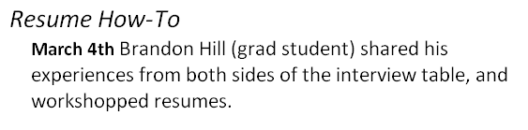
The List: Professional Development
Events for success
Other event ideas:
Networking How-To
Networking Social
Mock Interviews
…from a technical woman’s perspective?

Slide 7

The List: Conference Opportunities
GHC10: 4 students presenting!
1: New Investigators
1: poster competition
2: general session
INWIC, MidWIC, etc.

Slide 8
The List: Secure a sense of community and belonging
Attending conferences is important, too:
More enthusiasm about CS
Networking and exploring interests
CSWN: a mini-GHC?
Social events with other students

Slide 9
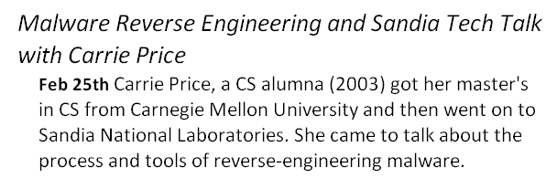
The List: Promote Visibility
Tech talks featuring women researchers and engineers – like this one:
– or women from within the department.

Slide 10
The List: Informational Events and Resources
Partner with other orgs
“How to survive…” events
Start our “Gender & STEM” library
Prepare women for what they will face
…and all students to help tackle the issues

Slide 11

The List: Informational Events and Resources
Information sessions on graduate school…
…or grants and scholarships.
CREU
Anita Borg Scholarship

Slide 12
We need your support.
We have 26 new women this year.
Last year, we had 18.
Notes:
12

Slide 13
How to help
Help us highlight and connect technical women
Host a social, professional development, or networking event
Contribute to our library or conference funds
General sponsorship or fundraising support

Slide 14
Questions?
Website: http://www.cs.purdue.edu/cswn
Corporate Liaison: Emily Friesen, efriesen@purdue.edu

