Slide 1
Fast Parallel Index Based GPU Particle Collision Detection
CEN5035

Slide 2
Particle Collision Detection

Slide 3
Particle Contact Detection
In order to determine if two particles are in contact, we compare the sum of their radii to the distance between their centers.
Greater than sum if radii – not in contact
Sum of radii
GLess than sum if radii – not in contact

Slide 4
Pairwise – Naïve or Brute Force search
Each comparison is called a query.
Compare Particle 1 with all other particles
Compare Particle 2 with all other particles
Compare Particle 3 with all other particles
1
1
1
2
2
2
3
3
3
4
4
4
5
5
5
6
6
6

Slide 5

Particle Collision Detection Complexity
6 particles are compared (5-1) other particles = 6*5=30 Queries
N particles are compared (N-1) other particles
Quadratic Complexity
$$N\left(N−1\right)≊N^{2}$$
$$N^{2}≊{1E6}^{2 }=1000,000,000,000$$
So, 1 million particles =1000 billion queries.

Slide 6
Particle Collision Detection Complexity
My workstation processes one query in 50ns. It then takes more than 7 hours to process 1M particles for a single time step.
We do 1M in less than 1/30 of a second!
Equivalently, we can process 1M particles thirty times a second!
How?
The GPU is a parallel processing device.
Break the collision detection process into parallel threads and run it on the GPU

Slide 7
Particle Collision Detection Processing steps in the GPU
Frame = 1 Time Step
Compute Pipline
Graphics Pipline
Step 3
Build Potentially Colliding set
Step 4
Render
Particles to an image
Step 1
Detect Collisions.
Step 2
Move Particles
Broad Phase
Narrow Phase

Slide 8
Particle Collision Detection is a two phase process
Broad Phase - Build The Potentially Colliding Set.
Narrow Phase - Check near neighbors for contact.
c1
1
2
0
0
c2
8
9
3
0
c2
c3
5
0
0
0
8
9
c4
4
0
0
0
3
c5
6
0
0
0
c6
7
10
0
0

Slide 9
Broad Phase - Spatial Sub-division
c1
c2
c3
2
5
8
1
9
3
c4
c5
c6
7
4
6
10
The spatial subdivision methods consists of dividing the total space into cells. The above is a uniform cell array since all squares have the same measure.

Slide 10
Broad Phase - Spatial Sub-division
c1
c2
c3
2
5
c1
1
2
0
0
8
c2
8
9
3
0
1
9
3
c3
5
0
0
0
Cell Array
c4
4
0
0
0
c4
c5
c6
7
c5
6
0
0
0
4
6
c6
7
10
0
0
10
The code structure that contains the particle(s) that occupy each cell is called
the cell array. Particles occupying the same cell are called near neighbors. The number of near neighbors depends on the size of the cell. Only near neighbors are tested for contact in the narrow phase.

Slide 11
Broad Phase - Spatial Sub-division
Occupancy
Sub-Array
c1
c2
c3
2
5
c1
1
2
0
0
8
c2
8
9
3
0
1
9
3
c3
5
0
0
0
Cell Array
c4
4
0
0
0
c4
c5
c6
7
c5
6
0
0
0
4
6
c6
7
10
0
0
10
It is a table with a row length, called the occupancy sub-array, long enough to hold the maximum number of particles that can fit in a cell.

Slide 12
Broad Phase - Spatial Sub-division
Occupancy
Sub-Array
c1
c2
c3
2
5
c1
1
2
0
0
8
c2
8
9
3
0
1
9
3
c3
5
0
0
0
Cell Array
c4
4
0
0
0
c4
c5
c6
7
c5
6
0
0
0
4
6
c6
7
10
0
0
10
The first process in particle collision detection is to build the cell array. Once built it is called the Potentially Colliding Set (PCS) because we haven’t tested particles for collision – we have only found the particles that live in the same neighborhood.

Slide 13
Narrow Phase - Particle Contact Detection
Cell Thread (invocation)
Parallel Processing the PCS
T1
c1
The GPU launces a thread (invocation) for each cell.
And within that thread cell, launces a sub-thread for each particle.
The sub-thread compares each particle to all the other particles in the cell.
Complexity is N² for each cell but each cell thread is working on fewer particles and doing it at the same time.
Cell Sub Thread
T1-1
2
Cell Sub Thread
T1-2
1
T2
c2
T2-1
8
T2-2
9
T2-3
3
T3
c3
T3-1
5
T3-2
6
T4
c4
T4-1
4
T4-2
7

Slide 14
Narrow Phase - Particle Contact Detection
A question which will give you an idea of the kind of benchmarks we perform.
Which is better – a large cell with allot of particles or a small cell with fewer particles?
VS

Slide 15
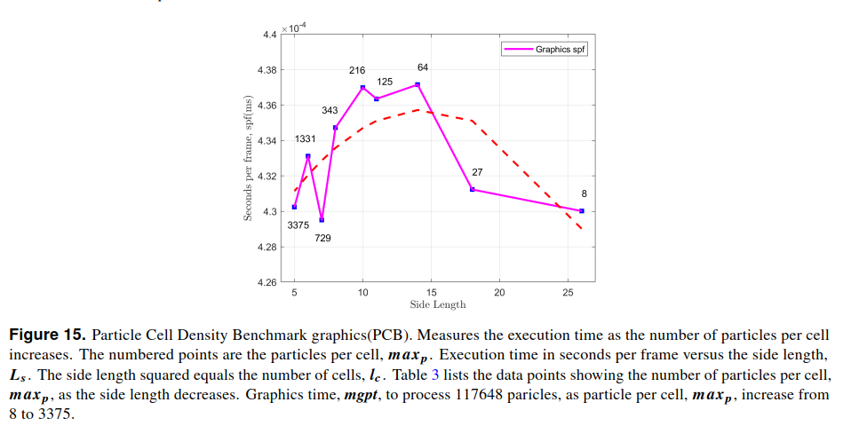
Narrow Phase - Particle Contact Detection
The answer? It is a balance as shown in Fig 15, by performing the Particle Cell Density (PCD) Benchmark. There are five of these benchmarks. We run each in debug and again in release mode because they provide different data. Debug returns verification numbers but is too slow to measure performance. The release mode turns the verification off and provides the maximum performance (frames per second).

Slide 16
Project Proposal

Slide 17
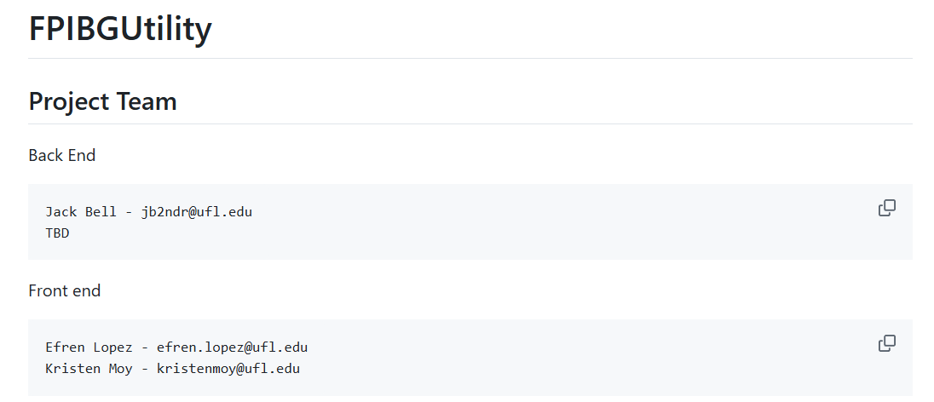

Slide 18
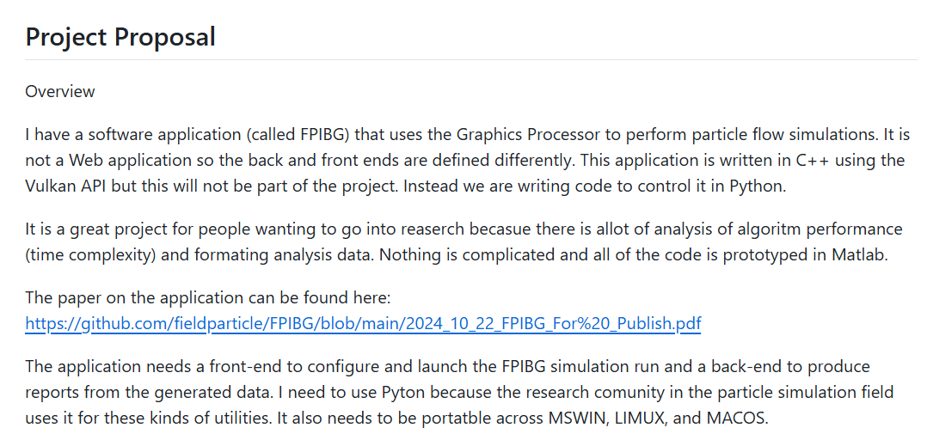

Slide 19
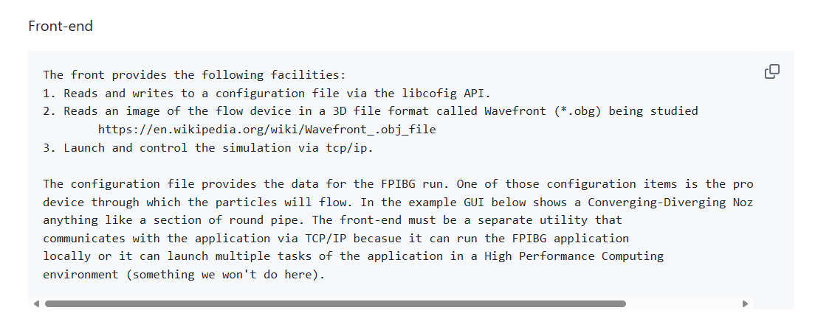

Slide 20
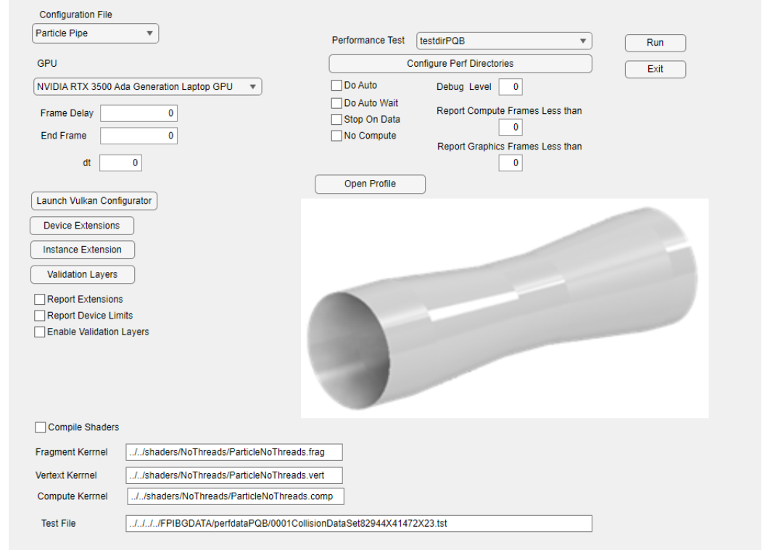

Slide 21
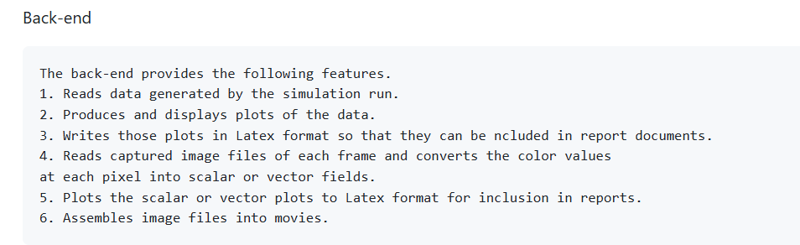

Slide 22
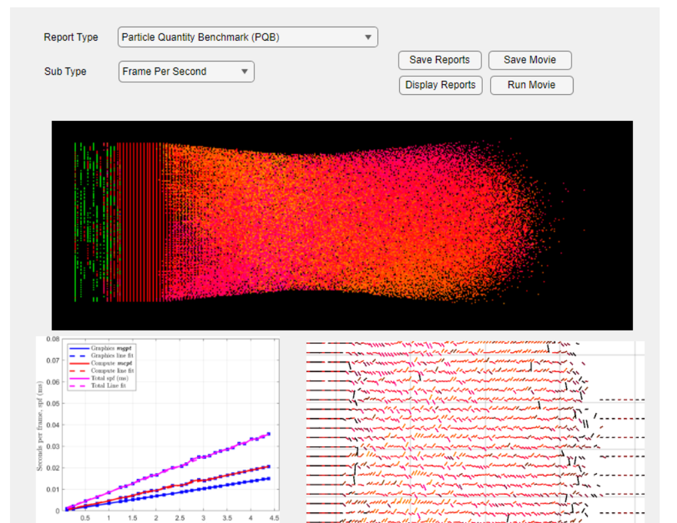

Slide 23

Project Process Overview
Each sprint (probably a week and called a module) there are two assignments.
Perform the coding for the sub module.
Create a sub module test bed to test and exercise.
Each module will have a branch named MODNNN where NNN is the module number.
Each module will have a test procedure (maybe google test?)
At the end of the module the everyone's work is merged and tested.
Upon successful testing start the new module.
Baby Steps!

Slide 24
Project Process Overview – Baby Steps!
Assign the least amount of work for a module that makes logical progress with the least amount of cross dependency.
The programmers need to see the assignment optimistic that they can complete their tasks.
Other wise if you try to do too much over too long a period the team members burnout without knowing it.
Increases bugs that delay project.
Less time to test.
Less time to develop clean code.
Impacts documentation.
Unanticipated changes in direction can be accommodated with much greater ease and speed.
Creates a flow that is not often disturbed so there is always a sense of organization.
Team members always have a sense of progress – less frustration.
Reduces the impact of a team member missing deliverables.

Slide 25
Module 001 Deliverables

Slide 26
Module 001 Task Description
M001Task 01 – Create base data object.
M001Task02 – Create base tcpip object.
M001Task03 – Incorporate libconfig.
M001Task04 – Create logfile class

Slide 27
Base Data Class

Slide 28
MODULE 001 SuperClass
CLASS
FPIBGBase __init__(workingDirectory, dataDirectory,
logFileHandle, configFileHandle)
MEMBER VARIABLES
m_logFileHandle
m_configFileHandle
m_workingDirectory
m_dataDirectory
MEMBER FUNCTIONS
testObject()
*Items in red are new elements this module.

Slide 29
Log File Class

Slide 30
MODULE 001 Logfile class
CLASS
logData
MEMBER VARIABLES
m_baseClass
MEMBER FUNCTIONS
openLogfile
closeLogFile
setAppName
setFunctionName
setErrorCode
*Items in red are new elements this module.
writeEntery

Slide 31
MODULE 001 Logfile class
Line Number:Date:24hrtime:Application:Object:Function:ErrCode:Error String
Example:
001:010825:1400:FPIBGAPPFRONT:DATAObject:getData:0005:Get Data Fields – File Not Open

Slide 32
Configuration File Class

Slide 33
MODULE 001 Configuration file class
CLASS
configData
MEMBER VARIABLES
m_baseClass
m_getFieldName
m_getFieldData
m_setFieldName
m_setFieldData
MEMBER FUNCTIONS
openDatafile
closeDataFile
readDataFile
*Items in red are new elements this module.

Slide 34
MODULE 001 Configuration file class – Configuration File
name = "particleOnly";
version = "11";
application =
{
window =
{
title = "MPS";
// Size of the window.
size = { w = 1000; h = 1000; };
};
phys_device = "NVIDIA RTX 3500 Ada Generation Laptop GPU";
//phys_device = "Intel(R) HD Graphics P530"
frame_delay = 0;
end_frame = 0;
dt = 0.1;
cap_name = "cube";
cap_num = 0;
cap_frames = 237;
framesBuffered = 1;
frag_kernParticle = "../../shaders/NoThreads/ParticleNoThreads.frag";
frag_kernParticlespv = "frag2.spv";
vert_kernParticle = "../../shaders/NoThreads/ParticleNoThreads.vert";
vert_kernParticlespv = "vert2.spv";
comp_kernParticle = "../../shaders/NoThreads/ParticleNoThreads.comp";
comp_kernParticlespv = "comp.spv";
doAuto = false;
doAutoWait = 0;
testfile = "../../../../FPIBGDATA/perfdataPQB/0001CollisionDataSet82944X41472X23.tst";
CONTINUED NEXT PAGE

Slide 35
MODULE 001 Configuration file class – Configuration File
//perfTest = "testdirPQB";
//perfTest = "testdirPCD";
//perfTest = "testdirCFB";
perfTest = "testdirDUP";
testdirPQB = "../../../../FPIBGDATA/perfdataPQB"
testdirCFB = "../../../../FPIBGDATA/perfdataCFB"
testdirPCD = "../../../../FPIBGDATA/perfdataPCD"
testdirDUP = "../../../../FPIBGDATA/perfdataDUP"
compileShaders = true;
enableValidationLayers = true;
stopondata = true;
noCompute = false;
debugLevel = 0;
reportCompFramesLessThan = 3;
reportGraphFramesLessThan = 0;
framesInFlight = 1;
device_extensions = ( "VK_NV_shader_sm_builtins",
"VK_NV_shading_rate_image",
"VK_EXT_shader_subgroup_ballot",
"VK_KHR_swapchain", "VK_KHR_shader_non_semantic_info",
"VK_EXT_fragment_shader_interlock", "VK_EXT_shader_image_atomic_int64",
"VK_EXT_shader_atomic_float" );
instance_extensions = ( "VK_EXT_debug_utils","VK_EXT_debug_report");
validation_layers = ( "VK_LAYER_KHRONOS_validation" );
printExtension = false;
printDevLimtits = true;
verbose_rpt = false;
};

Slide 36
Performance Data Class

Slide 37
MODULE 001 Performance data class
CLASS
DataClass
MEMBER VARIABLES
m_baseClass
MEMBER METHODS
openDatafile(self)
closeDataFile(self)
readDataFile(self)
getDataColumn(self,ColumnName)
printDataColumn(self,ColumnName)
*Items in red are new elements this module.

Slide 38
Collision Fraction Benchmark Data Format, Plots, Tables

Slide 39
MODULE 001 Performance data class
CFB – Collision Fraction Benchmark
time | fps | cpums | cms | gms | expectedp | loadedp | shaderp_comp | shaderp_grph | expectedc | shaderc | threadcount | sidelen | density | PERR | CERR
0 | 763 | 0.001311 | 0.000568 | 0.00044 | 117648 | 117648 | 0 | 0 | 58824 | 0 | 0 | 26 | 0.5 | 0 | 0
1 | 847 | 0.001181 | 0.000524 | 0.000431 | 117648 | 117648 | 0 | 0 | 58824 | 0 | 0 | 26 | 0.5 | 0 | 0
2 | 870 | 0.001149 | 0.000523 | 0.00043 | 117648 | 117648 | 0 | 0 | 58824 | 0 | 0 | 26 | 0.5 | 0 | 0

Slide 40
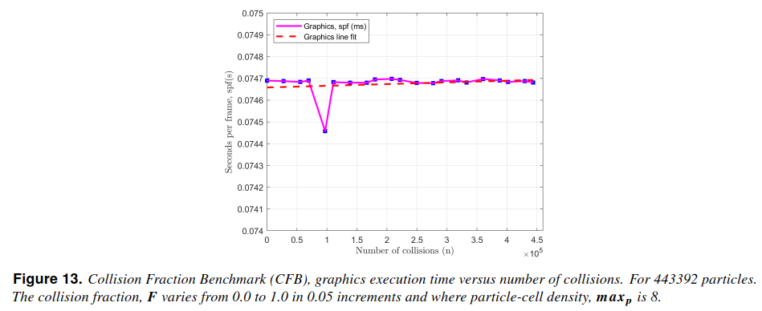
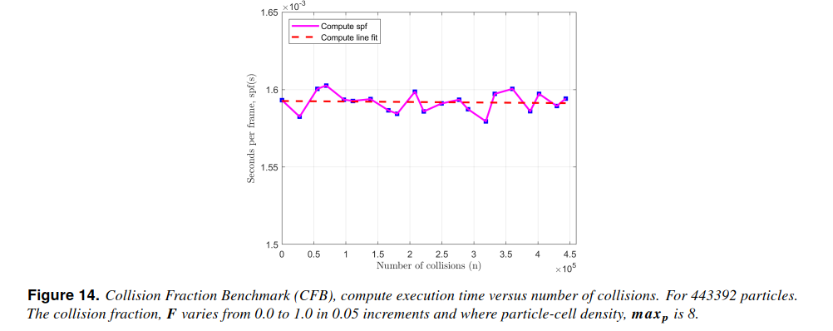
MODULE 001 Performance data class
CFB – Collision Fraction Benchmark

Slide 41
Particle Cell Density Benchmark Format, Plots, Tables

Slide 42
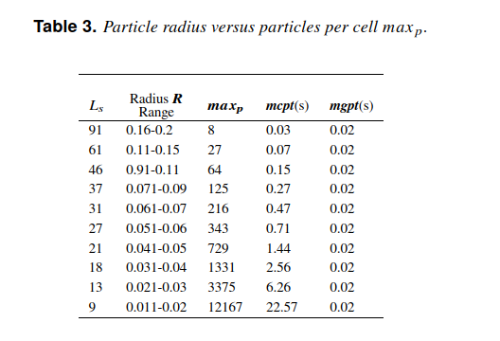
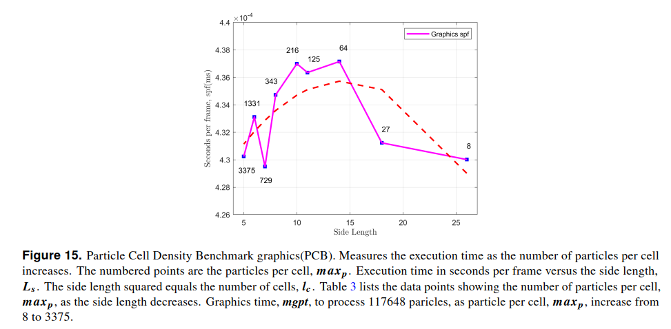
MODULE 001 Performance data class
PCD – Particle Cell Density Benchmark
time | fps | cpums | cms | gms | expectedp | loadedp | shaderp_comp | shaderp_grph | expectedc | shaderc | threadcount | sidelen | density | PERR | CERR
0 | 14 | 0.071429 | 0.075328 | 0.001619 | 443392 | 443392 | 0 | 0 | 0 | 0 | 0 | 21 | 0 | 0 | 0
1 | 13 | 0.076923 | 0.075264 | 0.001645 | 443392 | 443392 | 0 | 0 | 0 | 0 | 0 | 21 | 0 | 0 | 0
2 | 13 | 0.076923 | 0.074712 | 0.001642 | 443392 | 443392 | 0 | 0 | 0 | 0 | 0 | 21 | 0 | 0 | 0

Slide 43
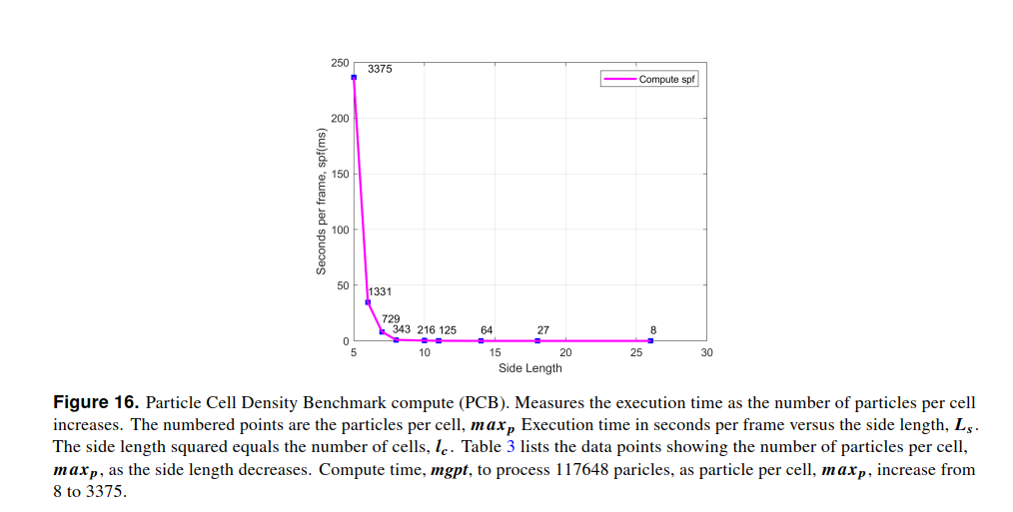
MODULE 001 Performance data class
PCD – Particle Cell Density Benchmark

Slide 44
Particle Quantity Benchmark Format, Plots, Tables

Slide 45
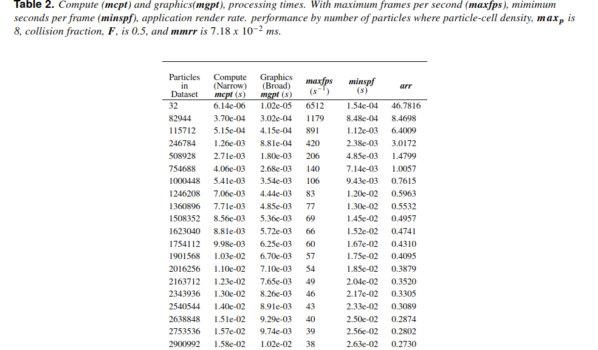
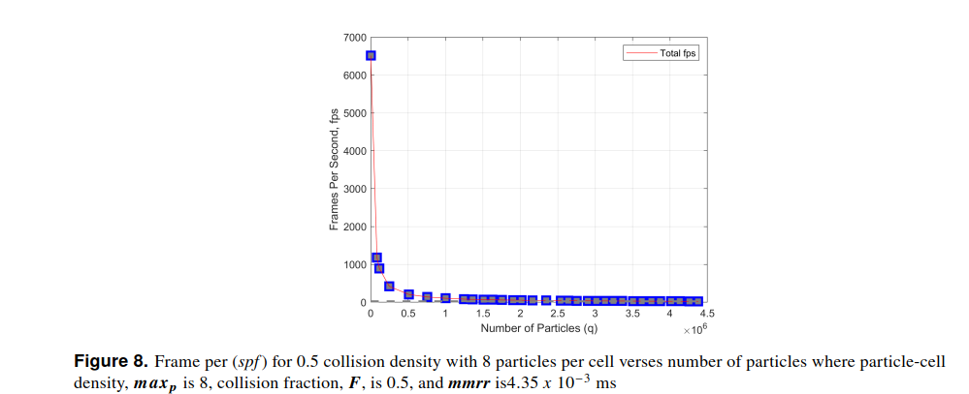
MODULE 001 Performance data class
PQB - Particle Quantity Benchmark
time | fps | cpums | cms | gms | expectedp | loadedp | shaderp_comp | shaderp_grph | expectedc | shaderc | threadcount | sidelen | density | PERR | CERR
0 | 5123 | 0.000195 | 7.04E-06 | 1.12E-05 | 32 | 32 | 0 | 0 | 16 | 0 | 0 | 3 | 0.5 | 0 | 0
1 | 6291 | 0.000159 | 6.34E-06 | 1.08E-05 | 32 | 32 | 0 | 0 | 16 | 0 | 0 | 3 | 0.5 | 0 | 0
2 | 6299 | 0.000159 | 7.23E-06 | 1.09E-05 | 32 | 32 | 0 | 0 | 16 | 0 | 0 | 3 | 0.5 | 0 | 0
3 | 6315 | 0.000158 | 7.07E-06 | 1.03E-05 | 32 | 32 | 0 | 0 | 16 | 0 | 0 | 3 | 0.5 | 0 | 0

Slide 46
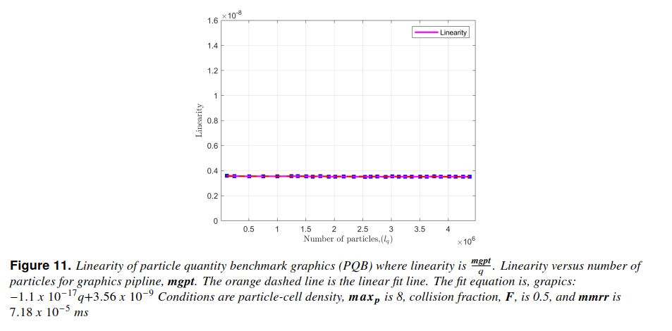
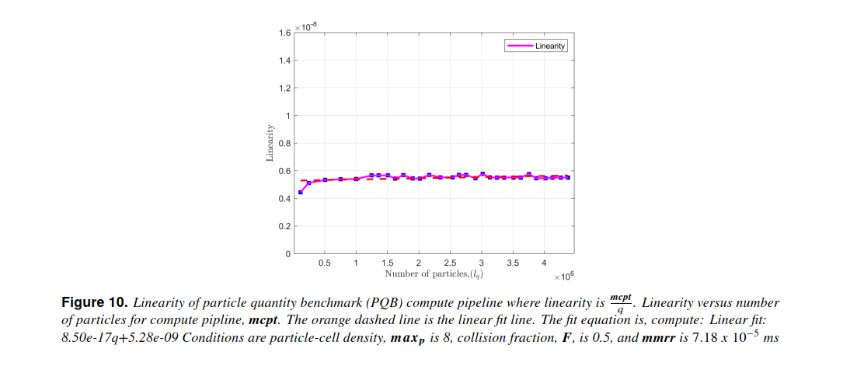
MODULE 001 Performance data class
PQB - Particle Quantity Benchmark

Slide 47
Sprints

Slide 48
