Slide 1

uint ArrayToIndex(uvec3 loc)
{
uint w = WIDTH;
uint h = HEIGHT;
uint indxLoc = loc.x + w * (loc.y + h * loc.z);
if(indxLoc > MaxLocation-1)
return npos;
else
return indxLoc;
}
The WIDTH and HEIGHT must be equal to the highest number cell location.
So, a particle located in the last cell<3,3,3> will have a HEIGHT,WIDTH of 4,4.
That is because the cell range is <0,0,0> to <3,3,3>

Slide 2
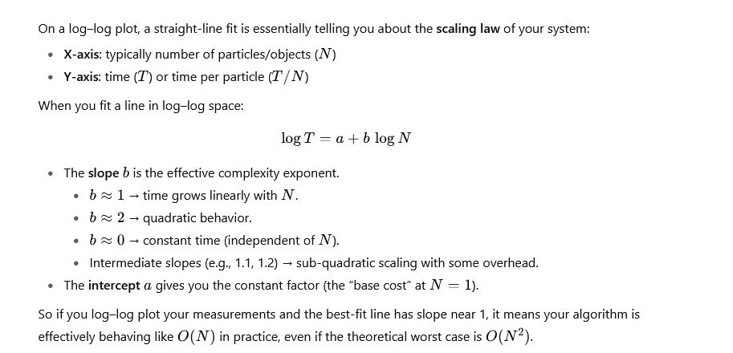

Slide 3
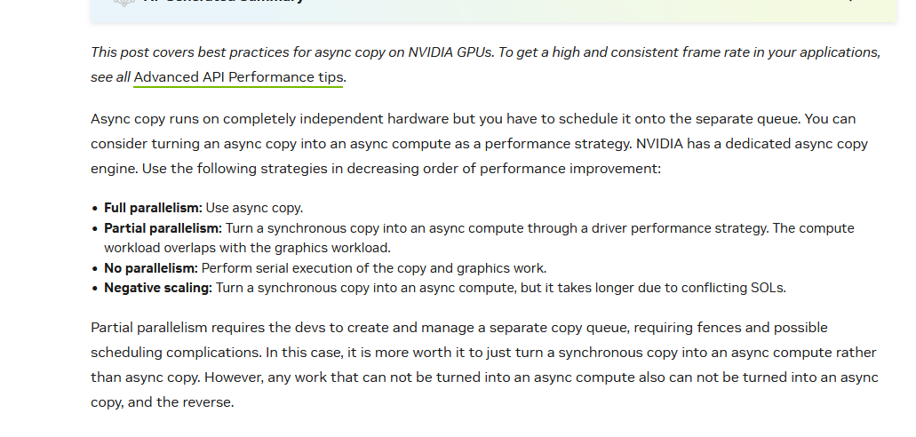

Slide 4
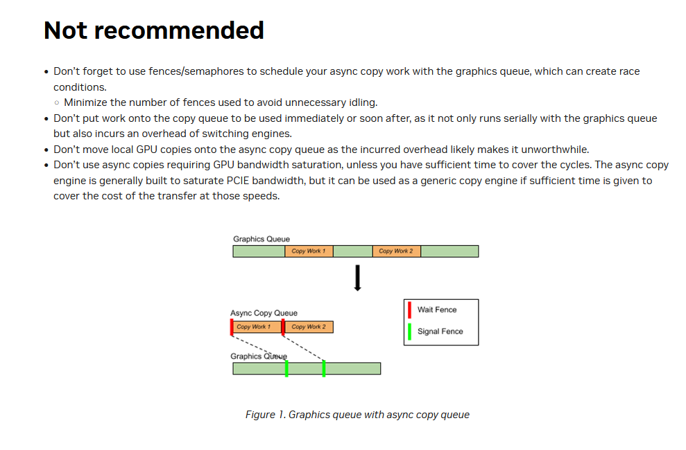

Slide 7
Steps:
Generate data sets
PQB,PQBR,PQBS
Run particleD.exe
Generates perfdataPQB.csv
Generates *.D.csv report files
Header
Run PQBTablePerfAllDiag.cfg
Generates perf
Runs in verification mode (cfg.mode)
Produces a repor of all unmatch parameters
Run ParticleR.exe
Generates *.D.csv report files

Slide 8
1,1

Slide 9
1,1

Slide 10
1,1

Slide 11
Nr = 2.0
C = 1.0/Nr
R = 0.2
D = C-2.0*R
S = D/2.0
x = 0.0;
y = 0.0;
for row = 0:Nr-1
for col = 0:Nr-1
x = 0.5 + S + R + col*(2*S+2*R);
y = 0.5 + S + R + row*(2*S+2*R);
fprintf("<%0.2f,%0.2f>\n",x,y)
end
end
Nr = 2
C = 0.5000
R = 0.2000
D = 0.1000
S = 0.0500
row:0,col:0<0.75,0.75>
row:0,col:1<1.25,0.75>
row:1,col:0<0.75,1.25>
row:1,col:1<1.25,1.25>

Slide 12
Cell and Lock array allocation and testing
In P Forge
Load config file
Generate paricle data and tst file
Select a bin file
Press Fill Cell Arry
Takes side length and adds one to it since the counter is <0,0,0> based
Allocates an cell array that is [(side_length+1)^3][(occupancy_list_size)]
Allocates a lock array that is [(side_length+1)^3]
In vulkan

Slide 13
Fill cell array
calculates cell array ise byts and len
calulates lock array bytes and len
Write cell array bytes to cfg(cell_ary_rpt_text = "cell_ary_rpt.txt“);

